Slide 1
Context and Linking in the Research Lifecycle
CERIF and other standards
Catherine Jones
Scientific Information Group
Scientific Computing Department
STFC Rutherford Appleton Laboratory
Catherine.jones@stfc.ac.uk

Slide 2
The science we do
Research Data lifecycle
Drivers for developments
Infrastructure to support data management

Slide 3
The science we do

Slide 4
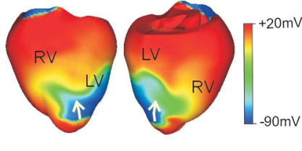
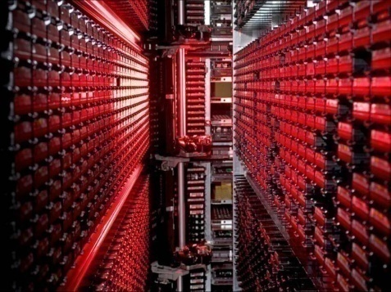
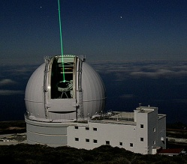
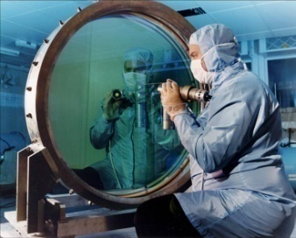
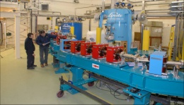
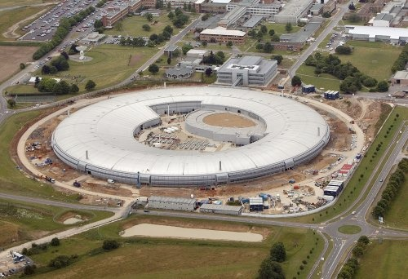

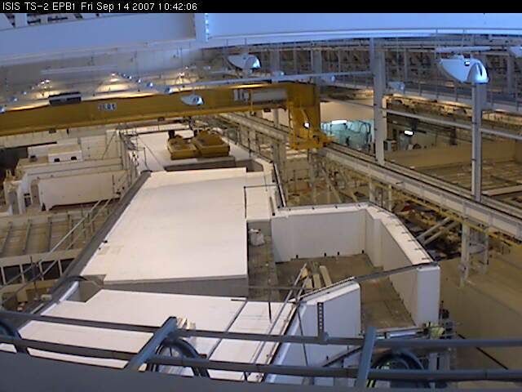
Science and Technology Facilities Council
Provide large-scale scientific facilities for UK Science
  particularly in physics and astronomy
  ISIS and Diamond Light Source facilities
Scientific Computing Department
  Provides advanced IT development and services to the STFC Science Programme
  Strong role in management of our science data
  Computational science and engineering

Slide 5
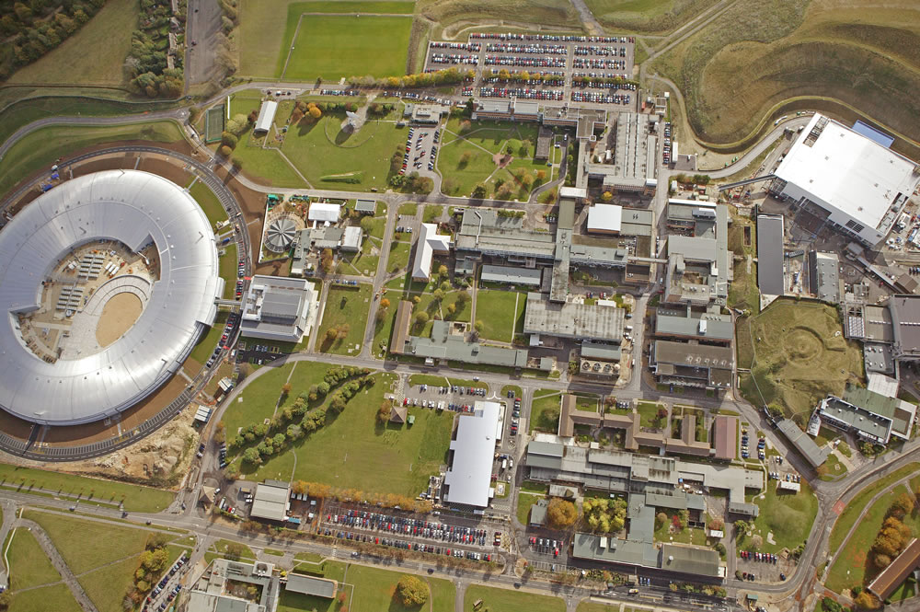
Large-Scale Facilities
Big Facilities for Small Science

Slide 6
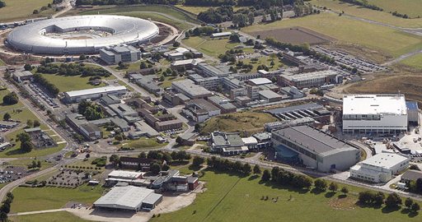
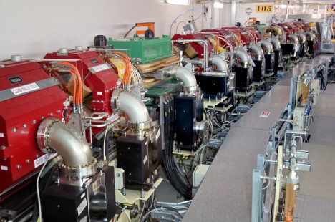

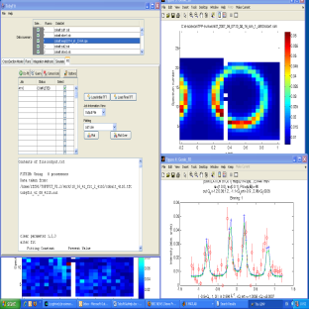
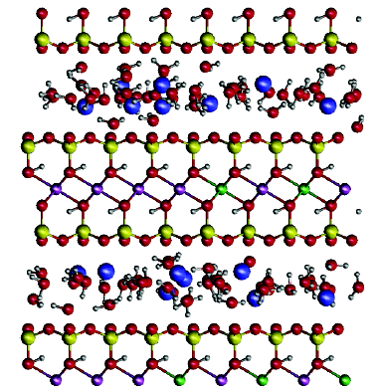
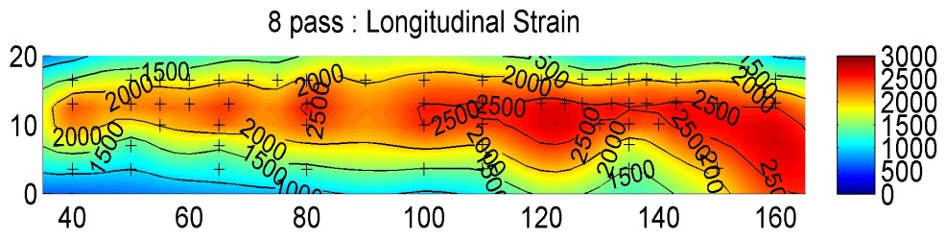
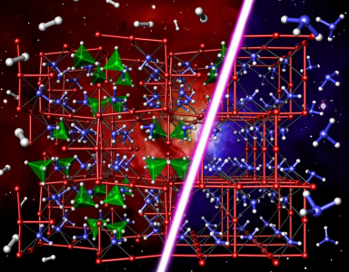
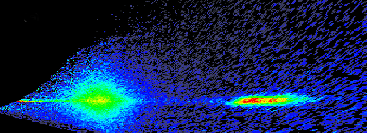
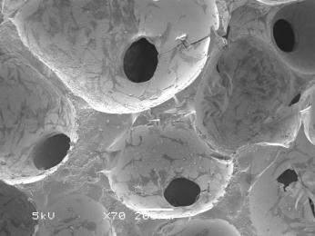

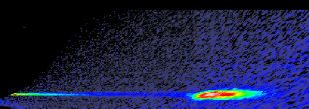
The Science we do - Structure of materials
Visit facility on research campus
Place sample in beam
Diffraction pattern from sample
Fitting experimental data to model
Structure of cholesterol
in crude oil
~30,000 user visitors each year in Europe:
  physics, chemistry, biology, medicine,
  energy, environmental, materials, culture
  pharmaceuticals, petrochemicals, microelectronics
Billions of € of investment
  c. £400M for DLS
  + running costs
Over 5.000 high impact publications per year in Europe
  But so far no integrated data repositories
  Lacking sustainability & traceability
Bioactive glass
for bone growth
Hydrogen storage for zero emission vehicles
Magnetic moments in electronic storage
Longitudinal strain in
aircraft wing
Notes:
30,000 user visitors each year
Billions of Euro of infrastructure
Support experiments in many scientific fields:
physics, chemistry, biology, material sciences,
energy technology, environmental science, medical technology
cultural heritage investigations.
Industrial applications are growing
pharmaceuticals, petrochemicals and microelectronics
experimental techniques including
photoemission and spectromicroscopy,
macromolecular crystallography,
low-angle scattering, dichroic absorption spectroscopy,
neutron and x-ray imaging.

Slide 7
Research Lifecycle

Slide 8
Vision for STFC data/publications
Data generated at STFC Facilities is discoverable and reusable.
  Creator privilege, commercial or IP considerations not withstanding
Stages in the research lifecycle linked in a machine readable way
Impact measurement
  Effective and shareable
  CERIF has a role here.
Retrievable context for the future

Slide 9
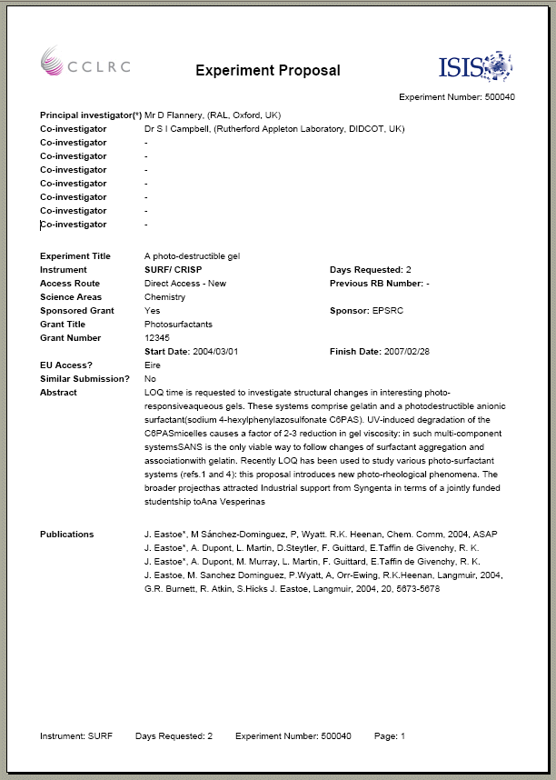
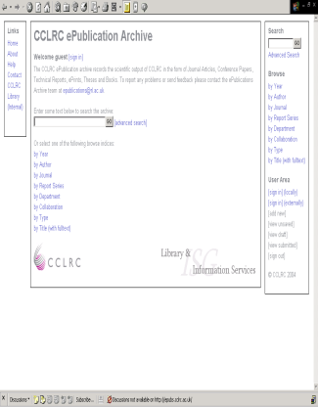
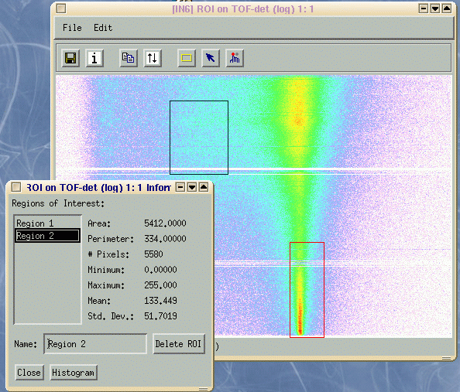
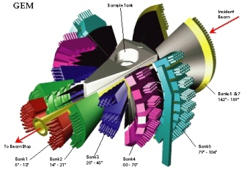
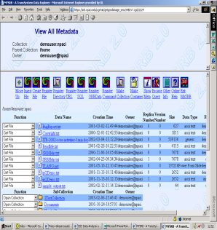
Research lifecycle
proposal
approval
experiment
Data production
Record publication info
Data management
Data analysis
External requirements
Internal to the Organisation
requirements
Notes:
Reporting
Good data management
Data management – linked to good preservation

Slide 10
Research lifecycle
proposal
approval
experiment
Data production
Record publication info
Data management
Data analysis
Links to organisational info: people, projects, organisational structure
Provenance and context for the results – machine readable links from data to publication

Slide 11
Why capture the lifecycle and linkage?
Explicitly links the stages in the process
  Makes each different kind of data part of a bigger process
Easy for the scientists
  Linking the notification of publications from the last proposal to the next proposal
  Reduces the need for re-keying
Provide the evidential basis for research
  Validate and verify publications
  Safeguard against error or fraud
Measure the impact of science
  Provide information on the value of the facility to service providers, funders and researchers
  Influence the policy makers
Reuse of data
  Get new science from old data
  Non-repeatable results
  Value for money
  Teaching material
  Comparative studies
Encourages good data management practices
  RCUK directives
  Data Preservation considerations at data creation stage

Slide 12
Drivers for developments in this area

Slide 13
Policy
RCUK/UK Government
  Open Data; Open Access to publications
  Impact agenda
  Active data management
    This includes preservation

Slide 14
Technological/Scientific developments
Standards for interchange
  CERIF; DC & domain specific
Interest in capturing analysis stages to enhance provenance of data
Electronic Lab notebooks
Social media and online communities
Persistent identifiers for digital objects
Possibilities for linking objects

Slide 15
Infrastructure to support data management

Slide 16
Key tools for STFC
ICAT – data catalogue
ePubs – publication repository
DataCite – assigning DOIs to data
Safety Deposit Box – ISIS preservation tool

Slide 17
ePubs – STFC’s publication Repository
Aims to collect the scientific and technical output of the Laboratories
Standard metadata concerning publications
Needs to be able to link the publication to its context: data; organisational structure

Slide 18
FRBR for publications
Conceptual Model
4 levels: Work; Expression, Manifestation and Item
Related items include People
Enables linking of related objects
ePubs uses this as the conceptual model

Slide 19
CSMD for Data –underpins ICAT
CSMD: Core Scientific MetaData model
Designed to describe facilities based experiments in Structural Science
Forms the information model
for ICAT, a production data management infrastructure employed by STFC
Forms the basis for extensions:
  To derived data
  To laboratory based science
  To secondary analysis data
  To preservation information
  To publication data
Topic
Publication
Keyword
Authorisation
Investigation
Investigator
Dataset
Sample
Sample Parameter
Datafile
Dataset Parameter
Parameter
Related Datafile
Datafile Parameter

Slide 20
Other projects working to realise this vision
WebTracks
  linking publications and data
ePubs revamp
  considering reporting impact requirements (CERIF possibilities)
SCAPE
  EU project considering scalable digital preservation
PANDATA
  Consortium of Photon and Neutron sources in Europe

Slide 21
Conclusions
Many more reasons for sharing data – or information about the data
Need to be able to use appropriate standards for data exchange
Interest in linking the stages in the Research Lifecycle
Requirements for impact reporting

Slide 22

Thank You
Questions?
Catherine.jones@stfc.ac.uk

Slide 23
PaN-Data Vision
Single Infrastructure → Single User Experience
Data Analysis
Different Infrastructures → Different User Experiences
Raw Data Catalogue
Analysed Data Catalogue
Publication Data Catalogue
Publications Catalogue
Raw Data
Data Analysis
Analysed Data
Publication Data
Publications
Facility 1
Raw Data
Data Analysis
Analysed Data
Publication Data
Publications
Facility 2
Raw Data
Data Analysis
Analysed Data
Publication Data
Publications
Facility 3
Capacity
Storage
Software
Repositories
Data
Repositories
Publications
Repositories

Slide 24
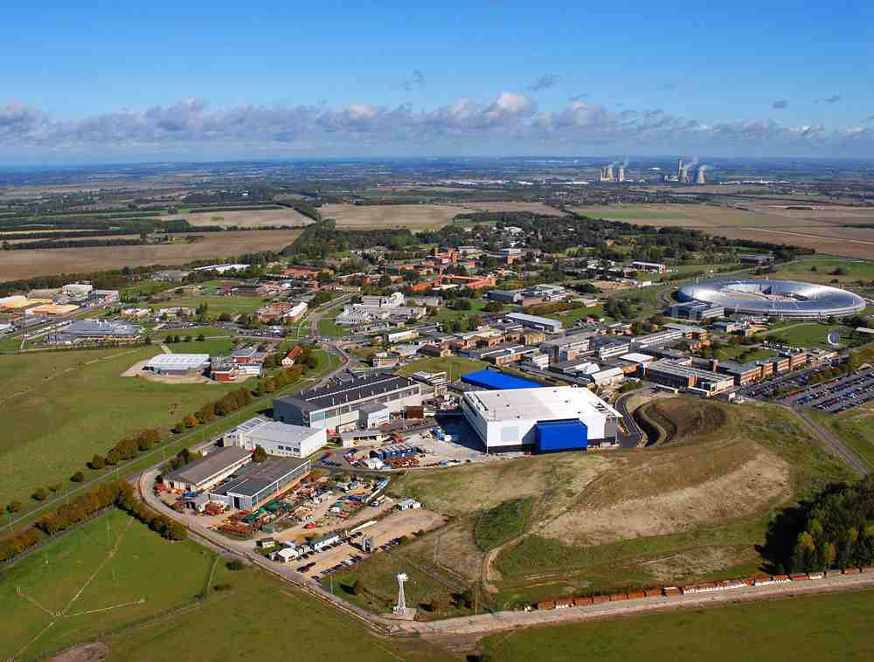

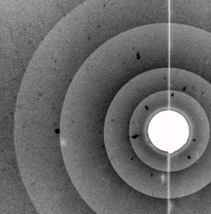
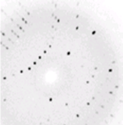
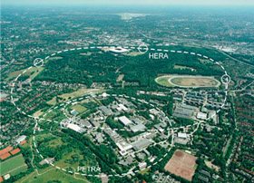

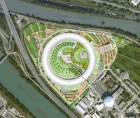
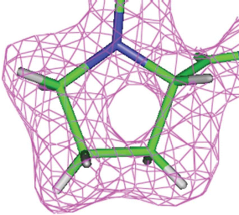
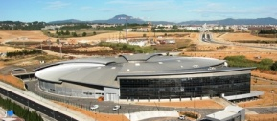
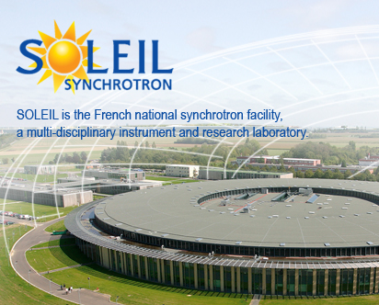
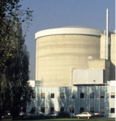
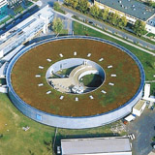










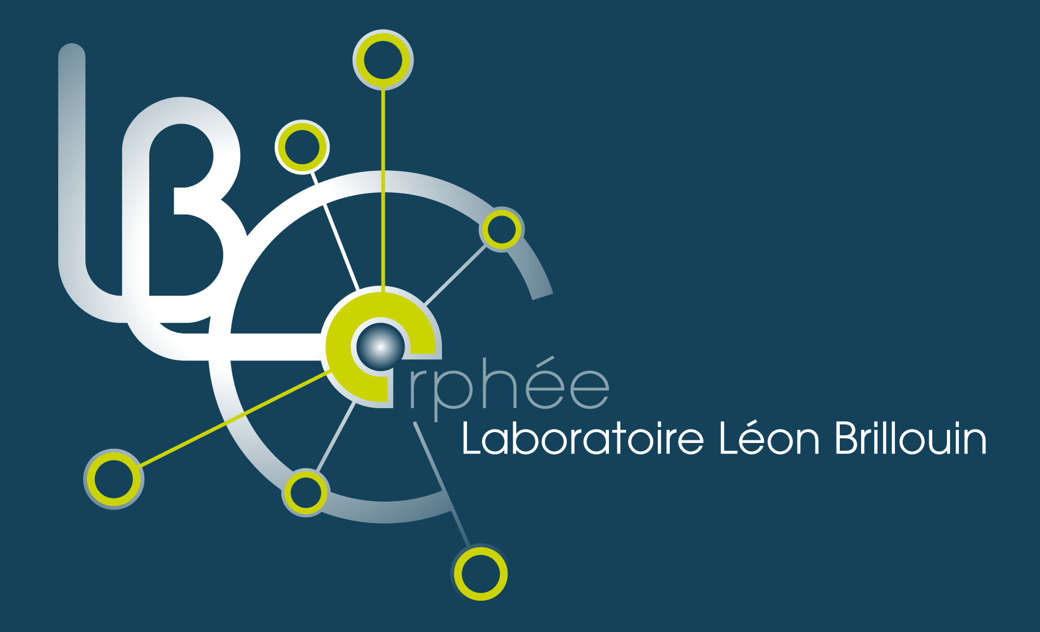

Driver 4: Interoperability across Facilities
PaN-data ODI– an Open Data Infrastructure for European Photon and Neutron laboratories
... to construct and operate a shared data infrastructure for Photon and Neutron laboratories...
Neutron
diffraction
X-ray
diffraction
Common data catalogue
Integration of users data from different facilities
Track provenance of data through analysis stages
Deploy standards for long-term curation
Support scalability through parallelisation
Deploy infrastructure in three different techniques
High-quality structure refinement
Notes:
PaNdata-ODI will develop, deploy and operate an Open Data Infrastructure across the participating facilities with user and data services which support the tracing of provenance of data, preservation, and scalability through parallel access. It will be instantiated through three virtual laboratories supporting powder diffraction, small angle scattering and tomography
PaNDATA – Photon and Neutron Data Infrastructure
Aims
PANdata brings together some of the major multidisciplinary Research Infrastructures in Europe to construct and operate a sustainable data infrastructure for the European Neutron and Photon laboratories. Such a unique infrastructure will enhance all research done in this community, by making data accessible, preserving the data, allowing experiments to be carried out jointly in several laboratories and by providing powerful tools for scientists to remotely interact with the data.
The current situation at many of the facilities, and in particular at the photon sources, leaves data management almost entirely to the individual users who essentially have to carry away data on portable media. These media are notoriously unsuitable to guarantee the longevity and availability of precious and costly experimental data. Not only is this becoming unfeasible considering the dramatic increase in size of some of the data sets, it is also counterproductive for the scientific workflow and in the end constitutes a dramatic loss because the data is inaccessible for the scientific community. This is why the participating laboratories have decided to join forces, create synergy, and remedy the current situation which has persisted for too long.
Neutron and photon facilities are major scientific data producers, serving an expanding user community of 25,000 to 30,000 scientists across Europe. The experiments in these facilities are of increasing complexity, they are increasingly done by international research groups and many of them will be done in more than one laboratory. The resulting data needs to be accessible over the Internet and remain on-line until the results are published and in many cases much longer to allow re-processing and to allow for the preservation of knowledge.
PANdata will provide our user communities with data repositories and data management tools to:
· deal with large sets and large data rates from the experiments,
· enable easy and standardised annotation of data,
· allow transparent and secure remote access to data,
· establish sustainable and compatible data catalogues, allow long-term preservation of data, and
· provide compatible open source data analysis software.
This will have a major impact on our scientific user community because it will offer:
· cross facility and cross discipline data analysis,
· secure access to large data sets over the network instead of using portable media,
· maintaining the records of science by having properly annotated data,
· linking publications to data,
· allowing efficient software developments, and
efficient scientific collaborations across Europe by providing compatible data formats and analysis software.
At the heart of the vision is a series of federated data catalogues which allow scientists to perform cross-facility, cross-discipline interaction with experimental and derived data, with near real-time access to the data – a ‘Google Earth’, at the scale of atoms and molecules. Along with this PANdata will thrive for a unification of data management policies in order for the common technology to be successfully adopted
Partners
ISIS Pulsed Neutron & Muon Source
ILL
PSI - Paul Scherrer Institut
Trieste Italy: Elettra Synchrotron Light Source
Diamond Light Source
Synchrotron SOLEIL
Deutsches Elektronen-Synchrotron DESY
HZBHelmholtz-Zentrum Berlin für Materialien und Energie
ALBA synchrotron - Cerdanyola del Vallès, Barcelona

Slide 25
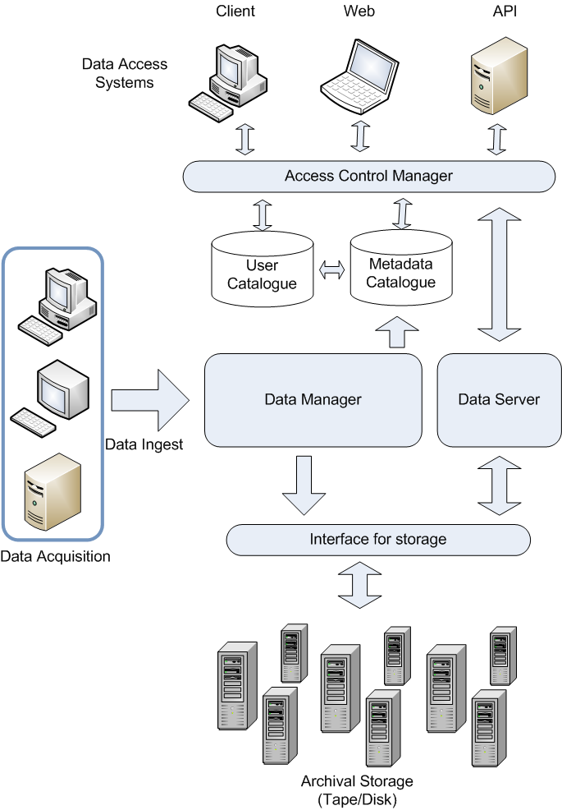
A Data Management Architecture
Generic
  Can be applied to different customers
Robust
  Can be monitored and maintained
Fast
  Manages large rates of data ingest
Scalable
  Manages the storage of very large amounts of data
Secure
  Allows role-based access control to be applied
Integrity
  Data Verification at ingest
  Does not lose or mis-identify data over time
Monitoring
  Must generate reports

