Slide 1
Using a CRIS to support communication of research: mapping the publication cycle to deposit workflows for data and publications
Federica Fina, Data Scientist, ff23@st-andrews.ac.uk
Jackie Proven, Repository & Open Access Services Manager,
jep10@st-andrews.ac.uk

Slide 2





Publications
Activities
WoS, arXiv, PubMed, Scopus…
Award/ recognition
Impact
Bibtex, Refman
Indicators
Case Studies
Dissemination / Engagement
Manual
Input
Entered
Research data
Measures
Uploaded
Entered
Harvested
Manual Input
Entered
Entered
PURE CRIS
Industry / SME’s
Interface
University Structure [HR]
HEI – Strategic
Planning, Benchmarking
Staff Records [HR]
Pulled In
Fed Out
REF, RCUK
SFC, HESA
Student Records [Registry]
Linked
Linked & held
Public, Media Recognition / Impact
Projects, Grants, KT [Finance]
Full Text
Repository
Open Access
Research data sets
(multiple locations and formats)
Collaborations
Research Pools
2

Slide 3
Research data requirements
Funders are: RCUK, EC (Horizon2020), the Royal Society, and others.
Applies to published results
Data Management Plan (DMP):
  how researchers intend to comply; what will be shared; where data will be archived; agreements with collaborators
Publications:
  acknowledge funder (grant number) and include a statement on how to access supporting data (where? On which conditions?)
Data:
  should be made publicly available
  should be retained - at least <10 years> from last date of access
Costs:
  could be included in grant applications

Slide 4
Open Access requirements
Funders include: RCUK, EC (Horizon2020), the Wellcome Trust, and others
Policy for the next REF: http://www.hefce.ac.uk/rsrch/oa/
Applies to published results
Publications:
  acknowledge funder (grant number)
  certain publication types need to be OA under certain rules
Repository deposit:
  should be made publicly available (when?)
  should be the correct version and comply with copyright (how?)
APC costs:
  centrally funded by some funders (which?)
  in some cases costs should be included in grant applications

Slide 5
Researchers’ questions
OA
Why do I have to do this?...
“Open Access is here: make sure you are ready!”
When and how do I upload my article?
When and how will my manuscript be made public?
…Do I need to pay?
…Does my publisher allow this?
…etc./…
RDM
Why do we have to do this?
What data should I deposit?
What formats should we use?
How and when should I deposit the data?
Where and when can I obtain a DOI for my data?
How do I link, in the CRIS, my data to my publication?

Slide 6
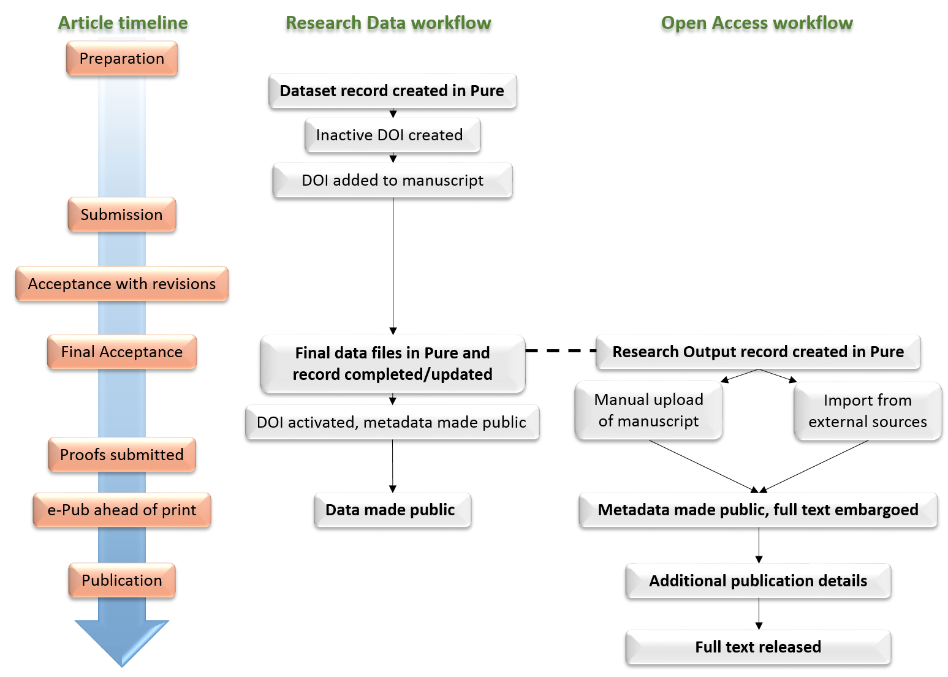

Slide 7

RDM deposit and validation workflow I
Stage 1: pre-acceptance
Publication timeline
Deposit workflow
Validation workflow
RDM team receive notification and check for duplicates
Dataset record created in Pure
Inactive DOI created
Coin DOI and notify authors
DOI added to manuscript
Datasets are created both by authors and RDM team
We do not explicitly offer mediated deposit for datasets
No support at school level yet

Slide 8
RDM deposit and validation workflow II
Stage 2: post-acceptance
Publication timeline
Deposit workflow
Validation workflow
Final Acceptance
Final data files in Pure and record completed/updated
Check and enhance metadata
Perform basic data quality control
DOI activated, metadata made public
Activate DOI – metadata made public
Proofs submitted
e-Pub ahead of print
Data made public
Validate record - files made public
Publication
Pure offers integration with DataCite to activate DOIs

Slide 9
Research data deposit trend

Slide 10
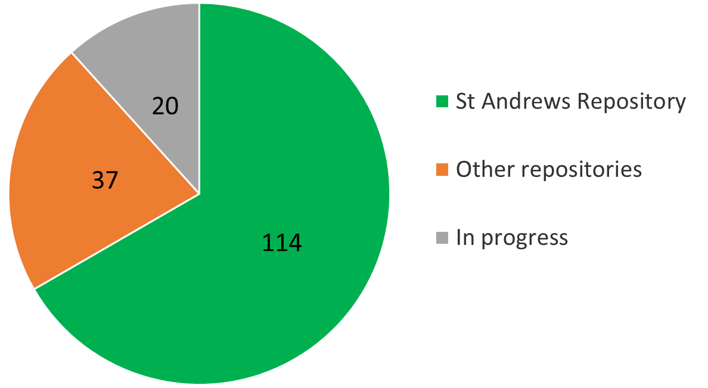
Our datasets since June 2015
171 dataset records in Pure
114 dataset records with files in St Andrews’ repository
20 datasets in progress
37 datasets deposited elsewhere but with metadata in Pure (CRIS as a catalogue)

Slide 11
OA deposit workflow
Act on acceptance
Deposit in Pure

Slide 12
OA roles and validation workflow
Automated import and deposit?
Researcher deposit
Mediated deposit
Identify and link data / funders / grants
Gold OA required?
OA team receive notification or check filters
Check and enhance metadata, perform copyright checks and set default embargo
Set embargo end date (write comments)
Validate record (with embargo)
Metadata and files to repository

Slide 13
OA deposit trends
Strategies developed as part of OA Good Practice project: LOCH (Lessons in Open Access Compliance for Higher Education)
Quick wins
Rise in author-driven deposits during pilot phase
Current deposit rates by subject area
Early increase in pilot Schools
Gradual increase in Arts & Humanities

Slide 14
Joint approach
Delivering joint OA-RDM Pure tutorials:
  being able to address any questions related to OA and/or RDM
  giving a complete overview of the processes and overlaps
Drop-in sessions in schools
  bringing the service to the researchers
Cross-team communications
  Raises awareness in researchers
Shared staff posts between Library and Research Policy Office
  brings together all the CRIS administrators
Notes:
Cross-team reminders – trialling mention of deposit for other content types

Slide 15
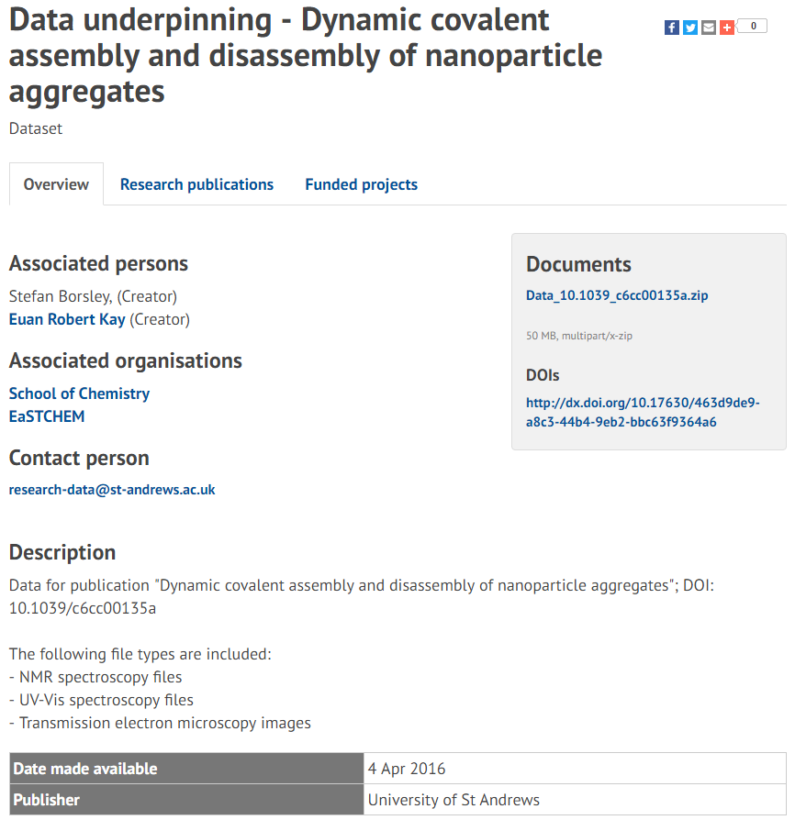
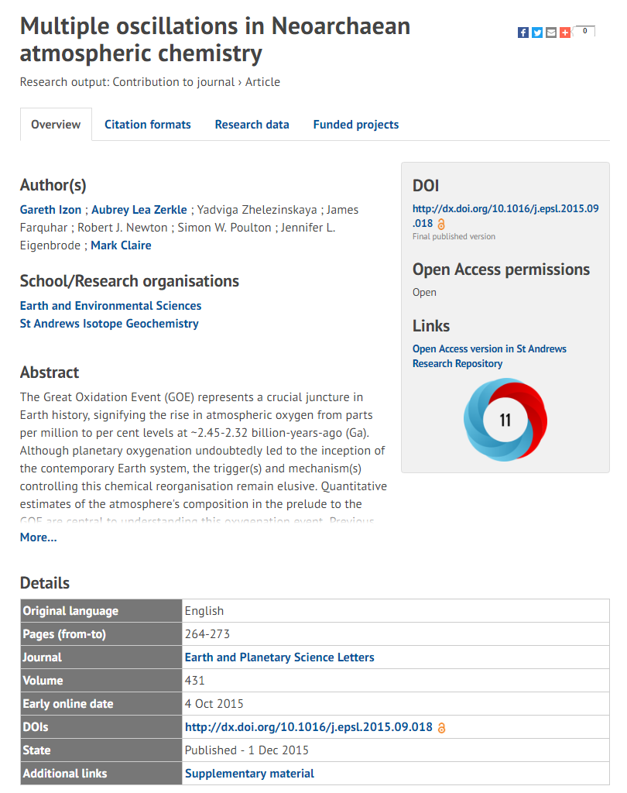
How does it all look?

Slide 16
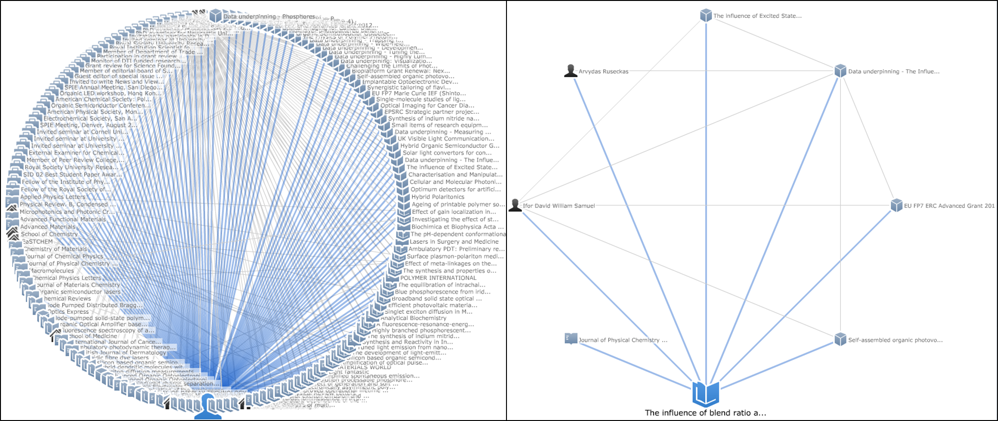
‘Graph of relations’

Slide 17

Thank you for listening
CC BY
https://www.flickr.com/photos/f-oxymoron/9647972522
Federica Fina, ff23@st-andrews.ac.uk, 0000-0003-2594-350X
Jackie Proven, jep10@st-andrews.ac.uk, 0000-0002-0702-0907
http://researchdata.wp.st-andrews.ac.uk/
http://openaccess.wp.st-andrews.ac.uk/

