Slide 1


Limitations of CRIS in assessing the progress of increasing research output in UrFU
Mark Akoev, Olga Leyba Scimetrics Lab of Ural Federal University
Lev Golitsyn Integrirovannye Sistemy LLC
Mark Akoev
m.a.akoev@urfu.ru
13th International Conference on Current Research Information Systems, CRIS2016,
9-11 June 2016, Scotland, UK

Slide 2
Challenge: To support the process of the University's evolution we need an instrument which would allow us to notice the emerging scientific practices on the earliest stages of the development (before the first publications), and also give us the ability to track the overall development of scientific groups in the University.
Notes:
Current research information systems # function efficiently # only if there is already a scientific output # of good quality. ## In a scenario of active development # of the University # it is crucial # to be able to get the data on the progress # of academic and research staff # within strict time windows # and without using too much resources # for monitoring process itself. ## So, # additional instruments # are required, # which would be able # to detect potential problems # and limitations # before # the traditional methods # of scientific activity monitoring # are able to do so.
In some projects # months # and even years # are expected to pass # before the moment # when traditional results, # such as papers, # can be registered # by CRIS. ## Being able # to assess progress # sooner than that # would enable us # to monitor # and adjust # resources allocation. ## As our resources # are limited, # the difference # could be vital. ##
Of course, # a risk-free development strategy # is hardly possible. ## Rather than that, # we would like # to have a tool # that would allow us # to conduct experiments # and measure outcomes # in “real time”. ## It is important, # however, # to make sure # that the information collection # would not interfere # with the research process # and would not irritate academics # and researchers # too much. ## It is also important # to be sure # that the local optimization # of scientific processes # does actually get the University closer # to achieving # its global goals. ##

Slide 3
Plan
Why Ural Federal University needs to change
The problem of grossindicators
CRIS – managing the individual research productivity
Monitoring of the Skills Training for Researchers development in UrFU and the general architecture of the research process in the University
The instrument for monitoring of changes on the university scale
Notes:
In this presentation # I would like to talk # about the context # in which the problem of changes monitoring # had emerged # and describe the solutions # we came up with in UrFU.

Slide 4
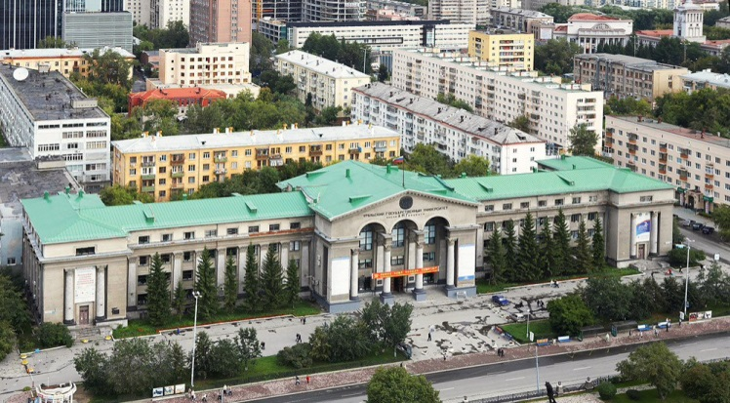
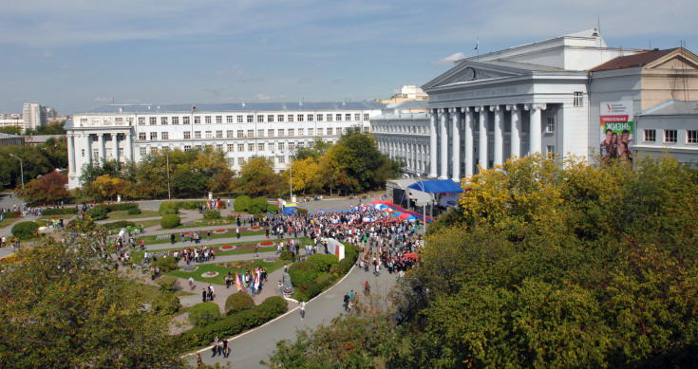
HISTORY
Ural University was founded in 1920.
Later it was divided into several separate institutions including
Ural State University (USU) and
Ural State Technical University (USTU-UPI)
In 2011, these two institutions
were merged again and become
The Ural Federal University (UrFU)
UrFU bears the name of Boris Yeltsin
the first President of Russia who graduated from the university
in 1955
Notes:
Ural Federal University # is located in Ekaterinburg # - in the center of the Urals Region #, in the middle of Russia, # at the border between Europe and Asia. ## The University, # as it is now, # is a result of the merge # of two large regional universities # in 2011 (two thousand eleven). ## Interestingly enough, # both these universities # originated from the same original Ural University, # created back in 1920. (nineteen twenty) ## Currently # UrFU is one of the 9 Federal Universities # elected as key centers # for the regional development # of science # and education # in Russia. ##

Slide 5
FACTS AND FIGURES
UrFU is recognized as one of the leading Russian Federal University (among 9 other Federal Universities)
95-year history, more than 300 000 graduates
About 2600 faculties
More than 40 000 students in 18 UrFU Institutes, including 25 000 full-time students
About 800 PhD students
UrFU takes part in two federal programs:
5 – year program of development of Federal Universities
(2010-2014, 9 Federal Universities), 20 mln Euro per year
The Program of Enhancement of Competitiveness of Russian Universities – Project 5-100 (2013 – 2020, 14 Universities), 10 - 15 mln Euro per year
Notes:
Ural Federal University # participates # in several government programmes # aimed at the development # of national higher education. ## One of them # is the Russian Academic Excellence project, # also known # as The 5-100 Project. ## The program’s goal # is to get at least 5 # Russian universities # to the top 100 # in the overall # or subject # World University Rankings. ##
The goal # of the Project 5-100 # is to maximize # the competitive position # of the group of leading Russian universities # in the global research # and education # market. ## Results # achieved by a university # during the 5-100 project # will affect # its further government financing. ##

Slide 6
Ural Branch of Russian Academy of Sciences
There are 20 research institutes of Ural Branch of RAS located in Ekaterinburg which are collaborating with Ural Federal University both in the field of higher education and joint research and development activities.
The Ural Division was established in 1932, with Aleksandr Fersman as its founding chairman. Currently research centers are open in Ekaterinburg, Perm, Chelyabinsk, Izhevsk, Orenburg, Ufa and Syktyvkar. As of 2007, the Division employed 3,600 scientists, 590 full professors, 31 full members, and 58 corresponding members of the Academy.
Notes:
The presence # of 20 different research centers # of Ural Branch # of Russian Academy of Sciences # in Ekaterinburg # is one of the most important factors # for the UrFU development.

Slide 7
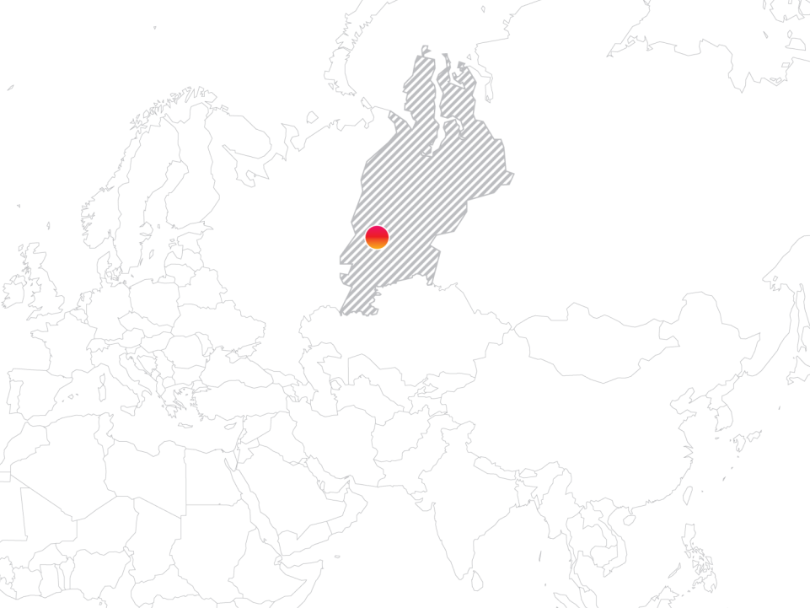
Re-industrialization
31%
of Russian
industrial
production
290 bn $
gross regional product
22,5
mln people
40 bn $
industrial
value-added
product
The Mission of Ural Federal University
is to ensure re-industrialization
and to enhance competitiveness,
to build human, scientific and technical capacity, to upgrade traditional sectors
of Russian economy and to develop
post-industrial ones in a balanced manner, in particular within the Urals
Share of the region in the production of Russia
Finished steel
Refined copper
Mechanical
manufacturing
Crude oil
Natural gas
Source: Russian Statistical Service
Notes:
The Ural Region # also is an important industrial cluster of Russia # well integrated # in the Global Economy. ## For example, # the VSMPO-AVISMA corporation # provides about 50% # of titanium alloys # for Boeing, # EADS (Airbus) # and Embraer aerospace corporations.
Research centres # for the Ural Branch of Russian Academy of Sciences # and regional industrial organisations # are the main employers # of UrFU graduates.
Re-industrialization and the industrial development # are the main goals of the region # since it aims to keep and advance # its competitiveness # on the international level. ## Thus # the mission of the UrFU # is to provide the means # for the Re-industrialization # and make it possible.

Slide 8

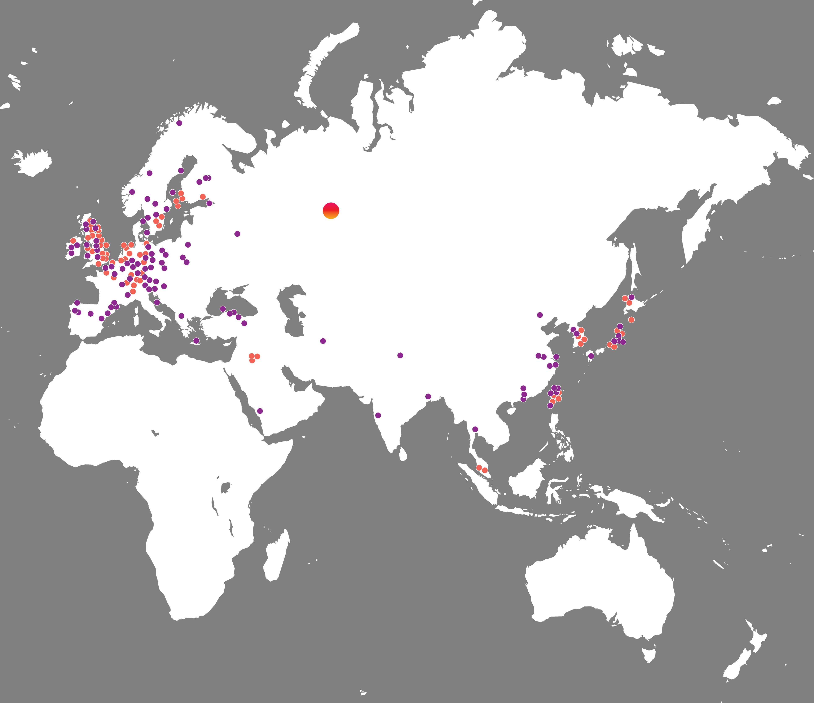

8
Our Dream is to establish
a World-Class University in the heart of Eurasia
Ural Federal University
Today:
Top 601-650 in QS World University Ranking
Top 601-800 in THE World University Ranking
The redpoints represent institutions of the top 200 of THE ranking
The purple points represent institutions of the top 200-400 of THE ranking
Source: Times Higher Education World University Rankings 2015-16
Notes:
The history of our university # and rich resources of our region # allow us to hope # that our dream # of creating a world-class university # in the heart of Eurasia # will eventually come true.

Slide 9
Research output UrFU
Growth in 2015 (to 2014)
SCOPUS +17%
WoS +28%
Growth in 2014 (to 2013)
SCOPUS +24%
WoS +34%
Growth in 2013 (to 2012)
SCOPUS +41%
WoS +35%
Growth in 2012 (to 2011)
SCOPUS +50%
WoS +30%
Source: Web of Science (Thomson Reuters), SCOPUS (Elsevier)
Notes:
Since 2012 # our researchers # consistently increase the number of publications # indexed in WoS and Scopus, # but these results # come mostly from the field of applied sciences, # which affects the overall impact value # of university publications.

Slide 10
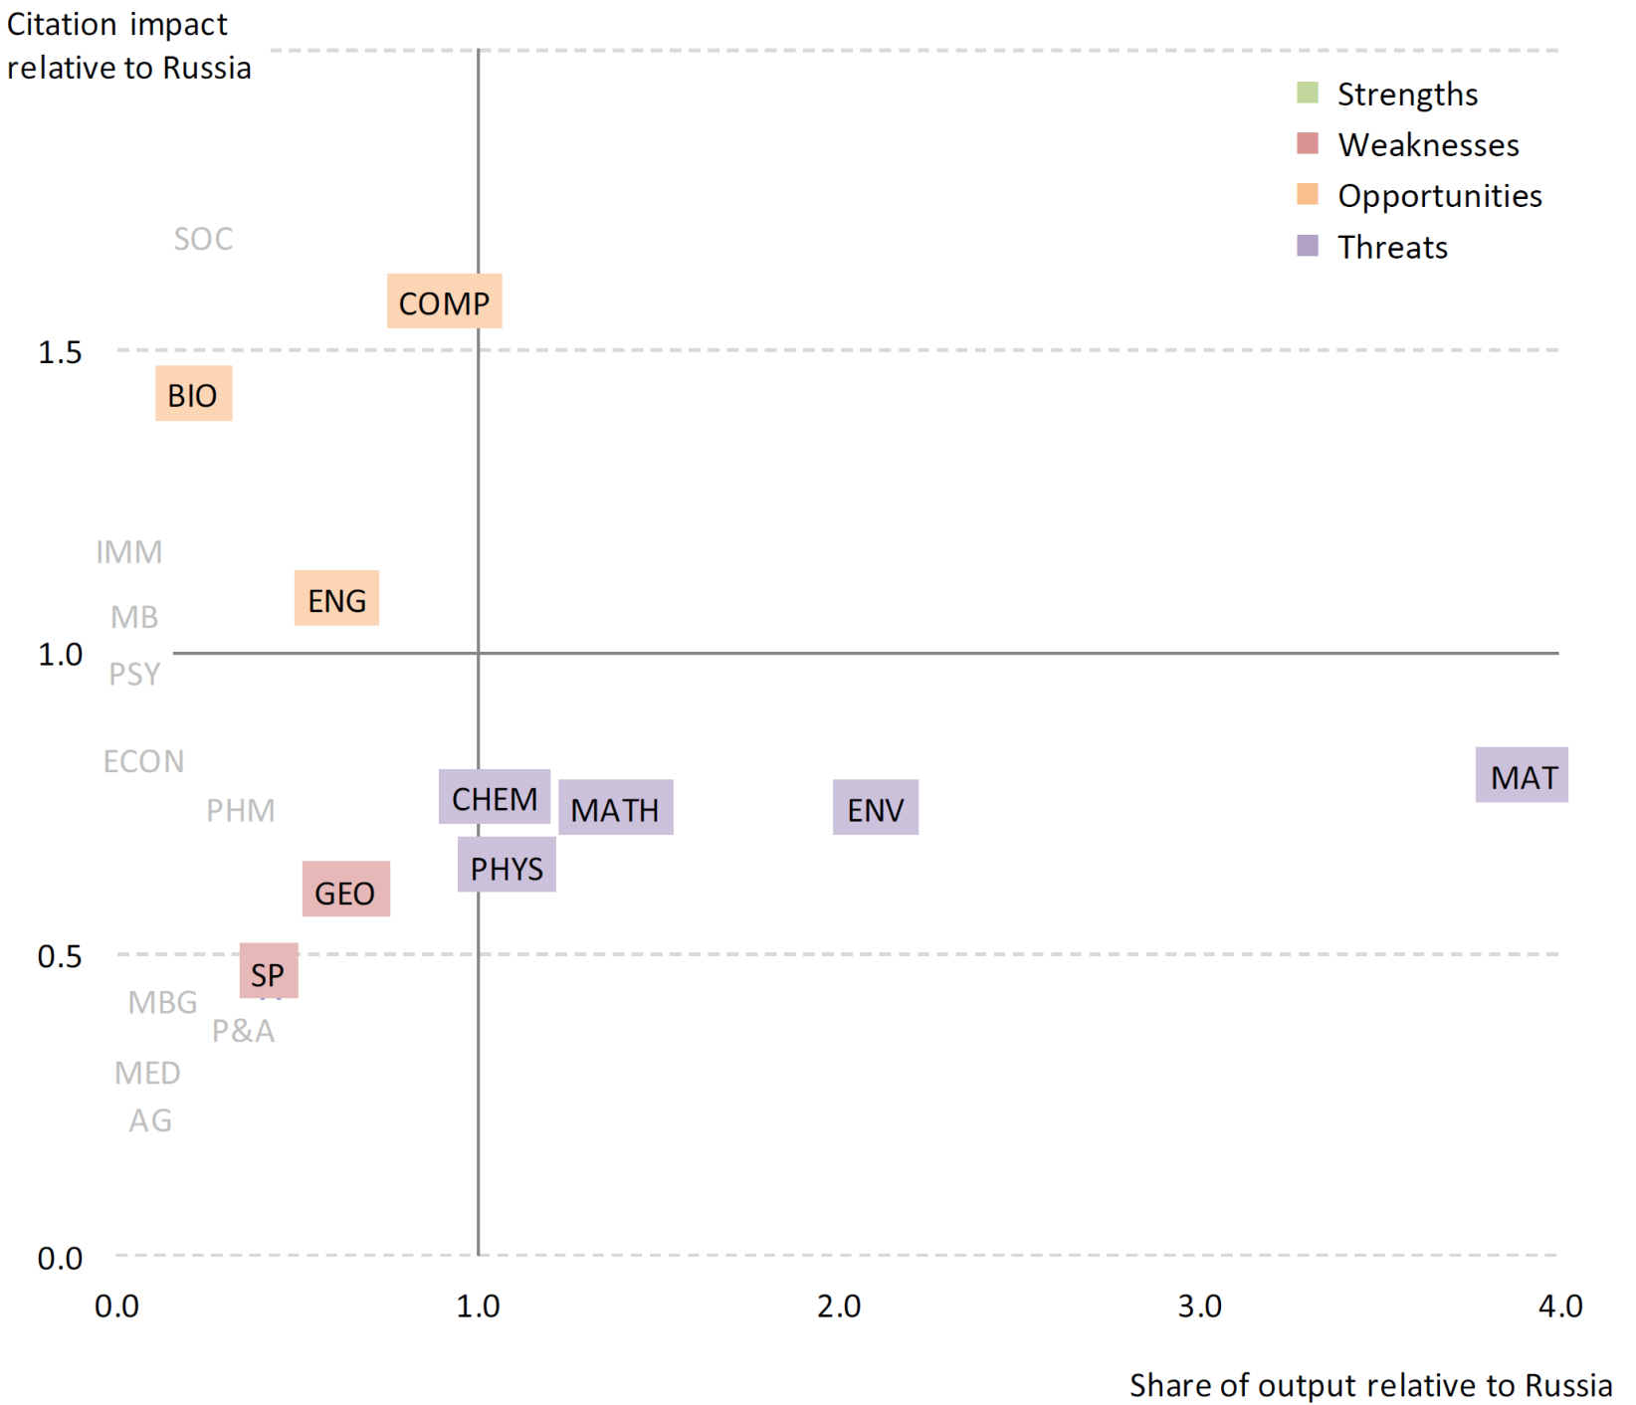
SWOT analysis of UrFU and the selected UB RAS institutes, 2003-2012
Source: Research project: development of strategic business plan
Phase 1: As is assessment of institution performance. Thomson Reuters
These analyses disaggregate the research output of UrFU and the selected UB RAS Institutes at the level of the 22 Essential Science Indicators (ESI) fields. Those fields in which they have no output are not shown.
Research field | Abbreviation | Research field | Abbreviation
Clinical Medicine | MED | Geosciences | GEO
Psychiatry/Psychology | PSY | Chemistry | CHEM
Neuroscience & Behavior | NEU | Physics | PHYS
Immunology | IMM | Space Science | SP
Pharmacology & Toxicology | PHM | Materials Science | MAT
Molecular Biology & Genetics | MBG | Mathematics | MATH
Biology & Biochemistry | BIO | Computer Science | COMP
Microbiology | MB | Engineering | ENG
Plant & Animal Science | P&A | Economics & Business | ECON
Agricultural Sciences | AG | Social Sciences | SOC
Environment/Ecology ENV
Notes:
This slide # shows the comparison made by Thomson Reuters # for our university # during the research # on the creation of the roadmap # of strategic development. ## You can see # that the very distinctive research field # for UrFU # is the material science, # which is not surprising # for an industrial region. ## It is also shown # that this field # is cited less # that the average for Russia.
This means # that it is not only important for our scientists # to increase the number of publications, # but also # to work on the quality of presentation # of achieved scientific results.

Slide 11
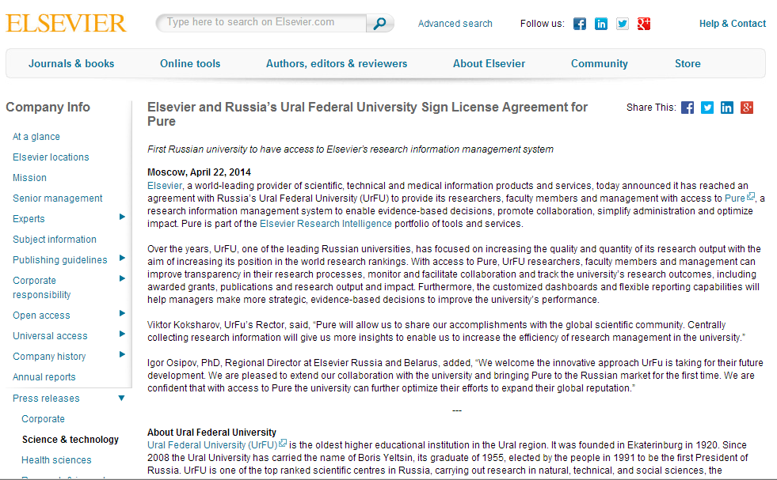
Acquisition of CRIS Pure, april 2014
Notes:
For the task of tracking # and analysis # of scientific results # CRIS Pure # was acquired and implemented.

Slide 12
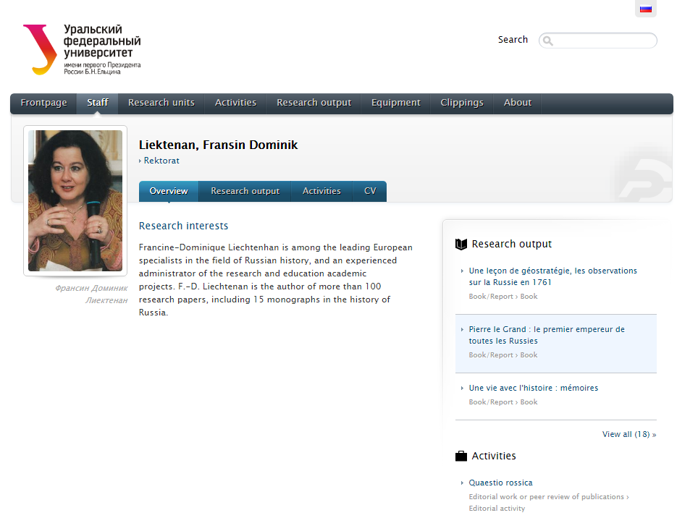
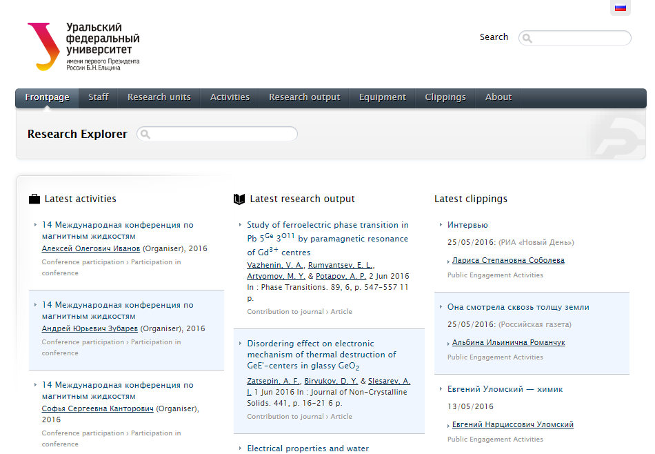
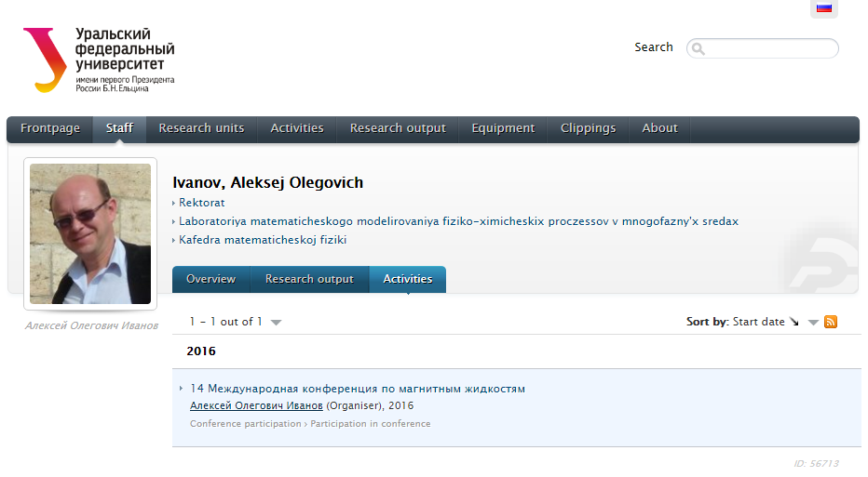
Launch, december 2015
Portal http://science.urfu.ru/
Notes:
CRIS Pure # collects and presents # all scientific results # from WoS и Scopus citation indexes, # as well as from a national index # - the Russian science citation index.

Slide 13
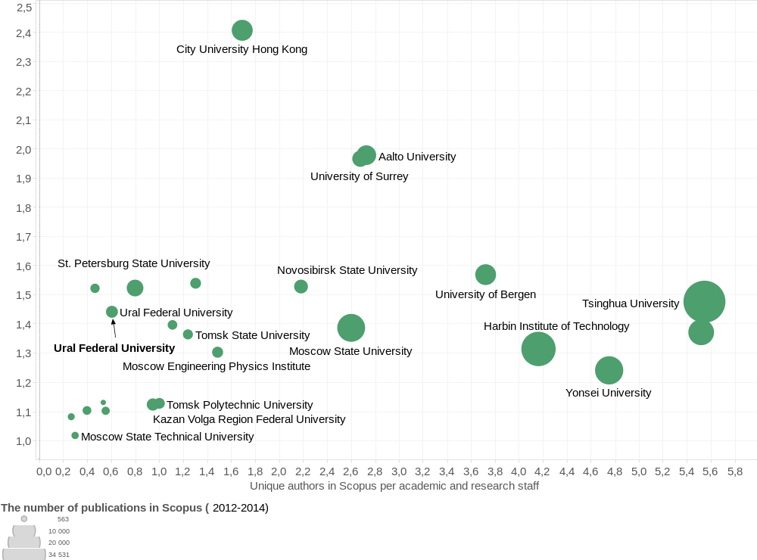
Comparison chart of author publication activity
Source: SciVal 2012-2014. Information about academic and research staff from The Report Russian Ministry of Education and Science 2013 and InCites 2012
Notes:
Another important question # regarding the increase of the number of publications # rises # from authors’ personal productivity. ## Do authors write less # than they can? # The answer # is No.
Using Scopus data # we built a comparison # of “productivity of unique authors” # and “share of active authors” # for the UrFU and a number of benchmark universities # chosen from UrFU direct “competitors” # in Russia.
Here # the productivity of an author is defined # as the number of articles # per one unique author # affiliated with a university, # and the share of active authors # is the number of unique authors # divided by the number of academic and research staff # for this university.
Comparison # showed that productivity numbers for UrFU # are in line # with benchmark universities, # but numbers for the share of active authors parameter # are much lower.
Therefore, # the additional growth in publications # can only be achieved # through a motivation of academics and researchers # affiliated with the university # to publish their results # in more relevant journals # and involvement of PhD and masters students # in the process of publishing their scientific results. ## In fact, # the discrepancy between UrFU and benchmark universities # comes mostly # from the difference in the involvement of postgraduate students # in scientific publications (to the right).

Slide 14
Dynamics of changes in the share of active authors in academic and research staff per department of the university, who wrote papers indexed in WoS Core Collection and Scopus
Share in 2013
Share in 2014
Share in 2015
Notes:
The increase in the number of publications # is possible only through the increase # of active authors # affiliated with the university. # Horizontal lines # indicate the share of active authors # indexed in WoS CoreColl and Scopus # in the academic and research staff # of different UrFU departments.
7% overall increase in the share # is a result of the internal reward program # implemented in 2011 # and still active now.
The program states # that every author # should be awarded a bonus # for each paper indexed. ## The bonus is substantial # as compared with a regular salary, # estimated at around 260% # of average monthly FTE (full time equivalent) # academic staff salary.
The diagram shows, # however, # that only two departments # achieved the more than 50% publication involvement # after the award program implementation.
It is also interesting # that the program gave uneven effect # for different departments and academic institutions # of the university: # the biggest increase # was in departments # which were already quite active.
It is also important # that the rate # in which involvement did increase # apparently began to decline.
Also # we should aim # not just for the increase # of the number of employees # who write, # it is also important # to increase # the number of authors # whose writing is of interest # for the research community.

Slide 15
So, maybe the main reason of the absence of growth in publications is the absence of actual valuable scientific results?
No.
According to Russian Science Citation Index (RSCI)
http://elibrary.ru
Interface and papers are mostly in Russian. The access to the system is free.
In 2015 in RSCI were 5873 UrFU publications while
only 1471 (25%) were in Scopus
Notes:
So, # maybe the main reason # of the absence of growth in publications # is the absence of actual valuable scientific results? ## No. ## According to the data # of Russian Science Citation Index # (web address is on the slide), # which is a Russian free-access scientific research database, # for the year 2015 # one quarter of UrFU publications in RSCI # were also indexed in Scopus # and other three quarters # were published on the national level.
Majority of employees # publish their works # in journals indexed by RSCI.

Slide 16
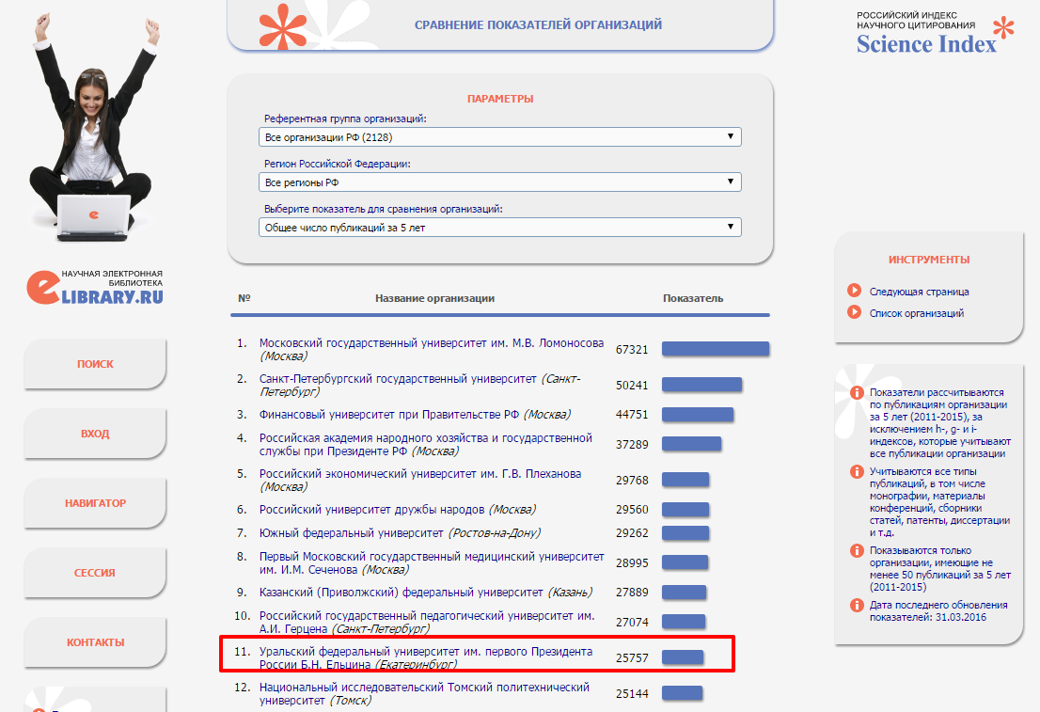
http://elibrary.ru/org_profile.asp?id=290
UrFU is 11th in RSCI by the number of publication in the last 5 years
Notes:
Currently # UrFU is at the 11th place in RSCI by the number of publications # in the last 5 years.
Through the internal analysis of the problem # and series of discussions with scientists # it was discovered # that they are mainly oriented # on the achieving of applicable scientific results # and are most comfortable with publishing them # in national journals in Russian. ## Currently # only a couple of hundreds of russian journals # are indexed in WoS and Scopus, # while RSCI # covers thousands of journals. ## Most of those remaining journals # offer low acceptance requirements # and thus do not provide any incentive for researchers # to develop and improve # a set of particular skills # required for the efficient work and results presentation # in the modern R&D.

Slide 17
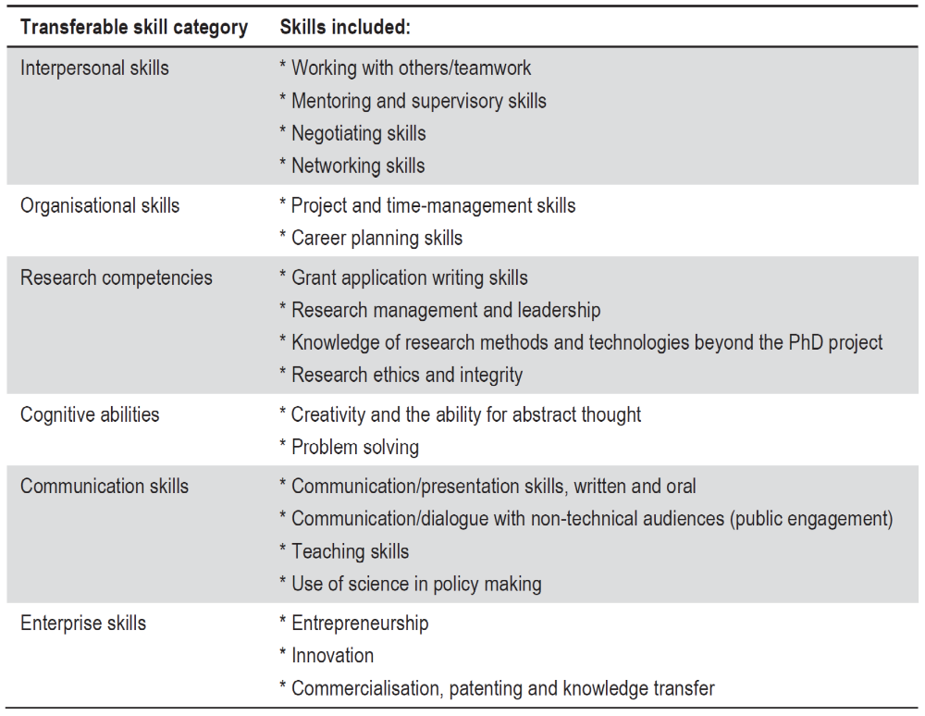
Transferable Skills Training for Researchers
Source: ESF (2009), grouped into categories by author.
Transferable Skills Training for Researchers / OECD. Paris:
Organisation for Economic Co-operation and Development,
2012. 151 p.
Notes:
The list of these skills # is presented on this slide. # The source of this list # is a research on the academic mobility # at the EU level. ## The research comes to the conclusion # that the academic mobility # is the key factor # for the development of these skills. ## Given that, # we hope to be able to help our researchers # to acquire these skills on-site. ## But in order to do so, # we have to establish # which particular skills # our researchers lack.

Slide 18
Which skills should be trained and what should be done on the organizational level to be able to train them?
To model the skills and their connections with organisational changes we used the Archimate language
The Open Group Standard
http://www.opengroup.org/subjectareas/enterprise/archimate
Results were discussed during a regular meeting of INCOSE RUS February 17 2016 (available in Russian)
http://incose-ru.livejournal.com/54648.html
Notes:
To assess # which skills are required # and have to be trained # we analyzed the scientific process # as a part of an enterprise architecture # - the university. # We built a model # using the Archimate modelling language.# Archimate is a standard # proposed by The Open Group # to generalize the system approach # to the organisational modelling.
Results of the modelling # were discussed during a meeting # of the Russian Chapter # of the International Council on Systems Engineering # on the February 17, this year. # Recordings of the meeting # and the presentation # are available in Russian. ## I hope # that after a verification of the model # it will be published in English # with open access.

Slide 19
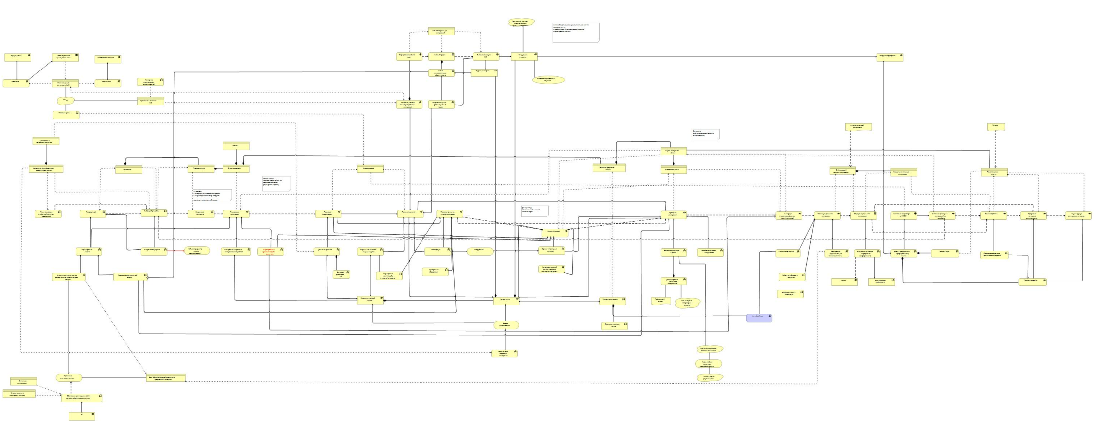
Strategizing
Architecture of the Academic and Engineering Work at the University
Education
Innovations
Scientific process
About Archimate: http://www.opengroup.org/subjectareas/enterprise/archimate
About the model: http://incose-ru.livejournal.com/54648.html (only in Russian, sorry)
Notes:
We created a detalization of skills # presented earlier today # up to the level of business functions. # Business function is both # a theoretical construct of “how to make something” # and instruments needed # to achieve the result.
For all business functions # we created a method # to detect their activities. # For example, # for the business function of scientific reading # we can use # the personal statistics of paper downloads # through the university’s EZProxy. # We structured our view # on how scientific processes connect # with educational and innovational activities # and established # how exactly # the management of scientific processes works # at the strategic level.

Slide 20
Why do we need a model for the scientific process of a university?
The ability to confirm the presence of the skills required to conduct the whole research cycle for university employees
Model of maturity of a scientific group
Ability to determine which information about a business function implementation cannot be found in CRIS.
Ability to design the process of information collection about business functions acknowledging the limitations of CRIS.
Notes:
Using the model # we are able to propose a tool # to assess the level of business functions # employed by university staff. # We can propose projects # to develop the lacking business functions # and plan the resource allocation # to fund these projects.
With the model # we can tell # which data about the exercise of business functions # by our employees # is relevant # but is absent in CRIS.
We are able # to account for limitations in methods of data collection, # given # that we should be able to compare # the collected information # to the information stored in CRIS.

Slide 21
Motivation for the usage of Cohort Analysis
Allows us to build indicators for measuring the progress of whole organization, and not only some processes within it
Is used to detect the differences in behavior of employees by grouping them by the cohort. For example, grouping them by the year of the first publication.
Allows us to track the results for both the information which can and cannot be displayed in CRIS.
Allows to compare the results with other benchmark universities.
Notes:
Introduction # of new business functions # is the basis of change in organisations, # and so in our University. ## A change in a large organisation # can’t be ensued # just from a policy change, # as people behaviour # often reflects a policy # in an unexpected way.
Experiments # offer a more reliable way # to introduce a change. ## To conduct an experiment # and propose the next one, # however, # one must be able # to measure the results. ## This approach # strongly resembles # the process of implementing a new products # in start-ups, # as well as sociology studies. ## A particular tool # used for measuring the results in those areas # is the Cohort analysis.
The underlying assumption # for the Cohort analysis # is that subjects, # in this case authors, # which belong to one cohort # will have the same background conditions. ## If noticeable differences # occur in the behavior # that different cohorts exhibit # then we could attribute # those differences # to the difference in conditions # we introduced in our experiment.

Slide 22
Cohort structure and dynamics
Year | 2010 | 2011 | 2012
Authors of cohort 2012 |  |  | New authors who published in 2012: 15 (PhD students 2012) 20 (New Researchers, may be with history)
Authors of cohort 2011 |  | New authors who published in 2011: 10 (PhD students 2011) 8 (New Researchers, may be with history) | Authors who published in 2011: 4 (PhD students 2011) 7 (New Researchers, may be with history)
Authors of cohort 2010 | 10 (PhD students 2010) 10 (Researchers) | Authors who published in 2010: 5 (Researchers, ex PhD students) 7 (Researchers) | Authors who published in 2010: 4 (Researchers, ex PhD students) 9 (Researchers)
Notes:
An illustration of the Cohort analysis # you can see on this slide. # Cohorts # are formed by authors # grouped by the year # when the first paper # affiliated with the University # was published. # We make an assumption here # that this year # represents the conditions # influencing the start of researchers career # within the University, # including any facilitating factors # introduced by us, # if any.
We want to answer # two important questions here. ## The first question is # if authors continue to publish # after their first result. ## The second one is # - how per-author output volume # changes over time.

Slide 23
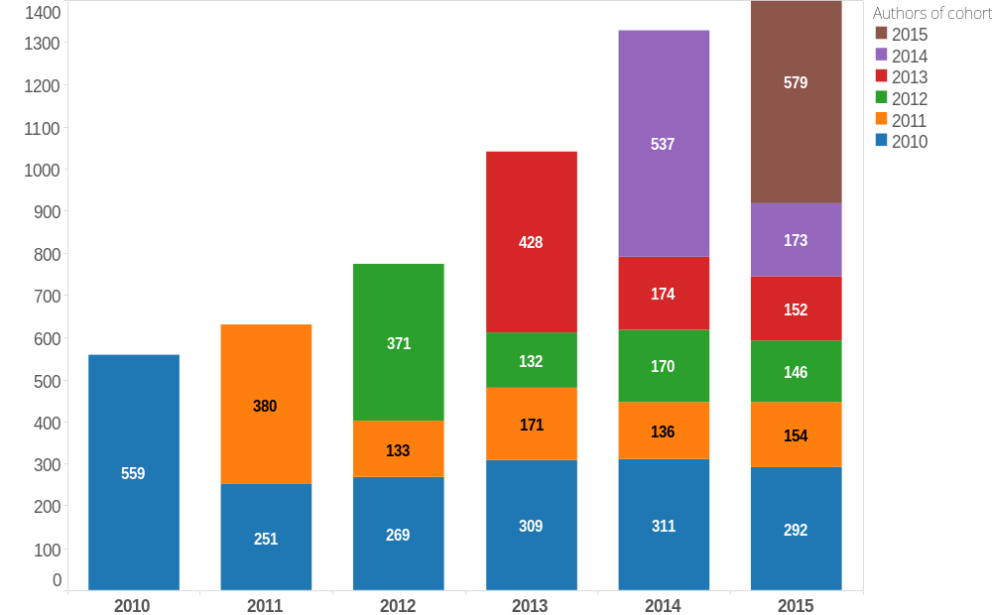
Cohort analysis of UrFU authors for years 2010-2015
Notes:
This chart # represents author dynamics.
As you can see, # cohorts shrink # right after they appear, # which means that authors # either take more than one year # to publish the second paper, # or leave the University. # The reason for the latter # could be that PhD students # leave the University # after their graduation # more often than not. # You could also note # that there’s a tendency, # though weak, # for this diminishing effect # to lower in size.
We can also see here # that the initial cohort size # grows over the years, # which of course # is important for us # to be assured of.
An advantage of this method # is that it could be easily applied # at a department-level, # or at research area level, # thus allowing us # to assess the effect of experiments # conducted on a smaller scale.

Slide 24
Cohort Analysis of publications dynamics
Publications of authors from cohort | 2010 | 2011 | 2012
2012-2012 |  |  | 20
2011-2012 |  |  | 5
2011-2011 |  | 8 | 14
2010-2012 |  |  | 10
2010-2011 |  | 6 | 4
2010-2010 | 10 | 9 | 12
Notes:
As publications # are often done in collaboration, # the author numbers increase # can happen # without the effect on publications number, # or at least # with an effect of a smaller size. ## Here # you can see an example # where cohorts are formed # by the minimum and maximum # of the first-publication-years # for authors. ## This view # shows us # that the growth in publications numbers # is in line # with the growth in author numbers. ## Such a view # is also interesting # if we want to estimate # the involvement of new authors # in existing research groups.

Slide 25
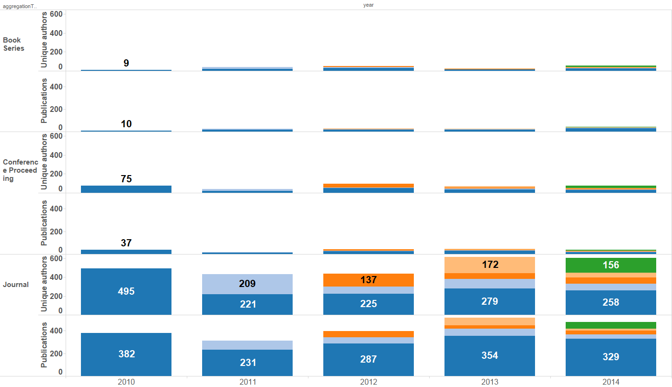
Cohort analysis by publication types. Authors of 2010, co-authors of 2010-2014. UrFU
Notes:
Here # you can see the cohorts # where authors from 2010 and earlier # participate. ## We can see # that the growth here # occurred mostly in collaboration # with younger authors, # or authors # who didn’t previously publish # with UrFU affiliation. ## One can speculate # that an increase in output # is hardly possible # without recruiting new people.
This chart also shows # that the distribution between papers, # conference proceedings # and book series # is maintained over the years, # so the increase can not be attributed # to a shift # to relatively easier ways # to present the result.

Slide 26
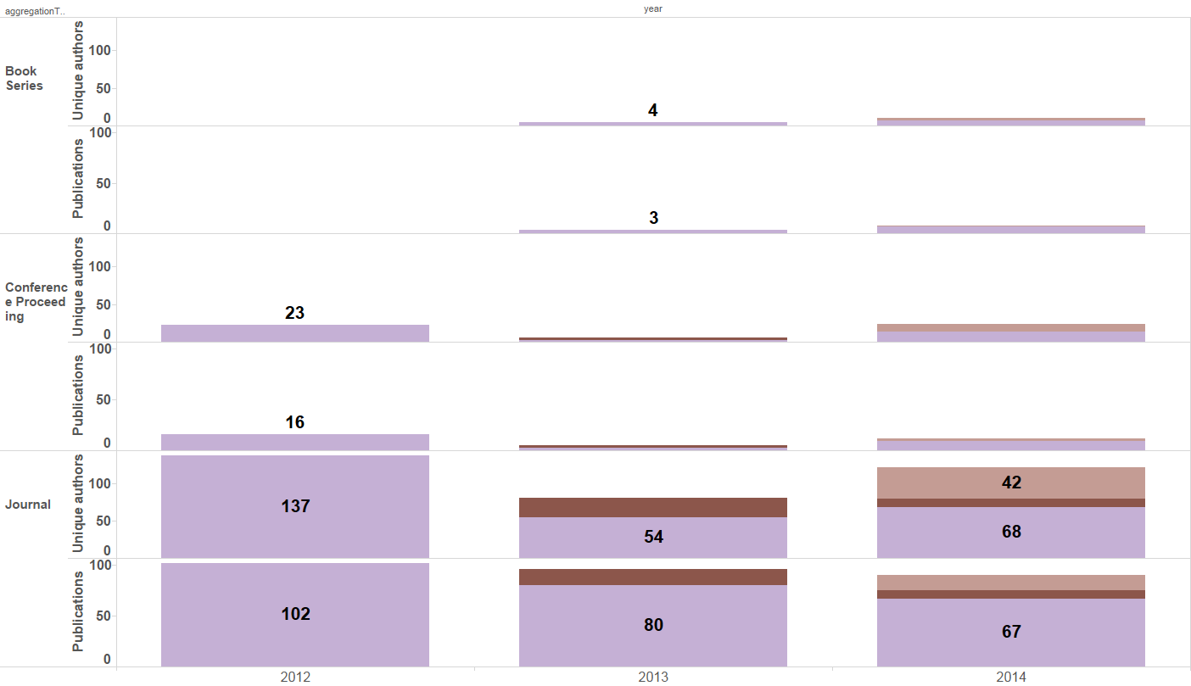
Cohort analysis by publication types. Authors of 2012, co-authors of 2012-2014. UrFU
Notes:
A similar picture # is seen for cohorts # of the most seasoned authors # active from the beginning of 2012.

Slide 27
Conclusion
CRIS allows for assessment of research performance of those of the academic staff who are already working at a level of publishing papers in indexed journals.
A model of research group maturity was proposed to aid facilitation and monitoring of the development of new research groups. Extending the CRIS capabilities to those of RIMS is needed in order to study the validity of the model and to employ it for action planning.
A cohort analysis method based on CRIS Pure data is proposed to validate the long-lasting effect of actions taken to increase the university’s research output.
Notes:
The resume is on the last slide

Slide 28
Thank you for attention
Mark Akoev
m.a.akoev@urfu.ru
The work is supported by Ministry of Education and Science of the Russian Federation, research project No. 14.579.21.0117 (id RFMEFI57915X0117).

