Slide 1



CRIS-ARGOS working out to approach CERIF model
05th November 2012
Núria Cuní CRIS Project Manager
José Luis Poy COO

Slide 2

SIGMA Gestión Universitaria
Research information System ARGOS – CRIS
Approach to standards

Slide 3




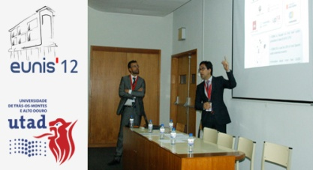
The company
SIGMA Gestión Universitaria is a non profit consortium founded more than 15 years ago by a group of Spanish public universities. Their goal was to find solutions to their business managing processes needs.
This was accomplished by developing a common student information system and a research management system.
CRIS-ARGOS working out to approach CERIF model, Madrid 2012 November 5th

Slide 4











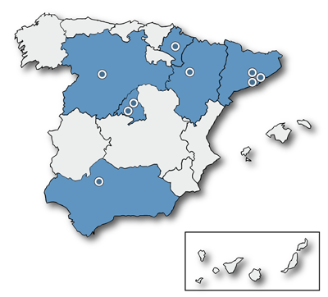
Our community
SIGMA is now focused on first class public universities in Spain (8 of 47, 17%)
SIGMA SIS is used by the 19% of total Spanish public universities students
Spanish market is completed by 22 private institutions (100k students) and 2 e-learning, public UNED (150k) and private UOC (40k
CRIS-ARGOS working out to approach CERIF model, Madrid 2012 November 5th

Slide 5

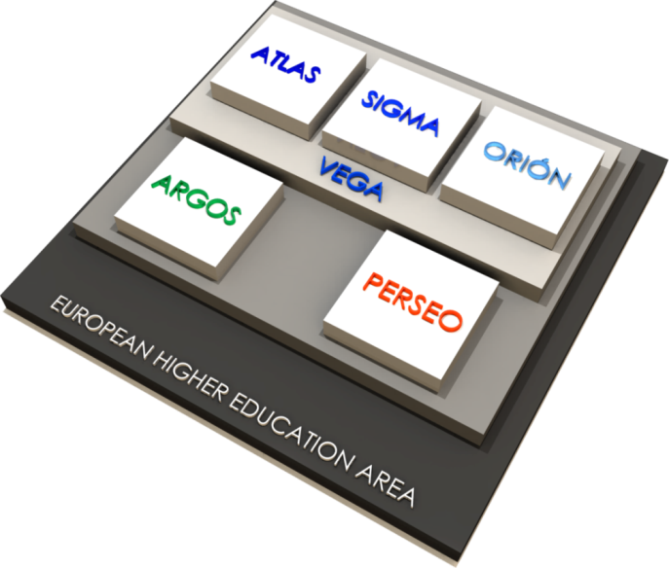



EHEA – Bologna Process
The European Higher Education Area (EHEA) was created to build the Europe of Knowledge and place it at the international forefront, for mobility's and employment opportunities' benefit, and also to unify higher education studies in the EU.
Since then, one of the main priorities of SIGMA AIE has been the adjustment of its products and services to the requirements of the EHEA, thus assisting the Universities inside the group as they go through this important transformation process.
The European Research Area (ERA) was created to facilitate the mobility of researchers, attract the best researchers in the world and coordinate national and regional programs.
SIGMA A.I.E. has incorporated into its adaptations, products and new features to support scientific activity together with its circulation to the public, and has focused his research project ARGOS to the requirements of the ERA
5
CRIS-ARGOS working out to approach CERIF model, Madrid 2012 November 5th

Slide 6
SIGMA Gestión Universitaria
Research information System ARGOS – CRIS
Approach to standards

Slide 7



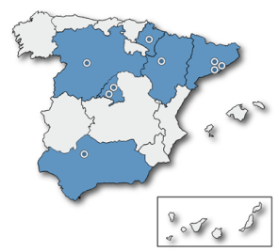








Institutions data flow
Spanish General State Administration
Autonomous Communities (Regions)
Regional Policies
& Plans
Work Program PN
Strategic Actions
JTIs
ERA NETS
OPIs Research Public Entities (CSIC, CIEMAT, …) + Technical Scientific Installations + Other Research Entities
University
Departments + Management Research Units + Other Administrative Services
ANEP
AQU …

Slide 8
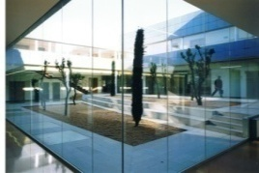






University Research Life-Cycle
Demand
University
Departments
Management research units
Researchers
University research policy
Research programs and topics
Society
PRODUCTION
Calls and proposal
management
Contract and agreement management
Business system
MANAGEMENT
Research project (Research production)
Researchers
Knowledge transfer
(spin-off)
Results communication and promotion
Results
PROMOTION
CRIS-ARGOS working out to approach CERIF model, Madrid 2012 November 5th

Slide 9
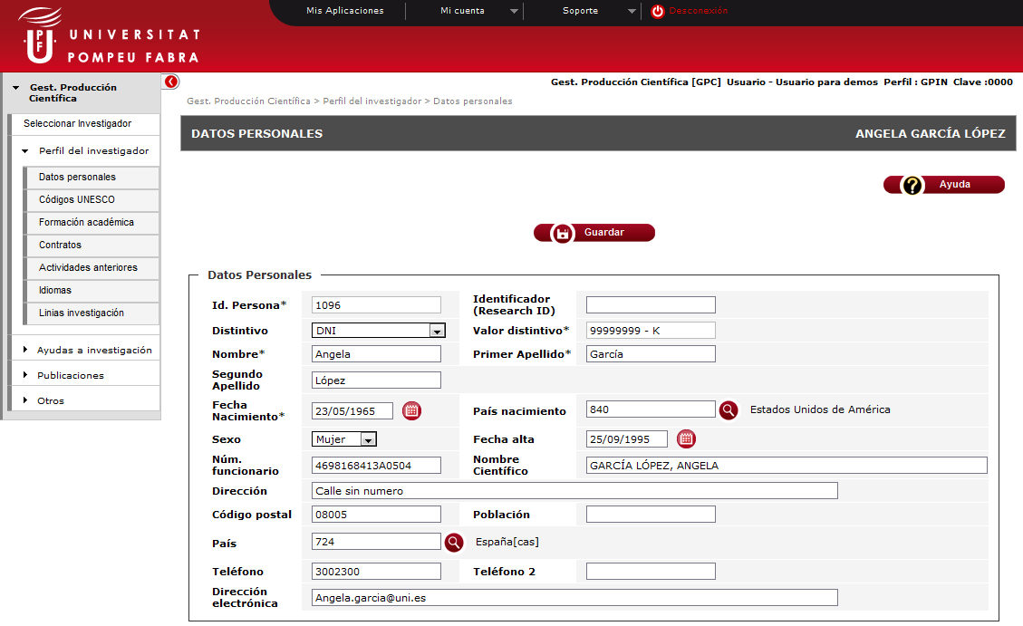
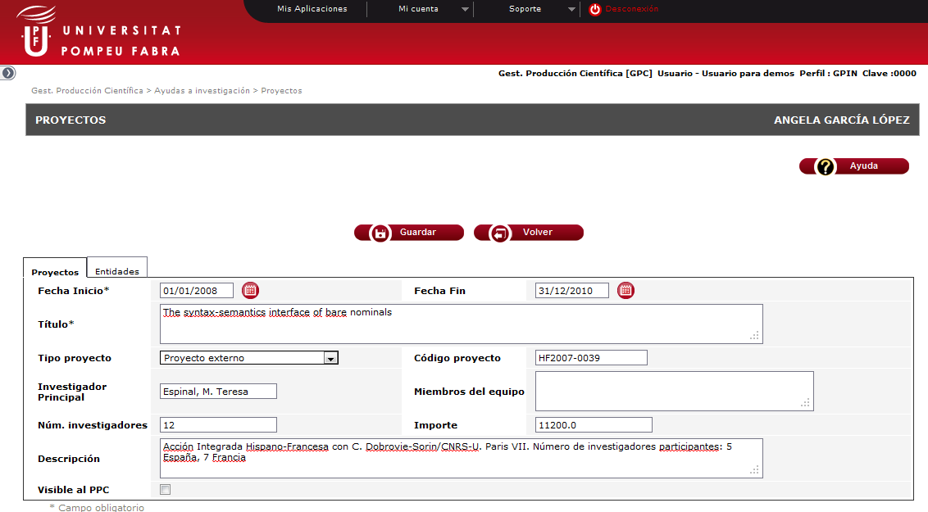
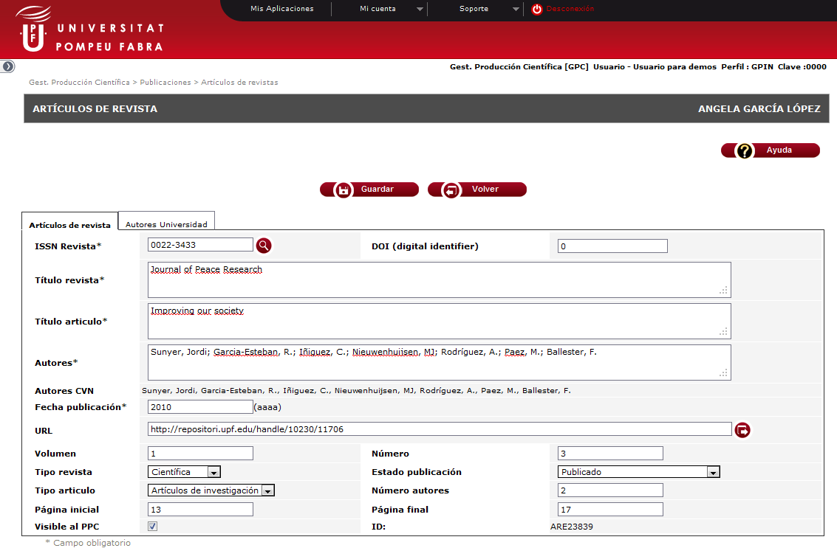
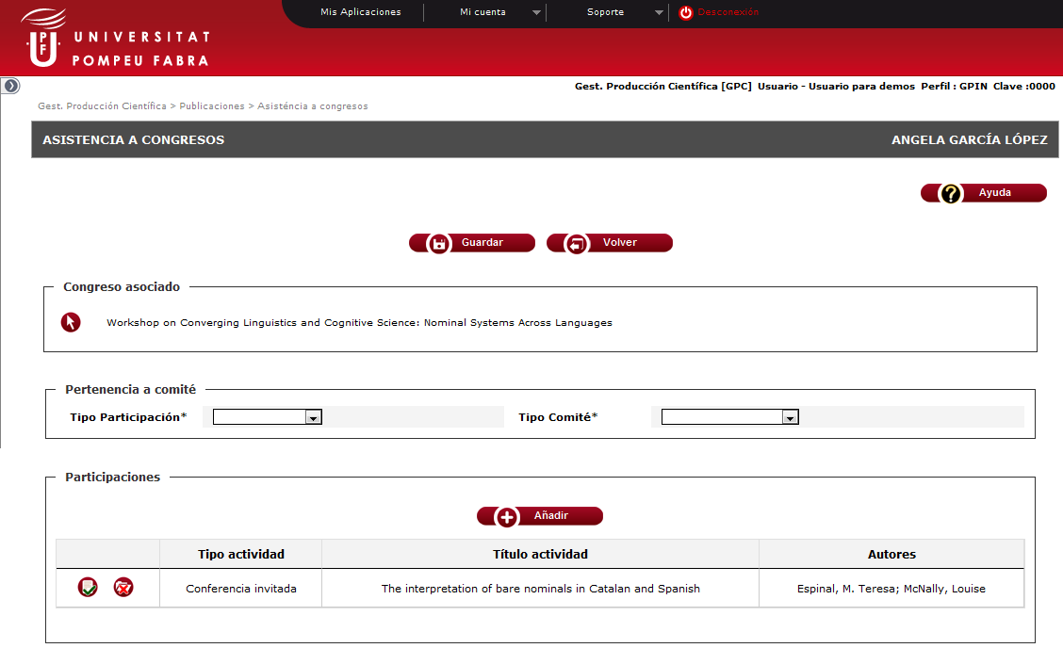
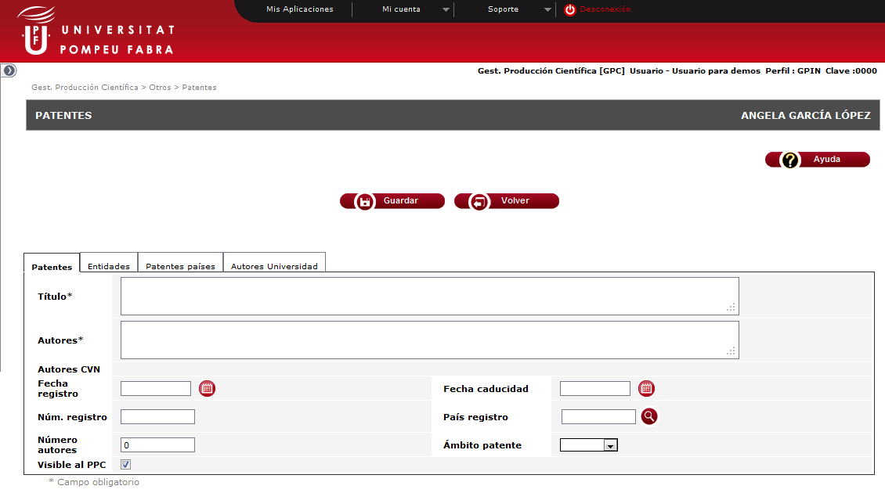
9
CRIS-ARGOS working out to approach CERIF model, Madrid 2012 November 5th

Slide 10
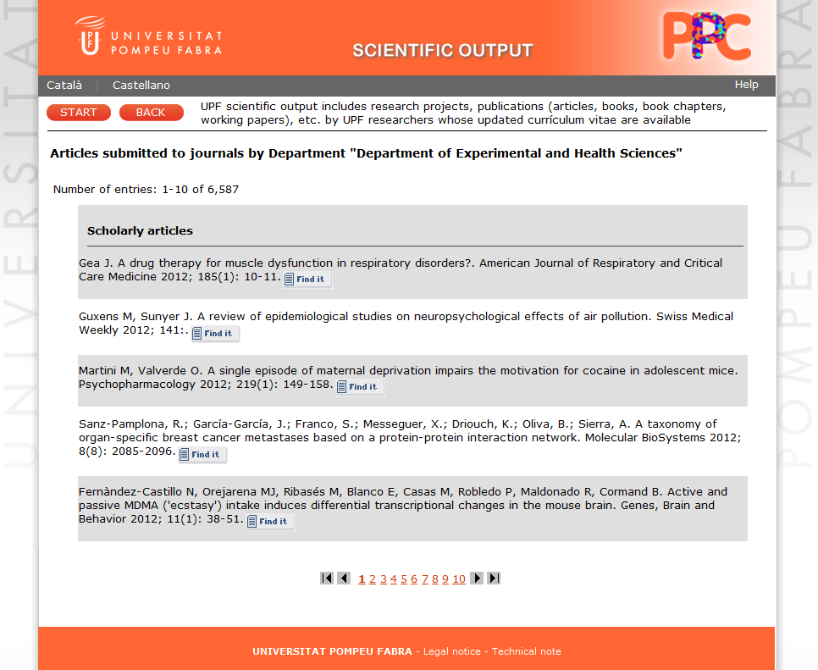
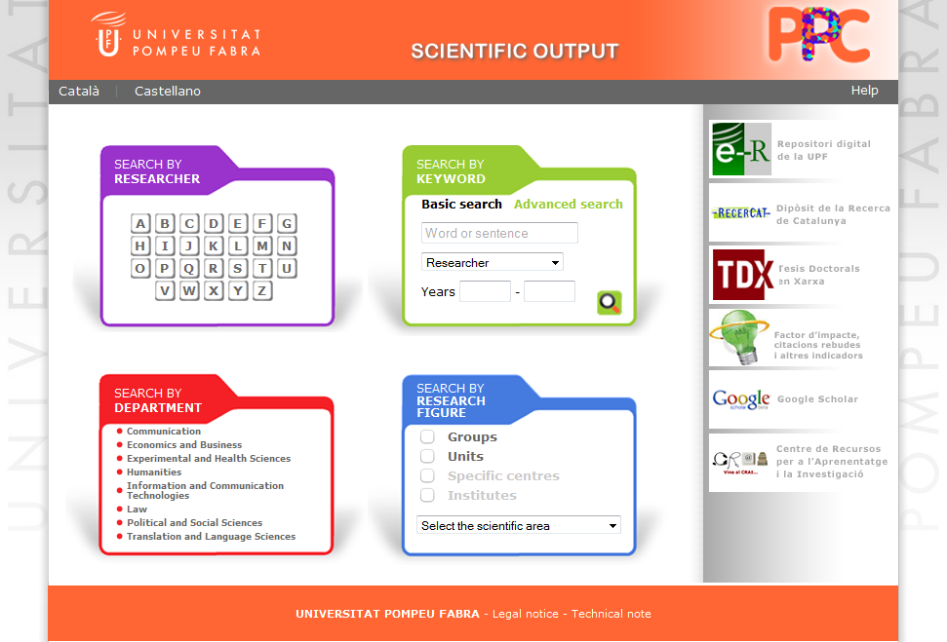
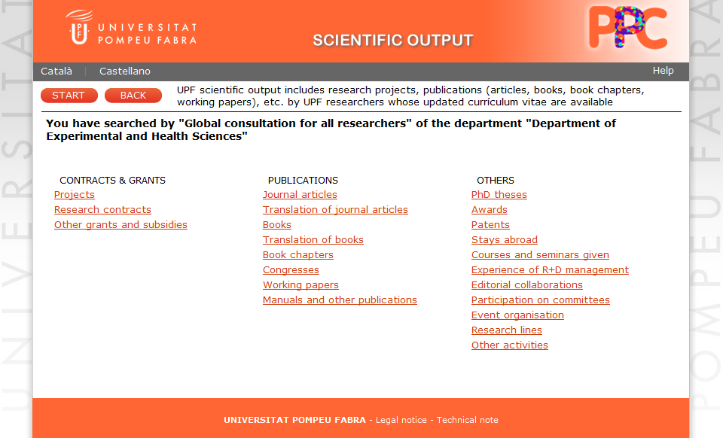
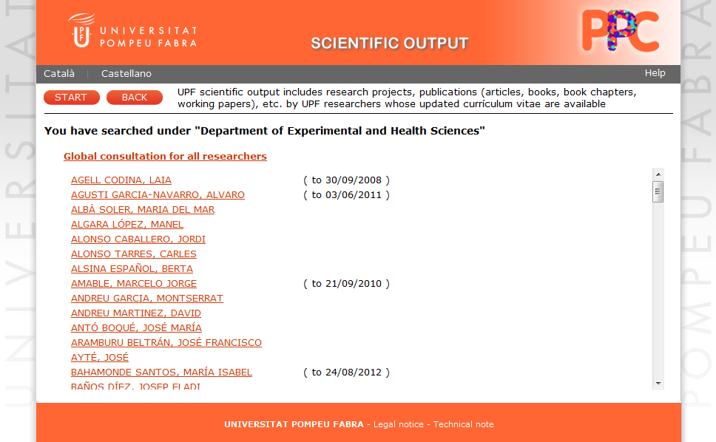
Researcher’s Public Consult
PPC
10
CRIS-ARGOS working out to approach CERIF model, Madrid 2012 November 5th

Slide 11




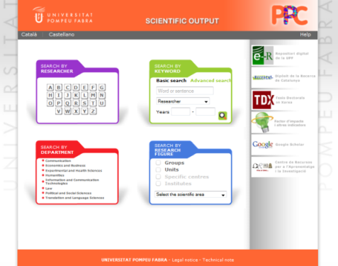
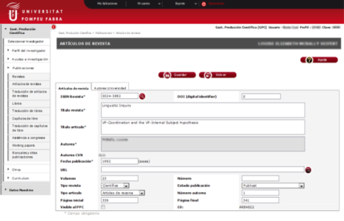





Scientific Production Outputs
Adding
Consulting
Output consultants
Export CV
4
Consult
Researchers
4
GPC
PPC
3
Publish
1
Introduce
5
Validate
Link
2
Attach/Publish
5
Librarian
CRIS-ARGOS working out to approach CERIF model, Madrid 2012 November 5th

Slide 12
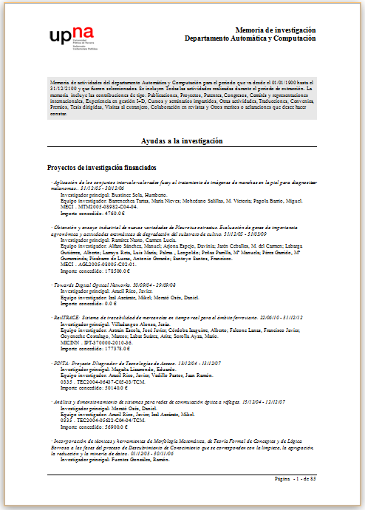
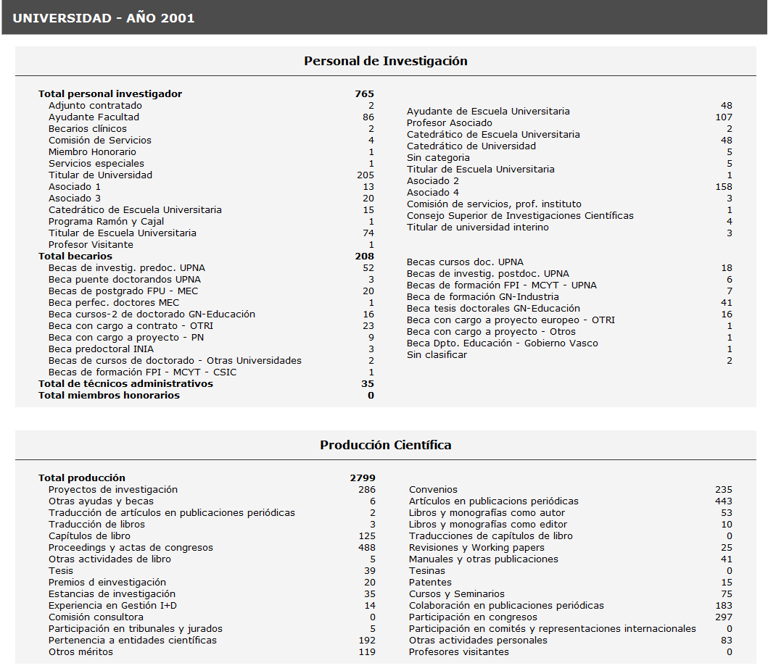
University's Report
MEMIN
Criterion
Extraction period
Extraction type
Members criterion
Researchers extraction
Activity criterion
Types of activity
Privacy configuration
Visibility configuration
CRIS-ARGOS working out to approach CERIF model, Madrid 2012 November 5th

Slide 13

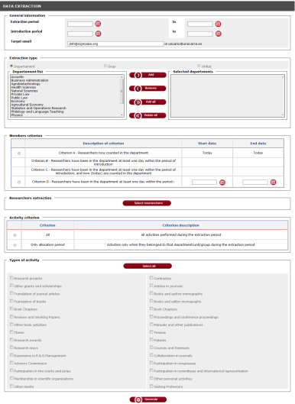


Scientific Production Outputs
University’s report and statistics
MEMIN
PPC
1
Administrador
Generate
Publish
3
1
Consult
Consult
3
4
4
Publish
Output consultants
2
Review/Validate
Researchers
Report
Statistics
CRIS-ARGOS working out to approach CERIF model, Madrid 2012 November 5th

Slide 14
SIGMA Gestión Universitaria
Research information System ARGOS – CRIS
Approach to standards

Slide 15
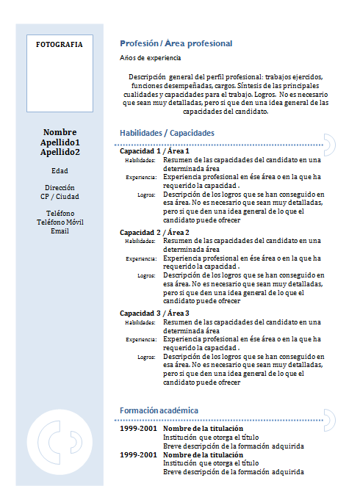
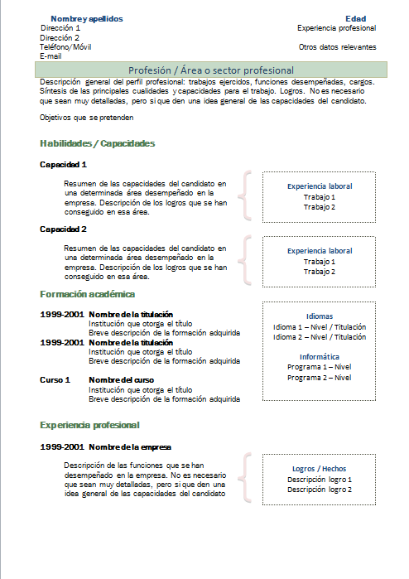
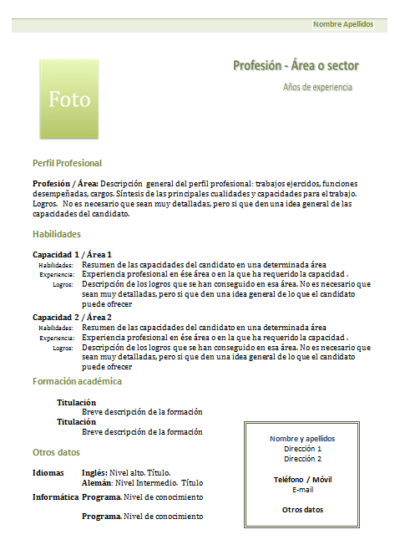


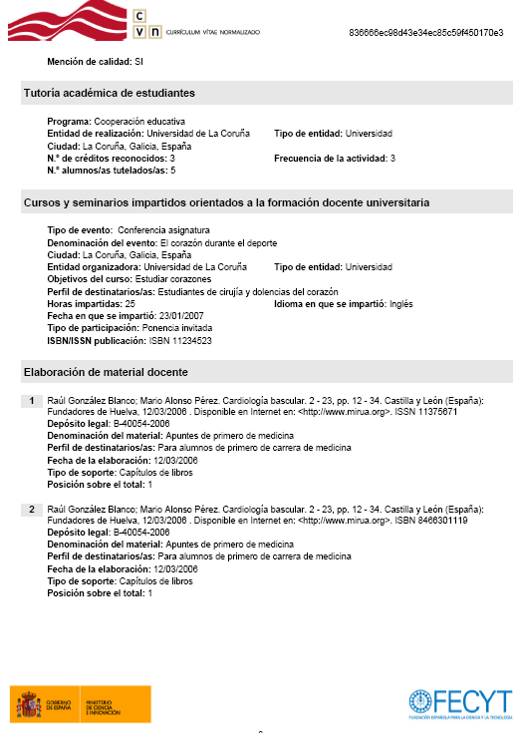
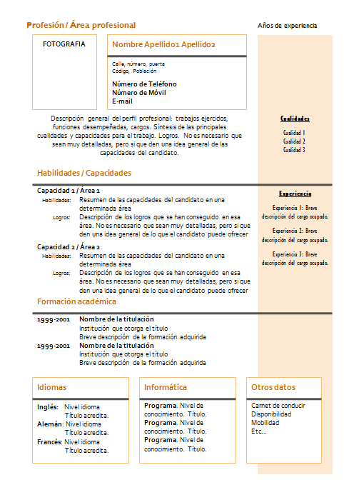




Normalized Curriculum - CVN
CRIS-ARGOS working out to approach CERIF model, Madrid 2012 November 5th

Slide 16
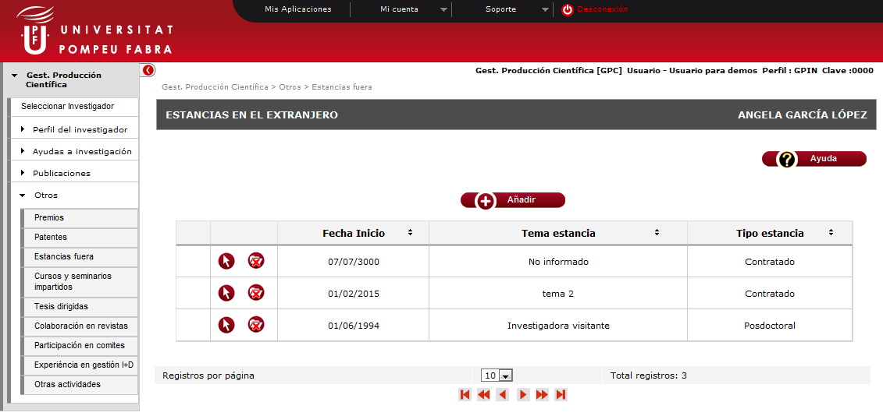
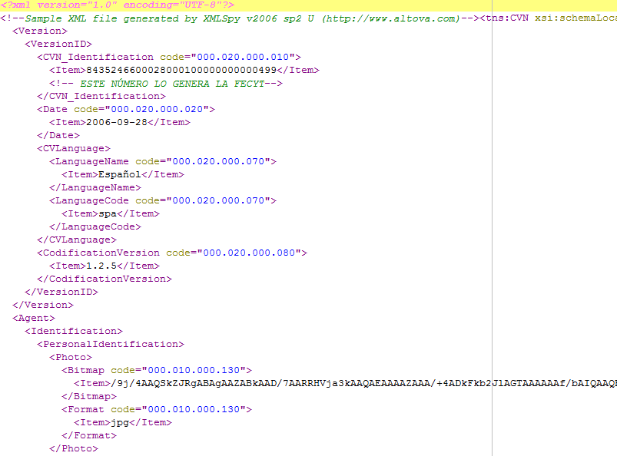
Normalized Curriculum - CVN
Import
Metadatas
Export
CRIS-ARGOS working out to approach CERIF model, Madrid 2012 November 5th

Slide 17
Normalized Curriculum - CVN
Professional status
Training received
Teaching experience
Experience in Science and Technology
Others credits
Scientific Activities and General Techniques
Current professional situation
Previous situation
Languages skills
Directing of doctoral thesis and projects
Scientific or technological activity
R+D+I non competitive projects
R+D+I competitive projects
Patents - Intelectual property
Scientific production
Scientific and technical documents
Results presented in conferences
Participation in seminars
Collection of other credits
Residencies in R+D+I centers
Transferred Experiences in R+D+I organization and management
Awards
CRIS-ARGOS working out to approach CERIF model, Madrid 2012 November 5th

Slide 18



CRIS
ARGOS
International repositories
NATIONAL
CRIS
SICA2
CRIS
Universitas XXI
INTERNATIONAL
European CRIS
CRIS-ARGOS working out to approach CERIF model, Madrid 2012 November 5th

Slide 19
CERIF View Model
Equipment
Facility
Fundings
ExpertiseAndSkills
ResultPublication
ResultPublication
ResultPublication
Service
Qualification
ResultPatent
ResultPatent
Result Product
ResultProduct
ElectronicAdresse
Prize
Project
Project
Project
PostalAdress
Manage
CV
Manage
Organization Unit
OrganisationUnit
Person
OrganisationUnit
Person
Person
Country
Citation
Indicator
Measurement
Currency
Metrics
Event
Language
CRIS-ARGOS working out to approach CERIF model, Madrid 2012 November 5th

Slide 20
ARGOS View Model
Journal
Congress
Acts
Thesis
Publication
Activities
Country
Books
Patent
Original Translation
PostalAdress
Charges
Person
Assignments
Authors
Activity Team
Participants
Research Team
Language
20
CRIS-ARGOS working out to approach CERIF model, Madrid 2012 November 5th

Slide 21
Approach to CERIF Model
Facility
Equipment
Facility
Equipment
Fundings
Fundings
ExpertiseAndSkills
ResultPublication
ResultPublication
ResultPublication
Service
Service
Qualification
Qualification
ResultPatent
ResultPatent
Result Product
ResultProduct
ElectronicAdresse
Prize
Prize
Project
Project
Project
PostalAdress
Manage
CV
Manage
Organization Unit
OrganisationUnit
Person
OrganisationUnit
Person
Person
Country
Citation
Citation
Indicator
Measurement
Measurement
Currency
Metrics
Event
Language
CRIS-ARGOS working out to approach CERIF model, Madrid 2012 November 5th

Slide 22
Approaching standards
Import
Common European Research Information Format
Export
CRIS-ARGOS working out to approach CERIF model, Madrid 2012 November 5th

Slide 23
Approaching standards
CRIS
ARGOS
International repositories
NATIONAL
CRIS
SICA2
CRIS
Universitas XXI
INTERNATIONAL
European CRIS
CRIS-ARGOS working out to approach CERIF model, Madrid 2012 November 5th

