Slide 1



The various aspects of Interoperability
A strategic partnership driving interoperability in research information through standards
David Baker
Ed Simons
Josh Brown
Joint presentation by:
CASRAI (David Baker)
euroCRIS (Ed Simons)
ORCID (Josh Brown)
euroCRIS strategic membership meeting
Amsterdam, November 11 2014

Slide 2
Purpose of the presentation
Added value of an integrated
approach
Introduction to the concept of “interoperability” and presentation of an integrated (“turn-key”) approach for the realisation of improved and sustainable interoperability in the research information ecosystem, based on a strategic partnership of international standards organisations, each dealing with separate aspects of interoperability.

Slide 3
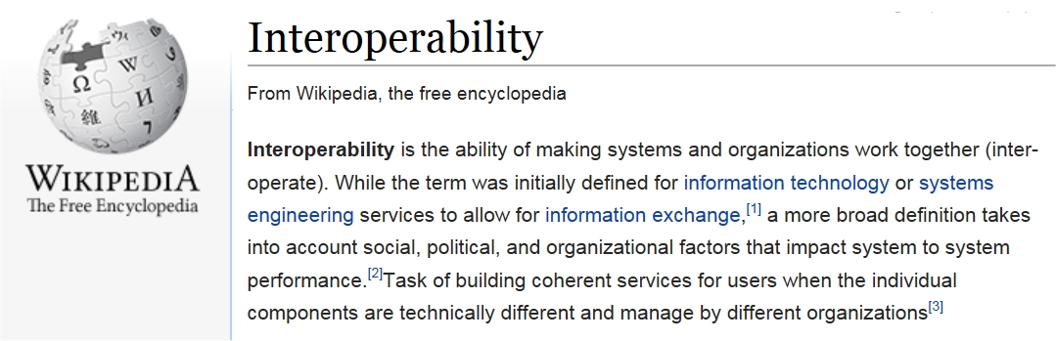
What is interoperability?
A definition
So not merely about technology or systems:
Also about organisations working together (stakeholders)
Apart from technology, other aspects are involved (political, organisational, …)
Within the context of services (use cases)
To realise full interoperability all these dimensions should be taken into account.

Slide 4
Applied to Research Information (RI)
Interoperability in the
Research
Information
Ecosystem
The exchange of information between systems of stakeholders in the research information ecosystem in an efficient and sustainable way.
Many stakeholders: researchers, funders, managers, reviewers, libraries, research administrations, academies of science, association of universities, disciplinary networks, etc…
Various applications/systems: CRIS, publication repositories, data repositories, project management systems, etc…
Various use cases: benchmarking/performance evaluation, grant submission, reporting, management information, profiling of institutes, CV-exposure, etc…
Conclusion: realising research information interoperability is quite a challenge.

Slide 5
The 3 “C”s of interoperability
Complete
Correct
Comparable
Interoperability is about (the exchange of):
Complete
Corrrect
Comparable
Information

Slide 6
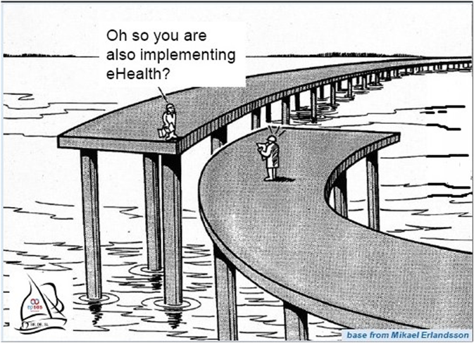
Aspects hampering interoperability
Lack of
Communication
between
stakeholders
Lack of (timely) communication between stakeholders, as a consequence of
silo-ed behavior of organisations/communities or even within institutions.

Slide 7
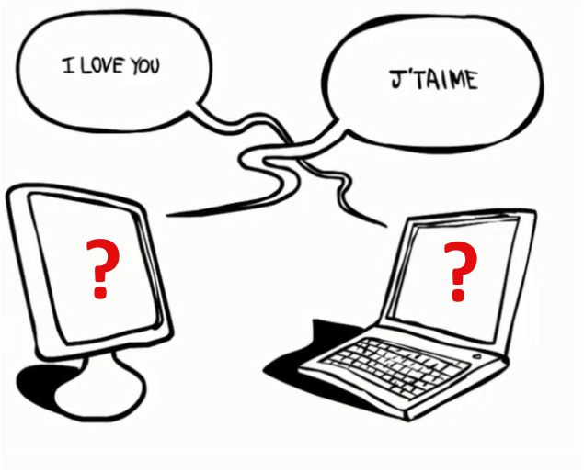
Aspects hampering interoperability
No shared
standard
vocabulary
Lack of standard language: shared vocabularies (terms) and semantics (meaning of terms).

Slide 8

Aspects hampering interoperability
No shared
standard
vocabulary
Solution: use of standard, shared, research information concepts and semantics.

Slide 9
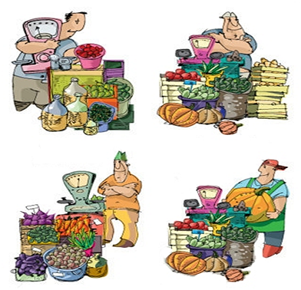
Aspects hampering interoperability
No standard
use cases
Who is the best performing vegetable grower?

Slide 10
Aspects hampering interoperability
No standard
use cases
Difficult to answer because of lack of standardised use case
(different set of indicators used)

Slide 11
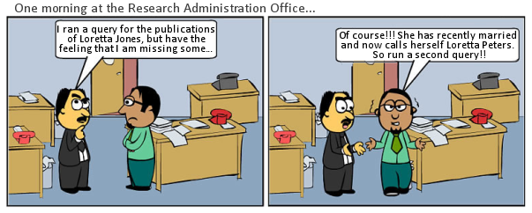
Aspects hampering interoperability
No unique
identification
of data
elements
Lack of standard unique and persistent identifiers (in and between systems)
(applies not only to persons but also to other objects in the RI ecosystem)

Slide 12
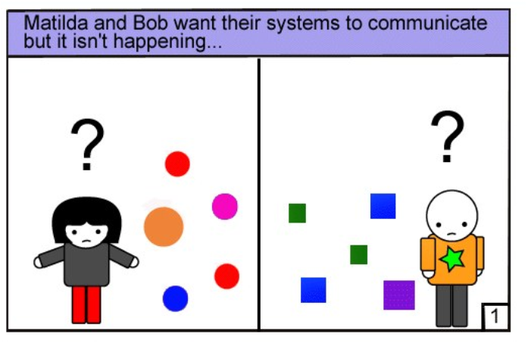
Aspects hampering interoperability
No standard
exchange
format
Lack of shared standard exchange format.

Slide 13
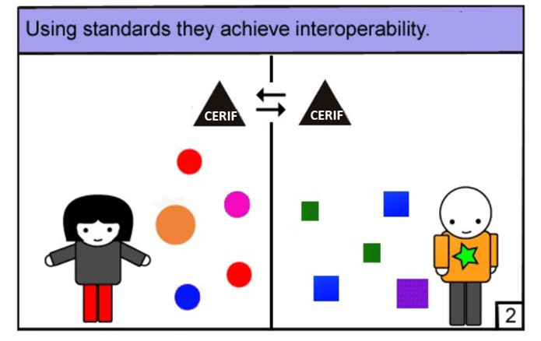
Aspects hampering interoperability
No standard
exchange
format

Slide 14
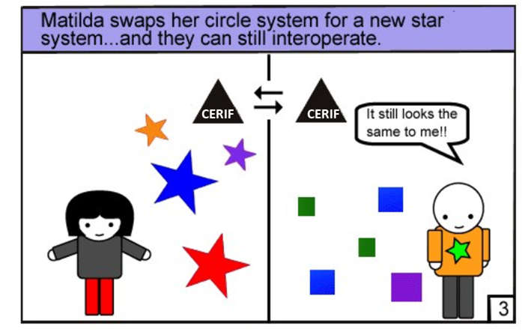
Aspects hampering interoperability
No standard
exchange
format

Slide 15
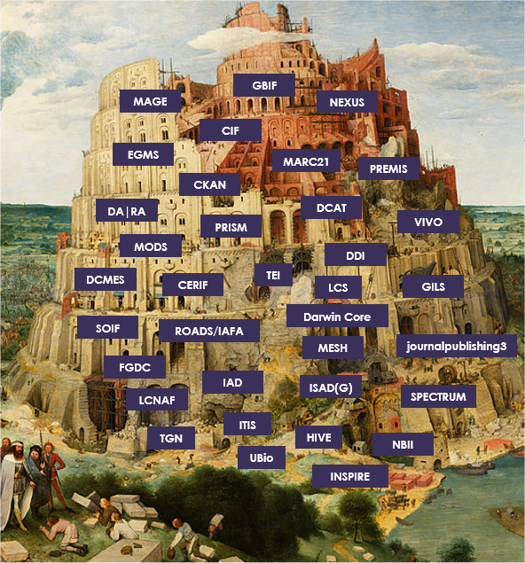
Aspects hampering interoperability
Plethora
of data formats
‘Tower of Babel’

Slide 16
Some (intermediate) conclusions
Interoperability driven
by standards
Interoperability:
Standardisation is the key
Needs a multidimensional, use case driven, approach

Slide 17
The various aspects of Research Information Interoperability: a 3-layer model
1. Subject matter/Domain layer (policy/business agreements; defining the interopearbility
framework: standard use cases and vocabularies):
o Communication between stakeholders: joint formulation of policies/strategies
o Agreement on a standardised vocabulary (terms) and semantics (meaning of terms)
o Agreement on standardised use cases.
2. Technology/Systems layer (technology and operations agreements: making interoperability work operationally):
o Use of standard exchange formats.
o Use of unique identifier registries/systems.
o Communication between technologists at system developers/vendors.
3. Governance/Sustainability layer (investment agreements: making interoperability sustainable):
o Leadership within organizations using standards (policy and technology) in their infrastructures.
o Appropriate shared contributions of expertise and funding to sustain infrastructure.
o Inter-organizational mechanisms between the non-profit orgs that maintain the standards infrastructure.
Conditions
for realising
Interoperability
Applicable to local, national
as well as international
level

Slide 18
The various aspects of Research Information Interoperability: a 3-layer model
1. Subject matter/Domain layer (policy/business agreements):
o clearly defined use cases and stakeholder communities
o open taxonomies and shared vocabularies
o support for the unique or niche alongside the common and general
2. Technology/Systems layer (technology and operations agreements):
o crosswalks, mapping, schema harmonisation
o programmatic connections between identifier registries/systems and data sources.
o open development, transparent partnerships, shared resources
3. Governance/Sustainability layer (investment agreements):
o create cross-community dialogues, coordinate and facilitate
o ensure balanced representation between public, private, not-for-profit and experts
o systematic consultation, driving and shaping community uptake and outreach initiatives
Practical steps towards
realising
Interoperability

Slide 19
The role of euroCRIS
Subject matter/Domain layer:
  support IT execs in explaining/reinforcing standards-based infrastructure and CRIS with policy execs
  contribute technology-perspective to policy deliberations
Technology/Systems layer
  maintain and evolve CERIF-XML and the underlying best practices in relational modelling
  consultancy for stakeholders concerning the implementation of the standard
  explaining/training of stakeholders (in the application of) CERIF.
  providing a platform for consultation between stakeholders.
Governance/Sustainability layer:
  speak with a common voice on the importance of investment in standards
  inter-operate with the other non-profit orgs delivering the standards infrastructure.
  publish and maintain its part of the standards.
euroCRIS

Slide 20
The role of CASRAI
Subject matter/Domain layer:
  convene/facilitate working groups on developing standard policy agreements for information requirements (profiles)
  convene/facilitate policy exec heads around the importance of standards-based operations consistently applied in their IT solutions
Technology/Systems layer
  provide unambiguous specifications of information requirements (profiles) as inputs to technology implementations
  provide a mechanism for testing profile compliance
Governance/Sustainability layer:
  speak with a common voice on the importance of investment in standards
  inter-operate with the other non-profit orgs delivering the standards infrastructure.
  publish and maintain its part of the standards.
CASRAI

Slide 21
The role of ORCID
Subject matter/Domain layer:
  convene/facilitate discussions, partnerships and implementations
  speak to the potential of Persistent Identifiers to enhance data governance
  encourage policies that incorporate the consistent and generalised use of PIDs and standards
Technology/Systems layer
  provide unambiguous links to people and associated data within and across systems
  provide systematic access to the identifier registry and tools to enable other systems to access, update and validate data in the registry
Governance/Sustainability layer:
  speak with a common voice on the importance of interoperability
  maintain an open and collaborative PID infrastructure component
  Ensure community voices drive development
ORCID

Slide 22
The role of evangelists
Vital stakeholders do not always recognise the benefits of interoperability. At each of the three levels of our model, evangelists are necessary to:
Assemble evidence of costs and benefits
coordinate community voices
gather expertise and experience to push improvements, case by case
ensure that partnerships and common goals are leveraged to benefit the whole research information ecosystem
The benefits of interoperability cannot be taken for granted

Slide 23
Be pragmatic.
Not every system can interoperate perfectly with every other.
Serve the core use-cases for your organisation and community.
Reinforce the development, uptake and evolution of your partners.
Some interoperation is almost always better than none.
Do not lock the gates - give it away to get it back.
The golden rule for achieving interoperability

Slide 24
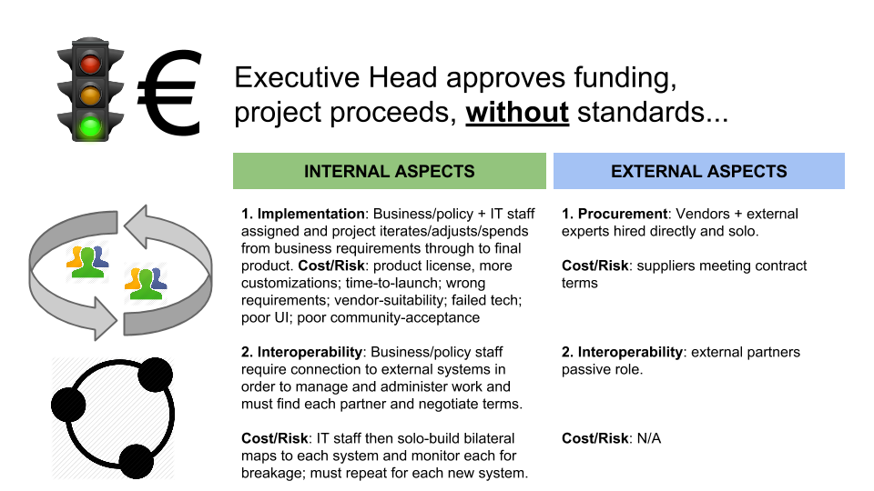

Slide 25
