Slide 1
PTCRIS status report
João Mendes Moreira

Slide 2
Outline
PTCRIS context and status
Next steps
Use case – Delivering a Funder OA Policy

Slide 3
Context
May-2014
Dec-2015
1S2013
Jul-Dec 2013
May 2014
Today
Merger
FCT- FCCN
Mobilization
Implementação Stage 0
Diagnosis
(processes & IT)
Improvment oportunities
Recomentations
Expert group
Technical studies
6 short-medium term
Go
PTCRIS
Reference model & Strategic plan
FCT Board
Workshops e Studies
PT-CRIS
Ministry
Seed funding
Proposal drafting
Long term (PT-CRIS)
Go Stage 1
Collaboration ES + Science
Collaboration science
Studies and strategy
Achievements
Notes:
Trabalho desenvolvido na fase 0 com financiamento de semente
Visão estratégica
Apoio político
Capital humana (quem sabe financiado em anteriores edições do PO CH)
Oportunidades de financiamento para
= Avançar para a próxima fase e escrever a proposta até ao final de outubro

Slide 4

Mission
Ensure the creation and sustained development of national integrated information ecosystem (PTCRIS) to support research management
Notes:
Apoiar os utilizadores na gestão, reporting e tomada de decisão relativos ao processo de investigação nas atividades de desenvolvimento de programas, atribuição de financiamento, avaliação de projetos, execução de projetos, geração de resultados, avaliação de resultados ou a transferência de tecnologia

Slide 5
Goals
Define the regulatory framework to adopt by the various systems
Coordinate FCT’s systems integration in accordance with the standards framework
Coordinate external systems integration with FCT (National and International) according to the standards framework
Support and promote within community the use of the systems of the PT-CRIS.
Notes:
Retirei - coordenar o desenvolvimento de novas funcionalidade sobre os sistemas PT-CRIS

Slide 6
The ecosystem
CRIS – Current Research Information Systems
Academic expertise
Research news
Funding database
Outcomes / outputs
Organizations database
Scientific equipment
Grant management
Research ethics
Research portal
Indicators
PTCRIS is ecosystem!
Notes:
After the studies and surveys we were able to identify several components of a national CRIS

Slide 7
Standards
Data model
Dictionary / Interop.
Ontologies
Researcher Id
PTCRIS
Org Id
Aligned:
H2020
Digital ERA fórum
RDA
Notes:
Um dos aspetos essenciais para assegurar a interoperabilidade entre sistema é a adoção de normas e standards internacionais.
Neste slide estão representados os standards que foram eleitos pelo grupo de trabalho

Slide 8
Priorities
Stage 1
Ilustrative
Stage 0.x
Stage 0
Notes:
Três pesos pesados:
Quick wins: org. db, academic. Expertise, outcomes / outputs
Grande impacto, médio risco, médio investimento:
Grande risco, grande impacto e grande custo

Slide 9
Roadmap stage 0
#1 - Data synchronization (input once, reuse multiple principle!)
#2 – Develop a new National CV system (ergonomic, usable, interoperable)
#3 – Identifiers (Researchers/ Contributers and Organizations)
#4 - Create a point of truth database for PTCRIS

Slide 10
Overview
Start Date phase 1: May/14
End date Phase 1 : Dec/15
 | On time
 | Delayed (recovereable)
 | Delayed (not recovereable)
General state of the project
WP1 - Interoperability
WP2 - Academic CV
WP3 - Organizations
WP4 - BD "single point of true"*
* Pilot

Slide 11
#1 - PTCRIS in context
CV
Scopus
Researcher
ID
DSpace
OA
aggregator
ORCID
OJS

Slide 12
#1 - A non solution
CV
Researcher
ID
DSpace
Scopus
OJS
ORCID
OA
aggregator

Slide 13
#1 - Our solution
CV
Researcher
ID
DSpace
ORCID
Scopus
OJS
OA
aggregator

Slide 14
#1 Current situation
Certified implementation of the synchronization protocol at the CV management system and OA aggregator expected to go live soon (already demoed in Feb 2015)
Implementations at two local CRIS will follow (pilot)
Working with CINECA on a new version of the protocol to be implemented in DSpaceCRIS

Slide 15
#1 More information
An ORCID based synchronization framework for a national CRIS ecosystem: paper describing the design methodology, presented at the 2015 ORCID CASRAI joint conference
http://f1000research.com/articles/4-181/v1
PTCRISync v0.4: current specification of the synchronization protocol for ORCID API 2.0
http://ptcris.pt/en/hub-ptcris-en/

Slide 16
#2 CV’s Platform in context
Two national CV’s platforms
Both are difficult to use
Low or inexistent integration with other systems
  Research units affiliation
  National Professors database
  Projects database
  National theses and dissertations database
  etc.
Not delivering the input once, reuse multiple principle
Not align with international standards

Slide 17
#2 Our solution
Production 1Q2016
Usable and ergonomic
Interoperable with other national systems (for auto population purposes)
PTCRISync compliant
Interoperable with repositories network
CASRAI Compliant
CERIF-XML Compliant (2Q2016)
AAI enabled (Authentication and authorization Infrastructure)

Slide 18



#3 - Identifiers
Provide databases authoritative in organizations and Researchers
Researchers, teachers, students, staff
Organizations
Notes:
Organizações
Identidade única em todo o PTCRIS
Interoperável com outros sistemas (CV - recensear Investigador, Infraestruturas, portal, projetos, financiamento)
Equipamento científico
Nacional (roadmap de infraestruturas)
Internacional (ESFRI, MERIL, Observatory Research infrastructures network)

Slide 19
#3 Identifiers – ORCID
ORCID is mandatory for researchers wanting to apply for FCT funding
Around 22.000 researchers have their ORCID registered at FCT|SIG (+63% since last national REF)
Several other systems can also register the ORCID (for example, around 6000 users have their ORCID registered at the CV management system)

Slide 20
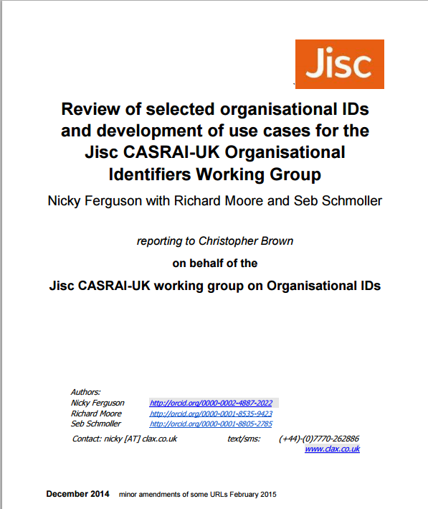
#3 Identifiers – Org Ids - Context
http://repository.jisc.ac.uk/5853/1/Review-of-orgIDs-usecases-clax.pdf

Slide 21
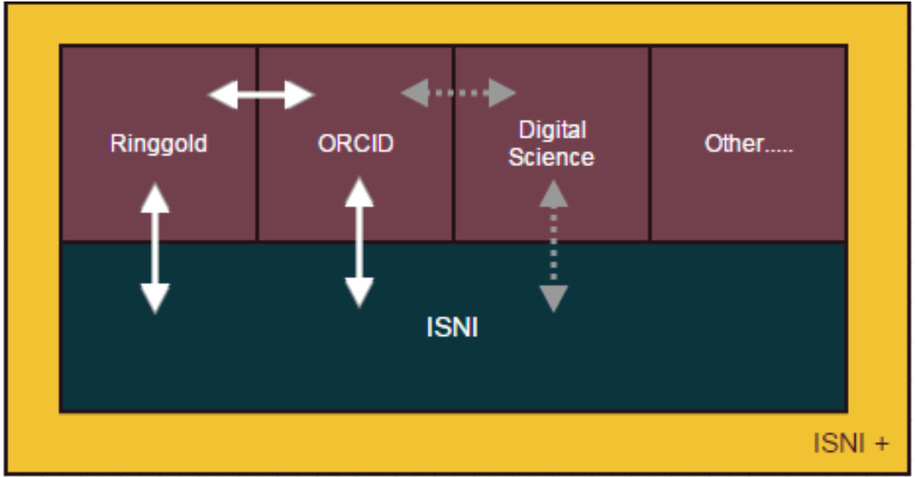
#3 Identifiers – Org Ids - Context

Slide 22
#3 Identifiers – Org Ids – Work
Architecture
Work plan
State of the art study
Rules, principles and processes for handling registry
Constitution of a BD for Portuguese organizations
Electronic services
  Portuguese Registry
  Reconciliation
  Portuguese registry synced with other providers
National (Portuguese)
Organizations database
AIMs for local and national CRIS:
1) ISNI and Ringgolds Ids (after retrospective reconciliation)
2) API for Org Ids authority control (replica of Ringgold DB)
Notes:
1. Study prospective - State of the art in the country
Legislation
Entities involved in the registration
Recording systems
Identifier features registration
Result: document on the characterization of national and international organizations recording systems
2. Rules, principles and processes log
Entities
Process creation, update, merger, split
Result: document on procedures for register organizations in Portugal

Slide 23




#4 - Challenge
Z
X
B
Y
THE

Slide 24

#4 - truth database PT-CRIS
Database "point of truth"
BD
CERIF
Legacy sistems
New systems
(comerciais)
New Systems (homemade)
Indicators (KPI)
Operational
indicadors
(excel ODBC)
DaaS / APIs
CERIF-XML
Notes:
Objetivos
Consolidar (normalizar e de duplicar) dados fragmentados em vários sistemas legacy
Suporte novas aplicações / módulos
Repositório CERIF poderá facilitar a adoção de sistemas comerciais ou de opensource (ex: VIVO)com base na norma CERIF
Base para sistema de reporting/datamining
3. Constitution and validation of BD organizations
IES (DGEEC)
IU (FCT)
Others
Result: basis of national organizations data
4. Electronics Services
Reconciliation services
National Register of Entities
Result: reconciliation service BD's places with BD's International
(ISNI and Ringgold)
National Register Information System (specifications)

Slide 25
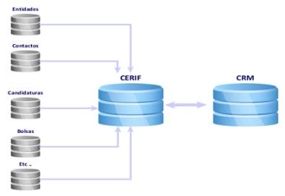

#4 - Pilot project
Migration to CERIF
  Entities
  People
  Contracts Program
  Working contracts
  Scholarships
Data sources
  BD Fellowships
  Scientific Employment BD
  BD Evaluations
  Application BD Investigator IF
EKT CERIF DB & API 0.9

Slide 26
#4 - Work in progress
Safety testing
Load tests
Access control
Extension to projects (DPP)
Curated data

Slide 27
#4 – Pre-production
The date the Service (DaaS)
    People
      https://api.ptcris.pt:8443/cerifapi/persons/320032
    Organizations
      https://api.ptcris.pt:8443/cerifapi/orgunits/8287
    Projects
      https://api.ptcris.pt:8443/cerifapi/projects/197341
    Funding
      https://api.ptcris.pt:8443/cerifapi/fundings/1574

Slide 28


ORCID Implementation Status / Roadmap
Sistema |  |  | PTCRISync (Import) | PTCRISync (Export)
New CV | 3Q2015 | 3Q2015 1Q2016 | 3Q2015 | 2Q2015 | 2016
New FCT (Grant Mng) | 3Q2015 | 2Q2016 |  | 2016 | 2016
RCAAP Portal | 1Q2016 | 3Q2016 |  | 1º Q. 2016 | 1Q2016
RCAAP (OJS) | 2016 | ? | NA | NA
RCAAP (DSpace) | 2016, (1), (2) | ? | 2016, (1), (2)
VIVO | 2016 | ? | 2016 | ? | 2016
1 –Using DSpaceCRIS, 2 – Gradual transition

Slide 29
Outline
PTCRIS context and status
Next steps
Use case – Delivering a Funder OA Policy

Slide 30
Work organization
WP 1
  Coordination
WP 2
  Regulator framework (RF)
WP 3
  National CRIS (RF compliance)
WP 4
  National CRIS(new)
WP 5
  Local CRIS (local)
WP 6
  Truth database (data warehouse)
WP 7
  Business Intelligence
WP 8
  Communication, dissemination and training
1-Sep-15
16

Slide 31
Work organization
WP2 - Regulatory framework
Research Indicators
HEI Indicators
Data interoperability formats
Interoperability pub admin
Unique identifiers
Data synchronization
Information security and privacy
Conformance and interoperability testing
WP3
National CRIS
(RF Compliance)
IS Funders
IS DG HEI
SI Accreditation Agency
IS Stats Bureau
IS DG Plan and control
WP4
New national CRIS
Research Network System
WP5
Local CRIS
Academic System
CRIS
DSpaceCRIS
IRIS?
WP6
Truth database
CERIF BD
Aggregation
Master Data Management
DaaS
WP7
BI
science
HE
Org Ids registry
Validation
17
Notes:
Governação de dados – assegurar a consistência e sincronização de informação. Vários casos de uso
Projetos e publicações. PTCRISync
Manuseamento de dados de forma a salvaguardar a sua proteção
Protocolos para interoperabilidade entre sistemas

Slide 32

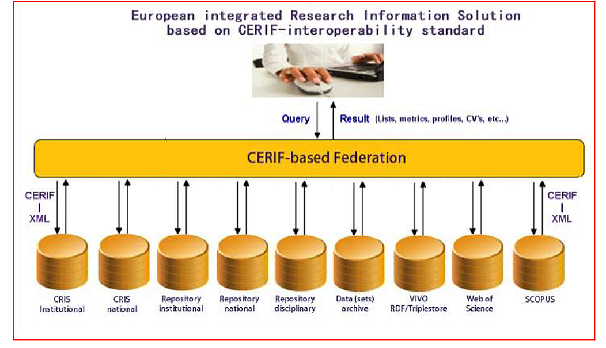
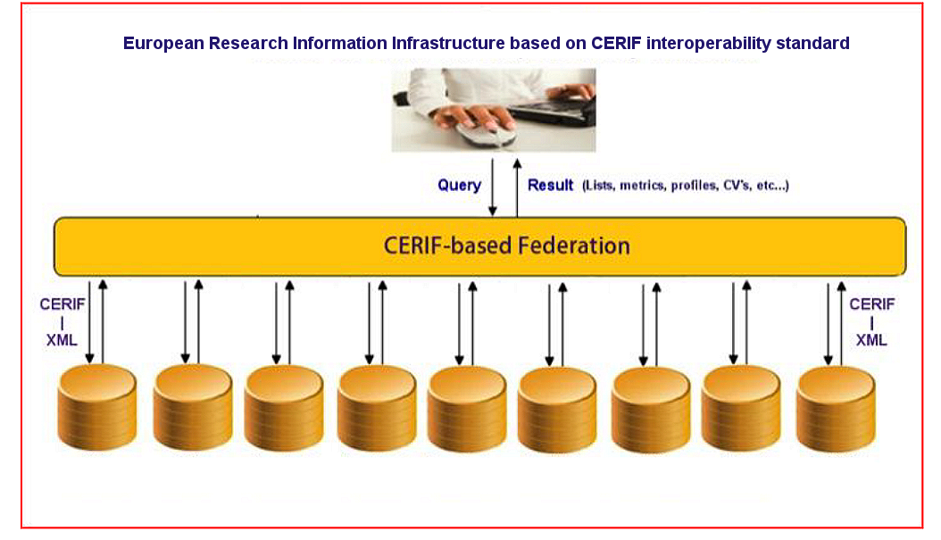
European Research Information Infrastructure: Architecture.
Standard
use case / profile
Standard
use case / profile
Standard
use case / profile
Standard
use case / profile
Standard
use case / profile
Standard
use case / profile
NATIONAL and LOCAL CRIS AND REPOSITORIES

Slide 33
Cooperation is power!

Slide 34
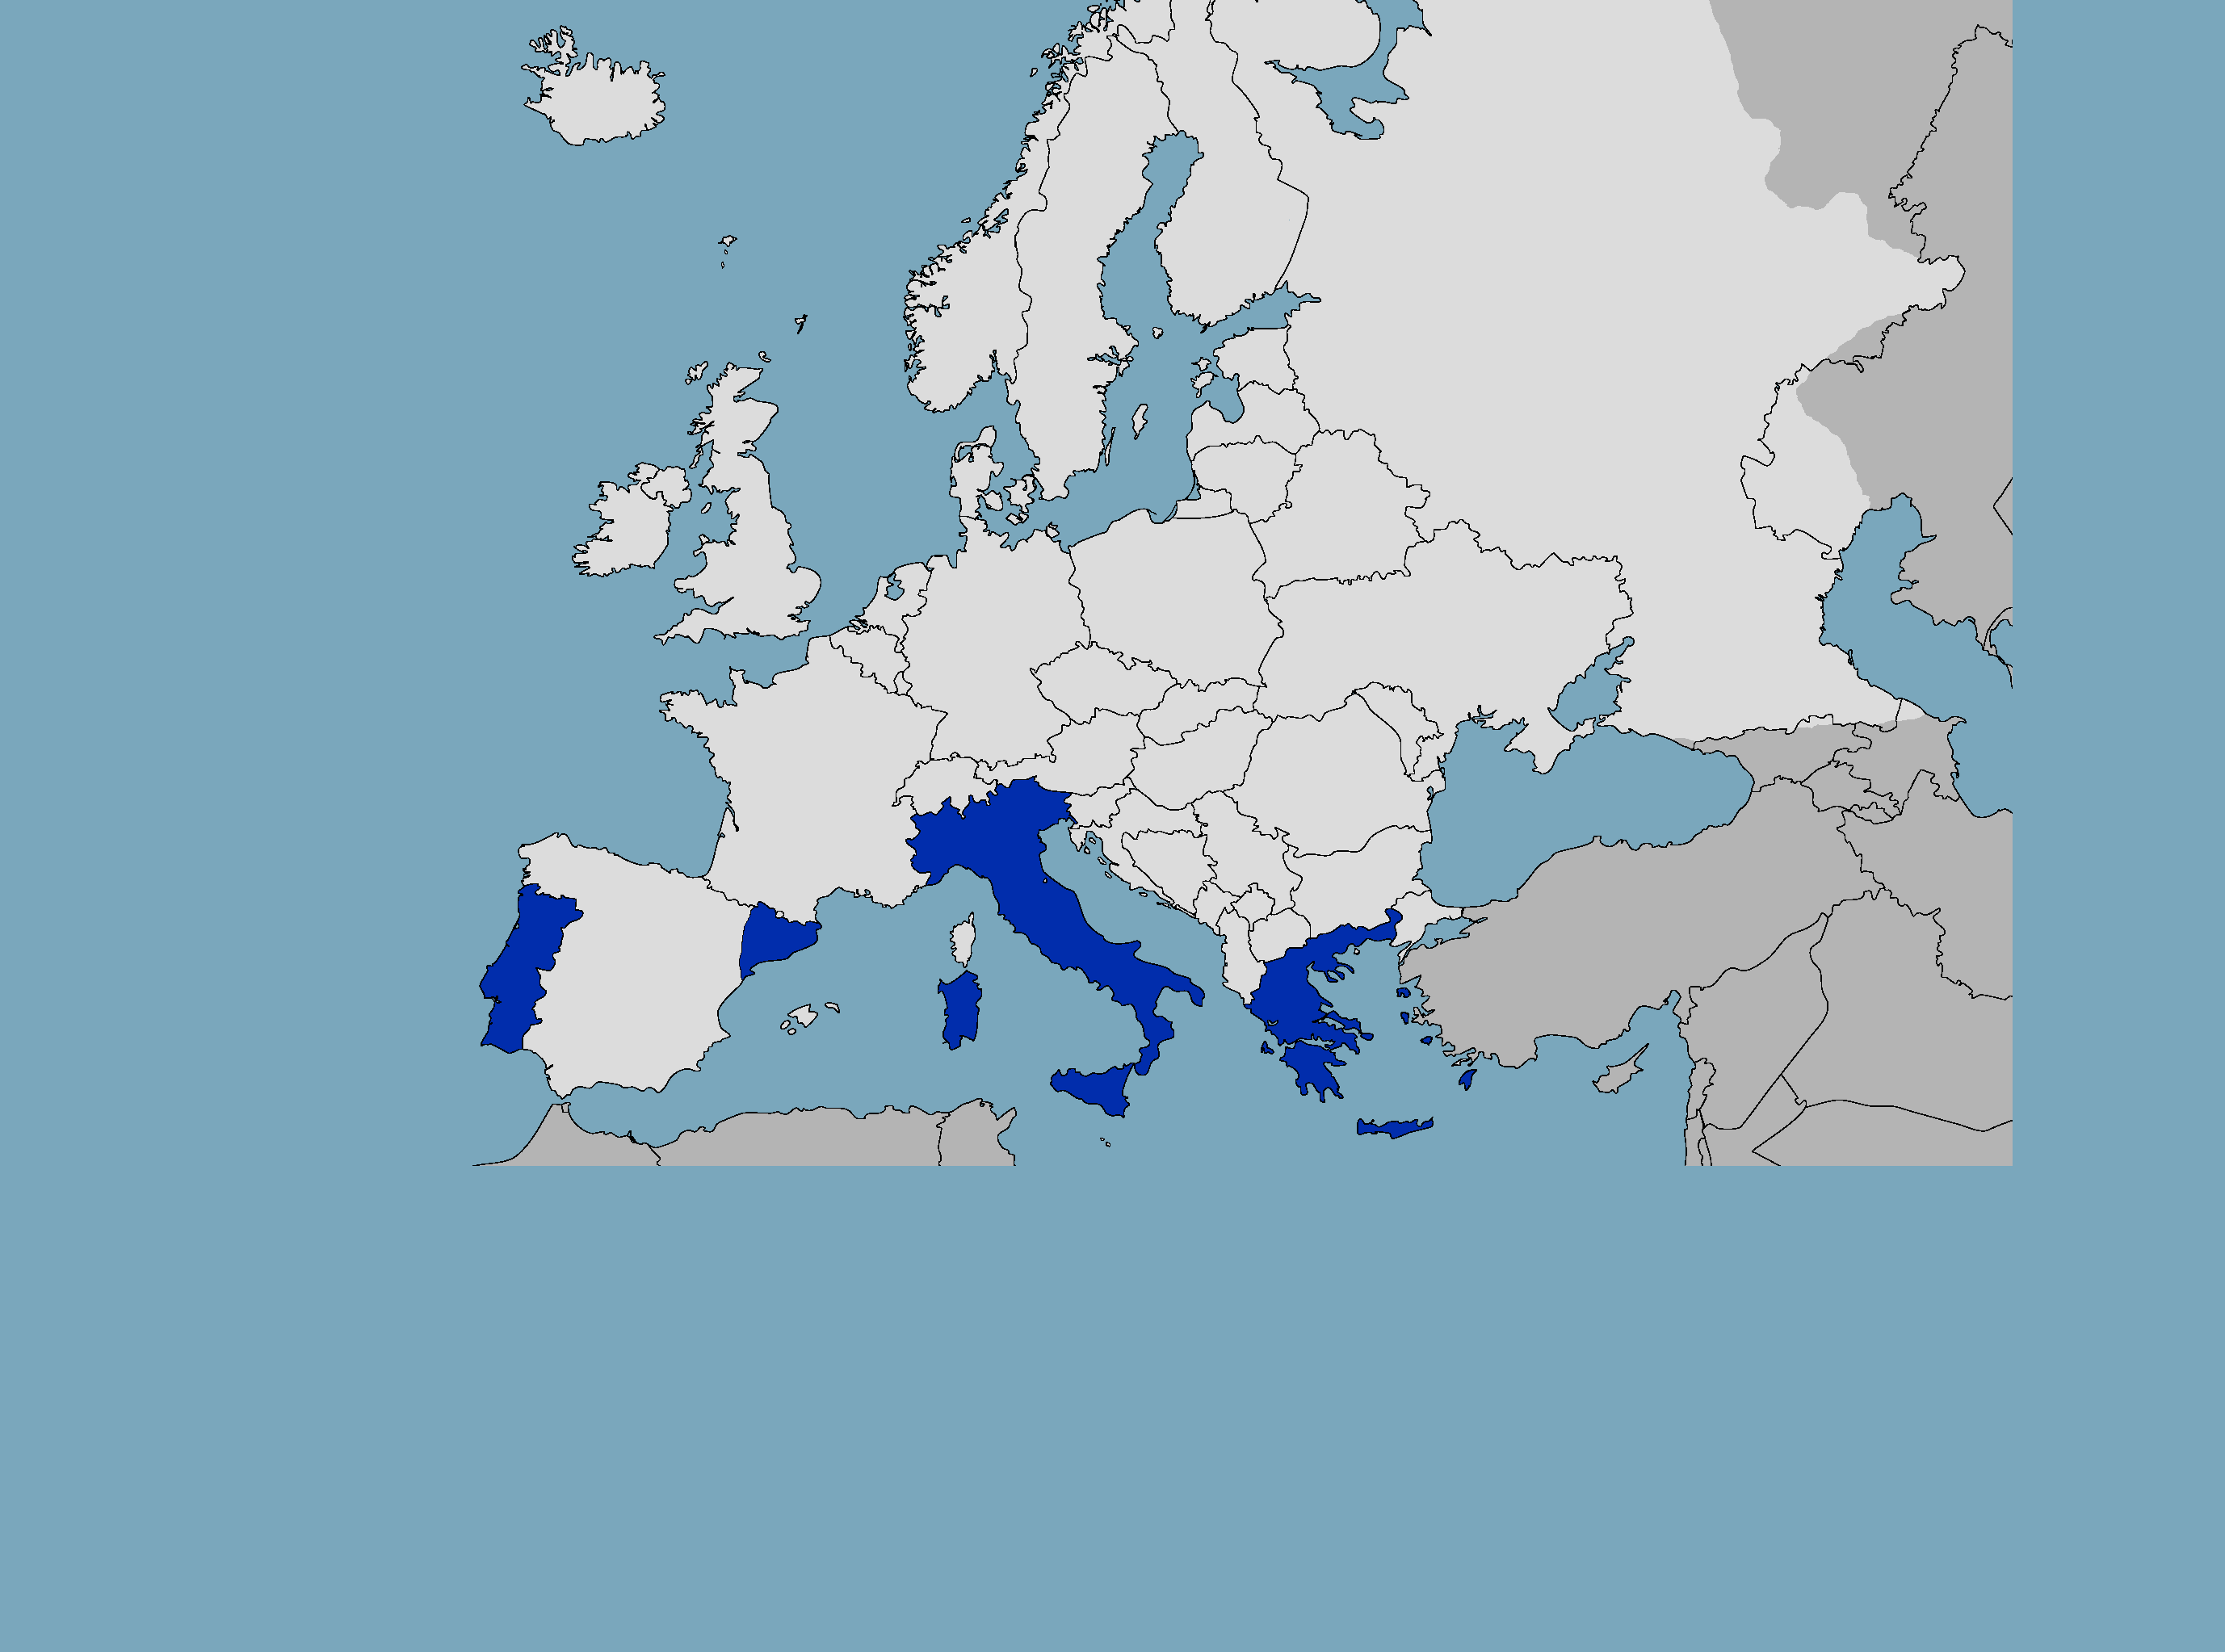
South European Link for Research Information Management
FCT|FCCN (Portugal)
GIVE
PTCRISync: ORCID Synchronization Framework
TAKE
CERIF Model | CERIF Services | CERIF REST API | CERIF OAI | DSpaceCRIS
CINECA (Italy)
GIVE
DSpace-CRIS | ORCID HUB | upgrades | roadmap
TAKE
ORCID Synchronization Framework | CERIF REST API | CERIF OAI
SELRIM
CSUC (Catalonia)
GIVE
CERIF validator | DSpaceCRIS early adaptor
TAKE
DSpace-CRIS | CERIF OAI
EKT (Greece)
GIVE
CERIF Model | CERIF Services | CERIF XML | CERIF REST API | CERIF OAI | upgrades
TAKE
Contribution

Slide 35

Cooperation with Brazil

Slide 36
Outline
PTCRIS context and status
Next steps
Use case – Delivering a Funder OA Policy

Slide 37

National Open Access Initiative

Slide 38
Electronic services
Institutional Repositories
(SARI)
Scientific data
(SARDC)
Scientific Journals
(SARC)
Portal RCAAP
Directory
Shared repository
Stats
(SCEUR)

Slide 39
Figures
47 Institutional Repositories (28 hosted by FCT|FCCN)
1 repository shared by 44 institutions
44 journals (14 hosted by FCT|FCCN)

Slide 40
Recognition / Consolidation RCAAP
RCAAP is the instrument used to insure compliancy with:
  Legal deposit of doctoral dissertations and master's theses
  Funder FCT’s open access policy.

Slide 41
Overview
Grant’s
Authority control
Deposit
Report
Publish

Slide 42
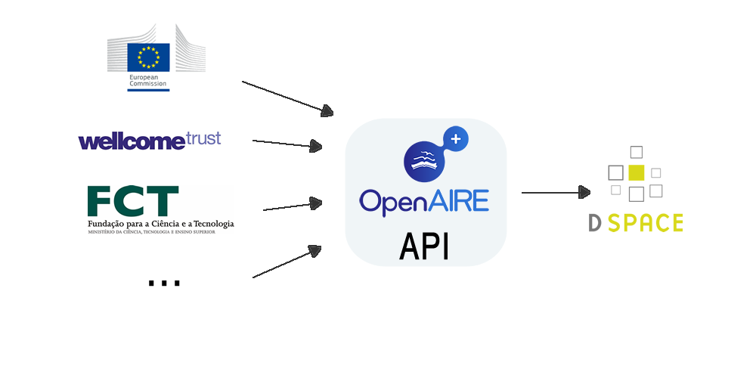
CERIF BD for Authority control
BD
CERIF
DaaS / CERIF APIs
http://api.openaire.eu

Slide 43
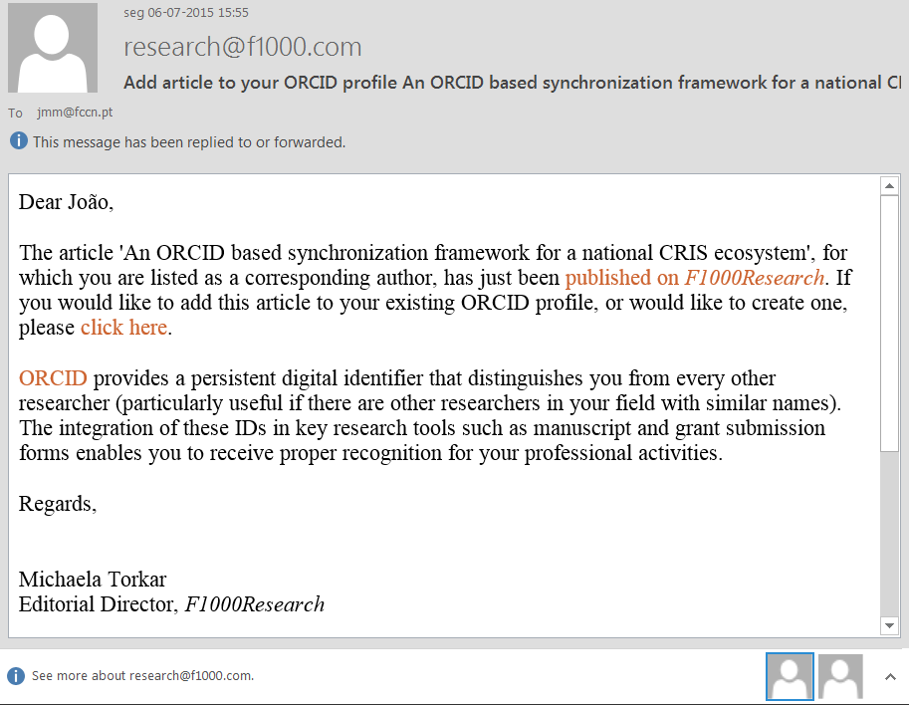
PTCRIS – Editor - ORCID

Slide 44
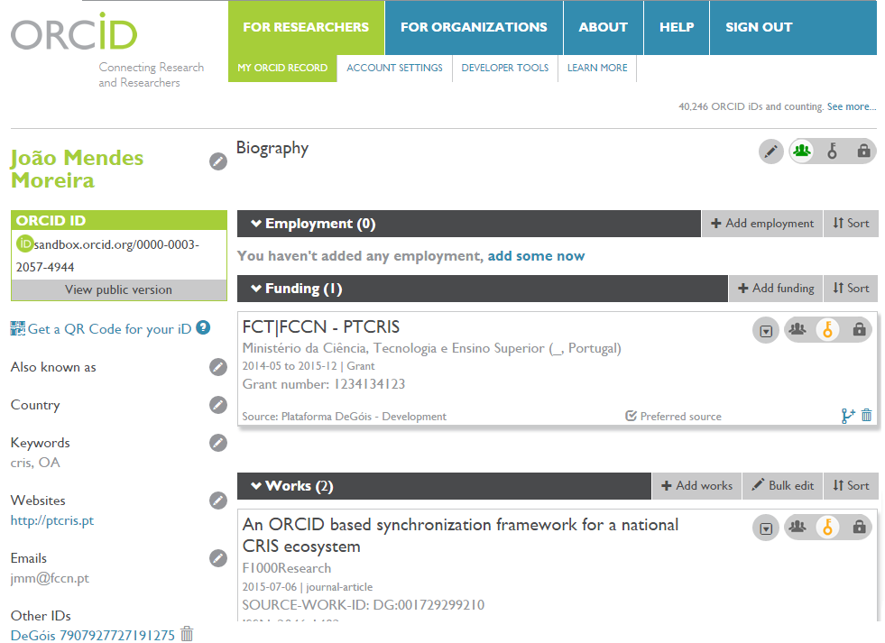
PTCRIS - ORCID

Slide 45
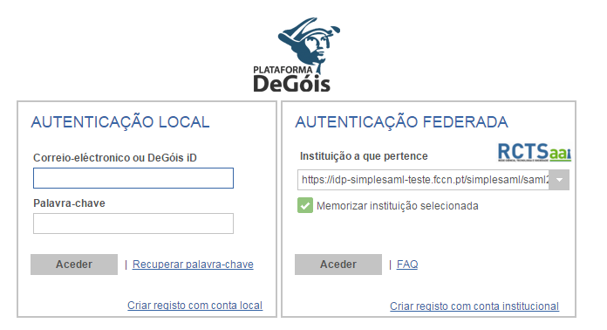
PTCRIS - DeGóis

Slide 46
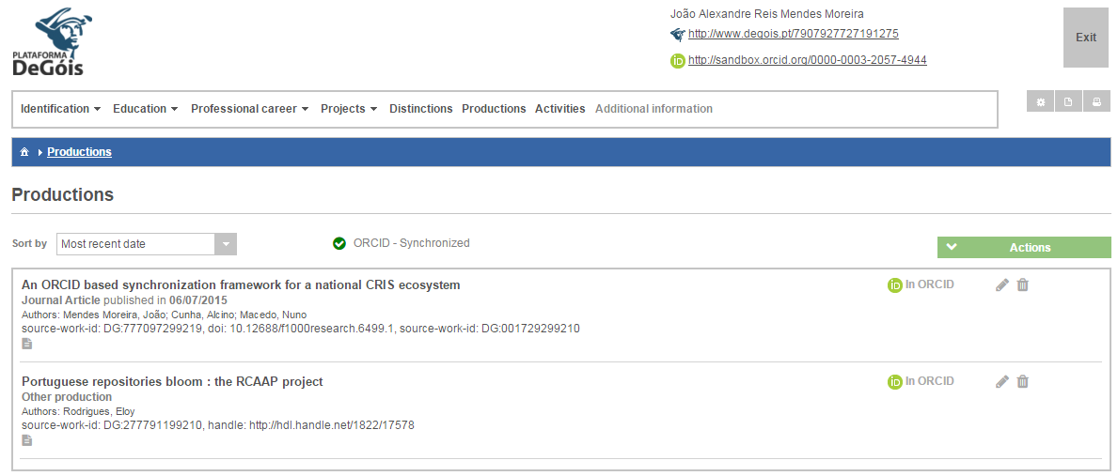
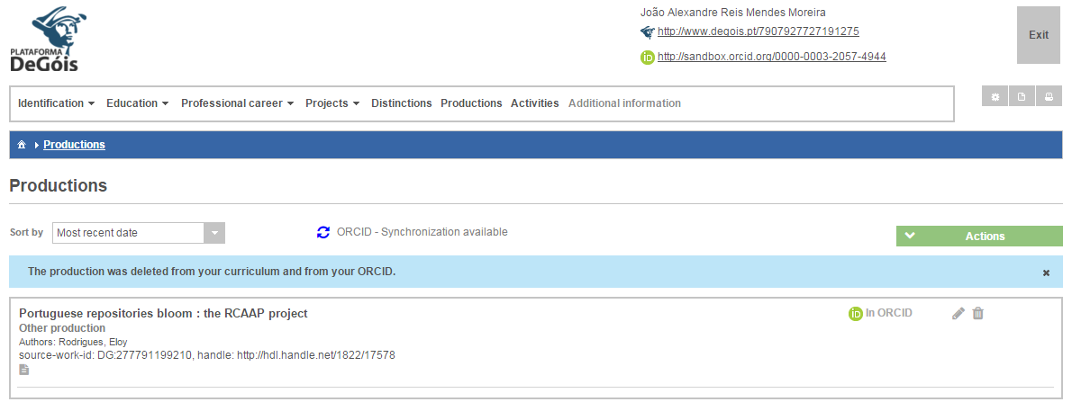
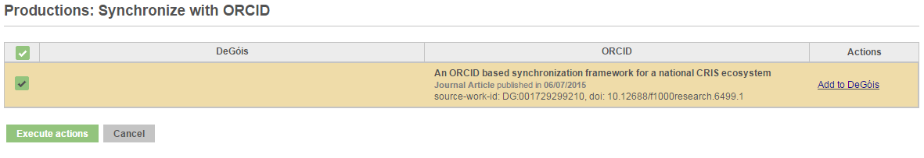
PTCRIS – ORCID - DeGóis

Slide 47
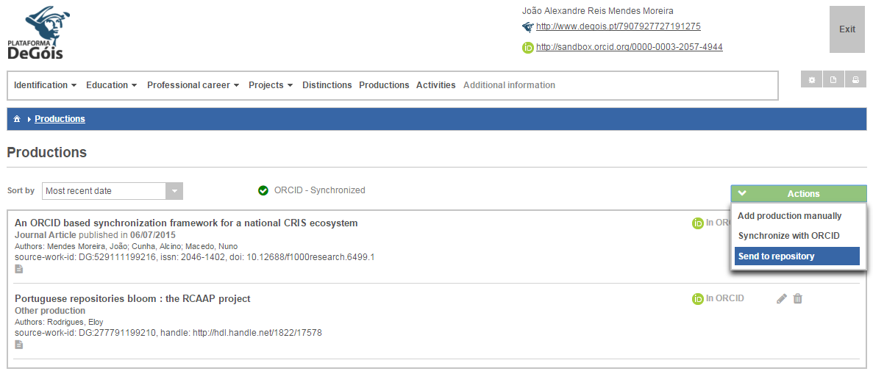
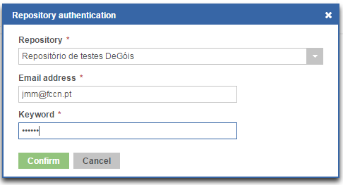
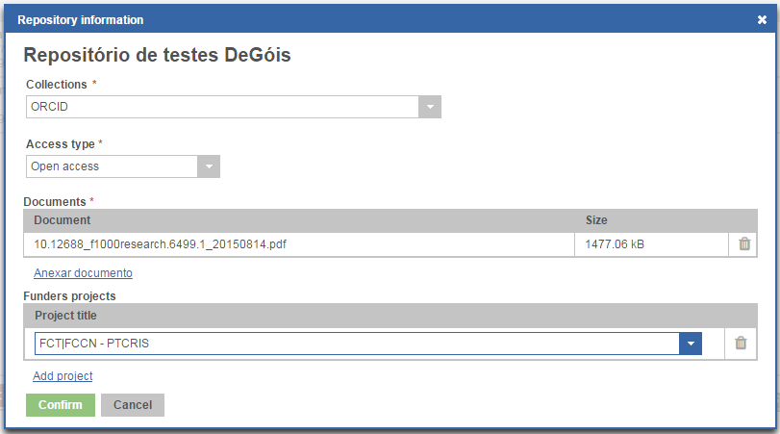
PTCRIS – DeGóis - RCAAP

Slide 48
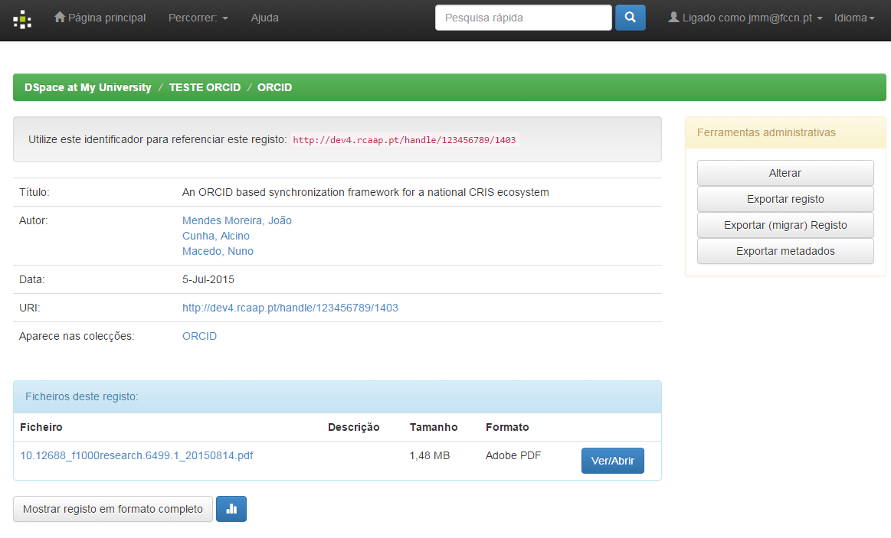
PTCRIS - RCAAP

Slide 49
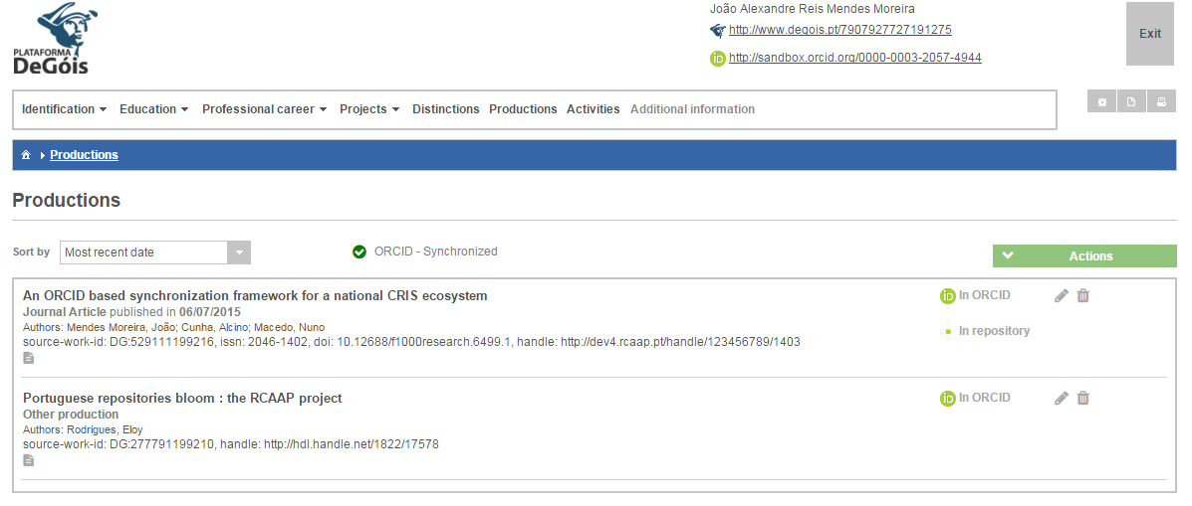
PTCRIS - DeGóis

Slide 50
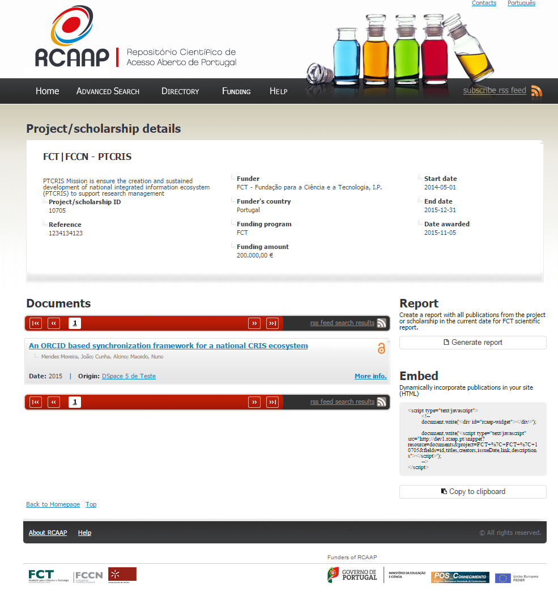

Slide 51
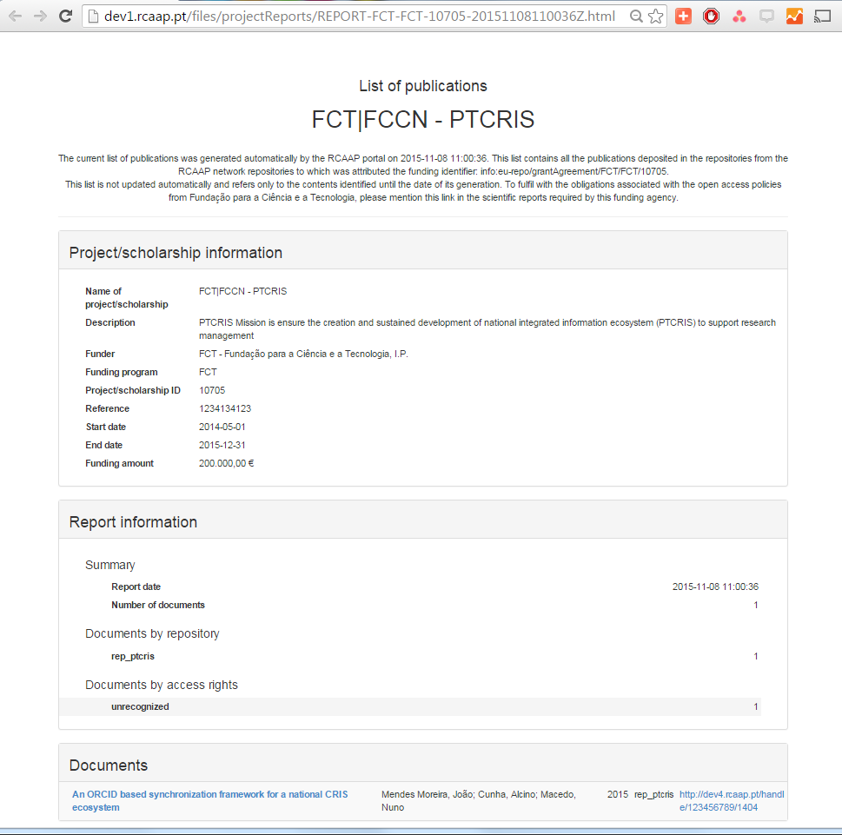

Slide 52
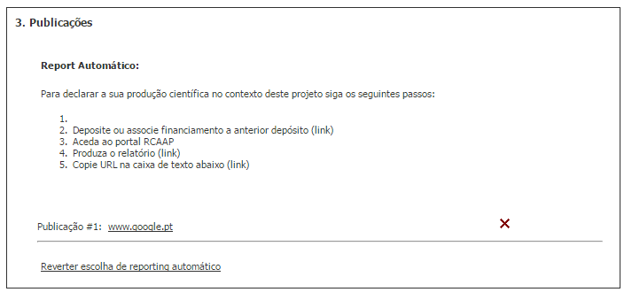
Grant Mng system Scientific Reporting
Grantees will only be able to report deposit publications.
Input once, reuse multiple principle delivered!

