Slide 1
Semi‐automated Proposals
Jan Andersen Senior Executive Advisor University of Copenhagen,
EARMA Ambassador
www.earma.org

Slide 2
Background
Master Danish Language and Computer Science 1995
  1994 Faculty of Science, University of Copenhagen
  1999 Rectors Office, University of Copenhagen
  2005 Royal Veterinary and Agricultural University (Merged with KU 2007)
  2006 Merger Secretariate, University of Copenhagen
  2007 Faculty of Life Sciences, University of Copenhagen
  2012 Faculty of Science, University of Copenhagen
Research Manager Profile:
  External funding of Research - EU-Liason Officer
  Research policy, strategy and planning
  Research output, performance indicators - CURIS
  International dimension – EARMA Chair 2010-
  DARMA, NUAS, SRA, NCURA…
  Innovative initiatives: Øresund University, EU-Erfa, DARMA, CURIS, CRF, Merger-process
Real Competence:
  Ability to read the map
  Courage to make new paths
  Will to go for the vision

Slide 3
EARMA
European Association of Research Managers & Administrators – Established 1995
  100 institutional 200 individual members
  Universities and research organisations
  Industry
  Service companies
  Funding bodies
Members from 29 European countries including Balkan states, Turkey and Israel – Topics
  Research Management, policy and strategy issues – Performance indicators
  Pre- and Post Award
  Financial management for research projects
  Audit
  Services – Training and tools
  The research support office, professional development, recognition of the profession
  International collaboration (Global Network of Research managers Associations e.g., INORMS, NCURA, ARMA, SRA, SARIMA, DARMA, EuroCRIS ….)

Slide 4
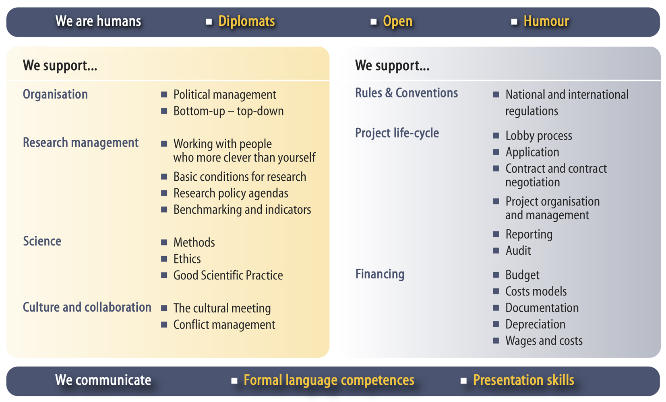
Results  Innovation  Technology Transfer  IPR  Patenting

Slide 5
Trends in research
  Funding complexity
  From national to international funding
  From small individual funds to large corporates
  Completive funding
  Research for research’s sake
  to research for society
  Control to Service
  The researcher in focus, not the
  admin system
  Targeted support and information
  Direct communication
  Proactive approach
  Global recruitment and competition
  New players in the academic field
  Mobility of researchers
  Organisation
  Critical mass in support functions
  Policy: Role and power management level
  Legalisation and rules: e.g. institutional commitment
  Organizational changes
www.earma.org

Slide 6
Nirvana
Commonly used to indicate an optimal state of a person (professional) or system (suitable)
Buddhism. “The ineffable ultimate in which one has attained disinterested wisdom and compassion”
Hinduism. “Emancipation from ignorance and the extinction of all attachment”
In a euroCRIS context, best possible CRIS system(s) for end-users backed by best advice

Slide 7
The Solution is Required:
To overcome the ‘effort threshold’ to :
    obtain the required answers from the CRIS
    input and update the information in the CRIS
    maintain data quality in the CRIS
Across
  local stand-alone CRIS
  heterogeneous distributed CRISs
Thus achieving ‘nirvana’

Slide 8

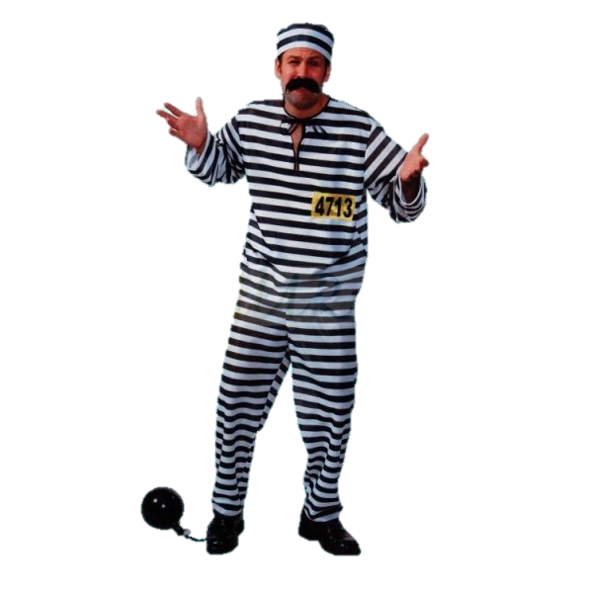




Res
ear
cher
CRIS-
DATA

Slide 9
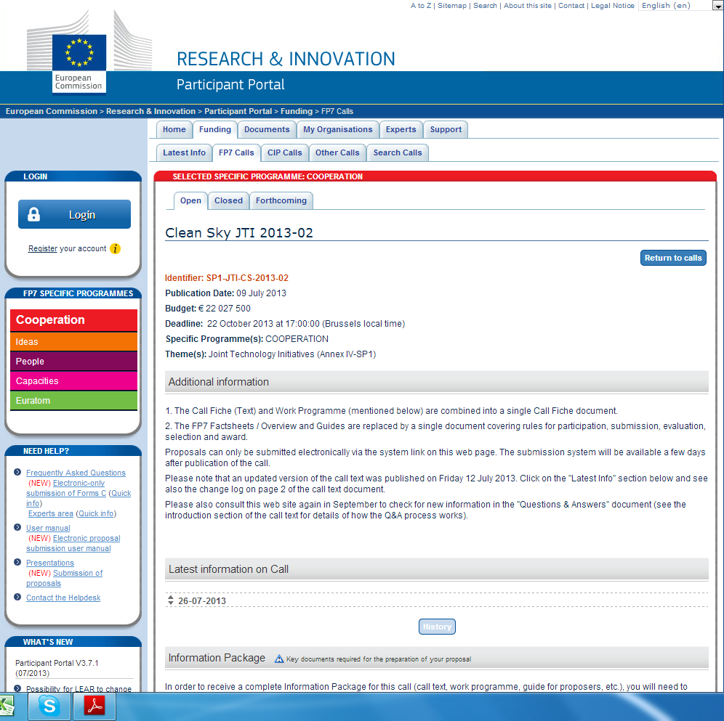

Slide 10
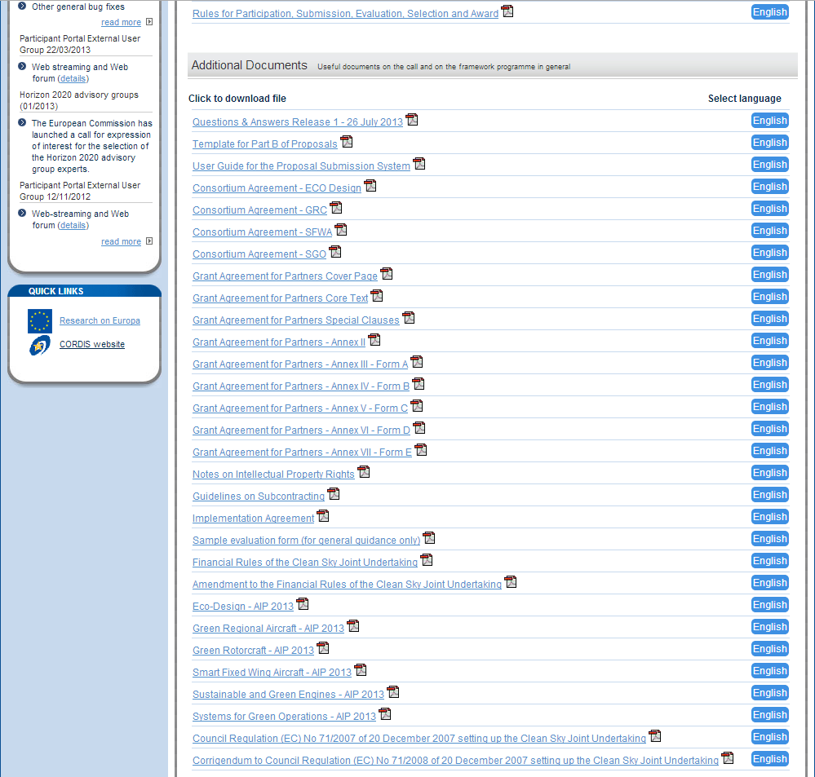

Slide 11
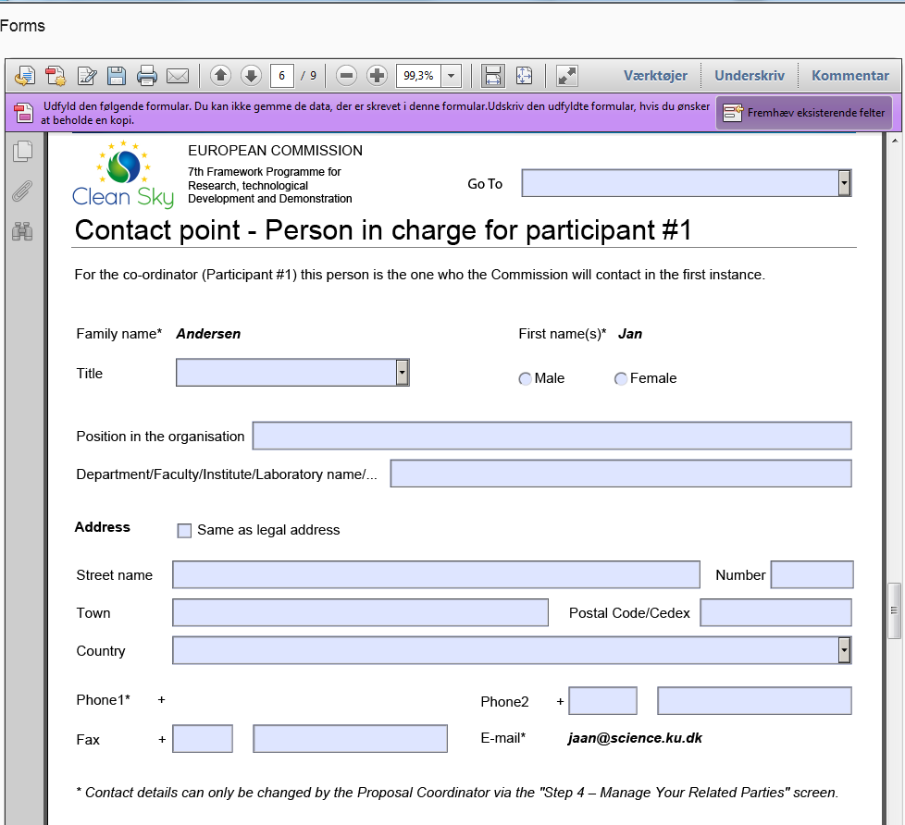

Slide 12
Find partners
Apply
Reports
Statistics
Document
Evaluate
Communi-cate
CRIS-
DATA

Slide 13

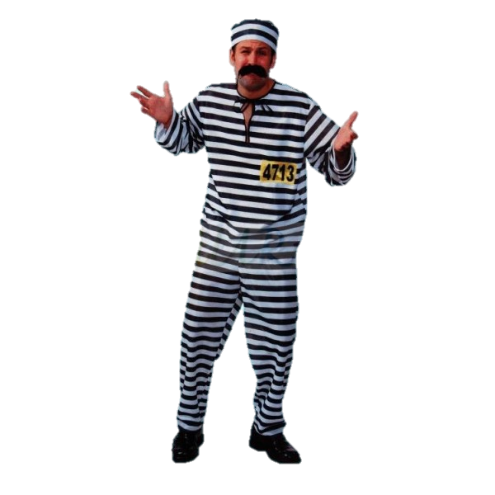
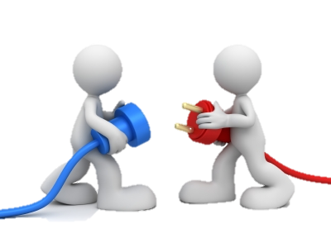
CRIS-
DATA
HOW?

Slide 14
”Intuition”
GREY-DATA:
Network
Facilities
Interests
….
Institutional policy
Strategic alliances
….
CRIS-DATA:
Name
Adress
Mail
Telephone
CV
Publications
….
Institution
….
Application:
Applicant
Partners
Budget
Elements of content
©Jan Andersen

Slide 15
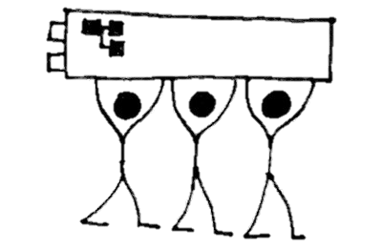
Glimpse of a strategy
Indentify alliances – Researchers, EARMA, CRIS-people, etc (share a common goal)
Identify positive counterparts – existing funding schemes
Identify barriers – Commission / National policies – ignorance or conservatism
Communicate solutions
Ownership – the big rotten apple in the basket

Slide 16
The FUTURE!
Is Nirvana ambitious enough?
The researcher in the center
Discrete collection of data – we are in 13 not 84
Value-added
Whole process in focus:
  Idea
  Project
  Publication
  Result!

Slide 17


