Slide 1


Bringing persistent identifiers into the CERIF Data Model
Brigitte Jörg
CERIF National Coordinator,
JISC, UKOLN, University of Bath, UK
CERIF TG Leader,
euroCRIS

Slide 2
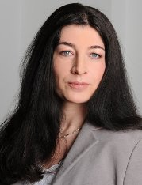
Introduction of Speaker
  CERIF National Co-ordinator
  JISC, UKOLN,
  University of Bath, Bath, UK
  CERIF TG Leader, Board Member
  euroCRIS, non-profit organization
  registered in the Netherlands
Contact:
b.joerg@ukoln.ac.uk

Slide 3
Outline
  CERIF in brief
    CERIF model
    CERIF internal identifiers
  CERIF and (persistent) Identifiers
    ER-Model
    XML
    Ontologies
    Vocabularies
Bringing persistent identifiers into the CERIF data model

Slide 4
Common European Research Information Format
– C E R I F –
CERIF 1.5
cfFederated Identifier
cfFunding
cfEquipment
cfExpertise
AndSkills
cfFacility
cfResult
Publication
cfService
cfQualification
cfPrize
cfResultPatent
cfResultProduct
cfElectronicAddress
cfProject
cfPostalAddress
Bringing persistent identifiers into the CERIF data model
cfCurriculum
Vitae
cfPerson
cfOrganisation
Unit
cfGeographic
BoundingBox
cfCitation
cfIndicator
cfMeasurement
cfEvent
cfCountry
cfLanguage
cfCurrency

Slide 5
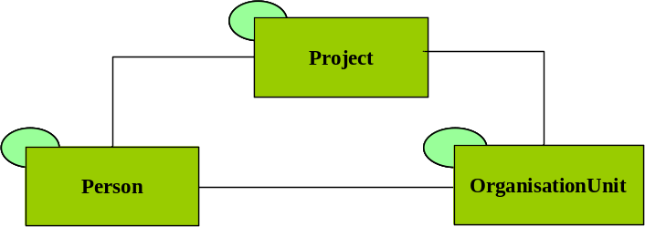
Common European Research Information Format
– C E R I F –
Base Entities
cfProject
cfProjectId
cfURI
cfAcronym
cfStartDate
cfEndDate
cfTitle
cfAbstract
cfKeywords
cfPerson
cfPersonId
cfURI
cfGender
cfFirstNames
cfOtherNames
cfFamilyNames
cfNameVariants
cfResearchInterest
cfKeywords
OrganisationUnit
cfOrganisationUnitId
cfURI
cfAcronym
cfName
cfHeadCount
cfCurrencyCode
cfTurnover
cfResearchActivity
cfKeywords
Bringing persistent identifiers into the CERIF data model

Slide 6
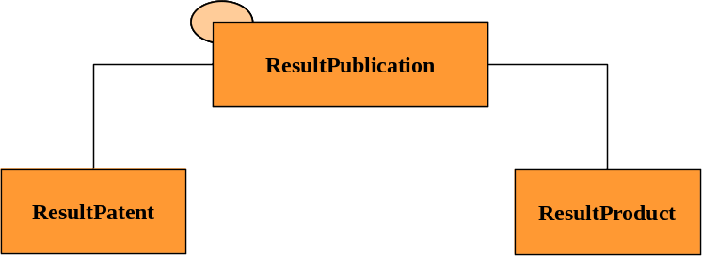
Common European Research Information Format
– C E R I F –
Base Entities
cfResultPublication
cfResultPublicationId
cfURI
cfTitle
cfSubtitle
cfAbstract
cfBiblNote
cfPublicationDate
cfTotalPages
cfStartPage
cfEndPage
cfKeywords
cfResultPatent
cfResultPatentId
cfURI
cfPatentNumber
cfTitle
cfCountryCode
cfRegistrationDate
cfApprovalDate
cfDescription
cfKeywords
Bringing persistent identifiers into the CERIF data model
cfResultProduct
cfResultProductId
cfURI

Slide 7
Common European Research Information Format
– C E R I F –
Semantic Layer
Class
cfClassification
cfClassificationId
cfClassificationSchemeId
cfURI
cfTerm
cfDescription
cfDefinition
cfExample
cfSourde
ClassScheme
Bringing persistent identifiers into the CERIF data model
cfClassificationScheme
cfClassificationSchemeId
cfURI
cfClassificationSchemeName
cfClassificationSchemeDescription

Slide 8
Common European Research Information Format
– C E R I F –
Link Entities
Class
cfPerson_Project
cfPersonId
cfProjectId
cfClassificationId
cfClassificationSchemeId
cfStartDate
cfEndDate
ClassScheme
Bringing persistent identifiers into the CERIF data model

Slide 9
Common European Research Information Format
– C E R I F –
via ID
cfFunding
Facility
via ID
via ID
cfExpertise
AndSkills
via ID
Equipment
Semantic Layer
cfQualification
via ID
Service
via ID
Class
via ID
via ID
cfPrize
via ID
cfElectronicAddress
via ID
ClassScheme
via ID
cfPostalAddress
cfCurriculum
Vitae
via ID
Bringing persistent identifiers into the CERIF data model
via ID
Indicator
via ID
Measurement
Geographic
Bounding Box
cfCitation
via ID
via ID
via ID
via ID
via ID
via ID
via ID
via ID
cfEvent
via ID
via ID

Slide 10
Common European Research Information Format
– C E R I F –
Base Entity Identifiers
  cfPersonId; cfProjectId; cfOrganisationUnitId, …
  cfResultPublicationId, cfResultProductId, …
CERIF Semantic Layer Identifiers
  cfClassificationId
  cfClassificationSchemeId
Link Entity Identifiers
  cfPersonId+cfProjectId+cfClassId+Timestamps,
  cfPersonId+cfOrgUnitId+cfClassId+Timestamps,
  cfOrgUnitId+cfProjectId+cfClassId+Timestamps
home-made
cfFederated Identifier
cfFunding
cfEquipment
CRIS
internal
IDs
cfExpertise
AndSkills
cfFacility
cfResult
Publication
cfService
cfQualification
Everybody can create
cfPrize
cfResultPatent
cfResultProduct
cfElectronicAddress
cfProject
Recommendation for UUIDs:
cf7799e0-3477-11e1-b86c-0800200c9a66
cf7799e1-3477-11e1-b86c-0800200c9a66
cf7799e2-3477-11e1-b86c-0800200c9a66
cf7799e3-3477-11e1-b86c-0800200c9a66
cfPostalAddress
Bringing persistent identifiers into the CERIF data model
cfCurriculum
Vitae
cfPerson
cfOrganisation
Unit
inherited
cfGeographic
BoundingBox
CRIS
internal
IDs
cfCitation
cfIndicator
cfMeasurement
cfEvent
cfCountry
cfLanguage
cfCurrency

Slide 11
Common European Research Information Format
– C E R I F –
CERIF 1.5
cfFederated Identifier
cfFunding
cfEquipment
cfExpertise
AndSkills
cfFacility
cfResult
Publication
cfService
cfQualification
cfPrize
cfResultPatent
cfResultProduct
cfElectronicAddress
cfProject
cfPostalAddress
Bringing persistent identifiers into the CERIF data model
cfCurriculum
Vitae
cfPerson
cfOrganisation
Unit
cfGeographic
BoundingBox
cfCitation
cfIndicator
cfMeasurement
cfEvent
cfCountry
cfLanguage
cfCurrency

Slide 12
Outline
  CERIF in brief
    CERIF model
    CERIF internal identifiers
  CERIF and (persistent) Identifiers
    ER-Model
    XML
    Ontologies
    Vocabularies
Bringing persistent identifiers into the CERIF data model

Slide 13
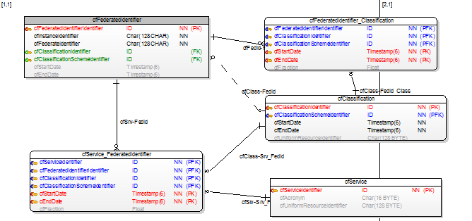

Common European Research Information Format
– C E R I F –
CERIF Entity Federated Identifier (ERM)
cfFederated Identifier
cfFunding
cfEquipment
CRIS
internal
IDs
cfExpertise
AndSkills
cfFacility
cfResult
Publication
cfService
cfQualification
cfPrize
cfResultPatent
cfResultProduct
cfElectronicAddress
cfProject
cfPostalAddress
Bringing persistent identifiers into the CERIF data model
cfCurriculum
Vitae
cfPerson
cfOrganisation
Unit
cfGeographic
BoundingBox
Global
IDs
cfCitation
cfIndicator
cfMeasurement
cfEvent
cfCountry
cfLanguage
cfCurrency

Slide 14
Common European Research Information Format
– C E R I F –
CERIF Entity Federated Identifier (XML)
cfFederated Identifier
cfFunding
cfEquipment
CRIS
internal
IDs
cfExpertise
AndSkills
cfFacility
<!-- this is the ORCID a Federated Identifier -->
<cfFedId>
<cfFedIdId>not needed in XML?</cfFedIdId> no cfInstId: embedding!
<!-- this is the ORCID of Brigitte Jörg -->
<cfFedId>0000-0001-7941-8108</cfFedId>
<cfStartDate>2012-10-17T00:00:00</cfStartDate> no enddate
<cfFedId_Class>
<!-- this is the CERIF ORCID uuid -->
<cfClassId>716bcc9a-c9dd-4b8b-b4ab-6c140e578ec3 </cfClassId>
<cfClassSchemeId>bccb3266-689d-4740-a039-c96594b4d916 </cfClassSchemeId>
</cfFedId_Class>
<cfFedId_Srv>
<!-- the issuing service behind ORCID-->
<cfSrvId>internal-srv-identifier1</cfSrvId>
.....
</cfFedId>
cfResult
Publication
cfService
cfQualification
cfPrize
cfResultPatent
cfResultProduct
cfElectronicAddress
cfProject
cfPostalAddress
Bringing persistent identifiers into the CERIF data model
cfCurriculum
Vitae
cfPerson
cfOrganisation
Unit
cfGeographic
BoundingBox
Global
IDs
cfCitation
cfIndicator
cfMeasurement
cfEvent
cfCountry
cfLanguage
cfCurrency

Slide 15
Common European Research Information Format
– C E R I F –
CERIF Entity Federated Identifier (LOD)
cfFederated Identifier
cfFunding
cfEquipment
CRIS
internal
IDs
cfExpertise
AndSkills
cfFacility
Namespaces + URIs (Identifiers in the Semantic Web
and Linked Open Data Web)
http://www.euroCRIS.org/#CERIF
cerif:Person URI=BrigitteJoerg
cerif:Organisation URI=euroCRIS; URI=UKOLN
cerif:Project URI= ...
bibo:Article URI= ...
bibo:Journal URI= ...
cfResult
Publication
cfService
cfQualification
cfPrize
cfResultPatent
cfResultProduct
cfElectronicAddress
cfProject
cfPostalAddress
Bringing persistent identifiers into the CERIF data model
cfCurriculum
Vitae
cfPerson
cfOrganisation
Unit
cfGeographic
BoundingBox
Global
IDs
cfCitation
cfIndicator
cfMeasurement
Paradigm = Re-Use of Vocabularies
cfCountry
cfEvent
cfLanguage
cfCurrency

Slide 16
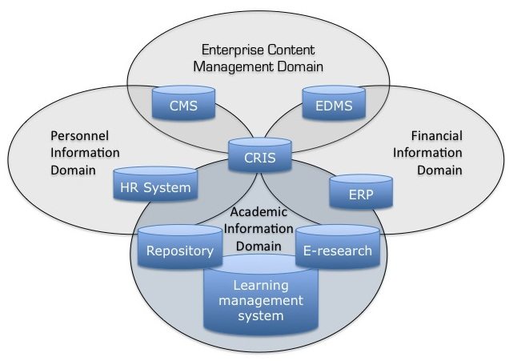
Common European Research Information Format
– C E R I F –
The Academic Information Domain
Godtsenhoven et al. 2009, p. 49
„Entities and Identities in
Research Information Systems“
Brigitte Jörg,
Thorsten Höllrigl,
Miguel-Angl Sicilia
CRIS 2012, Prague, Czech Republic

Slide 17
Common European Research Information Format
– C E R I F –
CERIF Entity Federated Identifier (e.g.)
  Person: ORCID, DAI, ReseacherID, Staff-ID
  OrgUnit: PIC, Funder-ID
  Publication: DOI, …
  …
  scalable …
  Identifier Types
  managed as a
  Vocabulary
cfFederated Identifier
cfFunding
cfEquipment
CRIS
internal
IDs
cfExpertise
AndSkills
cfFacility
cfResult
Publication
cfService
cfQualification
cfPrize
cfResultPatent
cfResultProduct
cfElectronicAddress
cfProject
cfPostalAddress
cfCurriculum
Vitae
cfPerson
cfOrganisation
Unit
cfGeographic
BoundingBox
cfCitation
cfIndicator
cfMeasurement
Global
IDs
cfEvent
cfCountry
cfLanguage
cfCurrency

Slide 18
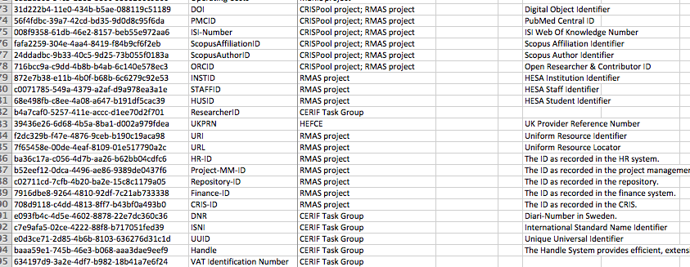
Common European Research Information Format
– C E R I F –
CERIF 1.5 Identifier Types
cfFederated Identifier
cfFunding
cfEquipment
cfExpertise
AndSkills
cfFacility
cfResult
Publication
cfService
cfQualification
cfPrize
cfResultPatent
cfResultProduct
cfElectronicAddress
cfProject
cfPostalAddress
cfCurriculum
Vitae
cfPerson
cfOrganisation
Unit
cfGeographic
BoundingBox
cfCitation
cfIndicator
cfMeasurement
cfEvent
cfCountry
cfLanguage
cfCurrency
CERIF 1.5 Excel Semantics – publicly at www.eurocris.org

Slide 19
Common European Research Information Format
– C E R I F –
CERIF Entity Federated Identifier (e.g.)
  Person: ORCID, DAI, ReseacherID, Staff-ID
  OrgUnit: PIC, Funder-ID
  Publication: DOI, …
  …
  scalable …
  Identifier Types
  managed as a
  Vocabulary
cfFederated Identifier
cfFunding
cfEquipment
CRIS
internal
IDs
cfExpertise
AndSkills
cfFacility
cfResult
Publication
cfService
cfQualification
cfPrize
cfResultPatent
cfResultProduct
cfElectronicAddress
cfProject
cfPostalAddress
cfCurriculum
Vitae
cfPerson
cfOrganisation
Unit
cfGeographic
BoundingBox
cfCitation
cfIndicator
cfMeasurement
Global
IDs
cfEvent
cfCountry
cfLanguage
cfCurrency

Slide 20
Summary
System-internal Identifiers (Base Entities)
UUIDs as Identifiers for Vocabularies
Federated Identifiers connecting to the World
Model Cleaning Activities (URIs)
  Discussion about ID attributes (one value in ERM)
  Current ongoing activities (e.g. ORCID, FundREF, …)
  Clear Distinction between cfElectronicAddress
  Awareness of multiple Technologies
Towards Discussion
cfFederated Identifier
cfFunding
cfEquipment
cfExpertise
AndSkills
cfFacility
cfResult
Publication
cfService
cfQualification
cfPrize
cfResultPatent
cfResultProduct
cfElectronicAddress
cfProject
cfPostalAddress
cfCurriculum
Vitae
cfPerson
cfOrganisation
Unit
cfGeographic
BoundingBox
cfCitation
cfIndicator
cfMeasurement
cfEvent
cfCountry
cfLanguage
cfCurrency

Slide 21
Contact
Brigitte Jörg
CERIF National Co-ordinator
JISC - Joint Information Systems Committee, UK
UKOLN, University of Bath, UK
euroCRIS, CERIF Task Group Leader
http://isc.ukoln.ac.uk/work/csp
b.joerg@ukoln.ac.uk
http://www.euroCRIS.org

Slide 22
Notes
-

