Slide 1


PTCRIS_OrgID
Portuguese organisation identifiers authoritative system
Maria João Amante, Susana Lopes,Teresa Segurado
João Duarte, Joaquim Godinho, Luís Quintano
Notes:
This presentation aims to describe the work done by Instituto Universitário de Lisboa and Universidade de Évora to achieve a Portuguese organisation identifiers authoritative system. The PTCRIS_OrgID is part of the national research information system PTCRIS.

Slide 2
PTCRIS “ecosystem”
CRIS – Current Research Information Systems
Academic expertise
Research news
Funding database
Outcomes / outputs
Organisations database
Scientific equipment
Grant management
Research ethics
Research portal
Indicators
Notes:
The image presents the PTCRIS “ecosystem”. Under this Current Research Information System we have academics and researchers, organisations, scientific equipment, indicators, funding and grants and research output. All of this information needs to be connected.

Slide 3










What we need to connect?
Industry
Publishers
Investment
opportunities
Research
institutions
Research
organizations
Publications
Libraries
Patents
Products
Projects
Researchers
Data centres
Research data
Equipment
Facilities
Governments
Researchers
Financiers
Notes:
The scientific system has several actors/participants but researchers are in the middle of it all. And monitoring by Funding agencies and organisations usually relies on them for information that connects everything. To avoid overload on the researchers side we have to rely on interoperability between all platforms

Slide 4
Synchronisation
Depends on unique identifiers
Individual identifiers
(ORCiD, ResearcherId…)
Organisation identifiers
(ISNI, Ringgold)
Research output identifiers
(DOI, Handle, ISBN)
Data quality
Uniqueness
Linking between systems
Deduplication
Notes:
Synchronisation depends on unique identifiers, for individuals, organisations, articles etc. Because unique identifiers assure
Data quality
Uniqueness
Linking between systems
Deduplication

Slide 5
PTCRIS “ecosystem”
CRIS – Current Research Information Systems
Academic expertise
Research news
Funding database
Outcomes / outputs
Organisations database
Scientific equipment
Grant management
Research ethics
Research portal
Indicators
Notes:
Our work focus on the national organisations database

Slide 6
Unique identifiers for organisations
Used to:
  Disambiguate
  Consolidate
  Establish hierarchy view
Advantages:
  Enforce uniqueness
  Eradicate duplication and improve quality of data
  Correct identification
Notes:
Unique identifiers for organisations are very important to disambiguate, consolidate and establish hierarchy view. Organisations are present as universities, publishers, funding agencies and more.
As a numeric or alphanumeric identifier and organisation id can unequivocally associated with a single entity
(Entity being = university/faculty/department/research institute/company …)
The advantages are:

Slide 7
Main tasks of this work
Create rules, principles and processes regarding registration of organisations in Portugal
Build a first version of an authoritative National Organisations Database relying on distinct sources of information:
Higher Education Institutions
Research Institutions
Other organisations involved with the scientific system
3. Develop an organisation reconciliation service
4. Set up a registration system for organisations (PTOrg-IS)
Notes:
Mains tasks:
1. Create rules, principles and processes regarding registration of organisations in Portugal
For the 1st task we carried out a study of anational and international agencies already involved with registration of organisations and, rules and standards used. International studies like the JISC/Casrai reports on organisaton ids were also taken in consideration specially the use cases identified by those studies.
2 . Build a first version of an authoritative Ringgold/ISNI compliant National Organisations Database based on distinct databases available:
Higher Education Institutions
Research Institutions
Other organisations involved with the scientific system
Task 3 was to Develop an organisation reconciliation service that was used to achieve the first version of the database in 2.
4. Set up a registration system for organisations

Slide 8




T3 : Reconciliation Service
Reconcile-CSV
Service to verify the correspondence between two databases
It works with fuzzy matching: works on the approximate correspondence between various segments of text
To use the Reconcile-CSV reconciliation service it was used Open Refine
This service was used to reconcile National HEI Database with RINGGOLD (1st iteration) and ISNI (2nd Iteration)
Notes:
Now, we will speak of the Portugal Organization's Information System architecture which is the end result of all the work developed by this team.
The system’s main objectives are:
Fill a gap in Portugal because there is no reference system in this area;
Enable each organization to manage their own data: Each organization should designate one or more users for this purpose (to act as Organization Manager);
Give access to the public. On the web and via an API to provide both, public and restricted access;
Synchronization with international reference databases;
All the data is up to date: The system is always connected with reference databases and organizations so all data is up to date;
Avoid multiple records for the same organization all entries are verified... so no duplicates.

Slide 9
T4 : PTOrg-IS
Main Goals:
Fill a gap in our country (no reference system in this area)
Enable each organisation to manage their own data
Provide access to data on the web (public) and via an API (public and restricted)
Synchronise with international reference databases (ISNI/Ringgold)
Assure that all the data is up to date
Avoid multiple records for the same organisation
Notes:
Now, we will speak of the Portugal Organization's Information System architecture which is the end result of all the work developed by this team.
The system’s main objectives are:
Fill a gap in Portugal because there is no reference system in this area;
Enable each organization to manage their own data: Each organization should designate one or more users for this purpose (to act as Organization Manager);
Give access to the public. On the web and via an API to provide both, public and restricted access;
Synchronization with international reference databases;
All the data is up to date: The system is always connected with reference databases and organizations so all data is up to date;
Avoid multiple records for the same organization all entries are verified... so no duplicates.

Slide 10
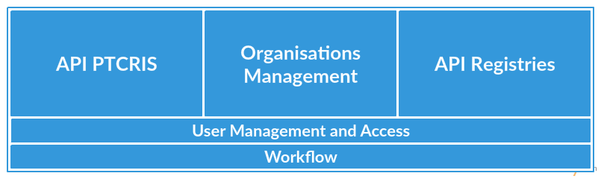
PTOrg-IS
Architecture
Notes:
These are the five system modules:
In the center we can see the core module: Organization's Management Module.
On the sides we find the modules that communicate with external systems. The API Modules.
Workflow Module and User Management and Access Module are common to all modules.

Slide 11
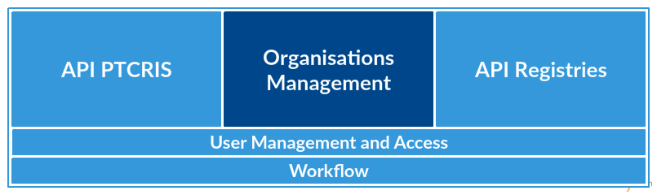
PTOrg-IS
Organisations Management
Where all the data is processed and stays organised
Binds together all the modules
Where all different modules of the system interact
Notes:
The core module is the Organization's Management Module:
Is where all the data is processed, stored and stays organized.
It’s responsible to bind together all the modules and holds the logic for all of them to interact with each other.

Slide 12
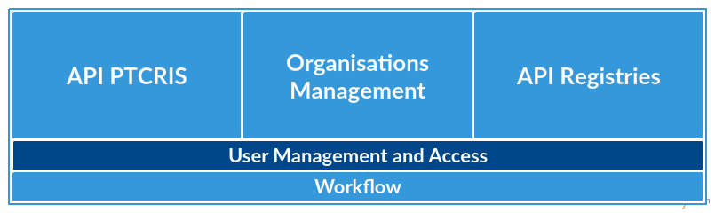
PTOrg-IS
User Management and Access
Administrator
Organisation Manager
Organisation
Public
Notes:
Another key module is the User Management and Access module. In this module the access control is defined by four different user profiles:
The administrator has full management of the system. Can register, edit or delete organizations. Can manage system users, start synchronizations and have access to all history events (regarding organizations and synchronization).
The organization manager is an administrator but only for a particular type of organizations. Is responsible for approving data changes requests and also to register, edit or delete the approved data.
Users with Organization profile are the owners of the organization information. They can propose data changes in their organization context and Can perform operations such as search or export organizations.
Public profile users can request to register an organization. It has to be approved by the Organization Manager. They can query data of organizations, perform searches and they can export filtered data.

Slide 13
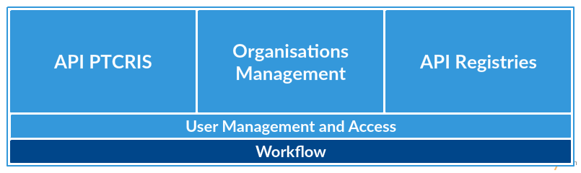
PTOrg-IS
Workflow
Notes:
Next, we have the workflow module.

Slide 14
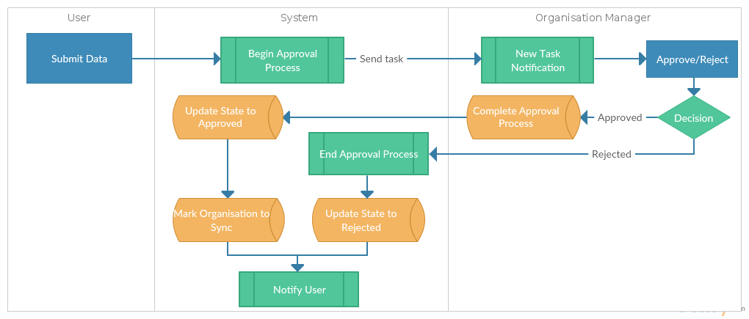
PTOrg-IS
Workflow
Notes:
An approval workflow was implemented:
Users can submit data to register, change or delete an organization (which is classified with a specific type). An approval workflow is created and a task is triggered for the user who has the responsibility to approve the changes for the chosen organization type (Organization Manager).
If changes are approved, the organization manager may complete or correct the submitted information and data is registered for internal update and synchronization with external databases/systems. All users who participated in the process are notified.
If changes are rejected, the workflow procedure terminates with a notification to the user that initiated the change proposal.

Slide 15
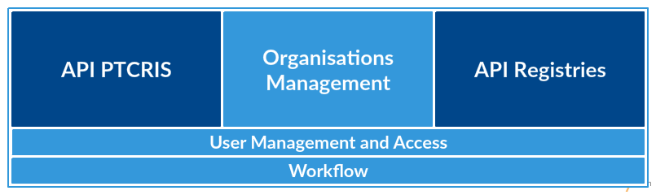
PTOrg-IS
API’s
Notes:
The last modules are the API’s Modules.

Slide 16
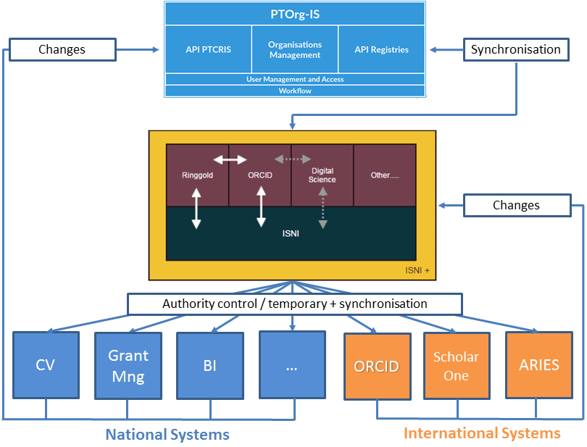
PTOrg-IS
Changes & Synchronisation
Notes:
The APIs modules allows external systems (national and international) to change and synchronize with the PTOrg system.
The figure shows that automatic synchronization is possible with the ISNI+ environment thanks to the API Registries Module.
And we can also see that the national systems (in blue) make direct changes on the PTOrg through PTCRIS API.
It’s important to note that the international systems (represented in orange) make changes on ISNI+ that synchronizes with the PTOrg-IS system.
This mechanism guarantees that all local changes are sent for update as all changes in the ISNI+ are updated in PTOrg-IS repository.
The synchronization mechanism must be triggered regularly to minimize data incoherence between local and external databases.

Slide 17
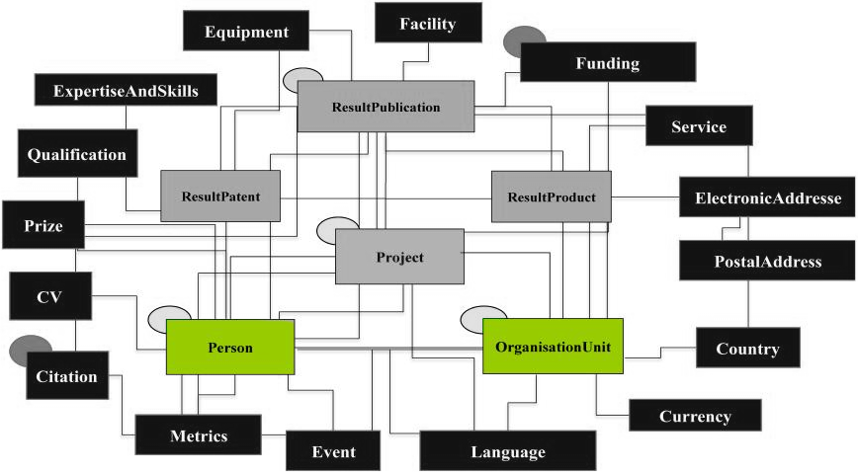
PTOrg-IS
Database (CERIF)
Notes:
Finally, it’s important to say that the database follow a CERIF (Common European Research Information Format) implementation.
All entities of the system are a subset or superset of the full CERIF model, developed and maintained by EUROCRIS.
As we can see highlighted our main entities of the system are:
cfOrganisationUnit (cfOrgUnit), represents the organization;
cfPerson (cfPers), represents the users.

Slide 18
João Duarte
( jtpd@uevora.pt )
Susana Lopes
( susana.lopes@iscte.pt )
Thanks!
Notes:
… And that's all! Thanks for listening!

