Slide 1

Is a Current Research Information System (CRIS) a critical corporate system for HEIs?
A Case Study from the University of St Andrews
Anna Clements, Assistant Director (Digital Research), University Library, University of St Andrews
Chair, UK Pure Strategy Group
Exec Strategy, euroCRIS
Chair, CASRAI Data Management Planning Working Group
Member, Snowball Steering Committee
akc@st-andrews.ac.uk
@annakclements
Henry Legg
Notes:
Funder and grant acknowledgement: all you need to know
This short session will explain the value of acknowledging funders and grants in your publications, and the best way of doing this. We will cover statements about underlying research data, the basics of linking papers, as well as funding and data in Pure.
There will be a presentation, practical demo, and time for questions covering:
why proper funding acknowledgements in published journal articles are necessary
good practice and standard formats for acknowledgements
capturing funder and grant details – in submission systems and in Pure
benefits of funder acknowledgement – compliance, reporting, visibility of research
linking publications and data
access to underlying data
not forgetting … correct author affiliation

Slide 2
Definition of a CRIS
‘… any informational tool dedicated to provide access to and disseminate research information’
www.eurocris.org
‘… a database or other information system to store and manage data about research conducted at an institution’
http://en.wikipedia.org/wiki/Current_research_information_system

Slide 3
Why do we need a CRIS?
Strategic need
Operational need
… and for the researcher …

Slide 4
Strategic need
Research strategy – REF2020
Asset exploitation - impact
Promotion and reputation
Research income
  demand management & compliance

Slide 5

Why do we need a CRIS
The pain of RAE2008
REF will require at least as much data collection by Universities
RAE/REF determines a third of research income in UK > £1.5 billion

Slide 6
… BUT not just for REF … UK policy drivers
2007 | 2008 | 2009 | 2010 | 2011
 | RAE

Slide 7
… BUT not just for REF … UK policy drivers
2007 | 2008 | 2009 | 2010 | 2011 | 2012
 | RAE
 |  |  |  |  | Impact
 |  |  |  |  | EPSRC Roadmap
 |  |  |  |  | ROS

Slide 8
… BUT not just for REF … UK policy drivers
2007 | 2008 | 2009 | 2010 | 2011 | 2012 | 2013
 | RAE
 |  |  |  |  | Impact
 |  |  |  |  | EPSRC Roadmap
 |  |  |  |  | ROS
 |  |  |  |  |  | RCUK OA

Slide 9
… BUT not just for REF … UK policy drivers
2007 | 2008 | 2009 | 2010 | 2011 | 2012 | 2013 | 2014 | 2015 | 2016
 | RAE |  |  |  |  |  | REF
 |  |  |  |  | Impact
 |  |  |  |  | EPSRC Roadmap |  |  | EPSRC RDM policy
 |  |  |  |  | ROS |  | Rfish
 |  |  |  |  |  | RCUK OA
 |  |  |  |  |  |  | HEFCEOA

Slide 10
Operational reality
Pressure on budgets
Increased competition for students incl PGRs and PGTs
Senior Management need good quality, timely information
  Monitor our performance
  Evidence for strategies working/not working
  Promote our strengths
But have no extra resource

Slide 11
Operational need
REF
  Collect, review, select and submit
Open Access
  Monitor, collect, store, report, expose, measure
Research Data Management
  Monitor, collect, store, expose, share, measure
Benchmarking and KPIs
  Collect, calculate, compare

Slide 12
Benefit to institutional information management
Enter once : reuse many
Data governance & stewardship
Improve data quality without increasing burden
Breakdown information silos
Adoption of standards e.g. CERIF, ORCiD

Slide 13
Require high quality information on …
People
    * Researchers * Authors * Creators * Research Students
Outputs
    * Publications * Datasets * Products
Finance
    * Project applications & awards * APC payments
Organisations
    * Departments * Centres * Collaborators * Funders * Publishers
Activities & Impact
    * Engagement * Policy * Evidence metrics * Recognition

Slide 14
Activities
Impact
Publications
Award/ recognition
Indicators
WoS, arXiv, PubMed, Scopus…
Case Studies
Bibtex, Refman
Dissemination// Engagement
Entered
Measures
Manual
Input
Uploaded
Entered
Harvested
University Structure [HR]
Entered
Industry / SME’s
Interface
St Andrews
PURE CRIS
HEI – Strategic
Planning, Benchmarking
Staff Records [HR]
Pulled In
Fed Out
REF, RCUK
SFC, HESA
Student Records [Registry]
Linked
Linked & held
Public, Media Recognition / Impact
Projects, Grants, KT
[Finance]
Collaborations
Research Pools
Full Text
Repository
Open Access
Research data sets
(multiple locations and formats)

Slide 15
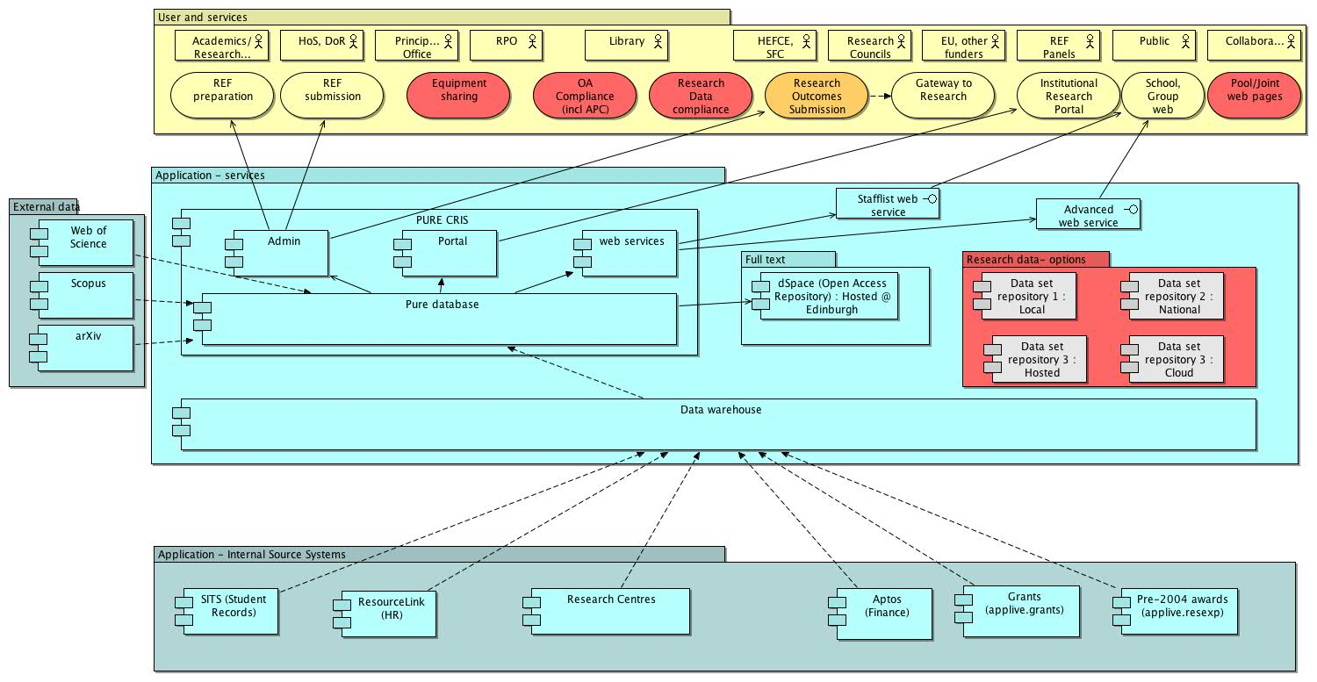
Archi overview 2013

Slide 16
For the researcher
Single point to collect/enter research info
View onto data held centrally – grants, students
Publications and data catalogue
Mechanism for reporting outputs to funders
Way to ensure publications are REF2020 eligible
Promotion via web pages
CV generation
Find collaborators

Slide 17
Require high quality information on …
People
    * Researchers * Authors * Creators * Research Students
Outputs
    * Publications * Datasets * Products
Finance
    * Project applications & awards * APC payments
Organisations
    * Departments * Centres * Collaborators * Funders * Publishers
Activities & Impact
    * Engagement * Policy * Evidence metrics * Recognition

Slide 18
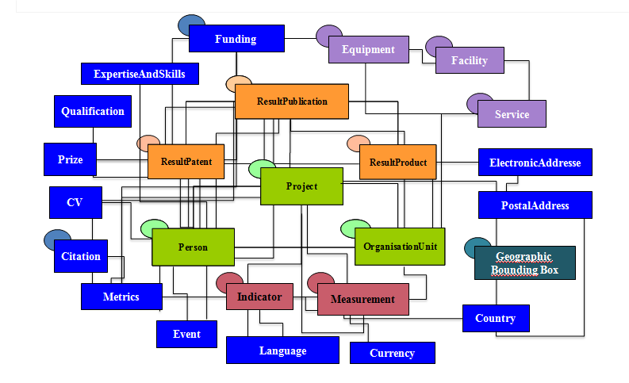
CERIF – building blocks of a CRIS
Common European Research Information Format
An international standard (meta)data model for storage and interoperability of research information

Slide 19
Features of CERIF
  Broad coverage: includes all aspects of RI (projects, persons, organisations, funding, publications, datasets, patents, products, bibliometrics, impact indicators, equipment, etc…)
  Fine-grained structure and flexible architecture, allowing:
    Role-based, time-stamped linkages providing context
    Mapping to virtually any (meta)dataformat existing in the Research Information Domain .. interoperable
    the expression of virtually any formalised use case
    the ingestion of an unlimited number of controlled vocabularies

Slide 20

Benchmarking : Snowball Metrics?
A set of clearly defined metrics measuring research inputs, process and outputs allowing universities to understand their strengths and weaknesses, so that they can build and monitor effective research strategies
Bottom-up i.e. agreed by institutions not imposed by funders or data suppliers

Slide 21



But need to benchmark more widely – nationally and internationally : Free metrics exchange due 2015
Institutional firewall
Exchange of equivalent metrics (not data) with other institutions when both parties agree
Data
Institutional
Commercial
Third party
System
Bespoke
SciVal / InCites
Pure / Converis
ResearchFish
Spreadsheet
etc.
Snowball Metrics
Supplier- and system-agnostic

Slide 22
CRIS looking forward : more interoperability
ORCiD integration
More unique persistent identifiers
  Organisations
  Projects
Publication process
  collect metadata earlier and earlier in the process
  interoperability with publisher systems
Interoperability with Researchfish

Slide 23
CRIS looking forward : impact
Exposure & Evidence
Research outputs are an institutional asset
Build & reinforce reputation
Especially if link to public engagement, knowledge transfer, actual measurable impact on society – cultural, economic, health
The CRIS can help support this by :
Timely capture of activities, outputs, outcomes – as evidence base for impact
Related to corporate data – staff, org structure, projects
Related to wider sources via persistent IDs e.g. DOIs

Slide 24

Is a Current Research Information System (CRIS) a critical corporate system for HEIs?
YES – absolutely!
akc@st-andrews.ac.uk
@annakclements
Notes:
Funder and grant acknowledgement: all you need to know
This short session will explain the value of acknowledging funders and grants in your publications, and the best way of doing this. We will cover statements about underlying research data, the basics of linking papers, as well as funding and data in Pure.
There will be a presentation, practical demo, and time for questions covering:
why proper funding acknowledgements in published journal articles are necessary
good practice and standard formats for acknowledgements
capturing funder and grant details – in submission systems and in Pure
benefits of funder acknowledgement – compliance, reporting, visibility of research
linking publications and data
access to underlying data
not forgetting … correct author affiliation

