Slide 1
Application of selected SK CRIS system indicators to evaluation of R&D and technology transfer in Slovak higher education and research institutions
Danica Zendulkova & Adriana Shearman
Slovak Centre of Scientific and Technical Information

Slide 2

Slovak Centre of Scientific and Technical Information
Scientific Library
Support of Science
    SK CRIS
    CIP RDI
    Publication and Artistic activity (CRPA)
    Theses and dissertations (CRTD)
    Open Access (national point of reference )
    PATLIB
    Technology transfer
Popularisation of Science
Projects (5 national – OP R&D and 6 smaller projects)

Slide 3
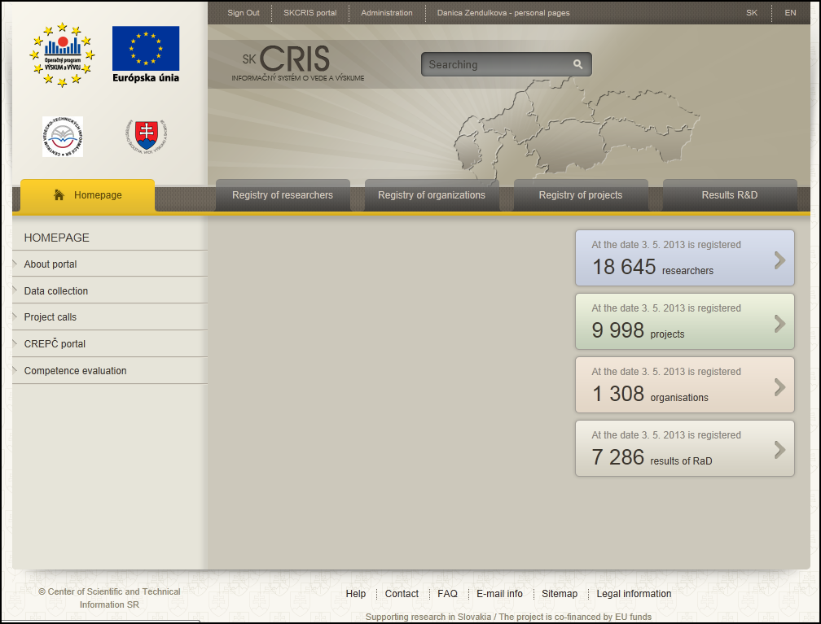
SK CRIS
Was started in January 2013
https://www.skcris.sk

Slide 4
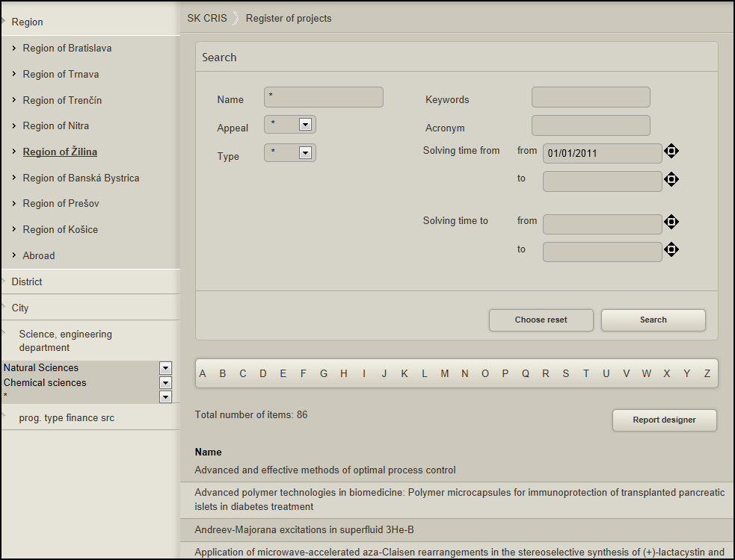
Projects
9997 projects funded by public resources
Projects starting in 2011 and later in the field of chemical sciences

Slide 5
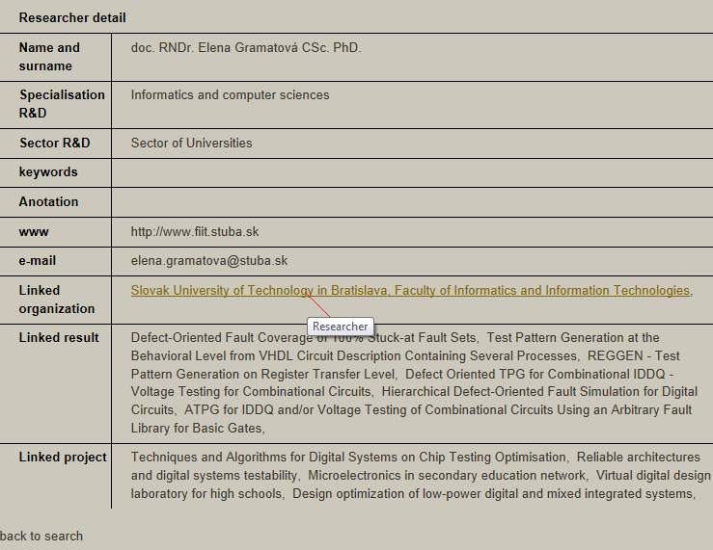
Persons
18 645 researchers, legal representatives and contact persons from
  universities
  SAS
  public and private institutes

Slide 6
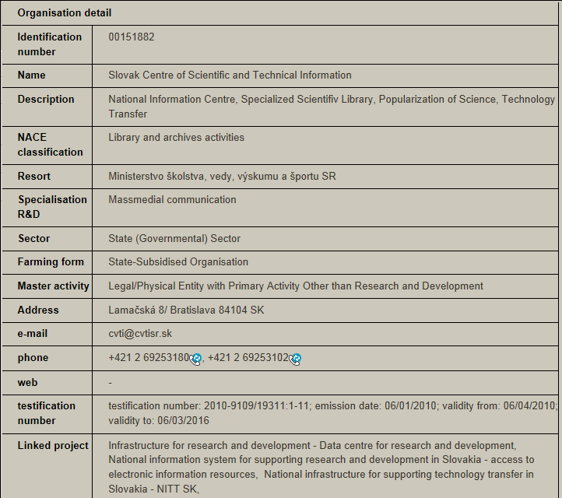
Organisations
1308 public and private R&D organisations

Slide 7
Certification to perform R&D
Issued by the Ministry of Education; Valid for 6 years; partially CERIF entities; Indicators:
Publishing activity
Citations
Organisation of Scientific and Professional events
Patent activity , licenses, utility models
Research activity (R&D finance support, projects)
R&D education and training
ISO certification of quality management
Use of research, Scientific and technical services
Laboratories
Activity in international R&D organisations

Slide 8
Statistical survey of R&D Quality
Realised yearly; aggregated data are published by CIP RDI
Innovations
Selected economic indicators of R&D entity
structure of R&D activities (capacity in personnel and FTE by type of research and by R&D field)
Laboratory equipment (level and acquisition value)
Number of publications, patents
Membership in international R&D organisations
International cooperation (active and passive; mobilities by time and country)

Slide 9




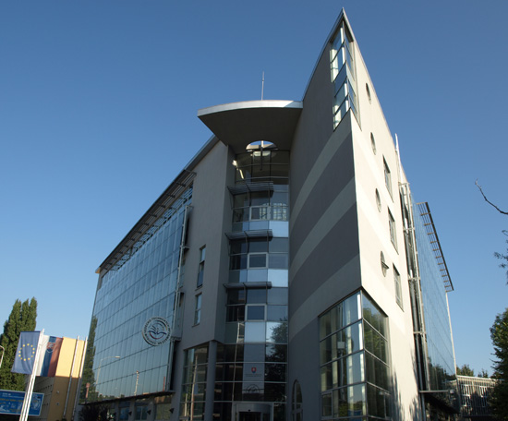
USE OF SK CRIS DATA
Podporujeme výskumné aktivity na Slovensku / Projekt je spolufinancovaný zo zdrojov EÚ
Adriana Shearman
Department of Technology Transfer
Centre of Scientific and Technical Information
Lamačská cesta 8/A
Bratislava
Slovak Republic
CONTACT:
: +421 2 69 253 133
e-mail: adriana.shearman@cvtisr.sk
skype: Adrikash1
web: www.cvtisr.sk

Slide 10
USE OF SK CRIS DATA
Contents:
Why we use data - briefly about the NITT SK project
Development of methodology – basic principles
What data we use (data sources )
Evaluation of public HE and publicly–funded R&D institutions
Conclusions

Slide 11
USE OF SK CRIS DATA
PROJECT National infrastructure for supporting technology transfer in Slovakia – NITT SK (http://nitt.cvtisr.sk)
To propose and put into effect the national infrastructure to support technology transfer, and thus contribute directly to more intensive and efficient state support to research and development.
Beneficiary : the Slovak Centre of Scientific and Technical Information in Bratislava
Operational programme : R&D
Co-financed by : European Regional Development Fund
Budget : €8,234,571.17
Duration : June 2010 – December 2014
Target group : academic community at SK universities, SAS, public research institutes

Slide 12
USE OF SK CRIS DATA
Technology transfer (TT)
is the process of transferring skills, knowledge, technologies, methods of manufacturing, samples of manufacturing and facilities among governments or universities and other R&D institutions to ensure that scientific and technological developments are accessible to a wider range of users who can then further develop and exploit the technology into new products, processes, applications, materials or services.
The transfer of new technology from the originator to a secondary user, in an attempt to boost economy.

Slide 13
USE OF SK CRIS DATA
OBJECTIVE 1 of NITT SK PROJECT
Establish and operate
Technology transfer centre at the SCSTI
Propose and implement a
NATIONAL SYSTEM FOR SUPPORTING TECHNOLOGY TRANSFER

Slide 14
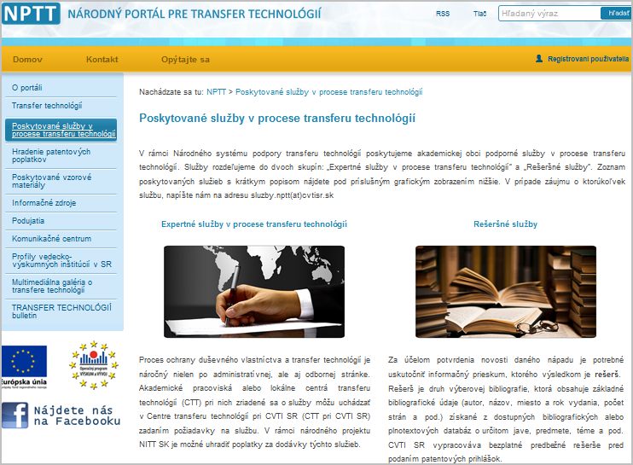
USE OF SK CRIS DATA
NATIONAL SYSTEM FOR SUPPORTING TECHNOLOGY TRANSFER
http://nptt.cvtisr.sk/
Services provided to public R&D institutions (e.g.):
1. Invention evaluation and commercial assessment
2. Invention/intellectual property protection, patent application filing
3. Contract drafting & negotiation
4. Research partnership development
5. Strategy & planning
6. Impact review
7. Consultancy & research services
8. Helping establish technology transfer centres at universities, etc.
9. Other auxiliary services (preparation of methodological materials, drafting default agreements and contracts, organising specialised training courses, seminars and conferences, etc.

Slide 15
USE OF SK CRIS DATA
Why we use SK CRIS data
Services related to TT and IPR protection are:
costly
provided externally by specialists, e.g. IP attorneys, lawyers, experts in commercialisation, evaluation of IP
If there is a demand for services exceeding financial resources we anticipate a competition for these resources
A task: to prepare a methodology for evaluation of R&D institutions and research teams from the aspect of TT

Slide 16
USE OF SK CRIS DATA
Pre-conditions:
no additional information will be requested from R&D institutions (i.e. using the existing data, no additional administrative burden on R&D institutions)
use only of databases administered by or licensed to SCSTI
selection of evaluation indicators with prime focus on TT
evaluation at two levels (faculty/research institute and research team)
methodology for evaluation is a confidential internal document of informative character and serves for decision-making for funding TT at public R&D institutions

Slide 17




USE OF SK CRIS DATA
Sources of information:
SK CRIS
CREPČ/CRPA - register of publications of universities classified by categories
InCites –Th-R analytical tool for evaluation based on bibliometric data
Derwent II – Th-R patent database
other publicly accessible databases – e.g. on awards

Slide 18
USE OF SK CRIS DATA
Criteria for evaluation from the aspect of TT (on the basis of data in the above databases and some inspiration from the literature, e.g. U-Multirank report) were identified, selected and grouped

Slide 19
USE OF SK CRIS DATA
R&D Institutional level
Area | Group | Source / database
1. Human potential | 1.A Publication activity | CRPA
 | 1.B IP protection | CRPA
 | 1.C Formal pre-requisites | SK CRIS
2. Cooperation | 2.A Projects | SK CRIS
 | 2.B Collaboration | SK CRIS
3. Environment | 3.A Infrastructure and services | SK CRIS
 | 3.B TT centre or equivalent | web site

Slide 20
USE OF SK CRIS DATA
R&D team level
Area | Group | Sources / databases
1. Human potential | 1.A Publication activity | CRPA
 | 1.B IP protection | Derwent II
 | 1.C Formal pre-requisites | SK CRIS
 | 1.D Impact | InCites, Derwent II
2. Cooperation | 2.A Projects | SK CRIS
 | 2.B Collaboration | SK CRIS, InCites
3. Environment | 3.A Infrastructure | SK CRIS

Slide 21
USE OF SK CRIS DATA
Formal pre-requisites: e.g. classification of academics from aspect of research field/expertise/specialisation, research degrees / degrees in education, membership in national/international scientific organisations, awards, etc.
Projects: projects in various scientific fields
Collaboration: involvement of R&D team/institution in national or international collaboration (e.g. number of Slovak or foreign R&D institutions participating in a project, exchange of academics)
Infrastructure and services: e.g. investment in research facilities, equipment, specific services provided by R&D institutions

Slide 22
USE OF SK CRIS DATA
Universities (12) | No. of Fac. (37) | Field
Comenius Univ. (BA) | 3 | Natural Sci.
Slovak Univ. of Technology (BA) | 7 | Technical Sci.
Slovak Univ. of Agriculture (NR) | 4 | Agri & Technical Sci.
Technical Univ. in Zvolen | 4 | Technical Sci.
Technical Univ. of Košice | 7 | Technical Sci.
University of Žilina | 4 | Technical Sci.
Alexander Dubček Univ. in Trenčín | 3 | Technical Sci.
Matej Bel Univ. in Banská Bystrica | 1 | Natural Sci.
Pavol Šafárik Univ. (KE) | 1 | Natural Sci.
University of Prešov | 1 | Natural Sci.
St. Cyril and Methodius Univ. (TT) | 1 | Natural Sci.
Constantine the Philosopher Univ. (NR) | 1 | Natural Sci.

Slide 23
USE OF SK CRIS DATA
F. of chemistry & food technol STU BA
F. elec eng STU BA
F. math & phys & info CU BA
F. civil eng STU BA
F. wood sci & technol TU ZV
F. nat sci CU BA
F. material technol STU BA
F. elec eng TU KE
F. manuf technol TU KE
F. mech eng UZ ŽA

Slide 24
USE OF SK CRIS DATA
Conclusions:
Quality of any evaluation depends on quality of data available
CRPA collects a suitable and validated data set on publications and citations only for Slovak public universities (no such data for SAS, R&D institutes)
Currently, evaluation is confined to public HE and R&D institutions (target group of NITTSK project)

Slide 25
USE OF SK CRIS DATA
Current tasks and future plans:
1. to complete evaluation of 11 working teams mainly from HEs, SAS
2. to complete evaluation of selected institutes of the Slovak Academy of Sciences (29) and public research institutes (10)
3. to modify calculations and revise indicators
4. to update methodology
5. to include more databases

Slide 26
USE OF SK CRIS DATA
Acknowledgement
Work of my colleagues on the preparation of Methodology is greatly appreciated:
Bilský Ľubomír Kyseľová Katarína
Cvik Oleg Mažári Daniel
Dušková Marta Molnárová Iveta
Hrčková Ľudmila Noskovič Jaroslav
Klimentová Eliška Števková Oľga
Králiková Eva Tlstovičová Jana
Kravjar Július Zendulková Danica

Slide 27
USE OF SK CRIS DATA
Thank you very much for your attention


