Slide 1

The assessment of competence to perform research and development by the SK CRIS: Research Organisation as an object of evaluation
Danica Zendulková,
Slovak Centre of Scientific and Technical Information
CRIS2016: Communicating and measuring research responsibly:
profiling, metrics, impact, interoperability
June 8-11 2016, St Andrews, Scotland

Slide 2



The system SK CRIS
Guarrantee: Ministry of Education, Science, Research and Sport
Supplier: InterWay s.r.o
Provider: SC STI
Scope: National Information system
Data format: CERIF
Put into operation: January 2013
Available at https://www.skcris.sk

Slide 3
Assessment of competence
The assessment of competence to perform research and development :
  Guarranted by Ministry of Education, Science, Research and Sport of Slovakia
  Realised based on Act No 172/2005 on State R& Support
  Data collection ongoing
  Evaluation Commission meets as required (every 1-2 months)

Slide 4
SK CRIS Databases
Place of assessment of competence in SK CRIS databases:

Slide 5
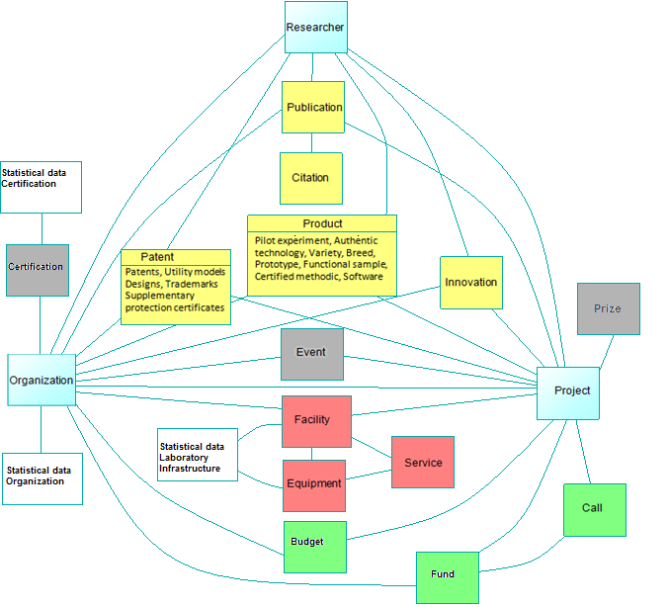
SK CRIS – data structure

Slide 6
Indicators
Organisation core data
Publications and Citations
Organization of scientific events
Patents and applications, utility models, other IP Licences
Amount of funds in the competition for targeted support R&D
R&D Projects with application in economic or social practice
International R&D Projects
Conditions for R&D education
Qualification structure
Certificate of Quality Management
Use of the results of R & D in practice and economic benefits
Scientific and technical services
Representation of the Slovak Republic in international R & D organizations, and tasks realisation
Laboratories and equipment

Slide 7
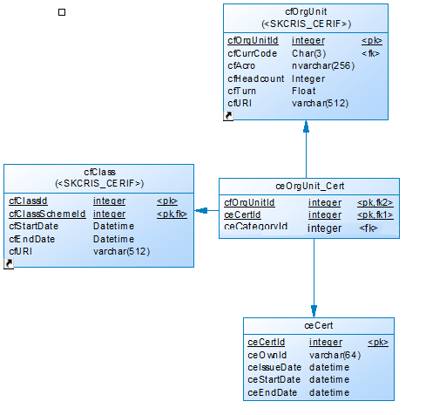
Data model
CERIF data entities are independent of other data structures
Data about certificate are linked to organisation by CERIF inspired linked entity

Slide 8
CERIF and CERIF inspired
Indicator corresponds exactly one CERIF entity
Indicator may correspond to one CERIF entity (after adding supplementary classification or CERIF entity at present not defined in the SK CRIS
The indicator can not be aligned with structure of data format CERIF („open“ questions)

Slide 9
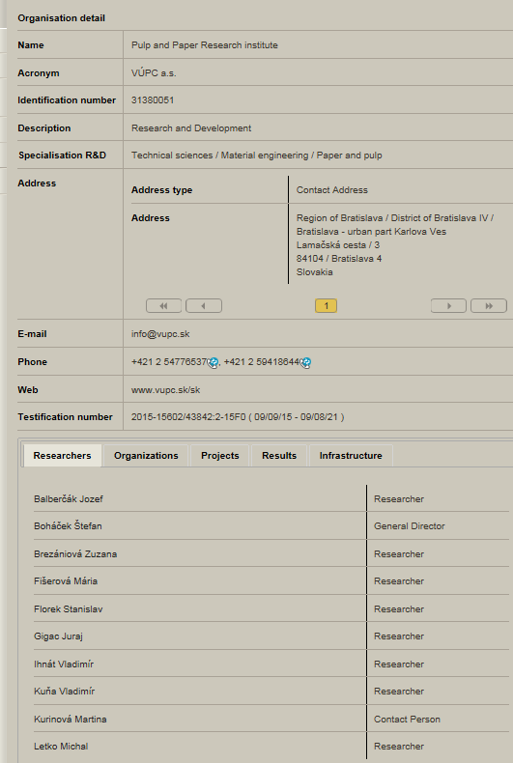
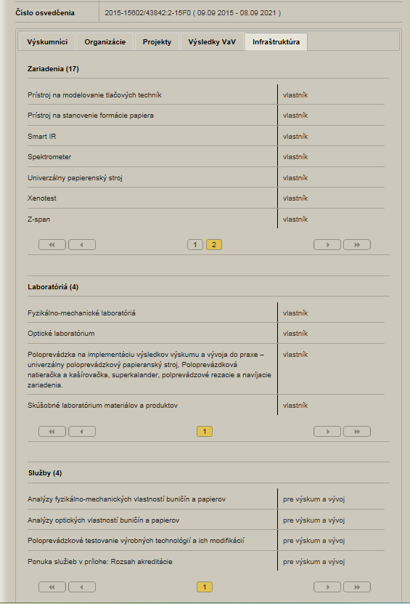
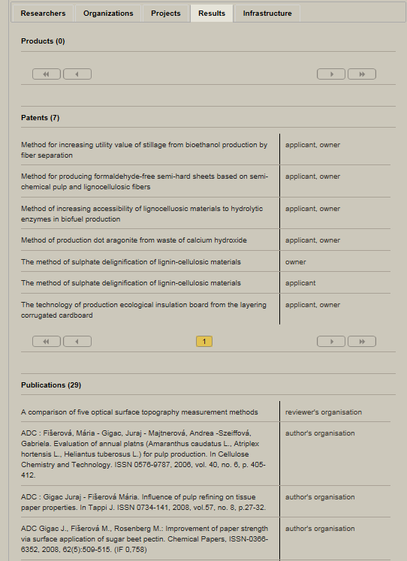
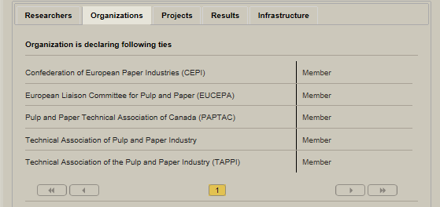
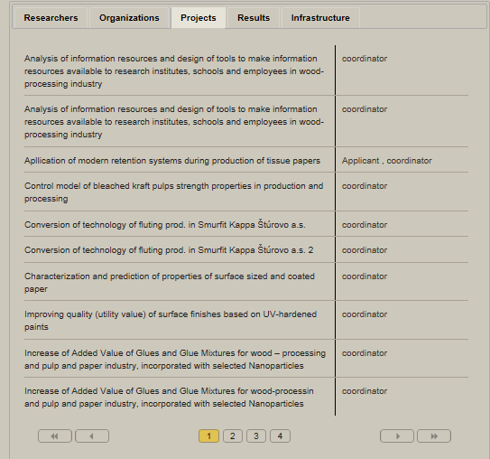
Example

Slide 10
SWOT Analysis
Opportunities
- Extending use of the format CERIF to other categories and.
Threats
Strengths - The existence of relevant legislation codifying evaluation process - Organisation‘ s motivation to provide information on R & D organizations to SK CRIS in order to obtain a certificate | Opportunities - Extending use of the format CERIF to other categories and objects which by their nature allow it. - Improving SK CRIS system data and their subsequent use by the target groups at home and abroad
Weaknesses - Exactness and measurability of the defined indicators are not always detectable - Administrative burden of filling the required data, which sometimes leads to the provision of a superficial and incomplete information | Threats - Subjective character of collected data and their complicated verification - Changes in legislation that would limit the obligation to provide data

Slide 11
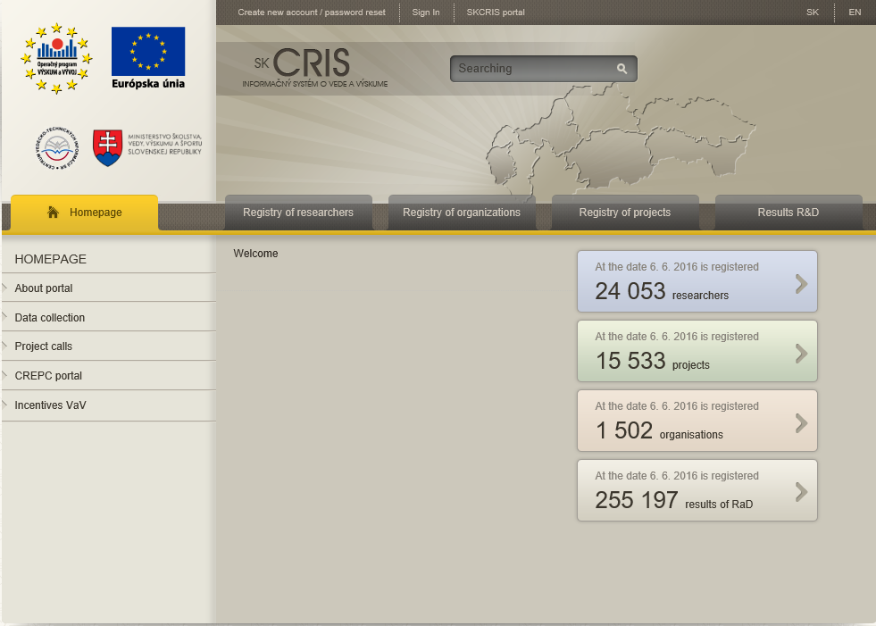
Thank you very much for your attention

