Slide 1


PTCRISync Framework
euroCRIS, Dublin, Ireland
Notes:
1

Slide 2
Mission
Ensure creation and sustained development of the necessary infrastructures for the implementation of a ecosystem national integrated (PTCRIS) to support management of scientific activity developed in Portugal
Notes:
CRIS systems are importante but they have to work toghether. That is why we decided to create PTCRIS program.

Slide 3
Motivation
"An output should be recorded
once and reused multiple times"
Notes:
Prova de conceito já realizada com o Authenticus e o DeGóis.
3

Slide 4
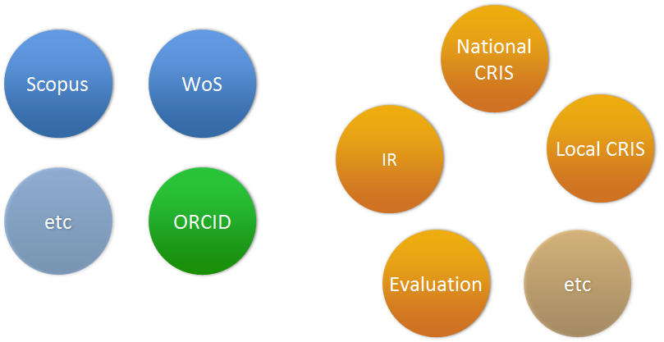
National and international ecosystem
Notes:
Input once, reuse often!
Automatic synchronization between services
4

Slide 5
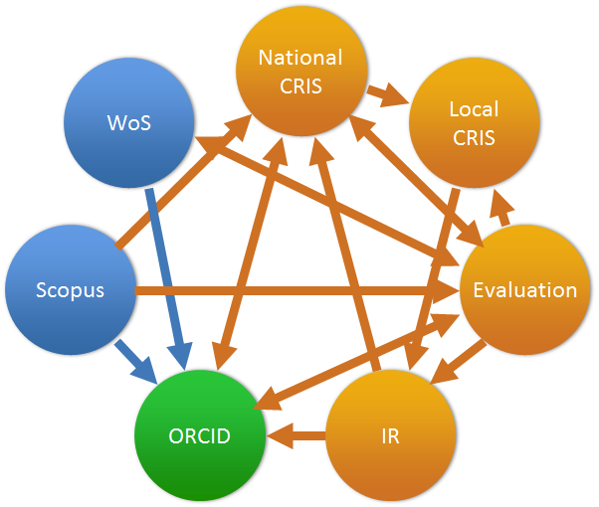
A non-solution
Notes:
Many synchronization procedures per service
Implementation and maintainability nightmare
No clear flow to achieve global consistency
5

Slide 6
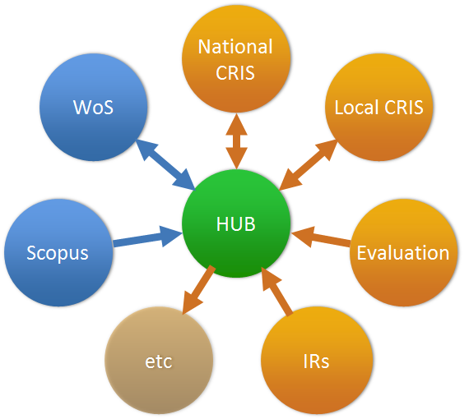
Our proposal
Notes:
Um procedimento de sincronização por serviço
Fácil de manter e de gerir
Fluxos claros para assegurarem a consistência global
6

Slide 7

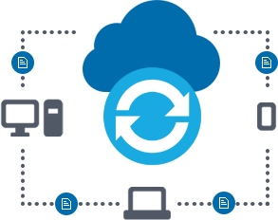


PTCRISync
The same files in any device.
The same metadata in any CRIS.
CV
WoS
CRIS IES
ORCID
Scopus
RI
AO
Aggregator
PTCRISync sync Framework

Slide 8
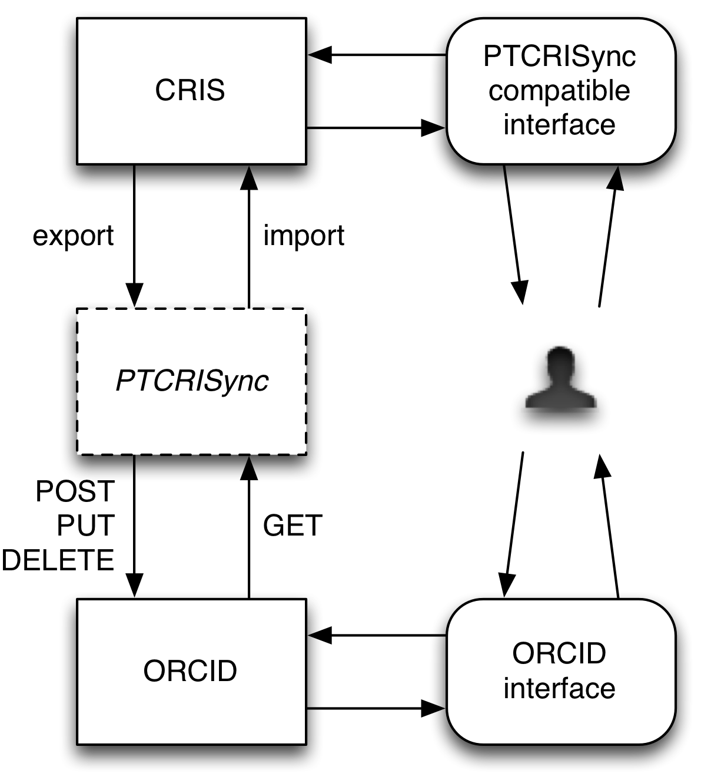

Architecture and API
The PTCRISync library
  Is purely stateless
  Input data follows ORCID format
  Available in Java and as a web-service
  Built on top of an ORCID client wrapper
Current API
  exportWorks
  importWorks
  importUpdates
  importInvalid
  importCounter

Slide 9
PTRISync: the framework
Algorithm (2015)
Interface (1Q2016)
Client (1Q2017)
PTCRISync SaaS (1Q2017)
Documentation (3Q2016)
Simulator (1Q2017)

Slide 10
Figures
210 305
3 (+/- 50%)
3
6760 – 20280 d
636 476 € - 1,909,426 €

Slide 11
Estimate benefits: assumptions
Global variables
Average time to register a job in (in minutes) | 3 (+ 50%, -50%)
Average number of coauthors by publication | 3
Variables
Total number of publications | 210 305
Annual variables
Annual number of publications | 20,533
Average annual salary of a researcher | 29 000 €
Assumptions:
Average registration time = 3 minutes (average for depositing an article in a repository is between 6 to 10 minutes Houghton et all. (2009).
authors and coauthors = average 3 by publication.
Publications = 210 305, in which 166 245 are obtained from DGEEC / MEd - MCTES, values since 1998 up until 2014 and up until 2016 were obtained through Thomson Reuters.
Average Salary = investigator 29 000eur (Value obtained from the 2007 study by the Commission European - salary comparisons in 2006). To calculate the average annual publications were taken into account only the years 2014 to 2016.

Slide 12
Estimates benefits (1998-2016): Time and Euros
#systems | Time (in days) | Euros
1 ORCID | 2254 - 6760 | 212 159 € - 636 476 €
2 | 4507 - 13520 | 424,317 € - 1,272,951 €
3 | 6760 - 20280 | 636 476 € - 1,909,426 €
4 | 9014 - 27040 | 848,634 € - 2,545,901 €
5 | 11267 - 33800 | 1,060,792 € - 3,182,376 €
Notes:
12

Slide 13
Estimates annual benefits: time and euros
#systems | Time (in days) | Euros
1 ORCID | 220 - 660 | 20 714 € - 62 142 €
2 | 440 - 1320 | 41 428 € - 124 284 €
3 | 660 - 1980 | 62 142 € - 186 426 €
4 | 880 - 2640 | 82,856 € - 248 568 €
5 | 1100 - 3300 | 103 570 € - 310 710 €
simulador
Notes:
13

Slide 14



Implementations
In progress

Slide 15
Average implementation time
4 to 6 weeks

Slide 16
More info
https://vimeo.com/215320281
https://github.com/fccn/PTCRISync
https://docs.google.com/presentation/d/19K08FB_g9y3VqKRNTaweOeL4awdvQVC6nd6E6-GKjvU/edit
ptcrisync@googlegroups.com (e-mail)

Slide 17
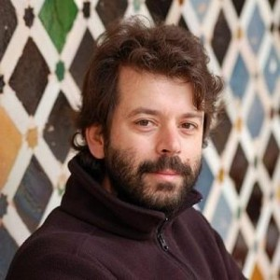
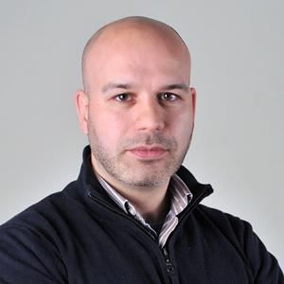
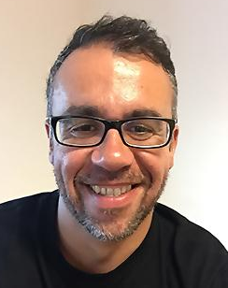
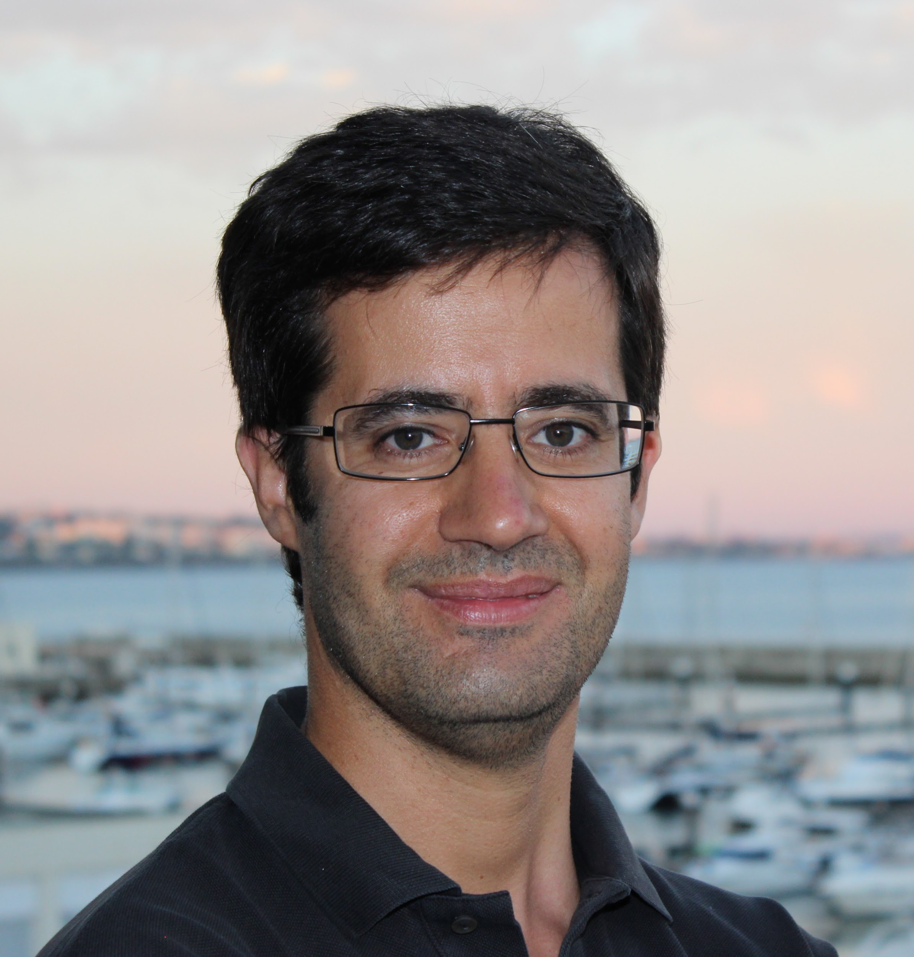
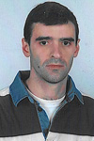
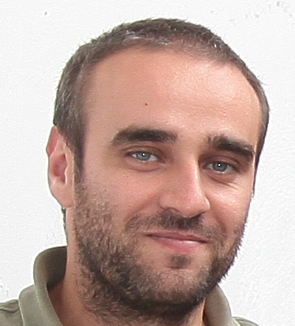
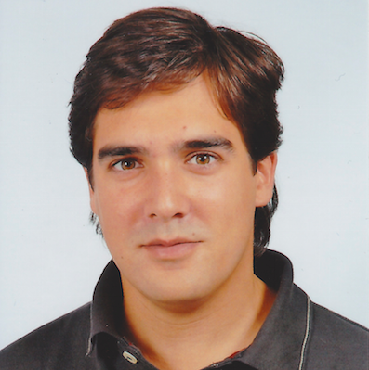
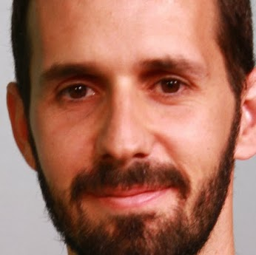
Team
Alcino Cunha Library design 0000-0002-2714-8027 | António Lopes Integrator & developer 0000-0003-3045-0304 | Bruno Monteiro UX Designer | João Mendes Moreira Project Leader 0000-0002-9081-2728 | Luís Pedro Integrator & developer 0000-0002-3936-6531
Nelson Madeira Integrator & developer 0000-0002-4575-4354 | Nuno Macedo Library design & developer 0000-0002-4817-948X | Paulo Graça Developer 0000-0002-3503-4812
Notes:
Project leader
UX Designer
Algorithm design
Developers
Integrator & devoper
17

Slide 18
Future work
ORCID tests and feedback (webinar 28-5-2017)
PTCRISync adoption
  Webinar
  Workshop
  Call for participation
  Support to potential adopters
  Offered directly by ORCID?
Synchronize better and more
  Recognize safely more updates (edits) and more CV elements
  Distributed synchronization
  “Better” timestamps (creation vs update dates, version vs date)
Notes:
18

Slide 19
DEMO

Slide 20
Story
Cátia Laranjeira
  Portuguese neuroscientist
National Institute for Medical Research, UK (2007-2014)
  PhD and Research in UK, profile in ORCID
IGC - Gulbenkian (2014-2016)
  Member in a Research Unit in Portugal, profile in Ciência Vitae, productions deposited in RCAAP
  Applied for an FCT funded project
ISCTE-IUL (2017)
  A new challenge, profile in Ciência-IUL

Slide 21
Demonstration
National Institute for Medical Research, UK:
  Update ORCID profile with scientific production registered in international systems (Scopus, or Crossref) and Bibtex
IGC - Gulbenkian:
  Update Ciência Vitae with productions imported from ORCID
  Update ORCID profile with productions stored in RCAAP (DSpace) and then synchronize incrementally with Ciência Vitae
ISCTE-IUL:
  Update Ciência-IUL profile with productions imported from ORCID
  Merge duplicated works in Ciência-IUL

Slide 22
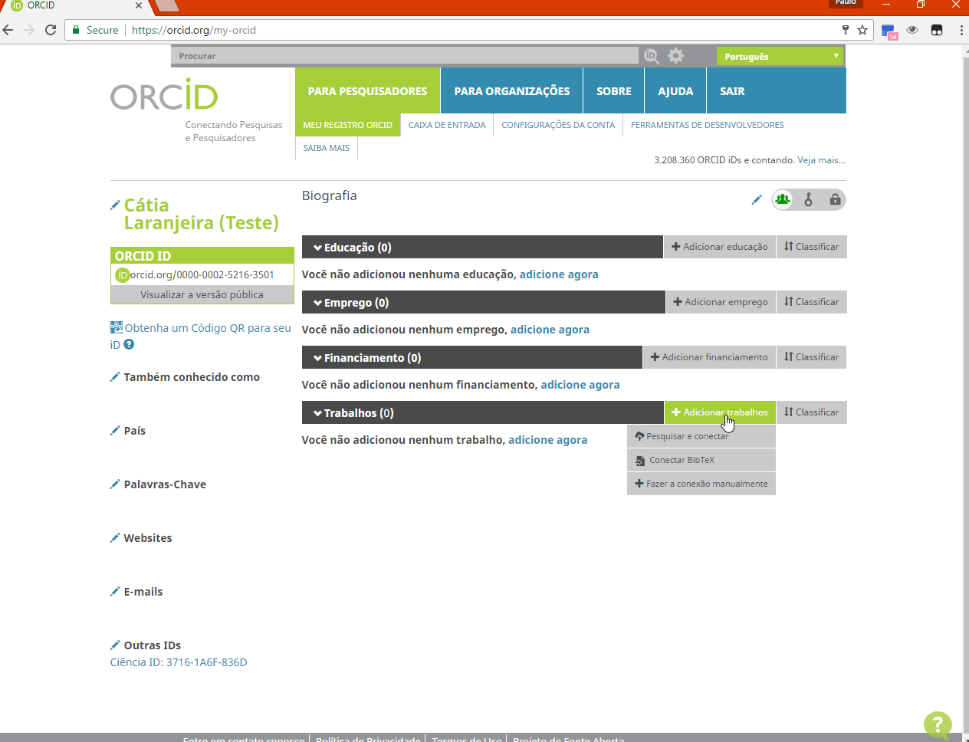

Slide 23
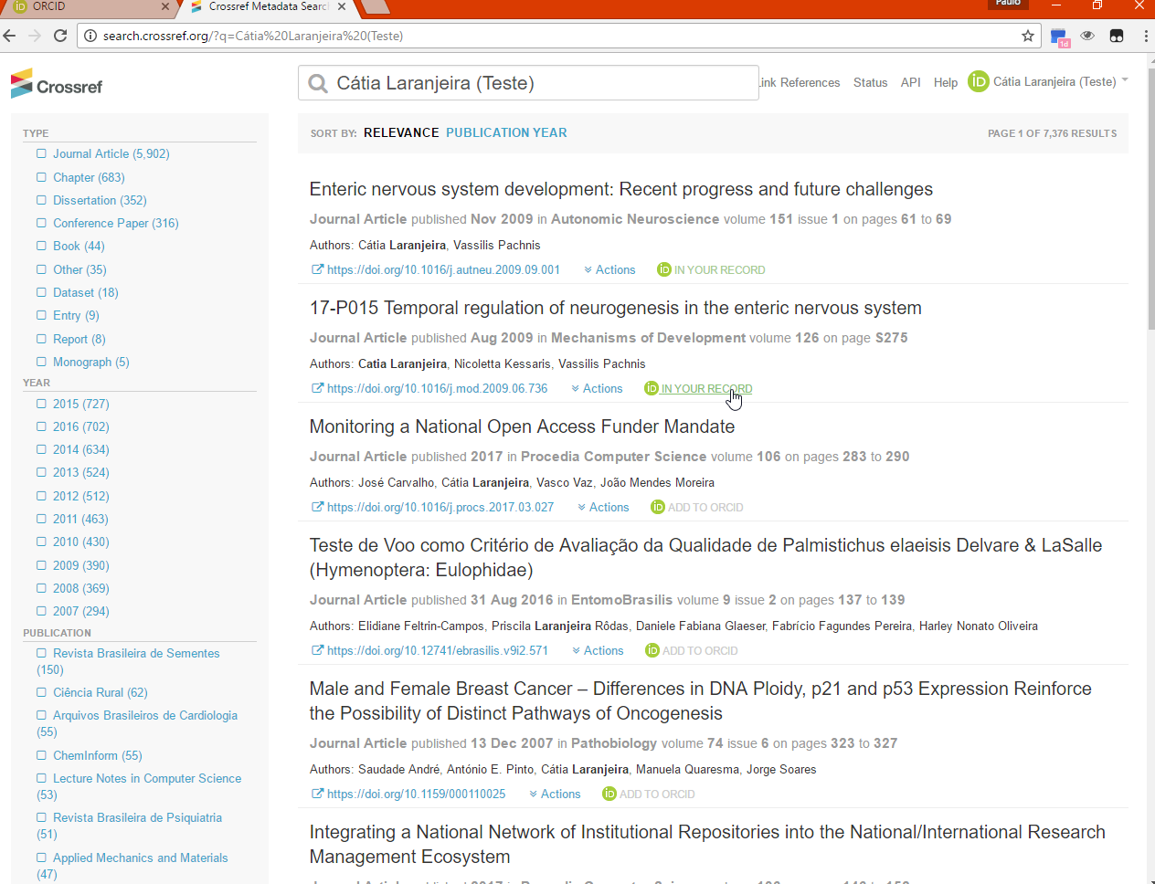

Slide 24
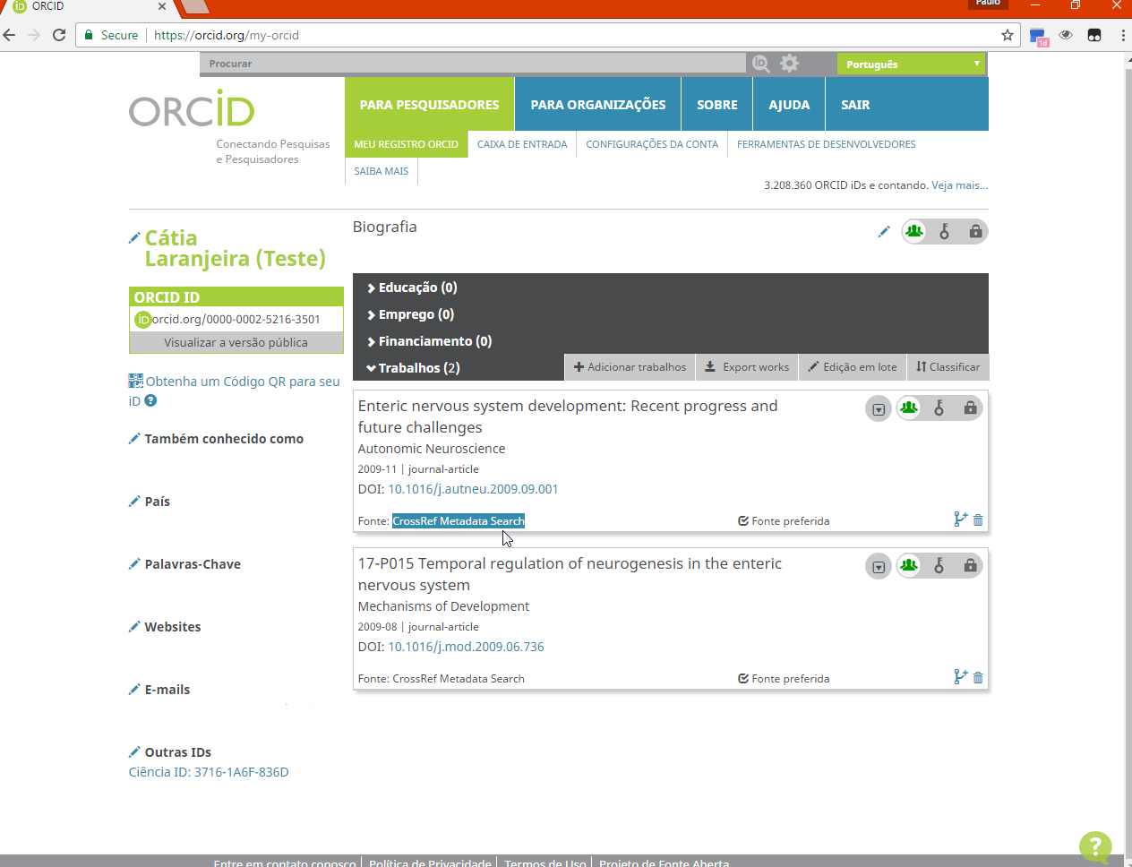

Slide 25
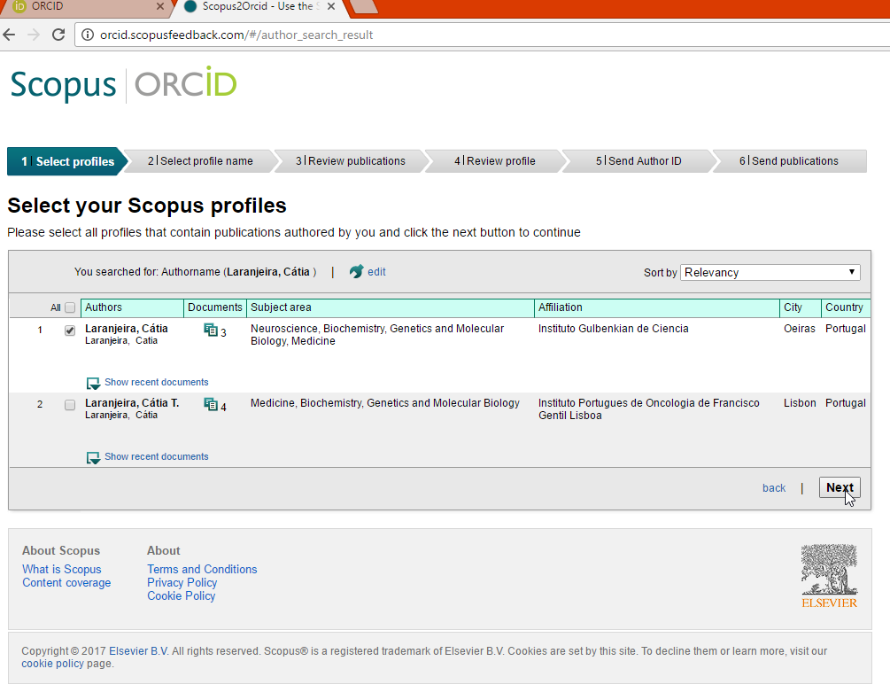

Slide 26


Slide 27
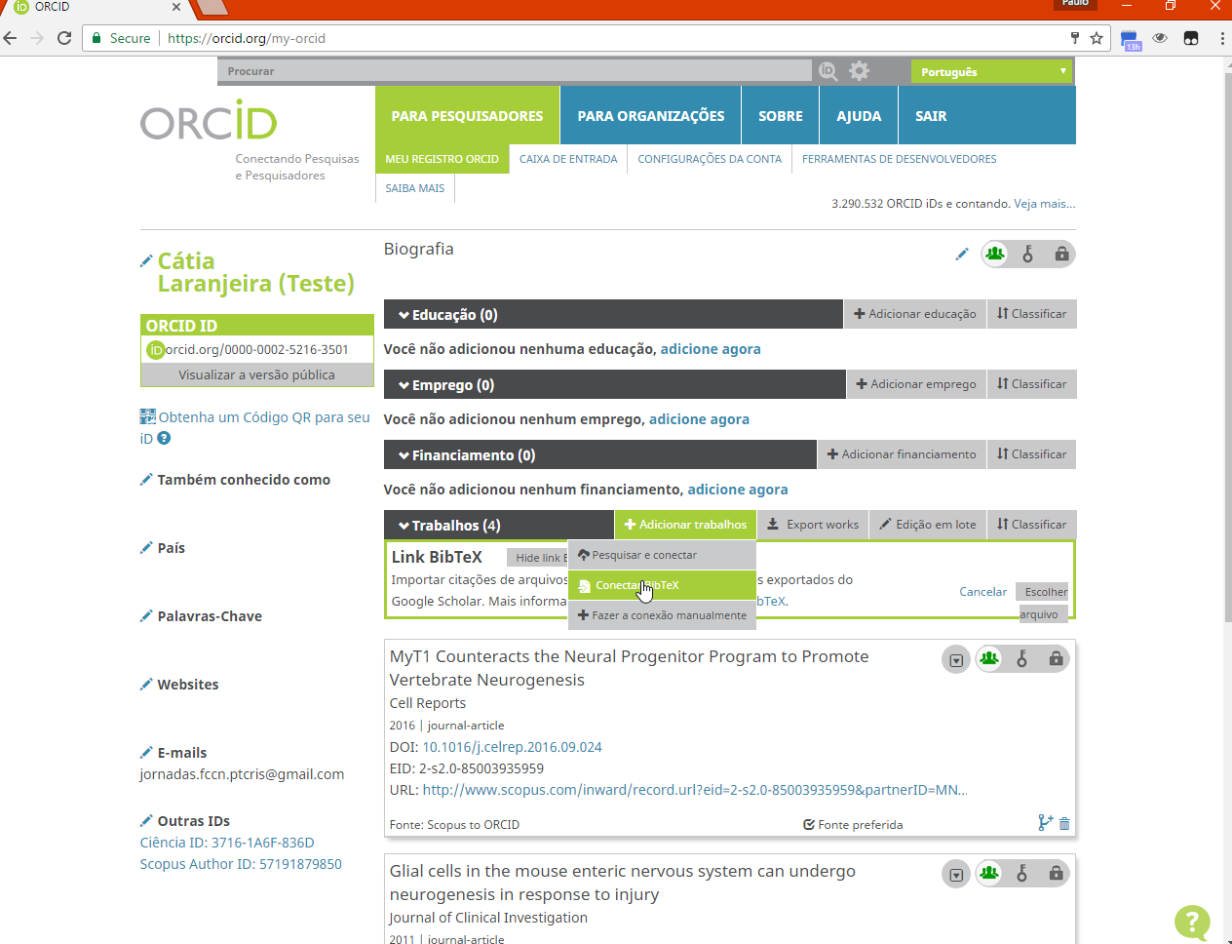

Slide 28
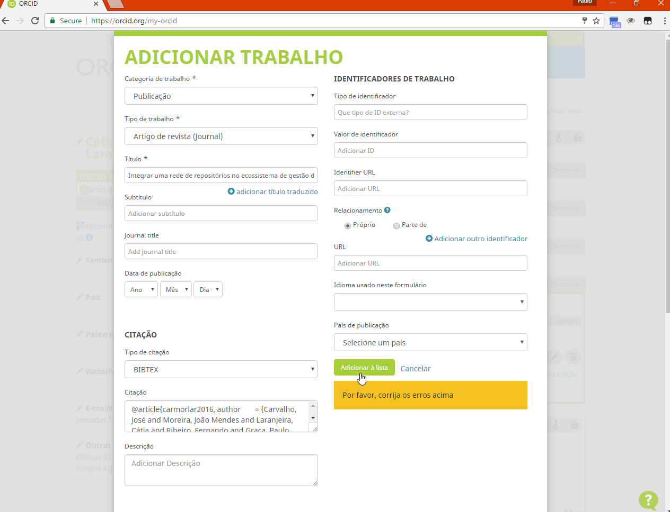

Slide 29
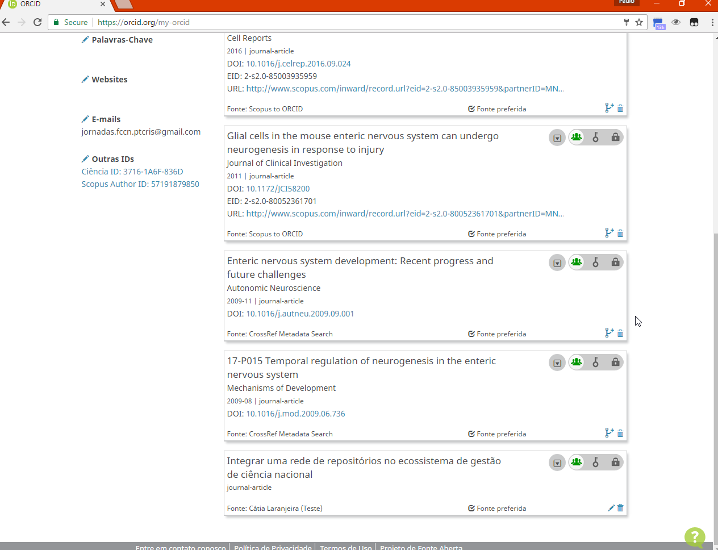

Slide 30
Demonstration
National Institute for Medical Research, UK:
  Update ORCID profile with scientific production registered in international systems (Scopus, or Crossref) and Bibtex
IGC - Gulbenkian:
  Update Ciência Vitae with productions imported from ORCID
  Update ORCID profile with productions stored in RCAAP (DSpace) and then synchronize incrementally with Ciência Vitae
ISCTE-IUL:
  Update Ciência-IUL profile with productions imported from ORCID
  Merge duplicated works in Ciência-IUL

Slide 31
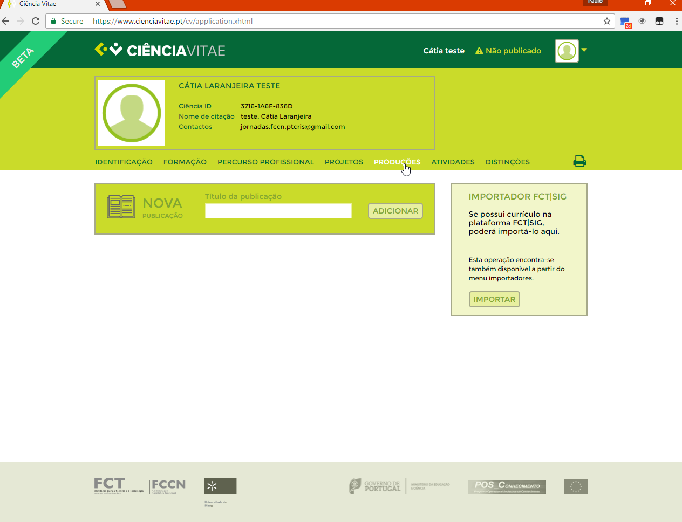

Slide 32
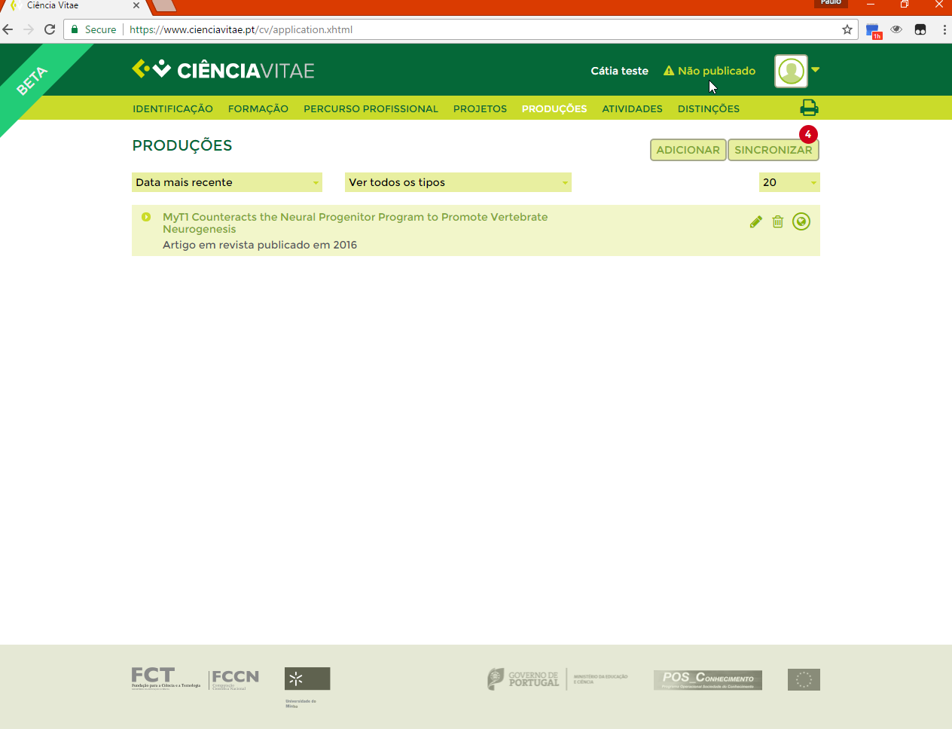

Slide 33
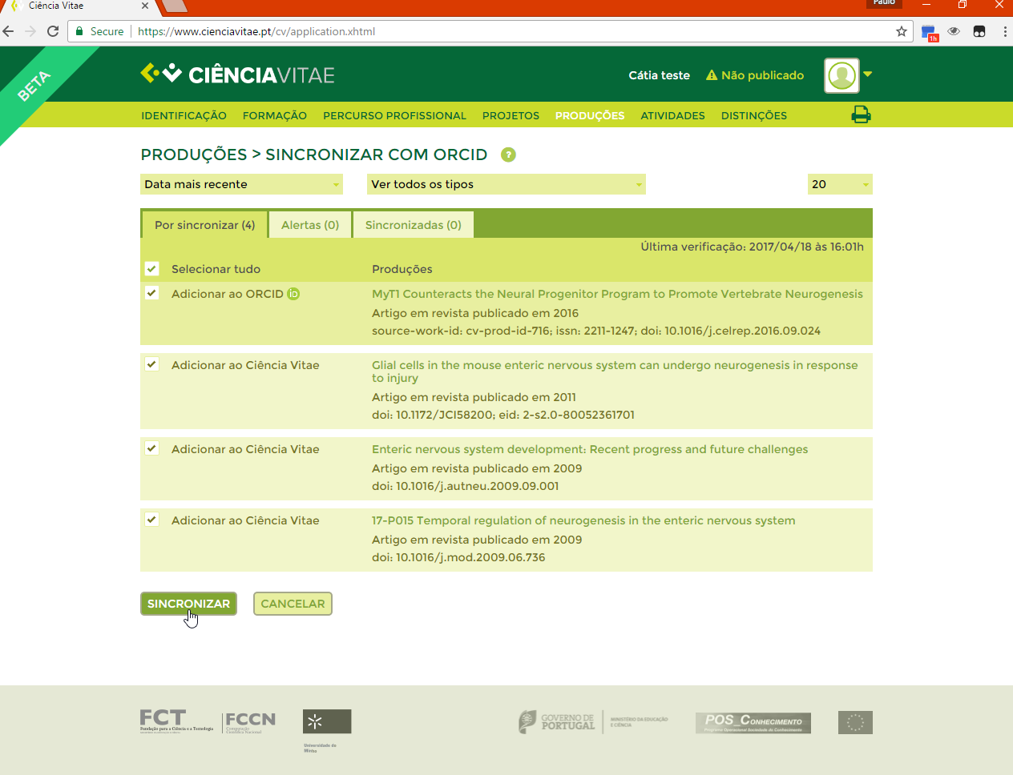

Slide 34
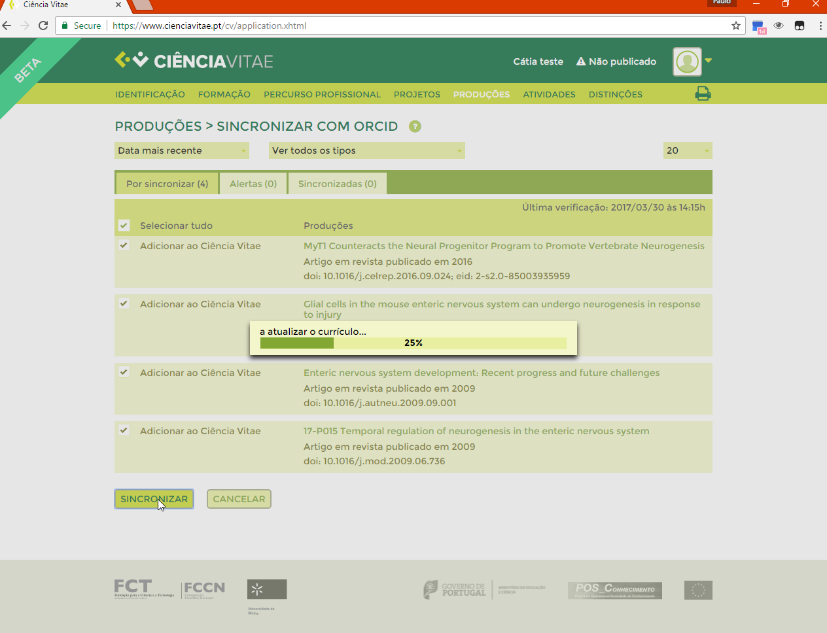

Slide 35
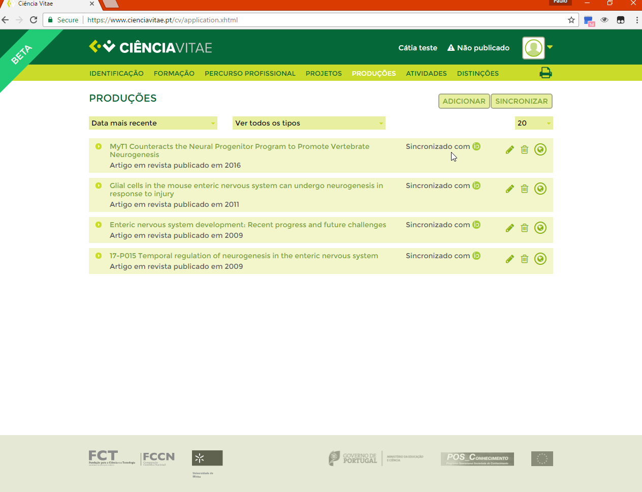

Slide 36
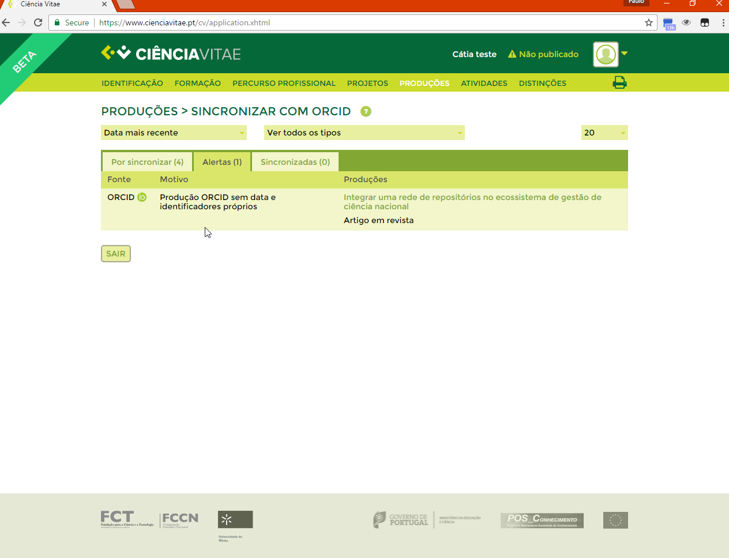

Slide 37
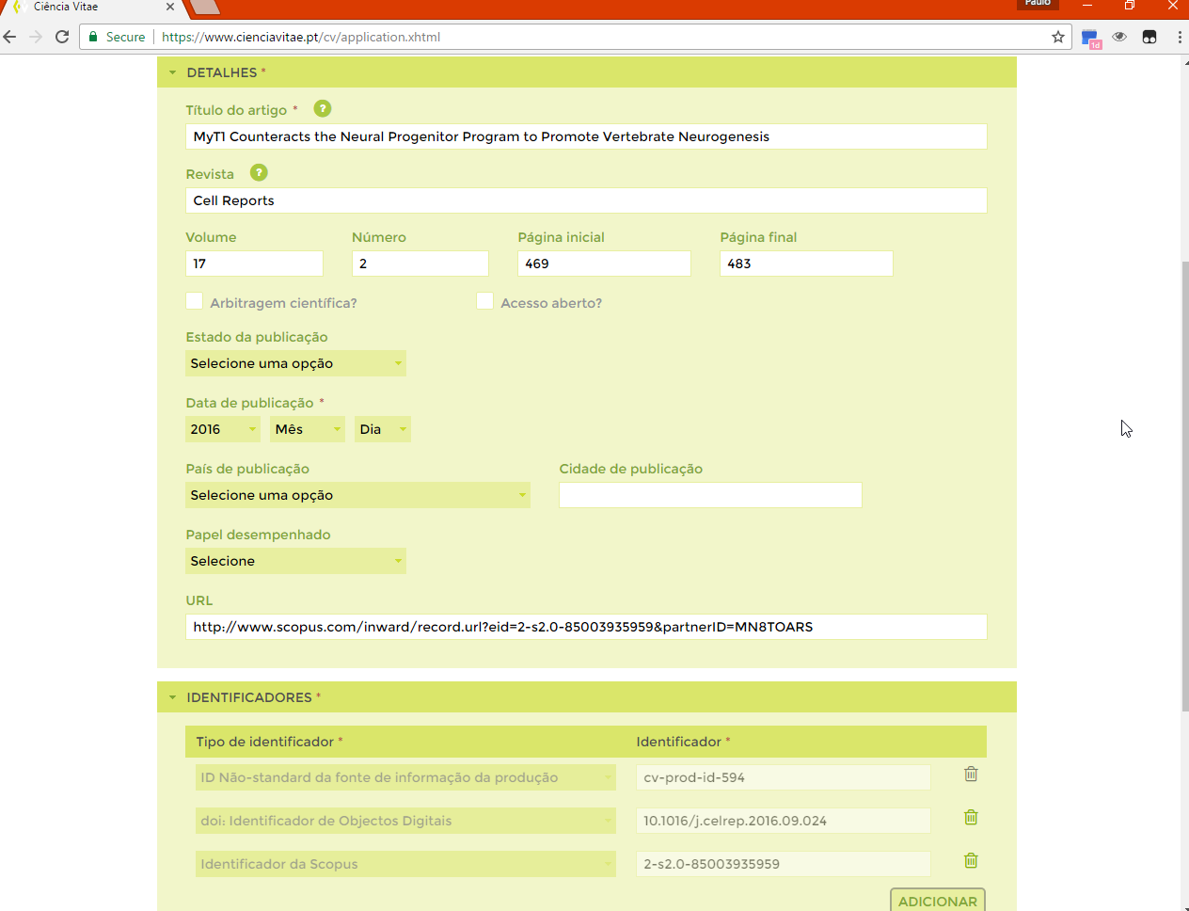

Slide 38
Demonstration
National Institute for Medical Research, UK:
  Update ORCID profile with scientific production registered in international systems (Scopus, or Crossref) and Bibtex
IGC - Gulbenkian:
  Update Ciência Vitae with productions imported from ORCID
  Update ORCID profile with productions stored in RCAAP (DSpace) and then synchronize incrementally with Ciência Vitae
ISCTE-IUL:
  Update Ciência-IUL profile with productions imported from ORCID
  Merge duplicated works in Ciência-IUL

Slide 39
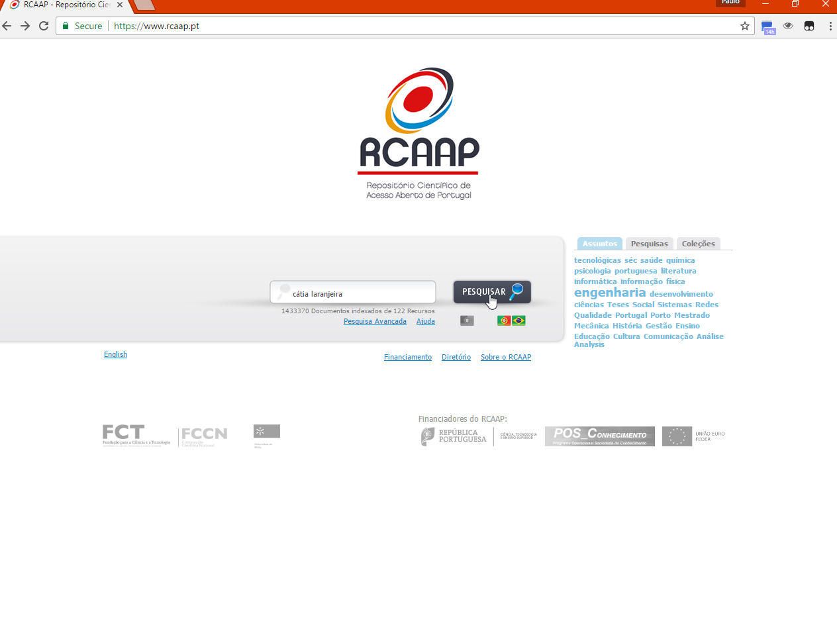

Slide 40
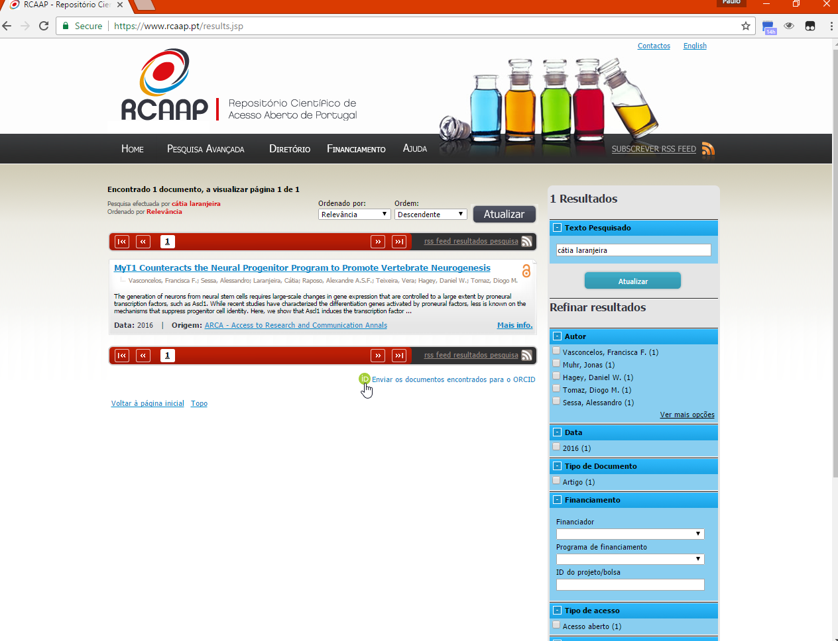

Slide 41
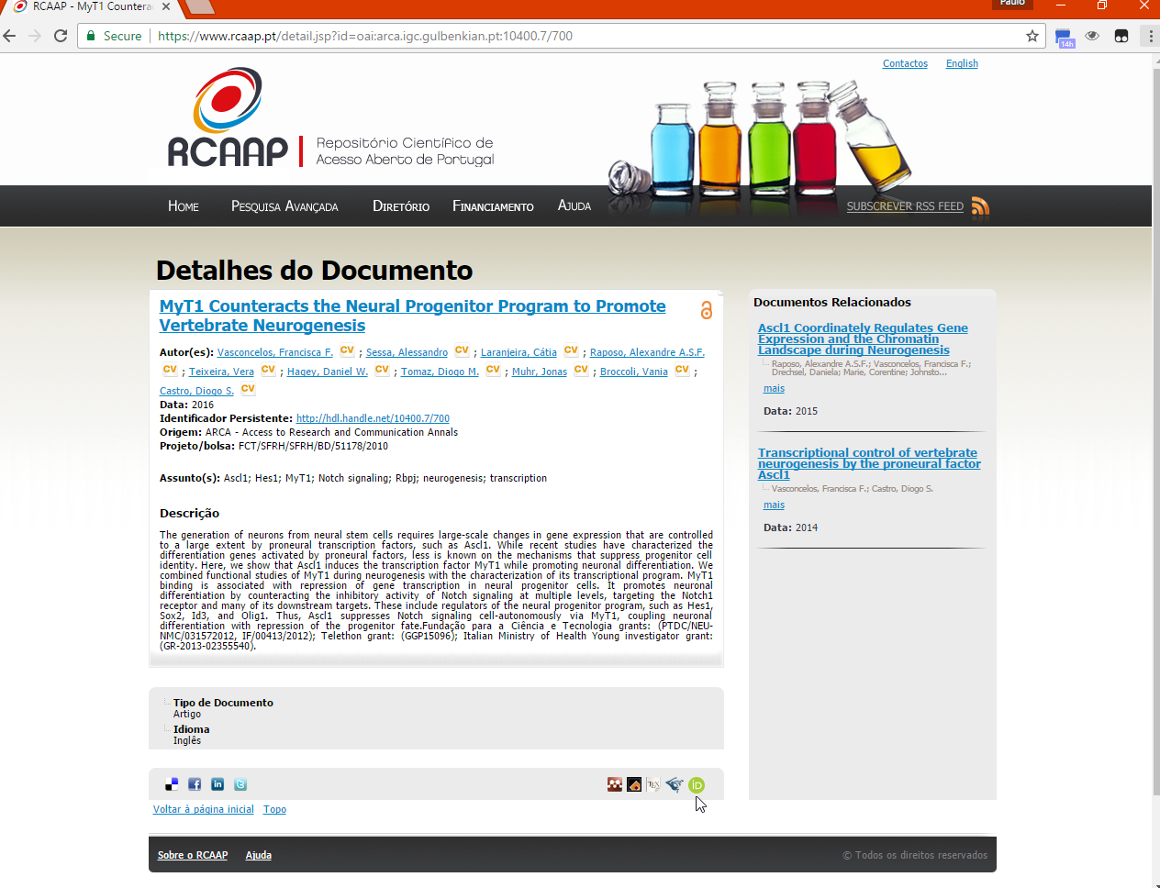

Slide 42
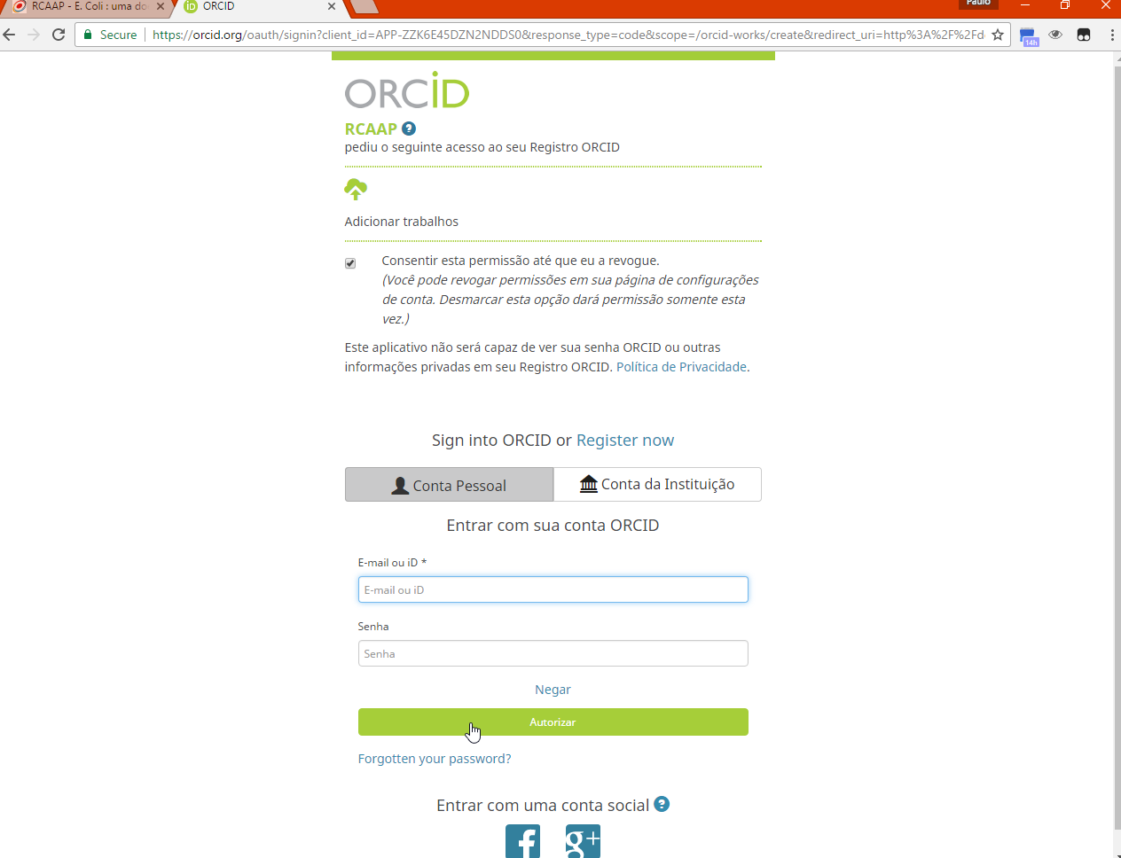

Slide 43
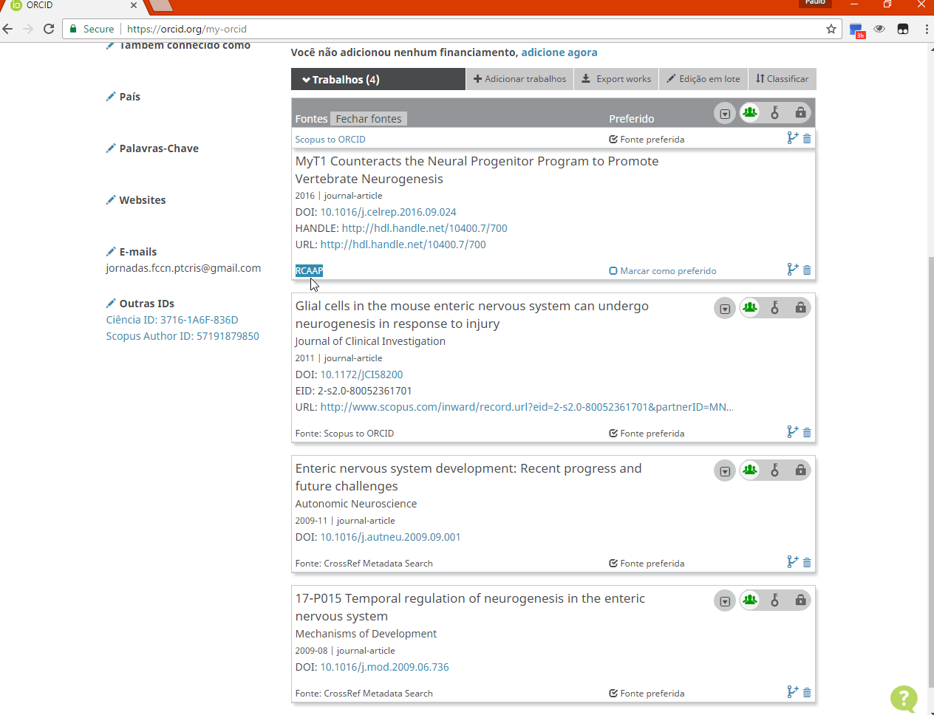

Slide 44
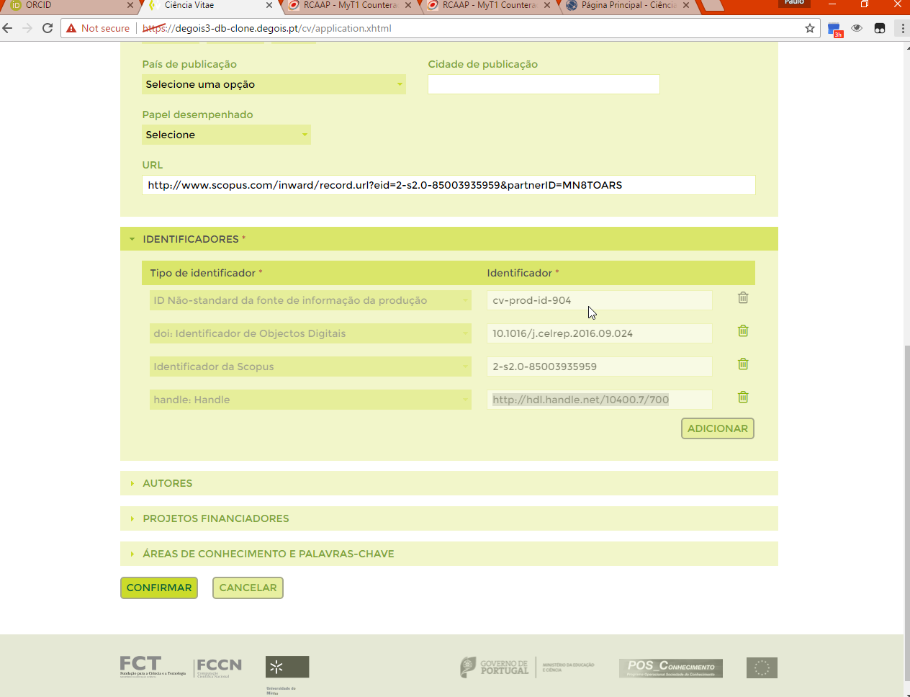

Slide 45
Demonstration
National Institute for Medical Research, UK:
  Update ORCID profile with scientific production registered in international systems (Scopus, or Crossref) and Bibtex
IGC - Gulbenkian:
  Update Ciência Vitae with productions imported from ORCID
  Update ORCID profile with productions stored in RCAAP (DSpace) and then synchronize incrementally with Ciência Vitae
ISCTE-IUL:
  Update Ciência-IUL profile with productions imported from ORCID
  Merge duplicated works in Ciência-IUL

Slide 46
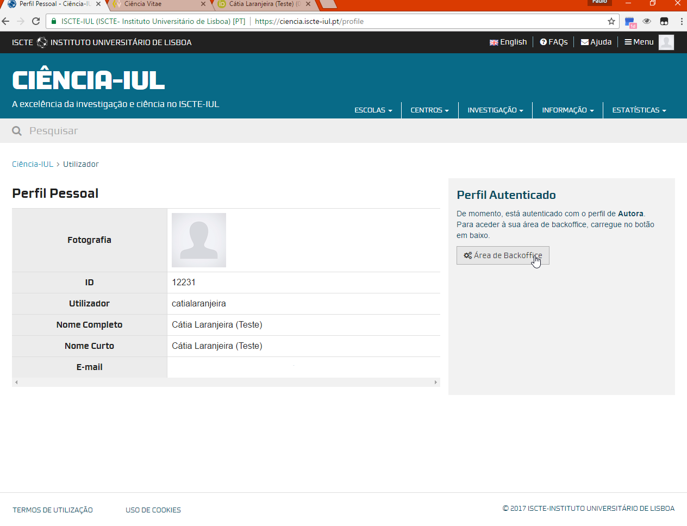

Slide 47
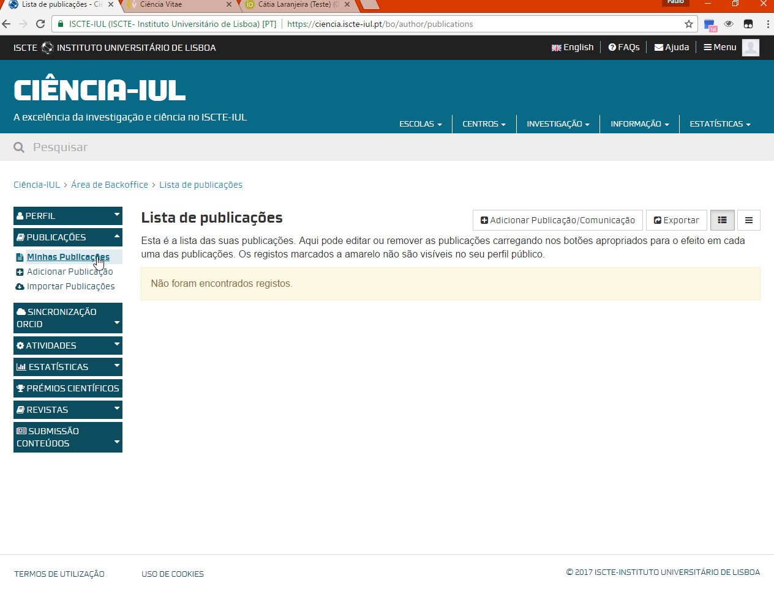

Slide 48
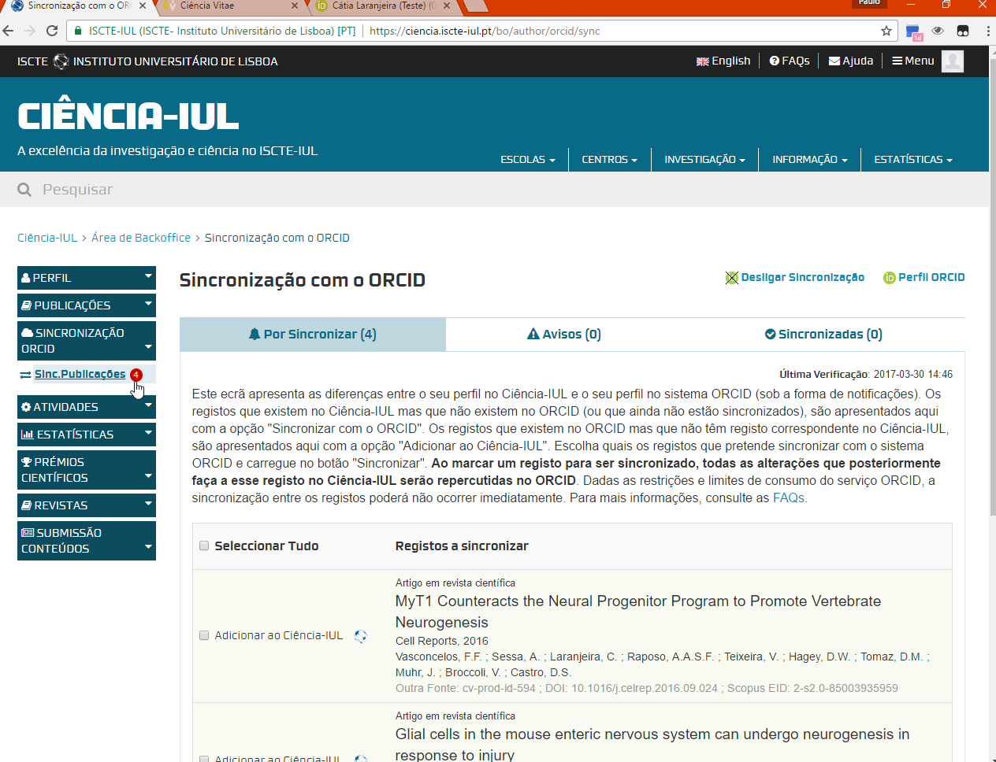

Slide 49
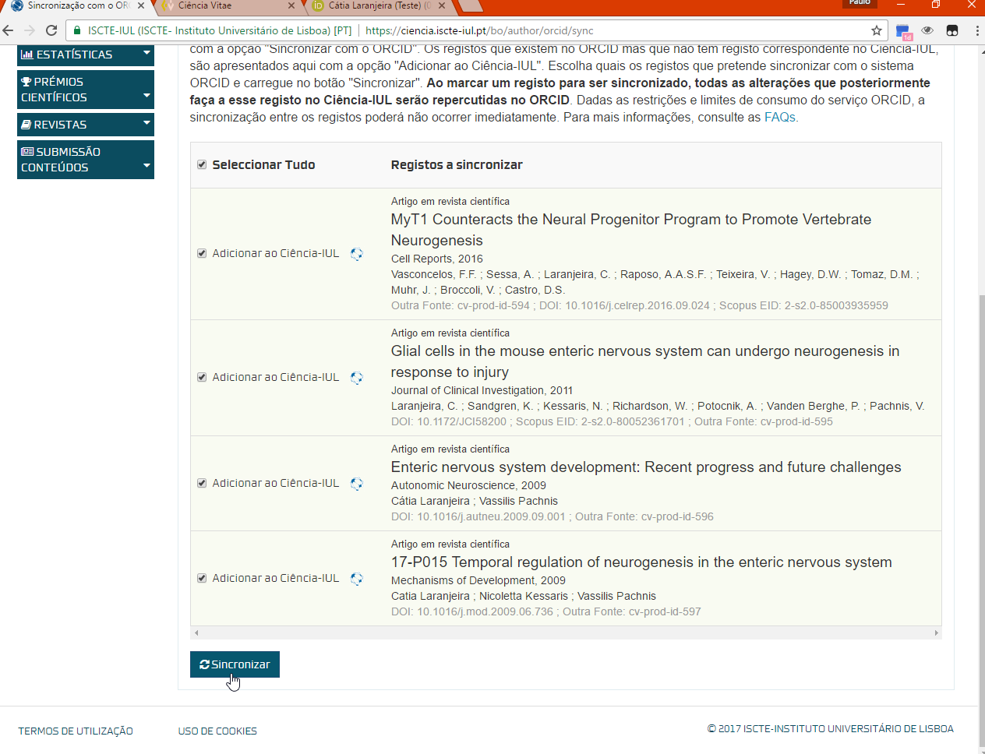

Slide 50
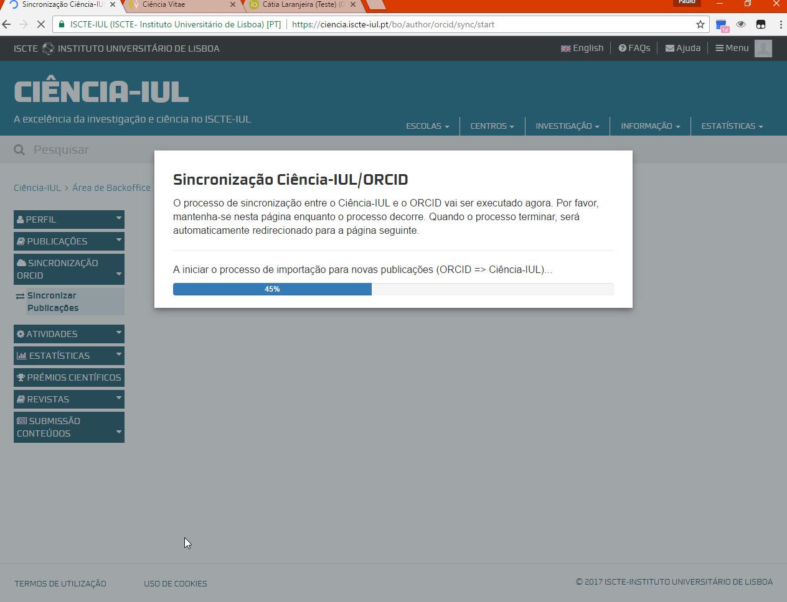

Slide 51
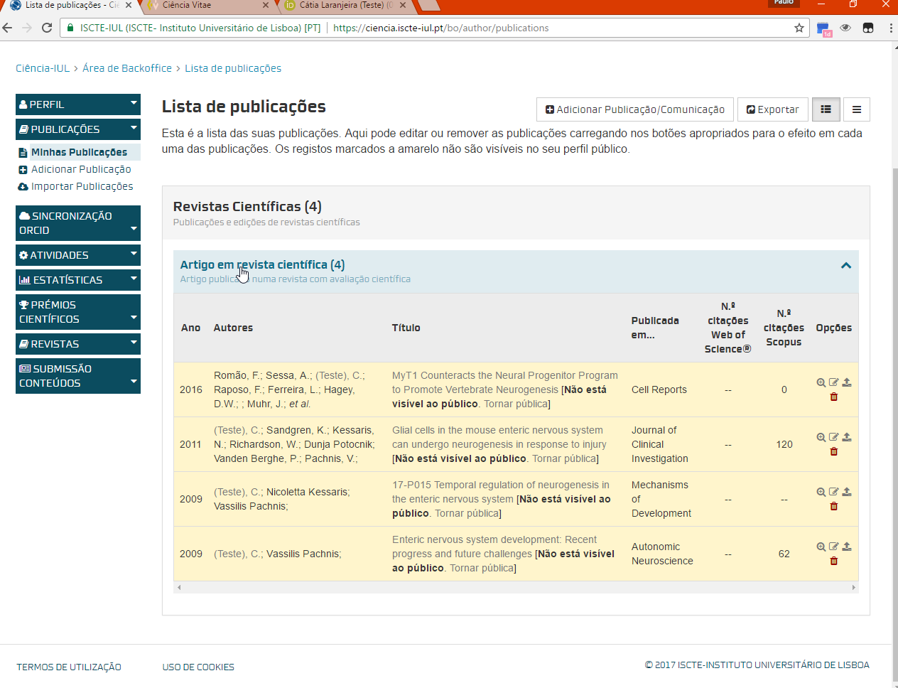

Slide 52
Demonstration
National Institute for Medical Research, UK:
  Update ORCID profile with scientific production registered in international systems (Scopus, or Crossref) and Bibtex
IGC - Gulbenkian:
  Update Ciência Vitae with productions imported from ORCID
  Update ORCID profile with productions stored in RCAAP (DSpace) and then synchronize incrementally with Ciência Vitae
ISCTE-IUL:
  Update Ciência-IUL profile with productions imported from ORCID
  Merge duplicated works in Ciência-IUL

Slide 53
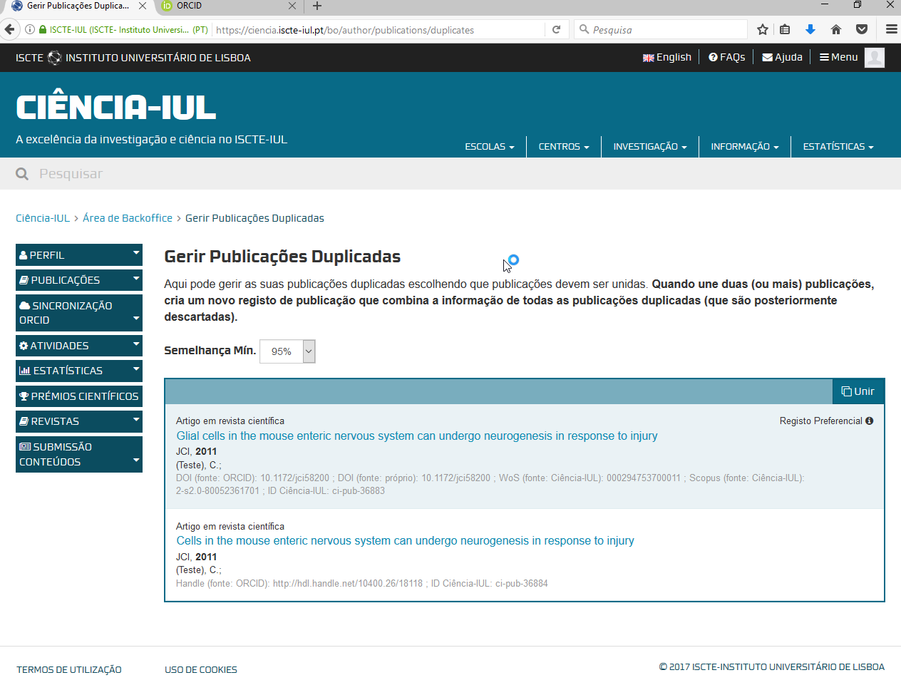

Slide 54
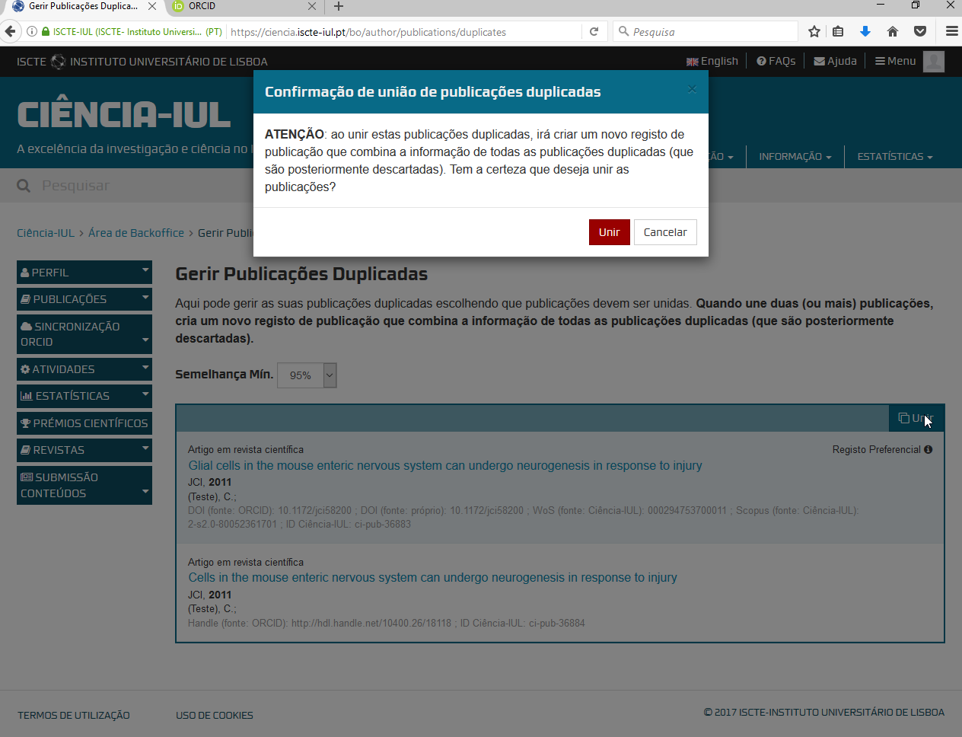

Slide 55
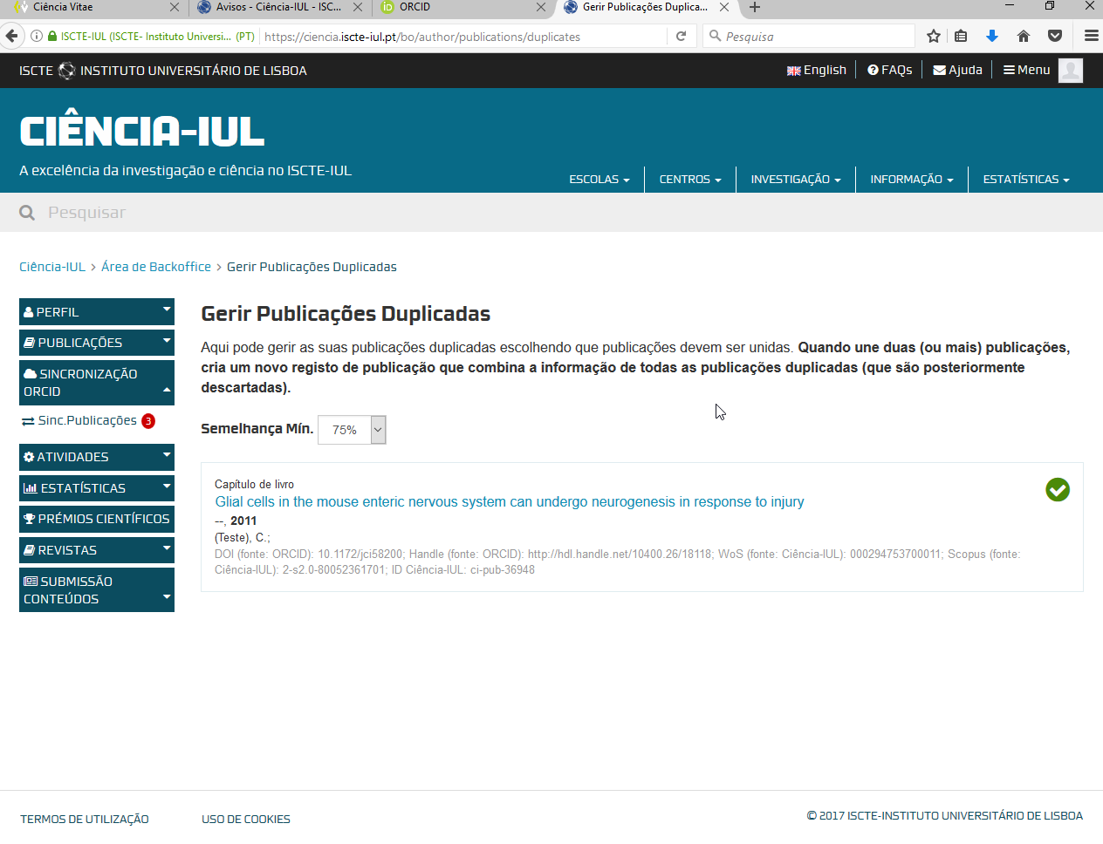

Slide 56
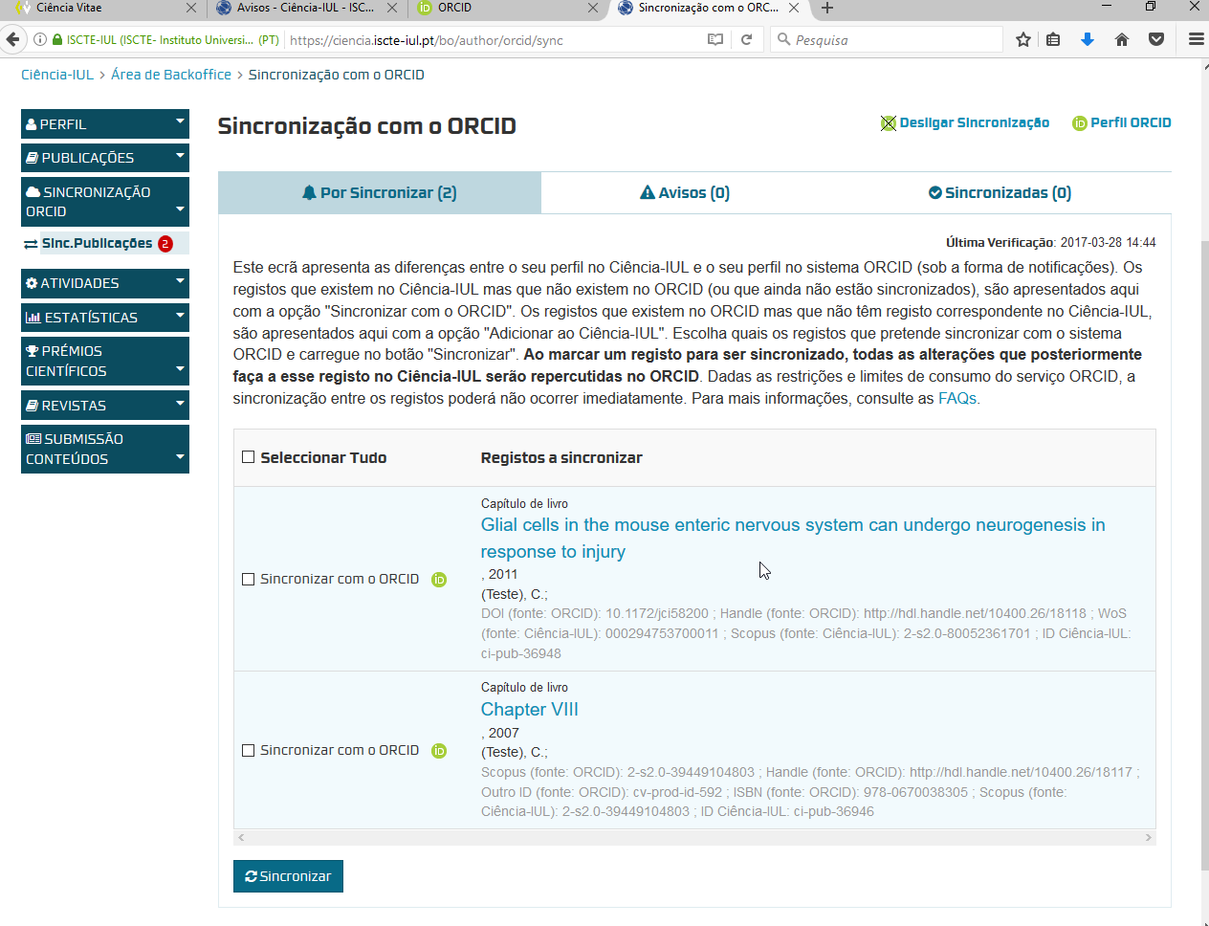

Slide 57
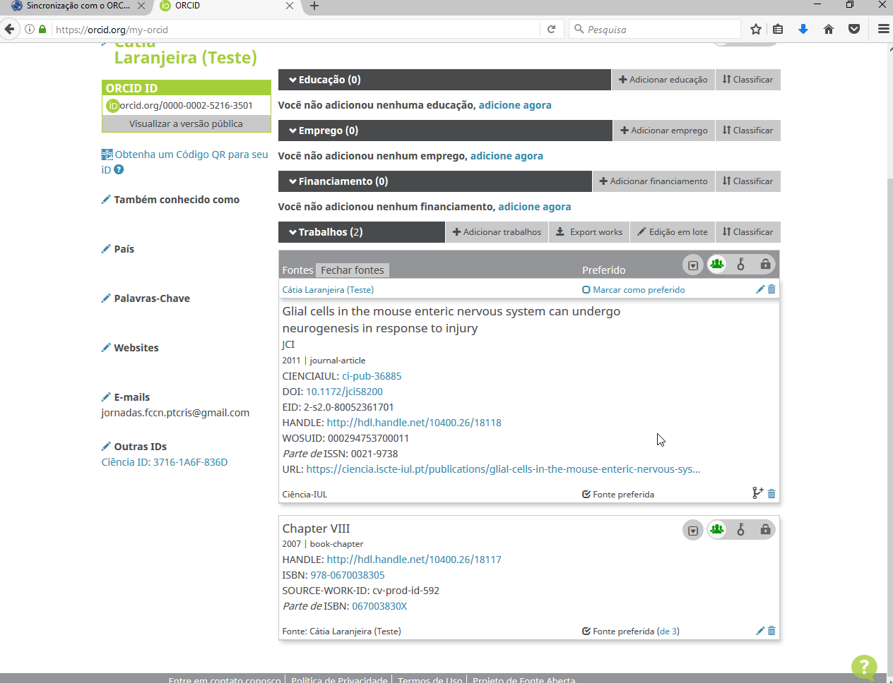

Slide 58
Collaboration is power!
Notes:
58

