Slide 1
Improving Research Indicators using Crowdsourcing
Ivan Nevolin, CEMI RAS
11 May 2015

Slide 2
Sources of information in Russia
Report
Scopus
Web of Science
RSCI

Slide 3
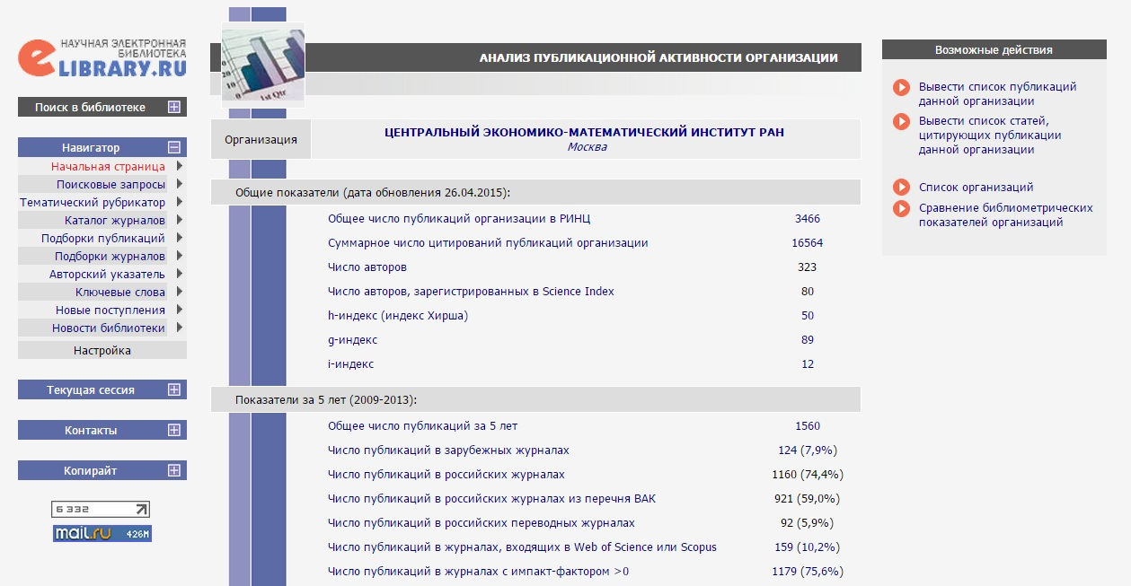
eLIBRARY – Platform for RSCI

Slide 4
Indicators from eLIBRARY
Researcher
  Number of publications
  Number of citations
  Collaboration and self-citation
  h-index
  Types of publications
  Types of citation
  Research fields
Organization
  Number of publications
  Number of citations
  Number of authors
  h-index
  g-index
  i-index
  Types of publications
  Indicators per author or per publication

Slide 5
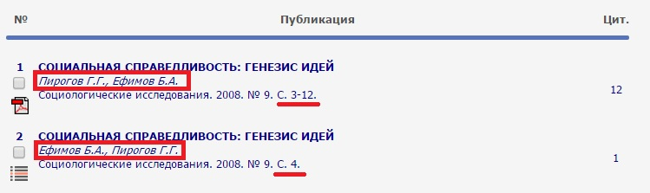
Misprints and Errors
Misprints in title and abstract
Incorrect citation
Different spelling of names and organizations

Slide 6
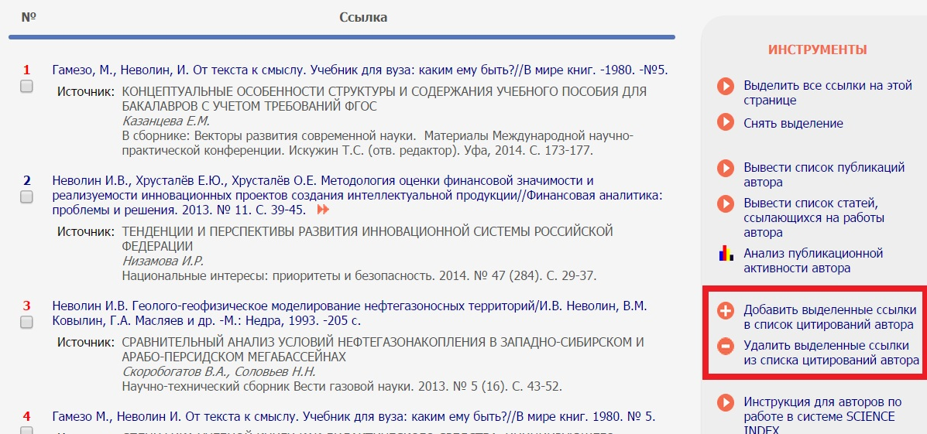
Author manages his Profile

Slide 7
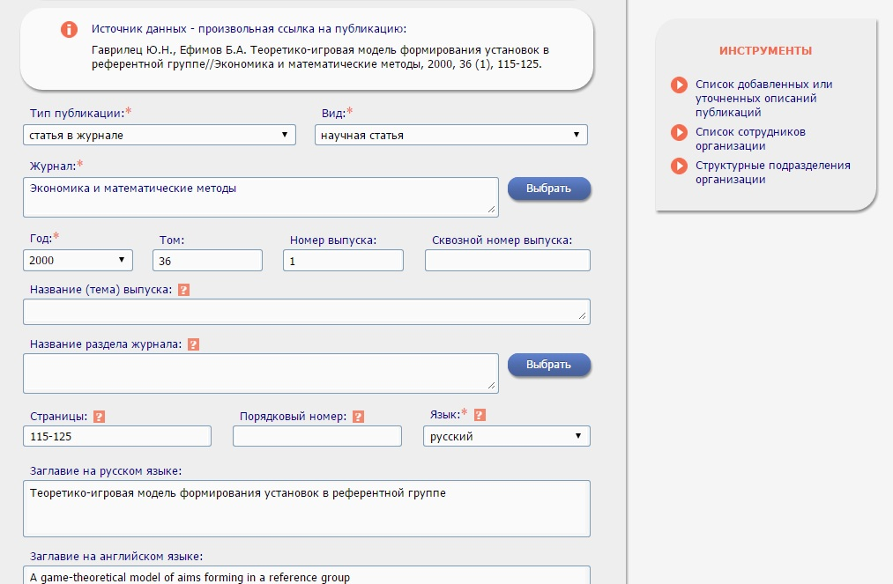
Organization manages its Profile

Slide 8
Manual Review is a Problem
Submit
Moderate
Update
800 organizations and 93 000 authors edit the content

Slide 9
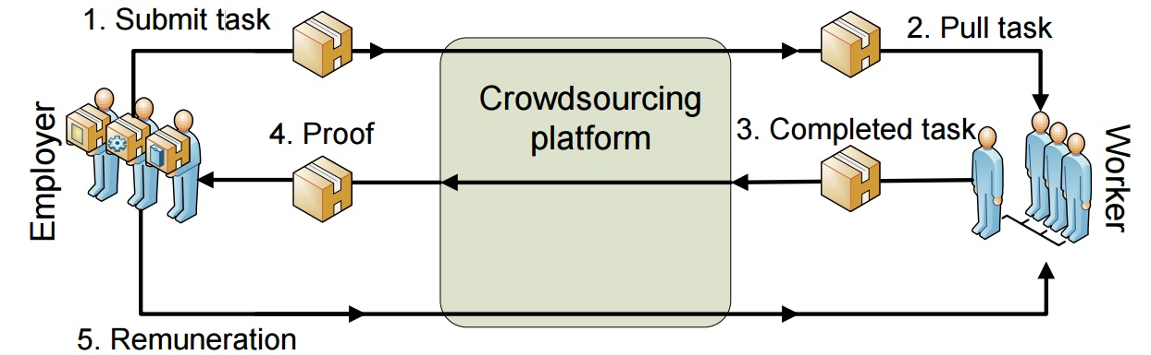
Crowdsourcing as a solution
Involve - select job easy for people, hard for computer.
Make rules for job to be approved.
Image source: Hirth et al (2011)

Slide 10
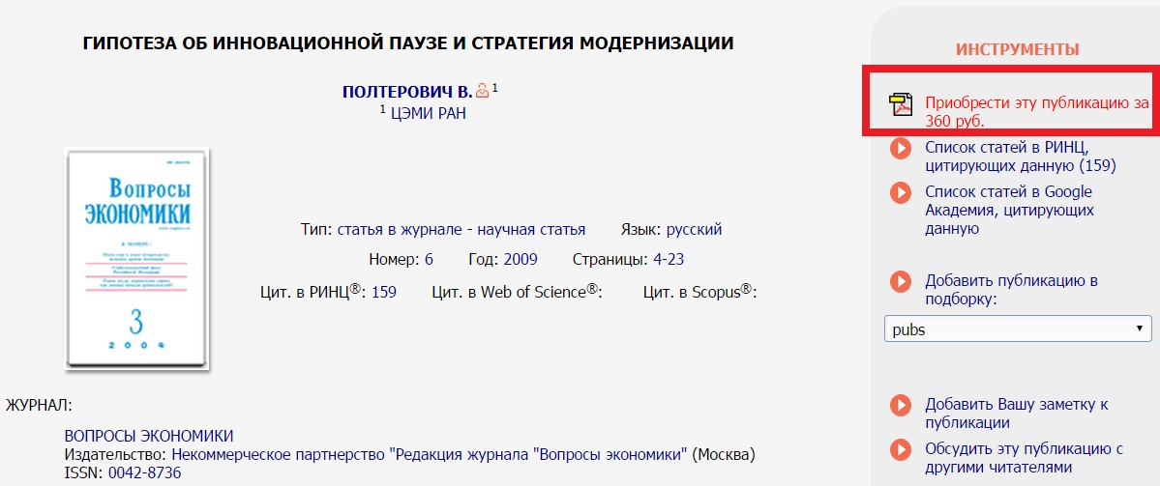
Motivation
Get article
for 6 Euros
Suggest scores for the access to the paid services

Slide 11
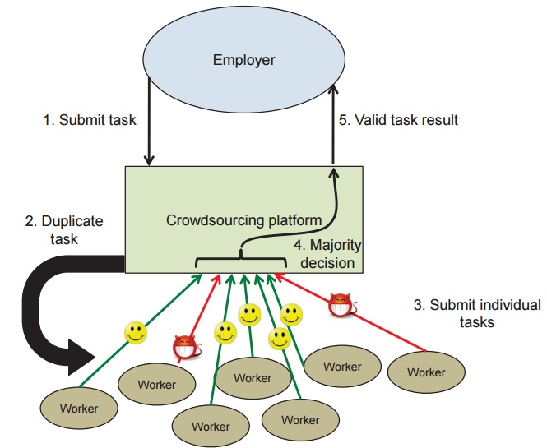
Quality Control
Majority decision
Golden standard
Image source: Hirth et al (2011)

Slide 12
Conclusion
Users support valuation process and culture of e-science
Provide clear rules and manage the activity
All the instruments are at hand
Let’s level-up the users’ experience from our systems!

Slide 13
Ivan Nevolin
Researcher at CEMI RAS
i.nevolin@cemi.rssi.ru

