Slide 1


Support tools for the VQR Italian Research Assessment Exercise: the Sapienza Experience
EuroCris Membership meeting
Bonn May 14, 2013
Camil Demetrescu, Marco Schaerf
Dept. Computer, Control and Management Engineering

Slide 2
Outline
The Italian VQR research assessment exercise
The Sapienza experience
Results
Conclusions
Notes:
2

Slide 3
The VQR National Research Assessment Exercise
In 2012, public Italian universities and research centers have participated in a major research assessment exercise (VQR)
Goal:
inform selective funding allocation
Coverage:
research products published in 2004-2010
Evaluation:
mix of peer-review and bibliometrics
Main challenge for universities & RC:
choosing a selection of the best products to submit
Notes:
3

Slide 4
VQR in a nutshell (1/2)
Each researcher/faculty member submitted up to 3 of her/his best products published in 2004-2010
No duplicate submissions: each product selected by at most one coauthor of the same institution
Evaluation done by 14 panels (GEV)
Different evaluation criteria for each panel
Reference databases:
  Thomson Reuters Web of Science (WoS) [main]
  Elsevier Scopus [additional]
For each submitted product, institutions had to choose:
  a specific evaluation panel to evaluate the product
  a subject category
Notes:
4

Slide 5
VQR in a nutshell (2/2)
Mandatory pieces of information to submit:
  Meta-data (title, authors, etc.)
  Full text (pdf)
  Abstract
  ISSN (journals)
  ISBN (other publications)
Outcome of the evaluation: a numeric score for each submitted product
Total score of the institution = sum of scores of submitted products (will determine part of the funding allocation for next years)
Notes:
5

Slide 6
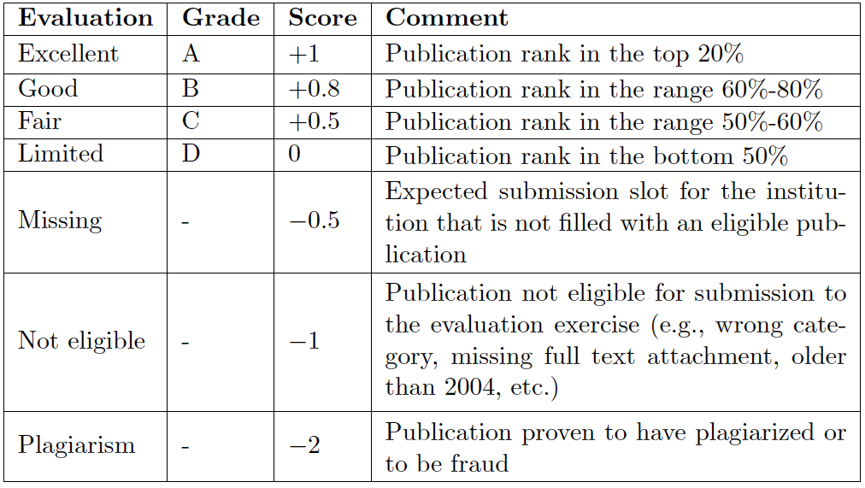
VQR grades and scores

Slide 7
Products eligible for evaluation
Articles in journals with ISSN
Books, book chapters, and conference proceedings papers with ISBN
Critical editions, translations, scientific comments
Deposited patents
Compositions, drawings, design, performance, exhibits and organised exposures, artifacts, prototypes and artworks and their projects, databases and software, and thematic maps (provided that they are supported by accompanying publications)
Notes:
7

Slide 8
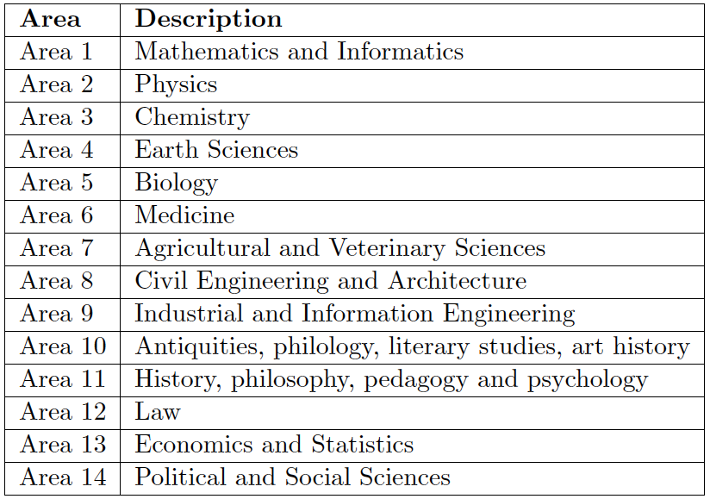
VQR evaluation panels (GEV) for Subject Areas

Slide 9
Evaluation criteria
Hard sciences:
  Subjects defined using WoS/Scopus or explicitely through lists of area-specific journal rankings (A, B, C, D)
  Citations
  Impact factor or Scopus SJR
  Informed peer-review (IR) and Peer review for non-journal articles
Soft sciences: peer review
Countless details:
  Different evaluation for survey articles
  Different thresholds for different panels, etc. etc.
Notes:
9

Slide 10
Example: GEV 03 (Chemistry)
2004-2008
2009-2010
Impact Factor / SJR grade
Impact Factor / SJR grade
A
B
C
D
A
B
C
D
A A A IR
B B B IR
IR C C C
IR D D D
A IR IR IR
A B C D
A B C D
IR IR IR D
A
A
B
B
Citations grade
Citations grade
C
C
D
D
Example: article published in 2005, with:
Citations grade A (top 20%)
Impact Factor grade C (top 50%)
Overall grade: A
Score: +1

Slide 11
Example: GEV 03 (Chemistry)
2004-2008
2009-2010
Impact Factor / SJR grade
Impact Factor / SJR grade
A
B
C
D
A
B
C
D
A A A IR
B B B IR
IR C C C
IR D D D
A IR IR IR
A B C D
A B C D
IR IR IR D
A
A
B
B
Citations grade
Citations grade
C
C
D
D
Example: article published in 2010, with:
Citations grade A (top 20%)
Impact Factor grade C (top 50%)
Informed peer-review

Slide 12
VQR Timeline
November 7, 2011:
call for participation published
February 29, 2012:
(incomplete) evaluation criteria published
June 15, 2012:
product submission deadline for institutions
Selection process for institutions:
3 months (+ 2 weeks last-minute extension)
Notes:
12

Slide 13
Outline
The Italian VQR research assessment exercise
The Sapienza experience
Results
Conclusions
Notes:
13

Slide 14
Sapienza in a nutshell
One of the largest universities in Europe
129,500 students in 2010, 1st in Europe, 43rd in the world as number of students
One of the oldest in Italy, founded in the 14th century
Over 4,000 researchers from 63 departments
21 museums and more than 50 libraries
Research catalog including 250,000 publications
~75,000 considered for the VQR
Notes:
14

Slide 15
Selection approach
Top-down: central coordination for all deparments based on a sofware system especially designed for the VQR
Goal: use optimization algorithms to maximize the expected total score of Sapienza
Same product may have different scores depending on:
  Panel to which the product is submitted
  Subject category in which the product is classified
Our software simulated all possible panel/subject category combinations, computing the expected score
Human validation selected “reasonable” combinations
Notes:
15

Slide 16
Example: journal article in physics
Expect. Chosen Chosen
grade panel Relev. subject category Database
C 02 3 METEOROLOGY & ATMOSPHERIC SCIENCES WoS
B 02 3 ATMOSPHERIC SCIENCE Scopus
C 03 0 METEOROLOGY & ATMOSPHERIC SCIENCES WoS
B 03 0 ATMOSPHERIC SCIENCE Scopus
C 04 0 METEOROLOGY & ATMOSPHERIC SCIENCES WoS
B 04 0 ATMOSPHERIC SCIENCE Scopus
C 07 0 METEOROLOGY & ATMOSPHERIC SCIENCES WoS
A 07 0 ATMOSPHERIC SCIENCE WoS
C 08 0 METEOROLOGY & ATMOSPHERIC SCIENCES ISI
A 08 0 ATMOSPHERIC SCIENCE WoS
C 11 0 METEOROLOGY & ATMOSPHERIC SCIENCES ISI
B 11 0 ATMOSPHERIC SCIENCE WoS
C 09 0 METEOROLOGY & ATMOSPHERIC SCIENCES ISI
A 09 0 ATMOSPHERIC SCIENCE WoS
“Reasonable” choice
Physics
Maximization choice
Agricultural and Veterinary Sciences

Slide 17
Surviving “big” data…
Problem: manually choosing the best reasonable panel/subject category combination for all eligible products would have been overwhelming!
Our solution (for hard sciences):
Initial automatic choice of tentative panel/subject category to each journal article based on a maximum “relevance” metric we designed
=> yields initial “tentative” grade for each article
Automatic selection of the best 3 and 6 products for each author based on the tentative grades
Manual validation of selected products only
Optimization algorithm re-executed every night
Notes:
17

Slide 18
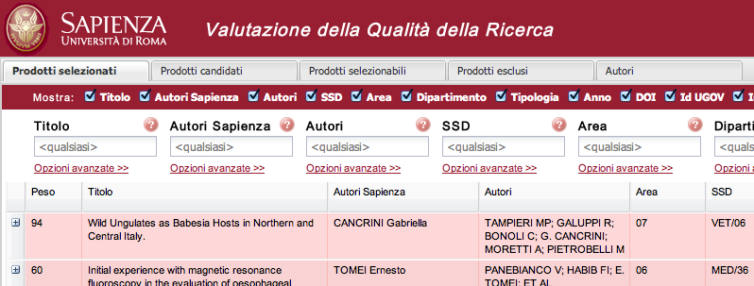
VQRselect Web interface
Faculty members and products assigned to them
Best 3 products per author
Best 6 products per author
All eligible products
Excluded products

Slide 19
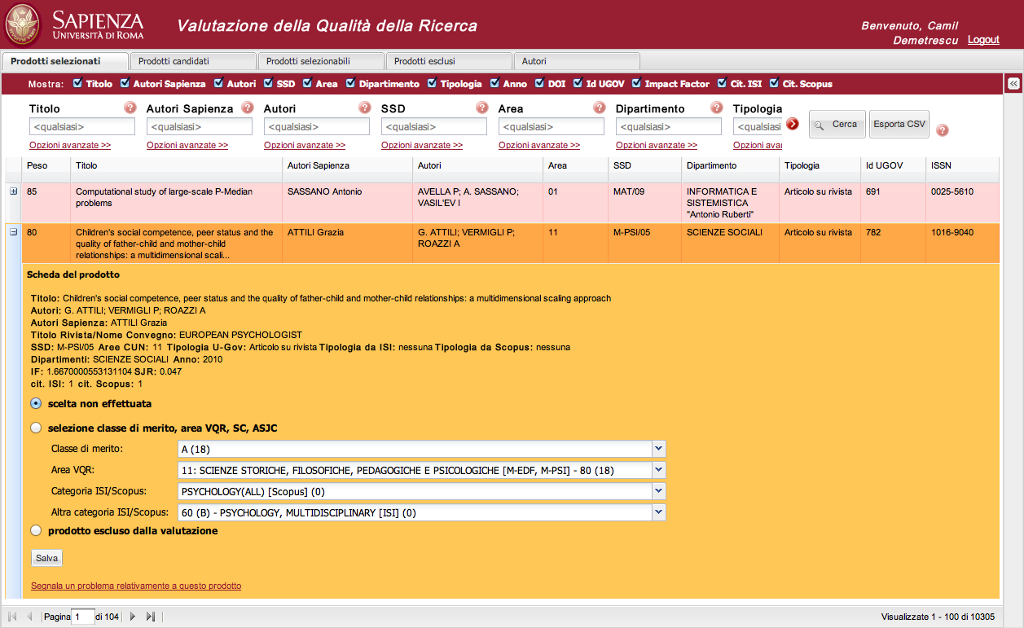
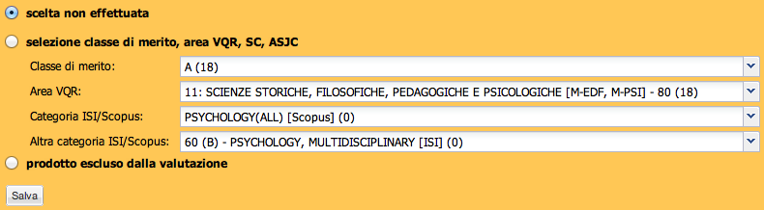
Manual validation of panel/subject category combination

Slide 20
Optimization algorithm
Author 1
Product 1
+1
Slot 1
Product 2
+0.8
Slot 2
Product 3
0
Slot 3
Product 4
+0.8
Author 2
Product 5
0
Slot 1
Product 6
+0.5
Slot 2
Product 7
+1
Notes:
20

Slide 21
Optimization algorithm
Author 1
Product 1
+1
Slot 1
Product 2
+0.8
Slot 2
Product 3
0
Slot 3
Product 4
+0.8
Author 2
Product 5
0
Slot 1
Product 6
+0.5
Slot 2
Product 7
+1
Notes:
21

Slide 22
Optimization algorithm
Author 1
Product 1
+1
Slot 1
Product 2
+0.8
Slot 2
Product 3
0
Slot 3
Product 4
+0.8
Author 2
Product 5
0
Slot 1
Product 6
+0.5
Slot 2
Product 7
+1
Notes:
22

Slide 23
Critical aspects (1/2)
Extremely tight time frame for selecting the research products
Large-scale coordination: 63 departments
(Incomplete) evaluation criteria known 3.5 months until the submission deadline
Different evaluation criteria for different panels
Critical data not publicly available (e.g., thresholds for determining if a product is in the top 20% ecc.)
Strange/wrong choices
  GEV09 with different criteria, GEV01 Applied Math problem ..
Notes:
23

Slide 24
Critical aspects (2/2)
Extensive data quality problems in our research catalog:
  Duplicates
  Wrong classification (e.g., proceedings as Article)
  Missing or wrong fields
  Missing coauthors
  Missing or wrong codes (DOI, PUBMED, ISBN, ….)
Data quality problems also in WoS and Scopus (e.g., incorrect subject categories)
Notes:
24

Slide 25
Sapienza timeline (3.5 months)
Phase 0: March 1 – April 11 [ 42 days ]
  What: VQRselect software development
  Who: Sapienza publications group + Exaltech Srl
Phase 1: April 12 – May 6 [ 25 days]
  What: product selection
  Who: department heads
Phase 2: May 7 – June 22 [ 16 days ]
  What: additional info, upload of PDFs
  Who: faculty members, department heads
Phase 3/4: May 23 – June 15 [ 24 days ]
  What: linking with WoS/Scopus, error corrections
  Who: VQR task force
Notes:
25

Slide 26
Timeline of product selection
Phase 1
-166
Phase 2
Phase 3
-19
Phase 4
-42
-49
Notes:
26

Slide 27
Outline
The Italian VQR research assessment exercise
The Sapienza experience
Results
Conclusions
Notes:
27

Slide 28
Selected products over 92% of expected
Notes:
28

Slide 29
Selected products: soft vs. hard sciences
Notes:
29

Slide 30
% selected products by type

Slide 31
Estimated scores for submitted journal articles (hard sciences)
Notes:
31

Slide 32
Conclusions
Sheer size of Sapienza, large number of products, data quality issues, incomplete evaluation criteria, and short time frame made the process extremely critical
Top-down approach, using IT methods
Optimization algorithms used to maximize the expected score of Sapienza
IT insfrastructure was crucial for the success of the process
Role of IT for research assessment will increase in the future
Notes:
32

Slide 33
Future Work
Transform the system into a day-by-day research assesment system
Modify our datamodel (the final data model was a mess, from 4 to 101 tables) to make it CERIF-compliant (working on it)
Allow for data-quality verification and more complex analysis
Better integration with other systems

Slide 34
Thanks
Pagina 34
Notes:
34

