Slide 1
OpenAIRE Guidelines for CRIS Managers 1.1
Jan Dvořák
euroCRIS
Czech Technical University
Charles University

Slide 2
OpenAIRE CRIS Metadata Interchange
CRIS
  Institutional: publications & other outputs, equipment
  Funder: funding programmes, calls, projects
  National/Regional: all of the above pre-aggregated
The OpenAIRE Aggregator

Slide 3
Original Guidelines
Houssos, N., Jörg, B., Dvořák, J. (2015):
OpenAIRE Guidelines for CRIS Managers 1.0.
DOI: http://doi.org/10.5281/zenodo.17065
Seen as a step in the right direction
More steps needed

Slide 4
Metadata interchange format wishlist
Less fragmented
  i.e., offer de-normalized views of the information
More suitable for APIs
  Incl. OAI-PMH
Less cryptic
  UUIDs for semantic terms

Slide 5
<Publication xmlns="https://www.openaire.eu/cerif-profile/1.1/" id="852734">
<Type xmlns="https://www.openaire.eu/cerif-profile/vocab/COAR_Publication_Types">http://purl.org/coar/resource_type/c_6501<!-- journal article --></Type>
<Title xml:lang="en">Strong selection against hybrids maintains a narrow contact zone between morphologically cryptic lineages in a rainforest lizard</Title>
<PublishedIn>
<Publication id="893204”>
<Title xml:lang="en">Evolution</Title>
<Type scheme="https://www.openaire.eu/cerif-profile/vocab/COAR_Publication_Types">http://purl.org/coar/resource_type/c_0640<!-- journal --></Type>
<Identifier type="https://www.openaire.eu/cerif-profile/vocab/IdentifierTypes#EISSN">1558-5646</Identifier>
<Publishers>
<!-- [ … ] -->
</Publishers>
</Publication>
</PublishedIn>
<Volume>66</Volume>
<Issue>5</Issue>
<StartPage>1474</StartPage>
<EndPage>1489</EndPage>
<Identifier type="https://www.openaire.eu/cerif-profile/vocab/IdentifierTypes#DOI">10.1111/J.1558-5646.2011.01539.X</Identifier>
<!-- [ … ] -->
</Publication>

Slide 6
<Publication xmlns="https://www.openaire.eu/cerif-profile/1.1/" id="852734">
<!-- [ … ] -->
<Authors>
<Author>
<Person>
<PersonName>
<FamilyNames>Singhal</FamilyNames>
<FirstNames>Sonal</FirstNames>
</PersonName>
</Person>
<Affiliation>
<OrgUnit id="301248">
<Name xml:lang="en">Museum of Vertebrate Zoology</Name>
<PartOf>
<OrgUnit id="329384">
<Name xml:lang="en">University of California, Berkeley</Name>
</OrgUnit>
</PartOf>
</OrgUnit>
</Affiliation> <!-- [ … ] -->
</Author> <!-- [ … ] -->
</Authors>
<!-- [ … ] -->
</Publication>

Slide 7
<Publication xmlns="https://www.openaire.eu/cerif-profile/1.1/" id="852734">
<!-- [ … ] -->
<Keyword xml:lang="en">hybrid zones</Keyword>
<Keyword xml:lang="en">phylogeography</Keyword>
<Abstract xml:lang="en">Phenotypically cryptic lineages comprise an important yet understudied part of biodiversity; <!-- […] --></Abstract>
<References>
<Product id="729487">
<Type xmlns="https://www.openaire.eu/cerif-profile/vocab/COAR_Product_Types">http://purl.org/coar/resource_type/c_ddb1<!-- dataset --></Type>
<Name xml:lang="en">Data from: Strong selection against hybrids maintains a narrow contact zone between morphologically cryptic lineages in a rainforest lizard</Name>
<VersionInfo xml:lang="en">1</VersionInfo>
<Identifier type="https://www.openaire.eu/cerif-profile/vocab/IdentifierTypes#DOI">10.5061/DRYAD.4GH6HF5G</Identifier>
<!-- […] -->
</Product>
</References>
</Publication>

Slide 8
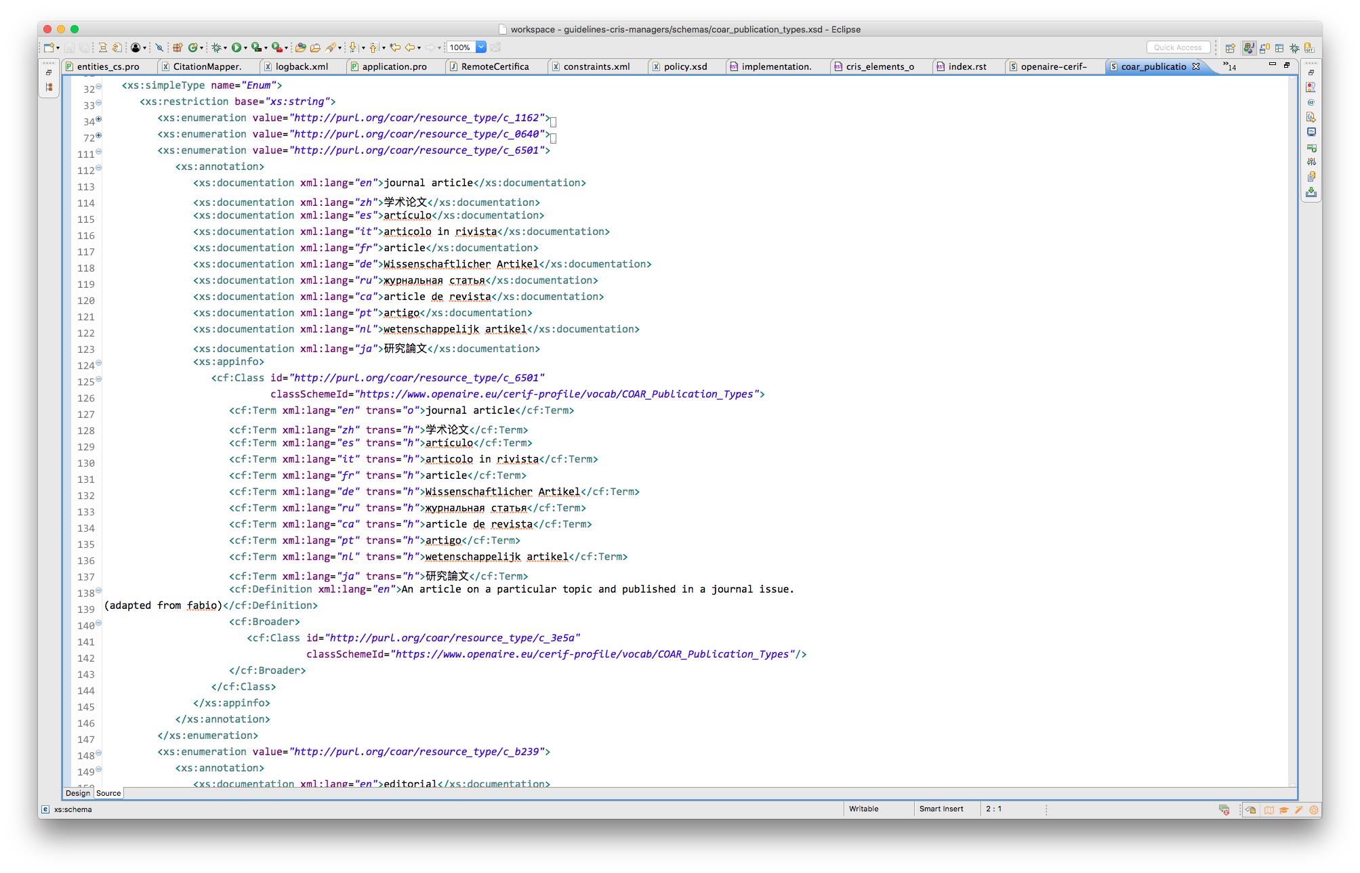
XML Schema embeds the classifications

Slide 9
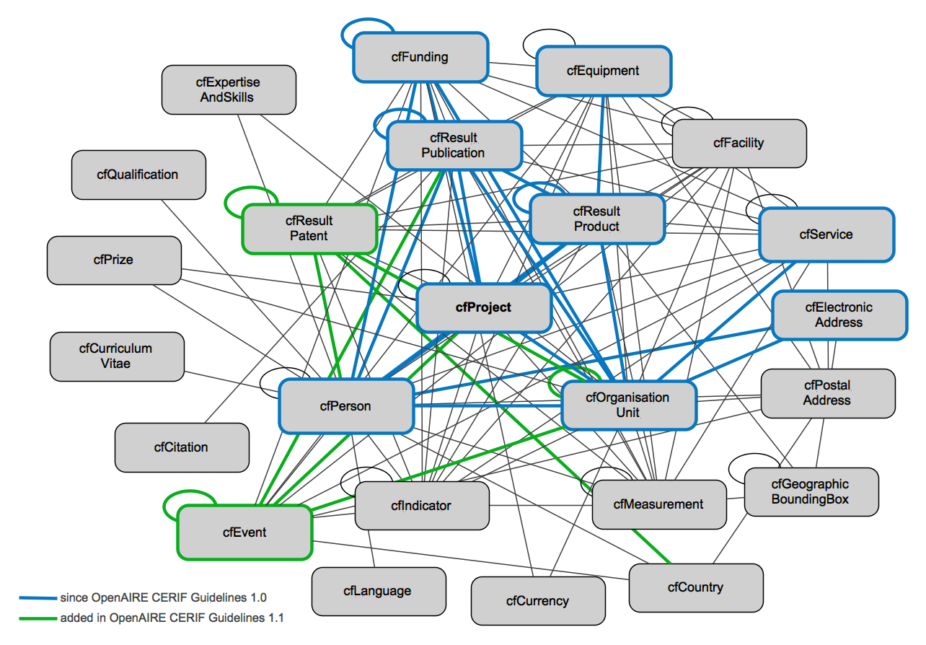
Expand the Scope

Slide 10
Wider Context
OpenAIRE Guidelines for CRIS Managers 1.1:
Build on top of the NL P-O-P-F project
  (excl. project financial data)
Can be a base for Project reporting profiles
  Institution ➔ Funder

