Slide 1

SUPPORT ACTIVITIES FOR OPEN SCIENCE IN SCSTI
EUROCris Bratislava Strategic Membership Meeting
November 21st 2017
Silvia Horáková

Slide 2
Agenda
Open Science
Action Plan
Working group
Website
Open Access course
EU activities - OpenAIRE
Data survey
New organisational structure of SCSTI
NISPEZ IV – OA activities

Slide 3

Umbrella term

Slide 4
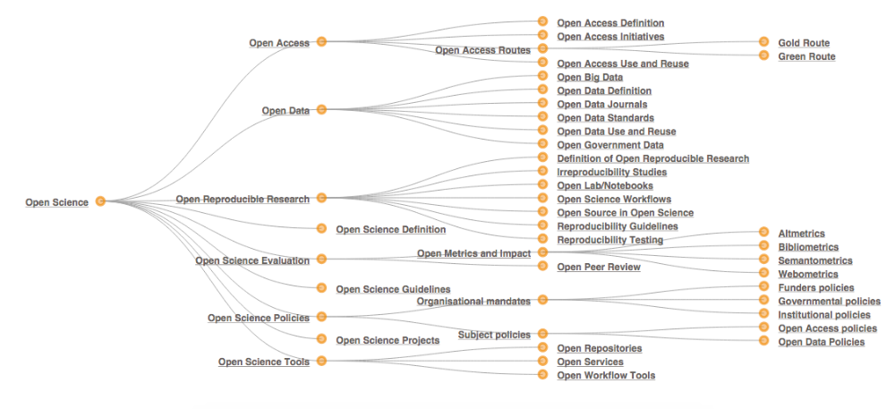

Slide 5
Agenda
Open Science
Action Plan
Working group
Website
Open Access course
EU activities - OpenAIRE
Data survey
New organisational structure of SCSTI
NISPEZ IV – OA activities

Slide 6

PART 2: Open Education and Open Science
Repository MinEdu SK
University textbooks, journals under CC BY
Rules for open publishing
OA Office

Slide 7
Agenda
Open Science
Action Plan
Working group
Website
Open Access course
EU activities - OpenAIRE
Data survey
New organisational structure of SCSTI
NISPEZ IV – OA activities

Slide 8

SINCE 2016
Has 27 members:
Research and academic libraries
Ministry of Interior SK
Ministry of Education SK
Researchers from SAS

Slide 9
Agenda
Open Science
Action Plan
Working group
Website
Open Access course
EU activities - OpenAIRE
Data survey
New organisational structure of SCSTI
NISPEZ IV – OA activities

Slide 10
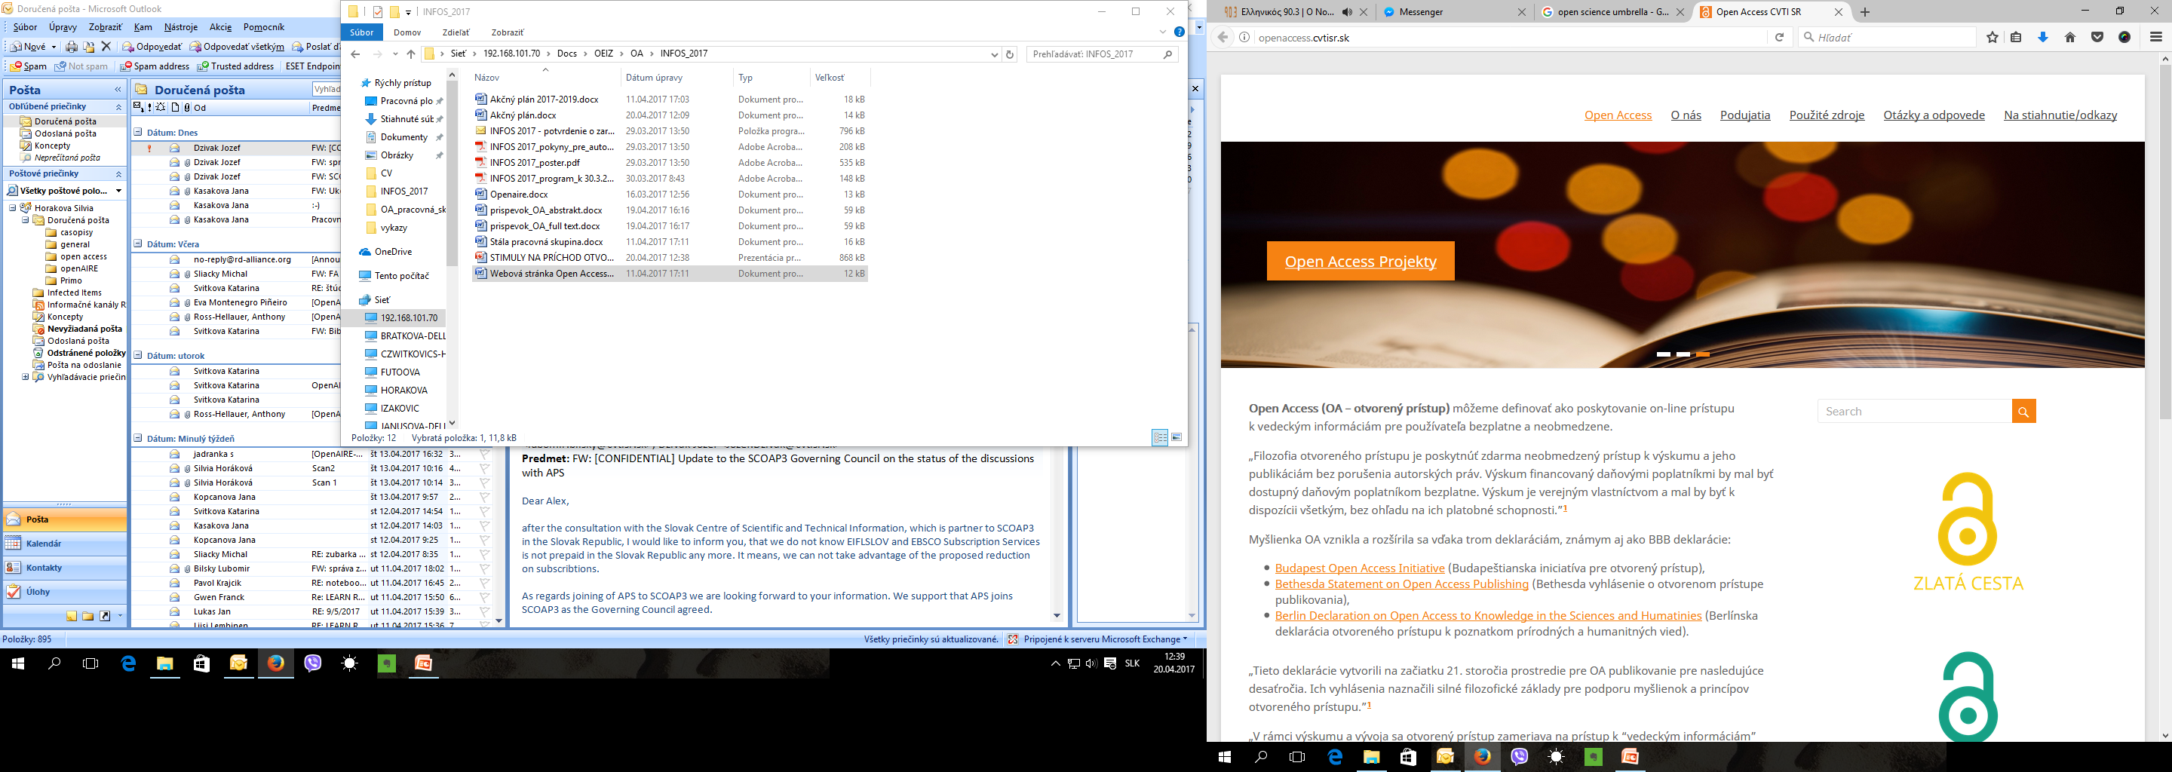

Slide 11
Agenda
Open Science
Action Plan
Working group
Website
Open Access course
EU activities - OpenAIRE
Data survey
New organisational structure of SCSTI
NISPEZ IV – OA activities

Slide 12

Educational programme accredited by MinEdu SK contains 4 modules:
Open Access basics, Open Access infrastructure, Optimalisation of Open Access sources, Interoperability and aquisition of sources
  Target group:
  librarian, information specialist, researcher, publisher...
Based on UNESCO Open Access Curriculum

Slide 13
Agenda
Open Science
Action Plan
Working group
Website
Open Access course
EU activities - OpenAIRE
Data survey
New organisational structure of SCSTI
NISPEZ IV – OA activities

Slide 14

NOAD Slovakia
(since 2015)
OPENAIRE 2020:
Reuse of research publications and data
OPENAIRE CONNECT + ADVANCE
Technological and social solutions
Open Science as a Service

Slide 15
Agenda
Open Science
Action Plan
Working group
Website
Open Access course
EU activities - OpenAIRE
Data survey
New organisational structure of SCSTI
NISPEZ IV – OA activities

Slide 16

Find out state of research data, publications, grey literature, usage of ICT and management of data in research institutions in Slovakia.

Slide 17
Agenda
Open Science
Action Plan
Working group
Website
Open Access course
EU activities - OpenAIRE
Data survey
New organisational structure of SCSTI
NISPEZ IV – OA activities

Slide 18
SCIENTIFIC LIBRARY
SECTION OF AQUSITIONS
SECTION OF LIBRARY AND INFORMATION SERVICES
SECTION OF OPEN SCIENCE AND RESEARCH SUPPORT
Department of print documents
Department of electronic publications and data
Department of digitalisation, repositories and archivation
Department of management of scientific information
Department of loans and protection
Department of electronic services
SKeLIB
Open Access Office
Department of promotions and education
Open Science publishing

Slide 19
Agenda
Open Science
Action Plan
Working group
Website
Open Access course
EU activities - OpenAIRE
Data survey
New organisational structure of SCSTI
NISPEZ IV – OA activities

Slide 20

Discovery system PRIMO
Research data management– connected with Scidap
SCIDAP – repository
Rosetta – digital archive
Electronic information sources
ERMs
MediaInfo – software for digital libraries
Analytical modul for science evaluation
OA publishing platform

Slide 21
Thank you for your attention

