Slide 1
CERIF Tutorial
cfFunding
cfFederated Identifier
cfEquipment
cfExpertise
AndSkills
cfFacility
cfQualification
cfResult
Publication
cfService
cfPrize
cfResultPatent
cfResultProduct
cfElectronicAddress
cfProject
cfPostalAddress
cfCurriculum
Vitae
cfPerson
cfOrganisation
Unit
Jan Dvořák
September 17th, 2018
CERIF workshop
Uni Bern, Switzerland
cfGeographic
BoundingBox
cfCitation
cfIndicator
cfMeasurement
cfEvent
cfCountry
cfLanguage
cfCurrency

Slide 2
Jan Dvořák
jan.dvorak@ff.cuni.cz , https://orcid.org/0000-0001-8985-152X
euroCRIS
CERIF TG Leader since 2013
CRIS 2012 (Prague, June 2012), Organization Committee Chair
Membership meeting Autumn 2010, Organizer
Charles University in Prague, Faculty of Arts, Institute of Information Studies & Librarianship
Researcher & Lecturer
Czech Technical University, Computing and Information Centre
IS Analyst: EZOP+V3S – institutional CRIS
InfoScience Praha
Research, Development & Innovation Information System
(the national CRIS for [CZ] – www.isvav.cz – 2004-2016)
___
This deck of slides is based on the CERIF Tutorial by Brigitte Jörg
CERIF TG Leader 2004-2012

Slide 3
What is Research Information?
The process of research
  Research projects
  Funding
  Research infrastructures
The research actors
  Researchers
  Institutions
  Funders
  Publishers
  Facility operators
  Associations
Relationships
Research results
Outputs (Publications, Research Datasets, Patents, …)
Outcomes, Impacts

Slide 4

Who needs Research Information?
visibility, finding collaborations,
competitors, CV generation
Researchers
Decision Makers
performance, strategic decisions,
priorities, comparisons
Funding Organisations
Project Managers
distribution of programs
evaluation of results, finding reviewers
overview of ongoing activities
Research Information
Libraries
Research Organisations
acquisition, dissemination
integration and interoperability
strategic management
Publishers
finding reviewers, editors
Educators
Intermediaries / Brokers
integration of relevant
findings into lectures
and training
finding research results of
potential market or innovative value
General Public
Enterprises
Media
finding information
for participation in projects,
partnerships, usage of results
distribution and
communication
information and education,
interest

Slide 5
Common European Research Information Format
    CERIF is an EU Recommendation
    to Member States
    The European Commission (EC)
    has authorised euroCRIS to maintain
    and develop CERIF and its usage
    http://cordis.europa.eu/cerif/

Slide 6

Model Levels
Conceptual Level (Specification)
Concepts relevant for the research domain
and their relationships
Logical Level (ER Model)
Entities and their relationships
Semantic Layer (Declared Semantics)
A formalized controlled vocabulary describing a
general contextual semantics of the research domain
inline with the conceptual, logical and machine description
Funding
Organisation
Person
Organisation
Person
Project
Skills
Project
Service
CV
Publication
Patent
Equipment
Classification
Product
Classification
(
(
)
Semantics
)
Event
Semantics

Slide 7
Common European Research Information Format
cfFederated Identifier
cfFunding
cfEquipment
cfExpertise
AndSkills
cfFacility
cfResult
Publication
cfService
cfQualification
cfPrize
cfResultPatent
cfResultProduct
cfElectronicAddress
cfProject
cfPostalAddress
cfCurriculum
Vitae
cfPerson
cfOrganisation
Unit
cfGeographic
BoundingBox
cfCitation
cfIndicator
cfMeasurement
cfEvent
cfCountry
cfLanguage
cfCurrency

Slide 8
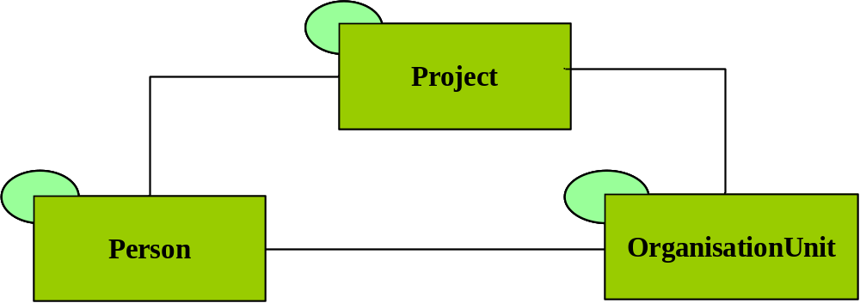
CERIF Base Entities

Slide 9
CERIF Base Entities
Project
ID
URI
Acronym
StartDate
EndDate
Title
Abstract
Keywords
Person
ID
URI
Gender
FirstNames
OtherNames
FamilyNames
NameVariants
ResearchInterest
Keywords
OrganisationUnit
ID
URI
Acronym
Name
HeadCount
CurrencyCode
Turnover
ResearchActivity
Keywords

Slide 10
CERIF Base Entities
cfProject
cfID
cfURI
cfAcronym
cfStartDate
cfEndDate
cfTitle
cfAbstract
cfKeywords
cfFamilyNames
cfOrganisationUnit
cfID
cfURI
cfAcronym
cfHeadCount
cfCurrencyCode
cfTurnover
cfPerson
cfID
cfURI
cfGender
cfBirthdate
cfName
cfFirstNames
cfDescription
cfDescription
cfOtherNames
cfKeywords
cfKeywords

Slide 11
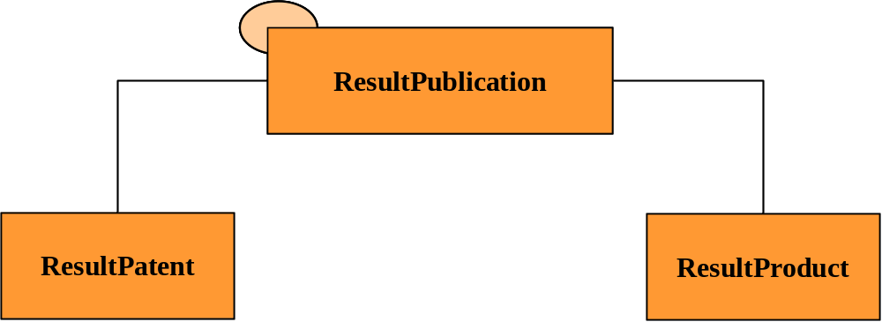
CERIF Result Entities

Slide 12
CERIF Result Entities
ResultPublication
ID
URI
Title
Subtitle
Abstract
Bibl. Note
PublicationDate
TotalPages
StartPage
EndPage
Keywords
ResultPatent
ID
URI
PatentNumber
Title
CountryCode
RegistrationDate
ApprovalDate
Description
Keywords
ResultProduct
ID
URI

Slide 13
CERIF Result Entities
cfResultPublication
cfID
cfURI
cfNumber
cfPublicationDate
cfStartPage
cfEndPage
cfTotalPages
cfEdition
cfSeries
cfIssue
cfVolume
cfISBN
cfISSN
cfTitle
cfBibliographic Note
cfSubtitle
cfVersionInfo
cfAbstract
cfAbbreviation
cfKeywords
cfName
cfName
cfResultPatent
cfID
cfURI
cfPatentNumber
cfCountryCode
cfRegistrationDate
cfApprovalDate
cfDescription
cfResultProduct
cfID
cfURI
cfAbstract
cfKeywords
cfKeywords
cfVersionInfo
cfVersionInfo

Slide 14
CERIF Infrastructure Entities
Facility
Equipment
Service

Slide 15
CERIF Infrastructure Entities
Facility
Equipment
Service
Facility
ID
Acronym
URI
Title
Description
Keywords
Equipment
ID
Acronym
URI
Title
Description
Keywords
Service
ID
Acronym
URI
Title
Description
Keywords

Slide 16
CERIF Infrastructure Entities
Facility
Equipment
Service
cfName
cfFacility
cfID
cfURI
cfAcronym
cfDescription
cfKeywords
cfEquipment
cfID
cfURI
cfAcronym
cfName
cfDescription
cfKeywords
cfName
cfService
cfID
cfURI
cfAcronym
cfDescription
cfKeywords

Slide 17
CERIF General Pattern
A typical CERIF entity has:
Identifier (internal)
Attributes
  the basic ones
  the multi-lingual ones
External Identifiers
Classifications
  Type
  Status
  Subject area
Links
  to other entities
  recursive

Slide 18
CERIF 1.6
cfFederated Identifier
cfFunding
cfEquipment
cfExpertise
AndSkills
cfFacility
cfResult
Publication
cfService
cfQualification
cfPrize
cfResultPatent
cfResultProduct
cfElectronicAddress
cfProject
cfPostalAddress
cfCurriculum
Vitae
cfPerson
cfOrganisation
Unit
cfGeographic
BoundingBox
cfCitation
cfIndicator
cfMeasurement
cfEvent
cfCountry
cfLanguage
cfCurrency

Slide 19
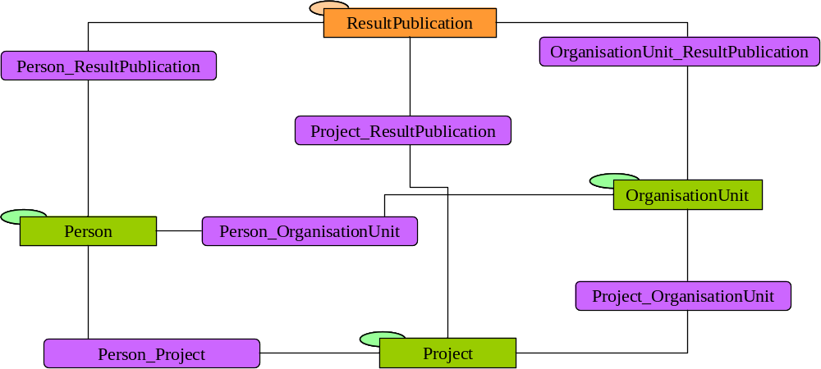
Some CERIF Link Entities
ExpertiseAndSkills
Funding
Equipment
Facility
Qualification
Service
Prize
ElectronicAddresse
CV
PostalAddress
Citation
Metrics
Indicator
Measurement
Geographic
Bounding Box
Event
Language
Currency
Country
role=author‘s affiliation
role=author
role=deliverable
role=research assistant
role=coordinator
role=principal investigator

Slide 20
Result_Publication Instance Diagram
(slide by Keith Jeffery)
OrgUnit M
part of
member
Person A
OrgUnit O
employee
member
OrgUnit N
project leader
part of
partner
Project P
owns IPR
author
deliverable
Publication X
has
associated
Measurement Z

Slide 21
Generic Linking Entity Structure
cfStartDate cfEndDate
cfFraction
Base object 1
(FK)
Base object 2
(FK)
Fraction
(optional)
Time range
of validity
role : cfClassification
(FK)

Slide 22
Recording Change in CERIF
Example: The Principal Investigator of project P changes: X is replaced by Y effective date D.
Before:
Validity range
Role
P
-∞ .. +∞
Principal Investigator
: cfClassification
X
After:
-∞ .. D
Principal Investigator
: cfClassification
X
P
D .. +∞
Principal Investigator
: cfClassification
Y

Slide 23
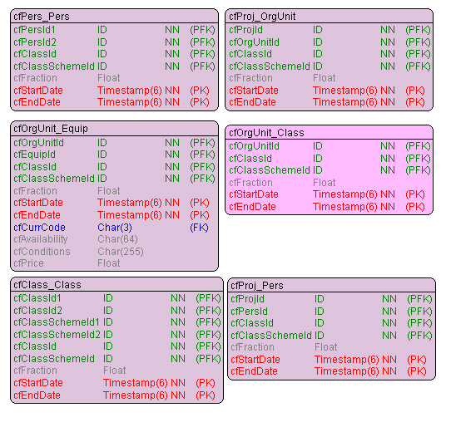
Some CERIF Link Entities
Binary classifications:
Role
Unary classification:
Type
Status
Subject area

Slide 24
CERIF 1.6
cfFederated Identifier
cfFunding
cfEquipment
cfExpertise
AndSkills
cfFacility
cfResult
Publication
cfService
cfQualification
cfPrize
cfResultPatent
cfResultProduct
cfElectronicAddress
cfProject
cfPostalAddress
cfCurriculum
Vitae
cfPerson
cfOrganisation
Unit
cfGeographic
BoundingBox
cfCitation
cfIndicator
cfMeasurement
cfEvent
cfCountry
cfLanguage
cfCurrency

Slide 25
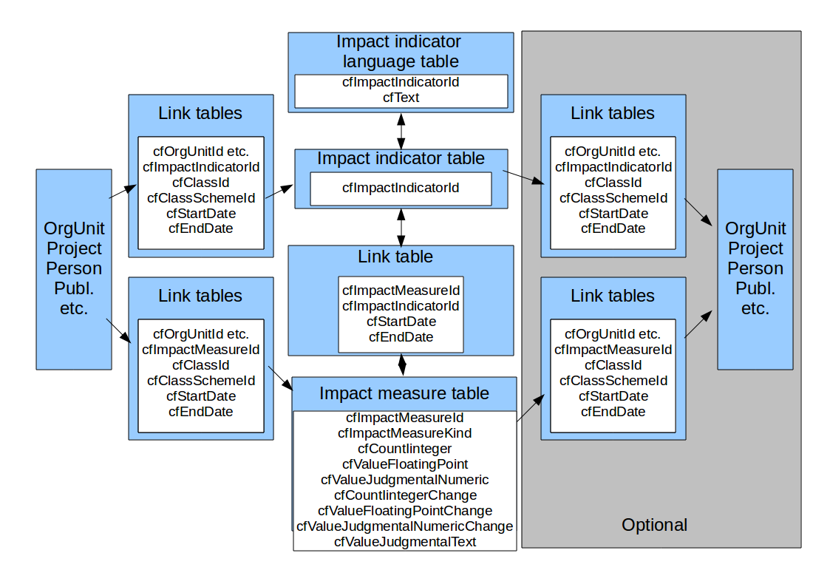
Measuring Impact in CERIF (MICE)
MICE, a JISC-funded Project coordinated by Richard Gartner, Kings College, London, UK

Slide 26
Measurement & Indicator (some examples)
  economic and commercial
    economic
      impact on business
        improving performance of existing businesses
          increased turnover by 1.2M€ in 2012
          time savings of 14.56%
          reduced costs by 42%
        new products/processes
          creating numbers of new products/services
          commercialising / other success measures
Indicators
Measurements
Extract from the MICE List of Indicators

Slide 27
CERIF 1.6
cfFederated Identifier
cfFunding
cfEquipment
cfExpertise
AndSkills
cfFacility
cfResult
Publication
cfService
cfQualification
cfPrize
cfResultPatent
cfResultProduct
cfElectronicAddress
cfProject
cfPostalAddress
cfCurriculum
Vitae
cfPerson
cfOrganisation
Unit
cfGeographic
BoundingBox
cfCitation
cfIndicator
cfMeasurement
cfEvent
cfCountry
cfLanguage
cfCurrency

Slide 28
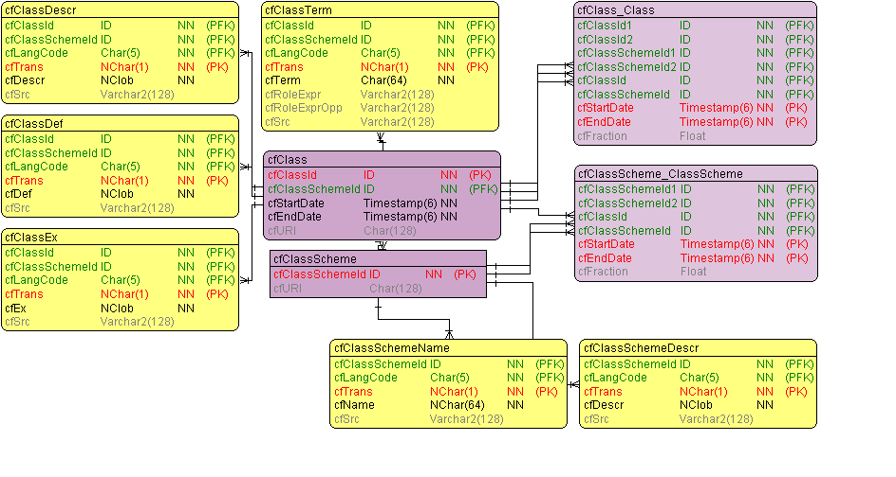
CERIF Semantic Layer
Allows to capture any Schema or Structure
Flat Lists
Thesauri
Classification Systems (e.g. SKOS, ...)
Taxonomies
Ontologies
Open / Extensible in all directions
New Schemas
New Concepts / Terms
New Relationships
Enables to manage
Roles / Types Semantics
Subject Headings
Versioning and archiving (start+end dates)
Allows for Mappings between Schemes

Slide 29
CERIF Semantic Layer (Declared Semantics)
Recursion
is-a
maps-to
is-part-of
Is-broader-term
Scheme-Assignment
Time-based

Slide 30
CERIF 1.6
cfFederated Identifier
cfFunding
cfEquipment
cfExpertise
AndSkills
cfFacility
cfResult
Publication
cfService
cfQualification
cfPrize
cfResultPatent
cfResultProduct
cfElectronicAddress
cfProject
cfPostalAddress
cfCurriculum
Vitae
cfPerson
cfOrganisation
Unit
cfGeographic
BoundingBox
cfCitation
cfIndicator
cfMeasurement
cfEvent
cfCountry
cfLanguage
cfCurrency

Slide 31
CERIF Federated Identifiers
ResultPublication
  ISBN
  ISSN
  DOI
  WoS Accession Number
  Scopus EID
  PubMed Central ID
Person
  Social Security Number
  Staff Id in HR system
  Author identifier
    ORCID, IdRef, DAI, ResearcherID, ScopusID
Project/Grant
  Funder’s reference number
  Organisation’s reference number
Organisation
  VAT Identification Number
  FundRefID
  GridID
Classification
  External Code

Slide 32
CERIF Federated Identifiers
Records the “tag” by which an object is known elsewhere
For any Base, Result, Infrastructure, or 2nd Level entity
“Identifier Types” classification scheme
(optionally) Connected to a Service representing the issuer of the identifier
    Usually an information system

Slide 33
CERIF XML Interchange Format
  XML Schema
  Based on the ER model
  Undergone a big update
cfFunding
cfFederated Identifier
cfEquipment
cfExpertise
AndSkills
cfFacility
cfQualification
cfResult
Publication
cfService
cfPrize
cfResultPatent
cfResultProduct
cfElectronicAddress
cfProject
cfPostalAddress
cfCurriculum
Vitae
cfPerson
cfOrganisation
Unit
cfGeographic
BoundingBox
cfCitation
cfIndicator
cfMeasurement
cfEvent
cfCountry
cfLanguage
cfCurrency

Slide 34
CERIF Profiles
Entities & attributes:
  Profile ⊂ CERIF
Semantic vocabularies:
  Profile – more specific
  Sources: CERIF & beyond
Integrity constraints:
  Profile ⊃ CERIF
Profile data is CERIF
Producers know what to include
Consumers know what to expect

Slide 35
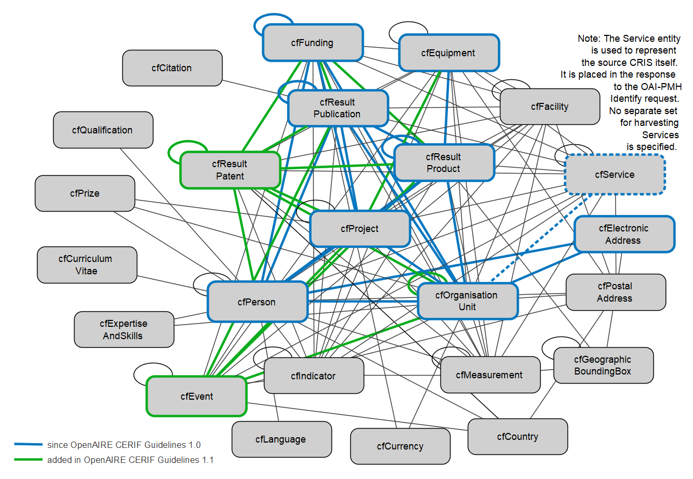
Subset of CERIF entities

Slide 36
<Publication xmlns="https://www.openaire.eu/cerif-profile/1.1/" id="852734">
<Type xmlns="https://www.openaire.eu/cerif-profile/vocab/COAR_Publication_Types">http://purl.org/coar/resource_type/c_6501<!-- journal article --></Type>
<Title xml:lang="en">Strong selection against hybrids maintains a narrow contact zone between morphologically cryptic lineages in a rainforest lizard</Title>
<PublishedIn>
<Publication id="893204”>
<Type scheme="https://www.openaire.eu/cerif-profile/vocab/COAR_Publication_Types">http://purl.org/coar/resource_type/c_0640<!-- journal --></Type>
<Title xml:lang="en">Evolution</Title>
<Identifier type="https://www.openaire.eu/cerif-profile/vocab/IdentifierTypes#EISSN">1558-5646</Identifier>
<Publishers>
<!-- [ … ] -->
</Publishers>
</Publication>
</PublishedIn>
<Volume>66</Volume>
<Issue>5</Issue>
<StartPage>1474</StartPage>
<EndPage>1489</EndPage>
<Identifier type="https://www.openaire.eu/cerif-profile/vocab/IdentifierTypes#DOI">10.1111/J.1558-5646.2011.01539.X</Identifier>
<!-- [ … ] -->
</Publication>

Slide 37
<Publication xmlns="https://www.openaire.eu/cerif-profile/1.1/" id="852734">
<!-- [ … ] -->
<Authors>
<Author>
<Person>
<PersonName>
<FamilyNames>Singhal</FamilyNames>
<FirstNames>Sonal</FirstNames>
</PersonName>
</Person>
<Affiliation>
<OrgUnit id="301248">
<Name xml:lang="en">Museum of Vertebrate Zoology</Name>
<PartOf>
<OrgUnit id="329384">
<Name xml:lang="en">University of California, Berkeley</Name>
</OrgUnit>
</PartOf>
</OrgUnit>
</Affiliation> <!-- [ … ] -->
</Author> <!-- [ … ] -->
</Authors>
<!-- [ … ] -->
</Publication>

Slide 38
<Publication xmlns="https://www.openaire.eu/cerif-profile/1.1/" id="852734">
<!-- [ … ] -->
<Keyword xml:lang="en">hybrid zones</Keyword>
<Keyword xml:lang="en">phylogeography</Keyword>
<Abstract xml:lang="en">Phenotypically cryptic lineages comprise an important yet understudied part of biodiversity; <!-- […] --></Abstract>
<References>
<Product id="729487">
<Type xmlns="https://www.openaire.eu/cerif-profile/vocab/COAR_Product_Types">http://purl.org/coar/resource_type/c_ddb1<!-- dataset --></Type>
<Name xml:lang="en">Data from: Strong selection against hybrids maintains a narrow contact zone between morphologically cryptic lineages in a rainforest lizard</Name>
<VersionInfo xml:lang="en">1</VersionInfo>
<Identifier type="https://www.openaire.eu/cerif-profile/vocab/IdentifierTypes#DOI">10.5061/DRYAD.4GH6HF5G</Identifier>
<!-- […] -->
</Product>
</References>
</Publication>

Slide 39
CERIF development
By the CERIF Task Group of euroCRIS
Adopting open-source software projects
tools & best practices:
https://github.com/EuroCRIS/CERIF-DataModel
CC BY license
Two branches:
master: latest official release (1.6.1)
develop: on-going development

Slide 40
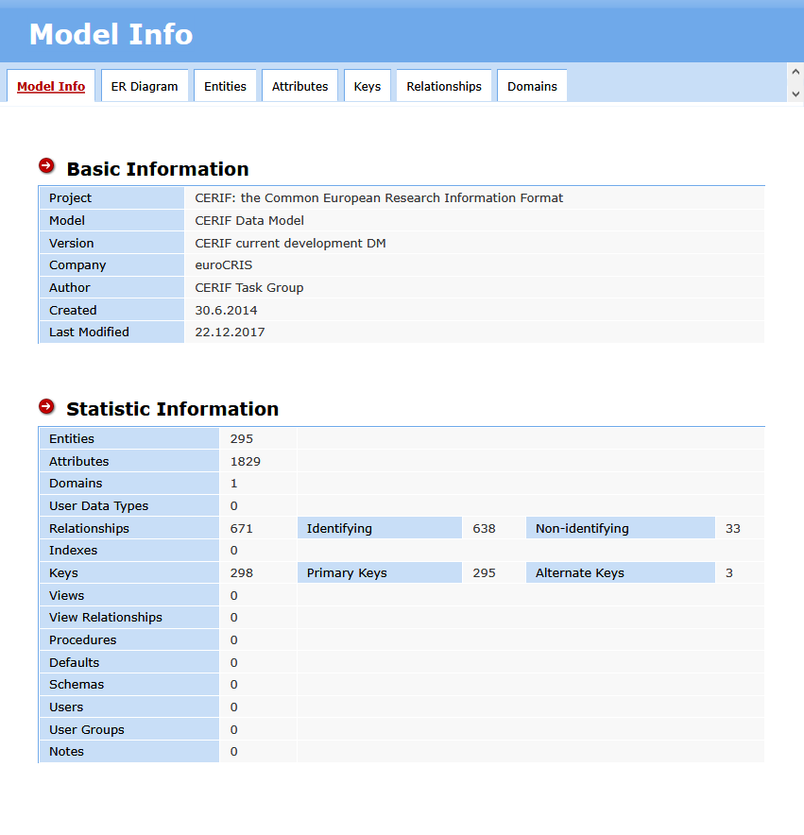

Slide 41
CERIF highlights
Right level of abstraction
Normalized model
  Record information only once
  Reference rather than copy
Versatile Semantic Layer
Time-based relationships
Clean design, regular structure

Slide 42
Metadata Layers
Discovery metadata
DC, VIVO, MODS, METS, eGMS, DCAT, …
Generate
Contextual metadata
CERIF
Reference
Detailed metadata
Domain-specific standards

Slide 43



https://www.eurocris.org/community/strategic-partners

Slide 44
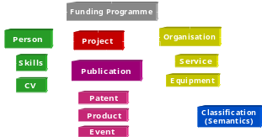

The CERIF Evolution
CERIF 1.3
CERIF 2006 / 2008 Model
Infrastructure
Link
Similar Ideas
UN/UNESCO
OECD
CODATA
Base
2ndLevel
Semantics
Language
Base
Link
Measurement
GEO
2ndLevel
Semantics
Language
Funding
Equipment
Facility
EU
Working Group
on Research
Databases
Workshop
ExpertiseAndSkills
Service
CERIF 2000 Model
Qualification
Profi les
Prize
ElectronicAddresse
CV
PostalAddress
Roles
EXPERTISE
Citation
Metrics
Indicator
Measurement
Country
OrgUnit
PERSON
Event
Language
Currency
CERIF 91
PROJECT
- Data Model
Infrastructure
- Facility, Equipment, Service
- Measurement & Indicator
- Entities and Link Tables
Geographic Bounding Box
- CERIF 1.3 Vocabulary
- UUIDs
- Terms
- Schemes
- CERIF 1.4 new XML format
- CERIF 1.5 Federated Identifiers
- CERIF 1.6 Dataset-ready
PROJECT
RESULTS
EQUIPMENT
Acronym: ERGO
Participant:
Keith Jeffery, Anne Asser
son, many more
Organisations:
Rutherford Appleton, Uni-
versity of Bergen, …
CLASSIFICATION
- Data Model
Model Normalization
- Robust/Consistent Structure
- Extensible Structure
- Semantic Layer
XML Exchange Specification
- Elaboration on Publication
CERIF Core Semantics (2008 1.2)
Data Model
- Multilinguality
- Controlled Vocabulary
- Roles / Types
- User-driven
EC Recommendation to
Member States
- Networking of DBs
Exchange of Records
EC Recommendation to
Member States
+ Linked Data
1987
1991
2000
2006
2008
2012
2013
2015

