Slide 1
Connecting research data, current research information and publications
Peter Doorn & Elly Dijk
10th EuroCRIS Strategic Seminar: Horizon 2020 and Beyond
10-11 September 2012, Brussels

Slide 2
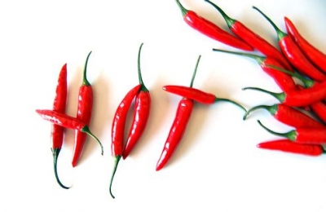
Contents
Data is hot!
Horizon 2020 and data
About DANS and digital archiving
Connecting content & community
Enhanced publications
  Linking CRIS information, publications and data
International research infrastructures

Slide 3


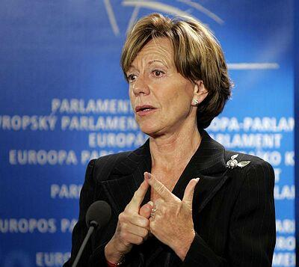

Data is hot!
Article on “trends for 2012”: “Keeping your research data secret until they are finally printed in a scientific journal is so 2011”
Neelie Kroes (Vice-President of the European Commission responsible for the Digital Agenda): “Data is the new gold”
David said this already!

Slide 4
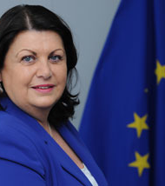
Horizon 2020 and data
  Máire Geoghegan-Quinn (European Commissioner for Research and Innovation):
  "We must give taxpayers more bang for their buck. Open access to scientific papers and data will speed up important breakthroughs by our researchers and businesses, boosting knowledge and competitiveness in Europe.”
This one David left out!

Slide 5
Horizon 2020 about publications and data
The Commission will:
define open access to peer-reviewed publications as the general principle in Horizon 2020, either through open access publishing ('Gold' open access) or self-archiving ('Green' open access)
promote open access to research data (experimental results, observations and computer-generated information etc.) and set a pilot framework in Horizon 2020, taking into account legitimate concerns in relation to privacy, commercial interests and questions related to large data volumes
develop and support e-infrastructures to host and share scientific information (publications and data) which are interoperable on European and global level
help researchers to comply with open access obligations and promote a culture of sharing.
Keith said most of this!

Slide 6


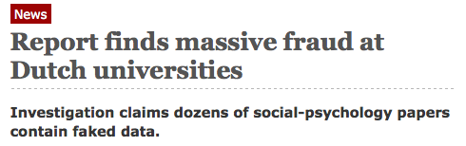
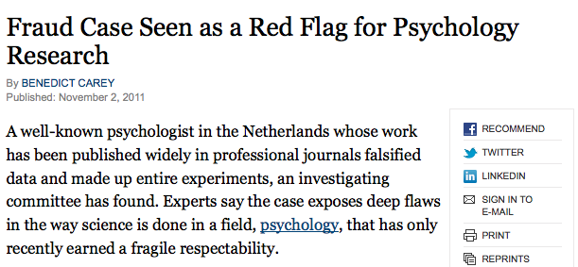

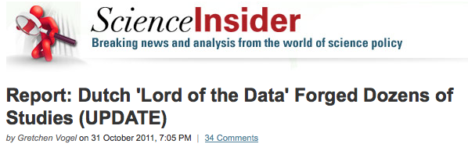

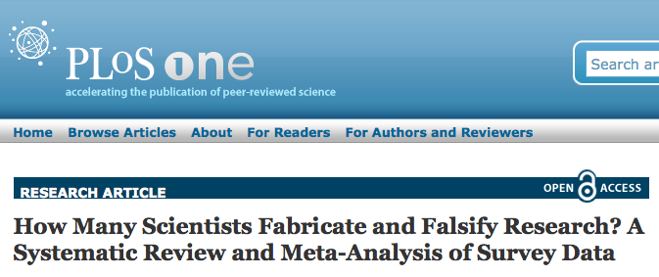

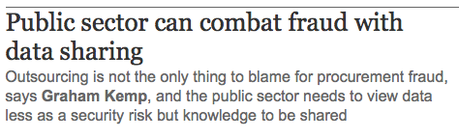
Niederlande
Renommierter Psychologe gesteht Fälschungen

Slide 7

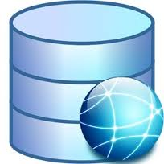
Why is digital preservation of data important?
Precondition for sharing and re-use
Makes research more transparent
Checks on claims made in publications
Promotes replication research
However, data re-use for comparative studies is much more important

Slide 8
What is DANS?
DANS: Data Archiving & Networked Services
Institute of Dutch Academy and Research Funding Organisation (KNAW & NWO) since 2005
First predecessor dates back to 1964 (Steinmetz Foundation), Historical Data Archive 1989
Academy’s Department Research Information (predecessor dates back to the ’60s) since 2011 part of DANS
Mission:
  promote and provide permanent access to digital research information (started with digital archives in the humanities and social sciences)

Slide 9
Our main activities and services
Encourage researchers to self-archive and reuse data by means of our Electronic Archiving SYstem EASY
Our largest digital collections are in archaeology, social sciences and history (moving into other domains)
Provide access, through Narcis.nl, to thousands of scientific datasets, e-publications and other research information in the Netherlands
Data projects in collaboration with research communities and partner organisations
Participation in FP7 projects and research infrastructures: e.g. APARSEN, OpenAireplus, CARARE, DASISH, CLARIN, CESSDA, DARIAH
R&D into archiving of and access to digital information (e.g. VIVO-project recently started)
  Advice, training and support (Data Seal of Approval, Persistent Identifier Infrastructure)

Slide 10
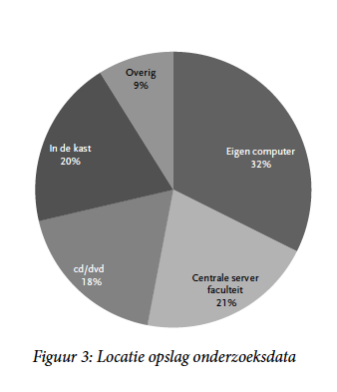
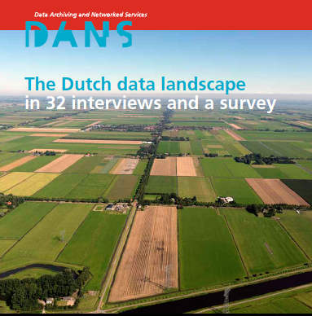
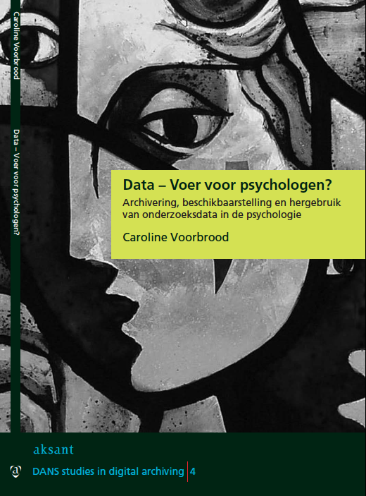
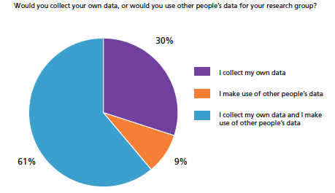
Cultures of data sharing differ over disciplines, but also change over time

Slide 11
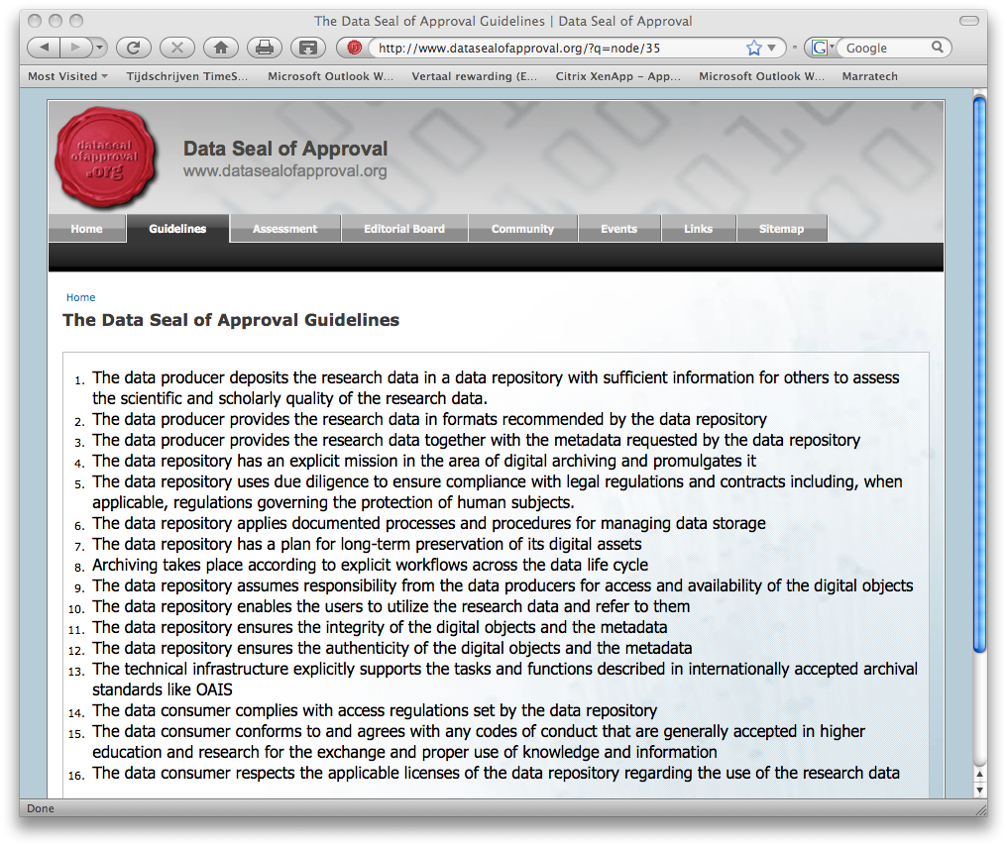
5 Criteria; 16 Guidelines
Data Seal of Approval
The research data:
can be found on the Internet
are accessible (clear rights and licenses)
are in a usable format
are reliable
can be referred to (persistent identifier)
www.datasealofapproval.org part of: www.trusteddigitalrepository.eu

Slide 12
Situation in the Netherlands
Academic CRIS-systems (METIS): institutes, researchers, research, bibliographical information
  But: no unified CRIS yet…
Academic repositories for (open access) publications
  But: not connected with each other!
In NARCIS.nl the information is brought together and partly connected by Digital Author Identifier (fits into international identifier initiatives such as ORCID)
Data archiving at universities: front office – back office model
Data in non-academic settings like museums/heritage institutes, libraries, A/V institutes, archives: collaboration in Dutch Digital Preservation Coalition, member of APA

Slide 13
Data archiving at universities: front office – back office model
Collaboration DANS – University Libraries
  DANS: long-term archiving of research data (like e-depot of National Library for publications ), providing expertise, training, standards
  University libraries: data lab services (VRE, repository) for local researchers
  Starting with Delft, Leiden, Wageningen, …
Challenges to archive data from University repositories:
  Explored in Podium Plus project (SURF Share)
  Auto-ingest from Dataverses
  Stumbling blocks not technical, but organizational/juridical
  IPR issues can be solved if universities, researchers and funders agree

Slide 14
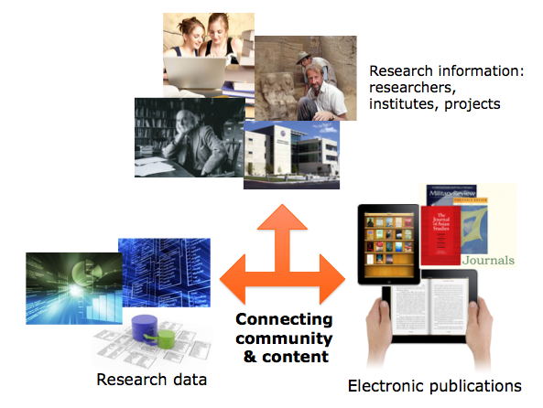
Connect Research Information
Not just open access to publications and data, but connect them to Research Information

Slide 15
Why connect data to publications and CRIS information?
Articles and data are increasingly interwoven
Users can find all information in one place
Enriches data: provides context to research data
Enhances publications: data serves as background/additional information for articles (check author’s claims and assertions)
Makes research information more meaningful: better instrument for evaluation and research quality assessment

Slide 16
Enhanced publications: approaches
  At DANS/Narcis: so far restricted to publications and data in Dutch academic repositories
Our wish:
  expand to publications in whatever form, published by commercial publishers as well
  Link-up with international partners and initiatives (OpenAIRE)
Other approaches:
  DataCite: link data to articles using DOI
  Pangaea: data publishing as a “data journal”
  Dryad: international repository of data underlying peer-reviewed articles in the basic and applied biosciences
  Linked open data: semi-automatically generated links
  Leen Breure: typology of 80 types of Enhanced Publications - http://xposre.nl/

Slide 17
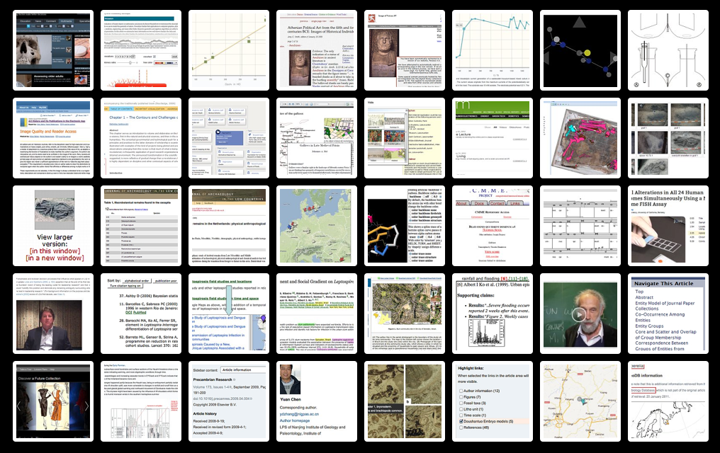
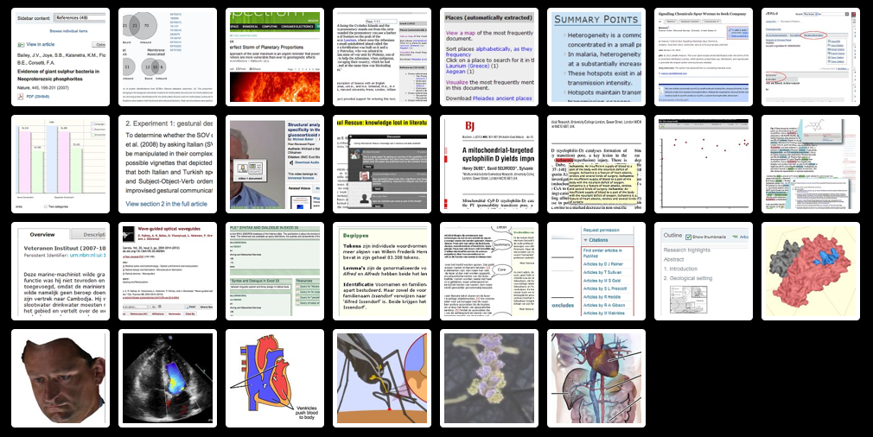
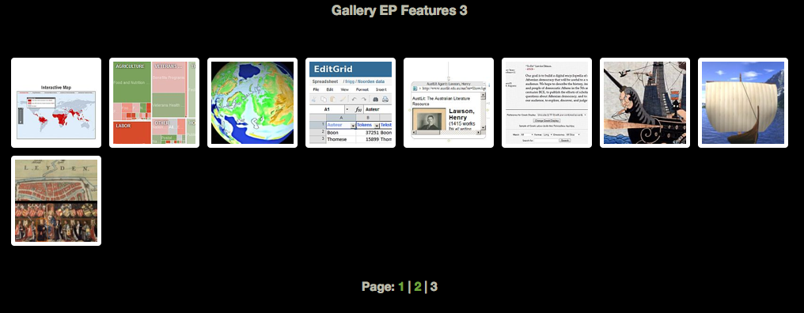
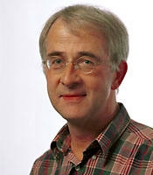
Leen Breure: typology of 80 types of Enhanced Publications - http://xposre.nl/

Slide 18
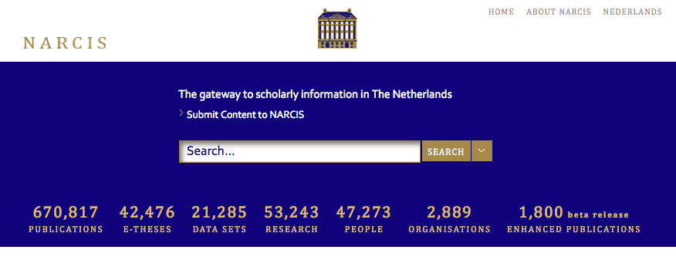
NARCIS.nl: Access to Research Information, e-Publications, Data Sets and more
New!!

Slide 19
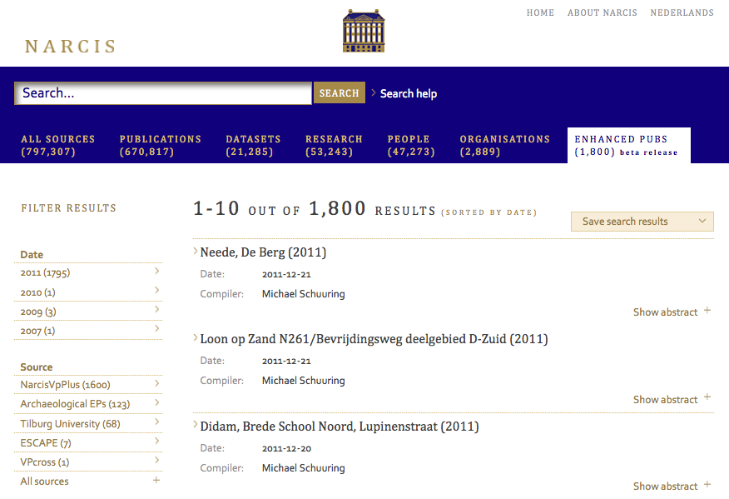
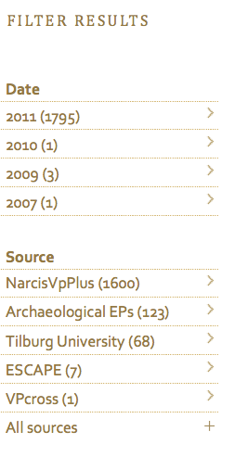
Doctoral Theses (Dissertations)
Archaeological excavations
Publications by Tilburg University researchers
Enhanced Scientific Communication by Aggregated Publication Environments (ESCAPE)
Gallows in Late Medieval Frisia

Slide 20
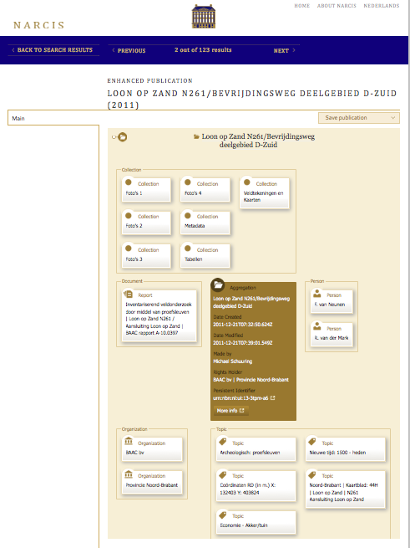
Najla already gave a preview of this!
Research Data
Report
Researchers
Aggregation: the enhanced publication
Organizations involved:
Funder and research institute
Topics linking to related information

Slide 21
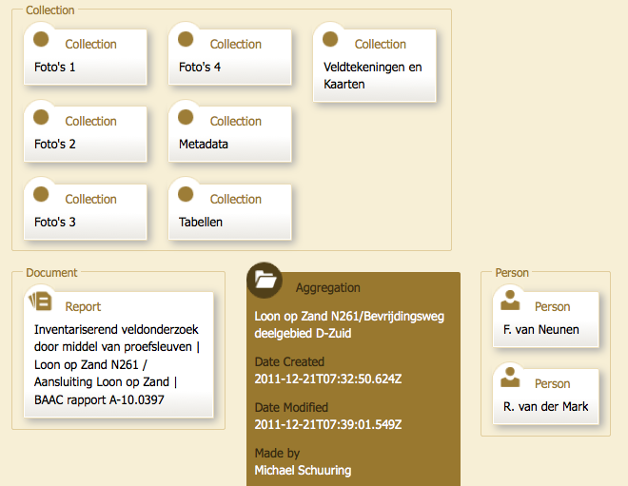
Research Data
Researchers
Publication
Enhanced publication

Slide 22
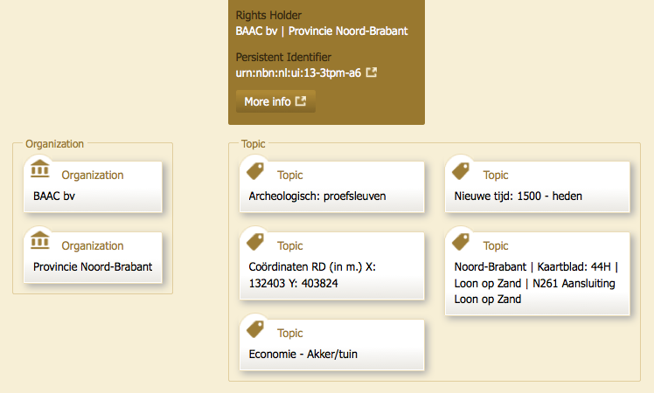
Persistent
Identifier
Research organization
Funder
Related subjects

Slide 23
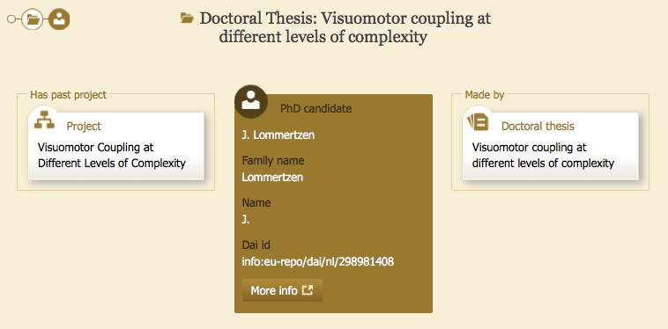
Digital Author Identifier

Slide 24
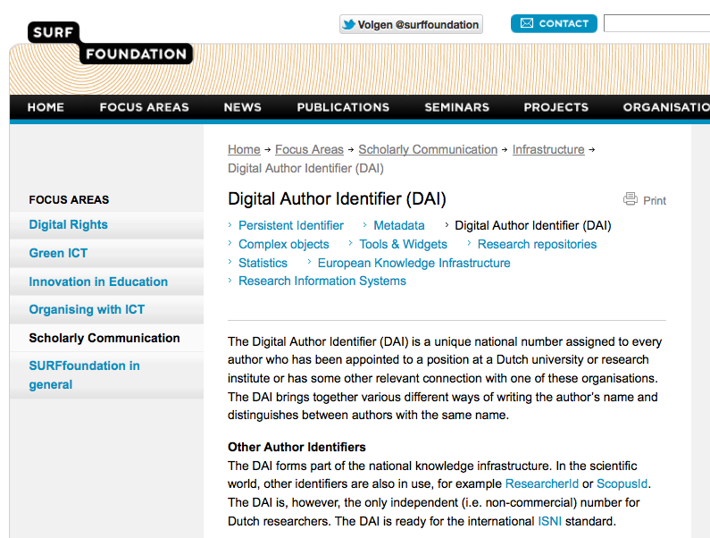

Slide 25
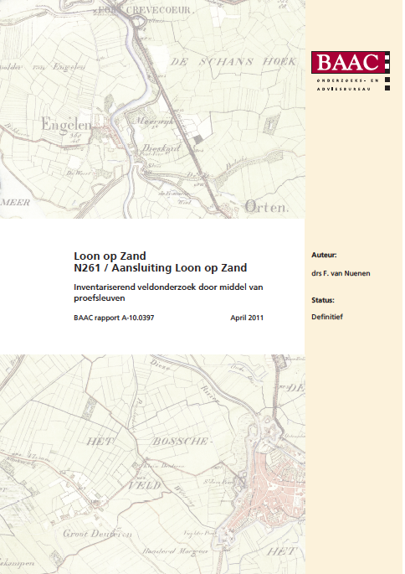
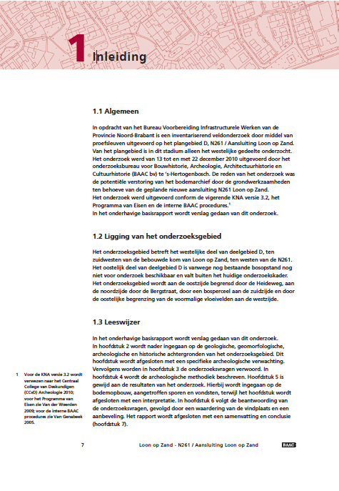

Slide 26
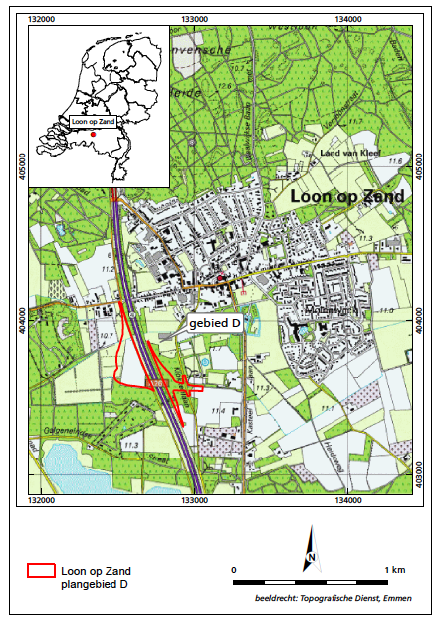
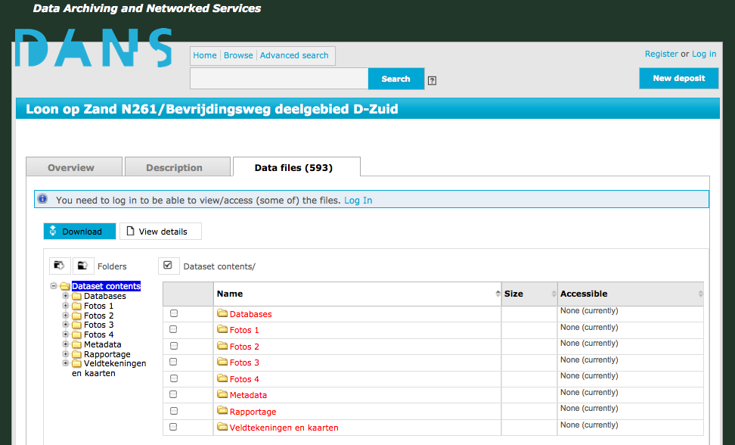
Links directly to data in DANS archive

Slide 27
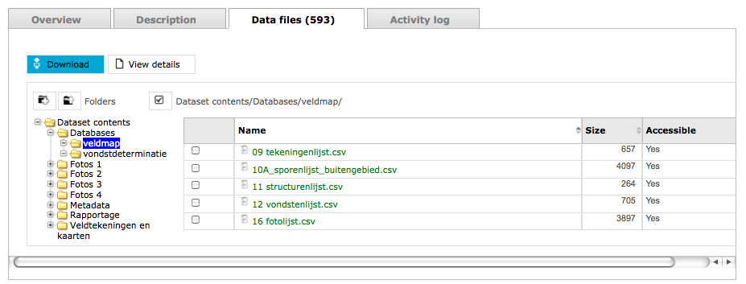
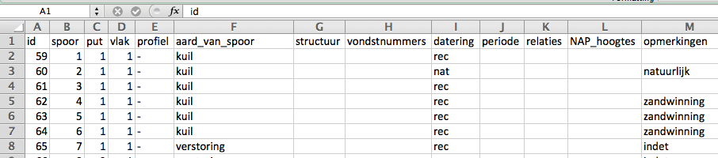
All data types: other examples with video, audio, still images…

Slide 28
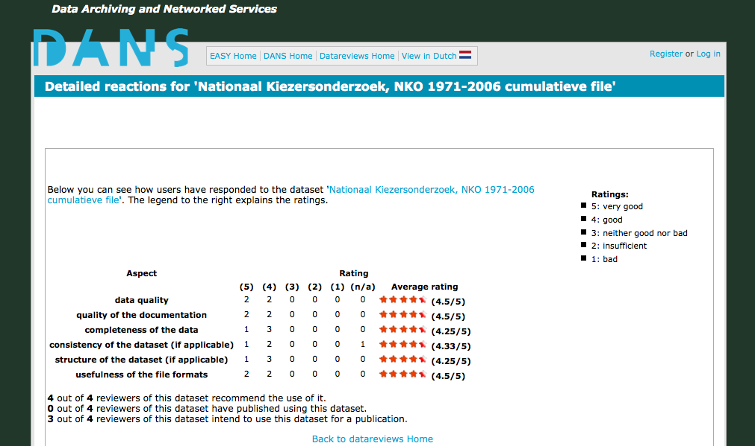
Community reviews of data sets

Slide 29
However…
As yet only a fraction of the data, publications and research information are linked

Slide 30
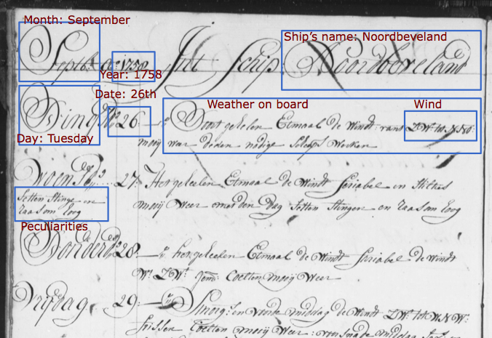
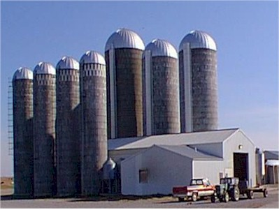
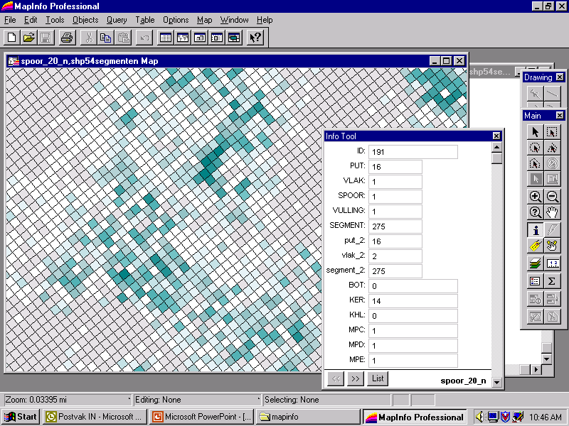
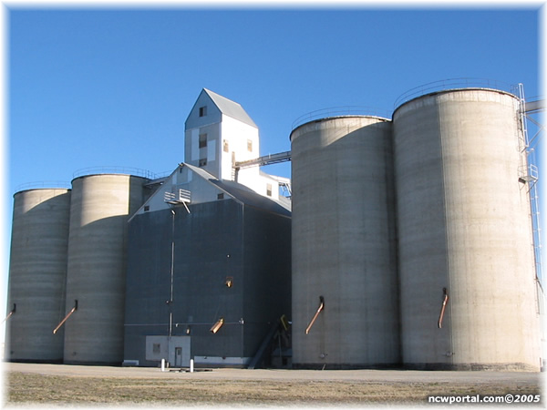
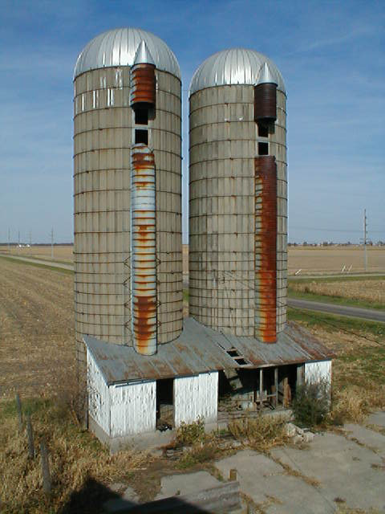
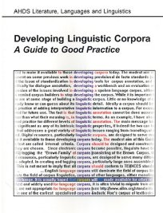
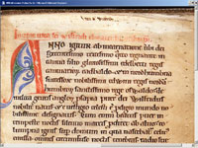
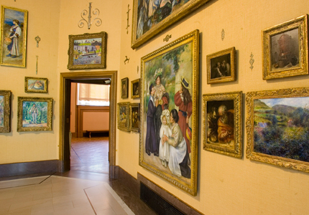
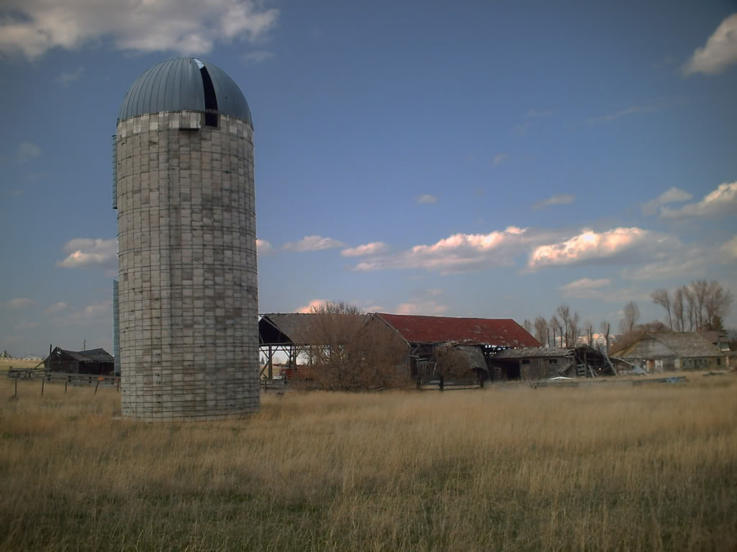
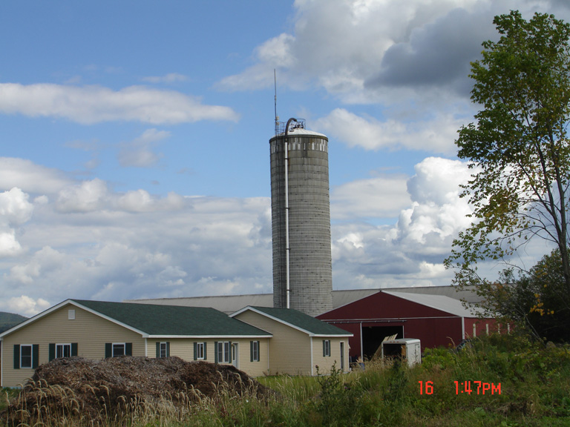
In many sciences and humanities: thousands of data silos
Linguistic corpora
Historical databases
Archaeological GIS
Arts image collections
Literary text bases

Slide 31
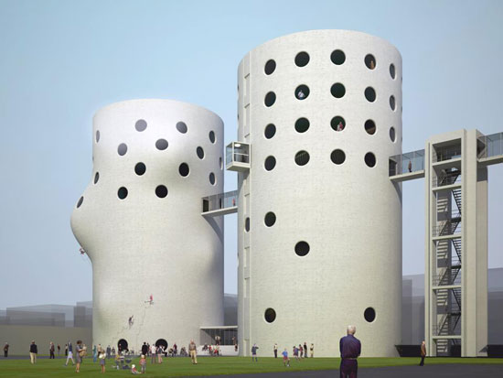
Since the last decade: let’s open up and connect the silos!

Slide 32
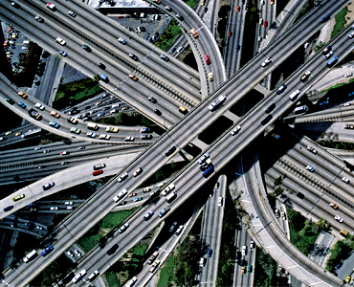
Infrastructures are required to support and maintain the collaborative efforts
Services need to be sustainable
Therefore they need to be generic and re-usable

Slide 33





European Research Infrastructures: Disciplinary examples
DARIAH: Digital Research Infrastructure for the Arts and Humanities
CLARIN: Common Language Resources and Technology Infrastructure
CESSDA: Council of European Social Science Data Archives
ESS: European Social Survey
LifeWatch: E-science European Infrastructure for Biodiversity and Eco-system Research

Slide 34
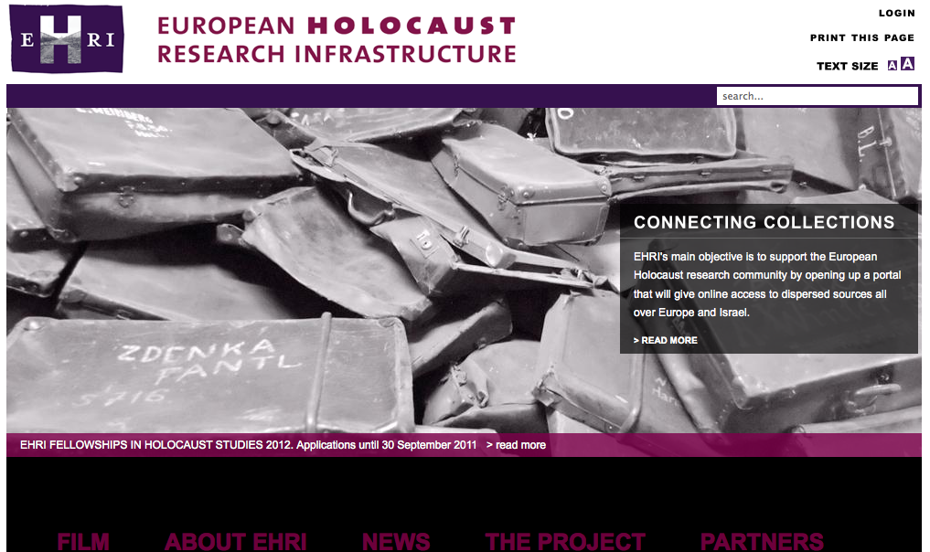
19 partners from 13 countries

Slide 35




European Infrastructures Projects: Interdisciplinary examples
OpenAire: Open Access Infrastructure for Research in Europe: European Repository Network
EUDAT: European Data Infrastructure
DASISH: Data Service Infrastructure for the Social Sciences and Humanities: CLARIN, DARIAH, CESSDA, ESS, SHARE
Europeana Cloud (New): Best Practice Network, establish a cloud-based system for Europeana and its aggregators: new content, new metadata, new linked storage system, new tools and services and a new platform - Europeana Research

Slide 36
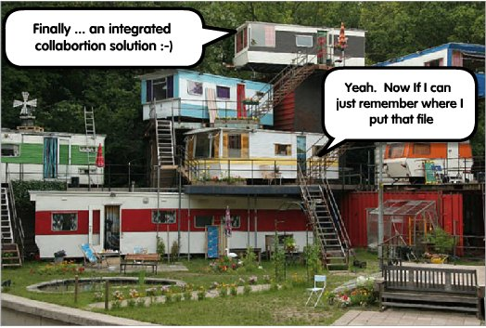
Finally, an integrated data infrastructure!
Yeah. Now if I can just remember where I put that file...

Slide 37
Conclusions/Challenges
Connecting research data to CRIS information and publications offers increased value to all
The access to the record of science needs to be permanent: long-term archiving is necessary
As yet, the information is stored and preserved in heterogeneous silos (repositories, libraries, archives), if it is preserved at all
We need standards such as CERIF to make the information interoperable
The effort to link up the information is not only national; international and cross-disciplinary approaches are necessary

Slide 38
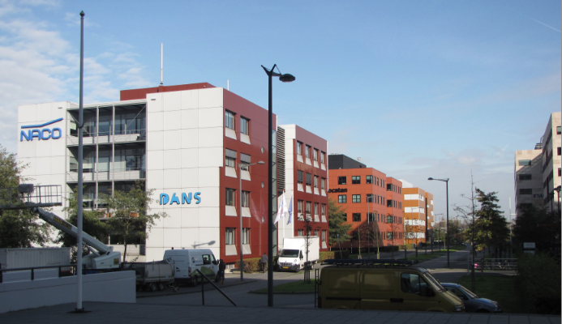
Thank you for your attention and visit us at:
www.dans.knaw.nl
www.narcis.nl
peter.doorn@dans.knaw.nl
elly.dijk@dans.knaw.nl

