Slide 1


The SK CRIS - information system on research, development and innovation
Zendulkova Danica

Slide 2
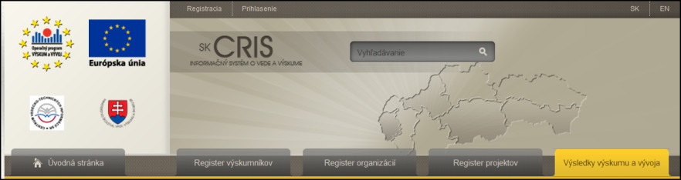
Content of presentation
International R&D information: CRIS and EuroCRIS
Data model CERIF
What is SK CRIS
The content of SKCRIS
Interoperability
Centrum vedecko-technických informácií SR

Slide 3

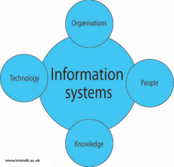

International R&D information
Basic concepts: what does it mean...
Research Information
CRIS system
The euroCRIS organisation
Centrum vedecko-technických informácií SR

Slide 4
What is research information?
Information about :
Researchers
Organisations (who Carry out, Fund, Publish, Commercialise, Benefit from: RESEARCH)
Funding Programmes & Calls
Projects (Proposed, Ongoing, Completed)
Publications, Patents, Data, Products
Impact (Indicators and Measures)
Facilities, Equipment, Services
Addresses, Geographic Bindings, Languages
And their Relationships
Centrum vedecko-technických informácií SR

Slide 5
Who needs Research Information?
visibility, finding collaborations,
competitors, CV generation
Researchers
performance, strategic decisions,
priorities,
bench-,marking
Decision Makers
Funding Organisations
Project Managers
distribution of programmes
evaluation of results, finding reviewers
overview of ongoing activities
Research Information
Libraries
Research Organisations
acquisition, dissemination
integration and interoperability
strategic management
Publishers
finding reviewers, editors
Education
Intermediaries / Brokers
integration of relevant
findings into lectures
and training
finding research results of
potential market or innovative value
General Public
Media
Enterprises
information and education,
interest
finding information
for participation in projects,
partnerships, usage of results
distribution and
communication
Centrum vedecko-technických informácií SR

Slide 6
What is a CRIS?
  “a Current Research Information System, commonly known as "CRIS", is any information tool dedicated to provide access to and disseminate research information” (www.eurocris.org)
  A CRIS consists of
    a data model describing objects of interest to R&D
    a tool or set of tools to manage the data
Current Research Information System ...
Centrum vedecko-technických informácií SR

Slide 7
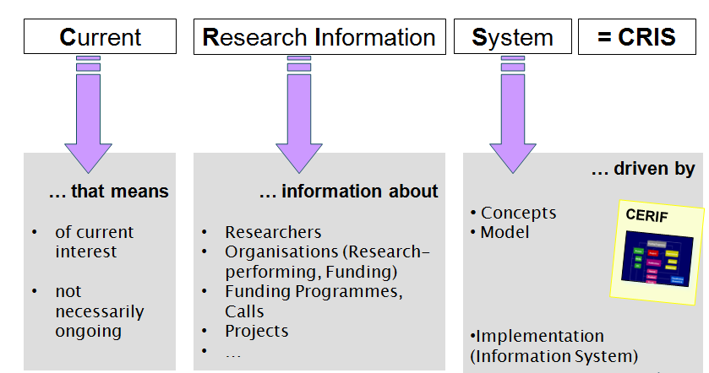
What is a CRIS?
© Brigitte Jörg, 2012
an integrated approach towards managing research information
Centrum vedecko-technických informácií SR

Slide 8
euroCRIS
euroCRIS (http://www.eurocris.org)is a not-for-profit organization of experts in research information and research information systems.
MISSION: To advance interoperability in the Research Community through CERIF
Main activity: development of the CERIF metadata model and its application (Common European Research Information Format)
Other function: international platform for exchange of research information knowledge and expertise.
Bi-annual (academic) Conferences, annual Seminars and Membership Meetings (twice a year)
Centrum vedecko-technických informácií SR

Slide 9

What is CERIF
Common European Research Information Format
Standard model for storage and interoperability of research information (metadata: data/information about research).
European Commision: CERIF recommendation to the EU Member States
Relational database architecture allowing to express any kind of relation between entities/attributes with every relation “time-stamped” and semantically defined.
Centrum vedecko-technických informácií SR

Slide 10
CERIF Model Structure
CERIF Entity Types
Base Entities
Result Entities
Infrastructure Entities
2nd Level Entities
Geographic Bounding Box
Link Entities
CERIF Features
Multiple Language
Semantics
Measures & Indicators

Slide 11
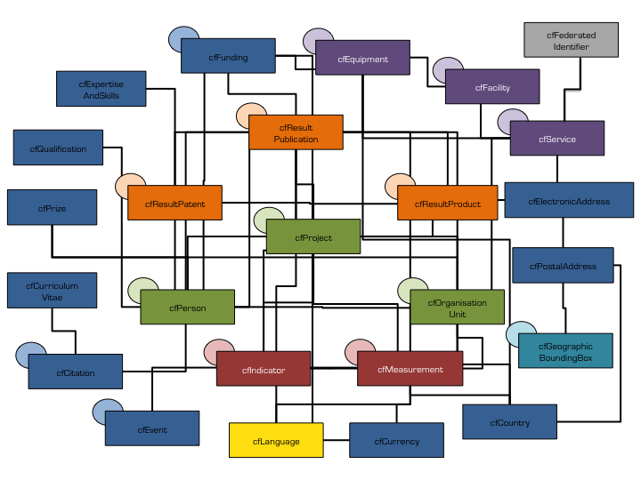
CERIF
Data format CERIF for obtain interoperability
The SK CRIS system uses CERIF ver. 1.3

Slide 12




The system SK CRIS
Guarrantee: Ministry of Education, Science, Research and Sport
Supplier: InterWay s.r.o
Provider: CVTI SR/SCSTI
Co-financed by EU structural funds
Scope: National Information system
Data format: CERIF

Slide 13
Main characteristics
The SK CRIS:
offers wide-range and detailed map of Slovak science, research and development (R&D)
provides the information in mutual relations to all target groups
contains the possibility of interoperability with similar systems across EU countries
uses data format CERIF

Slide 14
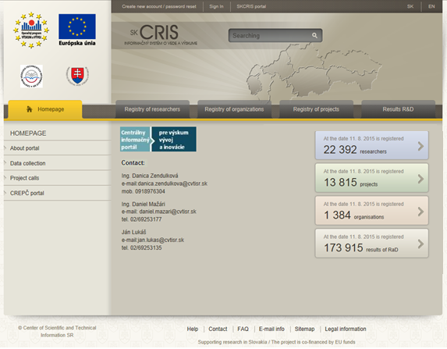
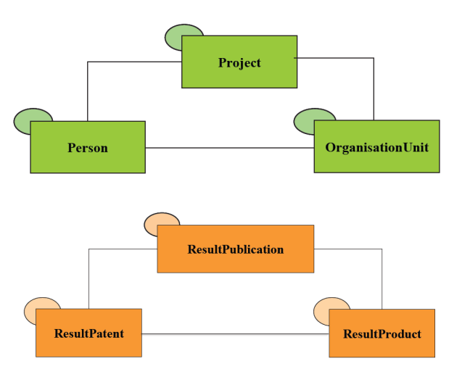
SK CRIS content
Researchers
R&D Projects
Organisations
  Assessment of competence to perform research and development
  Additionnal Statistical Survey of Research and Development Potential
R&D Results

Slide 15
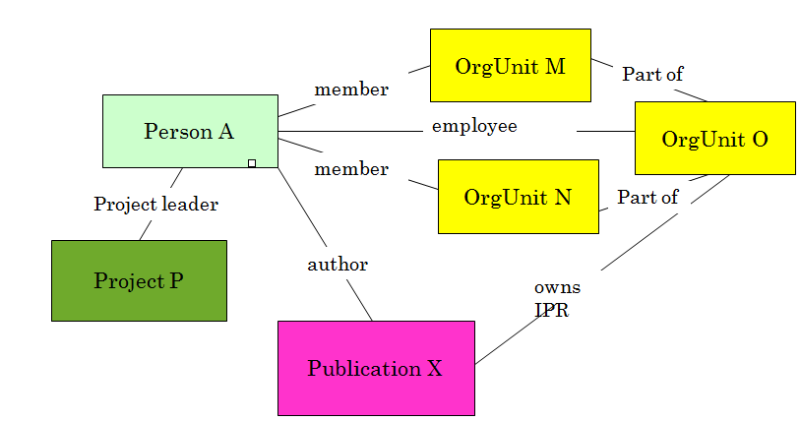
Result_Publication Instance Diagram
(slide by Keith Jeffery)

Slide 16
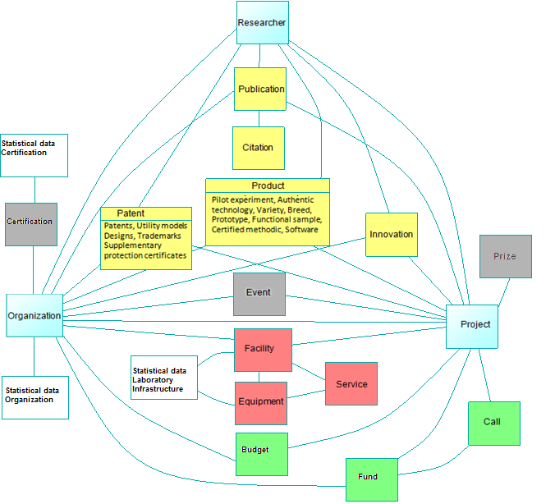
SK CRIS data model

Slide 17
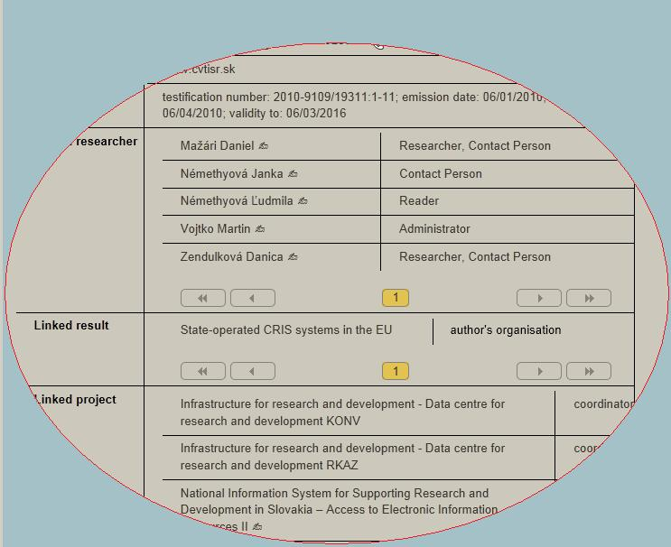
Properties
Slovak & English language
Fulltext search and faceted navigation
Semantics
Relations:
Person Organisation
Publication Organisation
Project Organisation

Slide 18
We want know...
Is the publication A result of any project?
Which publications were prepared in scope of project X?
We can not found it in bibliographic database CRPA...
But:
We do not want to enter data twice (to CRPA and to SK CRIS)
Solution: System Integration
Centrum vedecko-technických informácií SR

Slide 19
Data integration - overview
Organisation | Intgrated data
Slovak Academy of Science | Projects VEGA, international cooperation
 | Publication activity
 | Researchers employed on SAS
Slovak Research and Development Agency | Projects
Ministry of Education, Science, Research and Sport of Slovak Republic | Projects VEGA
 | Projects KEGA
 | CRPA
 | Researchers employed on Universities
The Agency of the Ministry of Education, Science, Research and Sport of the Slovak Republic for the Structural Funds of EU | Projects OP R&D

Slide 20
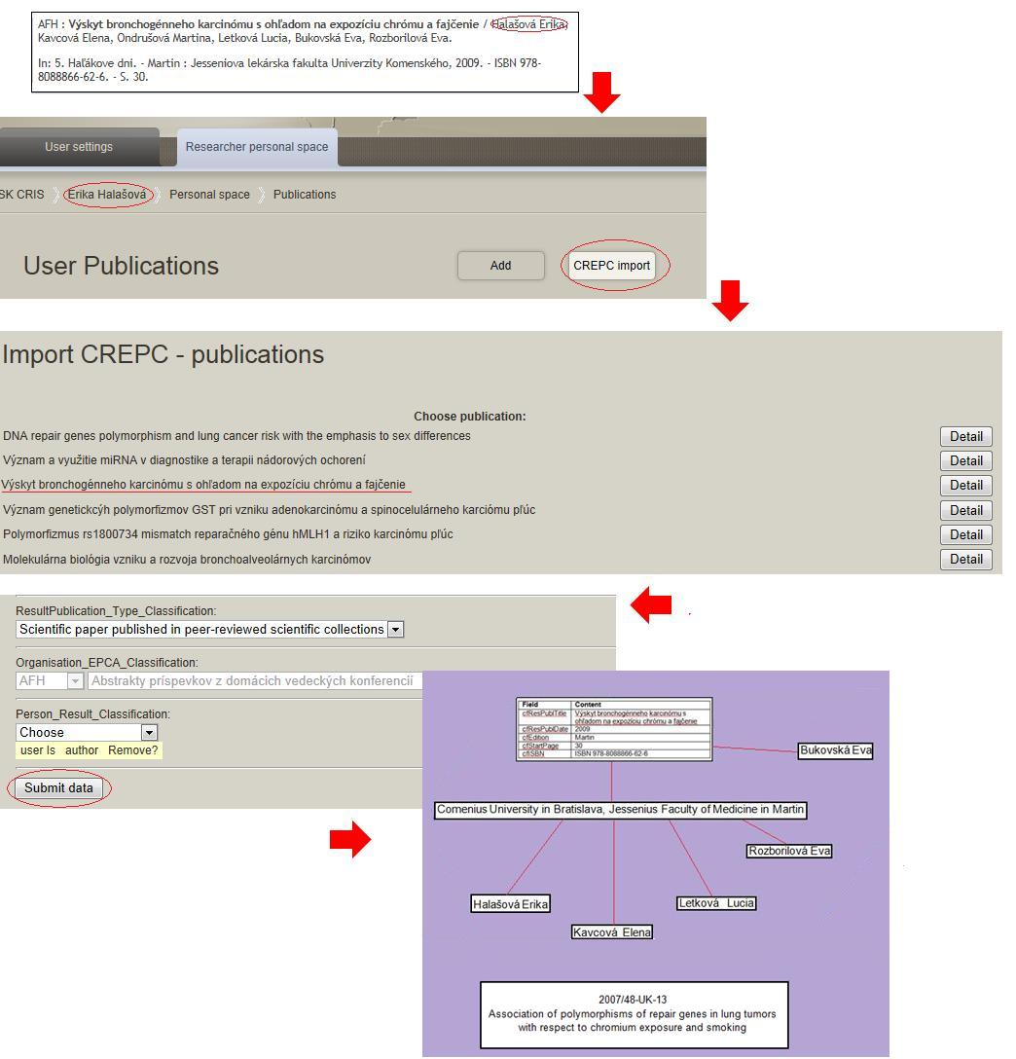
Integration with other systems
Central Registry of Publication Activities
SK CRIS

Slide 21
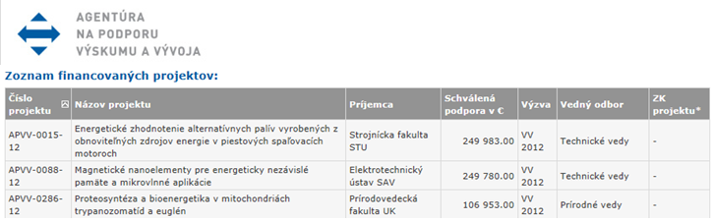
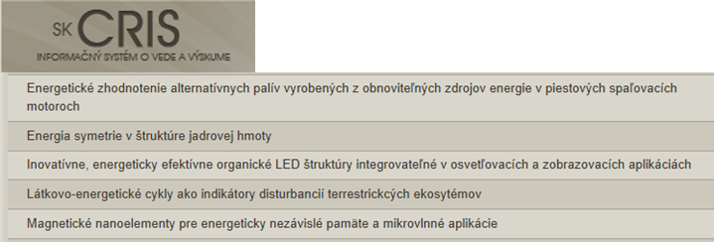
Data integration - projects

Slide 22
SK CRIS benefits
User friendliness
Rationalization: eliminate duplicate collections
Linking among collected objects
Improvement data quality
Integration of R&D data
Interoperability with CRIS systems worldwide
Presentation of knowledge
Communication between scientists
Knowledge application into practice
Popularisation of science in society

Slide 23
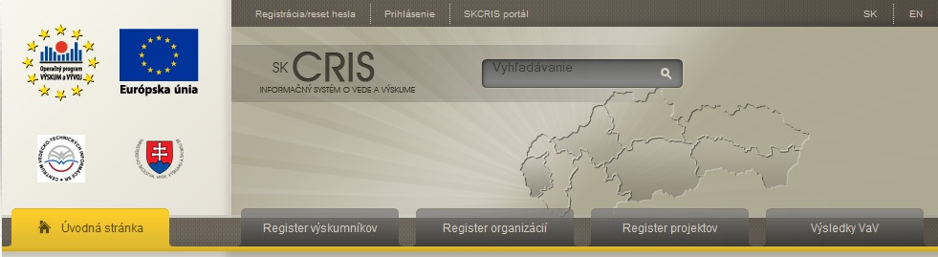
Thank you very much for your attention
https://www.skcris.sk

