Slide 1
Friedrich-Alexander-Universität
Erlangen-Nürnberg
CRIS2016 – St. Andrews
Introducing CRIS at FAU

Slide 2

FAU - one of the TOP 10 German Research Universities
More than 40,000 students
5 faculties (incl. Faculty of Engineering and university hospital)
23 departments
25 clinics
661 professorships

Slide 3
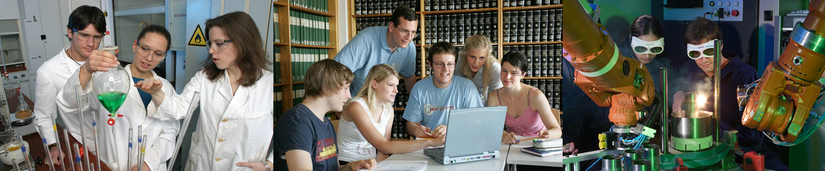
FAU - one of the TOP 10 German Research Universities
More than 3,000 members of academic staff
More than 2,000 employees in administration
More than 240 degree programs, among them
76 Bachelor’s degree programs and
87 Master’s degree programs

Slide 4
Our Major Research Areas
Humanities, Social Sciences, and Theology | Business, Economics, and Law | Medicine | Sciences | Engineering
 |  |  | New Materials and Processes
 |  | Optics and Optical Technology
 |  | Molecular Life Science and Medicine
 |  | Health Technology
Electronics, Information and Communication
Energy, Environment and Climate
Language – Culture – Region
Cohesion – Transformation – Innovation in Law and Economics

Slide 5
FAU CRIS Timeline
2011 | 2012 | 2013 | 2014 | 2015 | 2016…
Config
Purchase of Converis 4
Upgrade to Converis 5
Addition of further entities
Data model specification
Test users
Rollout of Publication module
Live
Live users (20-80 logins/day)

Slide 6
FAU CRIS Map
Reports
WoS, Scopus, Orcid, etc.
File import (BibTeX, etc.)
Viva (HR)
Websites
IdM
(Identity management)
FAU CRIS
fau.org (structure)
Research Portal
HIS FSV (finance)
Manual entry

Slide 7
Challenges for FAU CRIS

Slide 8
Challenges for FAU CRIS
Structural differences within FAU
Five faculties with different research culture
Organisational independence
Widely varying IT systems and structures

Slide 9
Challenges for FAU CRIS
Structural differences within FAU
Resistance to changing processes
Current processes in the faculties range from minimal to intricate
Many central processes are still „paper-based“
Higher workload for initial entry of „historical data“
Notes:
3. Bessere Formulierung, die Übergang von alt zu neu betont

Slide 10
Challenges for FAU CRIS
Structural differences within FAU
Changing processes
Fairness in reporting
Taking into account different research cultures
Refrain from purely quantitative evaluation

Slide 11
Incentives to use FAU CRIS

Slide 12
Incentives to use FAU CRIS
High reusability of entered data
Data only entered once per publication
Reports usable by central administration and researchers
One publication can be linked to numerous entities (e.g. projects)

Slide 13
Incentives to use FAU CRIS
High reusability of entered data
Improved visibility
Central Research Portal
Plugins for Websites (available for researchers, organisations, projects, etc.)
Compromise: Allow entry of data not important to the administration

Slide 14
Incentives to use FAU CRIS
High reusability of entered data
Improved visibility
Workload reduction
Central Administration can generate reports
No additional requests for projects, polls, etc.
Website research content doesn‘t need to be administered manually

Slide 15
Incentives to use FAU CRIS
High reusability of entered data
Improved visibility
Workload reduction
Active support
Training and online documentation available
Ticket system for questions and support
Dedicated support with two full-time staff

Slide 16

Thank you for your attention

