Slide 1

R&D Statistics Information System: An Interoperability Tail between CERIF and SDMX
Dimitris Karaiskos
Dimitrios Xinidis, Vasilis Bonis
National Documentation Centre / National Hellenic Research Foundation, Greece

Slide 2
Outline
Research & Development (R&D) Statistics
SDMX Standard
SDMX Reference Infrastructure (SDMX-RI)
R&D Statistics Information System
Interoperability between CERIF and SDMX
Conclusions and further steps

Slide 3
Research & Development (R&D) Statistics
R&D Statistics provide information regarding R&D expenditure and R&D personnel at the country level
form the basis for the development and monitoring of research policies at European and national level
  EU2020 headline target of investing 3% of the EU GDP on R&D (monitored by the R&D intensity indicator)
have been linked to the economic development of a country
  R&D Expenditure since 2008 is treated as a capital investment - used to be a consumption- in the national GDP (System of National Accounts)

Slide 4
Research & Development (R&D) Statistics
R&D data collection is framed by EC regulations 995/2012
  Annual statistical survey
  Carried out on a mandatory basis by each country
  Performed on R&D performing entities in private and public sectors (HES – Higher Education Sector, GOV – Government Sector, BES – Business Sector, PNP – Private Non-Profit Sector)
  Based on methodological manuals (OECD's Frascati Manual, Oslo Manual, Canberra Manual)
  R&D statistics are computed at the country level and relayed to major statistical bodies, such as Eurostat and OECD
National Documentation Centre of Greece (EKT) is the official organization for the collection and compilation of the Greek R&D statistics

Slide 5
Statistical Data and Metadata eXchange (SDMX) Standard
R&D statistics will be relayed to Eurostat using SDMX format (compulsory from June 2017 and onwards)
  Data exchange now is occurring using excel files
  SDMX data exchange pilot running from 2014
SDMX standard:
  provides a common model for the representation of statistical data and metadata
  provides a set of guidelines for exchanging statistical information between peers, e.g. statistical bodies, organizations, states etc.
  ISO standard since 2013 (ISO 17369:2013)
  SDMX message formats have two basic expressions
    SDMX-ML (using XML syntax)
    SDMX-EDI (using EDIFACT syntax and based on the GESMES/TS statistical message)

Slide 6
SDMX Reference Infrastructure (SDMX-RI)
Eurostat supports EU members to adopt SDMX standard for data exchange by providing the SDMX Reference Infrastructure (SDMX-RI)
SDMX-RI is a set of open source software tools that an organization can pick and choose according to their business needs in SDMX data exchange
  different types of SDMX service infrastructures for data exchange are offered by SDMX-RI
SDMX-RI provides:
  translation of local (dissemination database) statistical data and structural metadata into SDMX format
  expose of SDMX formatted data to the external world via web services (REST API, SOAP)

Slide 7
R&D Statistics Information System
EKT R&D Statistics Information System serves the objectives
  R&D micro-data collection
  workflow-based statistical analysis
  R&D indicators production
  benchmarking analysis with 3rd party datasets
  provision of access to R&D statistics to all stakeholders
Comprised by four subsystems:
  RDI Organisation Registry
  Online Data Collection System
  Data Management System (DMS)
  SDMX Reference Implementation

Slide 8
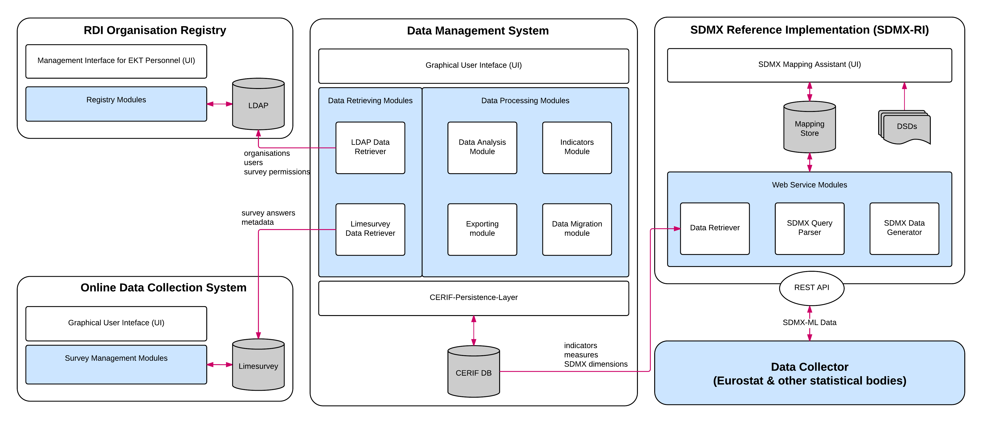
R&D Statistics Information System Architecture

Slide 9

Data Management System (DMS)
Stores, interconnects and manages
  R&D micro-data as collected via the online data collection system
  Organisations profiles as stored in the RDI Organisation Registry
  R&D indicators as produced from statistical analysis
Goals
  Single management point
  Preservation and archiving (time series)
  Data validation & estimation workflow analysis
  Real time automated generation of indicators
  Data exports (SDMX, CSV, Excel, JSON, CERIF-XML)
  Reporting
CERIF standard adopted

Slide 10
Interoperability between CERIF and SDMX
The integration between CERIF and SDMX occurred at both the data and the systemic layer
Integration steps
  at the data layer the SDMX semantic model -DSD- was mapped to CERIF and stored in DMS
  at the data layer again the R&D indicator's specification (as given by Eurostat) was also mapped to CERIF, stored in DMS and interlinked with the DSD
  at the systemic layer DMS was integrated with SDMX-RI acquiring that way a REST API that is able to receive SDMX queries and to respond with SDMX-ML data messages

Slide 11
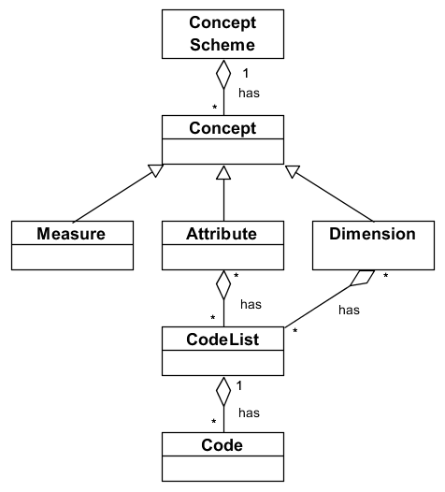
SDMX Data Structure Definition (DSD)
Data Structure Definition (DSD) acts as the semantic layer providing to SDMX the means to describe and characterize the indicators’ values
                DSD files are distributed in XML format by Eurostat (https://webgate.ec.europa.eu/fpfis/mwikis/sdmx/index.php/SDMX_DSD_availability )

Slide 12
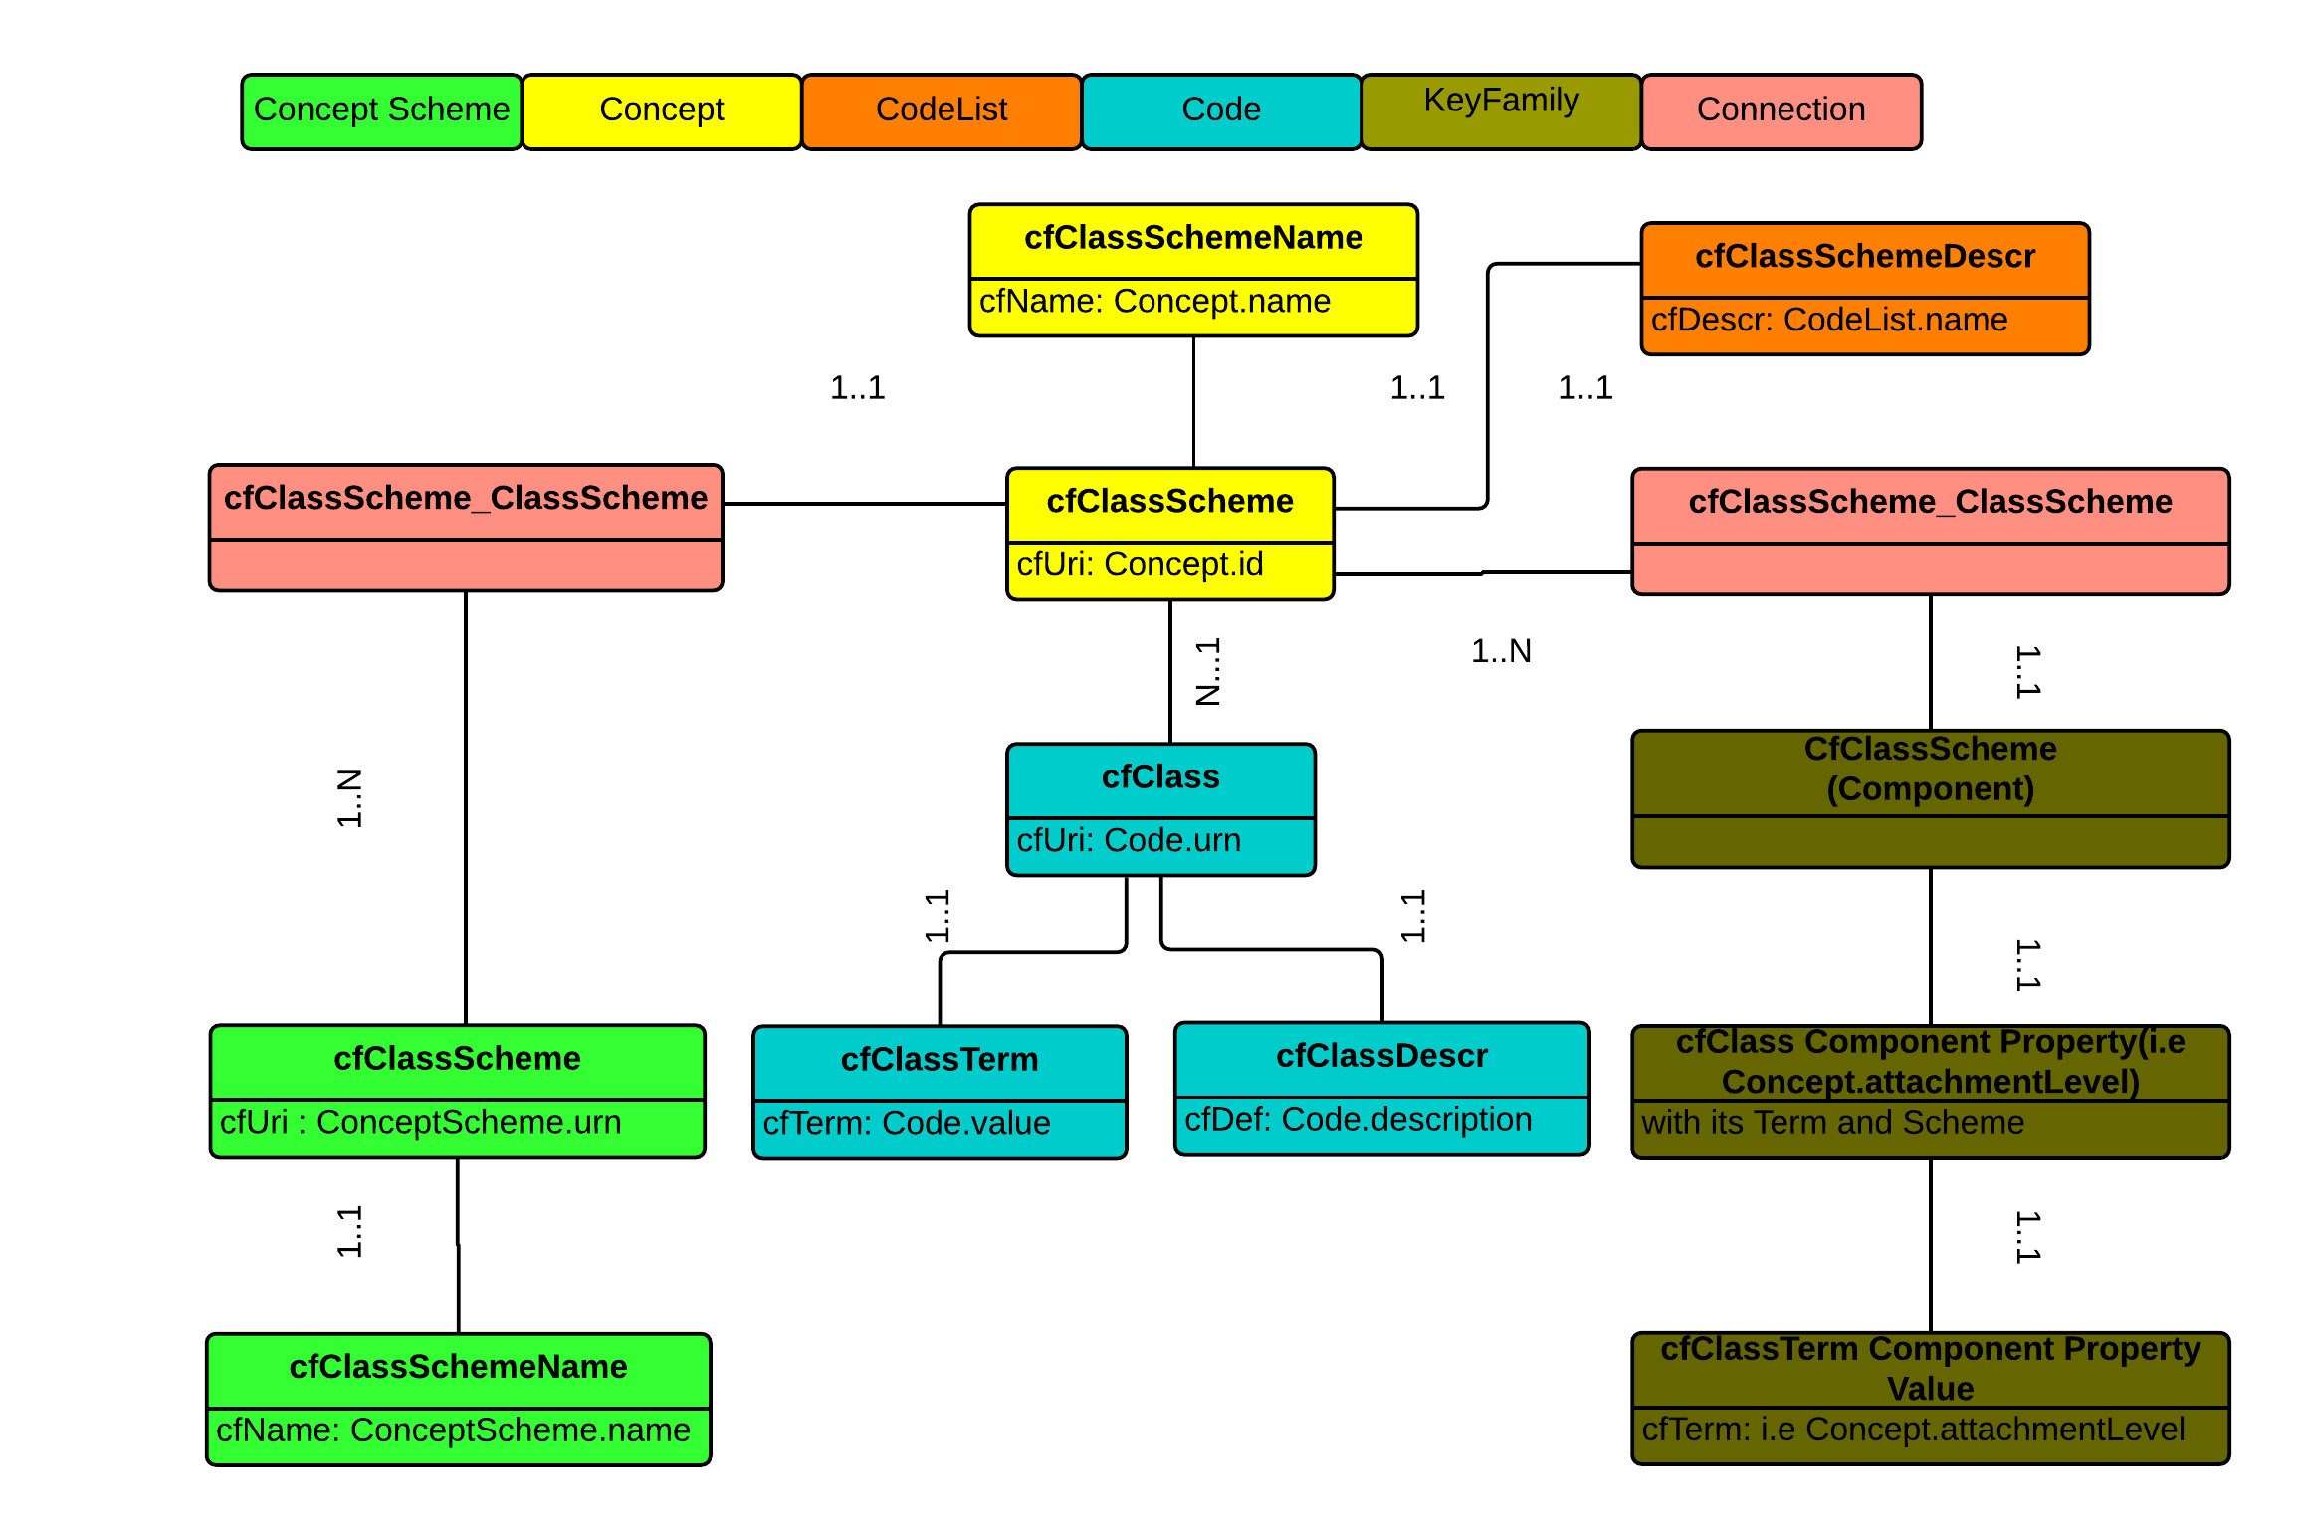
Step 1. Integrating SDMX DSD to CERIF

Slide 13
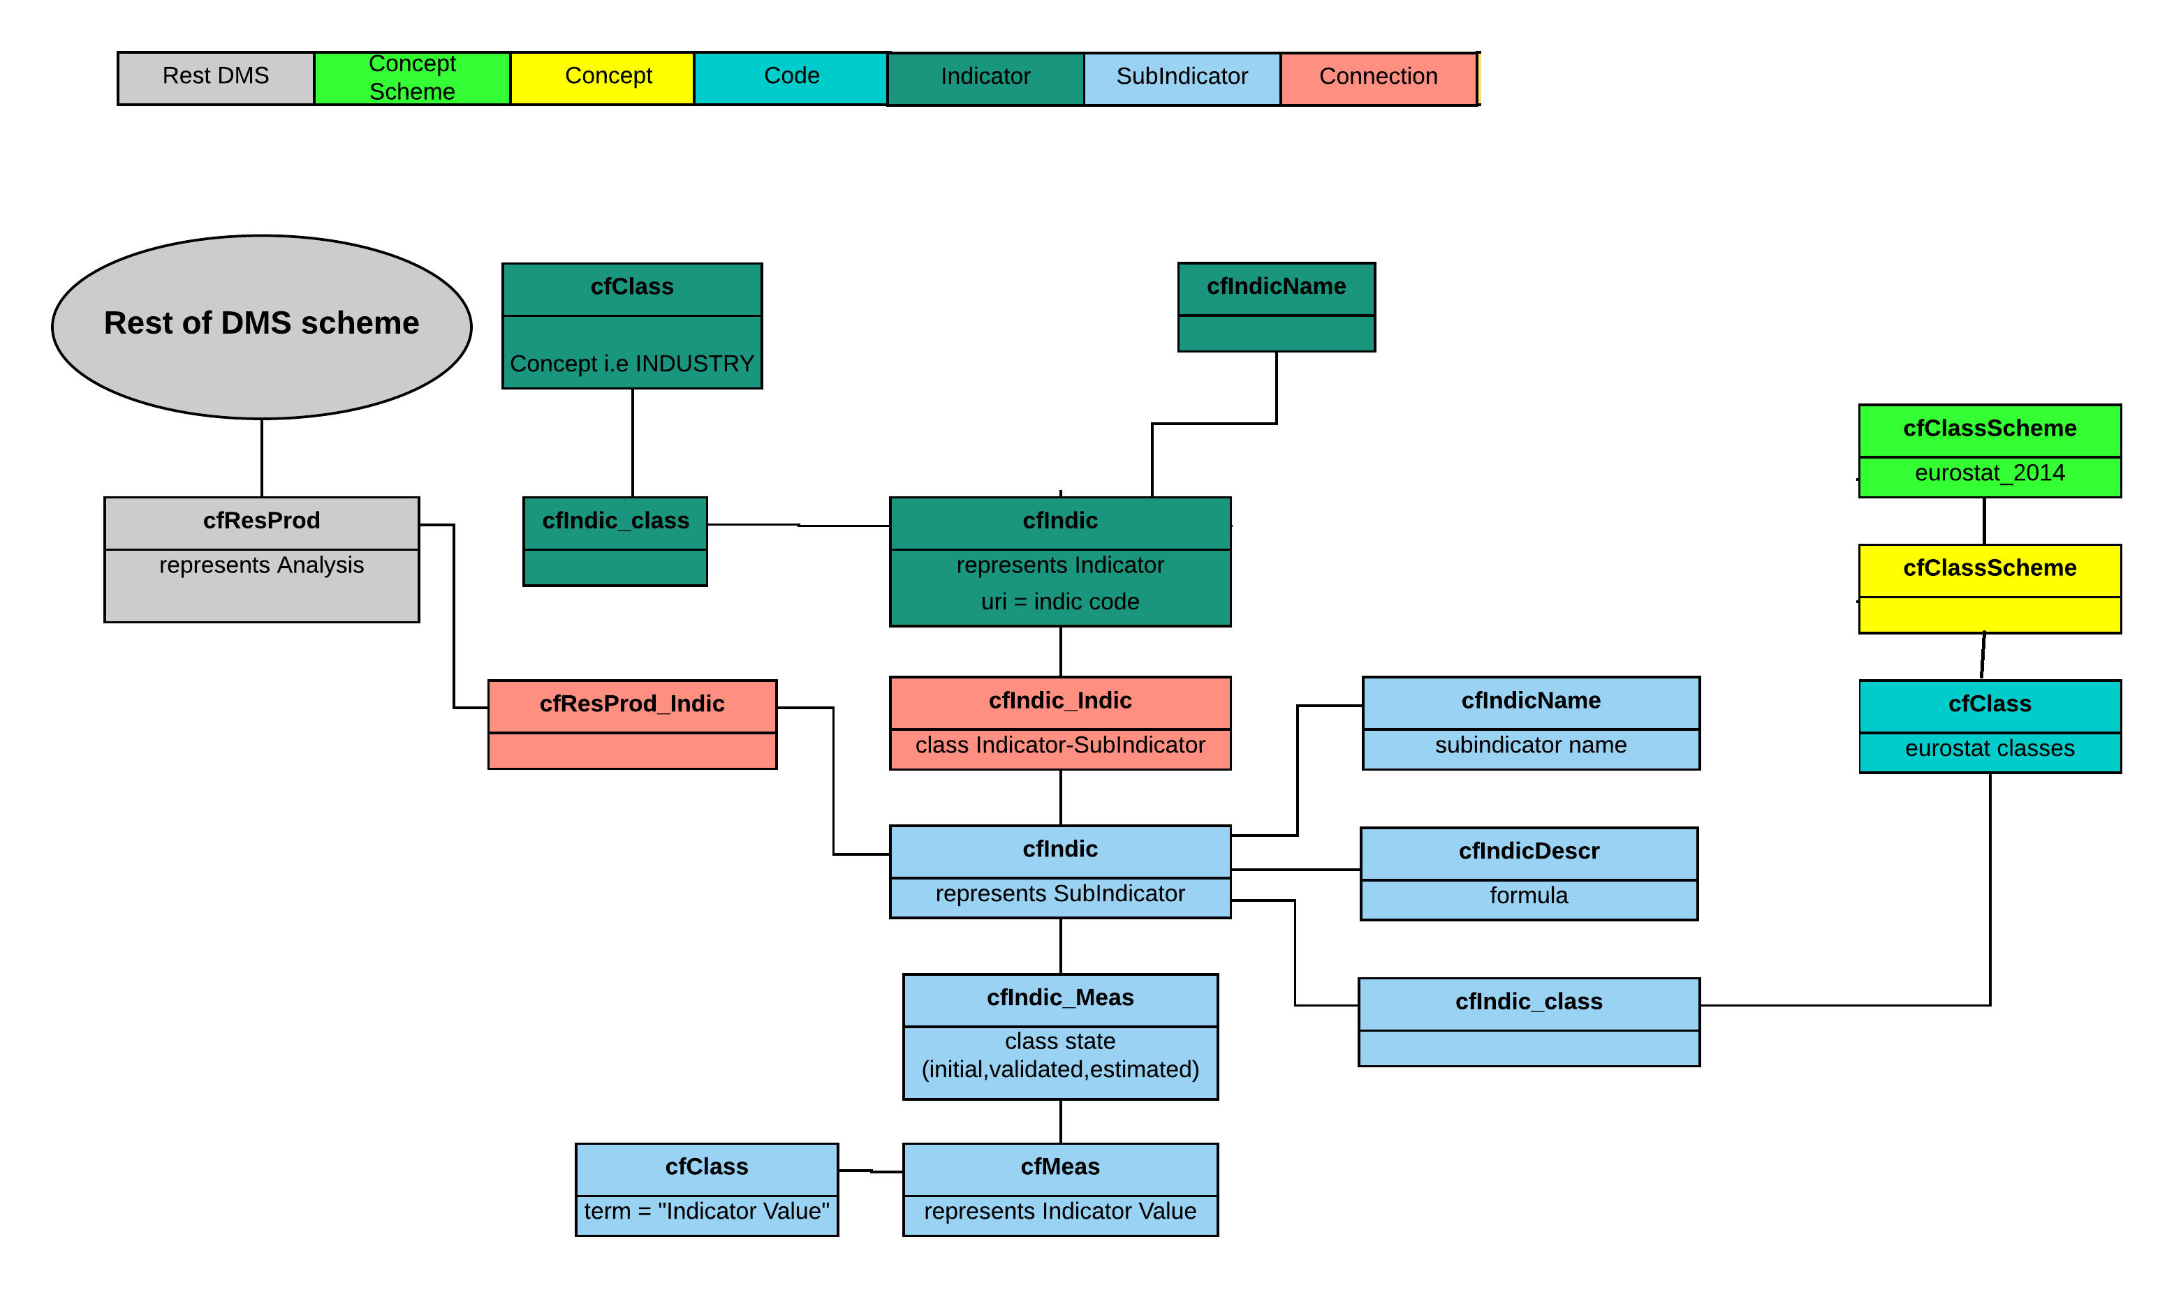
Step 2. Integrating R&D Indicators to CERIF
Eurostat provides the specification of the R&D indicators as an accompanying file with the DSD

Slide 14
Step 3. Systemic Interoperability: Integrating SDMX-RI to DMS
The goal is to make SDMX-RI aware of the DMS database, especially where the indicators and measures are stored, and retrieve the data and their linked metadata
SDMX-RI provides the SDMX Mapping Assistant:
  mapping actual data and their DSD metadata between DMS db and SDMX dissemination db
  creating indicators’ dataflows (option to have different flows for different indicator categories)
In order for the Mapping Assistant to map to CERIF db we added a data service layer on top of the CERIF db:
  focus just on the entities needed (subset of CERIF)
  better performance when retrieving data (~25000 indicators)

Slide 15
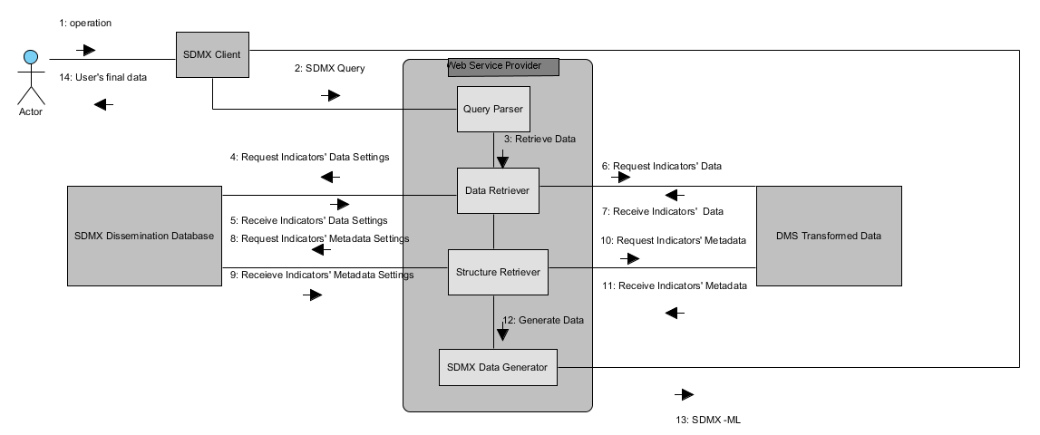
Step 3. Systemic Interoperability: Integrating SDMX-RI to DMS

Slide 16
Conclusions and Further steps
CERIF and SDMX provides:
  data and metadata quality maintenance and archiving
  valid and automated interchange of statistical data
R&D Statistics has helped to trace R&D funds across sectors at an aggregate level but this in turn has stimulated demand for more disaggregated information (OECD, Working Party of National Experts on Science and Technology Indicators, Fundstat, 2016)
CERIF and SDMX provides the appropriate tools to empower the shift to a national R&D data infrastructure of greater granularity down to the level of R&D projects, involved organizations, researchers and performed activities

Slide 17
Thank you for your attention
Q&A
More info:
  karaiskos AT ekt.gr
  http://metrics.ekt.gr/en/

