Slide 1

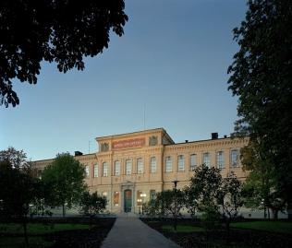
Bibliometrics for research evaluation
Ulf Kronman
Coordinator of OpenAccess.se
The National Library of Sweden
EuroCRIS, Brussels 2012-09-10

Slide 2
Parts of the bibliometrics session
A brief introduction to bibliometrics
  Data sources
  Methods
  Indicators
A critical view on bibliometrics
  Methodological issues, error margins and interpretation
  How should bibliometrics be used?
Documentation: Nordic funding allocation schemes based on bibliometrics
  The Norwegian/Danish/Finnish model
  The Swedish model

Slide 3
Bibliometrics – statistics on publications
Production: Publications
  How many – per year, per researcher, per euro …
  What kind – articles, conference papers, theses, books, reports …
Impact: Citations
  Assumption: A cited publication has been read and made impact
Cooperation and networking
  Which researchers/organisations/countries are publishing together?
  Who is citing who and what is citing what?
Dynamics of scholarly publishing
  Production, impact and cooperation put on a time axis

Slide 4
Commercial data sources for bibliometrics
Thomson Reuters (ISI) Web of Science
  11 500 journal titles covered from 1970's and onwards
  Started as Institute of Scientific Information (ISI) in the 1960's
Elsevier Scopus
  17 000 journals and conference proceedings covered from 1996 and onwards
Google Scholar
  Collects ”everything" on the web
  Also contains monographs, dissertations and reports
Subject specialized sources
  PubMed, Chemical Abstracts, ArXiv, SPIRS, ...

Slide 5
Institutional database (CRIS) for bibliometrics
Advantages
  Better coverage – all document types covered
  Verified data – known authors and organisations
Disadvantages
  No clear definition of what scientific material to include
  No citation analysis
  No world data to compare with
Combining CRIS and commercial data source
  Verified data and citations and world data

Slide 6
Differing conditions for different research fields
Varying publication patterns
  Varying use of publication types
  Varying publication frequencies
  Varying citation conventions and lengths of reference lists
Difference in coverage in bibliometric data sources
  Medicine and natural sciences is well covered
    Most publications are articles in international journals
  Engineering is half-covered
    Publishes in articles, conference proceedings and reports
  Social sciences and humanities is poorly covered
    Publishes in books and non-English regional journals

Slide 7
Visibility of scientific publishing in Thomson database
Journal articles
Conference proceedings
Reports
Books
Natural sciences
and medicine
Engineering and
Social sciences
Humanities
Data from Norwegian Database for statistikk om høgre utdanning (DBH)
Notes:
I Norge har man byggt en databas som innehåller både självregistrerat material och material från Thomson
Därför kan de se hur mycket som kommer från Thomson och hur mycket man behöver registrera manuellt
Databasleverantörerna indexerar främst det material som är lättast att samla in – artiklar in engelskspråkiga tidskrifter

Slide 8
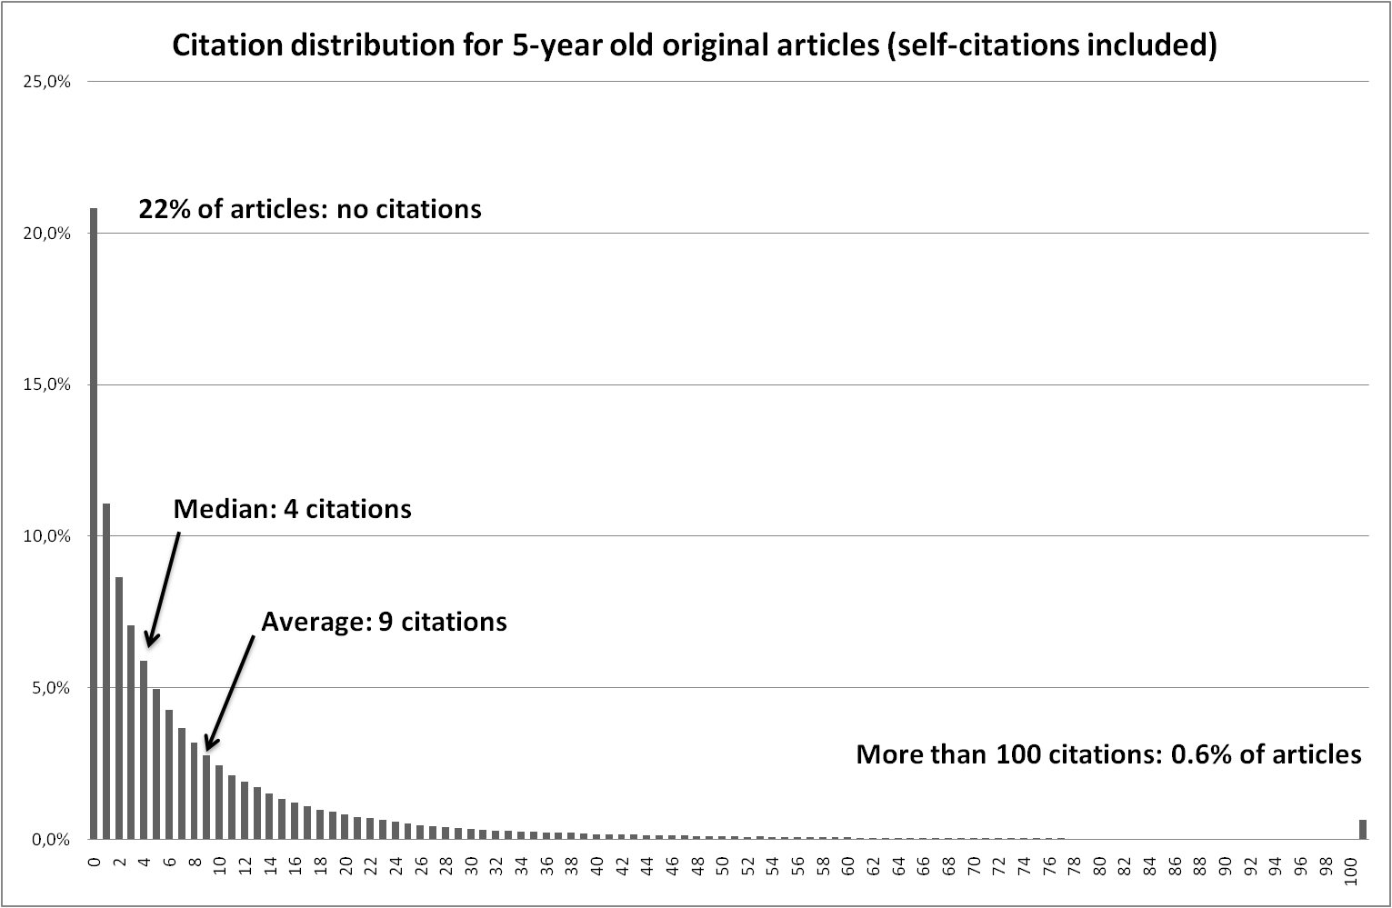
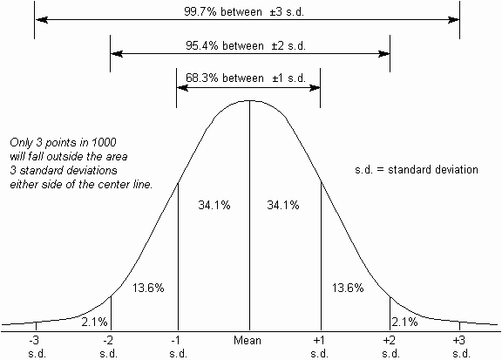
Citations – a skewed distribution
http://www.syque.com/quality_tools/toolbook/Variation/measuring_spread.htm
Notes:
Den skeva fördelningen är ett problem när vi sysslar med statistik
Byta mot färska data?

Slide 9
Citations in relation to publication type and age

Slide 10
Citations in relation to research field and age

Slide 11
Field normalized citation rate (c_{f} "crown")
Normalization – compare publications that are alike
Field normalization compares publications with the world average for publications in:
  The same field
  The same publication year
  Of the same publication type
The world norm is 1
  A value > 1 means more cited than the world average
  A value < 1 means less cited

Slide 12
Summary:
Commonly used bibliometric indicators
Publications (P)
Citations (C)
  Field normalized (c_{f})
Journals
  Thomson Reuters Journal Impact Factor (JIF)
Researchers
  h-index: h number of publications cited at least h times
Networks
  Usually presented as visualizations
Notes:
h-index – populär "vulgärindikator"
Lätt att förstå, lätt att räkna ut
Ej justerad för tid eller fält

Slide 13
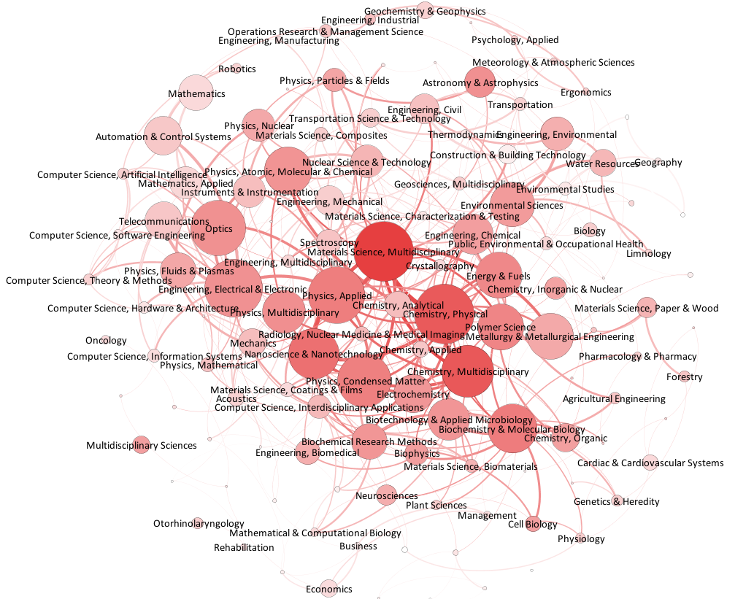
Visualizations of bibliometric relation networks

Slide 14
Does bibliometrics measure research quality?

Slide 15
Methodological issues in bibliometric studies
Data source coverage and quality
  Does the source cover the publishing of the analysed unit?
Data selection and validation
  Is publication data verified or just selected by author name or address search?
Sample size and error margins
  Is the data set sufficiently large for statistics?
Methods and indicator details
  Fractionalization, citation windows, self-citations

Slide 16
Inherent noise in the data material
Artifactual boundaries between groups creates noise
  Analysis constructs boundaries between years, fields, journals and (sometimes) organisations
The researchers' publishing is somewhat "random" at the micro level
  Choice of journal and publishing date
  Choice of articles for reference list
  Attribution of affiliated organisation
Random errors in data
  Citation matching in Thomson system misses on average 6% of the citations due to spelling errors

Slide 17
Citation mean is affected by a few publications
Notes:
When we deal with citation values we have to remember that we are working with a very skewed distribution.
This graph shows the citation distribution for 5-year old original articles. Note that a fifth, 22% of the articles remain uncited, even if we include self-citations.
Also note that the average value is 9 citations, which is more than double the value of the median – the middle value - which is 4 citations. In normal distributions, the median and the average are usually close to each other.
The average value is driven up by a few very highly cited articles, less than 1% of the population. One could argue that it is these highly cited articles we should study, rather than the average values of the big "gray mass" down below, because we can be almost certain that these highly cited articles represent important research.
This skewed distribution of citations shows up in every selection of publications; for fields, countries, universities and journals. So when we are comparing two groups of publications, you have to remember that we are comparing one steep slope against another steep slope.

Slide 18
A study of noise in time series of c_{f}
Yearly variation in field normalized citation rate

Slide 19
Correlation between publication count and noise level in field normalised citation rate
10 % noise level

Slide 20
Does bibliometrics measure research quality?
Yes, if: | No, if:
If the analysed unit publishes its findings in international journals | The research generates books, reports, patents, popular articles or practical results
Citations = impact = quality | Citations indicate something else than quality
The research is conventional and understood by many | The research is young, specialized and breaks paradigms
The data material is big (> 500 publications) | The data material is small (< 50 publications)
Bibliometrics is not diagnostic: It does not detect absence of quality
Notes:
Bibliometri mäter inte frånvaro av kvalitet
Brist på publikationer och citeringar kan ha förklaringar utanför den bibliometriska "sfären"

Slide 21
How should bibliometrics be used?
As a statistical background material to be used by experts
  A non-biased complement to subject and organisation knowledge
Bibliometrics works best at the macro level when used alone
  Best suited for studies on 1000 publications or more
Peer review
Bibliometrics
Countries
Universities
Groups
Individuals
Publications per year
Notes:
Dags att vakna: Föredragets viktigaste bild.
Bibliometri fungerar bättre ju närmare verksamheten och sakkunskapen det används.

Slide 22
Using bibliometrics as performance metrics
  Note the difference between statistical indicators and exact performance metrics
Bibliometric numbers are statistical indicators
  Commercial data with skewed coverage
  Non-transparent methods and statistical error margins
  Works on macro level – large numbers needed
Performance metrics for funding are required to be exact
  Preferably self-reported and ”self-established”
  Transparent
  Comparable between analysed units
  Often used on micro level – departments, research groups and individual researchers
Notes:
Copy slide from Linnéuniv speech

Slide 23
Discussion: Why a hausse on bibliometrics?
Globalization of the scientific community
  Global competition for researchers, students and reputation
  University ranking lists
We are entering an era of knowledge
  Research is the industry of the knowledge society
  Universities are the factories of the knowledge society
Investments in research is a major financial undertaking today
  How measure return on investments?
Very few measurable results from basic research
  Publications and citations are two of the few measurable results from research

Slide 24
Thanks for your attention!
Questions?
E-mail: ulf.kronman [at] kb.se
Twitter: @UlfKronman

Slide 25
Nordic national models for funding based on bibliometrics
Notes:
20 minuter + 10 minuter för frågor

Slide 26
An overview of Nordic funding models
Norway (2004)
  Publication based model with “channel” levels
  Self-registered data + verified Thomson data
  Author fractionalised
Denmark (2010)
  Adapting the "Norwegian model"
Finland (2012?)
  Introducing the "Norwegian model”
Sweden (2009)
  Citation based model
  Only (non-verified) Thomson data
  Address fractionalised

Slide 27
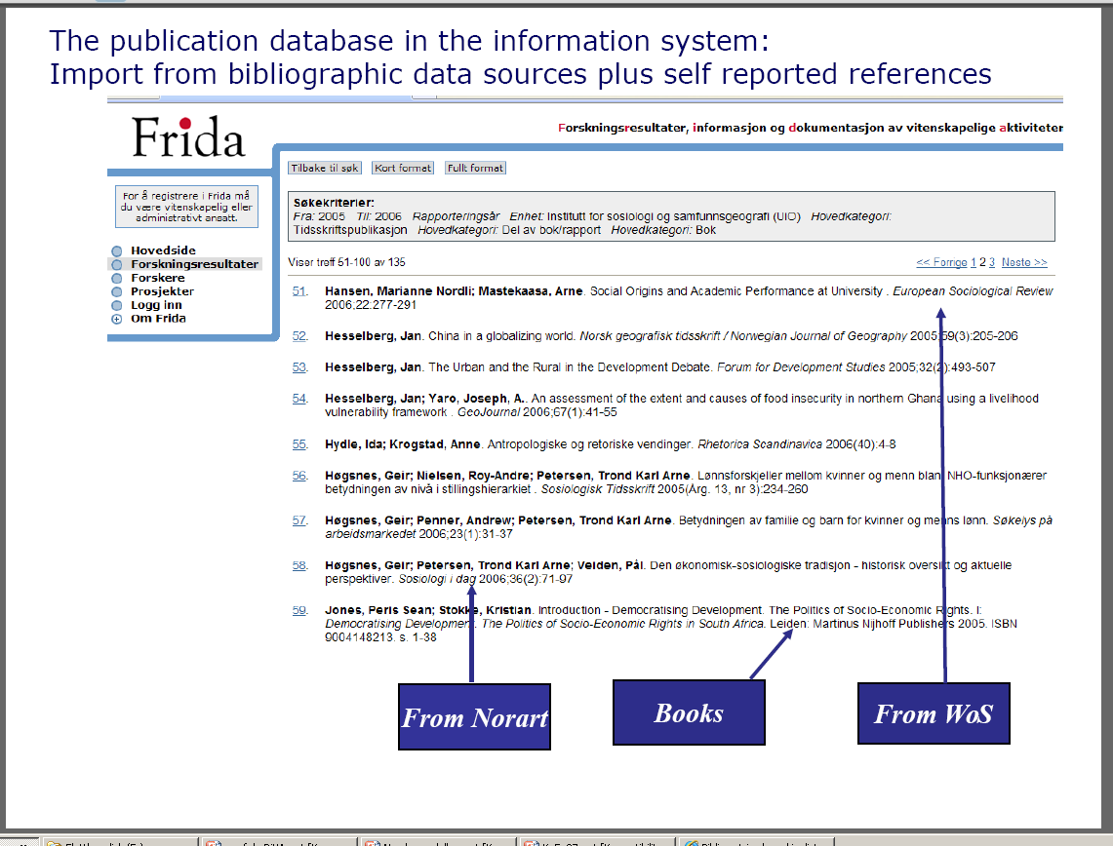
The Norwegian publication channel model
Introduced 2004
About 2% of funding distributed based on publications
Publication records are self-registered
Records from Thomson can be re-used
Three types of publications
  Article in ISSN title = Article in journal
  Article in ISBN title = Chapter in book
  ISBN title = Book

Slide 28
Publication channels divided into two levels
Level 2 consists of higher rated channels = journals and publishers
  Scientific boards for each area decides on the channel levels
Publications in level 2 channels can at maximum represent 20% of the publications in each area
Approximately 20 000 channels have been rated
  Level 2, Level 1, Level – (not considered as peer reviewed)
Level 2:
20% of the publications gives higher publication scores
Level 1:
80% of the publications gives normal publication scores

Slide 29
Publication points in the Norwegian system
Publication type | Points level 1 | Points level 2
Monograph (ISBN) | 5 | 8
Article in journal (ISSN) | 1 | 3
Chapter in book (ISBN) | 0.7 | 1
Publication points for each publication is fractionalised between authors
Publication points are credited to universities in proportion to their share of authors to the publication

Slide 30
Bibliometric funding model in Denmark
Decided for a modified “Norwegian model” in 2009
Will be implemented gradually during 2010-2012
Publication type | Level 1 | Level 2 | No level
Scientific monographs |  |  | 6
Scientific articles in journals | 1 | 3
Scientific articles in anthology-series with ISSN | 1 | 3
Scientific articles in anthologies |  |  | 0.75
Ph’d theses |  |  | 2
Doctoral theses |  |  | 5
Patents |  |  | 1

Slide 31
The Swedish bibliometric funding indicator
Production * Impact
  Field normalized publications * field normalized citations
Field normalised citations
  A conventional bibliometric method exists
Field normalised publication production
  No conventional bibliometric method exists
  New innovative/experimental method was developed by bibliometric researcher/consultant

Slide 32
Basic problems with the Swedish indicator
How compare publication volume between different research fields?
How handle areas with very low visibility in the Thomson database?
  Arts, humanities and social sciences
We need to add self-registered publication data
SwePub.se
Notes:
Når Vetenskapsrådets analysavdelning började arbeta med att kvalitetssäkra och vidareutveckla indikatorn såg vi några stora problemställningar
Och en rad mindre problem (som jag lämnar därhän)

Slide 33
Thomson + SwePub = full coverage?
SwePub data
Thomson data

