Slide 1
CERIF XML update
Jan Dvořák
Andrea Bollini
Thomas Vestdam

Slide 2
Outline
The Goal
Motivation
Solution
Tools and processes
When?

Slide 3
CERIF XML update
A novel approach to constructing the CERIF XML exchange format
Goals:
  Easier to understand & use
  More in line with general expectations

Slide 4
Motivation
Current CERIF XML perceived as:
  Not easy to embed in documents
  Fragmented
  Unsuitable for processing of longer streams
  Not attractive for developers
  Vestdam T., Plauborg B., Van Campe L.:
  CERIF XML in large scale exchange of research information.
  CRIS 2016
  http://dspacecris.eurocris.org/handle/11366/495

Slide 5
Real world CERIF usage
Anyone needs the full CERIF at once
(in one CRIS)?
  Very unlikely
Everybody needs to support
specific information interchange scenario(s)
  Specific subsets of CERIF
  Profiles

Slide 6
A CERIF Profile
Entities & attributes:
  Profile ⊂ CERIF
Semantic vocabularies:
  Profile – more specific
  Sources: CERIF & beyond
Integrity constraints:
  Profile ⊃ CERIF
Profile data is CERIF
Producers know what to include
Consumers know what to expect

Slide 7
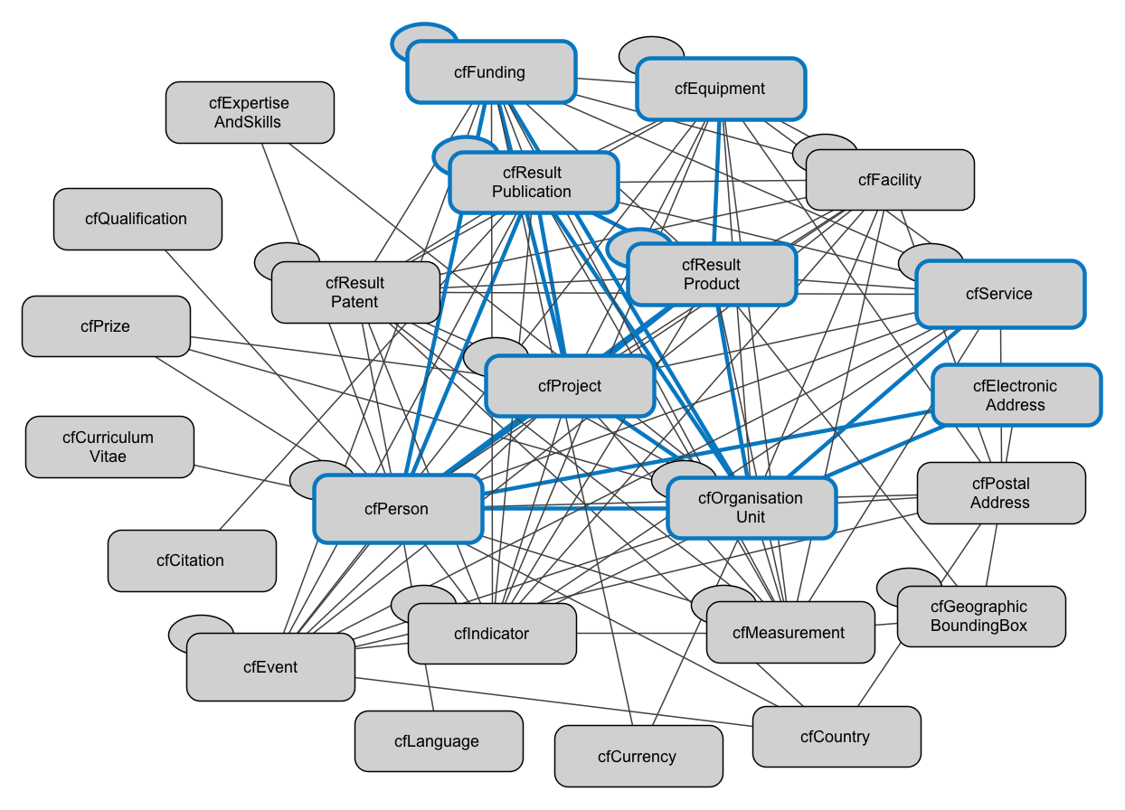
Example of a CERIF Profile:
The OpenAIRE Guidelines for CRIS Managers
https://doi.org/10.5281/zenodo.17065

Slide 8
CERIF Profile Requirements
Easy to construct and share
Effective to use
Remain CERIF
  through the links to the CERIF Data Model

Slide 9
CERIF Profile Artefacts
Description
Examples
XML Schema
  with CERIF annotations

Slide 10
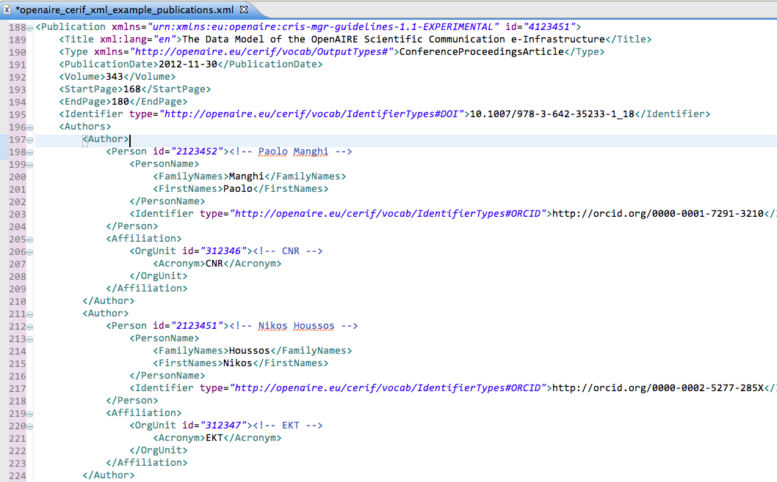
Example

Slide 11
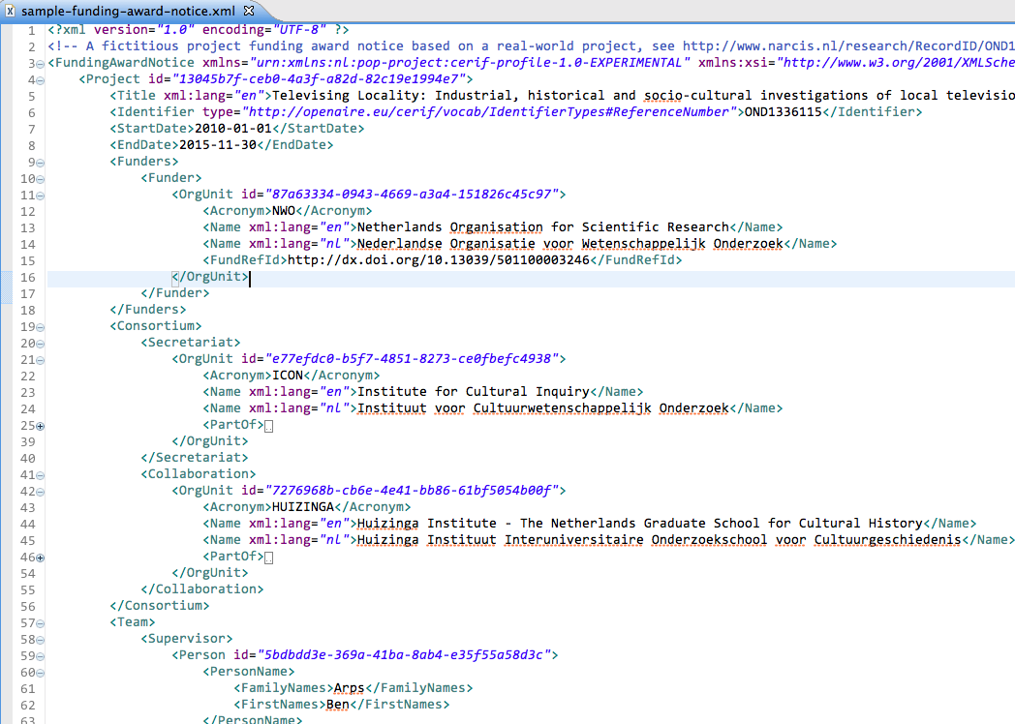

Slide 12
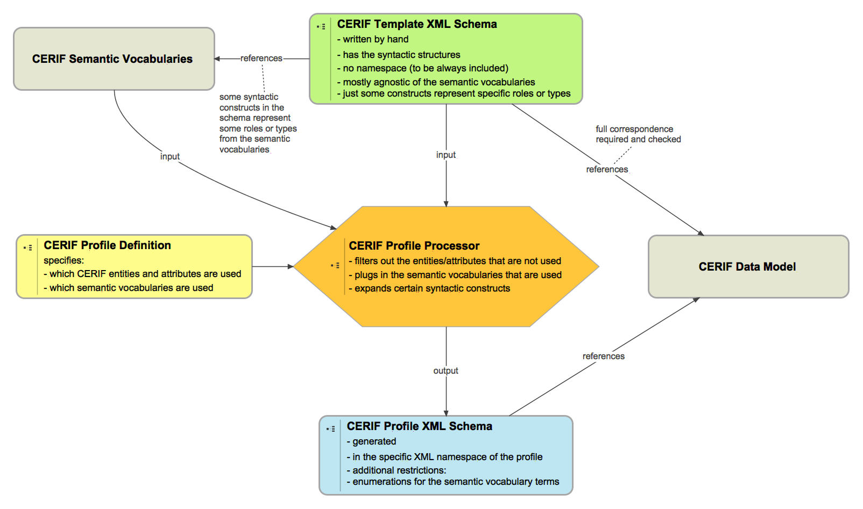
CERIF Profile Workflow

Slide 13
Benefits
For users:
  Readable
  Understandable
  Closer to the domain
For developers:
  Tool-friendly
  Streamable

Slide 14
CERIF development update
More like an open source software project
With feature requests, releases, …
Using proper infrastructure:
GitHub, Wiki, Issue tracker
Using structured governance and roles:
stable members, contributors, etc.

Slide 15
Next Steps
Applications:
Pilot in NL
Snowball
OpenAIRE
CERIF TG:
Work out the tooling
Implement the new working mode
Architecture TG:
Review CERIF API to support profiles

Slide 16
When?
Help by joining the TG!
Embrace the updated CERIF XML
for new projects

Slide 17
The Future
Several CERIF profiles
All of them derive from the same model
Used
by many parties
around the world
in many research information interchange scenarios

