Slide 1
Dr. Philipp Fondermann, Karlsruhe Institute of Technology
Participation, Transparency, Compliance
Struggling for Acceptance implementing a CRIS in the Era of New Public Management

Slide 2
Struggling for Acceptance Implementing a CRIS - Agenda
Praeliminaria
Scepticism and Resistance
Increasing the Probability of Acceptance
Participation
Popular Statements & Questions
Karlsruhe Institute of Technology (KIT) – Facts & Figures
Project KIM-FIS
Fears behind the Statements
Reasons for the Fears
Service Orientation
Compliance
Smart Rollout
Notes:
First I want to give You some preliminary information about the Karlsruhe Institute of Technology, called KIT, and the s.c. KIM-FIS Project.
In a second step I will try to give You an impression of the strong Resistance and Scepticism, we have to face in Rollout or preparing Rollout.
In the Final Chapter it will be shown, with what Approach we try to increase Probability of Acceptance.

Slide 3


Karlsruhe Institute of Technology - Facts & Figures
20.000
students
employees
9.000
800
400
professors
million euro annual budget
Notes:
The Karlsruhe Institute of Technology (KIT) is a German academic research and education institution resulting from a merger of the former University of Karlsruhe and the former Nuclear Research Center Karlsruhe, that took place a few years ago.
KIT is unique in Germany`s Research-Landscape, because it bundles two Missions: We are University of the state of Baden-Wuerttemberg with teaching and research tasks and at the same time a large-scale research institution of the Helmholtz Association conducting program-oriented provident research on behalf of the Federal Republic of Germany.
Here some Facts & Figures.

Slide 4
3 big Applications and 1 Identity Management System
Research & Innovation
Human Resources
Higher Education
Finance
Campus Management
System
Current Research Information
System
Identity Management
Identity Management
Enterprise Resource Planing
System
Notes:
To support or enable the several Lifecycle-Processes in these Fields of Activity, we currently are establishing three major Applications:
in HR & Finance we are merging the two ERP-Systems, that worked independently in both Missions of KIT in the last years,
In Higher Education a Campus Management System,
in the Area of Research and Innovation – besides our excellent Services in Scientific Computing and Large Scale Data Management and Analysis – we are implementing a Current Research Information System.
As the Center of an Integrated and Service Oriented Architecture we developed a federated Identity Management already in 2006.

Slide 5
Project KIM-CRIS – Think Big In Small Steps
Phase I
KIT-CRIS today
Phase II
KIT-CRIS tomorrow
Horizontal Module
Reporting, Controlling, Quality Management
Publications Open Access Repository
Projects / Funding
Technology Transfer
Higher Education
Doctoral Research
Identities Roles Organizational Structure
Vertical Module
Vertical Module
Vertical Module
Vertical Module
Vertical Module
Notes:
Since January 2011 in the Phase I we enabled the System to manage Publications and Projects.
In the Module Reporting, Controlling, Quality Management we established mechanisms, that enable the KIT-CRIS to work as a Business-Intelligence Tool.
With Publications and Projects the system currently is rolled out at 3 of overall 140 institutes.
If the system is accepted and successfully deployed, we expect an easier and faster rollout at the remaining 137 institutes in 2013 and 2014.

Slide 6
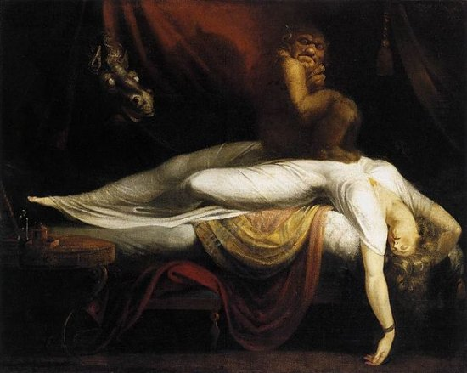
Scepticism and Resistance – Popular Statements
„The networks I have in my
Community are sufficient for me.“
„Why should I give any information to Central Administration? They always used to keep me from working instead of supporting me!“
„Why should I give any information to Central Administration? I am working with partners from Industry mainly.“
„I know what I published.“
I`m already now drowning in reports to be delivered!
„First they will measure, then they will manage.
But in Germany we still have Freedom of Research and Higher Education!“.
Output- oriented Approach es to Quality Measureme nt are outdated and don`t tell anything about Quality of Re search.
„Central Administration seems to keep `inventing problems`. We don`t have.“
If I get some staff in return, I may participate.
Notes:
Acceptance – as You all know – is one of the biggest Risks of CRIS-Implementation Projects and something, that Project Managers definitely have to deal with.
On this Slide I have collected Popular Statements of our Scientists – both Professors and ordinary Staff – that might seem familiar to You.
What I found especially interesting is the Attitude towards the Executive Board and the Central Administration expressed here. I just want to highlight two Aspects:
People use to make very clear, to what degree the Institutes see themselves as only loosely connected with the KIT as the overarching structure.
Executive Board and Central Administration are seen neither as Partner nor as an Authority, that the Institutes Heads want to allow any Influence on Strategy and Daily Work.

Slide 7
Scepticism and Resistance – Popular Questions
„Isn`t that the first
step towards the `
Scientist made of glass`?“
„Who sees my Data?“
„Can my Institutes Head force
me to participate, especially
to reveal my Acticities
and Output?“
„Do I have any Influence
on who sees my Data?“
„Will they make a Black List with lazy Scientists then?“
„Won`t the Chinese
and Iranian then
find
everything relevant
to them a lot easier than before
in one place after just hacking our Repository?“
Could my Institutes Head, in case he would want to get rid of me, try to prove me unproductive `constructing` arguments from CRIS Data, to have a reason to fire me?“
Notes:
On this Slide I have collected Popular Questions of our Scientists, that might also seem familiar to You.
Most of this is common, for it concerns Issues of IT-Security and Data Privacy.
But some Statements are very interesting because of the Fears and Concerns they reveal.

Slide 8
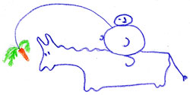


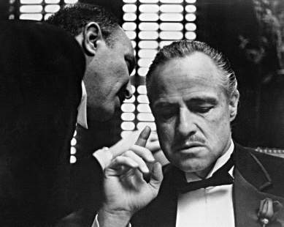
Scepticism and Resistance – Reasons for the Fears
Resistance aginst a Science Management inspired by the principles of New Public Management including Measurement & Management;
Nostalgic Clinging to the old German Humboldt-Model with its Freedom of Research and Higher Education without any Measurement or Management.
The currently Bad Reputation of Social Networks, that secretly collect Informations about our Life and Disposition and sell them to who-knows-who,
and that especially the Scientists Profiles of CRI-Systems are quite similar to.
The currently Bad Reputation of Companies like Google, that secretly track us surfing in the Internet or using Google-Products like Google+ and Google-Mail and sell these Informations to who-knows-who,
and that especially the automated Import of Data from external Sources and the intelligent Mapping to Persons reminds of.
Distrust in THEM in Supervisory Board, Executive Board and Central Ad-ministration, who with a CRIS in their hands would have another instrument
  to end the Freedom of Academia,
  to erect a System of Surveillance made to control and to exploit Scientists,
  to justify the next Dismissals, Wage Cuts and Budget Cuts.
Notes:
I identified several Resons for these Fears and Concerns:
Resistance against New Public Management
The currently Bad Reputation of Social Networks
The currently Bad Reputation of Google etc.
Distrust in THEM in the Supervisory Board, Executive Board and Central Administration.

Slide 9
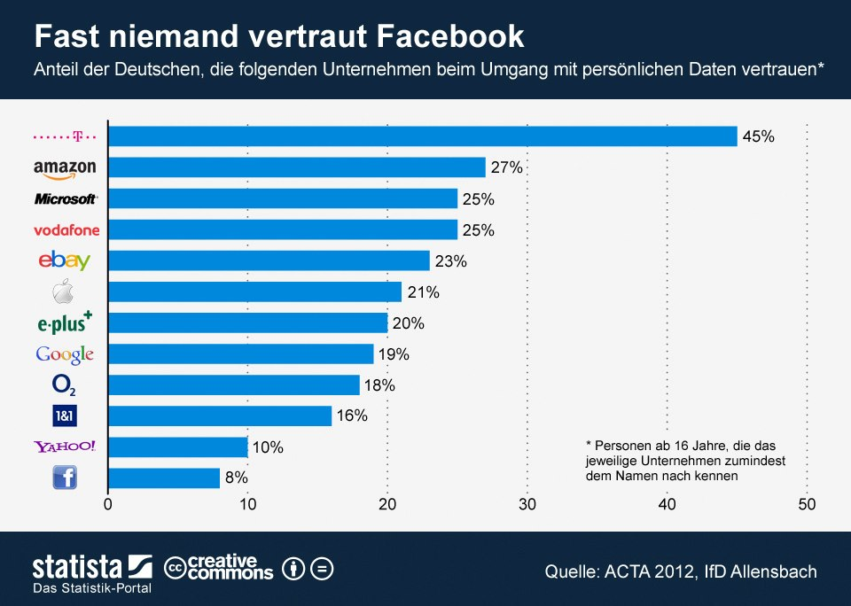
Scepticism and Resistance – Reasons for the Fears
Notes:
Let me illustrate the Mistrust in Google and Facebook by a Statistics from 2012, that is overwritten: Nobody trusts Facebook.
It says, that only about 20% of the German Population thinks, that Google ensures Data Privacy processing Personal Data.
Just 8% think, that Facebook can be trusted Data-Privacy-wise.

Slide 10

A fourfold Approach to increase Probability of Acceptance
Service Orientation
Compliance
Smart Rollout
Participation
Notes:
Well, it doesn`t depend on if You as a Project Manager consider these Fears justified.
Management expects You to develop Strategies to ensure Acceptance in spite of all that, or: to increase Probability of Acceptance.
We chose a Fourfold Approach, that is based on the 4 Columns
Participation
Service Orientation
Compliance
Soft Rollout.
I want to give You some examples from those 4 Fields.

Slide 11
A fourfold Approach to increase Probability of Acceptance
Service Orientation
Compliance
Smart Rollout
Participation
Notes:
Well, it doesn`t depend on if You as a Project Manager consider these Fears justified.
Management expects You to develop Strategies to ensure Acceptance in spite of all that, or: to increase Probability of Acceptance.
We chose a Fourfold Approach, that is based on the 4 Columns
Participation
Service Orientation
Compliance
Soft Rollout.
I want to give You some examples from those 4 Fields.

Slide 12


Participation
Strong Influence of Scientists and Science Managers
Executive Board
Service Providers in
Central Administration
Scientists & Science Managers have
a significant Influence on
Requirements Determination
Call for Tender
Award of Contract
Prototype`s Assessment
Functionality
Usability
Science Managers
Scientists
Notes:
Instead of a Top Down Approach, we from the very Beginning chose a Bottom Up Approach.
That means we ensured, that the Institutes Heads and Scientists have a significant Influence on f.e.
Requirements Determination
Call for Tender
Award of Contract
Prototype`s Assessment
Functionality
Usability.

Slide 13




Participation
Example: Call for Tender and Award of Contract
Interviews with all Stakeholders especially Scientists and Science Managers (S & SM)
Assessment of the Specifications by all Stakeholders especially S & SM
Approval of Specifications by all Stakeholders especially S & SM
Joint Decision of a Representative Commission with a Majority of S & SM
Notes:
Let me give You an example, that already in a very early Phase of the Project, or let`s say: before the Start of the Project we tried to lay the fundament for later Acceptance with a Participation-Model.
When preparing the Call for Tender we
Made Stakeholder Interviews especially with IH`s and Scientists asking for Requirements concerning the Tracking of Research-Activities and –Results,
After the Definition of Requirements ensured their Assessment and Approval especially by IH`s and Scientists,
and ensured a Joint Decision of a Representative Commission with a Majority of IH`s and Scientists.

Slide 14
A fourfold Approach to increase Probability of Acceptance
Service Orientation
Compliance
Smart Rollout
Participation

Slide 15
Service Orientation
Satisfying Stakeholders Needs
Executive Board
Service Providers in
Central Administration
The Stakeholders Influence on
Requirements Determination
Call for Tender
Award of Contract
Prototype`s Assessment
Functionality
Usability etc.
guarantees
meeting Expectations and
satisfying Needs.
Science Managers
Scientists
Notes:
Service Orientation means, that we try to create Services that attractive, that even the Sceptics would use the System without any Enforcement.

Slide 16

Service Orientation
Satisfying Stakeholders Needs
Executive Board
Service Providers in
Central Administration
Science Managers
Scientists
Notes:
What turned out to be especially helpful in this Context was the Stakeholders Infulence f. e. on Requirements and Prototype`s Assessment, that guarantees
meeting Stakeholders Expectations or
satisfying Stakeholders Needs.

Slide 17

Service Orientation
Service Orientation – a Trojan Horse Strategy?
Notes:
A Kind of a `Trojan Horse Strategy`?
Well … Yes – and No.
Of course by ensuring Acceptance and Usage by the Scientists we try to increase or improve Data Quantity and –Quality. And the Back End with its Need for Reporting, Controlling & Quality Management will profit from that.
But at the same time we know, that without creating excellent Conditions for Scientists also concerning the Documentation and Spreading of Research Information we as KIT won`t be attractive enough for World Class Scientists, like we want to.
So both sides profit from a Bottom-Up-designed CRIS.

Slide 18
A fourfold Approach to increase Probability of Acceptance
Service Orientation
Compliance
Smart Rollout
Participation

Slide 19
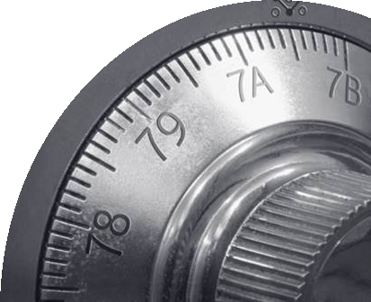
Compliance
Cooperation with Experts developing a Data Privacy Concept comprising
a Register of Processing Operations
  What personal Data
  Is mined and processed how
  visible to whom
  Used for what purpose
  On what legal Basis?
a Contract between KIT and the Supplier with instructions for the Supplier`s Obligations when processing KIT Data having via Access or Remote Access for
  Development
  Migration
  Implementation
  Tests
  Support
  etc.
Influence on the Design of Requirements, Processes, Data Model, Surfaces etc.
Notes:
Also in this Field we from the very beginning we cooperated closely with external Experts developing a Data Privacy Concept.
It consists of several components like
A Register of Processing Operations
A Contract between KIT and the Supplier
Significant Influence of the Experts on the Design of
Surfaces,
Processes,
Data Model etc.

Slide 20
Compliance
Cooperation with IT-Security Experts developing an IT-Security Concept ensuring
  a State-of-the-Art Protection of Data from unauthorized Access or Manipulation
  a State-of-the-Art Back Up-Routine avoiding Data Loss in case of any emergency imaginable
Notes:
Closely cooperating with our internal IT-Security Experts we developed an IT-Security Concept comprising
A State of the Art Protection of Data from unauthorized Access or Manipulation
A State of the Art Backup-Routine avoiding Data Loss in Case of any Emergency imaginable.

Slide 21
Compliance
Cooperation with Employee`s Representatives comprising
  the Assessment of the Data Privacy Concept
  the Assessment of the IT-Security Concept
  an Agreement between Employer and Employees to determine the Employers and Employees DO`s and DON`t`s concerning the Use of the CRIS
Notes:
And last, but not least,
We ensured the Assessment and Approval of the
Data Privacy Concept and
IT-Security Concept
by the Employee`s Represantatives.
In Addition we exaggerated an Agreement between Employer and Employees
to determine the Employers and Employees DO`s and DONT`s concerning the Usage of the CRIS.

Slide 22
A fourfold Approach to increase Probability of Acceptance
Service Orientation
Compliance
Smart Rollout
Participation

Slide 23

Smart Rollout - FRONT END
Rollout Step by Step cooperating with Pilots and Promotors

Slide 24
Smart Rollout - FRONT END
Rollout Step by Step cooperating with Pilots and Promotors
Beginning in
April 2013
140 Institutes
Pilot Phase
Rollout Tranche 1
Rollout Tranche 2
Rollout Tranche 3
2 Institutes
Amount of Use / Users
Notes:
In a first step we set the System in Production at just 2 of about 140 Institutes, called Pilots.
If the CRIS will have been successfully accepted and eventually improved and optimized there, we are optimistic, that
the participating Scientists and Heads of Institutes will be something like Promotors for the System for the Colleagues,
and then the remaining Institutes won`t hesitate to participate too, when comes the time to do so.

Slide 25
Smart Rollout – BACK END
Complete Rollout in Backend independent from Frontend Usage
in
April 2013
140 Institutes
Selected Data
All Publication- and Project-Data
Amount of BACK END Users
Notes:
In a first step we set the System in Production at just 2 of about 140 Institutes, called Pilots.
If the CRIS will have been successfully accepted and eventually improved and optimized there, we are optimistic, that
the participating Scientists and Heads of Institutes will be something like Promotors for the System for the Colleagues,
and then the remaining Institutes won`t hesitate to participate too, when comes the time to do so.

Slide 26
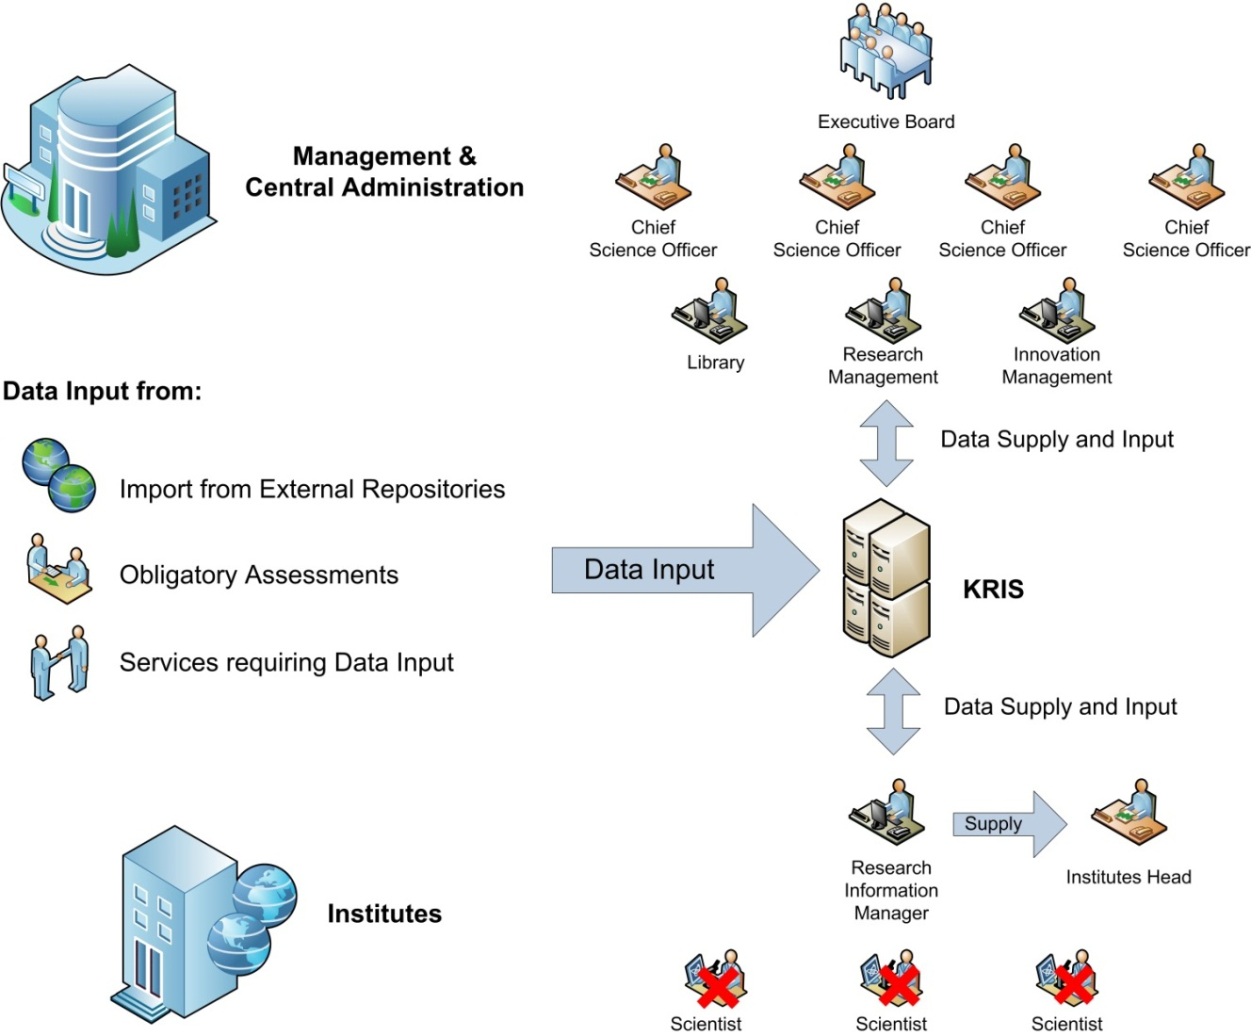
Smart Rollout – BACK END
Data Quality without the Scientists Participation - INPUT
Notes:
Viele Wissenschaftler erklärten, das Profil nicht nutzen und ihre Daten nicht einpflegen zu wollen.
Um uns daher von der Mitwirkung der Wissenschaftler unabhängig zu machen, haben wir uns zunächst klargemacht, wie sehr die Datenquantität und –qualität davon wirklich abhängt.
Das Ergebnis: Die händische Ergänzung von nicht automatisiert oder im Zuge von Serviceprozessen in das System gelangten Informationen spielt eine untergeordnete Rolle – ein Nice to Have.
Wir legen daher keinen Wert darauf, alle Wissenschaftler bspw. eines Instituts zur Nutzung ihres Profils zu bewegen oder gar zu zwingen. Stattdessen legen wir Wert darauf, dass es an jedem Institut einen Informationsmanager gibt, der im Auftrag der Institutsleitung die Forschungsdaten des Instituts pflegt und auch Daten von Verweigerern eingeben und zu diesen relatieren kann.
Ein Zwang zur Nutzung des Profils entsteht bspw. dann, wenn die Institutsleitung Wert auf eine überzeugende Präsentation der Mitarbeiter des Instituts im Web legt. Dann kann die Aufforderung zur Pflege des Profils als interne Policy durchaus ergehen.

Slide 27
Smart Rollout – BACK END
Data Quality without the Scientists Participation - OUTPUT
Notes:
Viele Wissenschaftler erklärten, das Profil nicht nutzen und ihre Daten nicht einpflegen zu wollen.
Um uns daher von der Mitwirkung der Wissenschaftler unabhängig zu machen, haben wir uns zunächst klargemacht, wie sehr die Datenquantität und –qualität davon wirklich abhängt.
Das Ergebnis: Die händische Ergänzung von nicht automatisiert oder im Zuge von Serviceprozessen in das System gelangten Informationen spielt eine untergeordnete Rolle – ein Nice to Have.
Wir legen daher keinen Wert darauf, alle Wissenschaftler bspw. eines Instituts zur Nutzung ihres Profils zu bewegen oder gar zu zwingen. Stattdessen legen wir Wert darauf, dass es an jedem Institut einen Informationsmanager gibt, der im Auftrag der Institutsleitung die Forschungsdaten des Instituts pflegt und auch Daten von Verweigerern eingeben und zu diesen relatieren kann.
Ein Zwang zur Nutzung des Profils entsteht bspw. dann, wenn die Institutsleitung Wert auf eine überzeugende Präsentation der Mitarbeiter des Instituts im Web legt. Dann kann die Aufforderung zur Pflege des Profils als interne Policy durchaus ergehen.

Slide 28
Thank You very much for Your Attention!

