Slide 1
Dr Lisa Colledge
Director of Research Metrics, Elsevier and
Snowball Metrics Program Manager
Snowball Metrics
A standard for research benchmarking between institutions

Slide 2

Snowball Metrics recap

Slide 3

The origins of Snowball Metrics
Competitive award won by Imperial College London and Elsevier to investigate the state of research management in the UK
Clear trends were voiced:
“Unless you have [data] you cannot make informed decisions; you would be acting based on opinions and hearsay.”
“[There is little] thought leadership and knowledge development around best practice.”
“The principle drivers for our systems are often external… but they shouldn’t be… a research strategy should… be developed… to respond to our strengths and the external environment, our systems should be defined to run our business.”
Report available at http://www.snowballmetrics.com/wp-content/uploads/research-information-management1.pdf

Slide 4
University recommendations
1
“The lack of a long-term vision makes it hard to… co-operate within a university let alone across the sector.”
Universities and funders should work more collaboratively, and develop stronger relationships with suppliers
“Universities should work together more to make their collective voice heard by external agencies.”
“Suppliers do not know what research offices do on a daily basis.” “How educated are we at asking suppliers the right questions?”
2
“Someone needs to take ownership of the process: it is impossible to please all of the people all of the time so somebody needs to be strong enough to stand behind decisions and follow through.”
“It would be great if the top five [universities] could collaborate.”

Slide 5









Snowball Metrics project partners
UK group
US group
University of Michigan
University of Minnesota
Northwestern University
University of Illinois at Urbana-Champaign
Arizona State University
MD Anderson Cancer Center
Kansas State University
Australia/New Zealand group
University of Queensland
University of Western Australia
University of Auckland
University of Wollongong
University of Tasmania
Massey University
University of Canberra
Charles Darwin University

Slide 6




Snowball Metrics in a nutshell
Vision: Snowball Metrics enable benchmarking by driving quality and efficiency across higher education’s research and enterprise activities, regardless of system and supplier
Bottom-up initiative: universities define and endorse metrics to generate a strategic dashboard. The community is their guardian
Draw on all data: university, commercial and public
Ensure that the metrics are system- and tool-agnostic
Build on existing definitions and standards where possible and sensible

Slide 7
Main roles and responsibilities
Everyone covers their own costs
Universities
  Agree the metrics to be endorsed as Snowball Metrics
  Determine methodologies to generate the metrics in a commonly understood manner to enable benchmarking, regardless of systems
Elsevier
  Ensures that the methodologies are feasible
  Distribute the outputs using global communications networks
  Day-to-day project management of the global program
Outside the remit of the Snowball Metrics program
  Nature and quality of data sources used to generate Snowball Metrics
  Provision of tools to enable generation and use Snowball Metrics

Slide 8
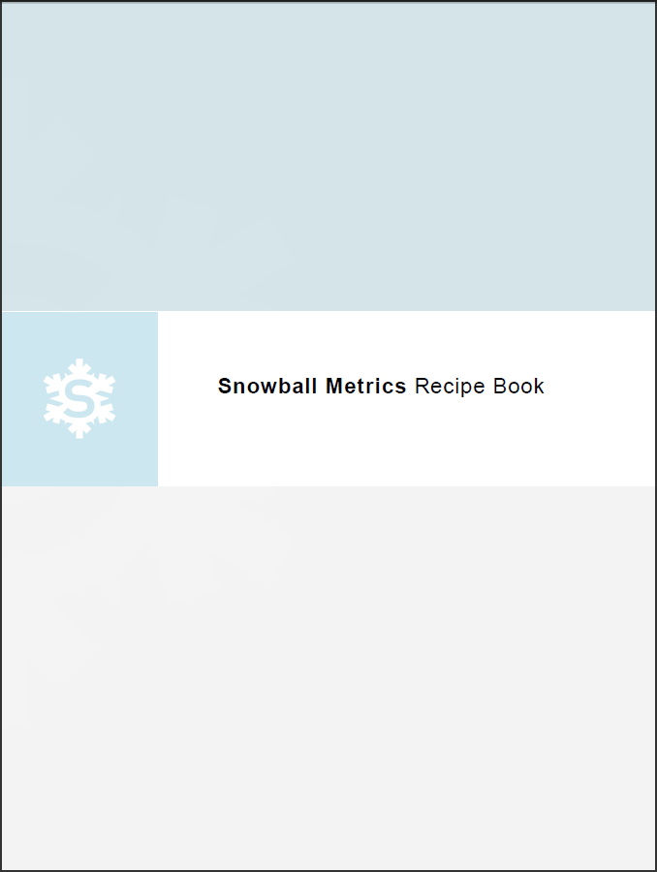
The output of Snowball Metrics
“Recipes” – free, agreed and tested metric methodologies – are the output of Snowball Metrics
From Statement of Intent:
Agreed and tested methodologies… are and will continue to be shared free-of-charge
None of the project partners will at any stage apply any charges for the methodologies
Any organization can use these methodologies for their own purposes, public service or commercial
www.snowballmetrics.com/metrics
Statement of Intent available at http://www.snowballmetrics.com/wp-content/uploads/Snowball-Metrics-Letter-of-Intent.pdf

Slide 9
Exchange of Snowball Metrics
Metrics are exchanged, never data
“I’ll show you mine if you show me yours”

Slide 10
News since euroCRIS conference
New and enhanced recipes
CERIFied recipes
CASRAI-Snowball Metrics project
Internationalisation of the recipes

Slide 11
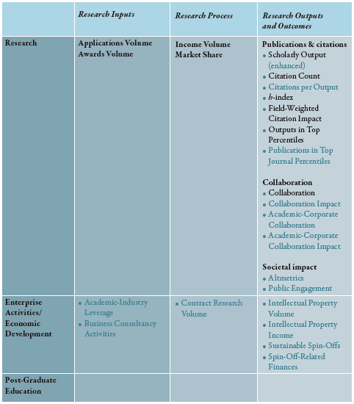
Recipe book version 2
Enormous flexibility in understanding performance is possible from this “basket” of standard metrics, especially with the “slicing and dicing” that can be applied
Recipes in first recipe book
Recipes added in second recipe book

Slide 12
Enhanced recipes

Slide 13
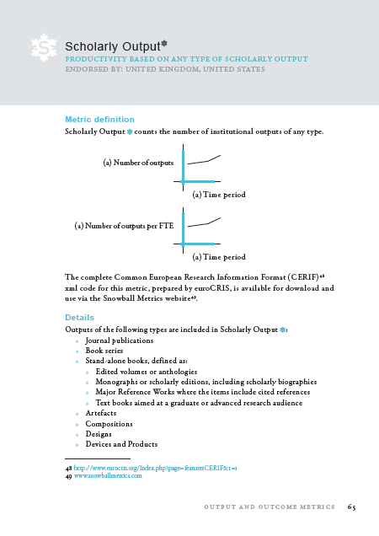
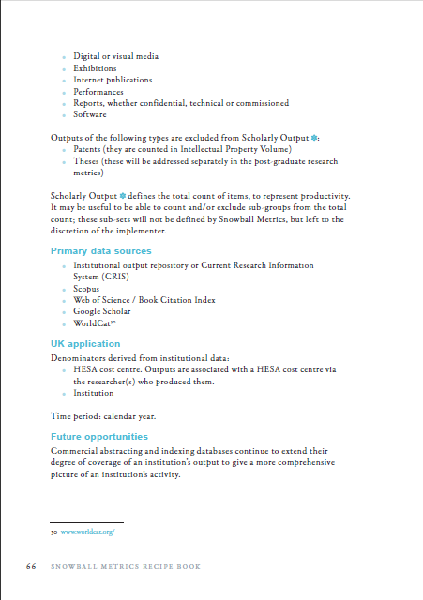
Enhanced version 2
Add detail on output types included and excluded

Slide 14
New: economic development recipes

Slide 15
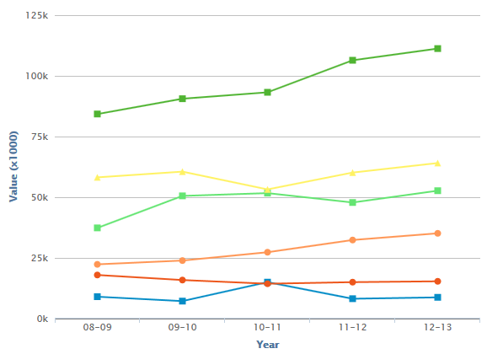
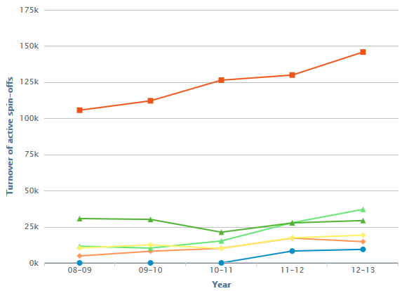
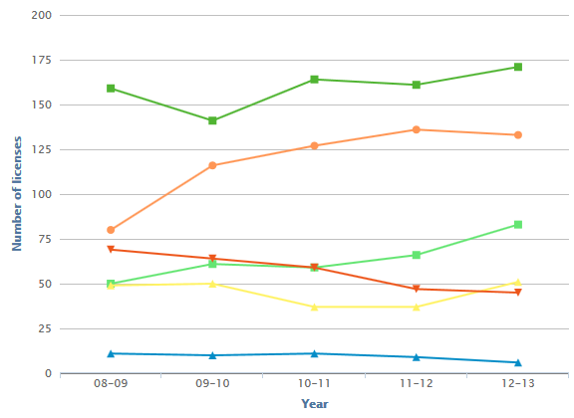
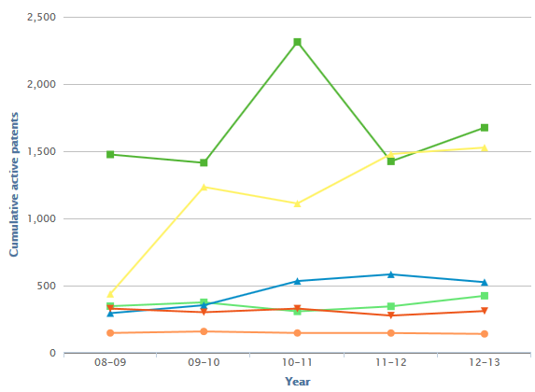
Economic development: a “basket of metrics” gives an accurate picture of performance
Contract Research
Spin-Off-Related Finances
IP Volume / Licenses
Cumulative Active Patents

Slide 16
New: altmetrics recipe

Slide 17
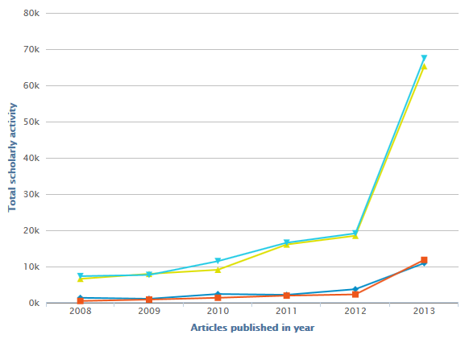
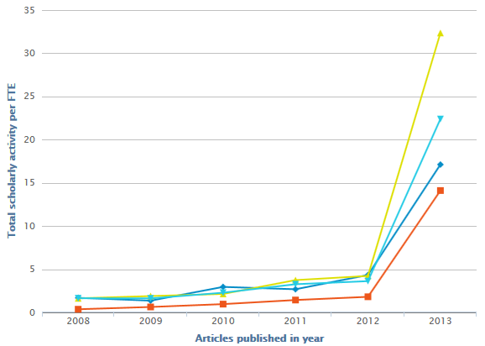
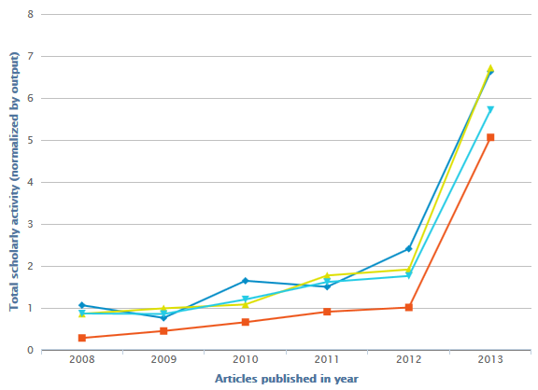
Altmetric: Scholarly Activity flavour
Institution – total counts
Normalised by FTE
Normalised by outputs

Slide 18
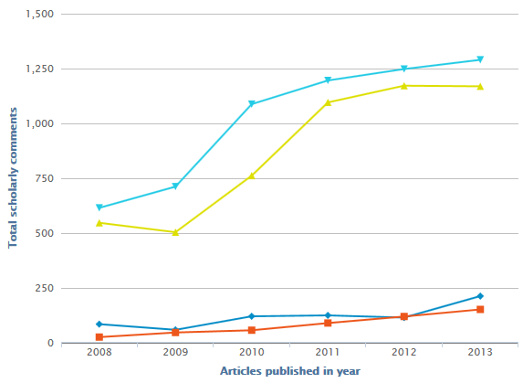
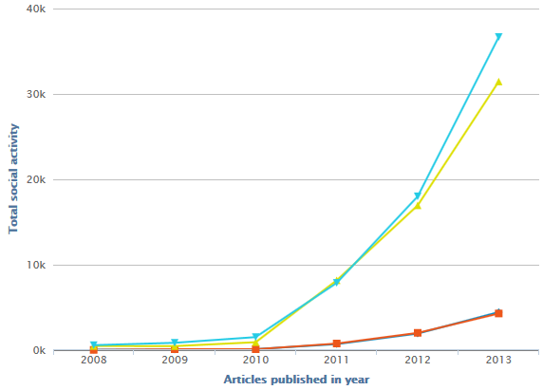
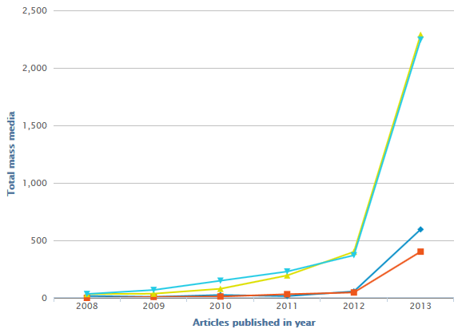
Snowball Altmetrics: 4 flavours
Scholarly Activity: posts in scholarly tools
Scholarly Commentary: comments in scholarly tools
Social Activity: social media posts
Mass Media: references from newspapers etc.

Slide 19
Why the interest in altmetrics?
Measures of engagement with the wider scholarly community
  Scholarly Activity and Scholarly Communication
Measures of engagement outside the academic sphere
  Social Activity and Mass Media
“I firmly believe that altmetrics offer a unique chance to bring Stem and non-Stem together again. How better to build on the current process of the evaluation of research (and the recent introduction in the UK of impact assessment) than by gathering, publishing and analysing data on scholarly influence among the audience beyond the scholarly sphere?”
Part of the Snowball Metrics landscape that aims to provide the most complete picture of research performance possible
  “I would argue that altmetrics alone in their current form cannot be used to judge the quality of research or its output... Nevertheless, pending on improving the underlying data sources, it is likely that altmetrics will play a crucial role in informing the research assessment and impact agenda…”
  Quotes from “Expanding altmetrics to include policy documents will boost its reputation”, Juergen Wastl, Head of Research Information, University of Cambridge, available at http://www.theguardian.com/higher-education-network/blog/2014/jul/23/expanding-altmetrics-include-policy-documents-boost-reputation?commentpage=1

Slide 20
CERIFied recipes

Slide 21
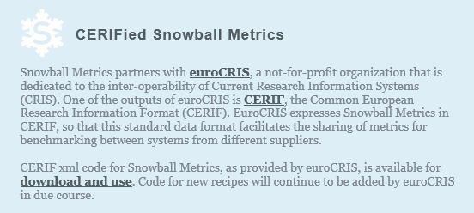
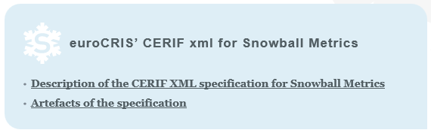
www.snowballmetrics.com/metrics

Slide 22
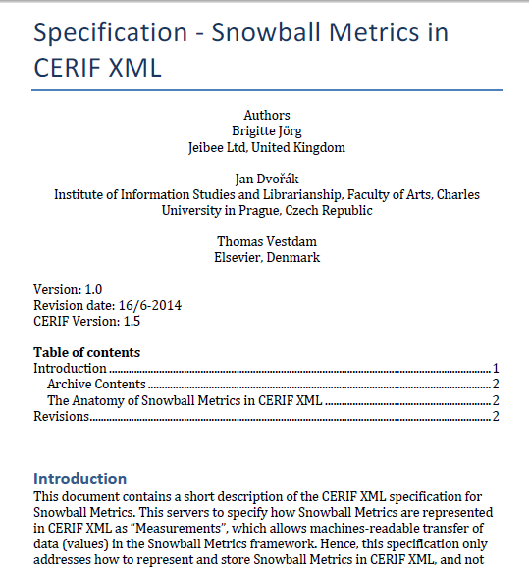
Description of CERIF xml specification

Slide 23
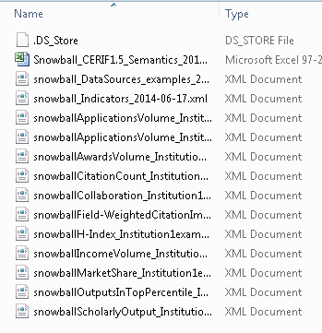
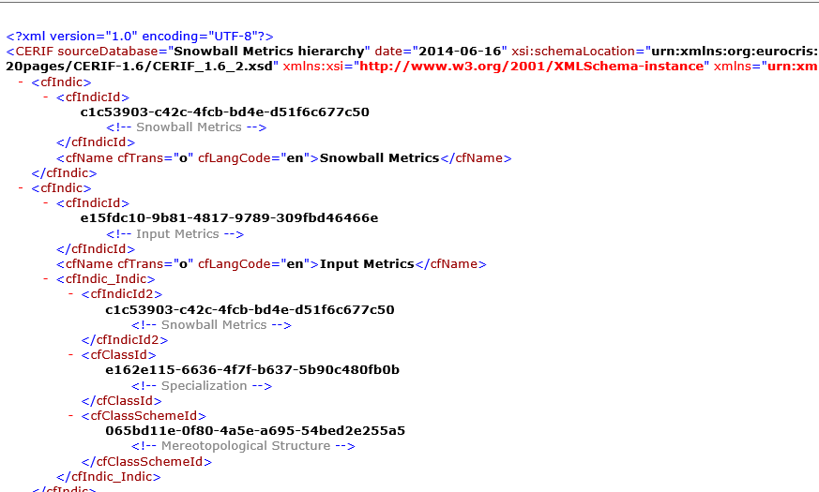
Artefacts of the specification

Slide 24
CASRAI profiles

Slide 25
CASRAI project
“The project to prepare the Snowball Metrics Recipe Book in the CASRAI format (exchange files based on a common vocabulary) will transform the current recipes into CASRAI terms, objects and fields and will conduct a wider review circle on these terms and objects to gather comment and suggested improvements and additions to both the CASRAI standards and the Snowball recipes. The final outputs will be one or more exchange files and a proposed integration/harmonization with current dictionary terms plus any new terms derived from Snowball Metrics.”
Project will also deliver “a streamlined process for the expression of new Snowball Metrics recipes / modified Snowball Metrics recipes as CASRAI standards”

Slide 26
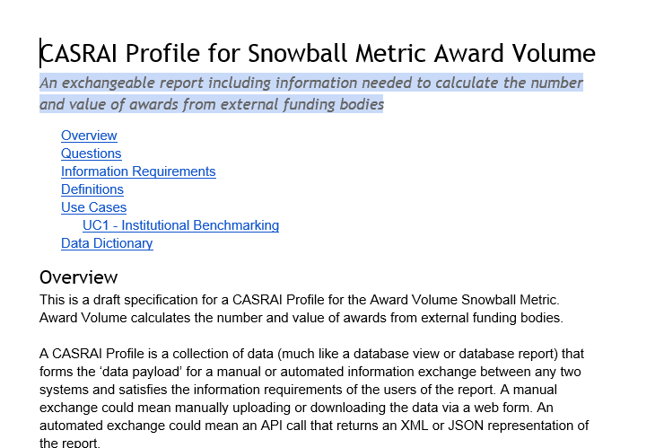
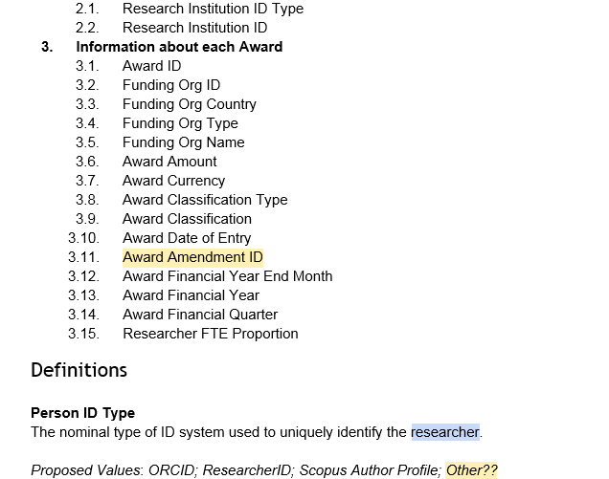
First profile is currently being developed for review

Slide 27
Internationalisation of the recipes

Slide 28

Researcher definition version 1
Very UK-focused without a generic global version
Feedback that it’s difficult for the global community to relate this to their national situations.

Slide 29
Researcher definition iteration by US working group
Any faculty or staff member with PI privileges who reports >0% Research on annual federal Effort Reporting
This definition includes:
Researchers who engage in “traditional” lab work and publishing papers
Researchers doing non-lab-based research: clinicians doing even a small amount of research are counted, but not the many clinicians who don’t do research
People who don’t have certified-PI-enabled status but who are eligible for it, and have time allocated to research of any kind
Librarians and professional research staff e.g. research associates who are performing research solely with internal or philanthropic funds
Postdoctoral fellows
Visiting faculty / researchers
This definition excludes trainees (undergrads, graduate students and postdoctoral fellows) without PI privileges.

Slide 30
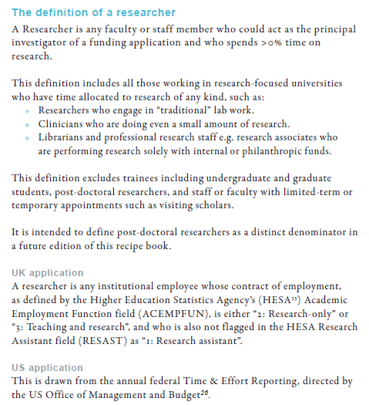
UK and US groups agree version 2
Published in recipe book version 2

Slide 31
National data structure and international benchmarking?
Discipline - desirable characteristics for benchmarking
Researcher assignment to a discipline
Up-to-date (used for national reporting)
Commonly understood
No strategic angle
Relevant outside the organization
UK
HESA cost centres
US
NSF HERD categories
?

Slide 32
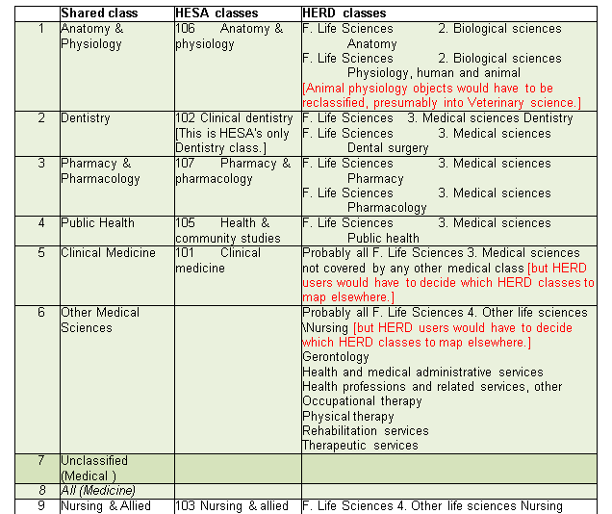
Mapping to a shared class is work in progress

Slide 33
THANK YOU FOR
YOUR TIME AND ATTENTION! l.colledge@elsevier.com snowballmetrics@elsevier.com

