Slide 1

Open Science: the crucial importance of metadata
To realise an optimal and workable Open Science Framework, a conditio sine qua non is that the information and data are FAIR, meaning:
Findable
Accessible
Interoperable \ Interpretable
Reusable
For all these aspects the availability of adequate (enough detailed, expressive) metadata is vital. And consequently: so is the availability of an appropriate metadata ecosystem to optimally handle, exchange and expose the metadata.

Slide 2
CRIS: Treasure Chests of metadata
A CRIS is an information system that holds (interlinked) metadata about virtually all aspects of research:
  The researchers (ID, name, title, affiliation, ...) and their role in the research.
  The projects (ID, title, description, key words, start- and enddate, ...)
  The organisations (institutes, universities,…) involved and their role (owner, funder, ...)
  The input invested in the research both in time (f.t.e.) and money.
  The output from the research (publications, datasets, software, patents, images, etc...)
  The equipment, services and tools (e.g. which version of whic software) used.
  The field or subject of the research.
  The impact of the research, both in- and outside of academia (metrics, impact indicators,…).
  Semantic classifications of the research on various dimensions (typologies, ...),
  Rights metadata: who is authorised or which conditions may apply to access (some of the) information in the CRIS
  Cooperations with other projects, researchers, groups, organisations.
  Links to other systems (HRM, financial, external: ORCID, WoS, Scopus, ...)
  Etc…

Slide 3
CRIS, a big switch in time.
In the course of time CRIS have made a big switch: from tools for research administration to primary resources of research information. In terms of stakeholders/target groups: from administrators to the research(ers) community.
  Initially, CRIS: resources for administrative purposes, notably management, monitoring, evaluation and benchmarking of research.
  Awareness has grown about the big potential of CRIS for profiling and showcasing research. In general: for making research known to the world
  The information in CRIS constitute what may be called, an interconnected and multiple chain of variables (entries) for searching, finding and interpreting research data, their accessibility and their reusability.
  Therefore: it makes a world of difference to a user searching for relevant research data when the metadata that directly apply to the datasets are enriched by the additional metadata available in CRIS. about aspects and entities linked to the dataset.

Slide 4
Resulting Propostions for discussion
In order to realize an optimal FAIR and Open data and Science infrastructure the integration of (the information available in) CRIS (infrastructure) is recommendable if not necessary.
Resulting from this:
The Open Science an FAIR Data communities on the one hand and the CRIS Community on the other should come together and jointly cooperate to work this out.

Slide 5
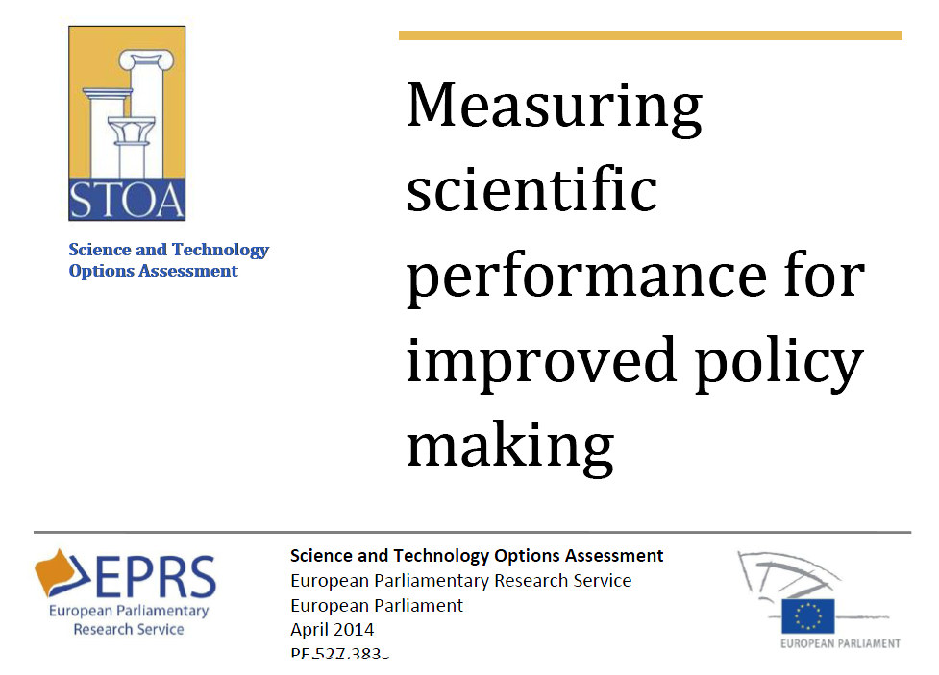
A European Research Information Infrastructure is possible in the near future.
Conclusion of a report of a working group of the European Parliament (April 2014):
“We conclude that a European Integrated Research Information Infrastructure is technically feasible thanks to recent technological developments and especially the maturity of the European CERIF standard, which allows seamless interlinking of datasets and/or research information systems, in different formats and including non-CERIF systems”

Slide 6
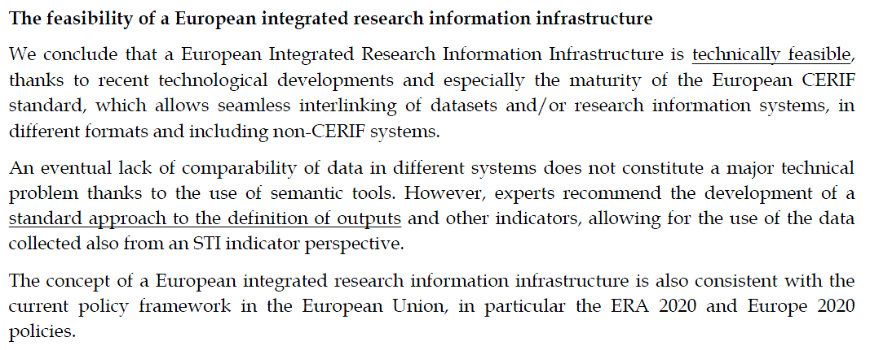
A European Research Information Infrastructure
is possible in the near future.
Conclusion of a report of a working group of the European Parliament (April 2014):
STOA-Report: Measuring Scientific Performance for Improved Policy Making, p. 14.

Slide 7
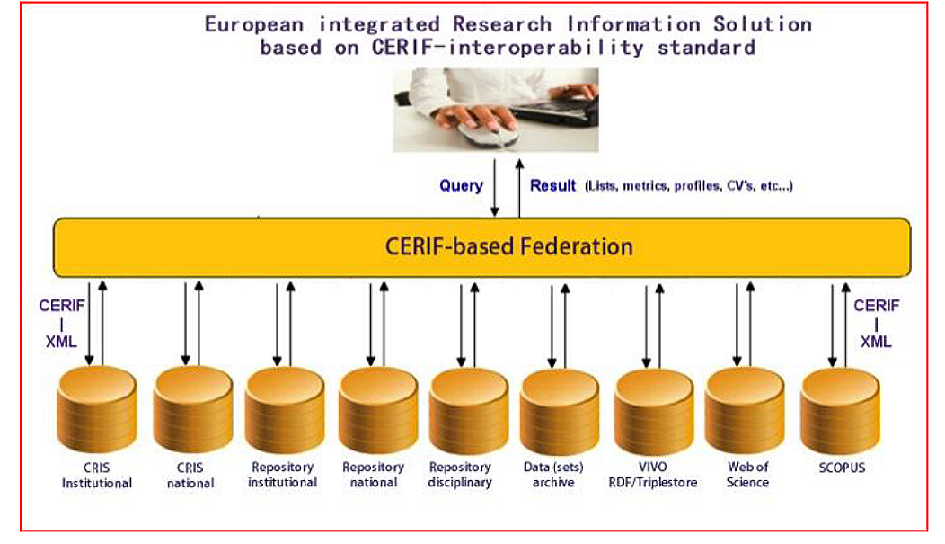
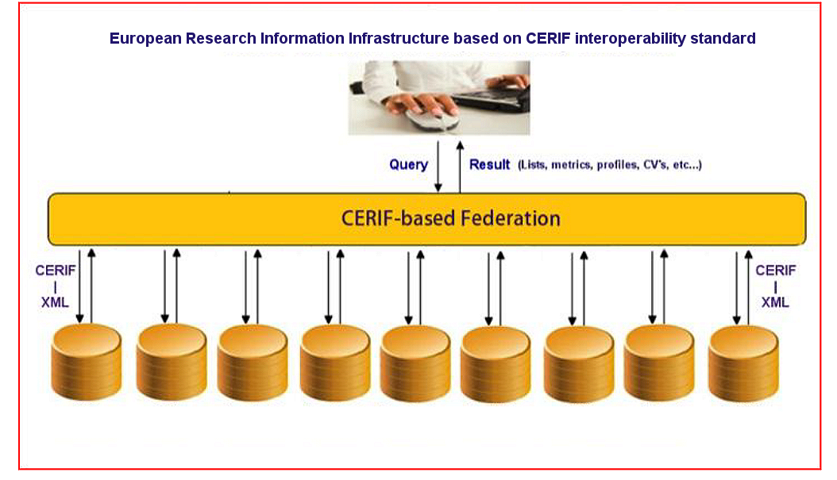
European Research Information Infrastructure: an Architecture.
Standard
use case / profile
Standard
use case / profile
Standard
use case / profile
Standard
use case / profile
Standard
use case / profile
Standard
use case / profile
NATIONAL and LOCAL CRIS AND REPOSITORIES

Slide 8
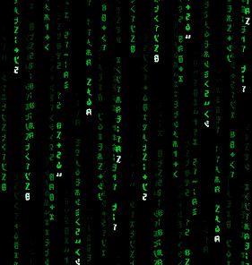

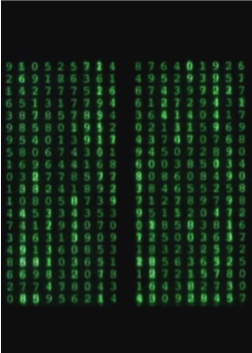

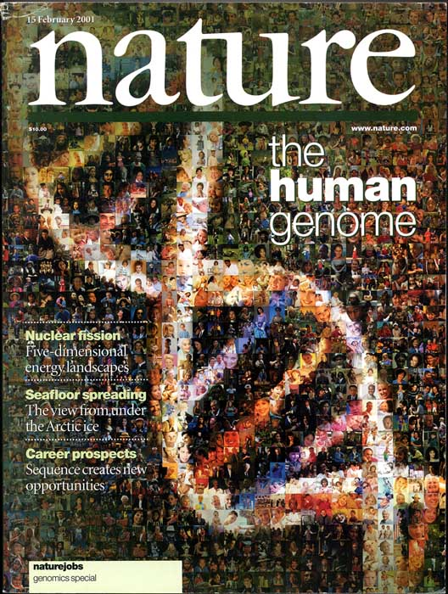




CRIS’s new field of application: Research DATA sets
selection
final dataset
articles
data life
cycle
management
analysis
temporary
storage
data collection
CRIS: linking publications to dataset + archiving of data.
CRIS: registration of (metadata) for dataset
publication of results

