Slide 1
Electronic Theses and Dissertations in Current Research Information Systems
Joachim Schöpfel, University of Lille 3, France
Danica Zendulkova, Slovak Centre of Scientific and Technical Information, Slovakia
Omid Fatemi, University of Tehran and Iranian Institute for Information Science & Technology, Iran

Slide 2
Review of CRIS2010 and CRIS2012
CRIS 2010:
  SEMAT, National Current Research Information System for Iran
CRIS 2012:
  CSTIS, Policy Making Body for National Research Information System in IRAN
CRIS 2014:
  NOSARS, yesterday.
  GANJ, National repository of ETDs today.

Slide 3
Iran Scientific Articles
Notes:
In Islamic Republic of Iran, as Iran 1404, the Vision Document or 20-Year Document dictates the country will be the first in the region
This has resulted in a national research movement and hence, the number of scientific documents has been extremely rising in the recent years.
The number of scientific production has grown substantially in the recent years in Iran. At the end of 2009, the number of Iranian scientific papers was 17,000 out of 1,670,000 global scientific papers. In 2010, 1 percent of global scientific productions was from Iran, while this rate has been increased to 1.2% before the end of 2011. [ISC] Iranian scientists have recorded a total of 88,827 scientific papers during 1990 to 2010; while this record has been only 1387 papers during 1990-2000. [ISC]

Slide 4
GANJ concept
We had SEMAT:
  Every research entity
  But – meta-data level
Full text is required
  Search,
  plagiarism, …
Repository of individual research object category (entity)
Registration mechanism
National ETD Repository (NOSARS)

Slide 5
Concerns
How to collect all full-texts?
How to have current information?
How to have valid data?
How to help universities to setup submission system?
What about security concerns of university?
What about copyright issues?

Slide 6
Design of GANJ
CSTIS (“Commission of Science and Technology Information System”) role
Assigning of national individual full text repositories to Iranian institutes (institutional mapping)
Both print and Electronic versions of ETD should be submitted to SEMAT and GANJ.
  Indexing should be done using controlled vocabulary and thesaurus.
  Presenting bibliographic information and abstract free of charge.
  Providing downloadable full text for members including:
    universities, research institute, and individuals

Slide 7
Commission of Science and Technology Information System
From CRIS2012 slides
Only S&T Information
Information Policy Making
Developing Guidelines and standards
Establishing S&T Information Registry
Institutional Mapping:
  Determine the job description for subsidiaries, units, committees and work groups
Design

Slide 8


Registration Mechanism
Student
Final proposal
Proposal submission
session
The data is registered and managed during the work flow of every individual object.
The result:
  Completeness
  Validity
  Being current and recent
  No extra effort
Major modifications
Defense request
Derense session
To Student
Grading / Accepting
Certificate
University Rep.
Getting started
Proposal Approval
To Student

Slide 9
SEMAT and GANJ
SEMAT (National CRIS)
Institute’s Library
Institute ‘s CRIS
Institutional Repository
Non – research system
National Repository of Journal Articles
National Repository of Dissertations
(GANJ)
National Repository of Patents

Slide 10
Message Hub
National CRIS - SEMAT
GANJ
Message Hub
Message
Message
National Repository for Dissertations
Other systems: HR, EMS
University Library
National Repository for Patents
Message

Slide 11













University
SEMAT
Message Gateway
Message Hub
Garbage Filtering
Security Control
validation
Business Rule
Control
Adaptor
Adaptor
Invalid
No Satisfied
Portal GUI
OK
User
Garbage Message
Incomplete messages
SEMAT DB

Slide 12
Facts and Figures
In 2013, 404 ETD registered daily
In total (2013):
  47251 ETD
    34851 MSc
    2806 Ph.D.
  44662 proposal
From 2008 registration started:
  151367 ETD

Slide 13
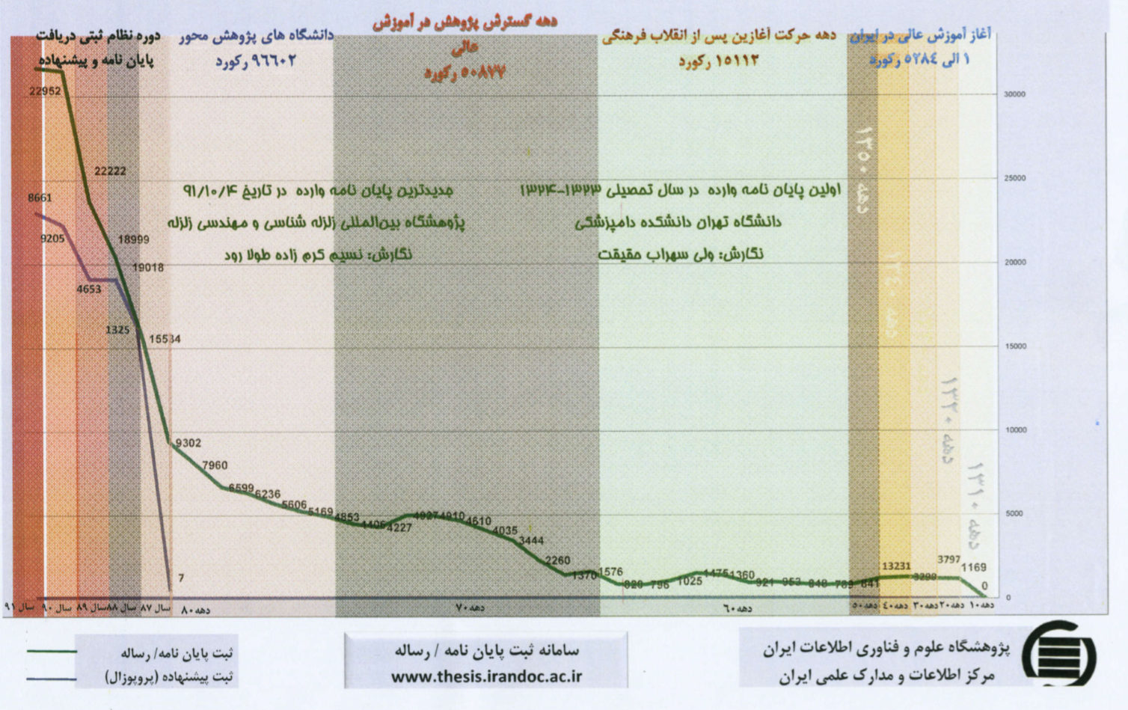

Slide 14
Thank you for your attention
Comments, Suggestions, Questions?
omid@fatemi.net

