Slide 1

Towards a European Research Information Infrastructure
Keith G Jeffery
Honorary President of euroCRIS
©Keith G Jeffery
euroCRIS Member Meeting November 2014
1

Slide 2
Structure
Why?
What?
Learning from the past
How?
When?
©Keith G Jeffery
euroCRIS Member Meeting November 2014
2

Slide 3

Why?
From European Union
The progress of science and technology is crucial:
  To help European companies innovate and stay competitive
  To create more and better jobs in Europe
  And to keep improving the European way of life
investment in research should increase in Europe. At present, less than 2% of Europe's wealth (GDP) is devoted to research, which compares poorly with 2.5% in the USA and more than 3% in Japan.
Our goal is to approach 3% of GDP for research. This is an important part of the so-called Lisbon Strategy. However, since the 3% goal was set in 2002, progress has remained too slow.
©Keith G Jeffery
euroCRIS Member Meeting November 2014
3

Slide 4
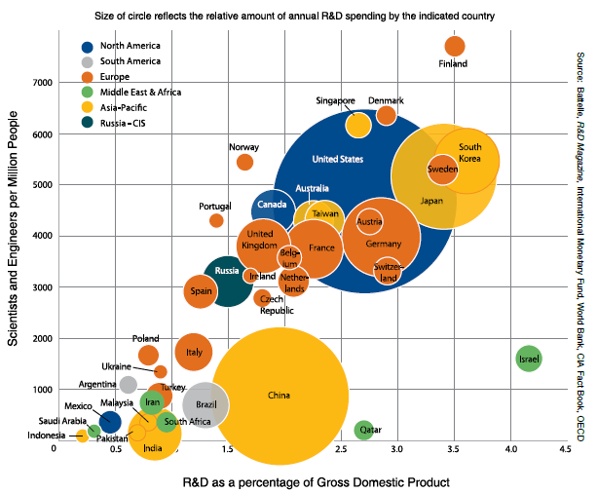
R&D as % of GDP
2014 Global Funding Forecast: Battelle
©Keith G Jeffery
euroCRIS Member Meeting November 2014
4

Slide 5


Why? : To Conclude
We need in Europe
  To increase research funding as % of GDP (excusing Finland & Sweden);
  We need to increase productivity
    Getting more (output) for less (than optimal funding)
    Driving from research to impact on society (economic and well-being)
      The open agenda
  ➔ need to manage research among all stakeholders
©Keith G Jeffery
euroCRIS Member Meeting November 2014
5

Slide 6
Structure
Why?
What?
Learning from the past
How?
When?
©Keith G Jeffery
euroCRIS Member Meeting November 2014
6

Slide 7


CRIS
To satisfy the user requirements
Using the information about R&D
Implies
  High quality, current data
    Formal syntax, declared semantics
    Integrity
    Temporal
  Data management tools
  Data analysis / visualisation tools
  Integration with institutional systems (publications, datasets, project, finance, HR, web..)
But also integrated with e-Research VRE (Virtual Research Environment) for the researcher
©Keith G Jeffery
euroCRIS Member Meeting November 2014
7

Slide 8

Use Case 1 (1)
I want…
A policymaker wishes to compare publicly funded research in geoscience in UK with that in Germany
She accesses the local (institutional) CRIS portal which interacts intelligently to provide authentication / authorisation for the request
  public funding, number of researchers, number of funded projects, value of funded projects, number of peer-reviewed publications, number of patents, licence value of patents, number of spin-outs, capitalised value of spin-outs for years 1984-2014
Institutional CRIS Portal
CERIF Catalog
©Keith G Jeffery
euroCRIS Member Meeting November 2014
8

Slide 9
Use Case 1 (2)
It’s working…
The portal assembles from the CERIF-CRIS globally mirrored metadata on:
  Relevant datasets, location, quality and relevance legalistics, financials
  Relevant software, location, quality and relevance, legalistics, financials
  Relevant resources (computers, data storage, detectors), location, quality and relevance, legalistics, financials
And creates a proposed deployment script with distributed parallelism
Institutional CRIS Portal
CERIF Catalog
©Keith G Jeffery
euroCRIS Member Meeting November 2014
9

Slide 10
Use Case 1 (3)
OK
The portal confirms with the end-user that the assembled proposed workflowed deployment is correct
  Appropriate assembled resources (relevance, quality)
Institutional CRIS Portal
CERIF Catalog
©Keith G Jeffery
euroCRIS Member Meeting November 2014
10

Slide 11
Use Case 1 (4)
It’s preparing it…
The portal then
  Sets up a screen graph of the workflow for the end-user (to keep track of processing)
  Dispatches selection software to each CRIS with appropriate datasets to send results to analytical node
  Dispatches analytical software to appropriate analytical node ready for processing;)
Institutional CRIS Portal
CERIF Catalog
CRIS
CRIS
CRIS
CRIS
©Keith G Jeffery
euroCRIS Member Meeting November 2014
11

Slide 12
Use Case 1 (5)
Go!
The portal
  Initiates the execution on analytical node when selected datasets assembled there;
Institutional CRIS Portal
CERIF Catalog
CRIS
CRIS
CRIS
CRIS
©Keith G Jeffery
euroCRIS Member Meeting November 2014
12

Slide 13
Use Case 1 (6)
Great results
The portal then
  Receives results for end-user and displays to her
  Closes and writes away the detailed log of the processing for future optimisation and audit
Institutional CRIS Portal
CERIF Catalog
CRIS
CRIS
CRIS
CRIS
©Keith G Jeffery
euroCRIS Member Meeting November 2014
13

Slide 14
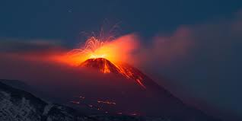
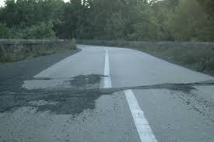
You may be interested to know
With the exception of
  Substituting CRIS for ICS-C and ICS-d
  Changing the query attributes to fit the research information domain
The previous 6 slides of the steps come from the architectural presentation on the EPOS (European Plate Observing System) project
➔ convergence of CRIS with VREs (e-Research)
©Keith G Jeffery
euroCRIS Member Meeting November 2014
14

Slide 15

Use Case 2 (1)
A researcher wishes to generate a research proposal.
  He accesses the CERF-CRIS (institutional) portal
    Is authenticated/authorised
    Sets up the request using CERIF
      Appropriate proposal form
      CV information
      Institutional information
      Bibliography
      Related research (worldwide)
      Related publications (worldwide)
      Any patents, spin-out companies relevant worldwide
  The portal confirms with him the request is as required
    Appropriate, quality
  And sets up the deployment to collect the appropriate information
Institutional CRIS Portal
CERIF Catalog
CRIS
CRIS
CRIS
CRIS
©Keith G Jeffery
euroCRIS Member Meeting November 2014
15

Slide 16


Use Case 2 (2)
The user receives
  The proposal form
  Partially completed as a draft
  With supplementary information
The user completes the form and
  forwards it to the institutional research office (workflow)
  They obtain a UID from the funder, validate, update local system and forward to the funder as CERIF-XML;
©Keith G Jeffery
euroCRIS Member Meeting November 2014
16

Slide 17
Use Case 2 (3)
The funder
  Acknowledges receipt (acknowledgement stored at institution);
  Processes the proposal storing appropriate evaluation information;
  Informs the institution of the result (evaluation form stored at institution)
  If successful sets up a financial account for this grant
  Sends the account UID to the institution
The institution
  Submits claims for payment using CERIF-XML
  The funder though its CERIF-CRIS requests information from the institution (deliverables, publications etc.)
  The funder authorises payment
©Keith G Jeffery
euroCRIS Member Meeting November 2014
17

Slide 18
You may be interested to know
This is CRIS systems acting as B2B (Business to Business)
Very much like most of the commercial world
➔ the point is that CERIF CRIS technology can be used everywhere
➔ and it provides a unifying environment for all aspects of research
©Keith G Jeffery
euroCRIS Member Meeting November 2014
18

Slide 19
What? : To Conclude
All systems CERIF-CRIS
  Not repositories; they do not have integrity
  Full CERIF - mirroring
CERIF metadata/data used as catalog
  Users, datasets/bases, software services, resources
Intelligent query management
  CERIF semantic layer with mutlilinguality
Distributed parallel execution
  Leaves data where it belongs for management (security, privacy) and update (currency)
Can interoperate with repository systems (locally)
  But provides a much richer intercommunication layer
Can interoperate with Open Government Data systems (locally)
  But provides integrity
Integrates with VRE (Virtual research Environment) of researcher
  Intimately in the workflow
Can interoperate with other institutional systems locally (project, finance, HR, web…)
  But provides integration
©Keith G Jeffery
euroCRIS Member Meeting November 2014
19

Slide 20

And strangely…
Using very primitive technology
  Email for query
  FTP for answers
The basic features of international interoperation were present in IDEAS and EXIRPTS (1984-1989)
So what happened in the meantime?
©Keith G Jeffery
euroCRIS Member Meeting November 2014
20

Slide 21
Structure
Why?
What?
Learning from the past
How?
When?
©Keith G Jeffery
euroCRIS Member Meeting November 2014
21

Slide 22
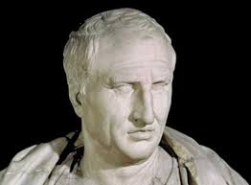
HISTORY
To remain ignorant of things that happened before you were born is to remain a child.
Any man can make mistakes but only a fool persists in his error.
I have always been of the opinion that unpopularity earned by doing what is right is not unpopularity at all but glory.
Cicero
©Keith G Jeffery
euroCRIS Member Meeting November 2014
22

Slide 23




CRIS Interoperation: The Need
In Europe
  recognised need for standard format for interchange of R&D information
Two reports
  Conference of European Rectors Conferences
  Committee of Heads of Research Funding Agencies
One initiative (1984-1987)
  IDEAS Project
  UK-IT-FR
  Demonstrated homogeneous query access to heterogeneous CRISs from all 3 countries (character set, language, syntax, semantics)
  Used ‘catalog technique’ / structured exchange data schema
The IDEAS project presented by UK,FR,IT to meeting of G8 Heads of R&D Demonstrated online in Abingdon, UK in 1987
The G8 (G7 plus SE) wanted a system
The EXIRPTS project was started in 1987
  Catalog technique like IDEAS
  Protocol for retrieval, update over
  heterogeneous distributed databases
Demonstrated online in Venice, IT in 1989
©Keith G Jeffery
euroCRIS Member Meeting November 2014
23

Slide 24

CRIS
Requirements 1990s
cover projects , persons, organisations
  and results: products, patents, publications
  and facilities, equipment, events, services
entities, not more attributes
lengths & types & language, character set
repeating groups (logical)
flexibility - relationships (conceptual)
better data quality
consistent coding (semantic)
record history (date/time)
©Keith G Jeffery
euroCRIS Member Meeting November 2014
24

Slide 25

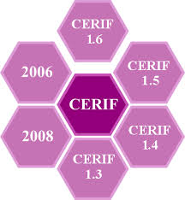
CERIF 2000
Working Group of national representative experts set up 1997 and coordinated by DGXIII-D4, EC
Included two of the IDEAS/EXIRPTS project architects
Formal specification by Jeffery & Asserson
  And demonstrated with MS Access database
CERIF2000 Guidelines, Final Report of the CERIF Revision Working Group, 1999
Common format for development of new CRISs
Common format for exchange of data from records in existing and future multiple different CRISs
CERIF is EU Recommendation to Member States
2002 EC requested euroCRIS to maintain, develop and promote CERIF
©Keith G Jeffery
euroCRIS Member Meeting November 2014
25

Slide 26
A ‘standard’
CERIF: An EU recommendation to Member States
Commission Recommendation concerning the harmonisation within the Community of research and technological development databases (1991-05-06)
Official Journal L 189 , 1991-07-13 p. 0001 - 0034
ftp://ftp.cordis.europa.eu/pub/cerif/docs/cerif1991.htm
This included the requirement to update CERIF which was done in 1997-2000 (and subsequently by euroCRIS).

Slide 27






European Projects
euroCRIS involved in EC-funded projects
  ENGAGE (Open Government Data)
  PASTEUR4OA (OA policy mapping and improvement)
  HOLA CLOUD (mapping CLOUDs research in Europe)
CERIF being used more widely:
  OpenAIRE (needed CERIF to overcome metadata problems)
  CERIF-DSpace (needed CERIF to overcome metadata problems)
  And of course commercial CRIS systems
And outside research information
  EPOS (earthquakes and volcanoes in Europe)
  PaaSage (Cloud computing middleware)
And in further research proposals
©Keith G Jeffery
euroCRIS Member Meeting November 2014
27

Slide 28
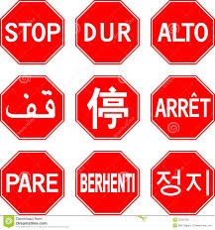
History: To Conclude
With CERIF-CRIS we have the basis for unifying research information – for research, research management, innovation… across Europe
Why is it not happening?
  Not all CRIS are fully CERIF
  Some repositories adding CERIF features but not adopting whole CERIF
  Commercial companies not implementing whole CERIF
  Some moves to LOD/SW (integrity, scale)
Until all systems are fully CERIF compatible (syntax and semantics) we cannot progress much
  There will be much cost and effort in interconversion
  There will be a loss of recall and relevance
  Cannot mirror
A standard is a standard for a purpose
©Keith G Jeffery
euroCRIS Member Meeting November 2014
28

Slide 29
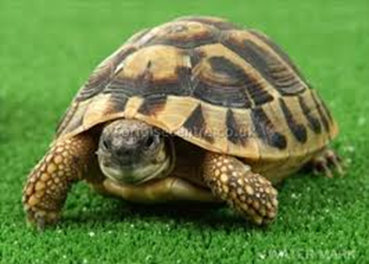
©Keith G Jeffery
euroCRIS Member Meeting November 2014
29

Slide 30
Structure
Why?
What?
Learning from the past
How?
When?
©Keith G Jeffery
euroCRIS Member Meeting November 2014
30

Slide 31
How to achieve a pan-European view of research information
Requirement
Technology
Political will
Users (all kinds) have to realise that they need it
  We have to provide a single technology to do it
  Full CERIF-CRIS everywhere
We have to persuade the EC and national governments
©Keith G Jeffery
euroCRIS Member Meeting November 2014
31

Slide 32

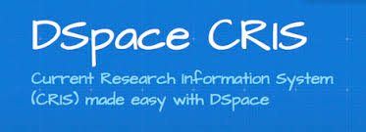

Requirement
Research proposals (input)
  Some movement towards CERIF-like
Research output
  OpenAIRE adopting (most of) CERIF
  Repositories moving to CERIF-like attributes
  Products (datasets): C4D. Products (software…)
  Patents
  Some funder systems (gateway to research) CERIF
Research evaluation
  National funders moving to CERIF-like systems (Research Fish)
Researcher workflow (incl.CV, bibliography…)
  Some part-CERIF (e.g. CRIStiN)
  Commercial systems
B2B research funder / institution
  Experiments in UK
Integration with VRE
  Some initial research projects
©Keith G Jeffery
euroCRIS Member Meeting November 2014
32

Slide 33
Requirement
Research proposals (input)
  Some movement towards CERIF-like
Research output
  OpenAIRE adopting (most of) CERIF
  Repositories moving to CERIF-like attributes
  Products (datasets): C4D. Products (software…)
  Patents
  Some funder systems (gateway to research) CERIF
Research evaluation
  National funders moving to CERIF-like systems (Research Fish)
Researcher workflow (incl.CV, bibliography…)
  Some part-CERIF (e.g. CRIStiN)
  Commercial systems
B2B research funder / institution
  Experiments in UK
Integration with VRE
  Some initial research projects
Which euroCRIS members
are evangelising
©Keith G Jeffery
euroCRIS Member Meeting November 2014
33

Slide 34
Technology
We are in a worse state for interoperation than 1987
  Then we had interoperating national portals
  Admittedly rather basic
We have commercial (almost-)CERIF-compliant CRIS systems
We have homebrew (almost-) CERIF-compliant CRIS systems
We have repository systems tending towards CERIF
We have CERIF-XML (profiles)
  But note potential loss of information and loss of integrity
  Complex connectors to deal with heterogeneity of CERIF partial implementations
This means that the end-user will not get an answer with integrity
  Recall will be < 100%
  Relevance may be compromised (terminology)
©Keith G Jeffery
euroCRIS Member Meeting November 2014
34

Slide 35
Technology
We are in a worse state for interoperation than 1987
  Then we had interoperating portals
  Admittedly rather basic
We have commercial (almost-)CERIF-compliant CRIS systems
We have homebrew (almost-) CERIF-compliant CRIS systems
We have repository systems tending towards CERIF
We have CERIF-XML
  But note potential loss of information and loss of integrity
  Complex connectors to deal with heterogeneity of CERIF partial implementations
This means that the end-user will not get an answer with integrity
  Recall will be < 100%
  Relevance may be compromised (terminology)
Which euroCRIS members
are implementing full CERIF
©Keith G Jeffery
euroCRIS Member Meeting November 2014
35

Slide 36



Political Will
Discussed with EC for 25 years
  CORDIS and CORDA not CERIF
  ERC system is (mainly)
STOA report to European Parliament committee (Technopolis)
  Recommended strongly CERIF
Carl Christian Buhr @ CRIS2014
  Subsequent discussions with
  euroCRIS President
©Keith G Jeffery
euroCRIS Member Meeting November 2014
36

Slide 37
Political Will
Discussed with EC for 25 years
  CORDIS and CORDA not CERIF
  ERC system is (mainly)
STOA report to European Parliament committee (Technopolis)
  Recommended strongly CERIF
Carl Christian Buhr @ CRIS2014
  Subsequent discussions with
  euroCRIS President
Which euroCRIS members
persuade their government
©Keith G Jeffery
euroCRIS Member Meeting November 2014
37

Slide 38

STOA Report (Technopolis)
©Keith G Jeffery
euroCRIS Member Meeting November 2014
38

Slide 39
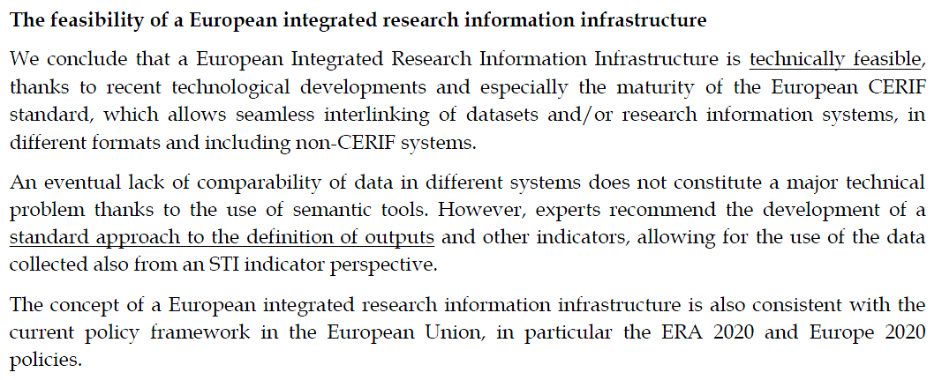
STOA Report (Technopolis)
STOA-Report: Measuring Scientific Performance for Improved Policy Making, p. 14.
©Keith G Jeffery
euroCRIS Member Meeting November 2014
39

Slide 40
How? : To Conclude
Requirement: need to raise awareness among all stakeholders;
Technology: need all implementations CERIF-CRIS (‘face’ of organisation);
Political Will: need a euroCRIS ‘year of action’;
All distributed and parallel
But coordinated
©Keith G Jeffery
euroCRIS Member Meeting November 2014
40

Slide 41
Requirement
Each euroCRIS member organisation should (co-)organise in their own country:
  A support desk
  Documentation in local language
  Demo portal for ‘test drives’ and compatibility testing
  Seminars and training
  Membership drive
  Meetings with funding agencies concerned with research
©Keith G Jeffery
euroCRIS Member Meeting November 2014
41

Slide 42

Technology
Web pages
Directory
Services
CERIF-CRIS
interconnector
This is fine for one organisation but research is international, so interconnector
Publication
repository
Dataset
Software
repository
Finance
system
Human
Resources
system
Project
Management
system
©Keith G Jeffery
euroCRIS Member Meeting November 2014
42

Slide 43
Technology
Web pages
Directory
Services
CERIF-CRIS
CERIF ‘front-ends’ the organisation
Hiding heterogeneity
interconnector
This is fine for one organisation but research is international, so interconnector
Publication
repository
Dataset
Software
repository
Finance
system
Human
Resources
system
Project
Management
system
©Keith G Jeffery
euroCRIS Member Meeting November 2014
43

Slide 44
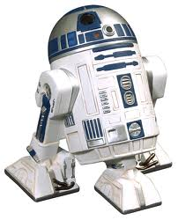

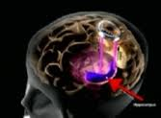
Technology (CRIS2012)
Resource Model
User model
CERIF
Processing model
CERIF
User model
CRISBOT
Virtualised
CRIS
CRISBOT
Data Model
CERIF
Research Information
©Keith G Jeffery
euroCRIS Member Meeting November 2014
44

Slide 45
Political Will
Each euroCRIS member should (co-)organise
  High level events showcasing what can be done with a CERIF-CRIS
    For researchers
    For research managers
    For policymakers
    For innovators / intermediaries
    For the media
©Keith G Jeffery
euroCRIS Member Meeting November 2014
45

Slide 46
Structure
Why?
What?
Learning from the past
How?
When?
©Keith G Jeffery
euroCRIS Member Meeting November 2014
46

Slide 47
NOW
Prof Keith G Jeffery CEng, CITP, FGS, FBCS, HFICS
Honorary President euroCRIS
keith.jeffery@keithgjefferyconsultants.co.uk
©Keith G Jeffery
euroCRIS Member Meeting November 2014
47

