Slide 1
IdRef – Service of reference frames for Higher Education and Research
François Mistral (ABES)
mistral@abes.fr

Slide 2
Introduction
“In 2011, Y. Wang was the world’s most prolific author of scientific publications, with 3 926 to their name — a rate of more than 10 per day.
Never heard of him ?
He is a mixture of many different Y. Wangs, each indistinguishable in the scholarly records.”
Source : Nature 30/05/2012 « Scientists : your number is up »

Slide 3
Agenda
(intro) This talk deals with reference frames.
(part 1) It starts from the issue of identification of author(s) in scientific activities.
(part 2) It presents IdRef - available service of reference frames.
(part 3) It shows web examples of what can be done with it between applications.
(outro) It ends with what does IdRef need to reach its edge.

Slide 4
Outline
IdRef reliably attributes research outputs to their true author by assigning every contributor a unique digital identifier.
Identifiers are a garanty of interoperability.
IdRef do such a thing for contributors, institutions and topics of french Higher Education and Research.
It’s free, public and safe.
Quality of the frames is ensured by metadata experts in networks of libraries.

Slide 5
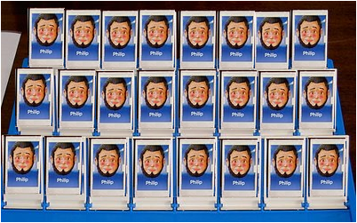
What we have

Slide 6
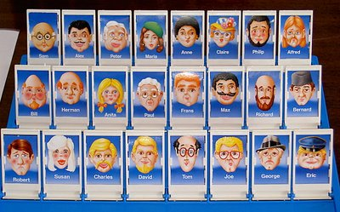
What we want

Slide 7
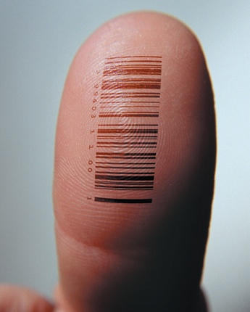
What we need

Slide 8
Origins : the authority records of Sudoc
An authority record can describe a subject, a person, a community, a family, a brand name, a geographical name or the title of a work standard.
Authority records are used to uniquely identify contributor(s) and subject(s) of an item being cataloged.
For 20 years, thousands of qualified librarians in more than 4500 institutions describe authorities of the cultural and scientific production.
Now critical mass is reached, the reference frame can be used in the wide domain of Higher Education and Research.
Notes:
Ensemble structuré d’informations utilisé pour l’exécution d’un logiciel et constituant un cadre commun à plusieurs applications.
Structured set of information used for the execution of a software component and a common framework for multiple applications.

Slide 9
The concept of authority record
theses.fr
Sudoc
These in progress dir. by Jean Martin
IdRef
In progress directed by
Book by Jean Martin
Written by
Jean martin = ID1
These dir. by Jean Martin
Directed by
≠
Calames
Jean martin = other ID2
Author
Archives of Jean Martin
Actes colloq. dir. by Jean Martin
Directed by

Slide 10
IdRef : visibility and re-use
IdRef, for « Identifiants & Référentiels », is both a database, containing authority data gathered in several sets (Persons, Topics, Corporate Bodies, and so on).
And a web application to search, to query and to product authority record.
The re-use of the data is through many differents ways : API, webservices, OAI storage, direct plug to IdRef.
But also in many different standard engine languages : html, XML, RDF, JSON

Slide 11






IdRef from ABES network…

Slide 12
A complet service of frames
3 major frames are available on IdRef
  Persons : Available : more than 250 000 persons involve in THESES and documents possessed by french university libraries and institutions of of our 180 partners' network
  Corporate bodies : Available : more than 5 000 institutions of Higher Education and Research involved in publications of our databases
  - Etablissements du supérieur et de la recherche
  - Ecoles Doctorales
  - Laboratoires
  - Entreprises
  Topics : Available : more than 200 000 concepts of controled vocabularies RAMEAU or FMESH (at least)

Slide 13













… to national network
Conditor

Slide 14

IdRef based on simple technology and is natively designed for interoperability.
IdRef based on active catalogs providing constant improvement.
IdRef based on trades : the skills of numerous professional of metadata in university libraries.
The complete description of theses ensures fine description of the roles of People and Organizations , both public and private , from University to research team.
IdRef is characterized by its triple opening :
  Legal : Licensed data
  Technical : interoperability with all type of application and data recovery
  Web : enrichment by crowdsourcing and contribution to linked data

Slide 15




Into international landscape
Conditor
VIAF

Slide 16
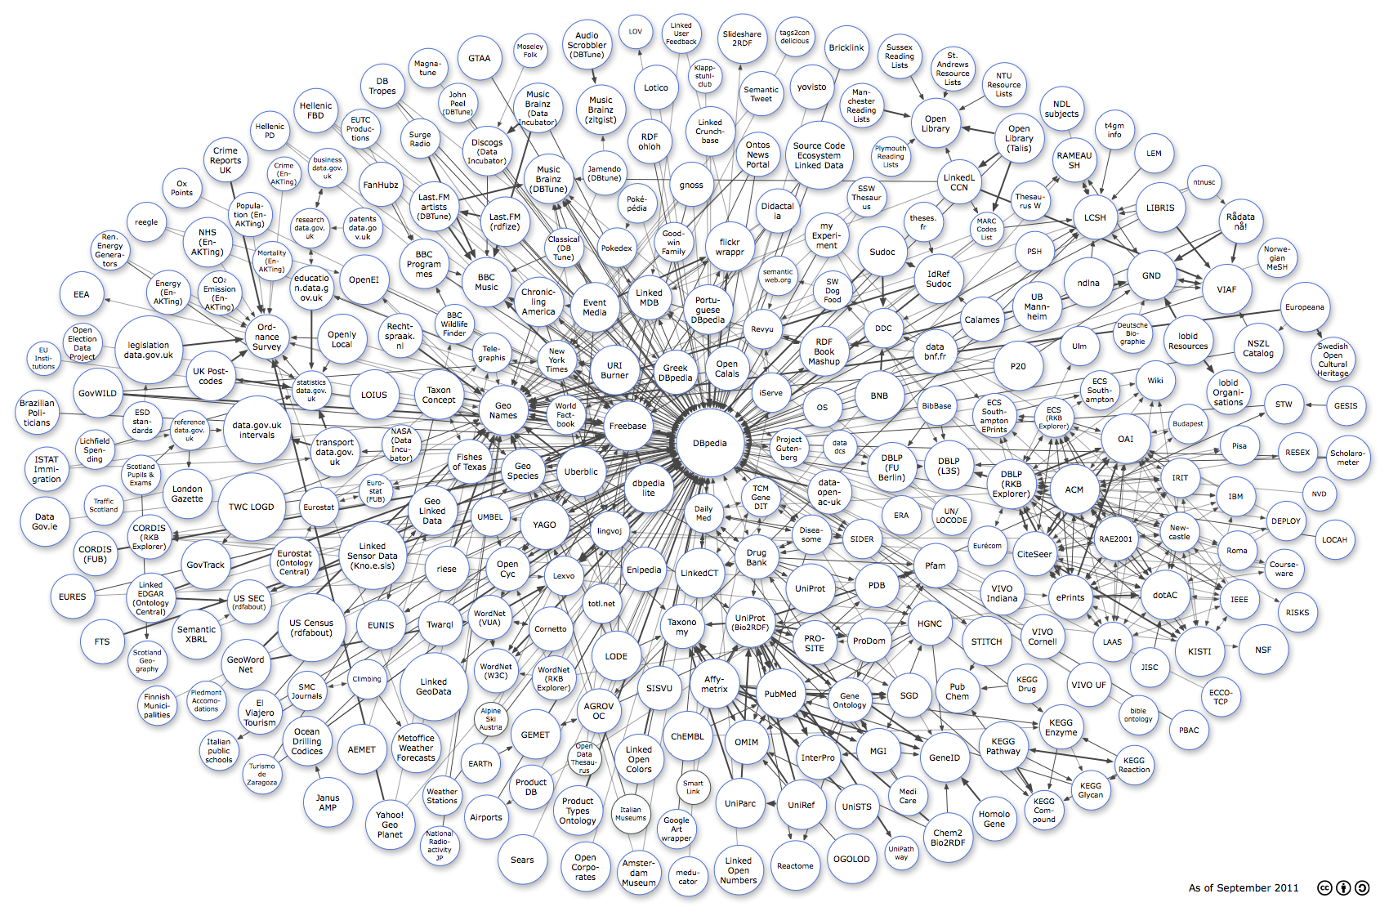
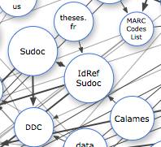
IdRef in Linked Web of Data

Slide 17
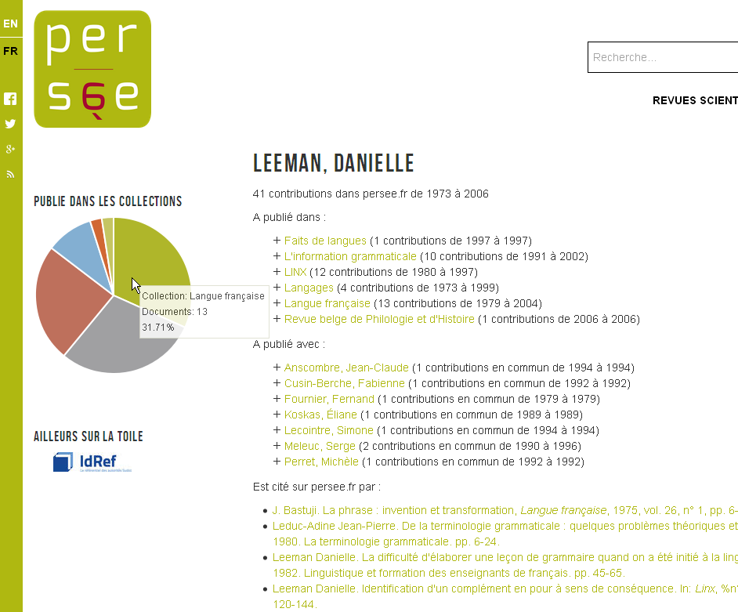
linked data for real : identifier 026743434

Slide 18

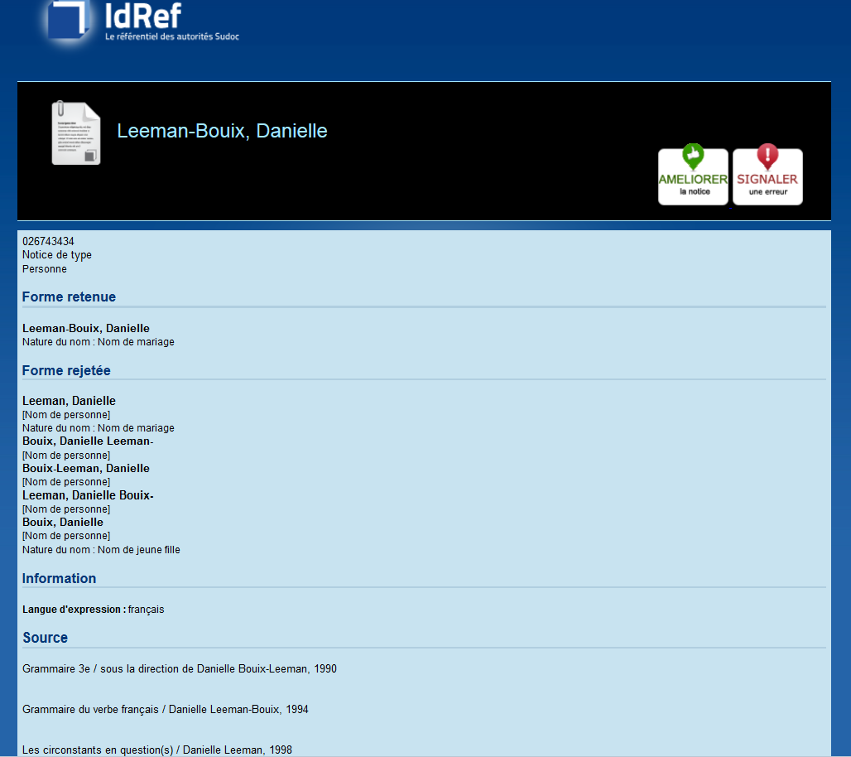

Slide 19

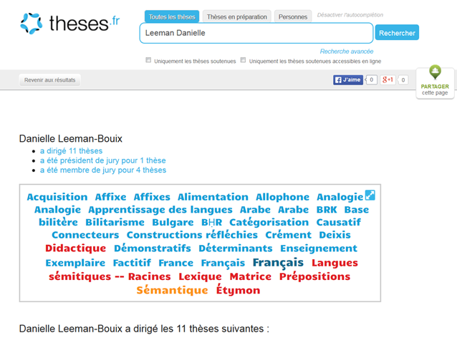

Slide 20
“Resolving ambiguities over author names is a major challenge.
Solving this problem broadly is a big deal in the science of science.”
Source : Nature 30/05/2012 « Scientists : your number is up »

Slide 21
What we have and what is needed
IdRef
Researchers
Administrativ staff
Curators
Librarians

Slide 22
What does IdRef need from here
To go on spreading into systems of Higher Education and Research
To go ahead with Conditor
To couple with identifiers in international scientific databases
To increase interoperability with HAL
To stay at your service
Notes:
And thank you all for your attention.
I will be glad to answer your questions.

Slide 23
Meeting EuroCRIS Paris 2015

