Slide 1
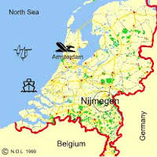


The important role of CRIS’s for registration and archiving of research data
Case study: Radboud University (NL) in cooperation with the DANS EASY archive
Eurocris 2016 conference
Presenter: Mijke Jetten, Radboud University,
the Netherlands
Co-authors:
Radboud University: Ed Simons, Maaike Messelink,
Hans Schoonbrood
DANS: Marnix van Berchum, Marion Wittenberg

Slide 2
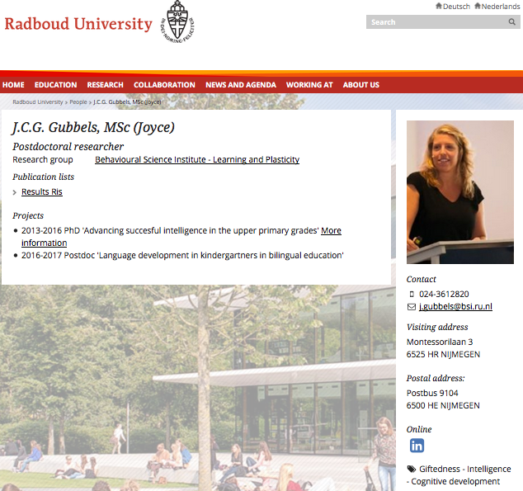
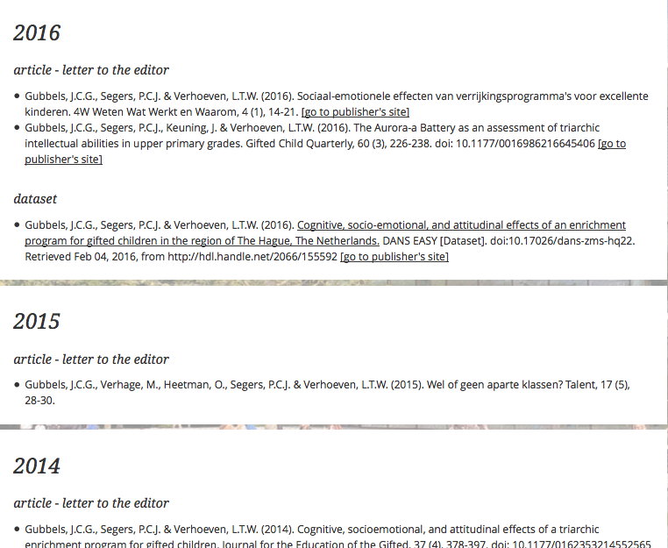
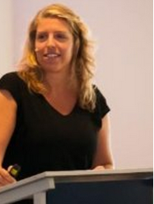
Registering & archiving data as key condition to open science
FAIR data
Findable, accessible, interoperable and reusable

Slide 3

To be honest …
Data preservation hasn't been very user-friendly
“Don’t make us use yet another system”
“This is again just administrative overhead”
“Surprisingly, data set registration and archiving is often looked upon as separate reality, without linking to publications and institutions”

Slide 4
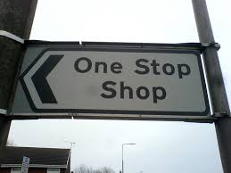
What about an alternative?
An integrated, user-friendly interface
Including support services
Registering and uploading publications and data sets at once
Quality check and a straightforward ownership policies
Overview of archived data
CASE STUDY: Research Data Services project (RDS) @
Radboud University (NL)

Slide 5
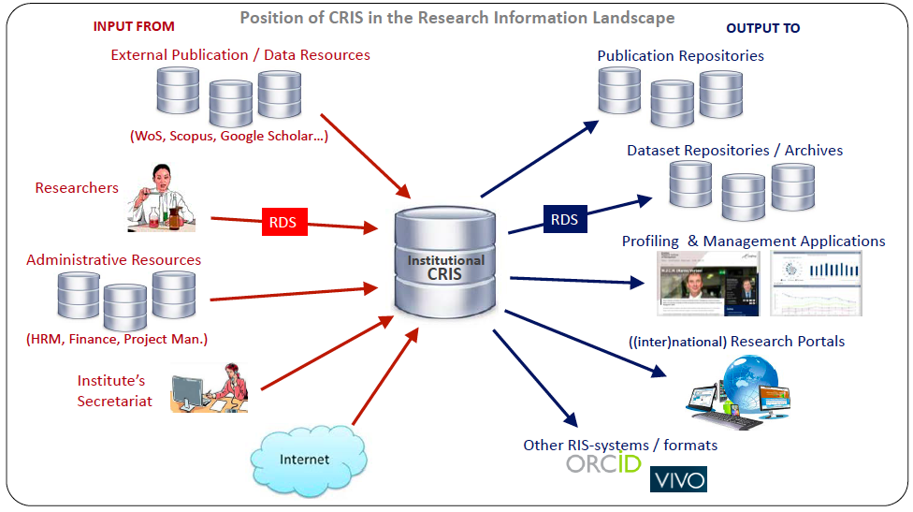
CRIS as central system
RDS-project,
@ Radboud
University
Long tail data
Reusing existing information
Future proof, i.e. in line with international developments
Optimal fit in existing infrastructures
Decision: as CRIS has been the primary source for research information for years, let’s adjust it to archiving and registering datasets as well.

Slide 6
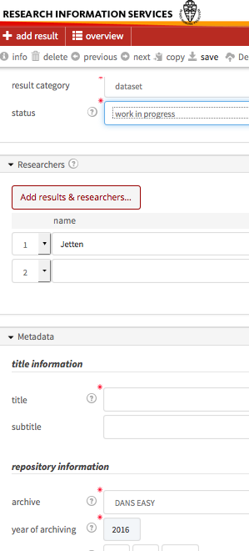
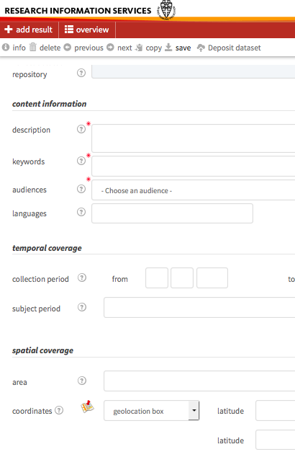
RIS interface
Action plan
Within the CRIS (Metis)
Stepwise and iterative
Pilot groups from various
disciplines
Features
Online form for researcher
Institutional login
Registering metadata (Datacite)
Uploading data files
Linking data set to publications
Partner
Not an own data repository
Dutch national data archive
DANS EASY

Slide 7
Technical solution
Java based application (Metis), with an underlying relational database management system (Oracle), using tools like Bootstrap, iBATIS and JQuery.
Interface with (local) systems, such as the publication repository (Dspace), personnel system, personal profile pages, Scopus and Web of Science.
SWORD protocol to communicate between the CRIS and DANS EASY (built upon Fedora).
Automatic mails between involved partners: DANS, Radboud University Library and researchers.

Slide 8
Frontoffice (Fo) backoffice (Bo) model
General RDM policies often overlook practical questions researchers may have.
At Radboud University Library (Fo): FoBo model in close cooperation with strategic department, IT services and the national DANS EASY archive (Bo).
Frontoffice: data curation (including preferred formats, anonymity and documentation) and contacting researchers.
Backoffice: long term storage, discovery and sustainable accessibility.

Slide 9
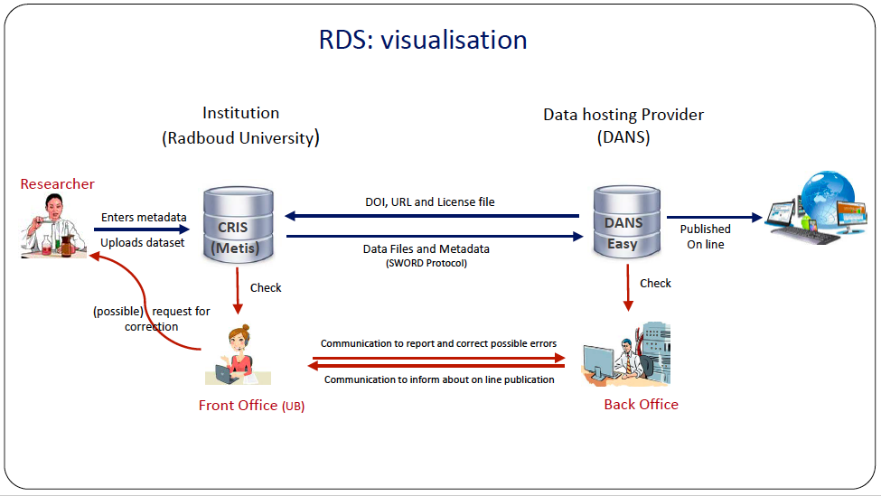

Slide 10
RIS service desk
Support with publication and data management
Easy-to-approach support
Including data curation (including preferred formats, anonymity and documentation)
Including best practices and workshops
And the development of disciplinary policies (including awareness)
Located at Radboud University Library
Library acts a linking pin
RIS is part of the library of the future
Library as a steady factor in the RDM-world of temporarily projects
Benefit-for-researcher approach, instead of compliance approach

Slide 11
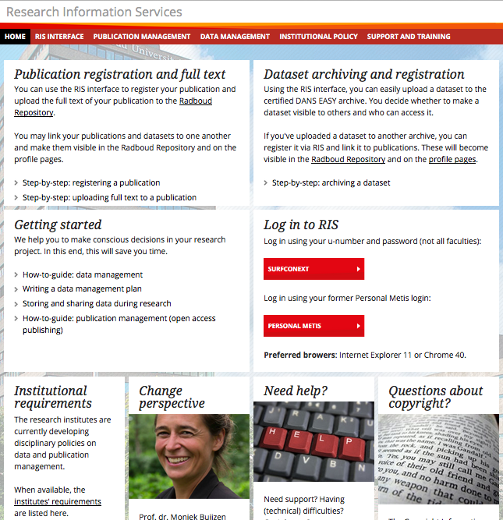
http://www.ris.ru.nl

Slide 12
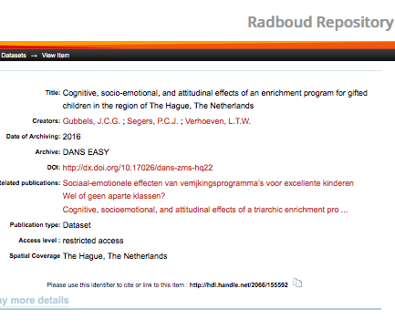
Making data visible (1)

Slide 13
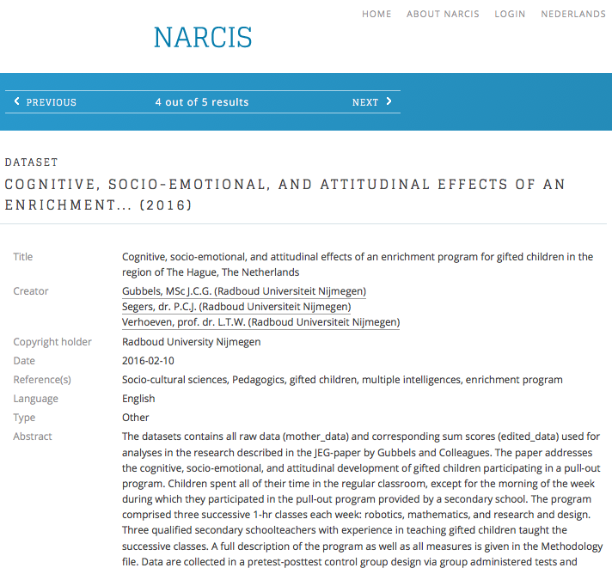
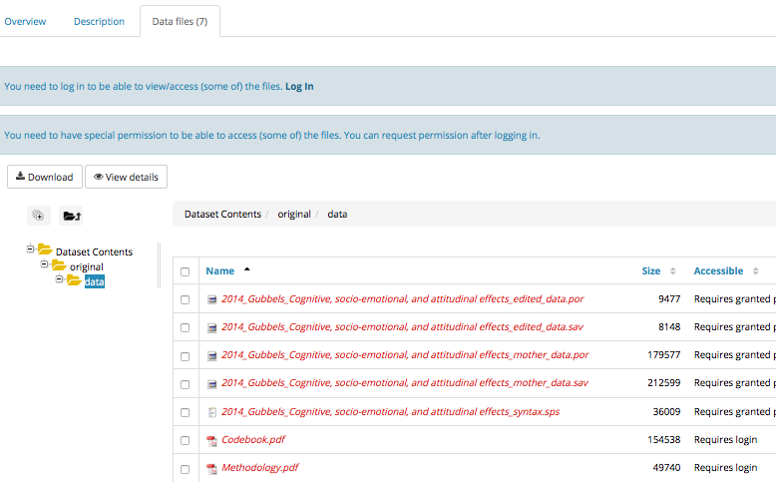
Making data visible (2)

Slide 14
Looking forward
Lessons learned (phase 1)
To make RDM policies work, proper infrastructure and support are vital.
Away from the silo- and closed vault-thinking
“The interface is easy-to-use.”
“I appreciated the support offered on preparing and documenting my data.”
“What a relief: a single interface and service desk for my questions.”
Future plans (phase 2 and further)
Strengthening the idea of CRIS as central system and one-stop-shop.
One-stop-shop idea is taken further by our Medical department building a Digital Research Environment (DRE), which will include a CRIS functionality in addition to tooling during the data life cycle.
Introducing CERIF as format to send metadata from CRIS to DANS.
We realise we have just started.
“Can we pilot with our local project management information in the CRIS.”
“An integrated digital DMP tool would be a nice addition.”
“Is there a way to automatically present Web of Science publications?”

Slide 15
Questions?
More information
http://www.ris.ru.nl
Mijke Jetten (m.jetten@ubn.ru.nl)

