Slide 1
New ways to monitor the results of science investments
Julia Lane
American Institutes for Research
University of Strasbourg
University of Melbourne

Slide 2
Key messages
United States universities and agencies are building a people-based framework drawing on STAR METRICS/UMETRICS
The EU and Australia/New Zealand have similar potential
CERIF and CASRAI can help inform the effort – focus on simplicity and value added of common standards

Slide 3
Overview
Motivation
Conceptual Framework
Empirical Framework
  What
  Who
  What results
International activities

Slide 4
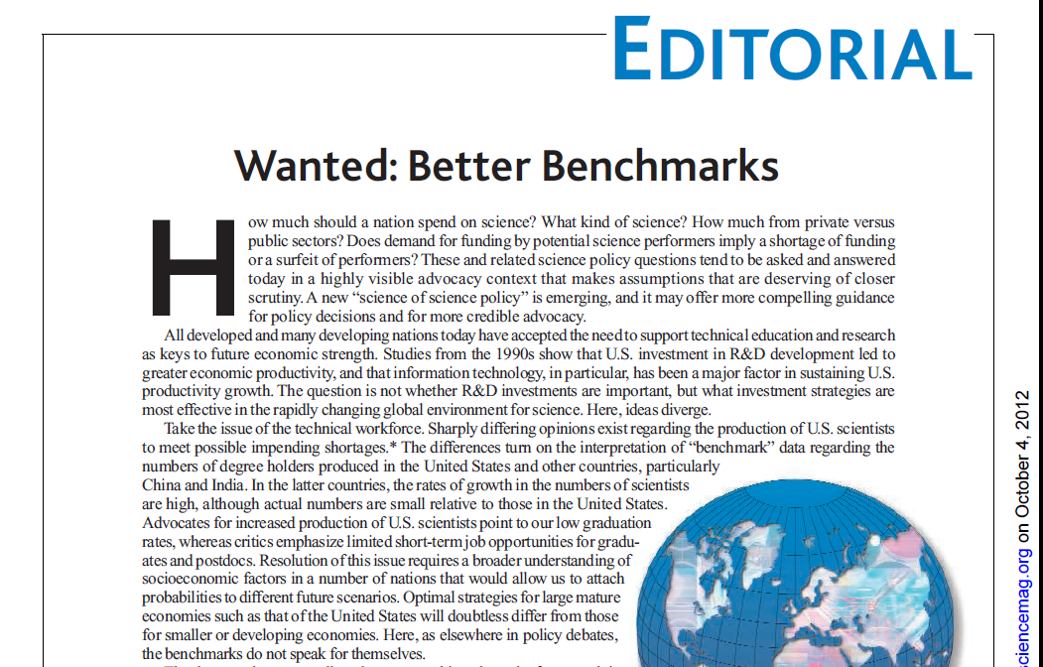
Key questions
How much should a nation spend on science? What kind of science? How much from private versus public sectors? Does demand for funding by potential science performers imply a shortage of funding or a surfeit of performers?......A new “science of science policy” is emerging, and it may offer more compelling guidance for policy decisions and for more credible advocacy

Slide 5
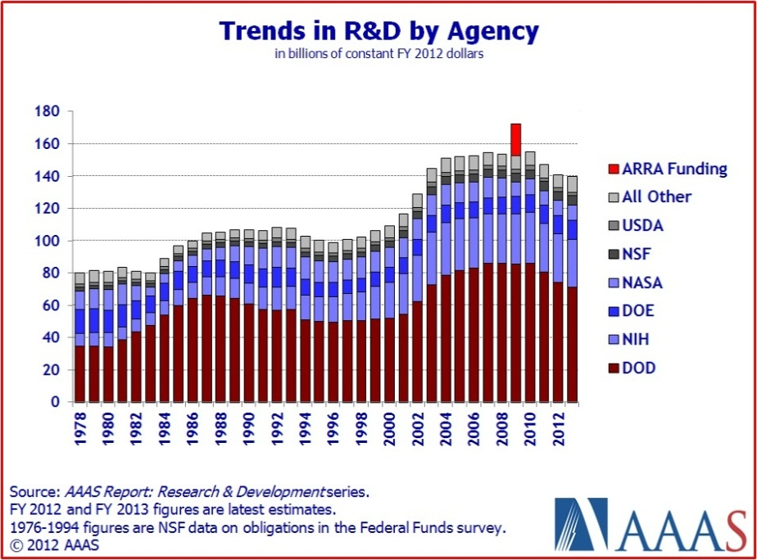
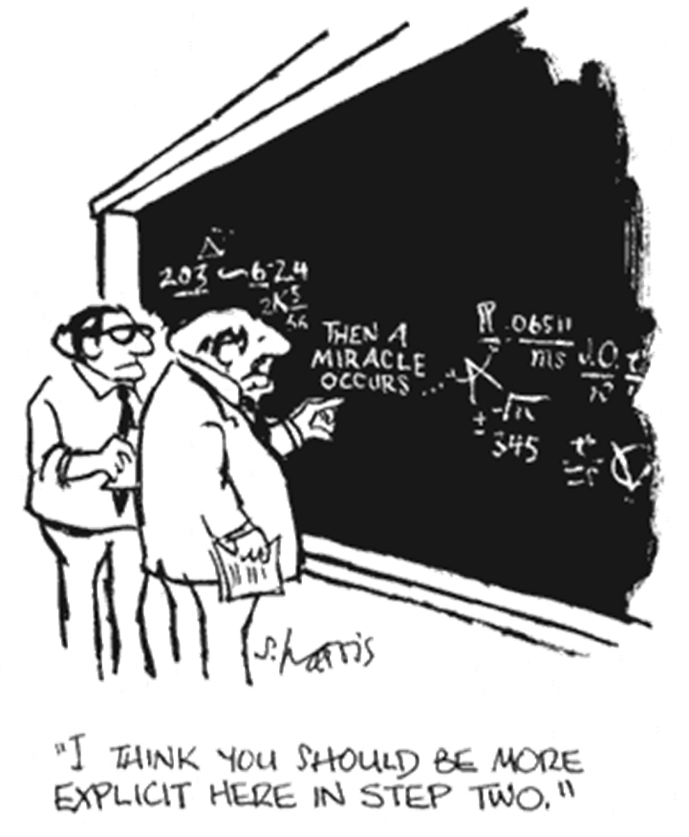

We spend a lot

Slide 6
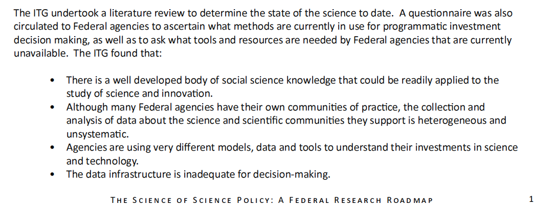

Note…the data don’t exist

Slide 7

An Opportunity
. . . STAR METRICS represents a valuable step toward developing detailed, broadly accessible and nationally representative data that would allow systematic and scientific analysis of the organization, productivity, and at least some of the effects of federally funded research [but] . . .
. . . STAR METRICS data are largely inaccessible . . .
. . . data collection could usefully be expanded to include more universities and other performers . . .
. . . STAR METRICS data would be more useful if steps were taken to ensure the data can be flexibly linked to other data sources [such as] those maintained by the federal statistical and science agencies . . . as well as proprietary data sources . . . Creating a robust and linkable dataset may require the addition of individual and organizational identifiers.
P. 4-10
Notes:
Note the same platform can be used to examine the effects of private, state and institutional investments . . .

Slide 8
Overview
Motivation
Conceptual Framework
Empirical Framework
  What
  Who
  What results
International activities

Slide 9

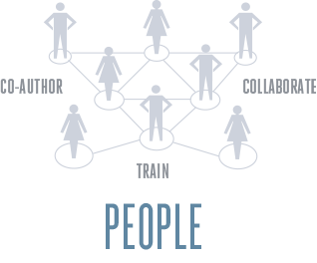

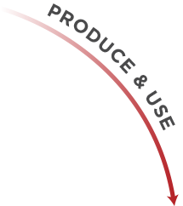






A conceptual framework

Slide 10
Framework
Discovery
Learning
Dissemination
Innovation
Entrepreneurship
Economic Growth
Public Health
Food Safety
Security
Rational Policy
…
Knowledge, People, Skills
Fund
Science
Investments
Universities
Hiring, Spending
Jobs
Stimulus

Slide 11
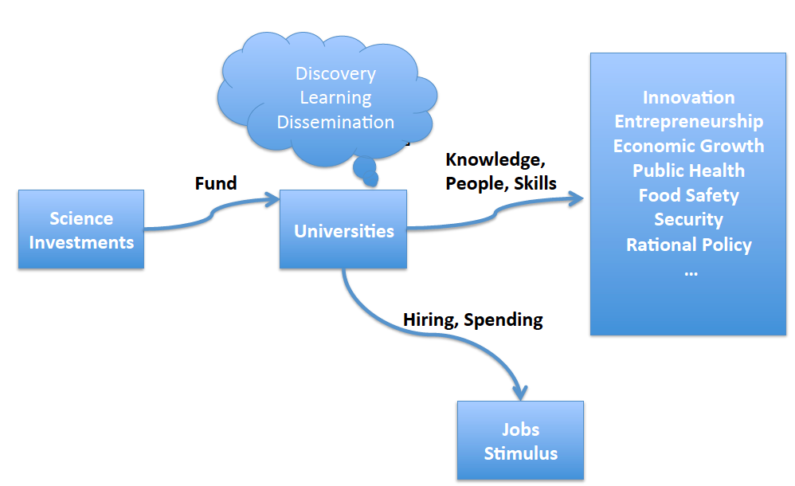
Most policy discussions focus here, on expenditures and obligations. The emphasis is grants, not people.

Slide 12
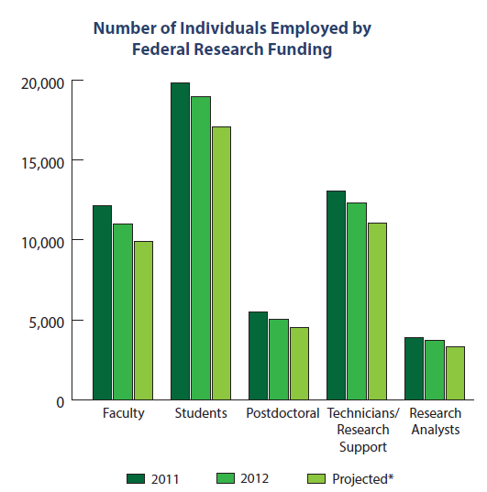
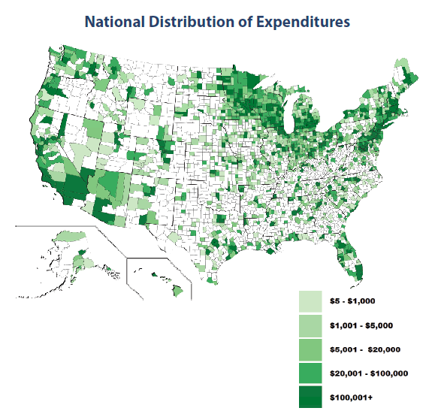
Science is not a jobs program, but research has substantial short term stimulus effects (Weinberg et al 2014)

Slide 13
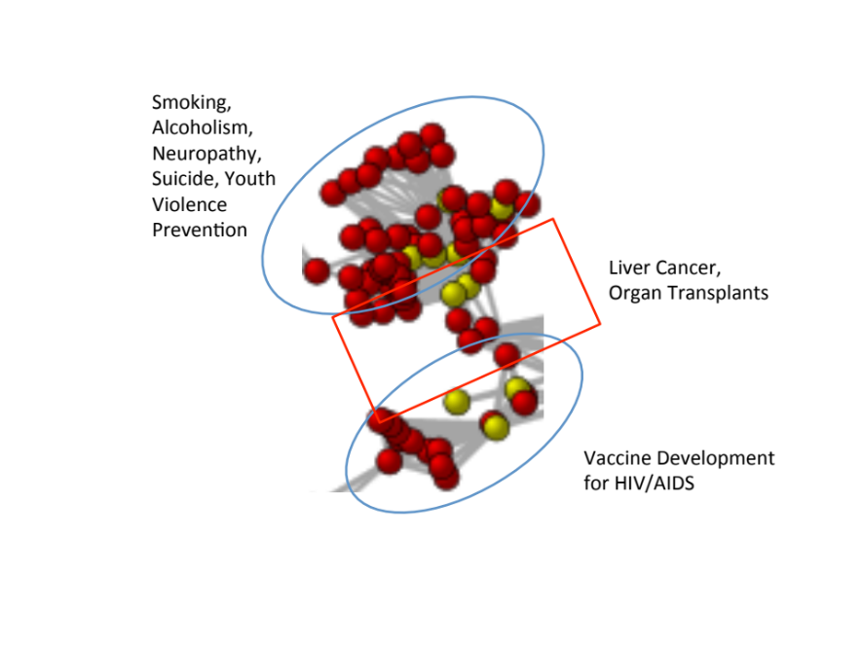
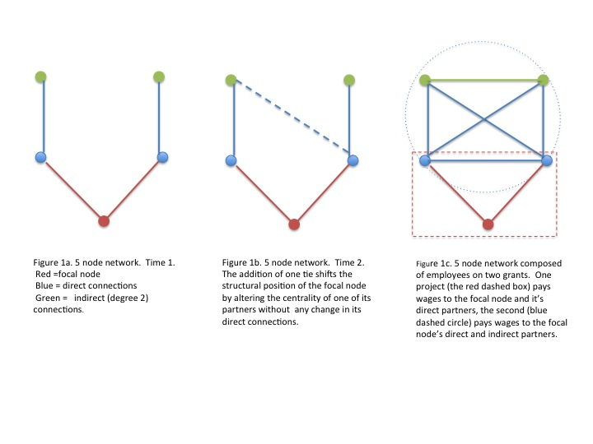
Improving institutions for discovery and training requires understanding the knowledge production function
Estimating network effects on outcomes
How does network structure and composition affect student research and career outcomes?
Investments create and sustain teams and those networks do research and train students
Identification strategy: Use higher order features of networks as instruments

Slide 14
This is the real public value of university research and the United States is building a systematic basis to evaluate, explain, or improve effects.
Develop and validate measures of knowledge transmission from academia to industry
- Document and inform knowledge transfer

Slide 15
Overview
Motivation
Conceptual Framework
Empirical Framework
  What
  Who
  What results
International activities

Slide 16
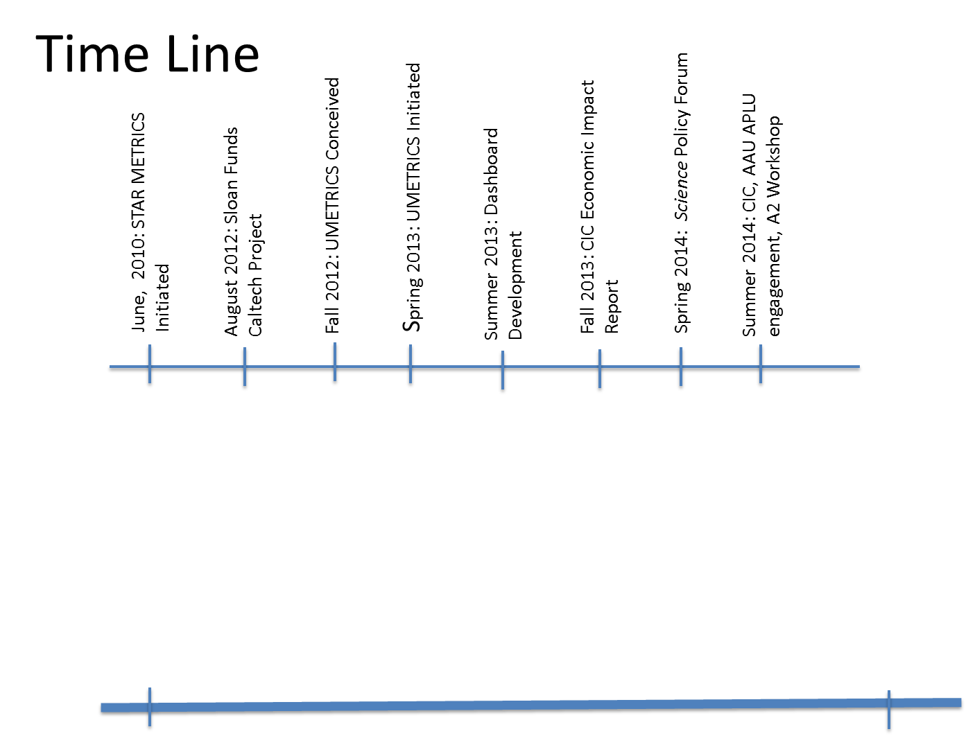
STAR METRICS/UMETRICS

Slide 17
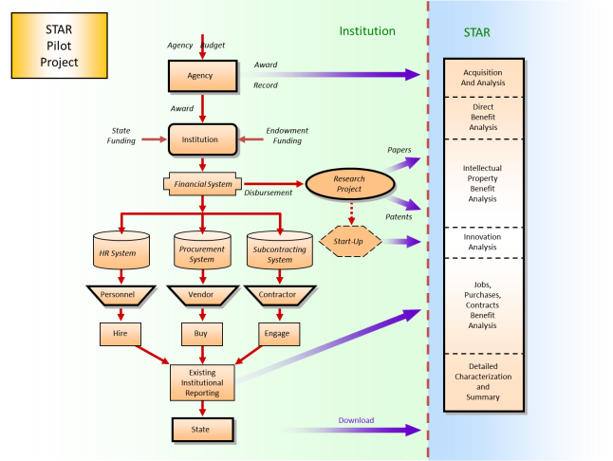
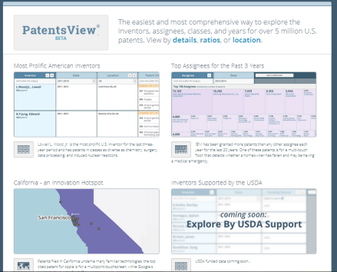
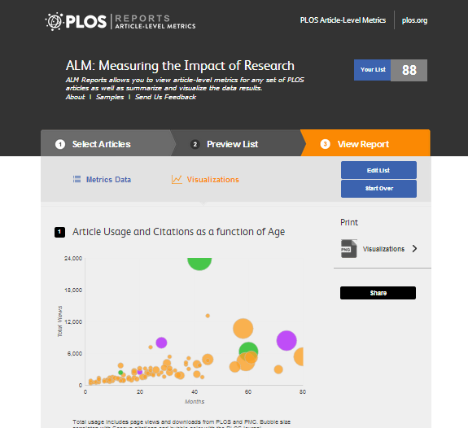
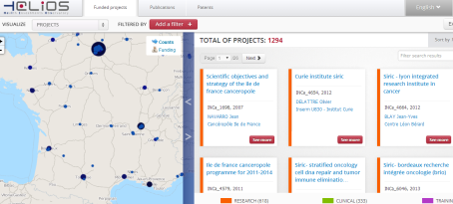
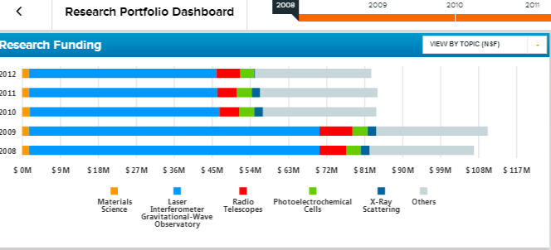
The Empirical Framework
Source: Ian Foster, University of Chicago

Slide 18
Lots of data
STAR Metrics employee transactions
  Caltech employee data contains 619,113 transactions and 11,939 employees spanning 1999-2012
  Purdue employee data contains 359,767 transactions and 27,248 employees spanning 2008-2013
STAR Metrics vendor transactions
  Caltech vendor data contains 5,564,643 transactions and 15,646 vendors spanning 1999-2012

Slide 19
Describing What is funded
Source: Ian Foster, University of Chicago

Slide 20
Different Text analytics paradigms: Best is to use statistical machine learning augmented with lexicons and linguistics (Rayid Ghani)
 | Lexicon-based Rules | Linguistic Rules | Statistical Machine Learning (augmented with linguistics & lexicons)
Description | Rules based on lists of words | Rules using words and linguistic operators (parts of speech for example) | Statistical approaches that can be trained and learn over time. Can incorporate lexicons and linguistics as well
Ease of creation & maintenance | Low | Low | High
Accuracy | Low | Medium | High
Context Sensitiveness | Low | High | High
Interpretability | High (unless the rules get large) | Medium | Medium
Do it by hand
Hire linguists
Do it the right way

Slide 21
Describing WHO is funded
Source: Ian Foster, University of Chicago

Slide 22
STAR
Pilot
Project
Institution
STAR
Agency Budget
Award
Record
Acquisition
And Analysis
Agency
Award
Direct
Benefit
Analysis
State
Funding
Institution
Endowment
Funding
Papers
Intellectual
Property
Benefit
Analysis
Financial System
Research
Project
Disbursement
Patents
Start-Up
Innovation
Analysis
HR System
Procurement
System
Subcontracting
System
Personnel
Vendor
Contractor
Jobs,
Purchases,
Contracts
Benefit
Analysis
Hire
Buy
Engage
Existing
Institutional
Reporting
Detailed
Characterization
and
Summary
State
Download
Notes:
Flowchart based on university reporting systems, but portable to other HR/Finance systems. Presented to and validated by pilot FDP universities

Slide 23
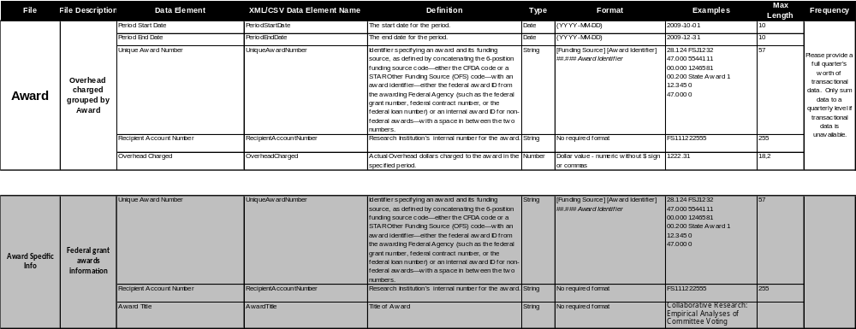
Award data

Slide 24
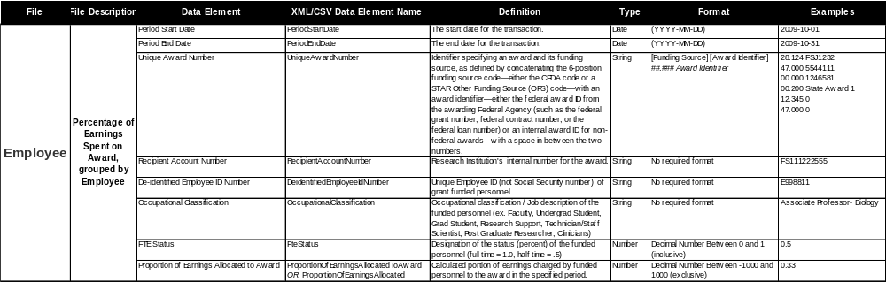
Employee data

Slide 25
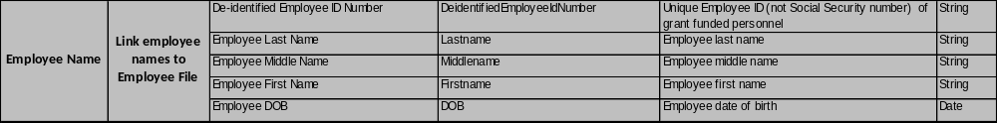
Employee data

Slide 26
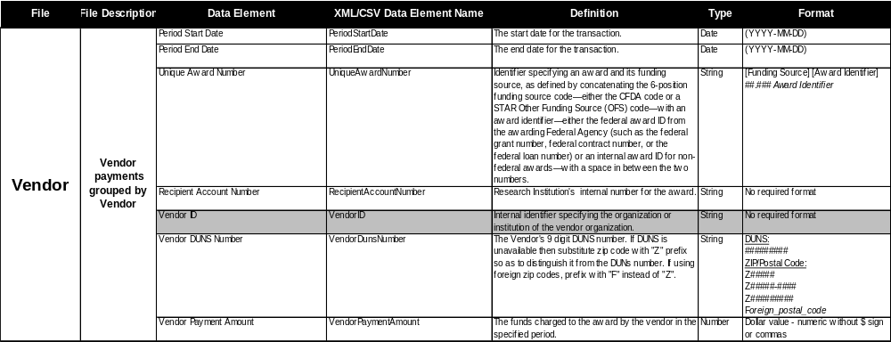
Vendor data

Slide 27
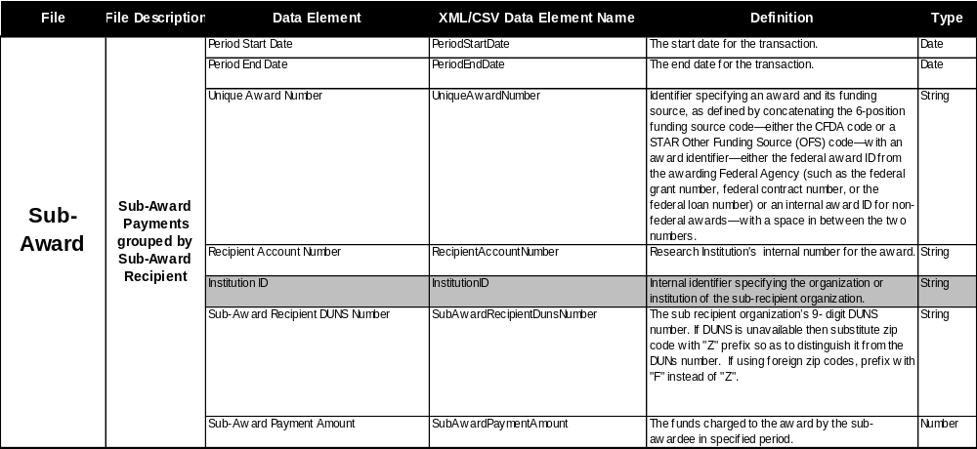
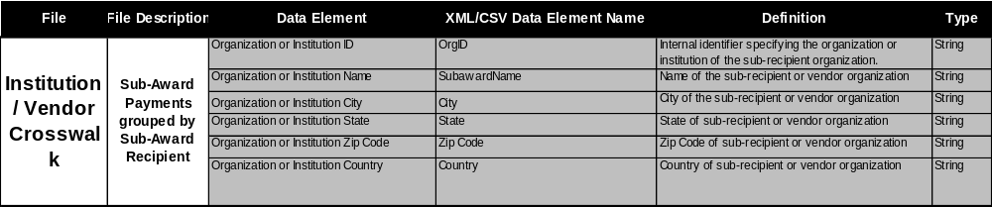
Subaward data

Slide 28
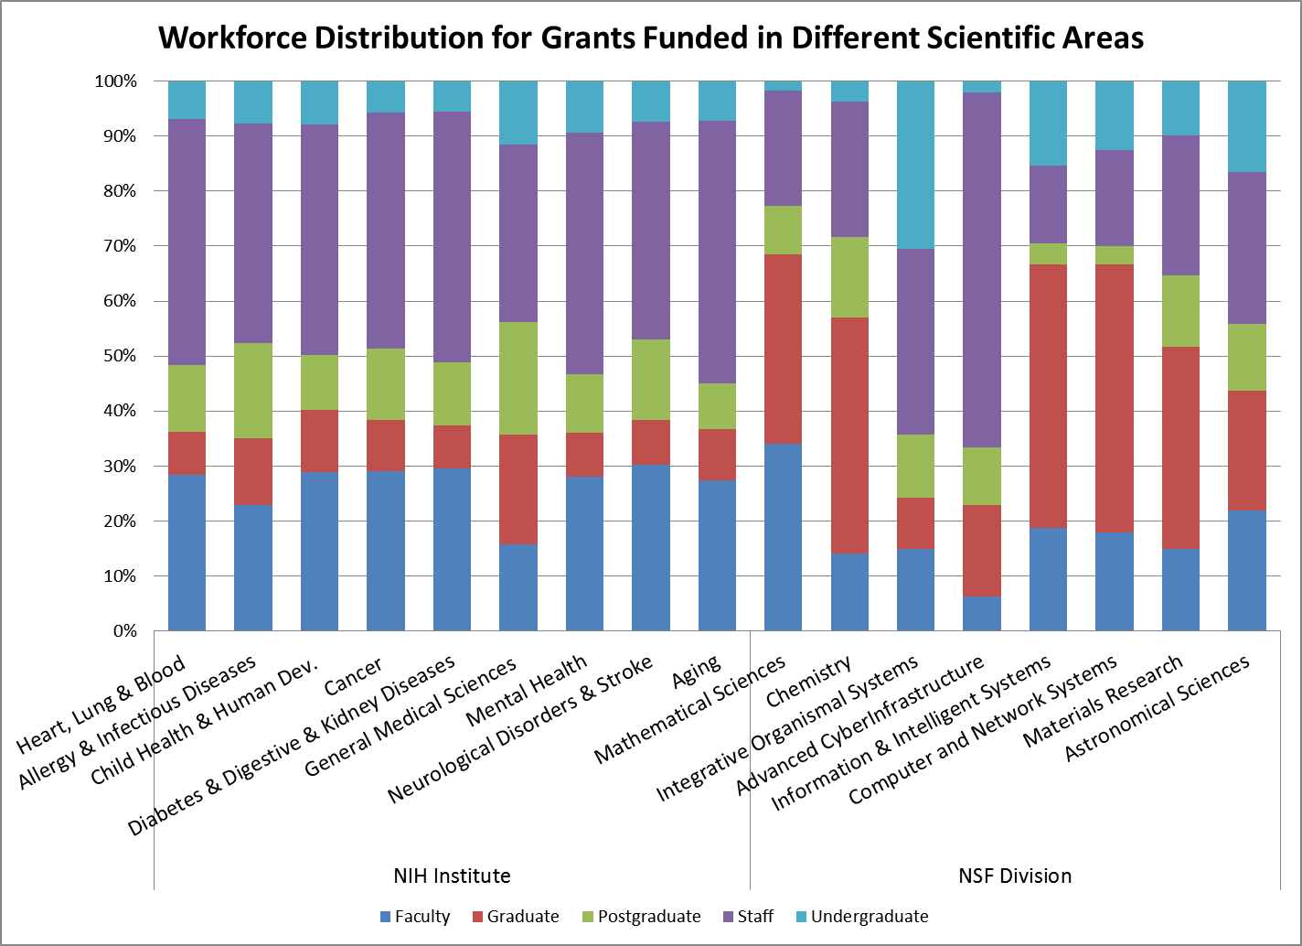
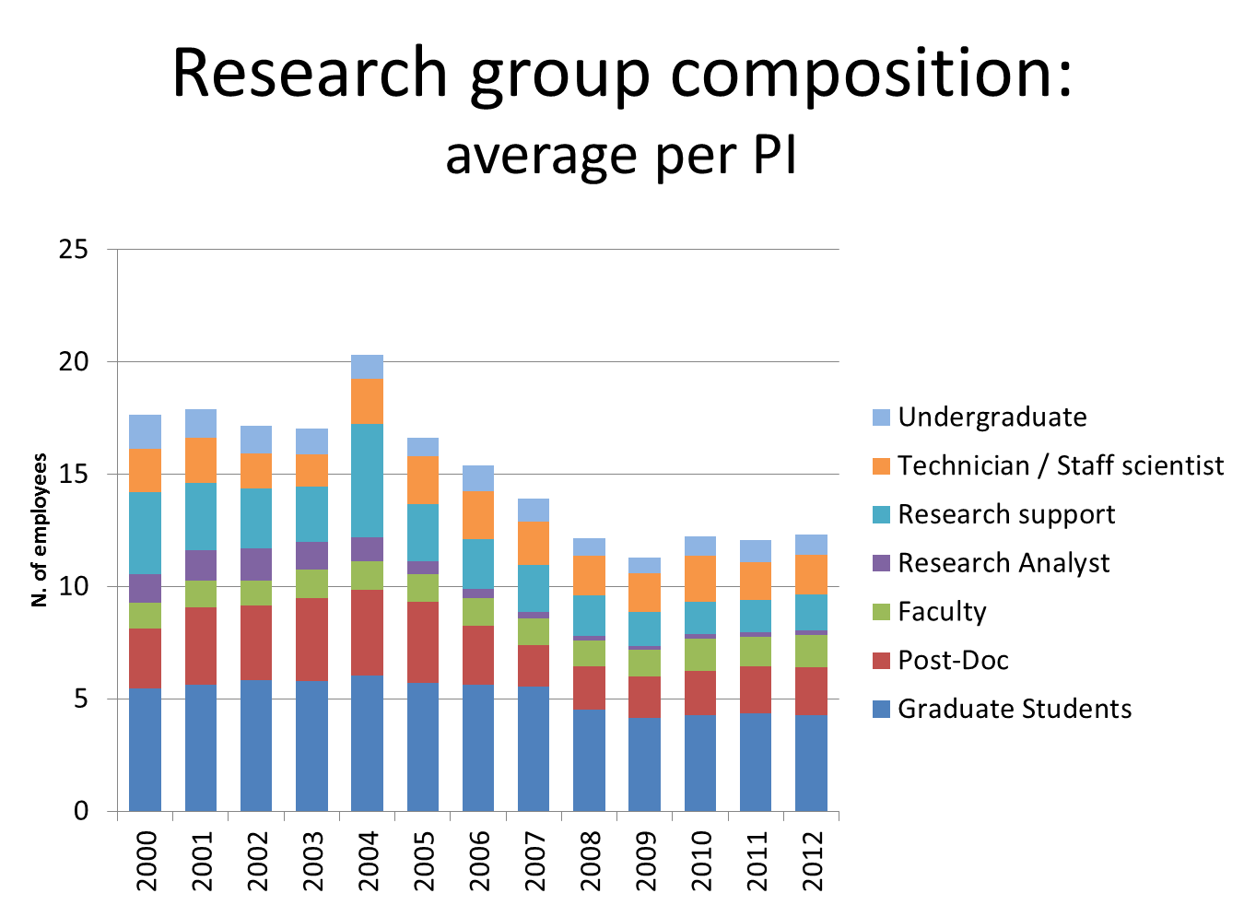
HR data

Slide 29
Lots of data
STAR Metrics employee transactions
  Caltech employee data contains 619,113 transactions and 11,939 employees spanning 1999-2012
  Purdue employee data contains 359,767 transactions and 27,248 employees spanning 2008-2013
STAR Metrics vendor transactions
  Caltech vendor data contains 5,564,643 transactions and 15,646 vendors spanning 1999-2012

Slide 30
Lots of opportunities
Data issues
Occupational coding
Transaction data
Standardization
Linkages
Gaps
Conceptual issues
Multiple sources of grant funds
Multiple units of analysis (individual, PI, grant, research field)
…

Slide 31
Example of occupational coding
prof school project assistant | 9514-Prof School Project Assistant
graduate instructor | 9515-Graduate Instructor
md student project assistant | 9516-MD Student Project Assistant
ph d candidate grad instructor | 9517-Ph D Candidate Grad Instructor
phd candidate teaching asst | 9519-PhD Candidate Teaching Asst
research assistant | 9521-Research Assistant
undergrad research asst i | 9522-Undergrad Research Asst I
undergrad research asst ii | 9523-Undergrad Research Asst II
ugrad rsrch asst(non-univ stu) | 9524-Ugrad Rsrch Asst(Non-Univ Stu)
ugrad tchg asst (non-univ stu) | 9525-Ugrad Tchg Asst (Non-Univ Stu)
graduate research project asst | 9526-Graduate Research Project Asst
ph d cand grad rsrch proj asst | 9527-Ph D Cand Grad Rsrch Proj Asst
advanced masters research asst | 9528-Advanced Masters Research Asst
phd candidate research asst | 9529-PhD Candidate Research Asst
administrative fellow | 9531-Administrative Fellow
phd candidate admin fellow | 9533-PhD Candidate Admin Fellow
professional program assistant | 9535-Professional Program Assistant
legal proj asst (w/o tuit ben) | 9539-Legal Proj Asst (w/o Tuit Ben)
pharmacy associate | 9540-Pharmacy Associate
pre-doctoral assistant | 9545-Pre-Doctoral Assistant
post-doctoral associate | 9546-Post-Doctoral Associate
veterinary medical resident | 9548-Veterinary Medical Resident
veterinary resident-grad prgm | 9549-Veterinary Resident-Grad Prgm

Slide 32
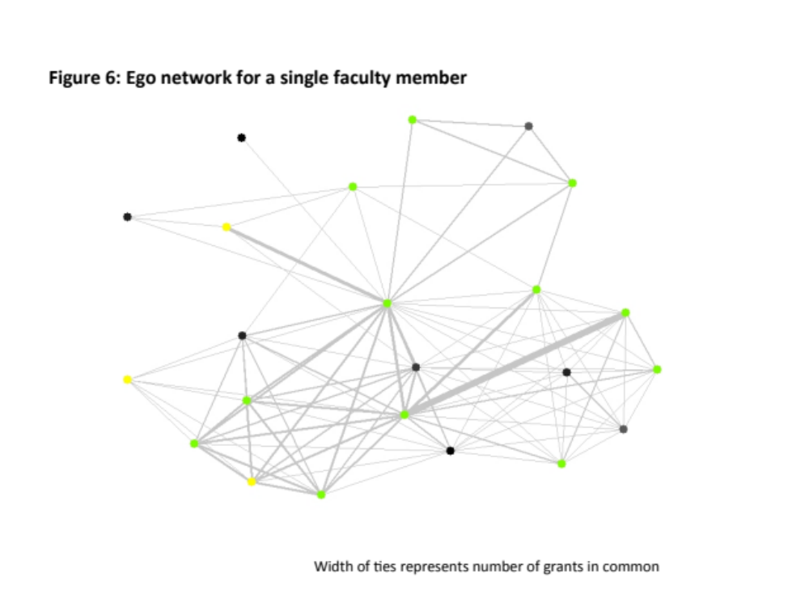
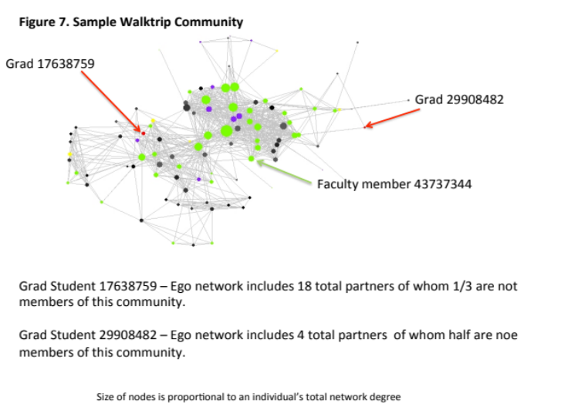
Unit of analysis: Networks
Jason Owen Smith

Slide 33
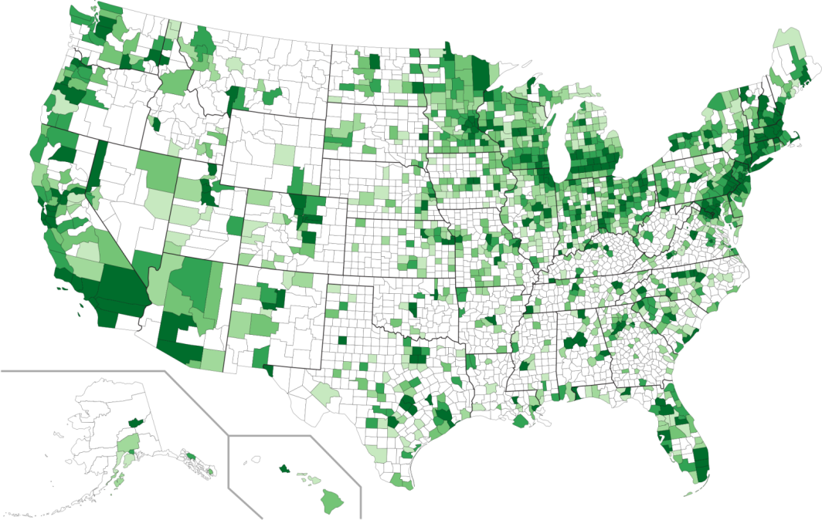
Unit of analysis: Projects

Slide 34
Describing the Results
Source: Ian Foster, University of Chicago

Slide 35
Summary Statistics
Joint Frequency by NAICS and Occupation
Most Purdue matches were Faculty members who performed Consulting and Educational Services

Slide 36
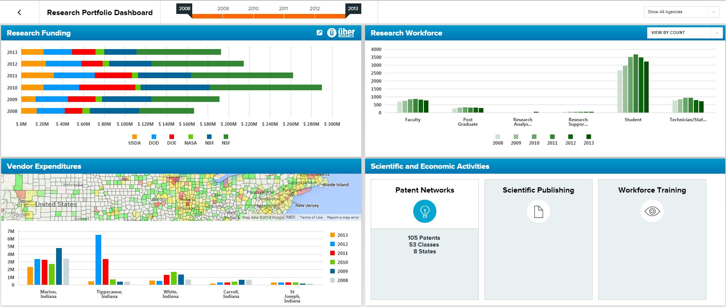

Slide 37
Overview
Motivation
Conceptual Framework
Empirical Framework
  What
  Who
  What results
International activities

Slide 38


Engage internationally

Slide 39
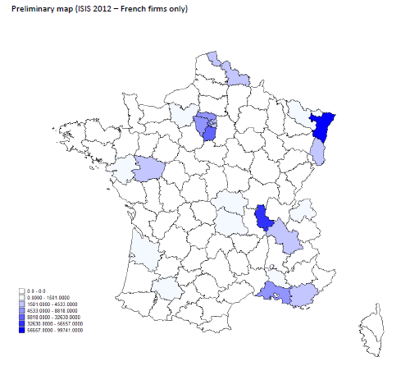
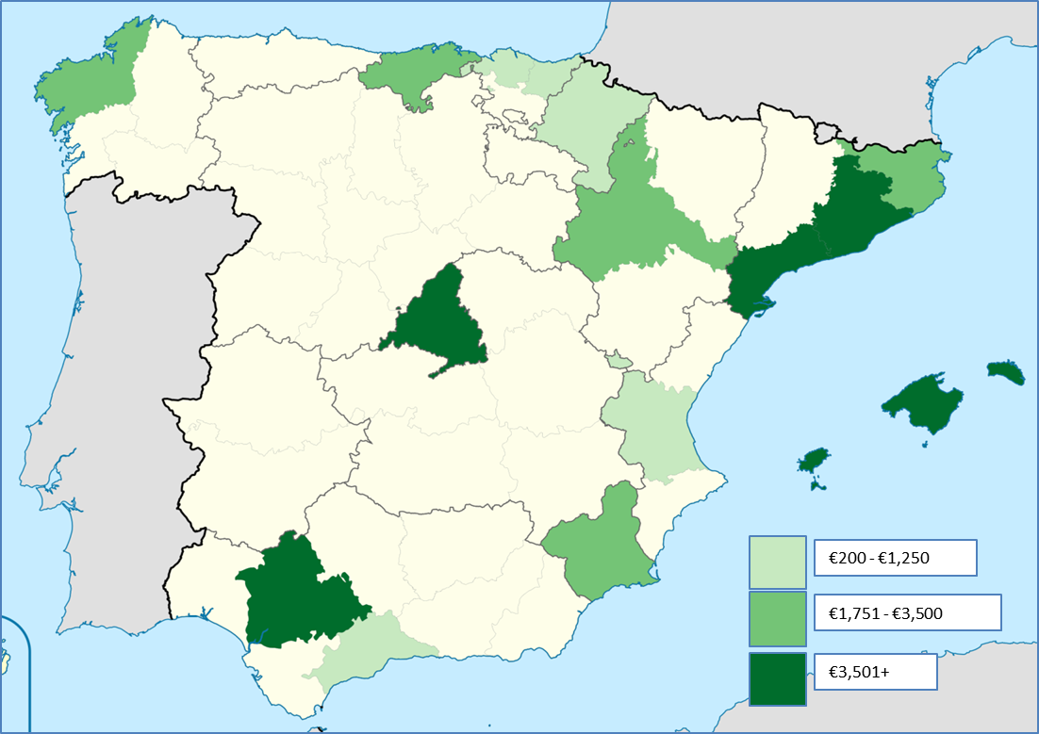
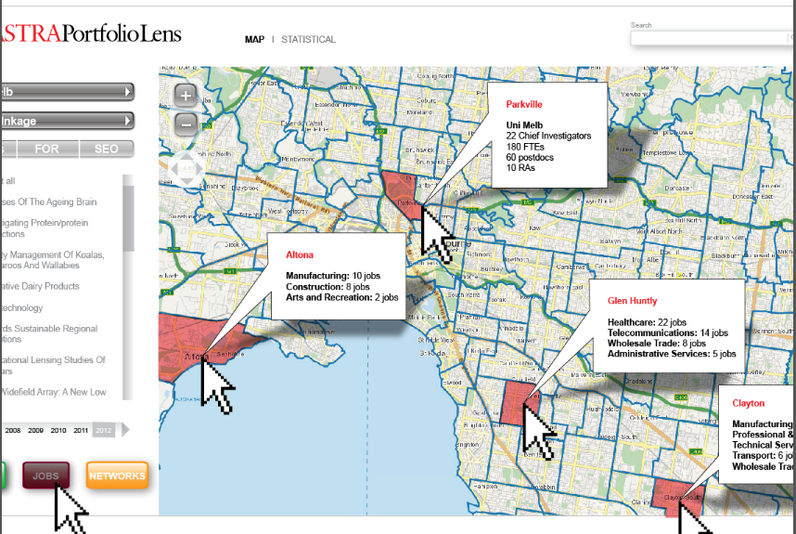
Example for international universities

Slide 40
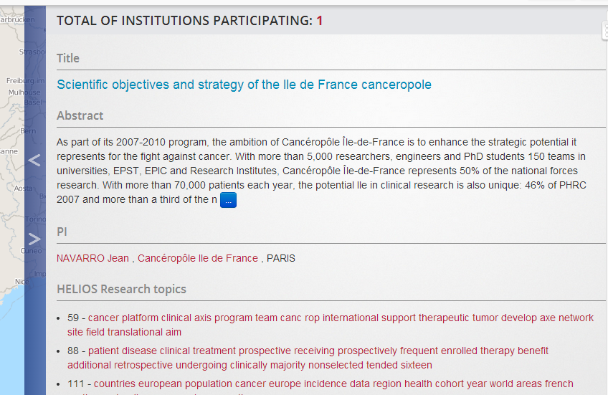
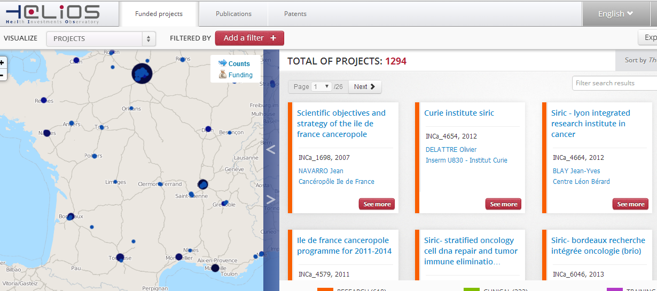
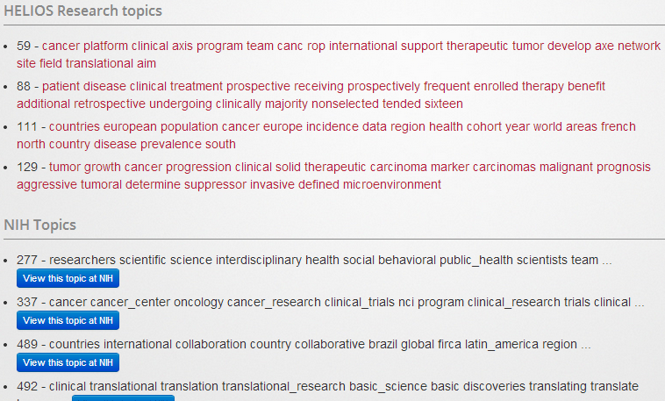
What work is being done

Slide 41
Key messages
United States universities and agencies are building a people-based framework drawing on STAR METRICS/UMETRICS
The EU and Australia/New Zealand have similar potential
CERIF and CASRAI can help inform the effort – focus on simplicity and value added of common standards

Slide 42
Comments and questions?

