Slide 1
The Catalan Research portal: ready to go
Ramon Ros i Gorné
(CSUC)
EuroCRIS Strategic Membership Meeting 2015
Barcelona, November 11th
a SELRIM member

Slide 2
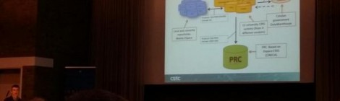
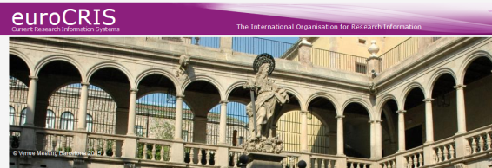
PRC evolution calendar
Definition (2013)
Implementation (2014)
Restricted opening (2015)
Amsterdam November 2014
Barcelona November 2015

Slide 3
Decision in 2012
What
To create a portal to find the research outputs of the Catalan research system, the PRC.
Why
To increase the visibility of the research done in Catalonia
To foster OA
To increase interoperability between data

Slide 4
First implementation decisions
  Model → NARCIS
  Identifiers → ORCID
  Software → Dspace-CRIS from CINECA
  Data flow → From local CRIS systems
  Data exchange format → CERIF-XML

Slide 5
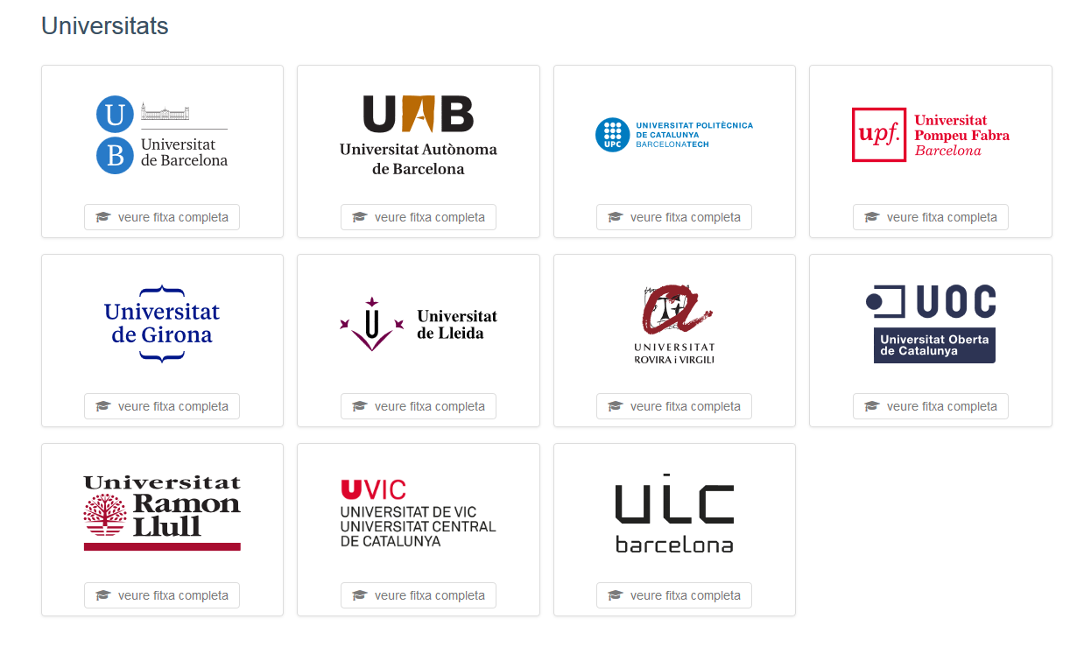
PRC members

Slide 6
PRC’s university CRIS systems
PRC members = CSUC’s universities + 1
They use 4 different CRIS systems
    5 use GREC from UB (inhouse developed)
    3 use SIGMA-CRIS from Sigma
    2 use DRAC from UPCnet
    1 use UXXI from OCU
    Any of this systems were CERIF compliant

Slide 7
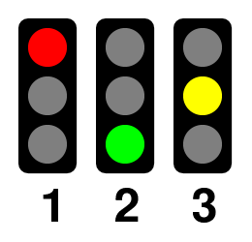

      Unique identifiers
Universities
Departments
Institutes
Research groups
Research projects
Researchers
Publications
Government & internal codes
Catalan government codes
PRC
Funding entities codes
DOI, Handle & ISBN

Slide 8
PRC with ORCID researchers
 | febrer | març | abril | maig | juny | juliol | 22 juliol | 29 setembre | 19 octubre
UB |  |  |  | 1.537 | 1.551 | 1.551 | 1.551 | 1.551 | 1.997
UAB |  |  | 687 | 655 | 687 | 666 | 666 | 666 | 760
UPC | 684 | 684 | 919 | 919 | 919 | 919 | 919 | 1187 | 1221
UPF |  |  | 680 | 680 | 680 | 680 | 680 | 680 | 562
UdG |  |  |  | 232 | 232 | 240 | 240 | 240 | 252
UdL |  |  |  |  | 322 | 322 | 322 | 322 | 402
URV |  |  |  | 55 | 55 | 179 | 179 | 179 | 252
UOC | 136 | 136 | 136 | 186 | 186 | 186 | 186 | 186 | 206
URL |  |  |  | 141 | 141 | 201 | 201 | 201 | 282
Uvic-UCC |  |  |  | 181 | 181 | 175 | 175 | 175 | 158
UIC | 81 | 142 | 142 | 142 | 142 | 142 | 143 | 143 | 144
Total | 901 | 962 | 2.564 | 4.728 | 5.096 | 5.261 | 5.262 | 5.530 | 6.236

Slide 9

Data flow, protocols, sources and formats
Protocol: XLS files
Format: UNEIX defined
Universitas XXI
Other
GREC
DRAC
UNEIX
SIGMA
Protocol: OAI-PMH/SWORD
Format: DC
Catalan government DataWarehouse
Local and consortia repositories.
Mainly DSpace
11 university CRIS systems (from 4 different vendors)
Protocol: OAI-PMH
Format: CERIF-XML
PRC
PRC. Based on Dspace-CRIS (CINECA)

Slide 10
CERIF model
cfFederated Identifier
cfFunding
cfEquipment
cfExpertise
AndSkills
cfFacility
cfResult
Publication
cfService
cfQualification
cfPrize
cfResultPatent
cfResultProduct
cfElectronicAddress
cfProject
cfPostalAddress
cfCurriculum
Vitae
cfPerson
cfOrganisation
Unit
cfGeographic
BoundingBox
cfCitation
cfIndicator
cfMeasurement
cfEvent
cfCountry
cfLanguage
cfCurrency

Slide 11
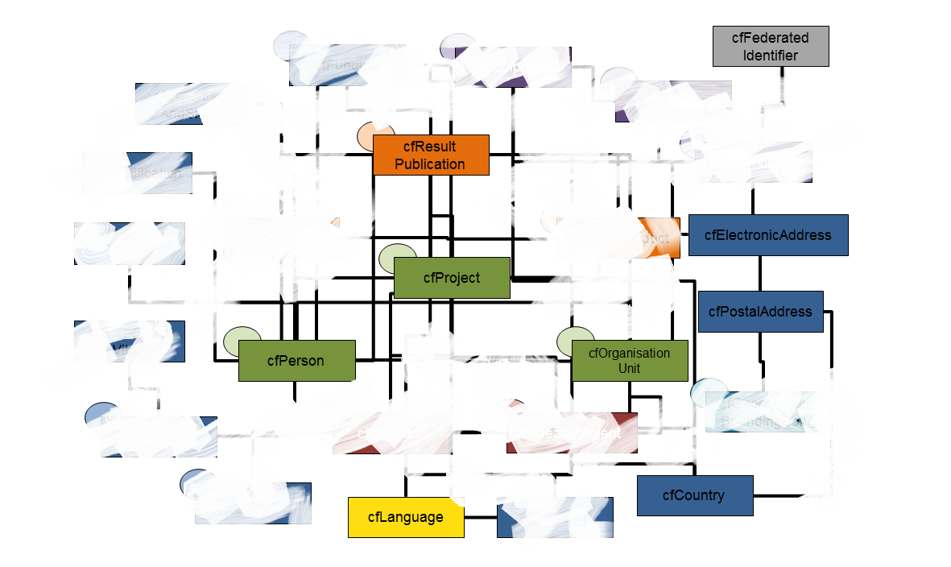
Simplification of CERIF for PRC

Slide 12
Simplified CERIF subset for PRC
cfResult
Publication
cfProject
cfPerson
cfOrganisation
Unit

Slide 13
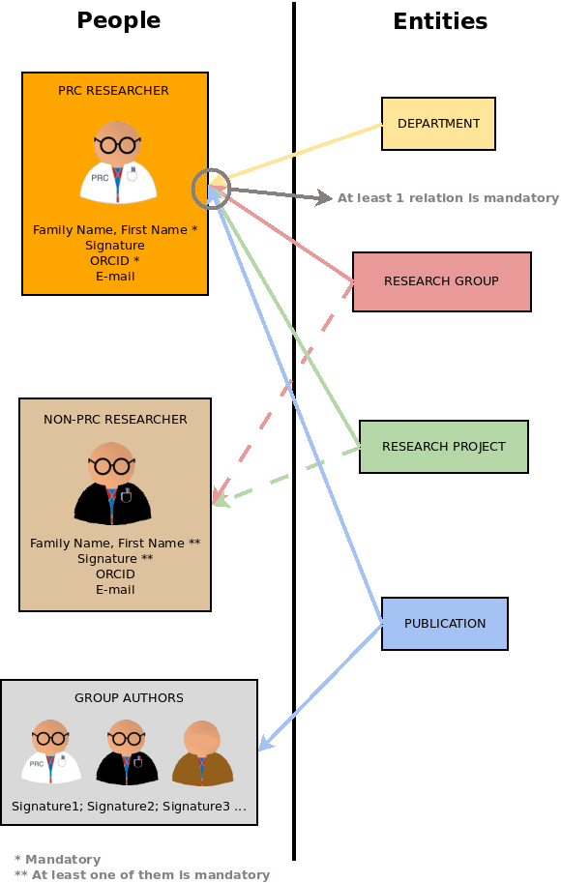
Researchers role in PRC

Slide 14
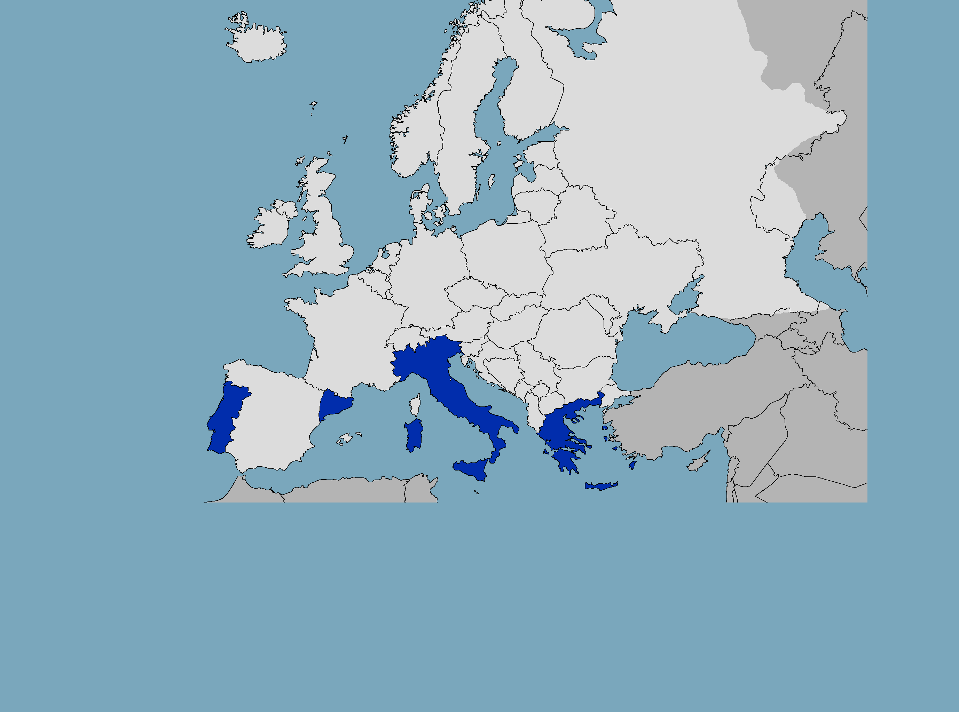
South European Link for Research Information Management
FCT|FCCN (Portugal)
GIVE
PTCRISync: ORCID Synchronization Framework
TAKE
CERIF Model | CERIF Services | CERIF REST API | CERIF OAI | DSpaceCRIS
CINECA (Italy)
GIVE
DSpace-CRIS | ORCID HUB | upgrades | roadmap
TAKE
ORCID Synchronization Framework | CERIF REST API | CERIF OAI
SELRIM
CSUC (Catalonia)
GIVE
CERIF validator | DSpaceCRIS early adaptor
TAKE
DSpace-CRIS | CERIF OAI
EKT (Greece)
GIVE
CERIF Model | CERIF Services | CERIF XML | CERIF REST API | CERIF OAI | upgrades
TAKE
Contribution

Slide 15
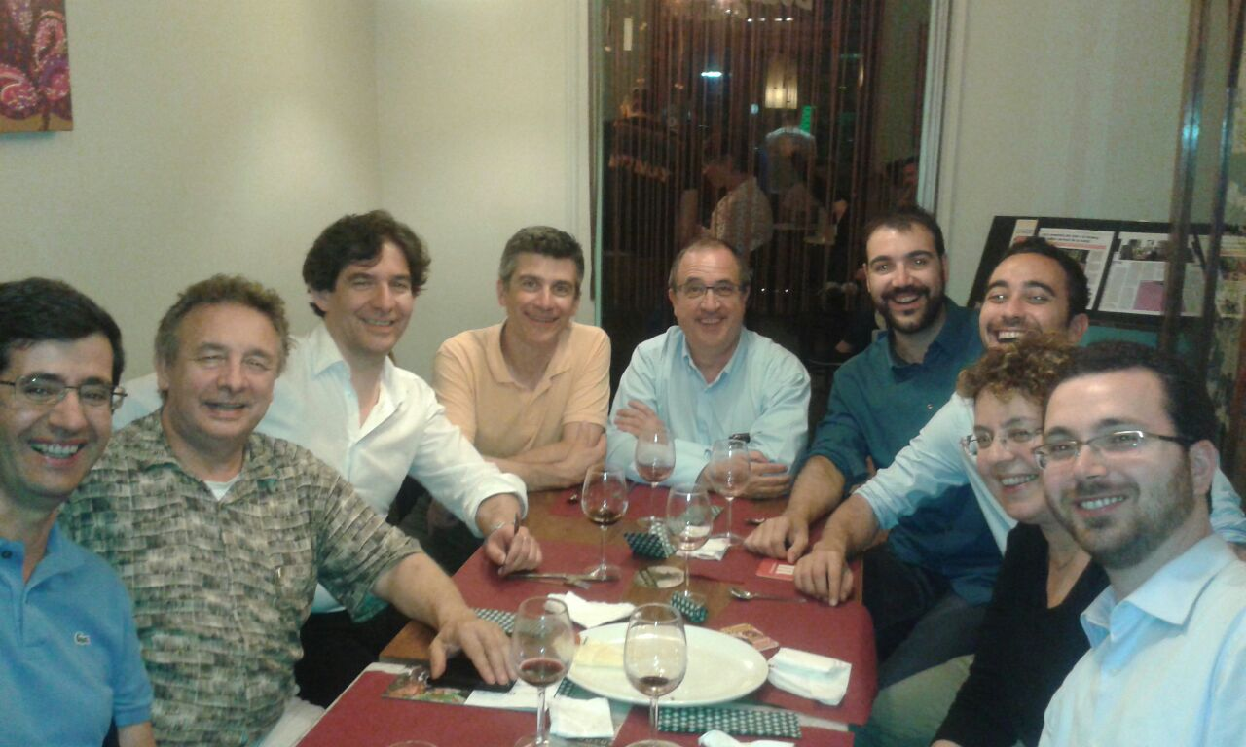
South European Link for Research Information Management
FCT|FCCN (Portugal)
GIVE
PTCRISync: ORCID Synchronization Framework
TAKE
CERIF Model | CERIF Services | CERIF REST API | CERIF OAI | DSpaceCRIS
CINECA (Italy)
GIVE
DSpace-CRIS | ORCID HUB | upgrades | roadmap
TAKE
ORCID Synchronization Framework | CERIF REST API | CERIF OAI
SELRIM
CSUC (Catalonia)
GIVE
CERIF validator | DSpaceCRIS early adaptor
TAKE
DSpace-CRIS | CERIF OAI
EKT (Greece)
GIVE
CERIF Model | CERIF Services | CERIF XML | CERIF REST API | CERIF OAI | upgrades
TAKE
Contribution

Slide 16
South European Link for Research Information Management
FCT|FCCN (Portugal)
GIVE
PTCRISync: ORCID Synchronization Framework
TAKE
CERIF Model | CERIF Services | CERIF REST API | CERIF OAI | DSpaceCRIS
CINECA (Italy)
GIVE
DSpace-CRIS | ORCID HUB | upgrades | roadmap
TAKE
ORCID Synchronization Framework | CERIF REST API | CERIF OAI
Identified common interest topics to work on 2016:
  Harvesting and sync info using OAI-PMH (1st quarter)
  CASRAI full academic CV express in CERIF xml (2nd quarter)
  Improving of data validation processes (3rd quarter)
  call for joining us !
SELRIM
CSUC (Catalonia)
GIVE
CERIF validator | DSpaceCRIS early adaptor
TAKE
DSpace-CRIS | CERIF OAI
EKT (Greece)
GIVE
CERIF Model | CERIF Services | CERIF XML | CERIF REST API | CERIF OAI | upgrades
TAKE
Contribution

Slide 17
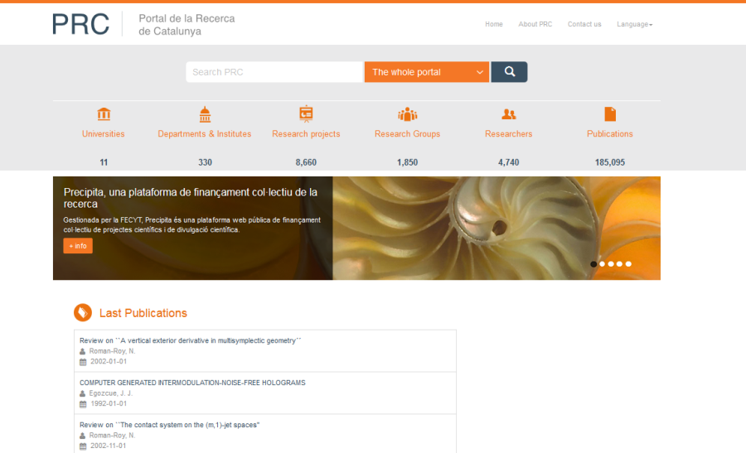
Current status
Portal built
Data from all universities loaded
All universities exporting in CERIF-XML
Reviewing data quality before public opening

Slide 18
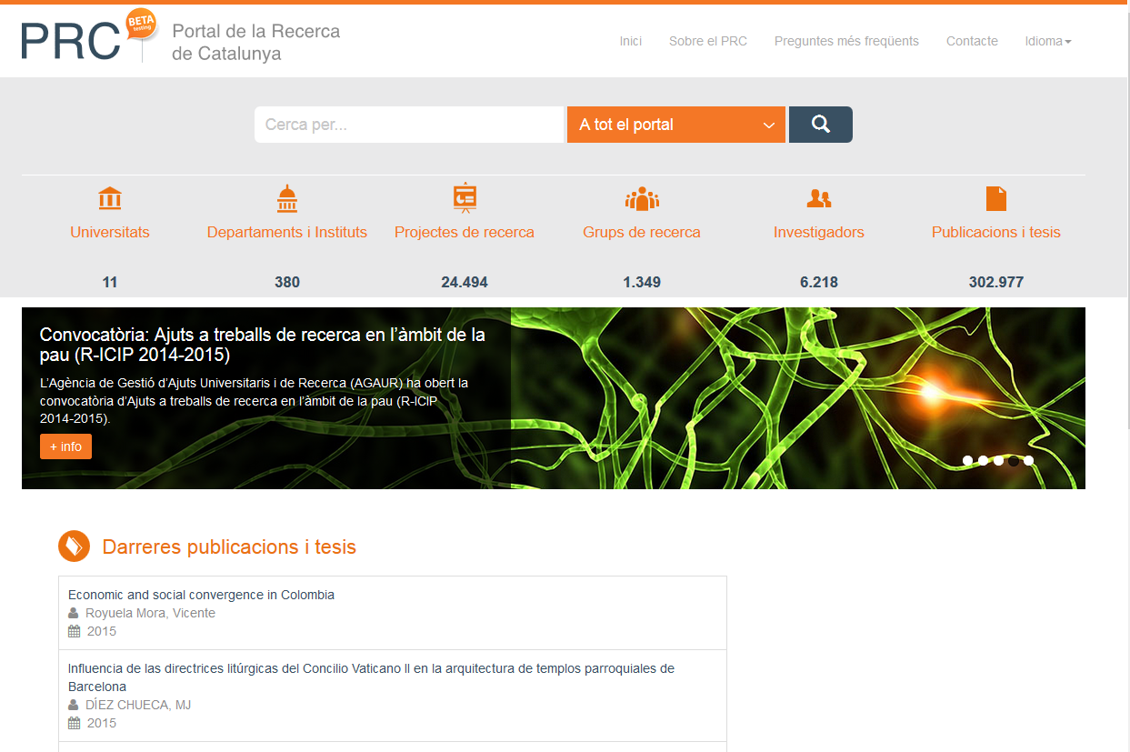

Slide 19
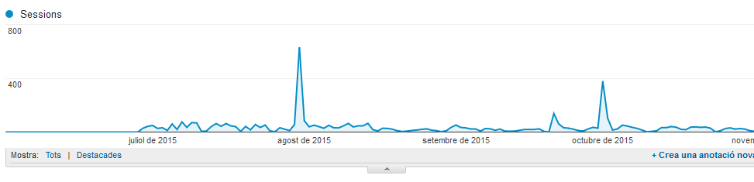
Researcher’s interest in the project

Slide 20

Lesson’s learned:
Benefits of using CERIF-XML
An european standard
Strictly well defined specifications
Groupwork: No fighting!
Improvement of CRIS systems

Slide 21

Lesson’s learned:
Dificulties using CERIF-XML
Current CRIS systems were not compliant with it
Complex (to understand, so to implement)
Defined for an ideal scenario, but…
    We have a lot of legacy data
    Many “foreing” researchers (so not well defined)
    Lack of identifiers in many entities (not CERIF’s fault)

Slide 22

Next steps : roadmap
Step 1: prototipe
Step 2: first batch load
Step 3: full batch load
Step 6: CERIF-XML OAI-PMH ingest
Step 5: go live
Step 4: CERIF-XML ingest

Slide 23
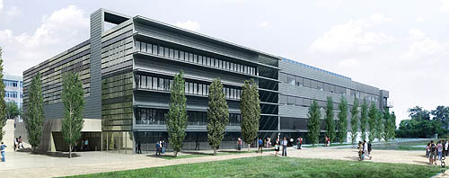
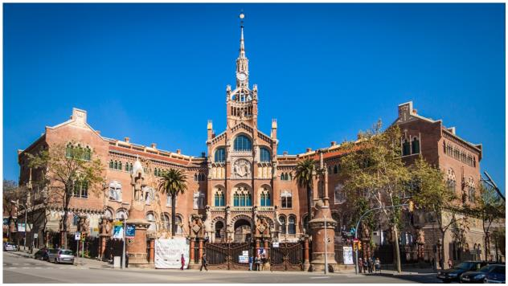

Next steps : what now?
Go live!
Improve data quality (avoid duplication)
Expand the project to other research centers

Slide 24

Thanks!
Any question?
Ramon Ros i Gorné
(CSUC)
ramon.ros@csuc.cat
http://www.csuc.cat

