Slide 1

(Research) dataset metadata - requirements
Kevin Ashley
Digital Curation Centre
www.dcc.ac.uk
@kevingashley
Kevin.ashley@ed.ac.uk
Reusable with attribution: CC-BY
The DCC is supported by Jisc

Slide 2
Overview
The disciplinary perspective
Research Community perspective
Funder, institution, creator perspectives
Observations
Much already said by C4D and others
There are more ecosystems than library & admin

Slide 3
Disciplines – current state
Typically specialised
Focussed on discipline-specific concerns
Frequently embedded – hence processing required to expose independently
Historic failure to express generic concepts generically
  Place
  Time

Slide 4
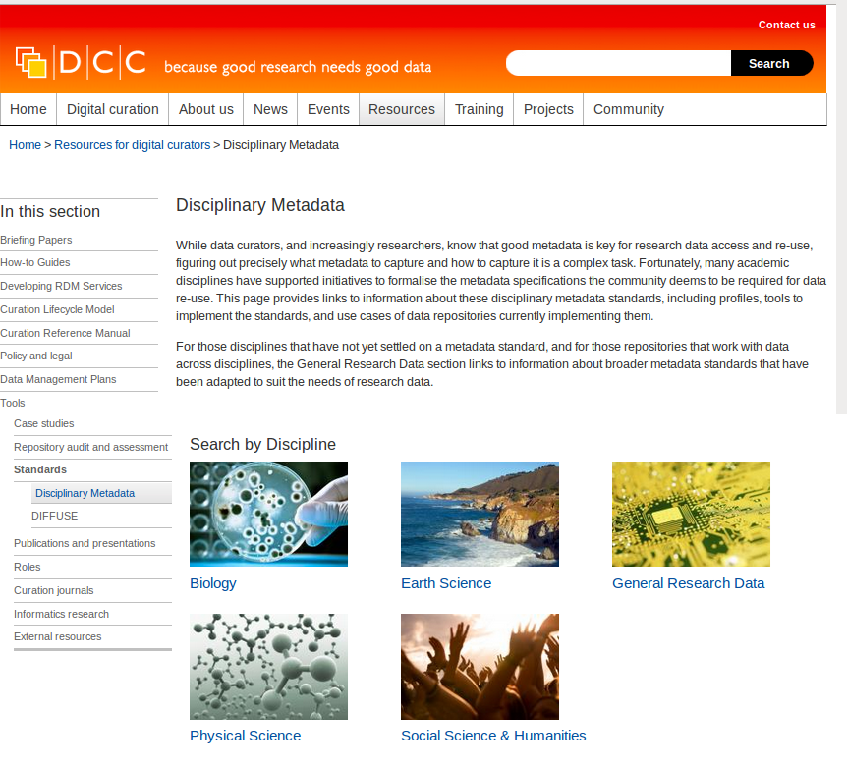
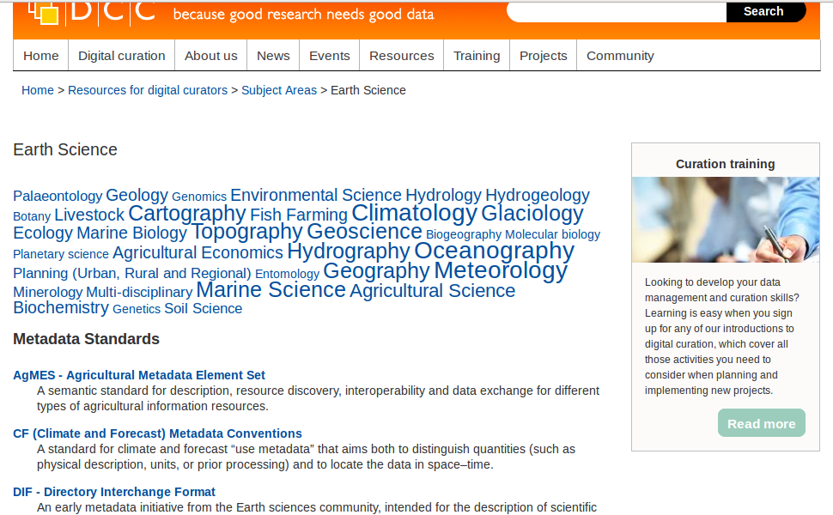

Slide 5
Discipline requirements
Don’t do anything that interferes with my
  Workflows
  Tools
  Standards
Help us discover, use relevant data from other disciplinary contexts
Help us aggregate data from disparate sources
Remove regulatory overhead

Slide 6
Community perspective
Ease data discovery and reuse within and across disciplines
Tackle generic tasks generically, e.g.
  Time & place
  Publication linking
  Licencing
  Quality
  Access control

Slide 7
Generic tasks - place
INSPIRE directive has driven uptake, acceptance
Benefits with public sector data encourage researcher uptake
A top-down approach that works, delivers benefits
Makes retrieval of related data from multiple discipline repositories much simpler

Slide 8
Generic tasks - time
Time has two meanings – as with publications
Time of production != time of coverage
Bibliographic metadata handles this badly, privileges publication
DC handling particularly bad:
  DC.Date
    Date.accepted, date.copyrighted,date.submitted
  DC.Coverage
ISAD(G) somewhat better

Slide 9
Funders, institutions, creators
All want credit, to assert ownership
All want to know about impact, reuse
All are interested in connecting data & publications
CERIF and CRIS meet (some of) these needs well

Slide 10
Data aren’t publications
SWISSPROT – records added, records annotated
Changing data can have fixed metadata –
  But don’t force the data to freeze
Data doesn’t always have clean boundaries
Beware of file-based models

Slide 11
Funders don’t control the world
Remember – not all data used by researchers is created by researchers
Data created outside research context is also outside research administrative control
Some data in research context is not funder- or project-associated
Standards may work – but incentives are absent or weak

Slide 12
Discovery service
CRIS
National or international data centre
Institution
The metadata that flows between these places isn’t all the same and isn’t all they have

Slide 13
Even when data is open, metadata may not be
Individual registering interest in knowing of changes or errors in data
Who has accessed the data?
Who will be publishing using this data?
Does CERIF handle selective disclosure? Is this a system function?

Slide 14
Other research objects
Requirement to connect other objects with data
Workflows (e.g. Taverna), data management plans, samples
Necessary for research & admin purposes
CERIF already appears to model other connections (e.g. instruments) well

Slide 15
BIG
DATA

Slide 16
Overall
Resist temptation to manage all metadata in one way in one place
Decide on control for elements by all means
Accept need for frequent and imperfect cross-walks and mappings
Research administration supports research

