Slide 1
CRIS and Research Data Management in the UK
euroCRIS Strategic Membership Meeting
Amsterdam, 11-12th November 2014
Anna Clements
@annakclements
University of St Andrews
Executive Board Member, euroCRIS
Chair, CASRAI Data Management
Planning Working Group
Chair, Pure UK Strategy Group

Slide 2

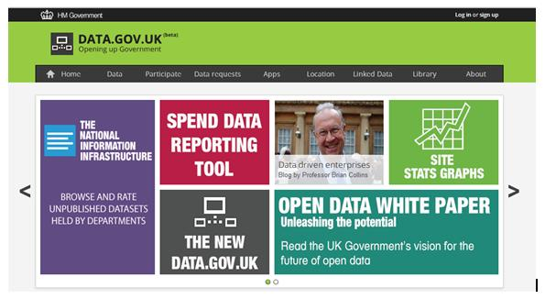

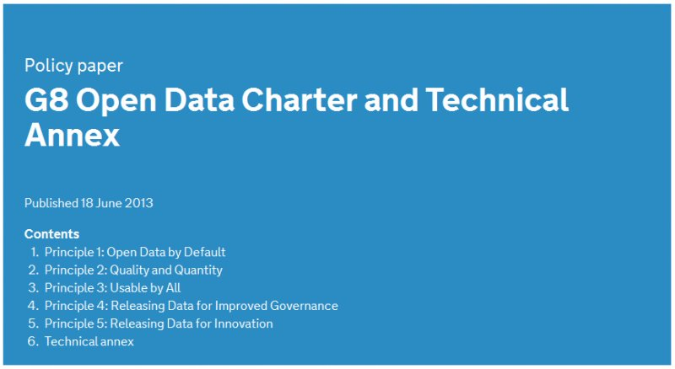
2012 & 2013 …all things open …
UK Government white paper on open data 2012
http://data.gov.uk/library/open-data-white-paper
Science as an open enterprise, Royal Society 2012
https://royalsociety.org/policy/projects/science-public-enterprise/Report/
“Open data is the bed-rock of the scientific process”
Report on open access 2012
http://www.researchinfonet.org/wp-content/uploads/2012/06/Finch-Group-report-FINAL-VERSION.pdf
G8 Report 2013
https://www.gov.uk/government/publications/open-data-charter/g8-open-data-charter-and-technical-annex
Notes:
Science as an open enterprise – June 2012
‘‘ Publishing data in a reusable form to support findings must be mandatory “
UK Government White Paper – June 2012
Research Transparency Sector Board announced to
‘.. consider how we open up publicly funded research data in a way that maximises public benefit.’
TODAY – announced that hospitals to publish staffing levels on the web from next year …. One of recommendations from North Staffs enquiry ….
Finch Report, June 2012
‘the infrastructure of subject and institutional repositories should be developed so that they play a valuable role complementary to formal publishing, particularly in providing access to research data and to grey literature, and in digital preservation;’
Led to RCUK Open Access policy .. In force since April 1st 2013
Articles should be OA either via paying an APC [article processing charge] .. Gold or via deposit into our existing Institutional full-text repository usually with an embargo period. Guidance available on Library web-site .. Look for open access support

Slide 3
UK research funding
  Dual-funding model
  7 discipline-specific research councils (RCUK)
    distribute £2.6bn (3.3bn euros) via competitive grant bids
  Funding bodies – quality of research at an institution
    distribute £1.6bn (2bn euros) on basis of quality research assessment exercise or REF (Research Evaluation Framework)
  Both are responding to the ‘open data’ opportunity and driving cultural change in UK academia

Slide 4
RCUK OA policy
  Includes reference to underlying data :
  “Papers should also include a statement on how the underlying research materials - such as data, samples or models – can be accessed. It is not necessary that the data itself be openly accessible if there are compelling reasons against this.”
  Came into force 1st April 2013
  Also published common data principles in 2011

Slide 5
1. Public good
2. Preservation
3. Discovery &
Reuse
BUT BALANCED BY
4. Confidentiality
5. First use
6. Recognition
7. Public funding
http://www.rcuk.ac.uk/research/Pages/DataPolicy.aspx
Notes:
RCUK, Common Principles on Data Policy, 2011
EPSRC Policy Framework on Research Data, May 2011 .. Look at in more detail later
Open Access Policy, 1st April 2013
‘All papers must include details of the funding that supported the research and, if applicable, a statement on how the underlying research materials – such as data, samples or models – can be accessed.’
Public good vs IP of scientist
Current guidance is that costs for RDM during a project and to prepare data for long-term preservation … not for the actual preservation period of 10 plus years
DCC policies – all require a data management plan or similar .. Will talk about EPSRC next ….
data centre … to curate unpublished data … preserving and adding value : repository to make published datasets available
Not just in UK, are HORIZON 2020 open data pilot
NSF and NIH have data sharing policies

Slide 6
Funder policy summary

Slide 7
EPSRC framework
Engineering and Physics Sciences Research Council
By May 2015, EPSRC has 9 clear expectations of organisations receiving EPSRC funding, including :
‘.. that appropriately structured metadata describing the research data they hold is published (normally within 12 months of the data being generated) and made freely accessible on the internet; in each case the metadata must be sufficient to allow others to understand what research data exists, why, when and how it was generated, and how to access it.’
Where access to the data is restricted the published metadata should also give the reason and summarise the conditions which must be satisfied for access to be granted. For example ‘commercially confidential’ data, in which a business organisation has a legitimate interest, might be made available to others subject to a suitable legally enforceable non-disclosure agreement.
‘… that EPSRC-funded research data is securely preserved for a minimum of 10-years from the date that any researcher ‘privileged access’ period expires or, if others have accessed the data, from last date on which access to the data was requested by a third party; all reasonable steps will be take to ensure that publicly-funded data is not held in any jurisdiction where the available legal safeguards provide lower levels of protection than are available in the UK

Slide 8
For next REF in 2020
A revolutionary OA policy for articles and conference proceedings
  “To be eligible for the next Research Excellence Framework, peer-reviewed manuscripts must be deposited in an institutional or subject repository on acceptance for publication. These requirements apply to all journal articles and conference proceedings
  “
  => Leads to a simple message ….

Slide 9
https://www.openaccess.cam.ac.uk

Slide 10
http://openaccess.wp.st-andrews.ac.uk/what-do-i-need-to-do/

Slide 11
…so what about data in next REF?
We can see the direction of travel – the REF2020 guidelines state:
  “Where a University can demonstrate that it has taken steps towards enabling open access for outputs outside the scope of this policy, credit will be given in the research environment component of the post-2014 REF. “

Slide 12
So can a CRIS help?
160 Universities and HEI organisations in the UK
Of top 50 (by research income), all but 7 have a CRIS
  Elsevier - Pure
  Symplectic – Elements
  Thomson Reuters – Converis
  ePrints + extensions
  Inhouse
Huge investment since last assessment exercise in 2008... but for more than just assessment

Slide 13
Activities
Impact
Publications
Award/ recognition
Indicators
WoS, arXiv, PubMed, Scopus…
Case Studies
Bibtex, Refman
Dissemination// Engagement
Measures
Entered
Manual
Input
Uploaded
Entered
Harvested
University Structure [HR]
Entered
Research
Information
System (PURE)
HEI – Strategic
Planning, Benchmarking
Staff Records [HR]
REF, RCUK. GtR
Pulled In
Fed Out
Student Records [Registry]
Public, Media Recognition / Impact
Linked
Projects, Grants, KT
[Finance]
Collaborations
Research Pools
Equipment & Facilities
Full Text
Repository
Open Access
St Andrews Research Information system …from 2003 and still evolving

Slide 14
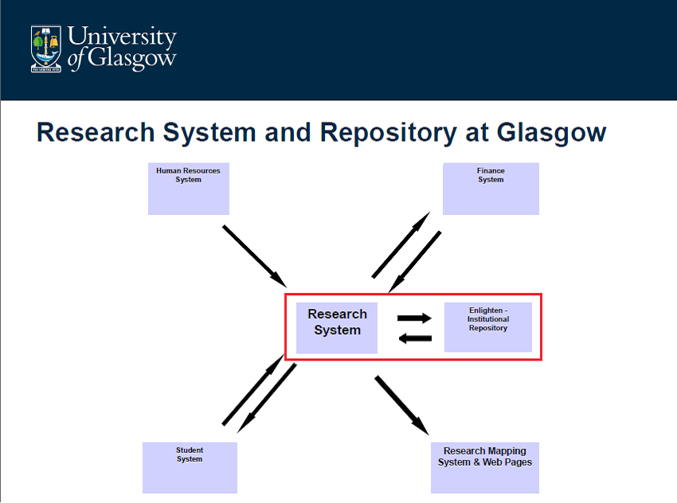
inHouse research system
Integrated with ePrints
Repository – which includes
datasets

Slide 23
Key requirements for RDM in UK
Compliance & Assessment
  Link data sets to funding and to articles
  Prepare for REF2020 .. impact & openness
Simple & quick to use - ROI
  Existing systems – researchers used to
  Reuse of information
  Interoperability with other data registries
  Single portal

Slide 24
Activities
Impact
Publications
Award/ recognition
Indicators
WoS, arXiv, PubMed, Scopus…
Case Studies
Bibtex, Refman
Dissemination// Engagement
Measures
Entered
Manual
Input
Uploaded
Entered
Harvested
University Structure [HR]
Entered
Research
Information
System (PURE)
HEI – Strategic
Planning, Benchmarking
Staff Records [HR]
REF, RCUK. GtR
Pulled In
Fed Out
Student Records [Registry]
Public, Media Recognition / Impact
Linked
Linked
Projects, Grants, KT
[Finance]
Collaborations
Research Pools
Equipment & Facilities
Full Text
Repository
Open Access
Research data sets
(multiple locations and formats)
St Andrews Research Information system …from 2003 onwards

Slide 25
A bit more complicated than that…
Researcher
Data deposit interface
Related Publications, Projects, activities etc in Pure
Deposit metadata
Data librarian
Info: redirect to external repository where possible
And data?
CRIS
External repository
Data repository
Metadata
Metadata
Data
Validate metadata and apply access restrictions
Data catalogue
Access storage
Archive storage
End user
Open access data
Jackie Proven, University of St Andrews
Notes:
All users interact with Pure interface
All storage is local (but external to the Pure database)

Slide 26
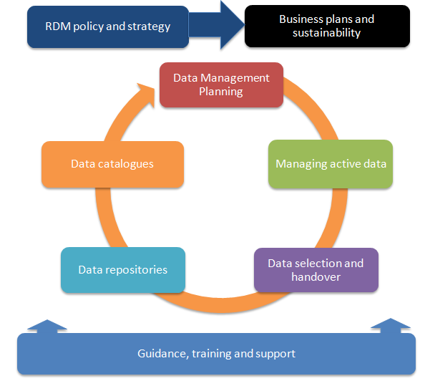
Components of a data management service : Digital Curation Centre: http://www.dcc.ac.uk/resources/how-guides
  CRIS
Notes:
So where could our CRIS support these services?

Slide 27
Components of a data management service : Digital Curation Centre: http://www.dcc.ac.uk/resources/how-guides
  CRIS? CRIS-IR?
Notes:
So where could our CRIS support these services?

Slide 28
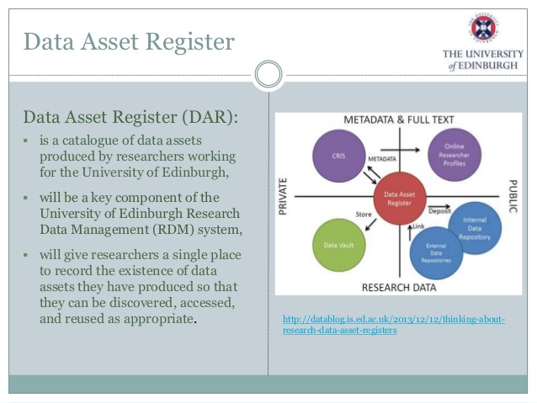

Slide 29
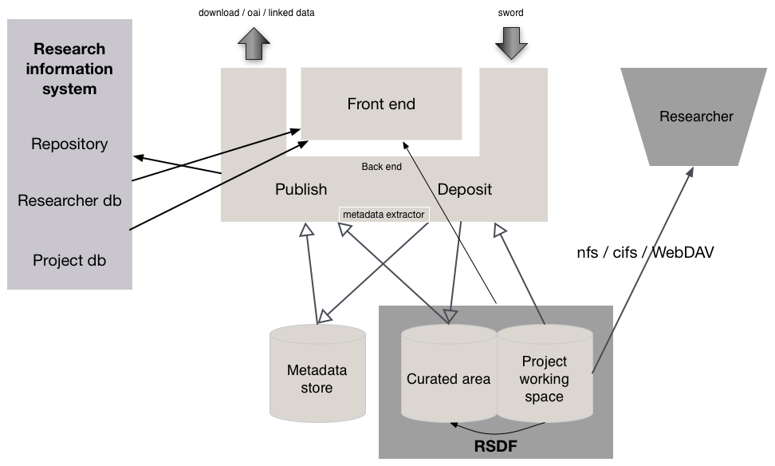
University of Bristol data.bris architecture http://www.dcc.ac.uk/blog/developing-joined-rdm-infrastructure-institutions

Slide 30
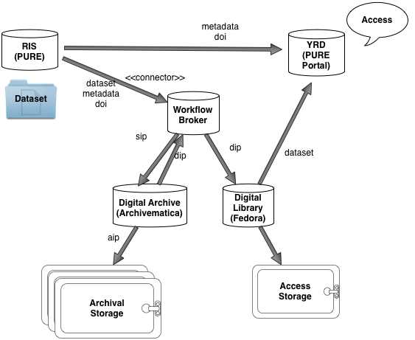
Proposed architecture for digital curation, Jen Mitcham, University of York, DCC EPSRC workshop, May 2014

Slide 31
Breaking news …

Slide 32
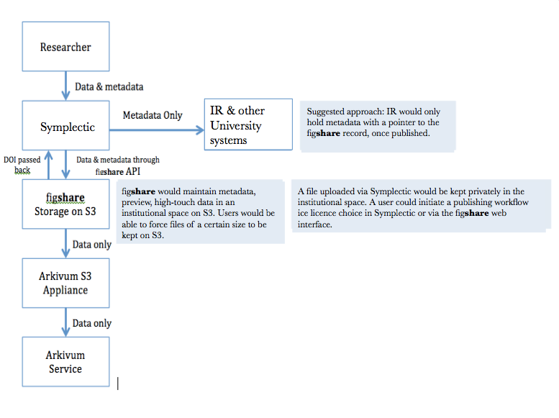

Slide 33
Standards and interoperability
Metadata harmonisation
  Cerif 4Datasets * Datacite *Pure/EPrints UG
UK National data registry pilot
    JISC * DCC * Institutions * Funders * Data Centres
Harmonisation of funder requirements
  CASRAI-UK DMP working group

Slide 34
Next steps
See how these models work in practice
Key success measures for institutions
  Ease of measuring compliance
  Simplicity of use by researchers
  ROI for institutions
  REF2020 and beyond
Key success measures for research process
  Increased openness of research data
  Increased reuse of research data
  Trace impact of research data

Slide 35
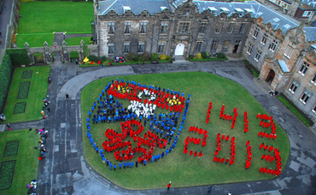
Thank you for listening
@annakclements

