Slide 1
Mapping solid earth data and Research Infrastructures to CERIF:
EPOS approach
Martin Nayembil (BGS), Daniele Bailo (INGV), Damian Ulbricht (GFZ), Luca Trani (KNMI), Alessandro Spinuso (KNMI), Keith G. Jeffery (ERCIM)
13th International Conference on Current Research Information Systems, CRIS2016, 9-11 June, 2016 - Scotland

Slide 2
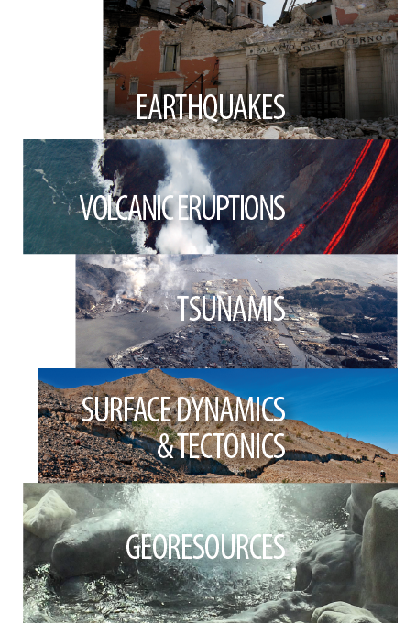
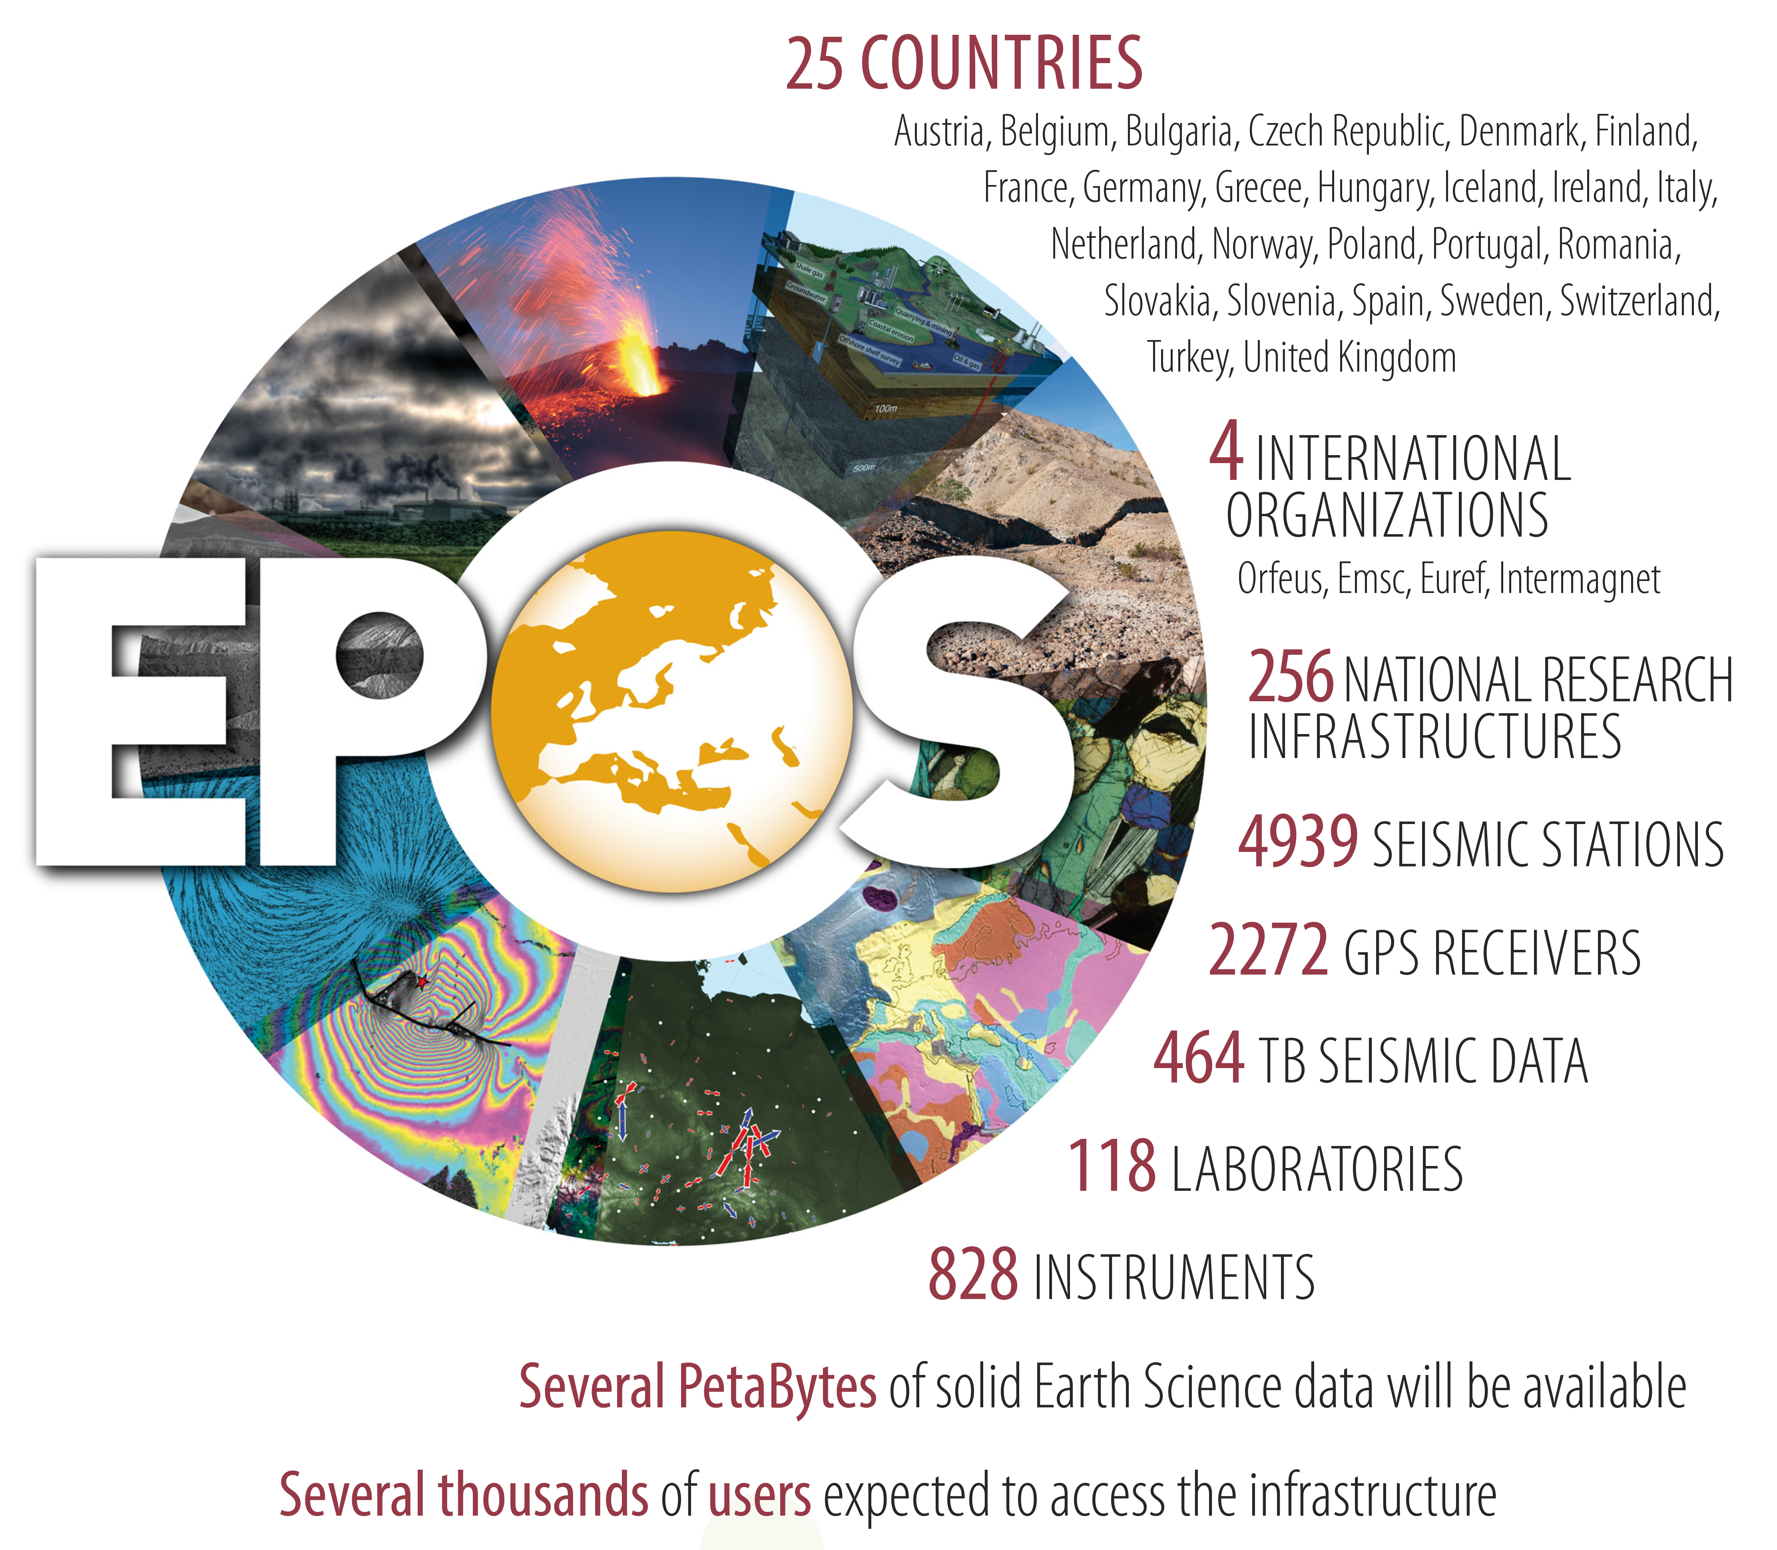
EPOS is a long-term plan
for the integration
of research infrastructures for
solid Earth Science in Europe

Slide 3
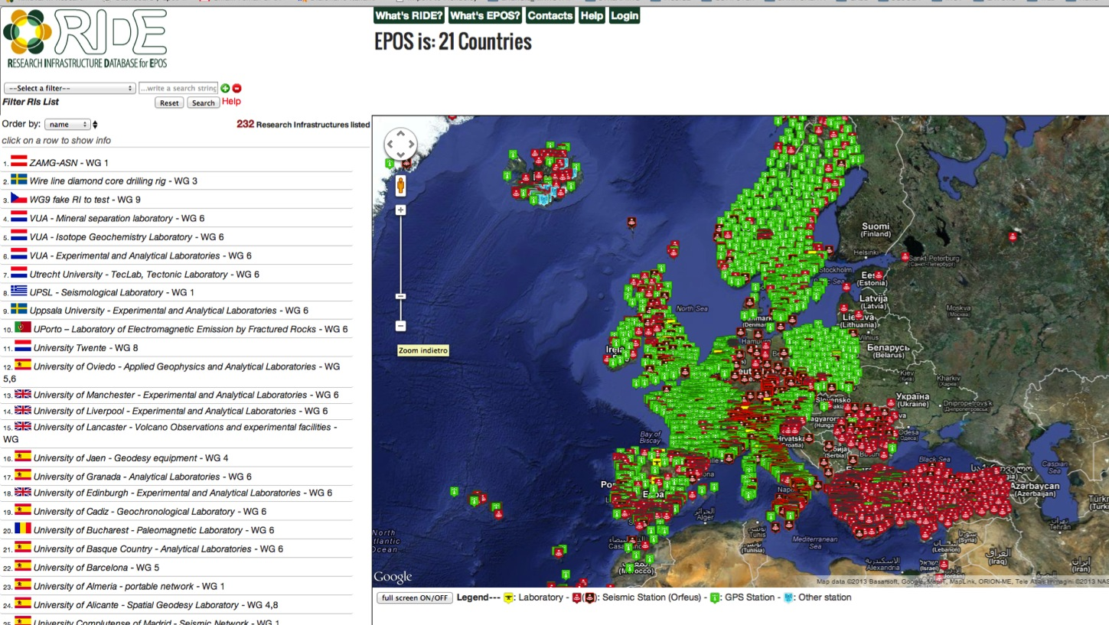
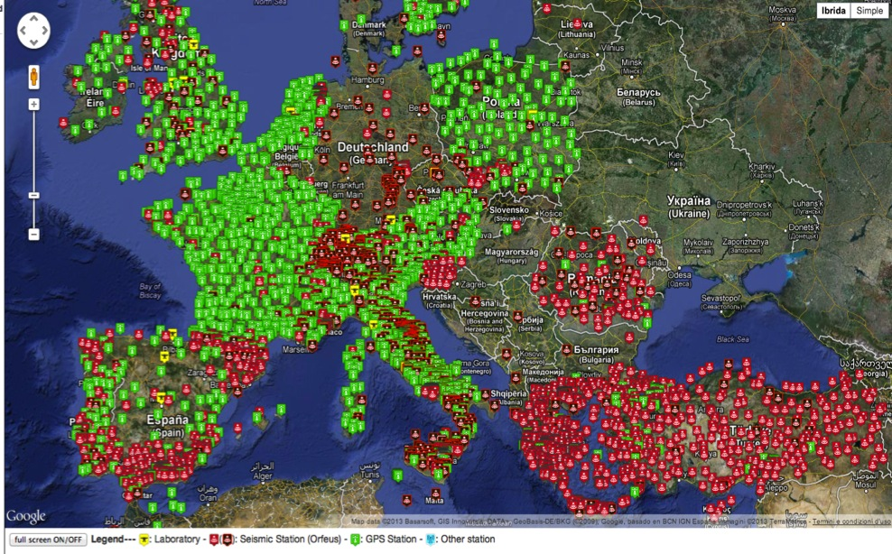
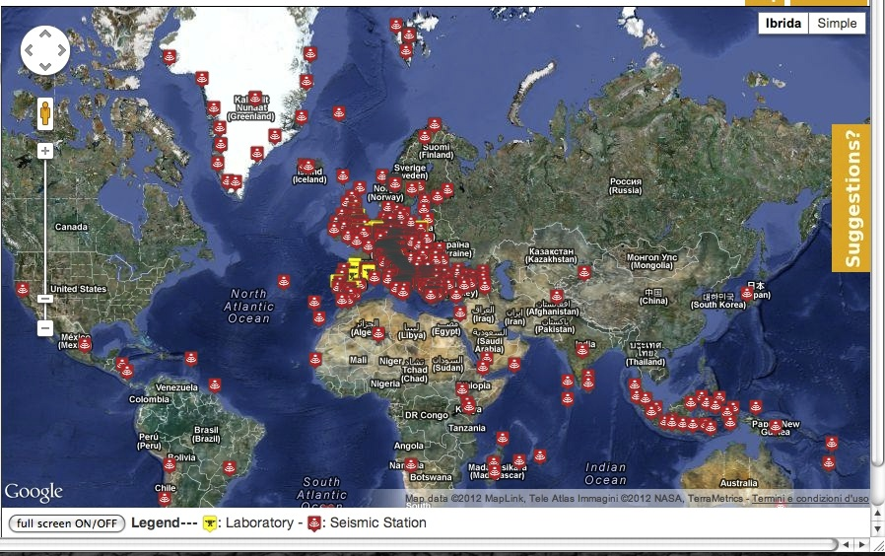
Communities in numbers
MAP OF:
- Seismic/GPS stations
Laboratories
- etc….
Diversity in data type and formats
http://www.epos-eu.org/ride/
Research Infrastructure
LIst
244 Research Infrastructures
138 Institutions
22 countries
2272 GPS receivers
4939 seismic stations
464 TB Seismic data
1.095 PB Storage capacity (seismology)
1.240 PB Storage capacity (GNSS DC)
828 instruments in 118 Laboratories

Slide 4
Future
Platform

Slide 5
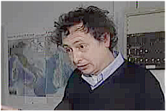

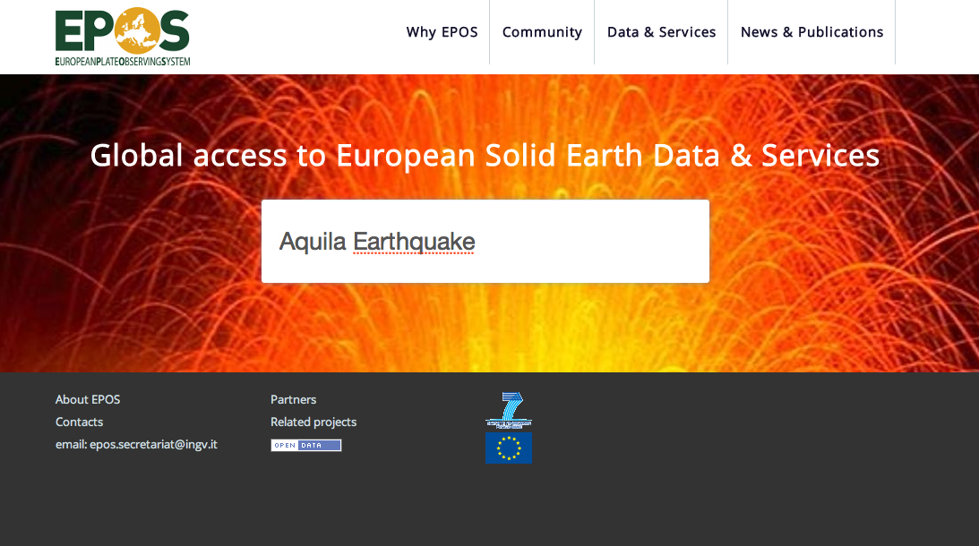
Scientist!

Slide 6
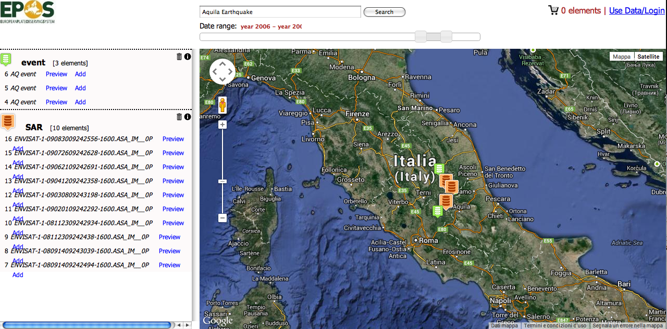


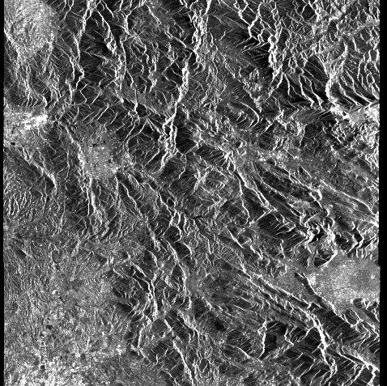


ENVISAT_987987998_
Sicily North East Coast
Switch to advanced search
Accelerometric Data
Lipari Islands M:2.2
2013.08.23 - add | show | info
Sicily North East Coast M:2.1
2013.08.21 - add | show | info
Sicily North East Coast M:2.3
2013.08.18 - add | show | info
SAR Data
ENVISAT_987987998_
add | show | info
square
ENVISAT_43287987998_6
add | show | info
square
Geodetic DAta
Rynex ad098098
2009.04.09 - add | show | info
Rynex ad098098
2009.04.09 - add | show | info
Rynex ad098098
2009.04.09 - add | show | info
Notes:
Aggiungere show

Slide 7
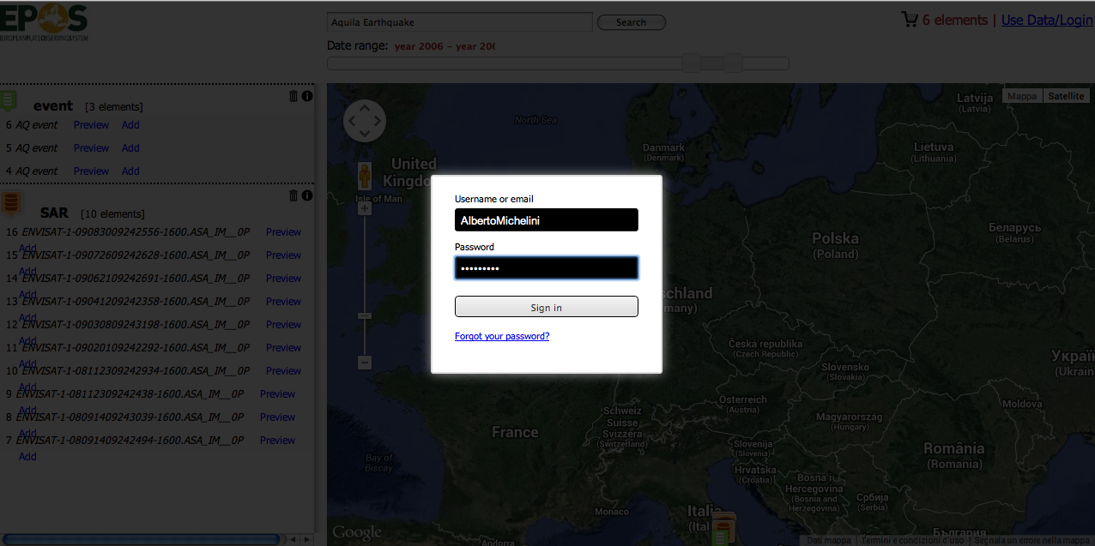
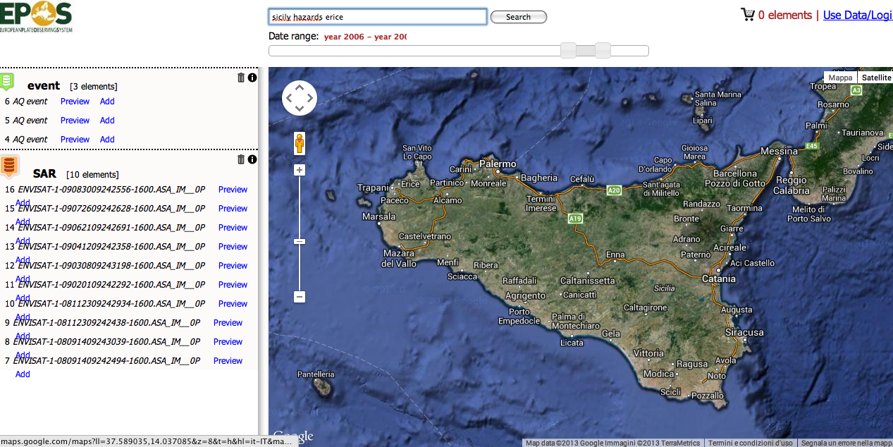


Sicily North East Coast
Latest Earthquakes
Lipari Islands M:2.2
2013.08.23 - Info
Sicily North East Coast M:2.1
2013.08.21 - Info
Sicily North East Coast M:2.3
2013.08.18 - Info
Shakemaps
Sicily North East Coast
2013.08.15 - Download
Sicily sea
2013.05.14 - Download
Hystorical Earthquakes
Siracusa Aea - Imax: 11MCS
1693.01.11 - Infos
Documents & other resources
Civil protection: Sicily hazards
2013.02.01 - Link
Hystory of Sicily Hearthquakes
2013.02.01 - Link

Slide 8
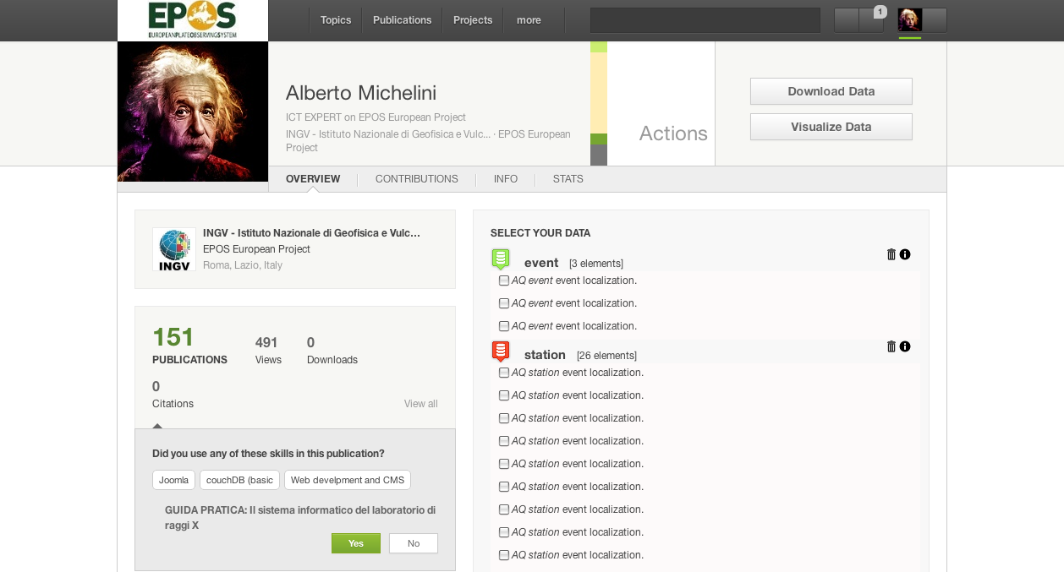
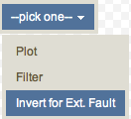
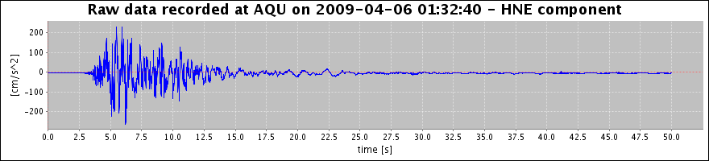

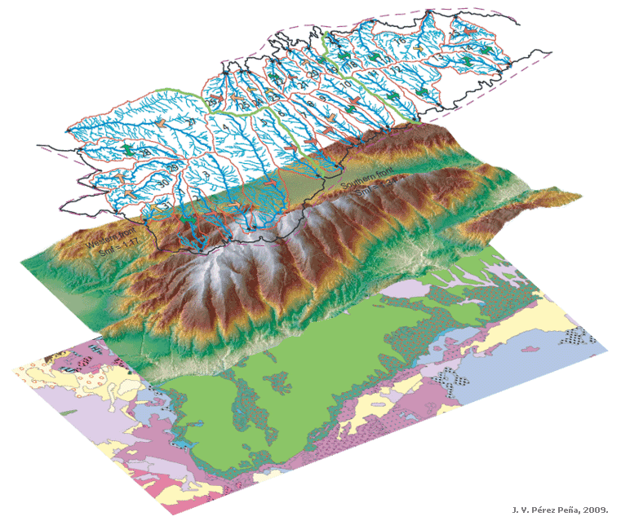
Bulk Actions
Accelerometric Data:
SAR Data:
Accelerometric Waveforms
Filter
Accelerometric Data
MI05 07-04-09 17:47 5.5
AQV 06-04-09 01:32 6.3
AQG 06-04-09 01:32 6.3
AQA 06-04-09 01:32 6.3
AQK 06-04-09 01:32 6.3
PCB 09-04-09 19:38 5.2
AQV 07-04-09 21:34 4.5
AQM 06-04-09 02:37 5.1
AQU 06-04-09 01:32 6.3
PCB 09-04-09 00:53 5.4
GSA 07-04-09 17:47 5.5
PCB 13-04-09 21:14 5.0
Hi-Pass
Remove | Show
Low-Pass
Remove | Show
Band-Pass
Remove | Show
Remove | Show
Remove | Show
Remove | Show
Remove | Show
Remove | Show
Remove | Show
Remove | Show
Remove | Show
Remove | Show
SAR Data
ENVISAT-1-09083009242556-1600.ASA_IM__0P
ENVISAT-1-09072609242628-1600.ASA_IM__0P
ENVISAT-1-09062109242691-1600.ASA_IM__0P
Notes:
Integrate use of SAR, GPS, Accelerometric Data, etc.
Use different codes and languages (python, fortran, any other…)
Perform heavy processing online (use of HPC resources)
Compare results (e.g. focal mechanism catalogues)
Compare different data
Save data in personal area
…and more… (even download the data)

Slide 9
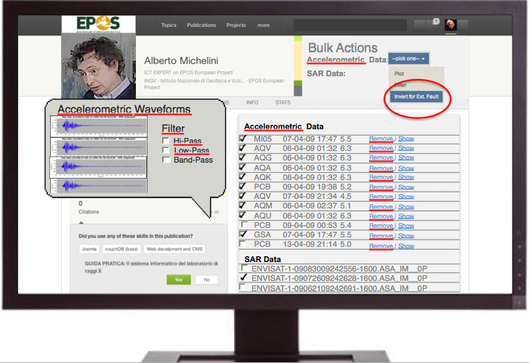
Scientist at work
Then… what can the scientist do?
  Integrate use of SAR, GPS, Accelerometric Data, etc.
  Use different codes and languages (python, fortran, any other…)
  Perform heavy processing online (use of HPC resources)
  Compare results (e.g. focal mechanism catalogues)
  Compare different data
  Save data in personal area
  …and more… (even download the data)

Slide 10
Generic Features
Download
Visualization
Processing
Modeling
Notes:
Per il red: contributi ics-d

Slide 11
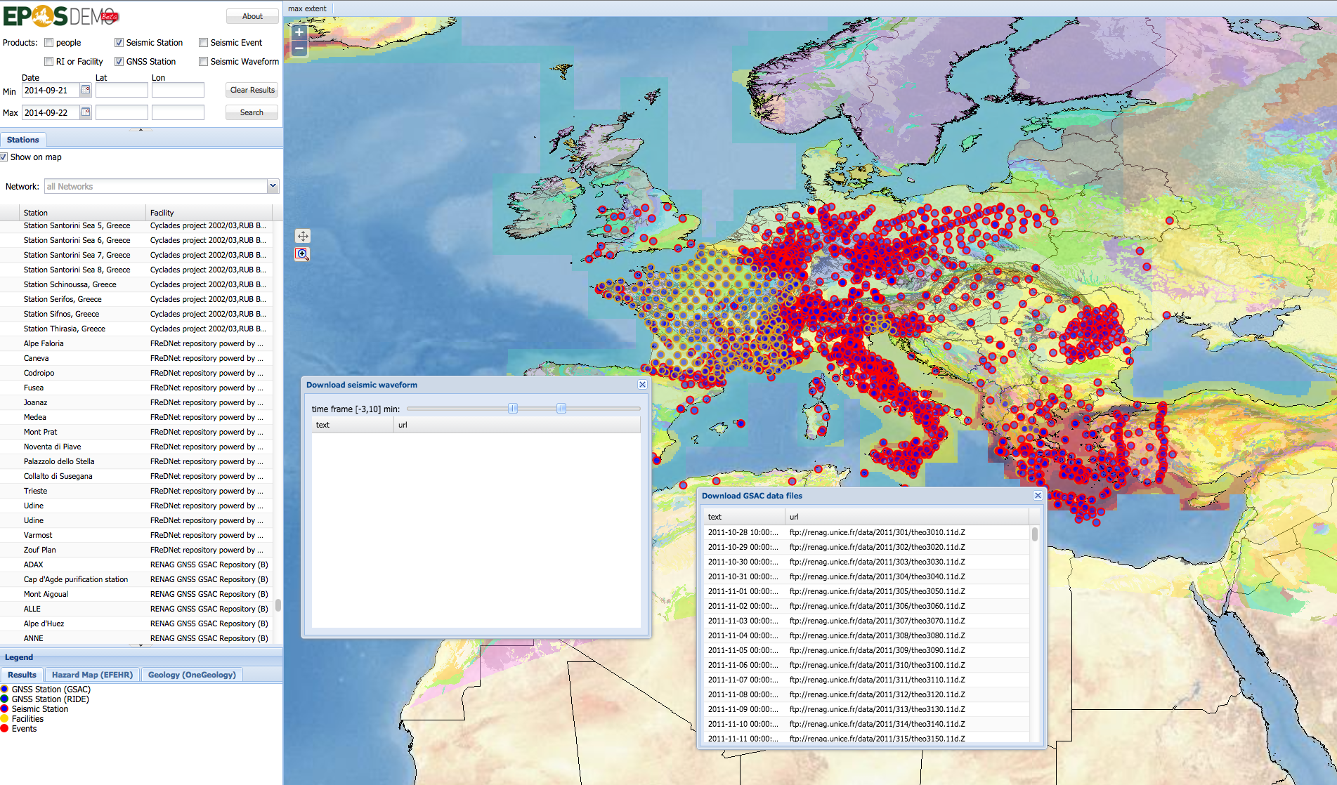
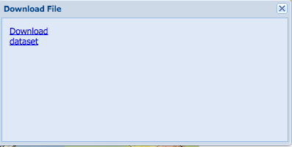
EPOS demonstrator
SEISMIC DATA
DOWNLOAD
GPS DATA
DOWNLOAD
Collaboration with VERCE http://epos.cineca.it

Slide 12
IT Architecture & Design

Slide 13
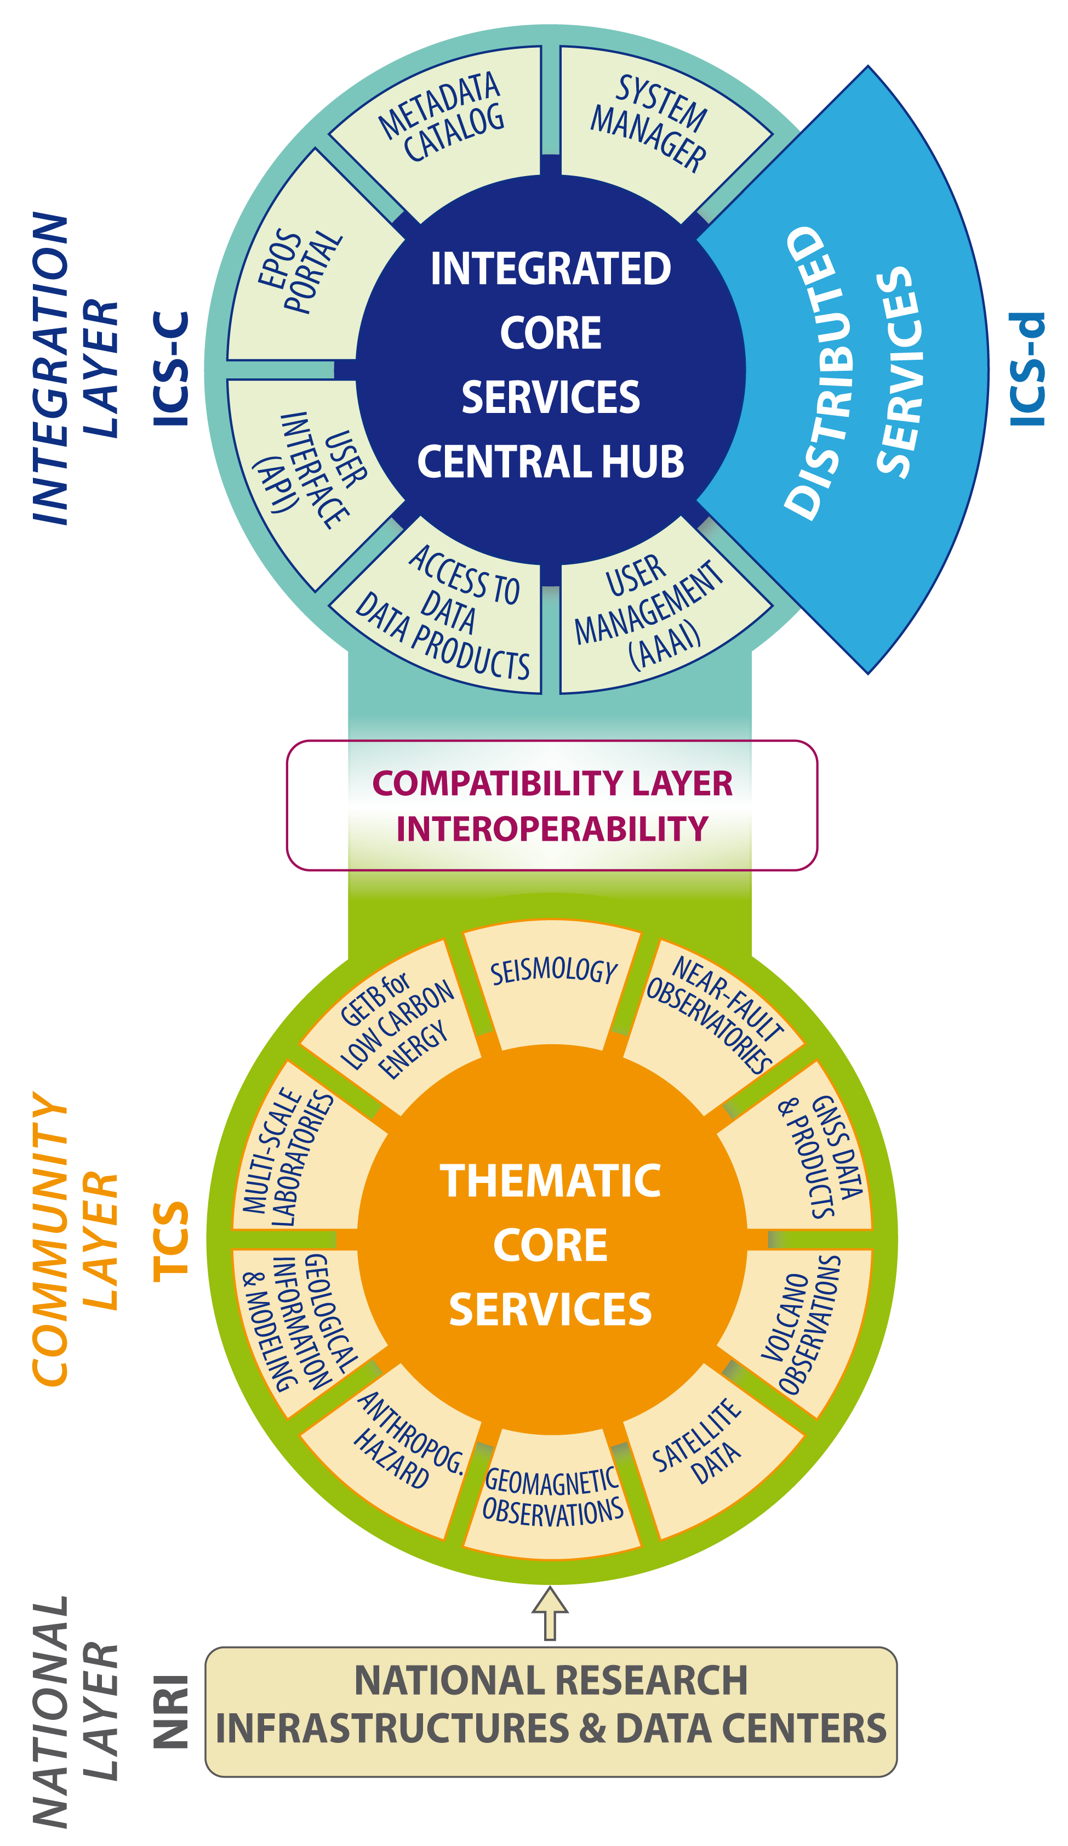
Architecture
Integrated Core Services
(ICS)
Interoperability layer
Thematic Core Services
(TCS)

Slide 14


ICS-C
EPOS GUI
ICS-D
EPOS APIs
METADATA
catalogue
System manager
AAI system
Workflow Engine
TCS
TCS API
TCS API
…Other TCSs
Data
set
Services
Software
Data
set
Services
Software
National
Layer
IT Seismic net
PT GPS net
FR Seismic net
NO GPS net

Slide 15
ICS - Integrated Core Services
ICS-C and ICS-D
ICS-C
ICS-D
ICS-Central Hub
Orchestrates external
resources (ICS-D)
EPOS member states
competition for hosting it
ICS-Distributed services
Provide IT resources not built by EPOS ICS-C
Computational resources
Visualization resources
Others…

Slide 16
Metadata model
3-layers
Manage the complexity (see previous slide)
CERIF (formal syntax, declared semantics)
Functions
-Discovery, selection
-Impact assessment
-Manage interoperability
Issues (selection of)
heterogeneity
Many standards to be mapped from TCS
Ontologies
Complex work
Web portal, Spatio-Temporal Search
Discovery (DC) and (CKAN, eGMS)
Generate
Contextual (CERIF metadata model)
Point to
Detailed (community specific)
domain specific – data
(TCS or Naational Ris)
Notes:
Esempio carta identità

Slide 17
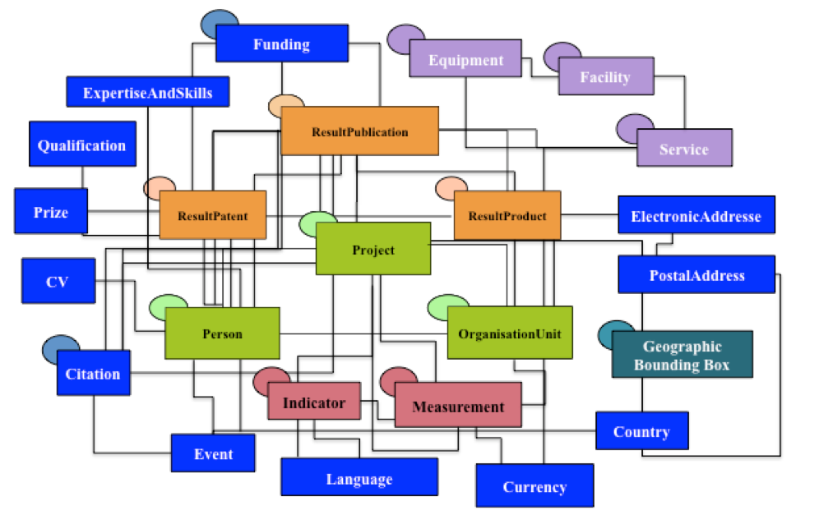
Contextual (CERIF metadata model)
(http://www.eurocris.org/)
Common European Research Information Format

Slide 18
Mapping to CERIF
What we need to model CERIF
a set of core elements based on internationally recognised standards (e.g. ISO19115, INSPIRE) for the DDSS- Data-Data Products-Software-Services
defines what in a minimum will be mapped to CERIF
will be used to communicate with the various TCS as to the minimum metadata required
Baseline Documentation

Slide 19
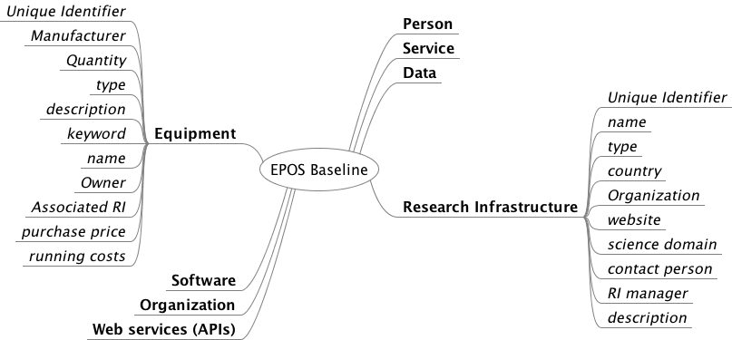
EPOS Metadata Baseline

Slide 20
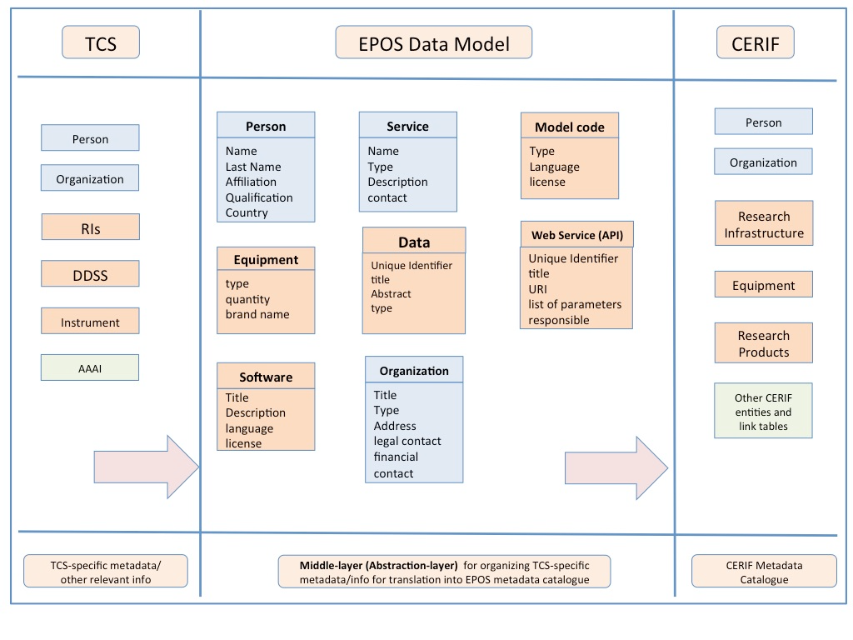
EPOS Metadata Baseline

Slide 21
Metadata Baseline - CERIF
Elements defined:
  Data – dataset, data series, data product
  Service - an offer of an RI to the community. It could be free or ask for something in return (money, publication of the datasets,...) or something tangible from the community.
  Software – software packages, application programs
  Web service (APIs) - Online interfaces (APIs) enabling a user or a machine to programmatically access the given resource
  Organisation – (Research Infrastructure RI, Institution, Facility)
  Research Infrastructure – facilities, resources and related services used by the scientific community to conduct top-level research in their respective fields. E.g. singular large-scale research installations, collections, special habitats, libraries.
  Equipment – Instruments - Devices
  Person

Slide 22
From Baseline to CERIF - an example
Mapped core metadata elements identified in the EPOS baseline to CERIF
  Data & Data Products
  Service
  Web service
  RI
  Organisation
  Person
  Equipment
EPOS CERIF Mappings
euroCris Comments
Research Infrastructure
Element (requirement) | Vocabulary | CERIF Entity/Relationship | CERIF Attributes
Identifier (m) (not needed) |  | cfFacil | cFacilID
Name (m) (not needed) |  | cdFacilName | cfFacilID, cfName
Type (o) | Scheme and Class to characterise the "type" | cfClass,cfFacil_Class cfClassCheme | cfClassScheme, cfClass
Postal Address (m) | Scheme: CERIF_ENTITIES Class: POSTAL_ADDRESS | cfFacil_Paddr, cfPaddr | cfFacilID, cfPAddrID, cfCountryCode, cfAddrLine1, cfPostCode, cfCityTown, cfStateofCountry
Website (o) (not needed) |  | cfFacil | cfFacilURI
Description (m) (not needed) |  | cfFacilDescr | cfFacilID, cfDescr
Science Domain (m) | Scheme and Class to characterise the "scientific domain" | cfClass,CfFacil_Class, cfClassCheme | cfClassScheme, cfClass
Affiliation (m) | Scheme: ORGANISATION_RESEARCH_INFRASTRUCTURE_ROLES Class: OWNER | cfOrgUnit_Facil | cfOrgUnitiD, cfFacilId
Manager (o) | Scheme: PERSON_RESEARCH_INFRASTRUCTURE_ROLES Class: MANAGER | cfPers_Facil | cfPersID, cfFacilID
Costs (o) | Scheme: RESEARCH_INFRASTRUCTURE_COSTINGS Class: OPERATING_COSTS | cfFacil_cfFund, cfFund | cfFacilID, cfFundID, cfAmount, cfCurrCode
Financial Contact Person (m) | Scheme: PERSON_RESEARCH_INFRASTRUCTURE_ROLES Class: FINANCIAL_CONTACT | cfPers_Facil | cfPersID, cfFacilID
Legal Contact Person (m) | Scheme: PERSON_RESEARCH_INFRASTRUCTURE_ROLES Class: LEGAL_CONTACT | cfPers_Facil | cfPersID, cfFacilID

Slide 23
Some Issues – CERIF Mapping
  The lack of concise definitions of generic concepts led to specific interpretations by different people
  Lack of a classification to define the type and scientific domain of the element of a Research Infrastructure (RI). A general lack of richness in describing roles for financial and legal contacts
  Lack of adequate vocabulary terms within the semantic layer to adequately characterise elements such as Equipment and Research Infrastructure
  CERIF supports provenance through the timestamp linked entities but improvements are needed in the integration of causal-effects relationships among entities, the activities involved and their re-use across processing tasks
  General lack of standard tools for mapping external metadata elements to CERIF
  The lack of a centralised repository/catalogue of previous and/or standardised mappings to existing, standard and well known metadata profiles
  Partial mappings available for concepts/elements: Temporal References, Web Service, open text, numeric and date fields, multi vertex - bounding box, Metadata versions

Slide 24
Conclusion - 1
Research Infrastructure Baseline element mapping, characterise roles with new classes (e.g. FINANCIAL_CONTACT , LEGAL_CONTACT)
Equipment baseline element mapping:
vocabulary to characterise a manufacturer
…OTHER ONTOLOGY RELATED ISSUES

Slide 25
Conclusion – 2
Standard tools for mapping:
- “manual” way (e.g. excel)
- need of software for mapping
2. Catalogues of mappings:
- canonical archive
- maintained by euroCRIS

Slide 26
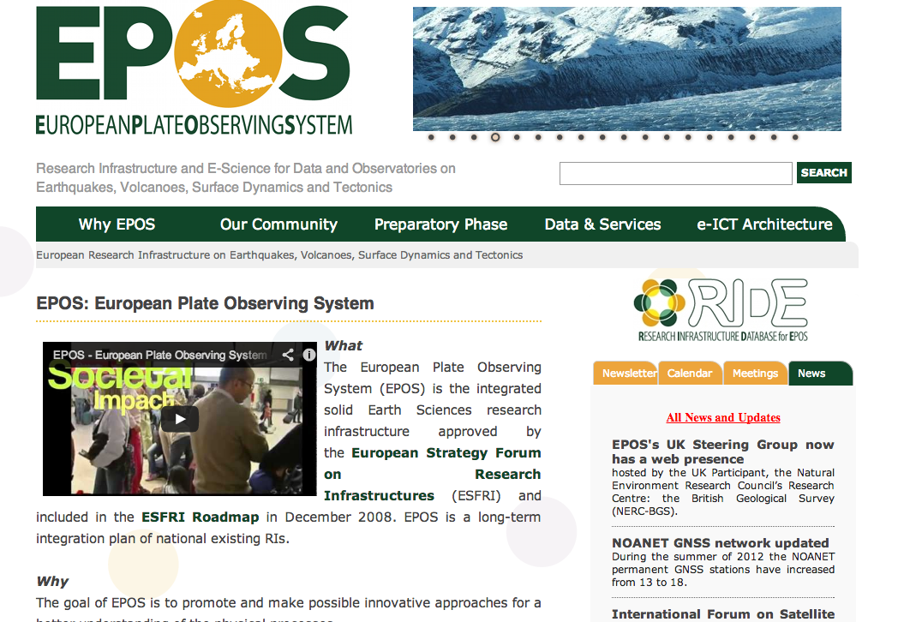
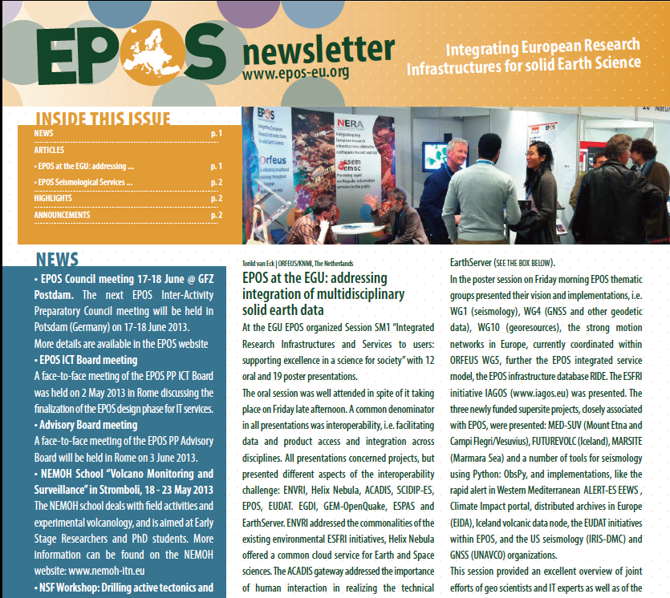
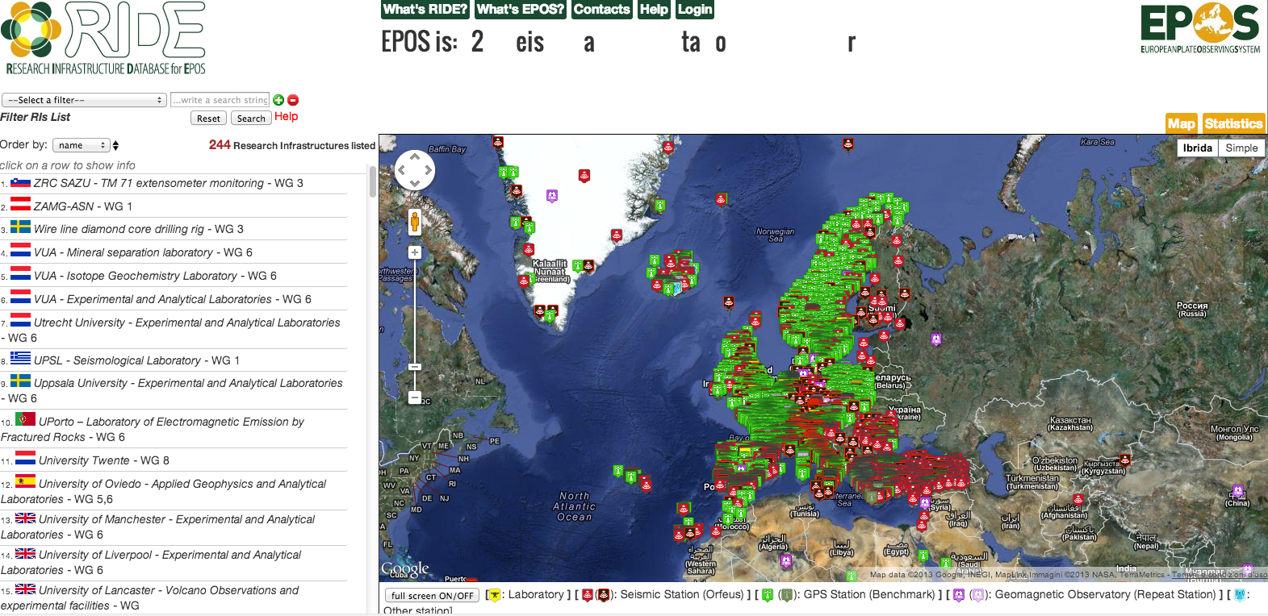



Thank You
WebSite
Newsletter
www.epos-eu.org
www.epos-eu.org/newsletter
R.I.D.E.
Epos Social
www.epos-eu.org/ride
www.epos-eu.org

