Slide 1
The BRUCE Project
(Brunel Research Under a CERIF Environment)
Rosa Scoble & Lorna Mitchell
Brunel University

Slide 2
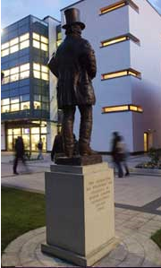
Introduction to Brunel
BRUCE in context
Introduction to the BRUCE Project
  Overview
  CERIF
  Project Outputs
Any Questions

Slide 3
Brunel University
  World class university based in Uxbridge, West London
  Small research-intensive institution with a broad disciplinary base, building on a very strong historical base in engineering
  15,000 students including more than 950 PhD students

Slide 4
BRAD and BURA
  BRAD
    Symplectic Elements
    Comprehensive record of publications
      Research profiles on Brunel website
  BURA (http://bura.brunel.ac.uk/)
    Launched in 2006; 4,372 full-text items
    Linked to BRAD via Repository Tools
RESEARCH
BURA
BRAD

Slide 5
The UK Context
Autonomous universities contracted by the funding council (HEFCE)
Data for the sector collected by the Higher Education Statistic Agency (HESA) in a standard format (Students, Staff, Finance, etc.)

Slide 6
The UK Context
Dual support systems for funding research
  Research Councils fund competitive projects
  Block grant (HEFCE) based on submission of research every 6 yrs
    Research Excellence Framework (REF)
    assessed by peer review
    outcomes presented as profiles

Slide 7
The BRUCE Project
Aims to develop a prototype tool, based on CERIF, to facilitate the analysis and reporting of research information from existing data sources

Slide 8
The BRUCE Project
6 month project, funded by JISC
Project partners:
    St George’s University of London
    Cottage Labs
    Symplectic Ltd
Steering group includes HESA
Advisory group of UK HEIs

Slide 9
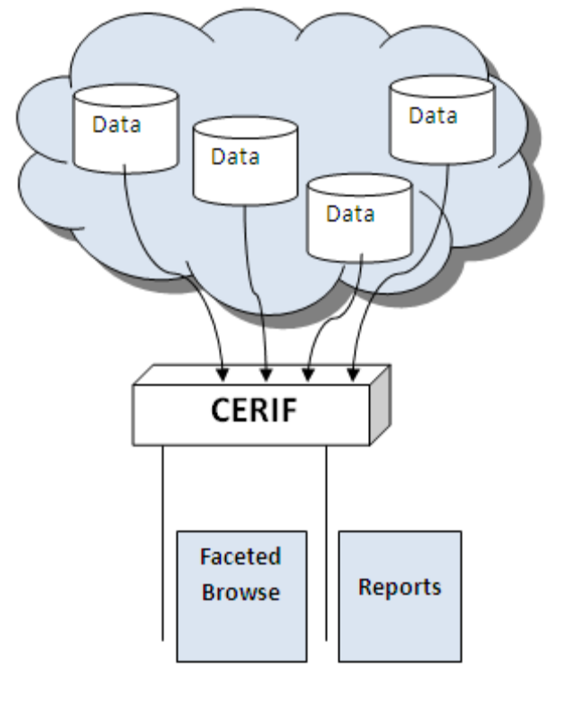

Slide 10
Project Outputs
Prototype tool
  Based on Apache Solr and Project Blacklight
  Open Source Software
BRUCE and CERIF
  Mapping CERIF to the HESA data
  Gap analysis
Sample Reports

Slide 11
BRUCE Reports
Bring together research information from different source:
  Contract information
  Academic areas
  PhD students supervised
  Publications
  Funding, etc

Slide 12
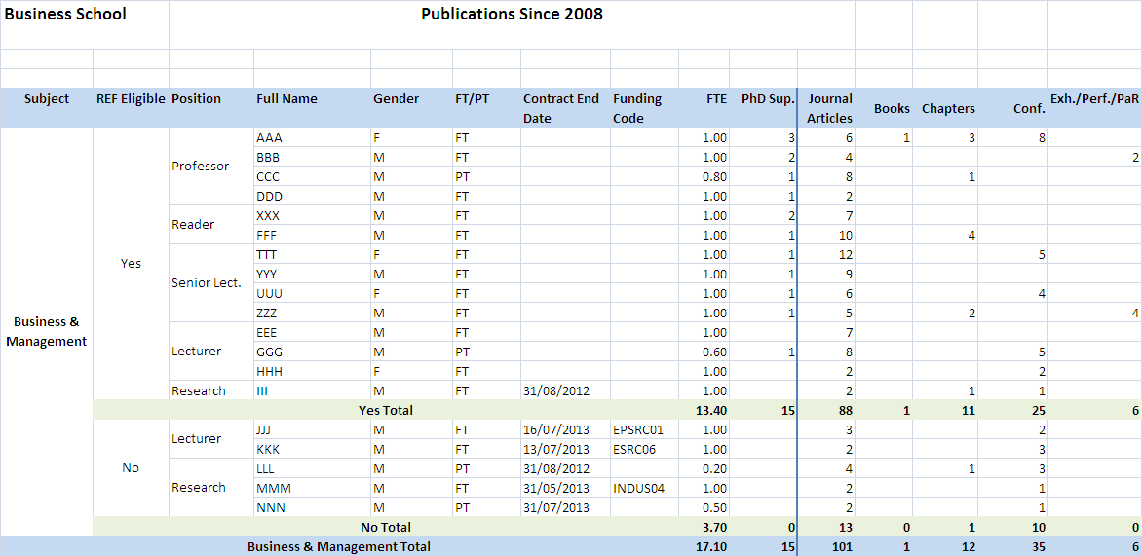

Slide 13
Progress to Date:
Created some data to play with
CerifEYE
    Thin python front end to browse the MySQL database and check the indexing in Solr
Generated a first dataset based on the sample report
https://bitbucket.org/richardjones/bruce

Slide 14

Contacts:
  BRUCE Project Blog
    http://bruceatbrunel.wordpress.com
  Email:
    Lorna.mitchell@brunel.ac.uk
    Rosa.scoble@brunel.ac.uk

