Slide 1
The CERIF profile in the
OpenAIRE Guidelines for CRIS Managers
Jan Dvořák
CERIF Task Group leader, euroCRIS
Charles University in Prague
InfoScience Praha

Slide 2
The Guidelines
Nikos Houssos, Brigitte Jörg, Jan Dvořák: OpenAIRE Guidelines for CRIS Managers 1.0. June 2015. DOI 10.5281/zenodo.17065
Contents:
Specification
XML Schema
Semantic vocabulary
Examples

Slide 3
OpenAIRE
Open Access research outputs
Research outputs of the ERA
Succession of projects:
OpenAIRE (2009-2012)
OpenAIREplus (2011-2014)
OpenAIRE 2020 (2015-2018)
Network of National OA Desks
Information sources:
Literature repositories
Data archives
CRIS
https://www.openaire.eu/

Slide 4
The OpenAIRE research information interchange
OpenAIRE Infrastructure
CRIS
OpenAIRE CERIF
within
OAI-PMH

Slide 5
A CERIF profile
Profile:
A set of data elements in a research information interchange scenario.
CERIF Profile:
A subset of CERIF entities will be populated
The populated entities will only be used for some of the objects they represent in the full model
Attributes are given more precise interpretations
Only specific semantic terms are allowed as types/statutes/roles

Slide 6
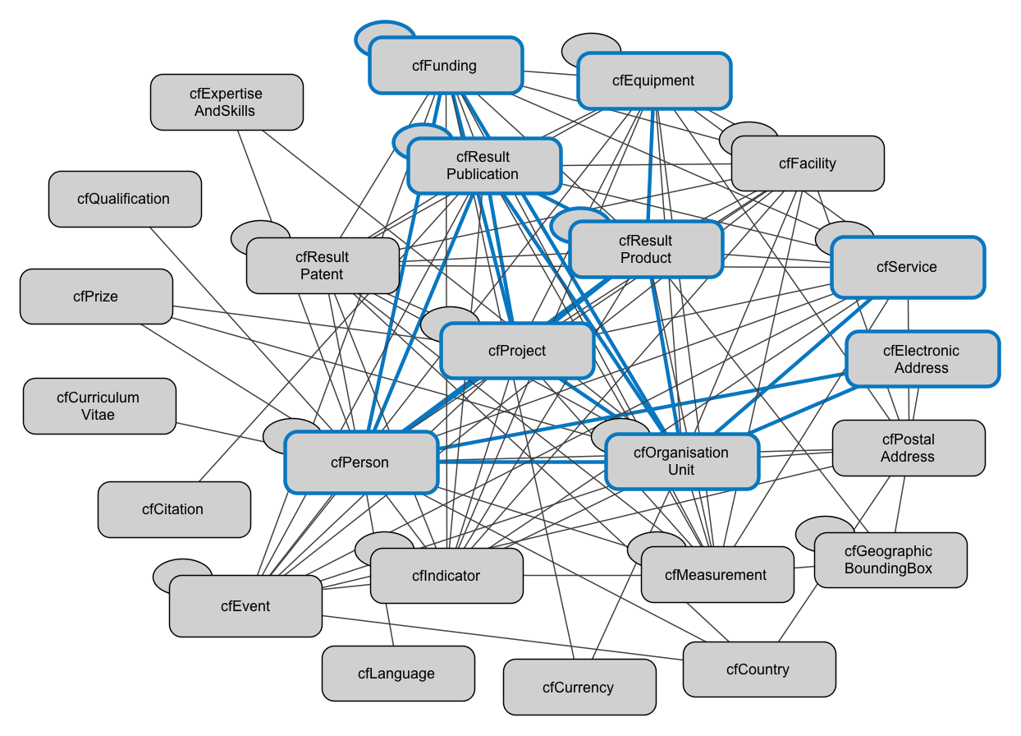
The OpenAIRE CERIF entities I

Slide 7
The OpenAIRE CERIF entities II
2.4 Organisation (cfOrgUnit) | The CERIF entity cfOrganisationUnit (cfOrgUnit) is used in the context of OpenAIRE to represent research performing organizations producing research results and/or involved in funded projects (e.g. coordinators, participants), or funder organisations.
Vs
An organization (or organisation - see spelling differences)
is a social group which distributes tasks for a collective goal.
The word itself is derived from the Greek word organon,
itself derived from the better-known word ergon - as we know `organ` -
and it means a compartment for a particular job.
Definition Source: http://en.wikipedia.org/wiki/Organization

Slide 8
The OpenAIRE CERIF Attributes
2.5 Project (cfProj) | The CERIF entity cfProject (cfProj) in the context of OpenAIRE is used to represent funded projects.
Attributes | Applicable Vocabularies | Multiplicity
Internal Identifier cfProj.cfProjId |  | 1
Start Date cfProj.cfStartDate |  | 1
End Date cfProj.cfEndDate |  | 1
Acronym cfProj.cfAcro |  | 0..1
Title cfProj.cfTitle |  | 1
... | ... | ...

Slide 9
The OpenAIRE CERIF Semantics
2.1 Publication (cfResPubl) | The CERIF entity cfResultPublication (cfResPubl) is used in the context of OpenAIRE to represent research results that are considered text publications. Metadata about scientific journals or other sources that contain the research results are also represented using the cfResPubl entity.
Attributes | Applicable Vocabularies | Multiplicity
Publication Type cfResPubl.cfResPubl_Class | The range of allowed types is limited to the following terms: - Book - Anthology - Monograph - Encyclopedia … from the “Output Types” scheme. | 1
Open Access Type cfResPubl.cfResPubl_Class | The range of allowed types is limited to the following terms: - Closed Access - Embargoed Access - Open Access - Restricted Access from the “Open Access Types” scheme. | 1

Slide 10
The OpenAIRE CERIF Semantics
2.1 Publication (cfResPubl) | ...
Attributes | Applicable Vocabularies | Multiplicity
License Type cfResPubl.cfResPubl_Class | The range of allowed types is limited to the following terms: - CC Attribution (CC BY) - CC Attribution-NonCommercial (CC BY-NC) - CC Attribution-NonCommercial-NoDerivs (CC BY-NC-ND) - CC Attribution-NonCommercial-ShareAlike (CC BY-NC-SA) - CC Attribution-NoDerivs (CC BY-ND) - CC Attribution-ShareAlike (CC BY-SA) - CC Zero (CC0) - GNU Free Documentation License (GFDL) from the “License Types” scheme. | 0..1

Slide 11
The OpenAIRE CERIF Semantics
2.1 Publication (cfResPubl) | …
Attributes | Applicable Vocabularies | Multiplicity
Federated Identifiers cfResPubl.cfFedId.cfFedId (where the type of identifier is given through cfResPubl.cfFedId.cfFedId_Class) | The range of allowed identifier types is limited to the following terms: - DOI - Handle - PMCID - ISI-Number - SCP-Number - ISSN - ISBN - URL - URN from the “Identifier Types” scheme. | 0..N

Slide 12
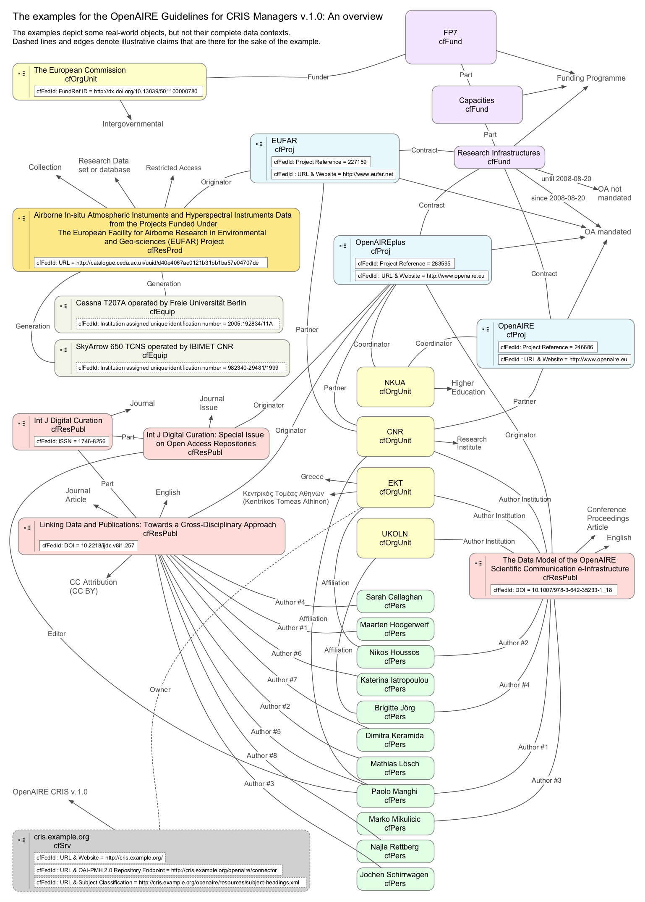
OpenAIRE CERIF Examples

Slide 13
A CERIF Profile
Entities & attributes:
  Profile ⊂ CERIF
Semantic vocabularies:
  Profile – more specific
  Sources: CERIF & beyond
Integrity constraints:
  Profile ⊃ CERIF
Profile data is CERIF
Producers know what to include
Consumers know what to expect

