Slide 1

State of the Art of CRIS
Implementation in Spain
Pablo de Castro
GrandIR, CB
pcastro@grandir.com

Slide 2
Spanish National Session – featuring two strands:
1. CRIS implementation + CRIS/IR integration
2. CERIF implementation

Slide 3
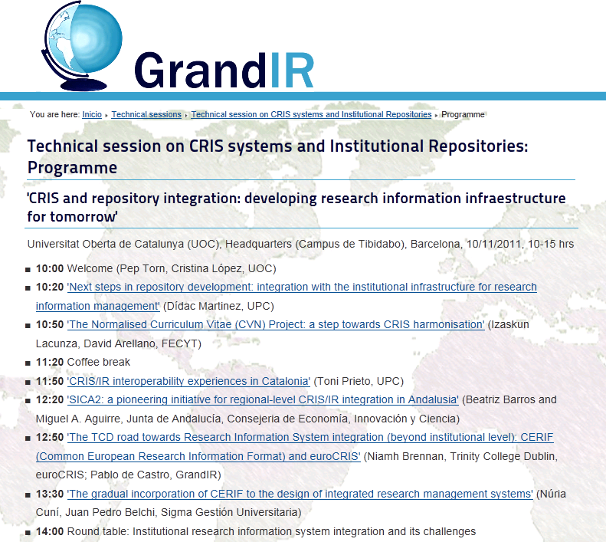
CRIS/IR integration in Spain: an ongoing discussion

Slide 4
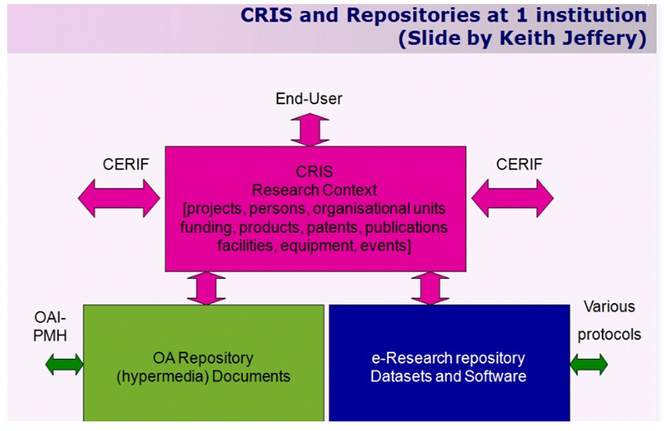
A model Research Information Mgt System

Slide 5
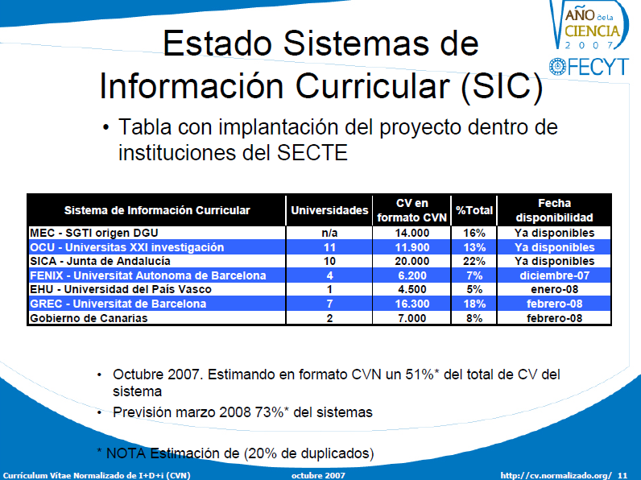
Gradual CRIS Implementation in Spain: 2007-
(slide by Florencio Núñez)

Slide 6
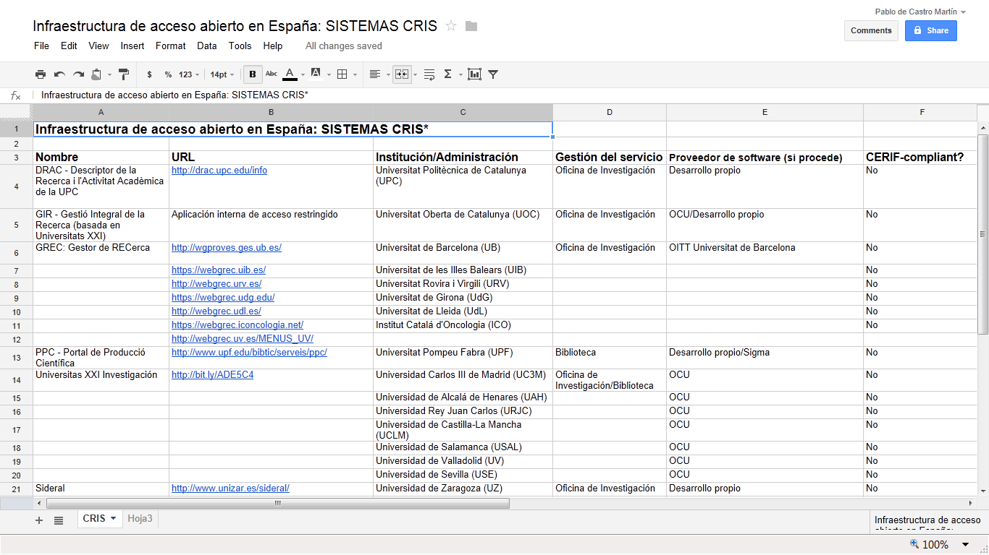
Gradual CRIS Implementation in Spain: today

Slide 7
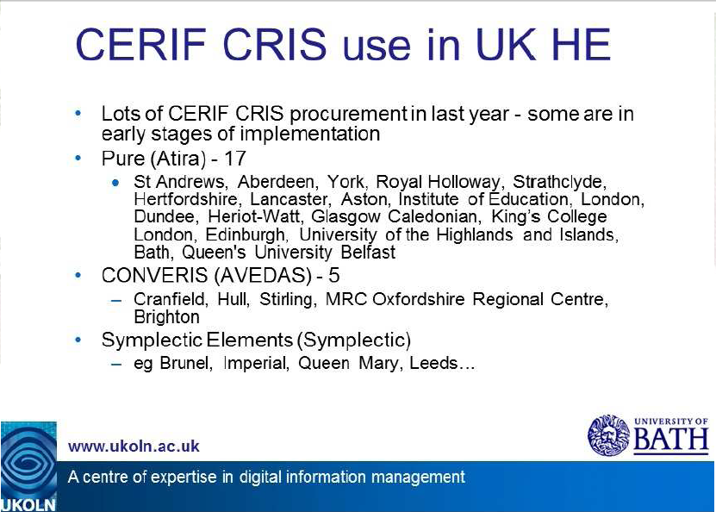
Best Practice: CRIS Implementation in the UK
(slide by Rosemary Russell)

Slide 8
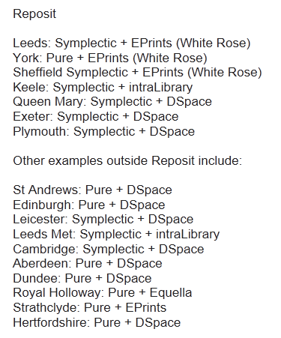
Best Practice: CRIS Implementation in the UK (II)
(list by Nick Sheppard for the JISC RePosit Project)

Slide 9
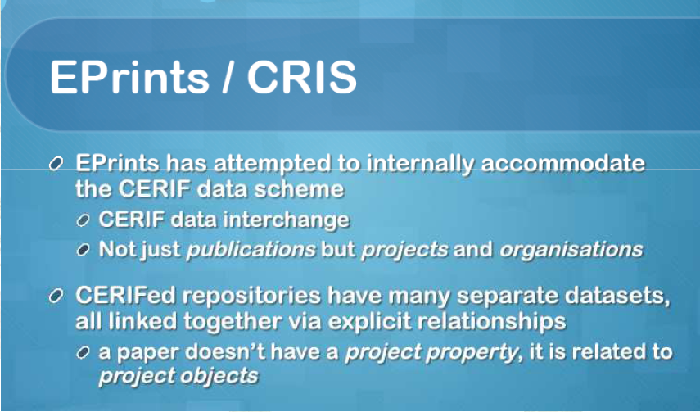
Best Practice: CRIS Implementation in the UK (III)

Slide 10
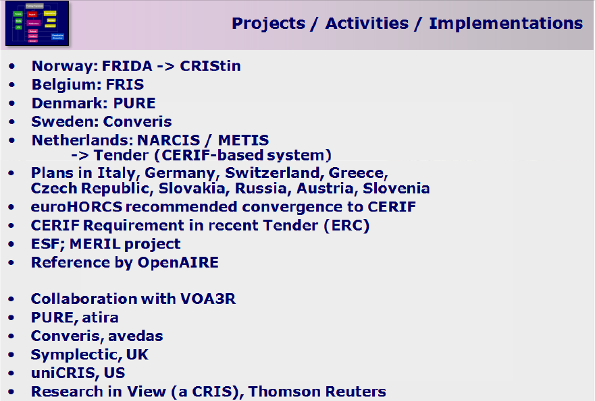
euroCRIS in Spain?

