Slide 1

A CERIF description of an OA Policy to ease monitoring compliance
CRIS2016 conference
Valerie Brasse, Keith Jeffery, Anne Asserson and Laurent Remy
9th of June 2016, St Andrews

Slide 2
Pasteur4OA
Common OA Policy schema
Mapping the schema to CERIF
The semantic layer
Demonstration platform

Slide 3

Pasteur4OA
Open Access Policy Alignment Strategies for European Union Research
help develop and/or reinforce open access strategies and policies at the national level
network of centres of expertise in Member States
facilitate the coordination of strategies among all Member States
Objective of the platform: demonstrate how CERIF can store OA policies.

Slide 4
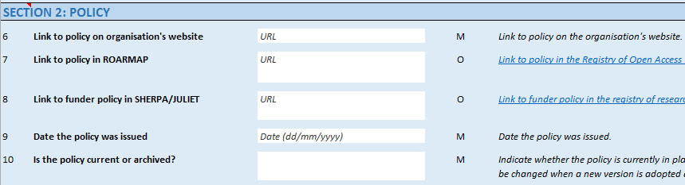
Common OA Policy schema
developed jointly by Jisc, SHERPA services and ROARMAP
canonical representation of a policy
questionnaire

Slide 5

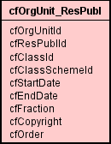
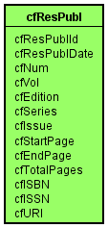
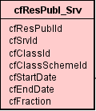

Mapping the schema to CERIF

Slide 6
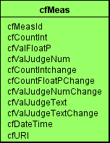
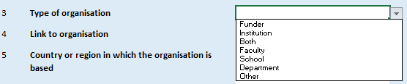
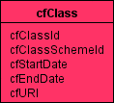
Mapping the schema to CERIF
Free text values
Stored in entities when available
  Policy’s issue date -> cfResultPublication.cfResultPublicationDate
Stored as a measurement
  Maximum allowable publisher embargo length -> cfMeasurement
Value to be chosen from a list
List -> cfClassificationScheme
Values -> cfClassification

Slide 7
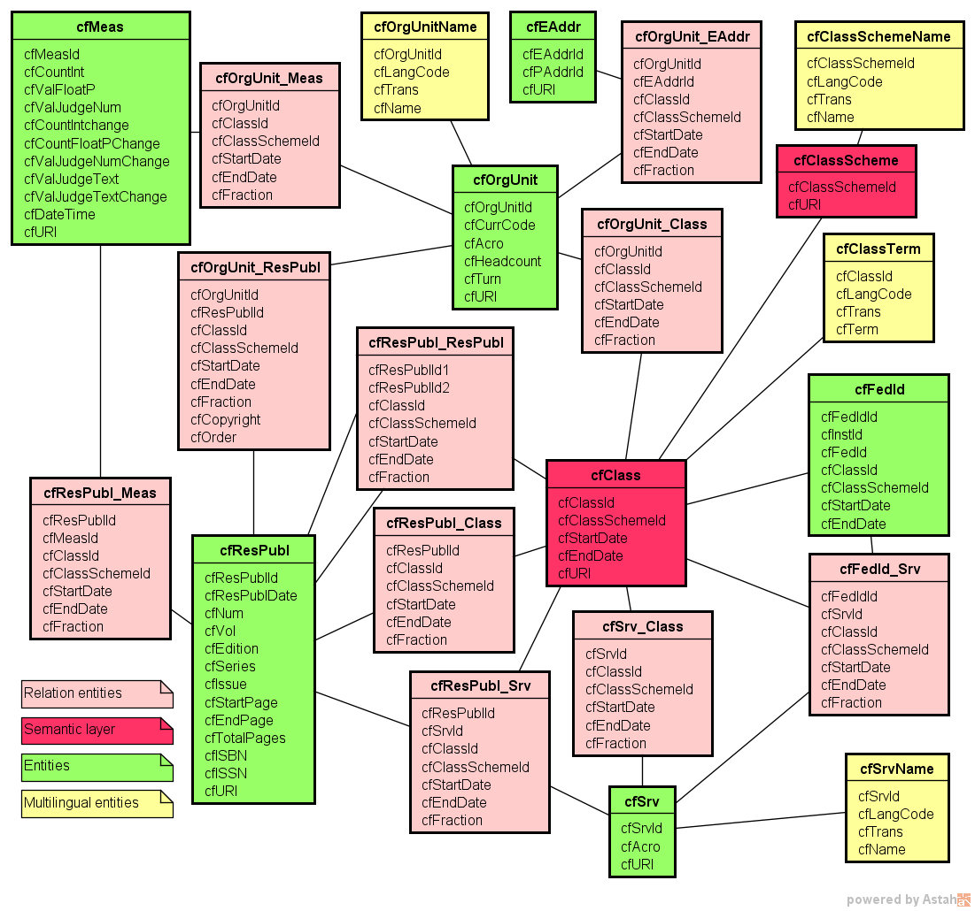
Mapping the schema to CERIF
3 main entities
Semantic layer
cfMeasurement
Multilingual entities (used attributes only)
+cfElectronicAddress
+cfFederatedIdentifier
All used relation entities

Slide 8
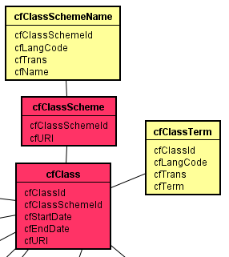
The semantic layer
<cfResultPublication> is an OA Policy
<cfService> is a repository
<cfOrganisationUnit> is a funder
<cfOrganisationUnit> is author of <cfResultPublication>
Is depositing the item a requirement or a recommendation?
Required
Recommended
Not specified

Slide 9
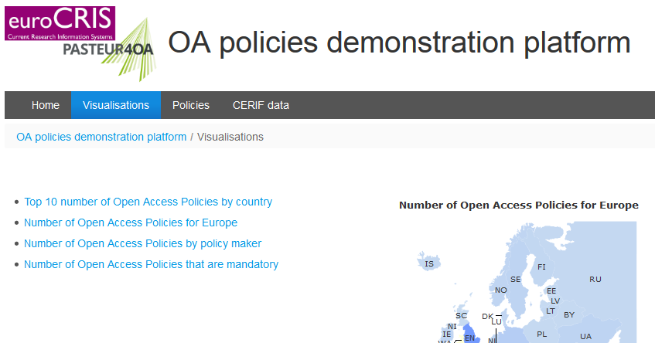
Demonstration

Slide 10
Questions
?
Laurent REMY
lremy@is4ri.com

