Slide 1
Monitoring a national Open Access funder mandate
José Carvalho, Cátia Laranjeira, Vasco Vaz, João Mendes Moreira

Slide 2
Outline
Open Access in Portugal
- FCT Open Access policy
- RCAAP
- PTCRIS
Implementation of a compliance monitoring strategy
Notes:
the development of Open Access policies in the country, including all aspects of implementation and supported infrastructures

Slide 3
Open Access in Portugal
2015
Legal framework for PhD and MSc thesis: RCAAP as the mandatory infrastructure for deposit
2008
Scientific OA repository of Portugal (RCAAP)
2004
Institutional OA policy – University of Minho
2014
FCT OA policy
2016
- Portugal2020: all peer-reviewed scientific publications must be freely accessible, at no cost
- Council of Ministers Resolution: OA to scientific publications & scientific data as a fundamental principle

Slide 4
FCT Open Access policy
free, online access to peer-reviewed publications arising from FCT funding
Approved on May 5th 2014
Covers: - papers in scientific journals/conference proceedings
        - Posters
        books, book chapters and monographs
        PhD theses
mandatory deposit in one of the RCAAP repositories
Embargo periods allowed
Exceptional timeframes | mts
Publications (STEM/HSS) | 6-12
Books, book chaptes, monographs | 18
PhD theses | 36

Slide 5
FCT Open Access policy
Publications accepted:
- subscription journal
no payment by author
embargoes allowed
self-archiving allowed
Creative Commons CC-BY license recommended
- publishing model - author pays = OA
APC elegible for refund
no embargo allowed
Creative Commons CC-BY license mandatory
Aligned with the best practices

Slide 6

RCAAP - aims
Scientific Open Access Repository of Portugal
To increase the visibility, accessibility and dissemination of research results from the Portuguese institutions
To streamline management and access to information about the national scientific output
To integrate Portugal in the wide range of international initiatives in this domain

Slide 7
RCAAP - services
Scientific Open Access Repository of Portugal
Institutional Repository Hosting Service
Data Repositories
(SARDC)
Scientific Journals Hosting Service
RCAAP Portal
Validator
Common Repository
Repository Usage Statistics
(SCEUR)
Communication, dissemination and training activities

Slide 8
RCAAP - figures
Scientific Open Access Repository of Portugal
Institutional Repository Hosting Service
(SARI)
Data Repositories
(SARDC)
Scientific Journals Hosting Service
(SARC)
RCAAP Portal
Validator
Common Repository
Repository Usage Statistics
(SCEUR)
47 IR
1 CR
330K doc
44 Journals
44 institutions
28 IR
14
Journals

Slide 9
Recognition/Consolidation RCAAP
RCAAP is the instrument used to ensure compliancy with:
  Legal deposit of doctoral dissertations and master's theses
  Funder FCT’s open access policy.

Slide 10










Science&Technology Universe
Industry
Research
institutions
Investment
opportunities
Research
organizations
Publications
Publishers
Patents
Products
Libraries
Projects
Researchers
Data centres
Research data
Equipment
Facilities
Governments
Researchers
Financiers
Source: EUROCRIS.org
Notes:
Recordar que para gerir bem a política de ciência através do financiamento é necessário ter uma visão global do universo de ciência e de tecnologia
Esta visão está ilustrada neste ppt:
1) Ao centro temos os investigadores:
2) Estes investigadores pertencem a organizações, executam projectos, usam equipamento para as suas experiências e produzem dados de investigação. Os resultados da investigação podem ser publicações, patentes e produtos.
3) À volta deste eco-sistema encontram-se outros stakeholders:
Um aspeto muito importante é que apesar da atividade da FCT se central no financiamento do sistema científico interage com todo o universo da investigação científica
Para transferir tecnologia para a industria
Para análise bibliometrica
Governos para a definição de políticas
Entidades financiadoras
Os editores que tratam e vendem as publicações científicas
A industria que procura inovar através de transferência de tecnologia
Vários itens de informação
A informação é distribuída para várias partes interessadas (muitas vezes em processos operacionais)
A informação é procurado por vários interessados
Trazer esta informação de forma transparente junto em um espaço virtual de informação de pesquisa = FRESCO
Há uma necessidade muito forte para bancos de dados de consultoria, encontrar pesquisadores, projetos ... (ver eResearch pesquisa, Nov 2007)
Verscheidene informatieobjecten
Informatie zit verspreid bij verschillende stakeholders (vaak in operationele processen)
Informatie wordt gezocht door verschillende stakeholders
Breng deze informatie op transparante manier samen in één virtuele onderzoeksinformatieruimte = FRIS
Er is een zeer sterke behoefte aan raadplegen van databanken, vinden van onderzoekers, projecten … (zie bevraging e-onderzoek, nov 2007)

Slide 11

PTCRIS -mission
Ensure the creation and sustained development of national integrated information ecosystem (PTCRIS) to support research management
Notes:
Apoiar os utilizadores na gestão, reporting e tomada de decisão relativos ao processo de investigação nas atividades de desenvolvimento de programas, atribuição de financiamento, avaliação de projetos, execução de projetos, geração de resultados, avaliação de resultados ou a transferência de tecnologia

Slide 12
PTCRIS ecosystem
CRIS – Current Research Information Systems
Academic expertise
Research news
Funding database
RCAAP
Organizations database
Scientific equipment
Grant management
Research ethics
Research portal
Indicators
PTCRIS = SoS = System of Systems = ecosystem
Notes:
After the studies and surveys we were able to identify several components of a national CRIS

Slide 13
Overview
Repositories
Deposit
RCAAP Portal
Harvest
FCT
Monitoring/Evaluation
Validator

Slide 14
Workflow – Deposit and reporting
Researcher Publishes Paper in a FCT Project
1
11
Deposit in Repository (Institutional or Common)
2
11
RCAAP Portal generates report
3
4
11
11
Scientific Report
Financial Report
Interim
Report
Final Report

Slide 15
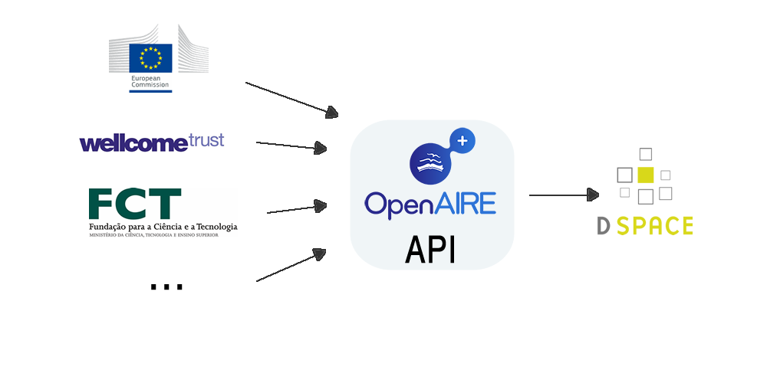
1. Deposit in repository
- Project Identification -
OpenAIRE – scholarly infrastructure to manage and monitor the outcomes of EU-funded research supporting OA policies.
Aggregates a list of projects from different funders
http://api.openaire.eu

Slide 16
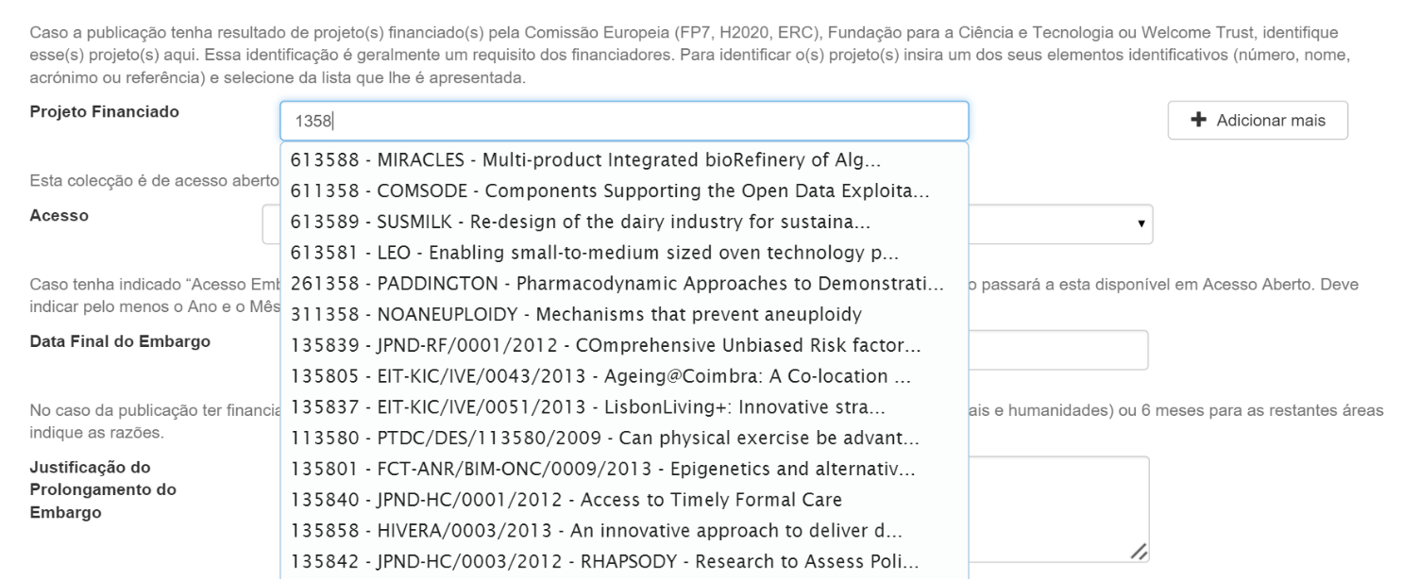
1. Deposit in repository
- Project Identification -

Slide 17
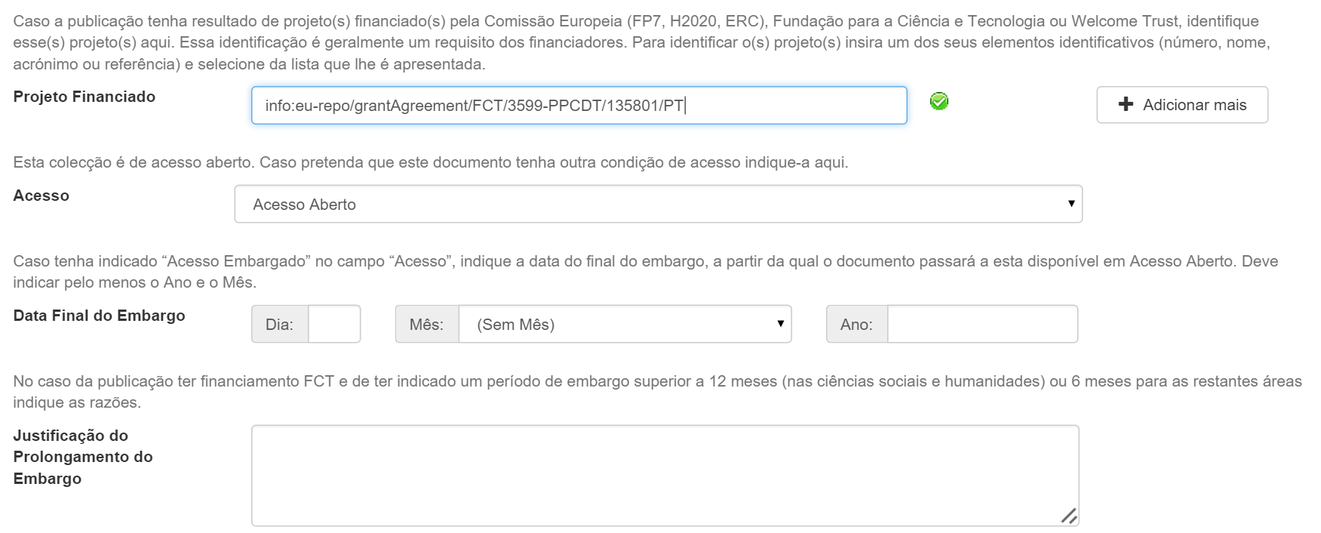
1. Deposit in repository
- Embargoes-
If embargo apply, the end date should be used.
If embargo need to be longer than allowed by FCT policy, a short justification will be asked at the time of deposit.

Slide 18
1. Deposit in repository
- Creative Commons License-
Creative Commons License CC-BY or equivalent mandatory for refund of Article Processing Cost (APC)

Slide 19
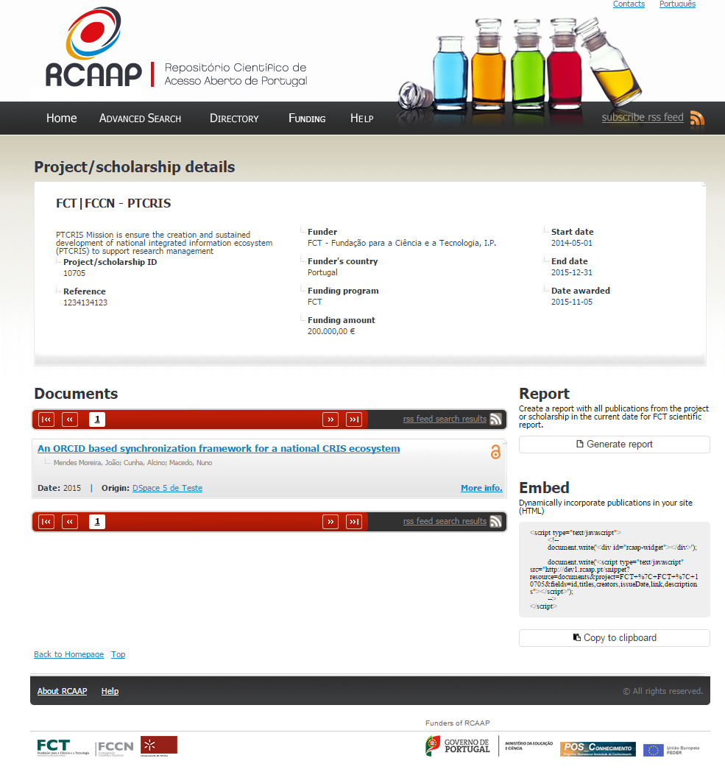
2. RCAAP portal
- project page -

Slide 20
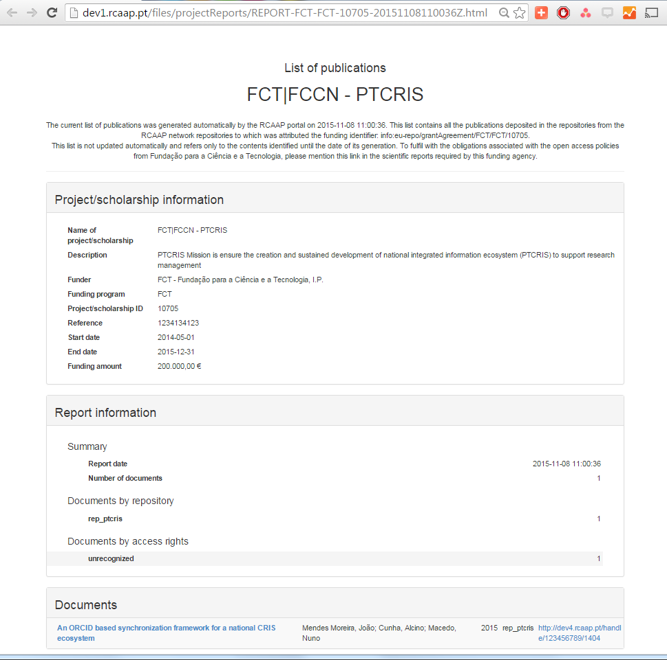
2. Project Report (RCAAP portal)
Automatic – Parses all repositories for documents associated with a project
Static – Contains all documents within a set period of time
Permanent – Is kept online for the longest foreseeable period of auditing.

Slide 21
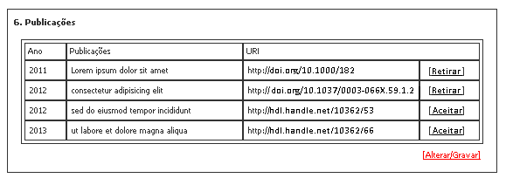
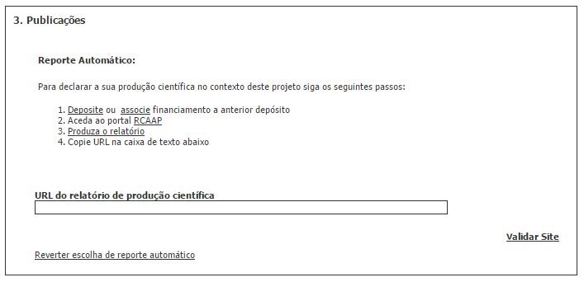
before
3. Grant Mng scientific report
now
Grantees will only be able to report deposited publications

Slide 22
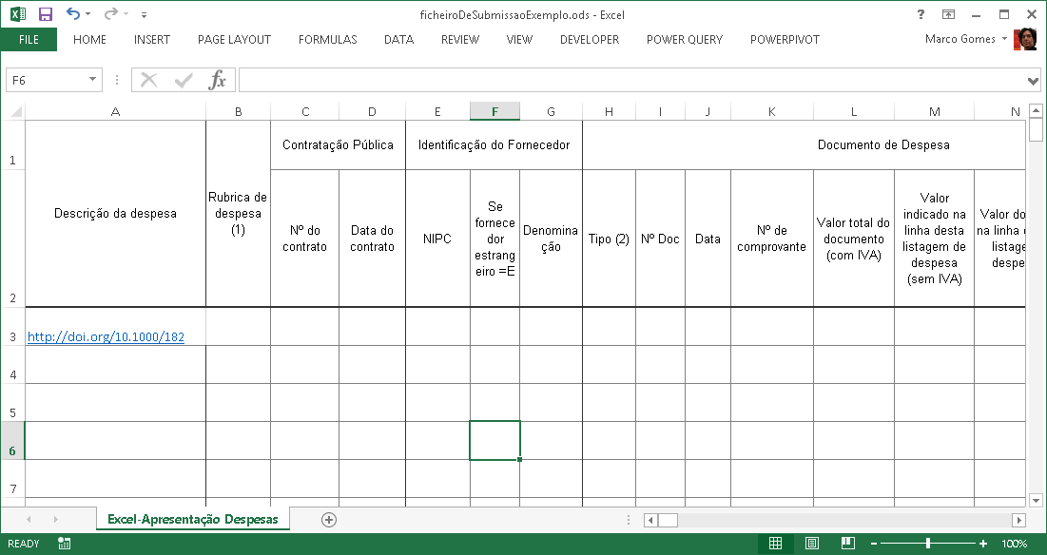
4. Grant Mng finantial report
Cost Claim Submission Template
Handles in the description field for APC refund.

Slide 23
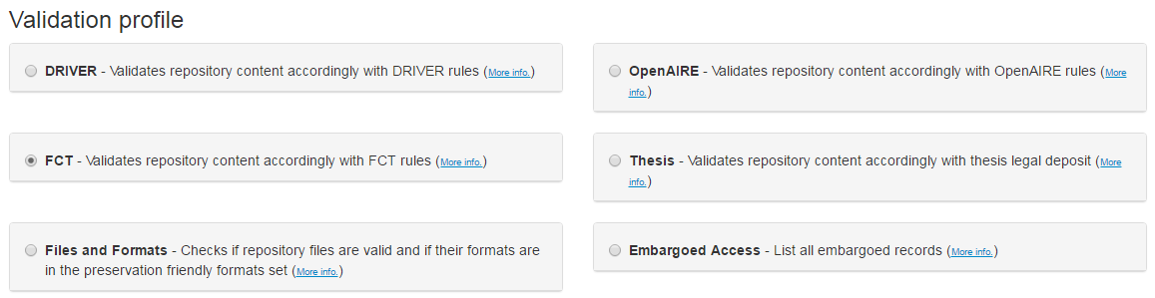
Monitoring
Online automatic parser, that checks compliance with FCT OA Policy.
Returns a list of publications that have associated funding from FCT, organized by the project identifier.
Available at http://validador.rcaap.pt

Slide 24
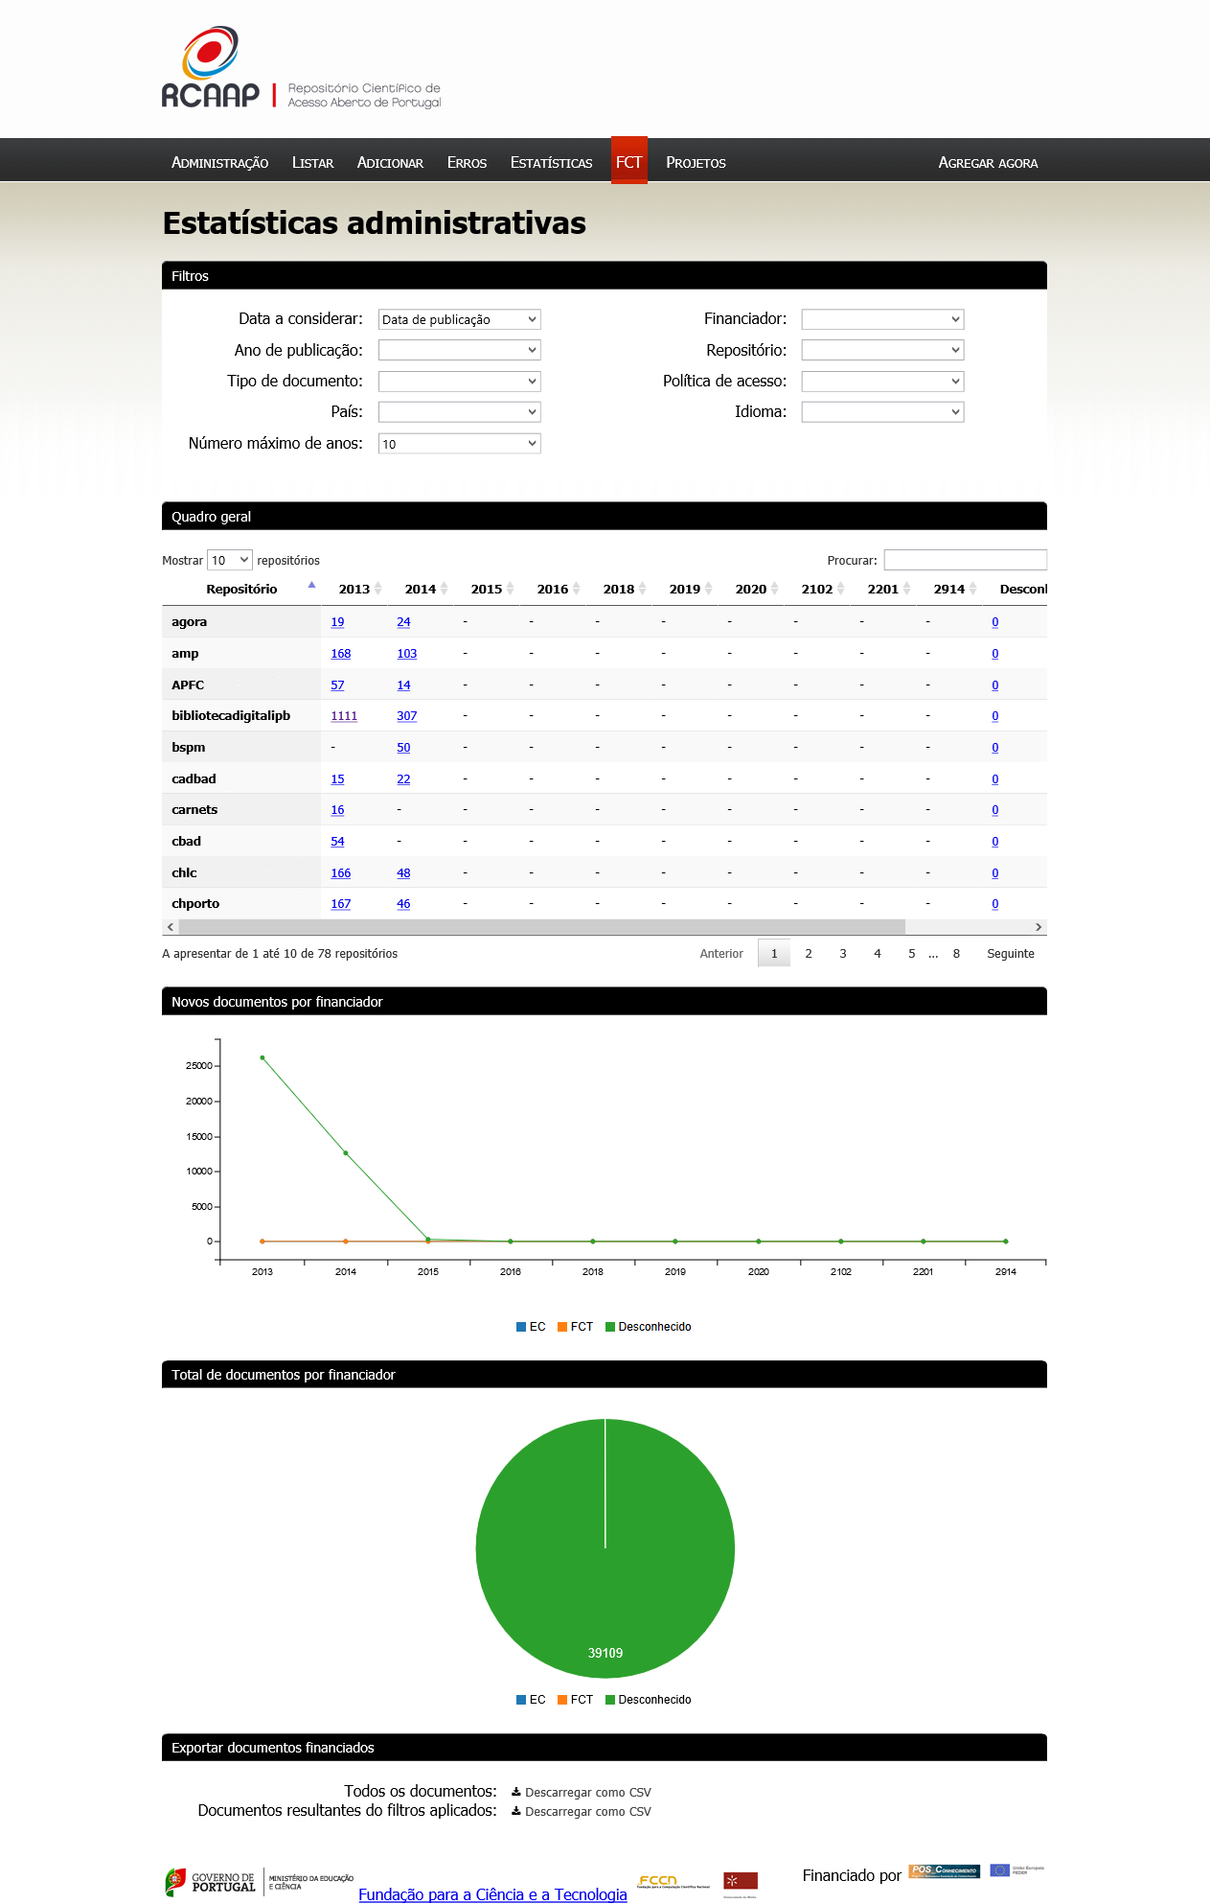
Monitoring
Available to any funding entity
Tabular and graphic view of the data
Excel export function

Slide 25
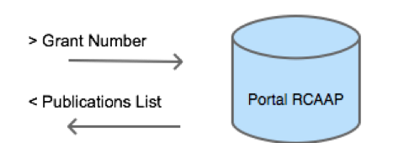
Monitoring
Public API
Institutions may search for information that is organized in the portal
Open interface for the community
Integration with funder (FCT) and other national systems

Slide 26
Summary
Promotes compliance with the FCT OA policy
Benefits:
- Researchers
Simplification of the scientific and finantial reporting
- Funders
Simplification of the monitoring and evaluation process
  - Institutions
Easier access to accurate, complete and updated information
Repositories
Deposit
RCAAP Portal
Harvest
FCT
Monitoring/Evaluation

Slide 27
Thanks!
José Carvalho, University of Minho, jcarvalho@sdum.uminho.pt
Cátia Laranjeira, FCT | FCCN, catia.laranjeira@fccn.pt
João Moreira, FCT | FCCN, jmm@fccn.pt
Vasco Vaz, FCT, vasco.vaz@fct.pt

Slide 28
The Open Access Policy of the Fundação para a Ciência e a Tecnologia
TOPICS
  Approved Policy
    Mandated Green Open Access
      Concerned publications
      Where to deposit
      When to deposit
      Timeliness of Open Access to the deposited publication
    Open Access publishing
      Cost eligibility requirements
    Policy monitoring and compliance
    Other issues to consider
      Copyright
      Bibliographic Metadata
      Research Data
02 | 10

Slide 29
Mandated Green Open Access
APPROVED POLICY
All beneficiaries are required to deposit and ensure Open Access to the publications arising from FCT-funded research
Deposit of the publication in one of RCAAP’s repositories is always required, regardless of whether the publication is being published on an Open Access publication outlet or not
03 | 10
Notes:
Aprovada em 16 de janeiro de 2014, entrou em vigor em 5 de maio de 2014
Prazo de embargo para artigos de revistas científicas contados desde o momento da publicação formal
Prazo de embargo para teses de doutoramento cfr. estabelecido pelo DL n.º 115/2013, de 7 de agosto
contados desde a concessão do grau de Doutor
Prazo de embargo para livros, capítulos de livros e monografias cfr. estabelecido pelo DL n.º 216/2000, de 2 de setembro (lei do preço fixo do livro)
contados desde o momento da publicação formal

Slide 30
Mandated Green Open Access
APPROVED POLICY
Concerned publications
A final peer-reviewed manuscript accepted for publication:
  final manuscript of a peer-reviewed paper accepted for journal publication (or equivalent), including all modifications from the peer review process, but not yet formatted by the publisher;
  books, book chapters and monographs subject to a peer-review process or other types of scientific scrutiny;
  doctoral theses
Where to deposit
Any repository affiliated in the RCAAP network of repositories, which usually is the Institutional repository of the research institution with which the beneficiary is affiliated
04 | 10
Notes:
Aprovada em 16 de janeiro de 2014, entrou em vigor em 5 de maio de 2014
Prazo de embargo para artigos de revistas científicas contados desde o momento da publicação formal
Prazo de embargo para teses de doutoramento cfr. estabelecido pelo DL n.º 115/2013, de 7 de agosto
contados desde a concessão do grau de Doutor
Prazo de embargo para livros, capítulos de livros e monografias cfr. estabelecido pelo DL n.º 216/2000, de 2 de setembro (lei do preço fixo do livro)
contados desde o momento da publicação formal

Slide 31
Mandated Green Open Access
APPROVED POLICY
When to deposit
Each beneficiary must deposit as soon as possible and at the latest on publication
Timeliness of Open Access to the deposited publication
Each beneficiary must ensure Open Access to the deposited publication — via the repository — within 6 months of publication (12 months for publications in the social sciences and humanities); Open Access to books, book chapters and monographs must be ensured within 18 months of publication; Open Access to doctoral theses must be ensured within 36 months of the PhD degree award
05 | 10
Notes:
Aprovada em 16 de janeiro de 2014, entrou em vigor em 5 de maio de 2014
Prazo de embargo para artigos de revistas científicas contados desde o momento da publicação formal
Prazo de embargo para teses de doutoramento cfr. estabelecido pelo DL n.º 115/2013, de 7 de agosto
contados desde a concessão do grau de Doutor
Prazo de embargo para livros, capítulos de livros e monografias cfr. estabelecido pelo DL n.º 216/2000, de 2 de setembro (lei do preço fixo do livro)
contados desde o momento da publicação formal

Slide 32
Open Access publishing
APPROVED POLICY
Costs of Open Access publishing, such as Article Processing Charges, are eligible for refund as research costs, within the remit of the funding granted and during the duration of the research project
Cost eligibility requirements
  Open Access is immediate and no embargo is allowed
  The publication post-print must be given permission to be deposited in repositories other than the publisher’s own repository
  The publication’s full content is attributed a Creative Commons CC-BY license (or equivalent). No restriction to its access or re-use is allowed
  There will be a cap for the APC amount, to be determined in accordance with international Open Access policies best practices
06 | 10
Notes:
Aprovada em 16 de janeiro de 2014, entrou em vigor em 5 de maio de 2014
Prazo de embargo para artigos de revistas científicas contados desde o momento da publicação formal
Prazo de embargo para teses de doutoramento cfr. estabelecido pelo DL n.º 115/2013, de 7 de agosto
contados desde a concessão do grau de Doutor
Prazo de embargo para livros, capítulos de livros e monografias cfr. estabelecido pelo DL n.º 216/2000, de 2 de setembro (lei do preço fixo do livro)
contados desde o momento da publicação formal

Slide 33
Policy monitoring and compliance
APPROVED POLICY
Breach of any of the beneficiary’s Open Access Policy obligations is considered a violation of the funding agreement and subject to the same measures foreseen for any other contractual breach, depending on the type of funding agreement.
At the limit, the beneficiary could be required to repay part of the funding granted.
07 | 10
Notes:
Aprovada em 16 de janeiro de 2014, entrou em vigor em 5 de maio de 2014
Prazo de embargo para artigos de revistas científicas contados desde o momento da publicação formal
Prazo de embargo para teses de doutoramento cfr. estabelecido pelo DL n.º 115/2013, de 7 de agosto
contados desde a concessão do grau de Doutor
Prazo de embargo para livros, capítulos de livros e monografias cfr. estabelecido pelo DL n.º 216/2000, de 2 de setembro (lei do preço fixo do livro)
contados desde o momento da publicação formal

Slide 34
Other issues to consider
APPROVED POLICY
Copyright
In all cases, the authors are encouraged to retain their copyright and grant adequate licenses to publishers. Licensing the publication with a Creative Commons CC-BY license is recommended except where APC’s are to be refunded by FCT, in which case it is mandatory
Bibliographic Metadata
At the moment of deposit, the following data must be made immediately available
  All bibliographic metadata of the publication required by the RCAAAP repository
  Indication of the embargo period to be applied to the publication’s content, if existent
08 | 10

Slide 35
Other issues to consider
APPROVED POLICY
Research Data
Publications must reference its underlying research data and these should be made available to other researchers whenever requested, provided that all legal requirements are met
09 | 10

Slide 36

2.Management and Sharing of Research Data
Policy on management and sharing of data arising from FCT-funded research
Recommendations for researchers
to share primary data and other data with the scientific community, within the shortest time possible
to place the data in open access databases
that future research proposals provide a “Data and Other Products Management Plan”
that questions related to privacy, legitimate commercial interests, national security, and the rule of law must be properly addressed before making the research data available
18 | 25

Slide 37

2.Management and Sharing of Research Data
Laying the groundwork for further measures
Study the setting up of data hosting capabilities on a larger scale (beyond the RCAAP’s data repository current capacity)
Make arrangements for the integration or the pooling of resources with other national or international data initiatives
Prepare a more intensive data management and sharing policy
19 | 25
Notes:
Pooling resources with other national or international data initiatives (e.g. OpenAIRE’s Zenodo)

Slide 38
Open Access to Research Publications Strategy
1. Open Access to Research Publications
Establish an Open Access repository network infrastructure
→ RCAAP
+
Mandate Open Access to Publications arising from publicly-funded research
→ FCT Open Access Policy
+
Integrate compliance with the Open Access Policy into project reporting and grant management procedures of FCT-funded research
→ Implementation measures
03 | 25

Slide 39

RCAAP
1. Open Access to Research Publications
Vital research e-infrastructure, part of the NREN
Initiated operation in November 2008 with 12 institutional repositories
Integrates every public HEI repository and makes all their deposited content available via a single entry point search portal
Monitors and ensures that every repository within the RCAAP network conforms to the highest quality and interoperability standards
→Open AIRE guidelines
04 | 25

Slide 40
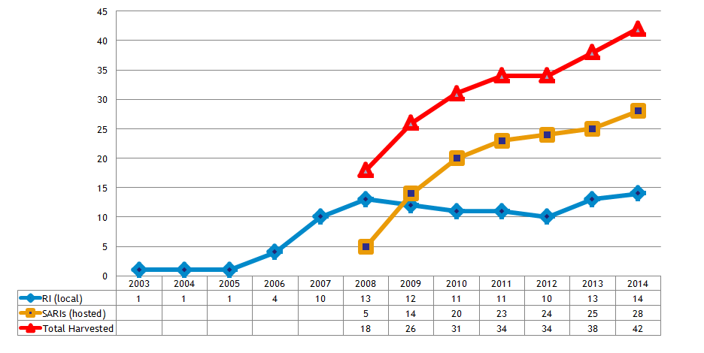
1. Open Access to Research Publications
RCAAP achievements
Evolution of the number of networked Institutional Repositories
Source: Project RCAAP
07 | 25

Slide 41
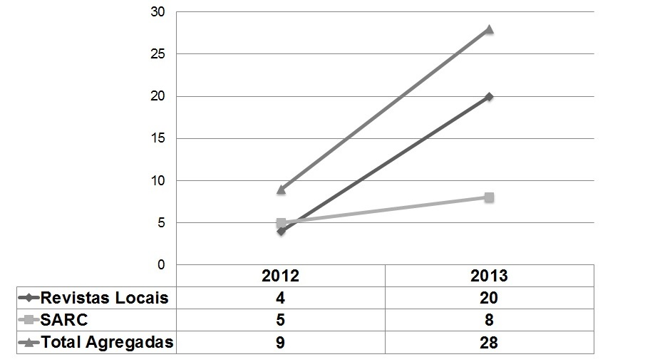
1. Open Access to Research Publications
RCAAP achievements
Evolution of the number of hosted Open Access journals
Source: Project RCAAP
08 | 25

Slide 42
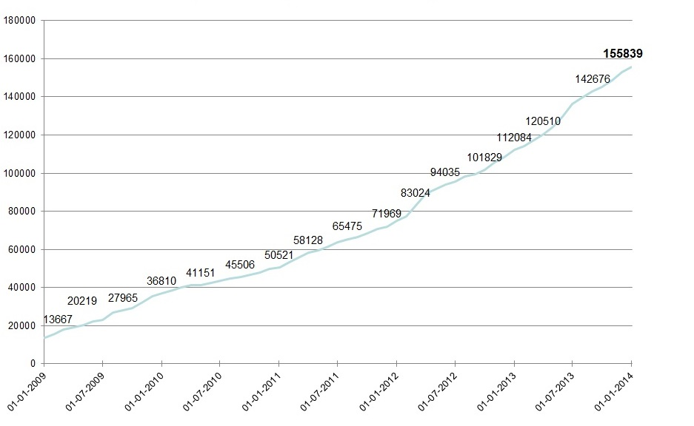
1. Open Access to Research Publications
RCAAP achievements
Evolution of the number of deposited Portuguese research publications
Source: Project RCAAP
09 | 25

Slide 43

Benefits
Researchers
Simplification of the scientific and finantial reporting
“Input once, reuse multiple” principle delivered!
Funder
Institutions

