Slide 1

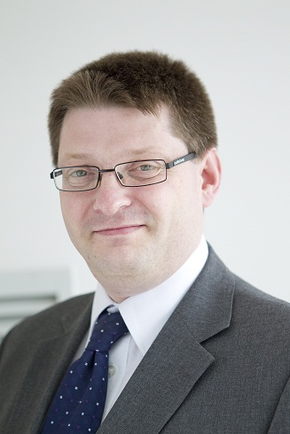


Improved Research Information and Decision Management for Strategic Advantage
Dr Simon Kerridge
S.R.Kerridge@kent.ac.uk
@SimonRKerridge
Chair
ARMA
The Association of Research Managers and Administrators
Director of
Research Services
University of Kent
Notes:
30 mins – first of 3 presentations in a 90 min slot before lunch
Improved RI and Decision Management for Strategic Advantage Simon Kerridge, ARMA / University of Kent, UK
Evaluation of Research: Outputs, Outcomes and Impact Ian Viney, Medical Research Council (MRC), UK
Influencing Decision Makers Carlos Morais-­‐Pires, European Commission, DG CONNECT, Scientific Data Infrastructure, Brussels, EU
===
this e-mail is to ask if you would be willing to speak at the 10th euroCRIS Strategic Seminar in Brussels, September 9th / 10th, 2013.
The theme behind this 11th Seminar is the ever-growing importance of quality Metadata within the Research Ecosystem. Not least, for strategic management, but also for evaluation, knowledge and technology transfer, Research Information management is an essential requirement. Increasingly, the research output system beyond research publications is broadened towards research products such as datasets and software and expanding to research outcomes and impact. Research Information Systems (CRISs) and in particular CERIF are increasingly recognised as a powerful means with respect to advanced metadata management. euroCRIS has developed inter-conversion services to/from CERIF with most-used metadata standards reinforcing the position of CERIF as an interoperation standard for RI and CRISs. Nonetheless there is room for the evolution of CERIF to meet new emerging requirements. The aim of the euroCRIS Strategic Seminar is to convene key stakeholders and to discuss the needs and forthcoming challenges in this context.
Reports of past seminars are available under: http://www.eurocris.org/Index.php?page=seminars&t=1

Slide 2

Outline
Strategic Ambitions
Research Information
Decision Management
Strategic Advantage
Current Initiatives

Slide 3

Context
  RMAs manage and support research…
  Information (including about research outputs & projects)
  Pre-award [proposals] (inc OA costs)
  Post-award [projects] (inc APCs)
  Development / Planning
  Strategy / Policy (inc OA, RDM)
  Assessment (REF) / Governance
  Metrics (including citations, etc)
  Research Students

Slide 4

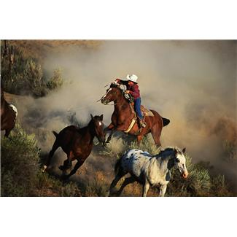
Context
  Research Intensive University in the UK
  A European Presence
  A Worldwide network of strategic partners
  New UK Regional Grouping (Eastern ARC)
  Hundreds of research collaborations

Slide 5

Strategic Advantage
  Research… Excellence
  External Funding & Esteem
  League Tables
    Attracting Staff
    Attracting Postgraduates
    Attracting Undergraduates
  Virtuous Circle ...
  to achieve Strategic Ambitions

Slide 6


Strategic Ambition
  Implies that
    You have a plan… with targets… and timescales
    You know who your competitors are
    You have a baseline of information about you and them
    You measure progress against the targets …
    … to see if you have levered an advantage

Slide 7
Strategic Ambitions
  http://www.kent.ac.uk/researchservices/about/research-strategy.html
  The university will increase the volume and intensity of world leading research across the whole of its disciplinary range
  A growing proportion of research activity will be interdisciplinary and involve partnerships with other research institutions
  The university will more deliberately seek ways to ensure that its research has beneficial impacts within its region and more widely
  All teaching will be supported by research activity; all students will have contact with the best researchers and their ideas and findings

Slide 8
Measurable Objectives
  Research grant income per HEFCE-funded member of staff in all subject areas will reach at least the average of our Peer Group
  The numbers of research students, post-doctoral and research staff, and externally funded research fellows per HEFCE-funded member of staff will reach at least the average levels attained by our Peer Group in most subject areas
  Citation rates per staff member will be comparable to those in our Peer Group across the University’s subject range

Slide 9
Measurable Objectives
  Research performance in disciplines newly established at the University and on the newer campuses at Medway, Brussels and Paris will demonstrate clear progress towards the overall research ambition
  The University will, in the overall context of a research-led institution, increase the number of research areas where the University is recognized as class-leading. These are likely to include cross disciplinary and cross institutional collaborations.

Slide 10
Measurable Objectives
  The University will continue to establish formal research partnerships and consortia with other universities and related organisations. These partnerships will increasingly drive the content and direction of the university's research, teaching and supervision.
  The University will establish mechanisms that record the impact of its research both within and beyond academe and inform the further development of mechanisms at university, faculty and school levels that deliberately advance impact. It will develop and implement a strategy to support greater engagement with its research by relevant stakeholders and the wider public.

Slide 11
Measurable Objectives
  And Finally…
  The University will upgrade its research management and administration systems and strengthen the use of research data including integration with research governance information, the achievement of open access targets, and development of research data holdings.
  Which of course is required to measure/achieve 1..7

Slide 12

Research Information
  Need to know what information you want …
  … to know what data to collect.
  Your plan (or strategy) will identify this / your benchmarks
  Eg Kent Strategy implies…[Peer Group]
    Staffing [all]
    Projects (Proposals?) [1]
    PGRs, PDRAs, RFs [2]
    Publications & Citations [3]
    Partners [6]
    Impact [7]
    And all of the above [4, 5]

Slide 13




Decision Management
  Who should we support? (individuals, groups)
  Which partners should we work with?
  Which activities should we prioritise?

Slide 14

Current Initiatives
  CERIF
  CASRAI
  ORCID
  GtR, G4HE [Research Fish, ROS]
  Snowball Metrics
  Altmetrics, (→ eg Public Engagement)
  REF
  RDM
  League tables
  Krimson

Slide 15



ORCID
  http://orcid.org/ (including http://orcid.org/0000-0003-4094-3719)
  Now nearly a year old, has >250,000 records
  82 organisational members

Slide 16

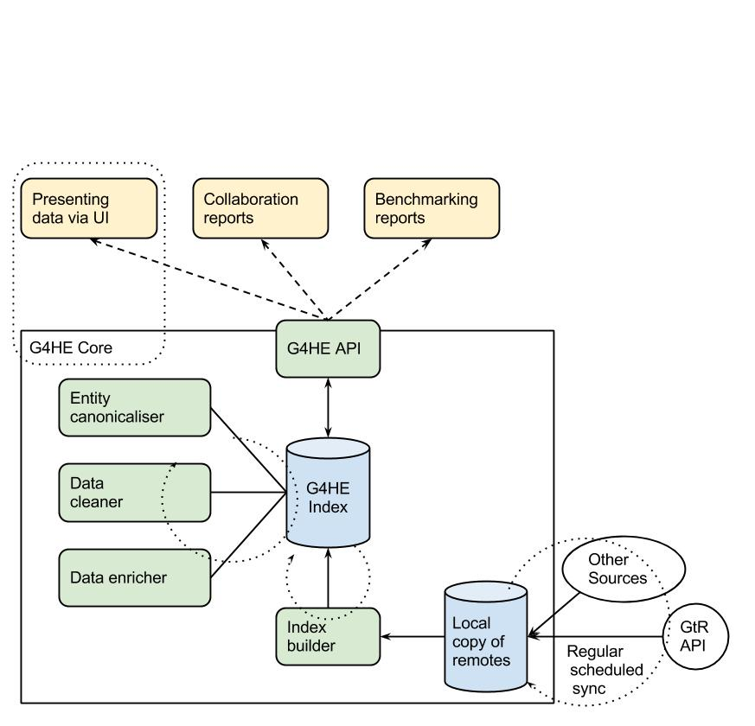

Gateway to Research
  GtR Beta: http://gtr.rcuk.ac.uk/
  Gateway for Higher Education (G4HE)
  http://g4he.wordpress.com/
  IRIOS-2
  irios2.unis4ne-system.net
  GUEST/guest
RMAS
Sunderland
ePrints
Search
RC SSC
UNIS
Glasgow
ePrints
Import
Filter
View
St Andrews
PURE
Query
Query
Query
Collaborative research app development
Maintain output types & relationships
Reconcile finance & grant status info

Slide 17
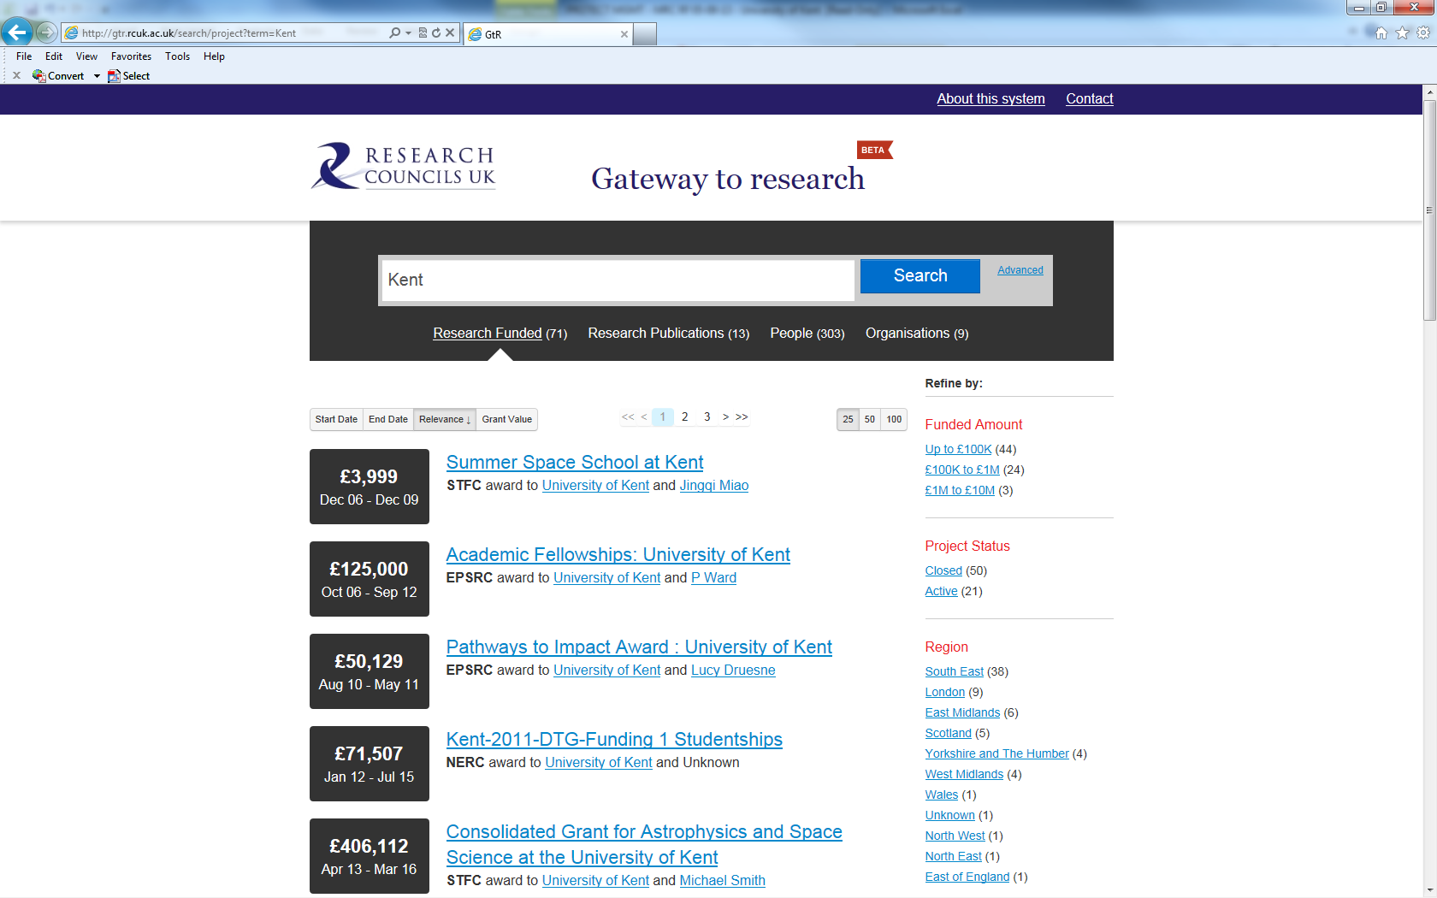
GtR

Slide 18
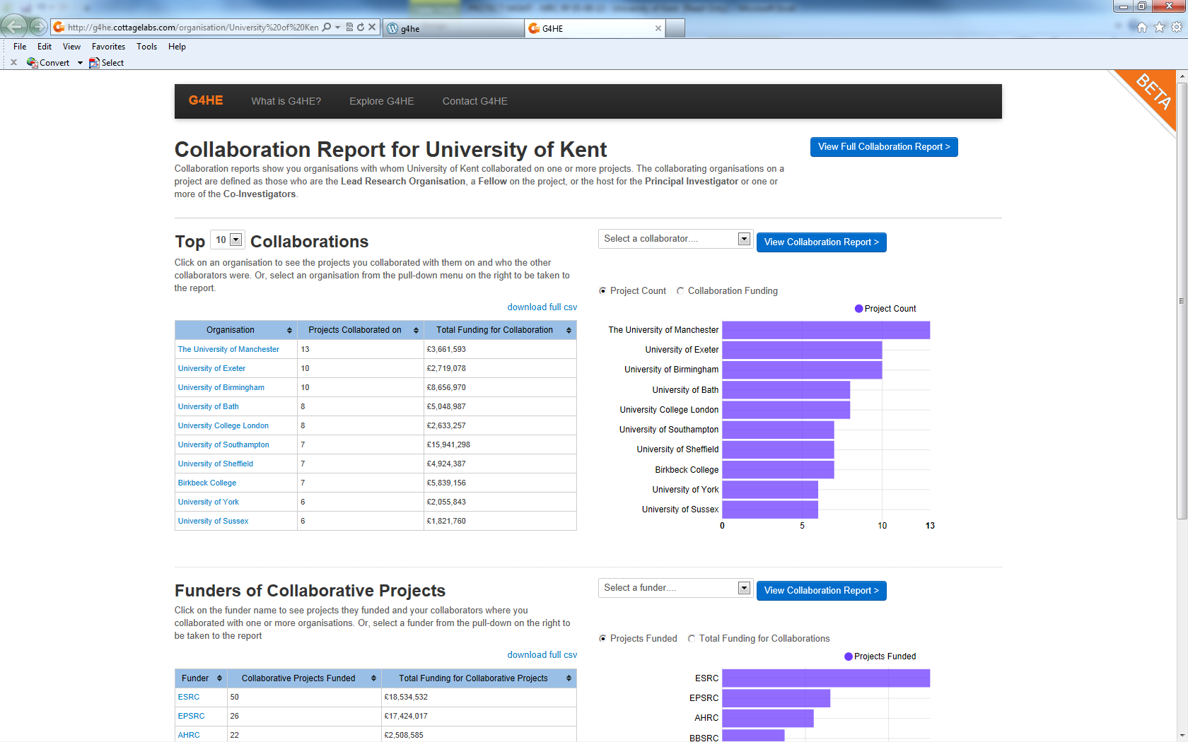
G4HE

Slide 19



Snowball Metrics
  http://www.snowballmetrics.com/
  INPUT METRICS
    Applications Volume
    Awards Volume
  PROCESS METRICS
    Income Volume
    Market Share
  OUTPUT METRICS
    Scholarly Output
    Citation Count
    h-index
    Field-Weighted Citation Impact
    Outputs in Top Percentiles
    Collaboration

Slide 20
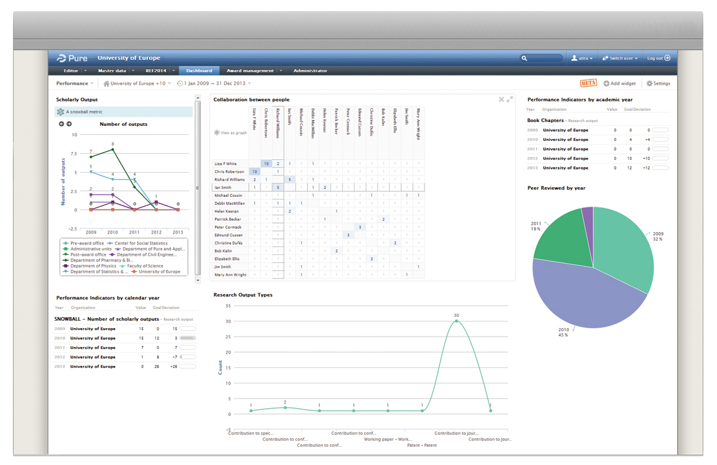
Example Snowball Metrics

Slide 21

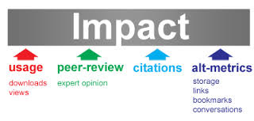
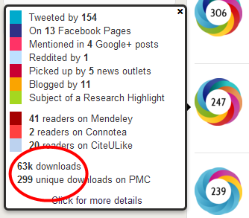
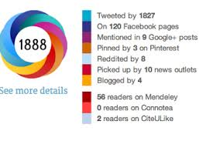
Alt Metrics
  Social Media
  Public Engagement
  Profile… Impact?

Slide 22


REF2014
quality profiles
  http://www.ref.ac.uk/
Overall Profile for each Panel
4 world leading
3 international excellence
2 internationally recognised
1 nationally recognised
Unclassified – not research or nationally recognised
Quality level | 4* | 3* | 2* | 1* | u/c
% of Research Activity | 20 | 25 | 25 | 15 | 15
65%¹
15%¹
20%¹
Research Environment
Research Impact
Research Outputs
4* | 3* | 2* | 1* | u/c
15 | 25 | 35 | 15 | 10
4* | 3* | 2* | 1* | u/c
25 | 25 | 15 | 20 | 15
4* | 3* | 2* | 1* | u/c
30 | 20 | 10 | 20 | 20
¹ These weightings fixed for all UoAs
Results will be used for funding from 2015/2016
Notes:
4 * world leading
3* international excellence
2* internationally recognised
1* nationally recognised
Unclassified – not nationally recognised
Observe that not all levels will be funded
The overall quality profile comprises the aggregate of the weighted profiles produced for outputs, research environment and esteem indicators – rounded to nearest 5%
4* 3* 2* 1* u/c weight
outputs 15 25 35 15 10 70%
envt 25 25 15 20 15 20%
esteem 30 20 10 20 20 10%
overall (unrounded) 18.5 24.5 28.5 16.5 12
overall (final) 20 25 30 15 10

Slide 23

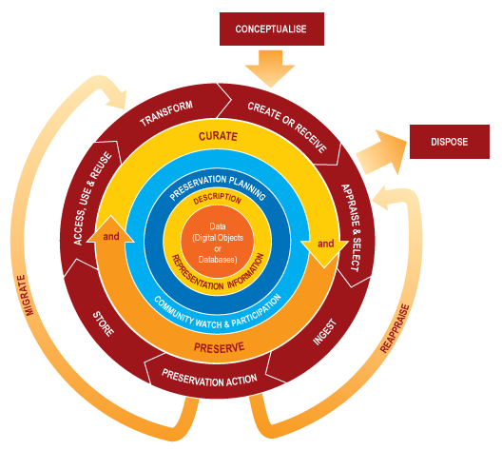
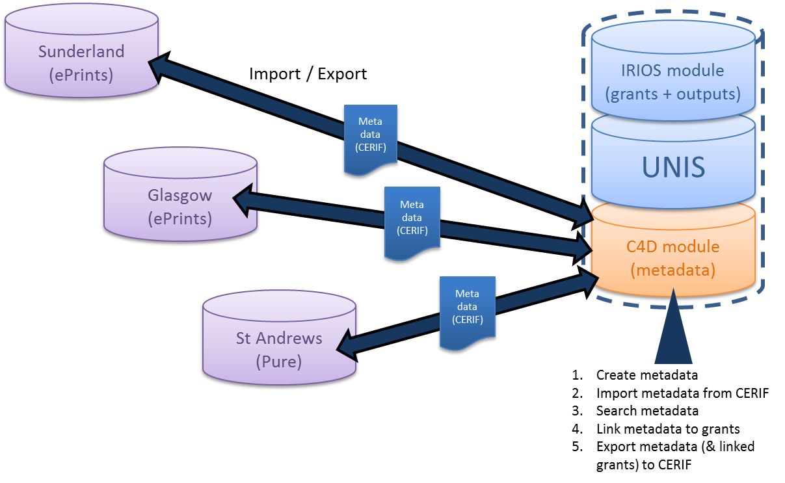

Research Data
  ‘Publication’
  Usage (‘citation’)
  Support (eg DCC): http://www.dcc.ac.uk/
  C4D
  http://cerif4datasets.wordpress.com/

Slide 24
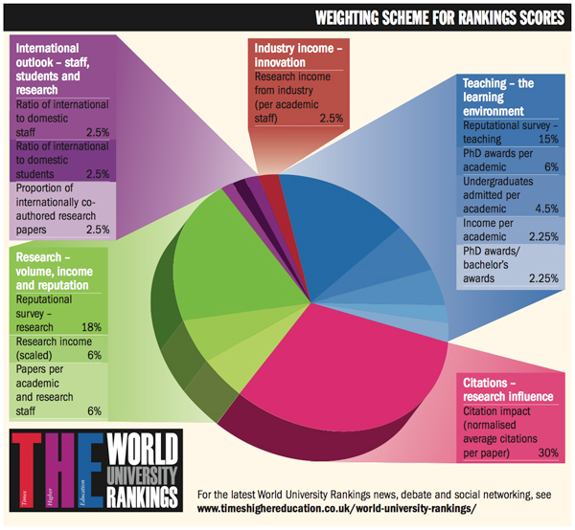

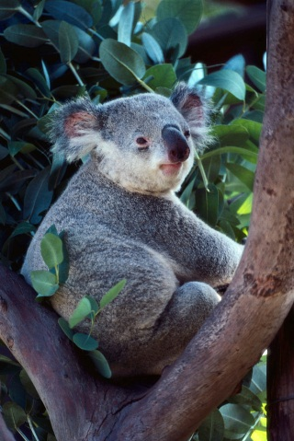

THE Methodology
Notes:
http://www.timeshighereducation.co.uk/world-university-rankings/2011-12/world-ranking/methodology

Slide 25
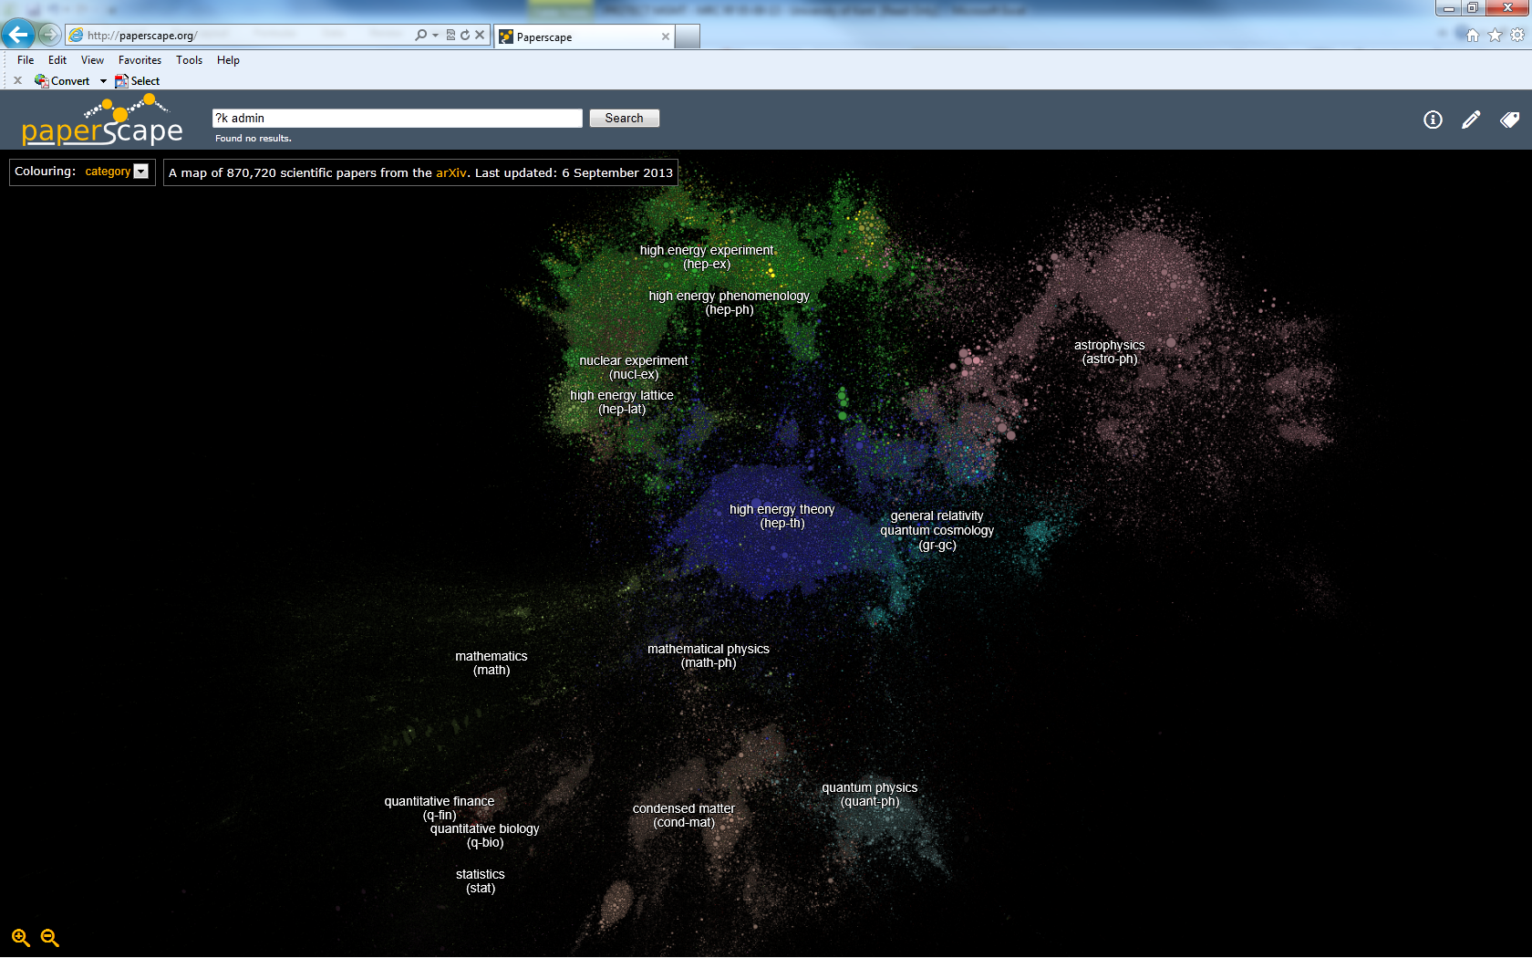
Citation Analysis

Slide 26

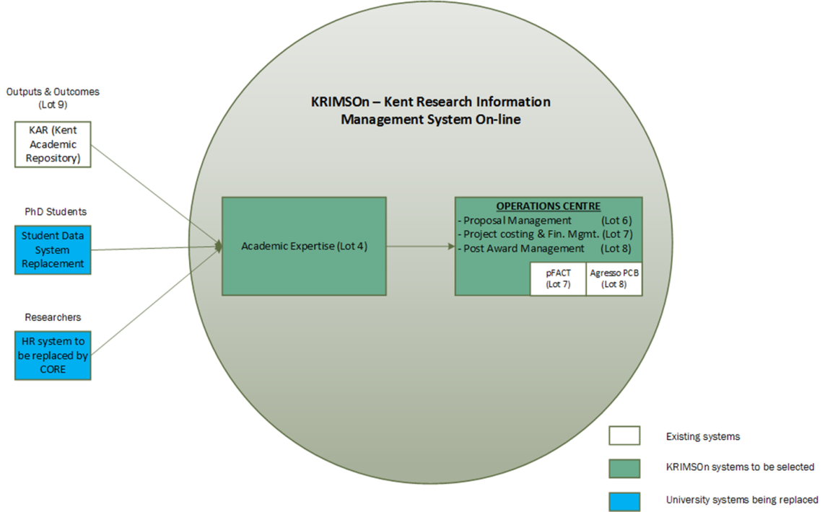
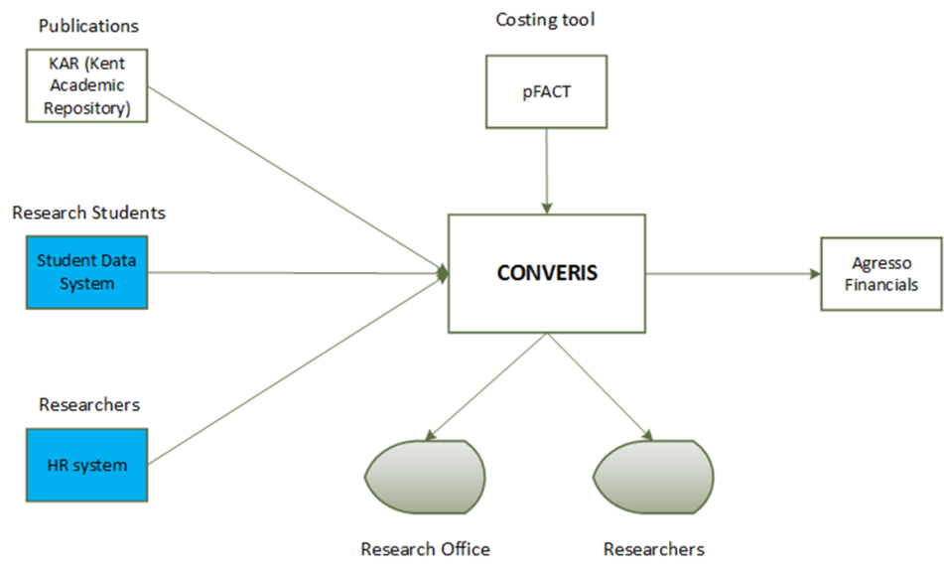
Krimson
  Use the RMAS Procurement framework
  http://www.rmas.ac.uk/

Slide 27




In Summary
  Strategic Ambition (eg increase league table position)
  Research Information (eg #citations [field weighted!])
  Decision Management (eg promote Open Access)
  Build a system… eg Krimson
  Collect the RI to inform the DM to achieve the SA
  Simple!

Slide 28





Questions
How many bears in the presentation?
S.R.Kerridge@kent.ac.uk
@SimonRKerridge
Notes:
Including this one, there are 8 (eight) bears…

Slide 29
References
  http://cerif4datasets.wordpress.com/
  http://gtr.rcuk.ac.uk
  http://irios2.unis4ne-system.net (GUEST/guest)
  http://orcid.org/
  http://paperscape.org/
  https://www.arma.ac.uk/professional-development-framework
  http://www.converis5.com/
  http://www.dcc.ac.uk/
  http://www.kent.ac.uk/researchservices/about/research-strategy.html
  http://www.ref.ac.uk/
  http://www.rmas.ac.uk/
  http://www.snowballmetrics.com/wp-content/uploads/snowball-metrics-recipe-book-upd.pdf
  http://www.timeshighereducation.co.uk/world-university-rankings/2011-12/world-ranking/methodology
  Krimson - R.S.Pender@kent.ac.uk
S.R.Kerridge@kent.ac.uk
@SimonRKerridge
Notes:
Including this one, there are 8 (eight) bears…

