Slide 1
COAR
Confederation of Open Access Repositories
Enhances the visibility of research outputs
Paves the road to interoperability
Fosters knowledge exchange on repository issues
Strengthens international open access implementation
Greater visibility and application of research through global networks of Open Access repositories

Slide 2
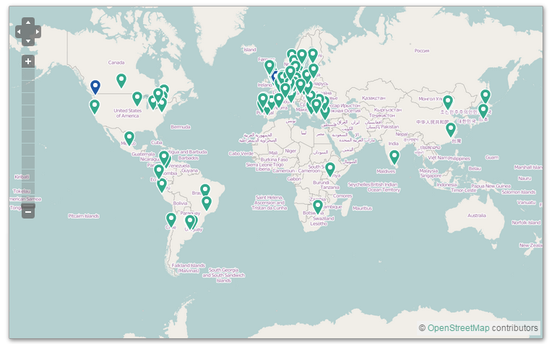
COAR members and partners

Slide 3
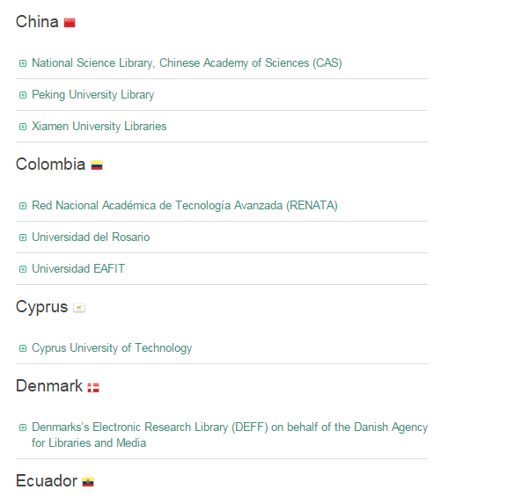
COAR Members

Slide 4
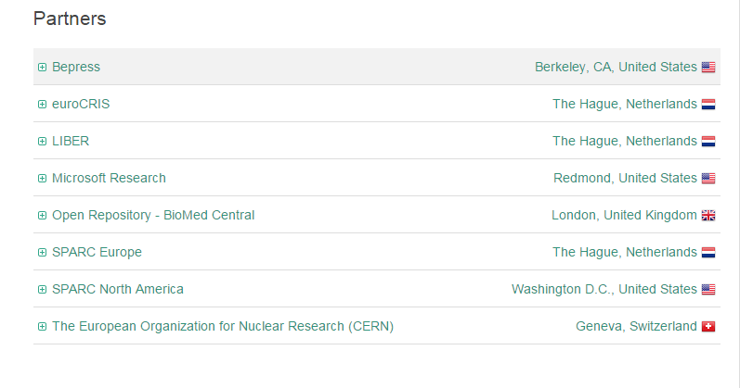
COAR Partners

Slide 5
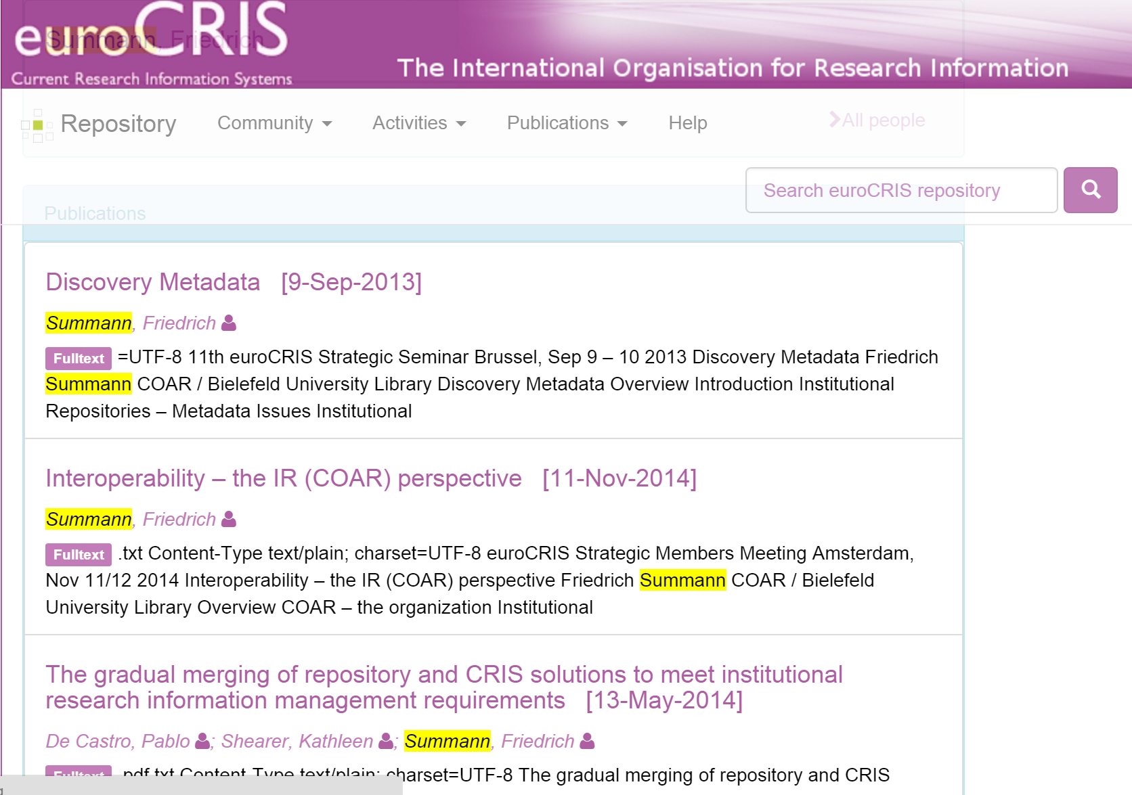

Slide 6
The key challenges
(from the IR perspective):
Relationship CERIF – bibliographic metadata formats
Integration of Services (via Interoperability)
The conclusion:
Communication to exchange experiences and to tie the activities

Slide 7
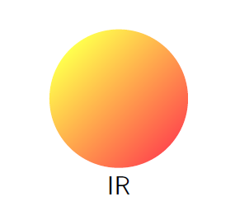
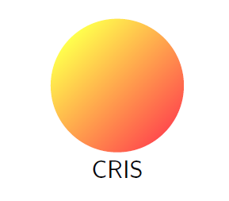
“Not quite a dichotomy – interoperability the key feature”

