Slide 1
Impact Measurement & CERIF
Brussels 10-11 September;
Horizon 2020 and Beyond
Gerry Lawson, Natural Environment Research Council, gela@nerc.ac.uk

Slide 2
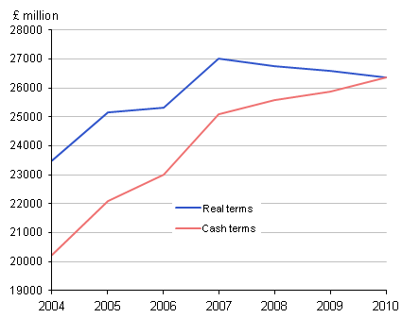
Research Impact – many pressures
  Still having to do ‘more with less’
  Business investment in R&D not rising in UK
  Impact of UK research is still high (per £ invested)
  Impact of UK Research on Growth and Innovation needs to be made more clearly
Gross domestic expenditure on R&D
2004 to 2010
Source: Office for National Statistics (March 2012)

Slide 3
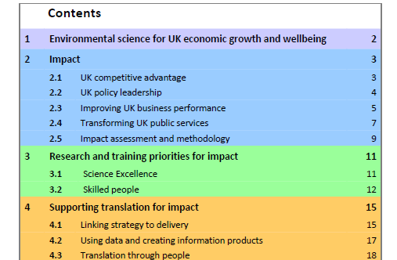
Research Impact – many meanings
NERC Impact Report 2011 – “Environmental Science for UK Economic Growth & Wellbeing”

Slide 4
Research Impact – many measurements
UK Research Councils: RCUK “Pathways to Impact”
UK Research Councils: “Outputs and Outcomes Collection”
Funding Councils Research Excellence Framework: “Impact Assessment”
Academic Journal Impact Factors.
Academic Research Publication Citations.
BIS Economic Impact Frameworks.
HE-Business & Community Interaction Survey.

Slide 5
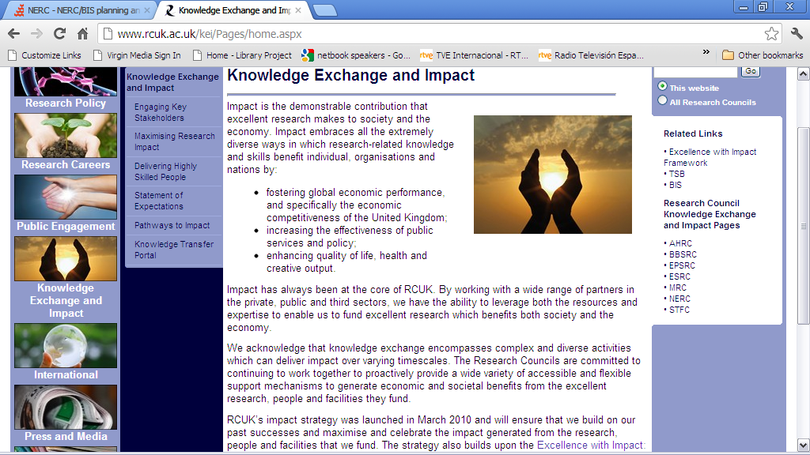
Research Impact – many programmes
Awards & Incentives
Brokerage
Collaborative Doctoral Studentships
Collaborative Research Grants
Cross-council research programmes
Data products and Services
Enterprise training
Evidence for public Policy
Follow-on Funding
Joint Strategic P:rogrammes
Networks
People Exchange
Support for Enterprise
Training in Business and Policy
Notes:
Linear, post research approach
Dedicated funding schemes
Dedicated professionals
Making knowledge exploitable, e.g. through IP
2012: still important in wider ecosystem
more flexibility
making knowledge openly available for reuse
Monitoring and managing outputs

Slide 6
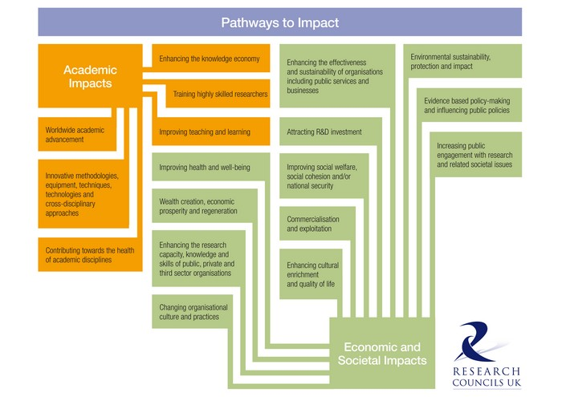
Research Impact – many pathways
Notes:
2,500 user organisations collaborate on our grants
RCs speaking to Industry with one voice, e.g. Pharma Forum
Inform innovation – process, product, …..

Slide 7
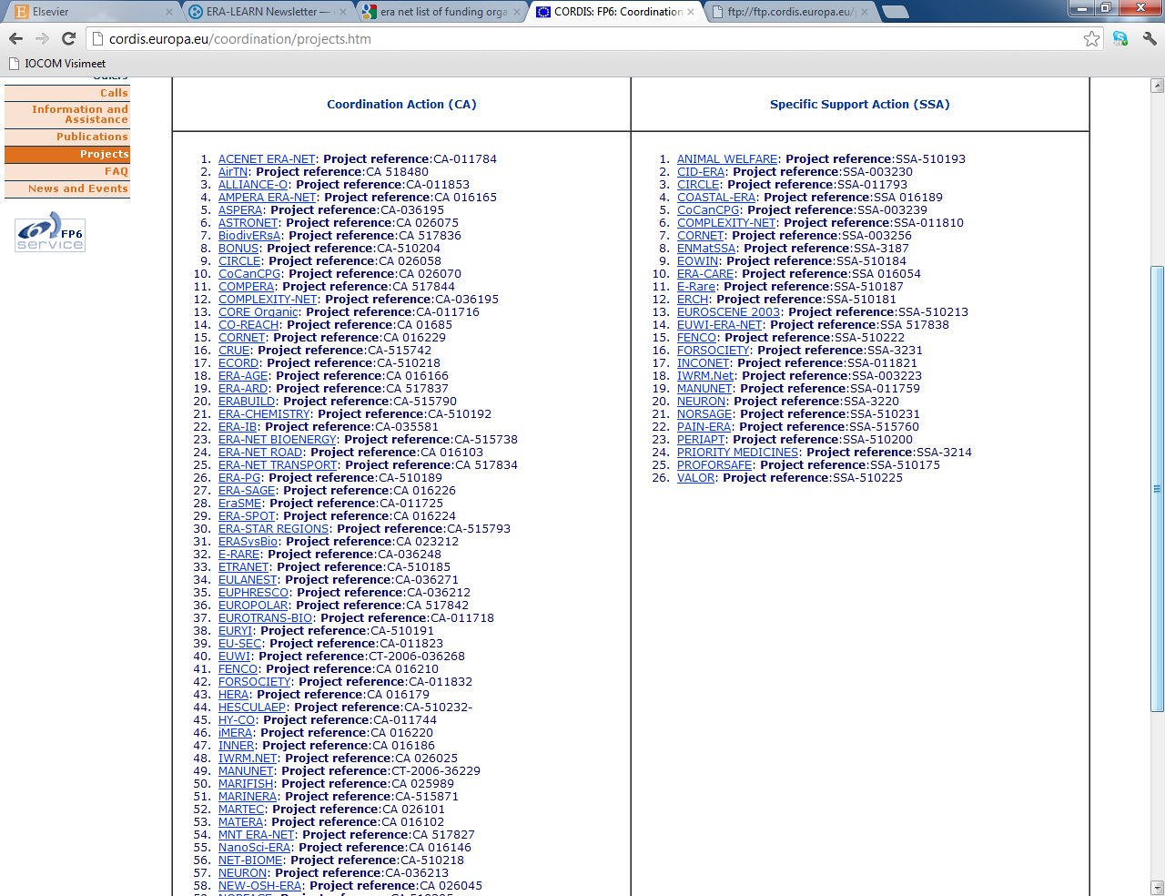
Research impact – much duplication – e.g. ERA-Nets

Slide 8
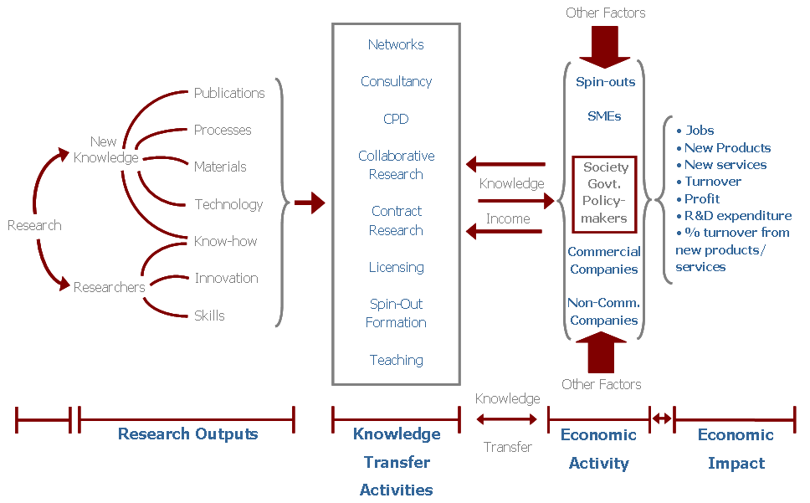
Research Impacts – many meanings
Notes:
Network model, co-production of research
Broader understanding of the wider contribution of science and research
User and public involvement in all stages
Scoping and specifying the research agenda
Commissioning the research
Managing the research
Research use and impact
Pathways to Impact
Skills development of academics

Slide 9
Research Impacts – scope for harmonisaiton
Largely qualitative (final reports and case studies) to largely quantitative (indices and metrics):
  Final reports (about to be abandoned by RCUK) -> RCUK Research Outcome Systems (ROS & eVAL)
  Tightening acknowledgement of funding in publications
  Harmonisation of outcome ontologies and semantics between funders (CERIF & DC Application Profiles)
  Harmonisation between funders and HEI CRIS systems
  Open Access & Open Data
  International Initiatives – EuroCris, OpenAire, Driver, CoData, ORCID, ISNI, CASRAI, VIVO, Star Metrics (NSF/NIH) etc..
  Avoid reinventing the wheel (e.g. 100+ ERA-Nets)
Notes:
http://www.vivoweb.org/files/HolmesSarliPosterFinal.pdf
http://www.alphagalileo.org/ViewItem.aspx?ItemId=123842&CultureCode=en

Slide 10
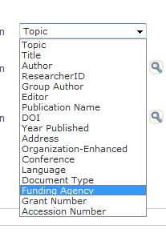
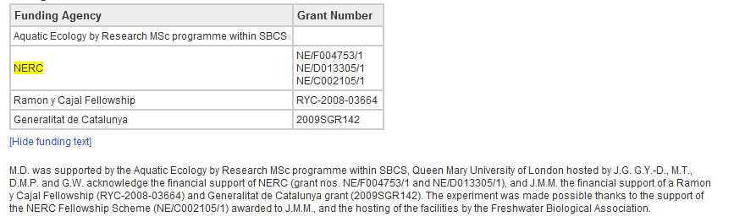
Research impacts - linking publications to funding...
Thompson – Web of Science
Elsevier- (FundRef)
National collaborations (e.g. UK Funders Forum, AMRC, LWEC)
EU – via ERA-Nets
Notes:
Today more than 50 countries participate in ERA-NETs, which encourage EU member states and other
countries to combine their existing
research and development resources
on projects in areas of common interest.
The networks implement around 35
calls per year and to date over 100
ERA-NET or ERA-NET plus activities
have received funding through FP6
and FP7 up to the end of 2010. http://netwatch.jrc.ec.europa.eu/static/download/pub_eralearn_newsletter_vol1.pdf
http://cordis.europa.eu/coordination/projects.htm

Slide 11
Research Impacts – business researchers too
Notes:
http://epp.eurostat.ec.europa.eu/tgm/refreshTableAction.do?tab=table&plugin=1&pcode=tsc00004&language=en

Slide 12
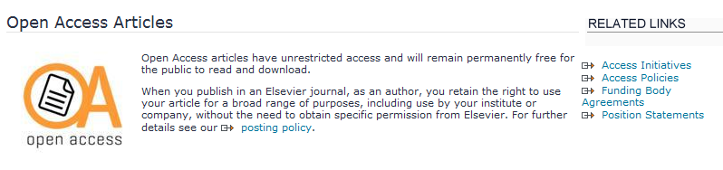
Research Impacts – OA gives new metadata needs
Standard article-level metadata needed – hopefully in conjunction with publishers:
  OA symbols on publishers sites
  Access metadata in CrossRef (APC, Subscription free)
  Copyright metadata in CrossRef (e.g. CC-BY)
  Research funder information in FundRef
  APC payment in FundRef (?)
Need for publishers to disseminate metadata to repositories and aggregators (DRIVER, BASE etc) – either a) Repository Junction service, b) CrossRef Metadata service; c) WoS Web Service; d) SciVerse Web Services?
Need for ‘faceted’ searches needed from aggregators – including Funder and GrantID fields?
Notes:
http://www.crossref.org/fundref/index.html
Crossref Metadata Service http://www.crossref.org/cms/index.html (but is this cost prohibitive since membership of Cross Ref is assumed).

Slide 13
Research Impacts – outcome sementics
AHRC, BBSRC, EPSRC, ESRC, NERC (from 1/1/2013) ROS
Publication (book, journal, conference, report, other)
Other research (bio-medical, creative, electronic, physical, research materials, other)
Collaboration (partnership, board, panel, committee, networks)
Further funding
Staff development
Communication (lecture, workshop)
IP (exploitation mechanism)
Award/recognition (research prize, medal, honorary degree, learned society fellowship, editorial board, international ;panel, other)
Impact (summary, policy, business, 3rd sector, final report)

Slide 14
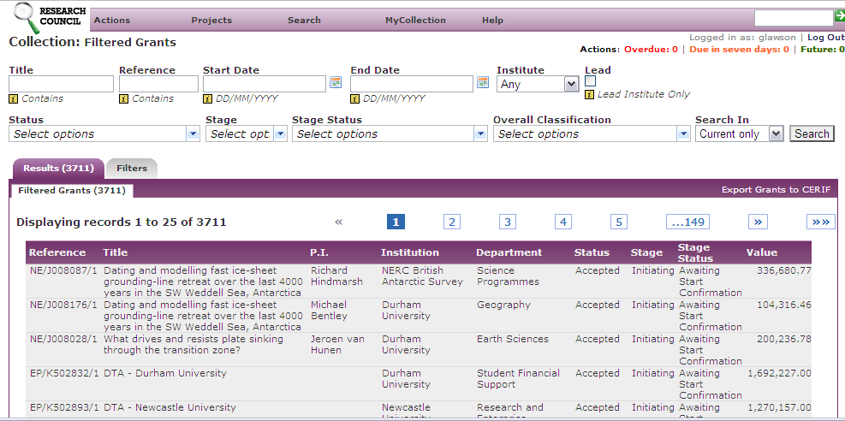
Integrated Research Inputs and Outputs – Inputs

Slide 15
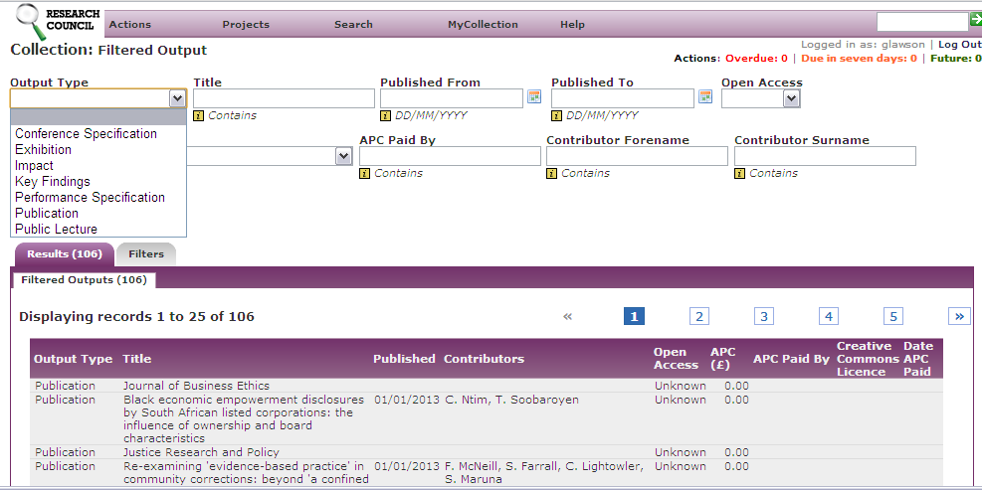
Integrated Research Inputs and Output Systems (IRIOS) - Outputs

Slide 16
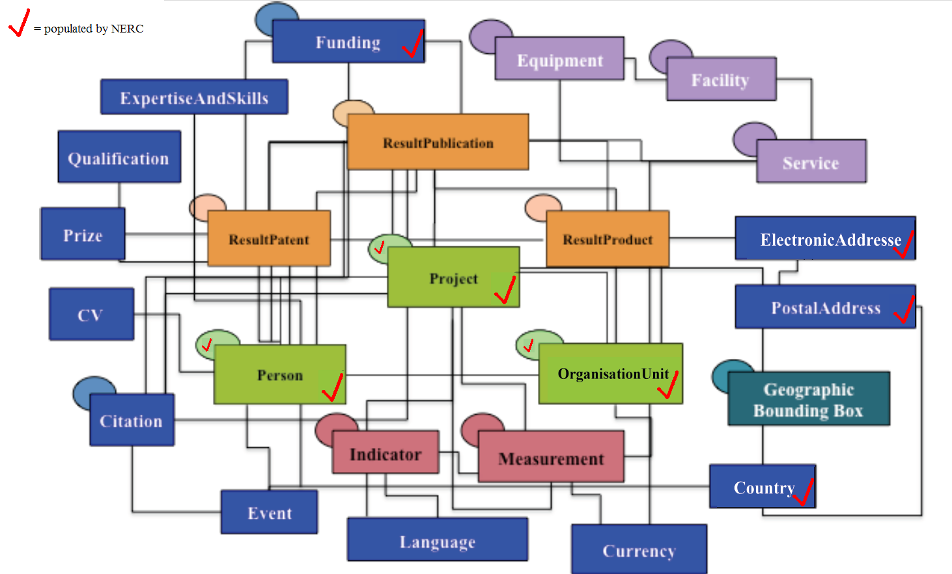
NERC/EPSRC Grant Data Provided to IRIOS platform

Slide 17
RCUK Gateway to Research
(All UK Research Councils)
Will provide cross-council information on:
  Research inputs (money, people, related grants, co-funders, classifications, abstracts, institutions, departments etc)
  Research outputs (publications, impact summaries, reports, staff development, other outputs etc) mapping ROS and eVAL
  Search portal and CERIF-xml output option
  CERIF used as internal model
  Prototype by December 2012

Slide 18
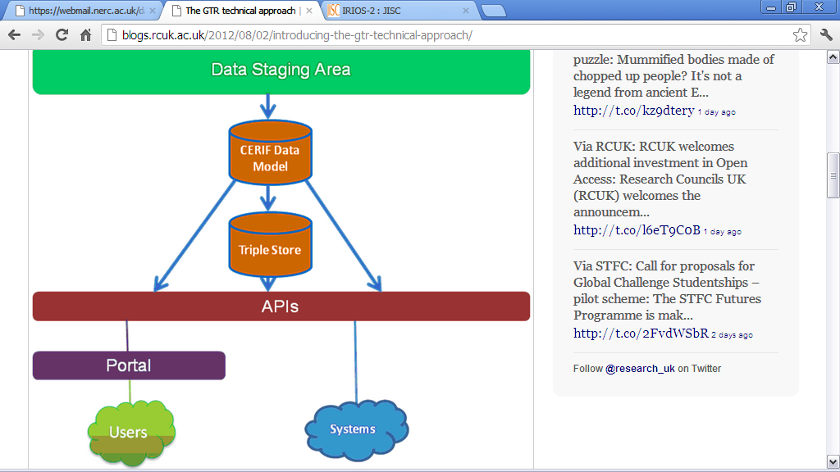
RCUK Gateway to Research
Data transformed and stored in 2 forms:
relational database using the CERIF data model. Following discussion with EuroCris CERIF will be used as the internal data model.
linked data format (RDF) via a SPARQL interface.
Wherever possible existing open source technologies will be used and integrated rather than built from scratch.
Any code or customisations will be made freely available.

