Slide 1

New Requirements for Dataset Metadata: a perspective from CODATA
Simon Hodson
Executive Director CODATA
www.codata.org/blog
execdir@codata.org
@simonhodson99

Slide 2
New Requirements: dataset metadata
How do euroCRIS stakeholders see new and emerging requirements for dataset metadata.
How may CERIF evolve in the light of this.
What cooperation/collaboration may be possible.
CODATA is a strategic partner of euroCRIS: http://www.eurocris.org/Index.php?page=partners&t=1
New ED and a new Strategic Plan: http://www.codata.org/CODATA_Strategic_%20Plan_2013-2018.pdf
Overview of CODATA activities.
Sample of initiatives that may have some implications for dataset metadata.

Slide 3
Some general points…
Huge diversity of metadata standards.
Importance of generic issues: time (for various functions), geographic locations/coverage, linking to publication, licensing, access control.
Some examples from initiatives in ‘data publishing’ – providing a place for datasets linked to publications or a means of ‘publishing’ datasets.
  But requirements of datasets are not the same as those of publications.
Importance of ‘assessability’ – provides a need for contextual information, provenance.
Policy issues are significant drivers. But so is a significant desire on behalf of researchers to get credit for datasets.
All have metadata as an important component of what is being done, but not the whole story: cultural aspects, business processes and issues of sustainability.

Slide 4
What is CODATA?
Mission: To strengthen international science for the benefit of society by promoting improved scientific and technical data management and use.
An Interdisciplinary Body of ICSU, the International Council for Science.
CODATA has been working at the forefront of data science since 1966 http://www.codata.org/about/CODATA@45years.pdf
Not-for-profit, membership organisation (national members, scientific unions, affiliate members, members-at-large).
CODATA is…
An international community and network of expertise on data issues.
An influential and authoritative voice in national and international policy regarding scientific data management.
A focal point for international, cross- disciplinary collaboration and communication on key scientific data issues.

Slide 5
What does CODATA
bring to the table?
  Unique position comprises national members’ committees, International Union members, Task Groups, strategic initiatives, close relationship to ICSU.
Genuinely international in reach
  23 National Members, many with very active national committees.
  Model can encourage activity at national and international levels.
  Recent new members: Mongolia, Finland, Czech Republic.
Helps address data issues in international science programmes
  Close association with ICSU (and WDS), supports strategic initiatives.
  16 International Scientific Union members.
  Provides engagement with data challenges in particular disciplines and in transdisciplinary programmes.
A community and forum for data science
  Affiliate members and members at large.
  Active Executive Committee
  International Conference, Data Science Journal, Working Groups and Task Groups.

Slide 6
Elements of Strategic Plan 2013-18
Policy frameworks for data: take the lead in defining a policy agenda for scientific data.
  First step is to establish Data Policy Committee. Provide focus and expertise.
  Support ICSU forum on Open Access.
  Forum on data principles for publicly funded and international science.
Frontiers in data science and technology: coordinate work in key frontiers of data science and interdisciplinary application areas; capacity building activities.
  CODATA workshop series on Frontiers of Data Science and Technology.
  Important to partner other organisations, stakeholders; build on work of Task Groups.
  Identify and support addressing of data issues in coordination with International Unions.
  Current activities: nanotechnology, data for sustainable development, approaches to data recovery.
  Expand CODATA’s capacity building activities, education and training activities including curriculum development.
  Initiative to encourage Early Career Data Scientists.

Slide 7
Elements of Strategic Plan 2013-18
Frontiers in data science and technology: (cont.)
  International Science Data Conference, with WDS, New Delhi 2-5 Nov 2014.
  Reinvigorate the Data Science Journal.
  Task Groups http://www.codata.org/taskgroups/index.html includes Groups working on data citation, data challenges in microbiology, anthropometry, materials science and earth and space science; preservation and availability of data in developing countries; open data for global roads.
Data strategies for international science: support major ICSU scientific programmes to address data management needs (including infrastructure, policies, processes, standards).
  Promote a coordinated data strategy for Future Earth
  Promote a coordinated data strategy for Integrated Research on Disaster Risk

Slide 8
CODATA Task Groups
TGs are approved for two-years by the CODATA General Assembly; seed funding provided; benefit from community endorsement, linkages.
Advancing Informatics for Microbiology
Anthropometric Data and Engineering
Data Citation Standards and Practices
Data at Risk
Earth and Space Science Data Interoperability
Exchangeable Materials Data Representation to support Scientific Research and Education
Fundamental Physical Constants: 2010 CODATA constants http://physics.nist.gov/cuu/Constants/bibliography.html
Global Information Commons for Science Initiative
Global Roads Data Development
Linked Open Data for Global Disaster Risk Research
OCTOPUS: Mining Space and Terrestrial Data for Improved Weather, Climate and Agricultural Predictions
Preservation of and Access to Scientific and Technical Data in/for/with Developing Countries

Slide 9
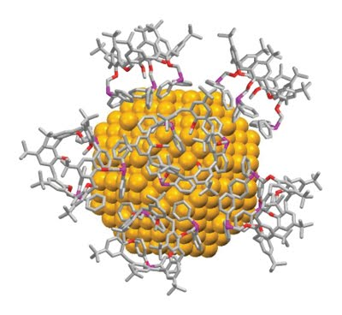
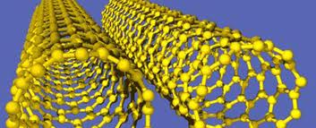
CODATA Nanomaterials
CODATA longstanding series of Task Groups on materials data.
ICSU and CODATA sponsored Workshop in February 2012
Representatives from 13 Unions, ISO 229, and other communities in attendance
Recommended new project to establish multi-disciplinary, multi-user groups to establish requirements of nanomaterials description system
CODATA and VAMAS (Versailles Project on Advanced Materials and Standards) established a Joint Working Group
Invited 14 Unions and many nanomaterials experts.
Two-year work plan includes international workshops.
Participation in FP7 Future Nano Needs Project.
Results to be given to ISO and other standards groups
Slide credit, John Rumble

Slide 10
CODATA Nanomaterials
Part of a large European project: Future Nano Needs.
Developing unified information model for describing nanomaterials.
CODATA provides liaison role with international standards bodies and scientific unions to disseminate work and promote uptake of the information models and other outputs.
Team working on the information model comes from the CODATA community.
Need to describe properties (interaction) as well as measurements.
Criteria for uniqueness and equivalency.
Different requirements of different disciplines:
  Chemistry
  Physics
  Materials science
  Food science and technology
  Nutrition science
  Toxicology
  Environmental and ecology science
  Medicine
  Biology
Slide credit, John Rumble

Slide 11

Royal Society Science as an Open Enterprise Report, 2012
‘how the conduct and communication of science needs to adapt to this new era of information technology’.
Intelligent Openness: data should be accessible, assessable, intelligible, usable.
‘As a first step towards this intelligent openness, data that underpin a journal article should be made concurrently available in an accessible database. We are now on the brink of an achievable aim: for all science literature to be online, for all of the data to be online and for the two to be interoperable.’
Royal Society June 2012, Science as an Open Enterprise, http://royalsociety.org/policy/projects/science-public-enterprise/report/

Slide 12
ICSU Consultation on Open Access and Metrics
ICSU (International Council of Science) consultation on Open access to scientific data and literature and assessment of research by metrics.
Contribute towards a report which will provide providing 'an analysis of the current situation and thinking on open access and the use of metrics and a statement of ICSU’s overall policies' with regard to these things.’
ICSU feels the need to clarify position, work with scientific unions on this.
Concerns about the Gold OA business model (for data and publications) and where this leaves researchers without grant funding.
What type of of metrics, to what end?
Consultation workshop on 25 September involving ICSU members and to which CODATA is contributing.

Slide 13
Data Citation, Standards and Practices
Co-Chairs: Christine Borgman, Jan Brase, Sarah Callaghan; Consultant: Paul Uhlir; see http://www.codata.org/taskgroups/TGdatacitation/index.html
Involvement of a range of key organisations and experts.
Major Report Out of Cite, Out of Mind to be released in September 2013
Forceful set of ‘First Principles’ for data citation:
  Status of Data: Data citations should be accorded the same importance in the scholarly record as the citation of other objects.
  Attribution: Citations should facilitate giving scholarly credit and legal attribution to all parties responsible for those data.
  Persistence: Citations should be as durable as the cited objects.
  Access: Citations should facilitate access to data by humans and by machines.
  Discovery: Citations should support the discovery of data and their documentation.
  Provenance: Citations should facilitate the establishment of provenance of data.
  Granularity: Citations should support the finest grained description necessary to identify the data.
  Verifiability: Citations should contain information sufficient to identify the data unambiguously.
  Metadata Standards: Citations should employ widely accepted metadata standards.
  Flexibility: Citation methods should be sufficiently flexible to accommodate the variant practices among communities.

Slide 14


The credibility and effectiveness of the research enterprise is due in large part to the social contract behind scholarly publishing. Researchers disclose their work to their peers in return for professional credit. In so doing, they also expose their findings to be confirmed or refuted, and enable other researchers to build upon their results. Dryad seeks to extend this social contract to research data by providing a model for how a disciplinary repository can motivate researchers to disclose the data that is of the greatest value for scientific reuse, that associated with publications, and realize the manifold benefits of free access to scientific data in perpetuity.
http://datadryad.org/pages/about
Vision ‘Open Data and the Social Contract of Scientific Publishing’ http://www.bioone.org/doi/full/10.1525/bio.2010.60.5.2

Slide 15
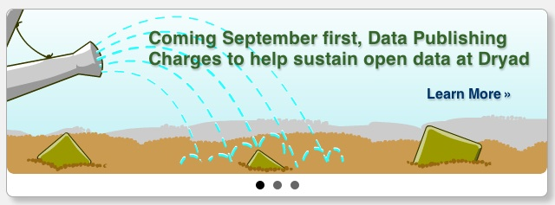
Dryad Data Repository
Dryad Data Repository: http://datadryad.org/
Provides a home for the data underpinning research articles.
Exploring a depositor pays business model: http://datadryad.org/pages/pricing
Relying on low cost, low curation, high throughput business model.
Emphasises researcher responsibility to ensure quality of data and metadata.

Slide 16
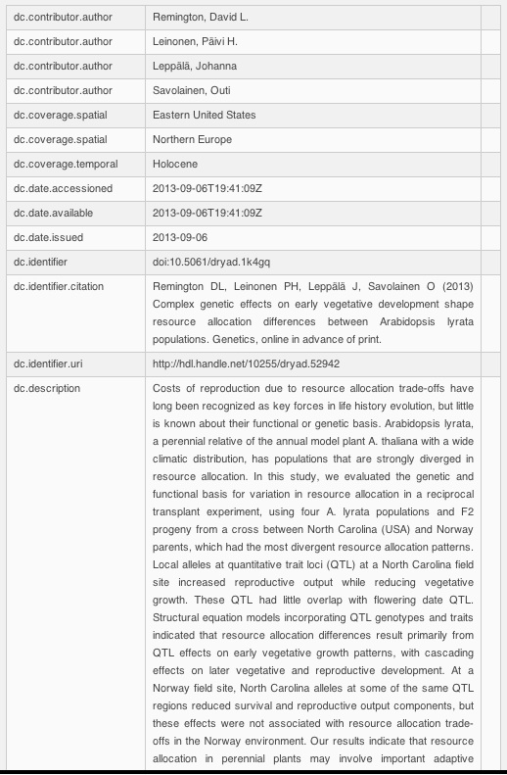
Dryad Data Repository
Encourages citation of the data package as well as the article.
Submission encourages: scientific names (species), spatial coverage, temporal coverage.
Keen to explore ways of enhancing the service and this will rely on enhanced metadata: collections relating to particular subjects, data types, methods, funders etc.
In part this rests assessability and making connections, on being able to draw in significant amounts of contextual information, identifiers and other metadata, from a ‘research information ecosystem’.

Slide 17
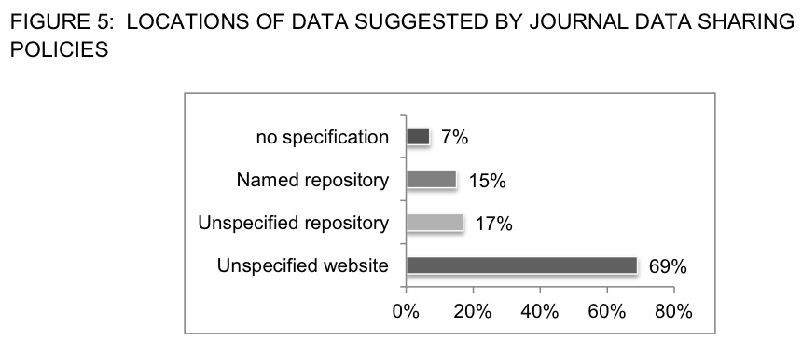
Policies / Standards / Repositories
Journal data availability policies:
JorD project http://jordproject.wordpress.com/ reports that nearly 50% of journals sampled have a data availability policy of some sort (though only 25% of these can be characterised as ‘strong’).
Journal policies generally not clear or specific about repository, standards etc.
Interest in aligning journal policies with funder policies, help researchers comply.
Clarify relations between Policies > Standards > Data repositories
What are the policy requirements from funders, what is said if anything about standards and repositories?
What standards have community uptake, are used in repositories?
What repositories have accreditation, employ given standards, are recommended in policies.
Build combined information resource: http://www.biosharing.org/
Contact: Susanna Sansone and Rebecca Lawrence

Slide 18
Understanding Data Publication Processes: PREPARDe Project
Examined and modeled a number of workflows for data publication (publishing data associated with research publications).
  Report on publication processes.
Data repository accreditation.
  White paper of principles of repository accreditation to be released.
Scientific review of datasets.
  White paper of principles and recommendations on data peer review.
Cross-linking between repositories and data publishers.
  Requirements for a third party broker to facilitate multi-directional linking between datasets and literature.
See http://proj.badc.rl.ac.uk/preparde/wiki/DeliverablesList and http://www2.le.ac.uk/projects/preparde

Slide 19
NPG Scientific Data
Open Access, online-only platform containing data descriptors that describe and explain datasets, supported by an APC model.
Why this approach? Drivers:
  Researchers: credit for depositing and describing their data, helps researchers meet funder requirements.
  Funders: helps realise objectives for data availability and reuse (RoI).
  Scholarly communications: enhanced product, metadata approach hopefully makes more interesting to market.
Data and metadata to be CC0, narrative has options ranging from CC BY to CC BY-NC-SA
Data descriptor provides detailed information about a dataset held in a third party repository (like Dryad or Figshare, but not limited to these).
Data descriptor will be peer reviewed.

Slide 20
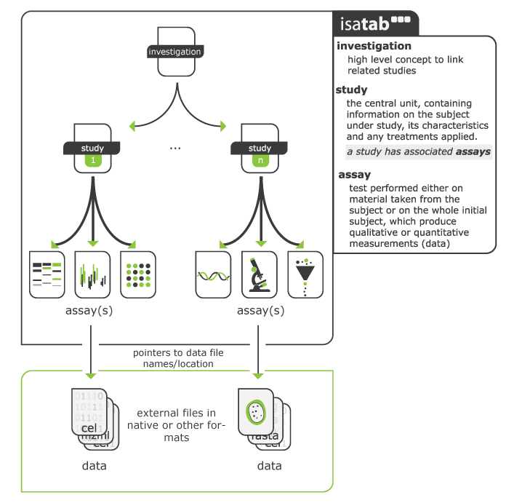
NPG Scientific Data: Data Descriptors
Data Descriptors use ISA Tab (Investigation, Study, Assay)
Increasing use in life sciences, biomedical and environmental sciences.
‘Investigation’ (the project context), ‘Study’ (a unit of research) and ‘Assay’ (analytical measurement).
Importance of metadata standards that capture research processes to some extent: e.g. DDI, ISA, CIF.
Enrich with contextual metadata, methods, workflows, DMP info…

Slide 21
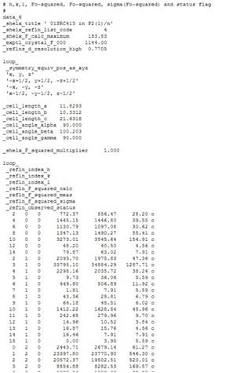
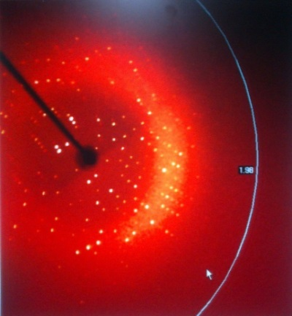
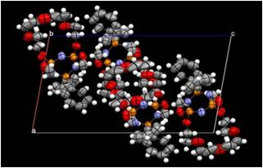
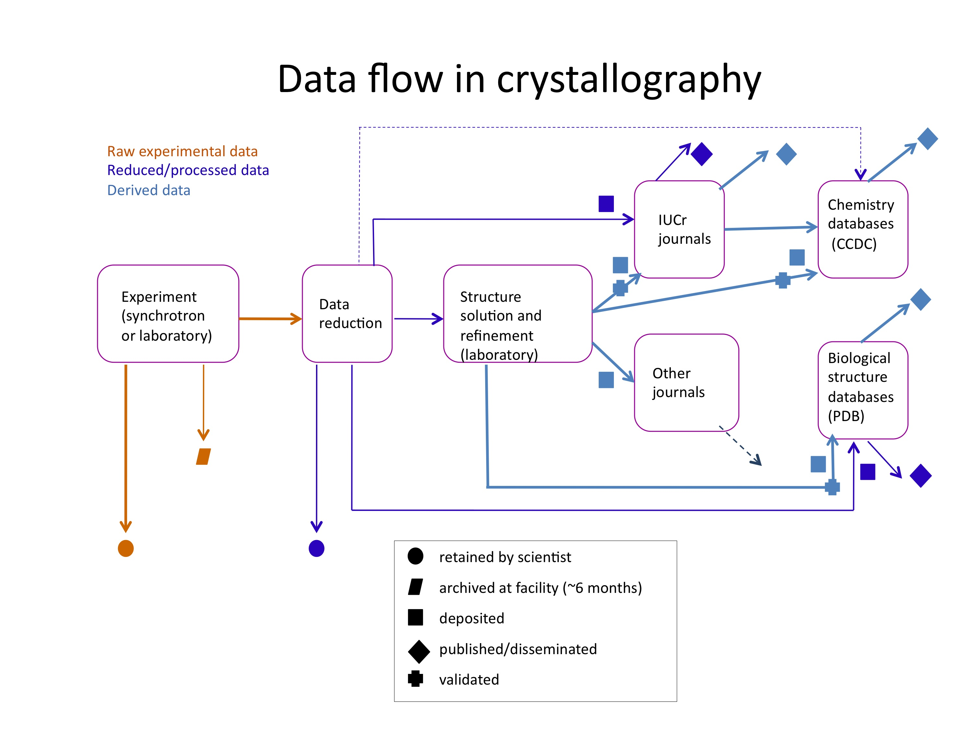
Crystallographic Data
Raises the question of which data should be available and described.
Raw data (few MB-few GB)
Reduced data (tens of kB-few MB)
Structure data (few kB – ~1 MB)
Established workflow and format for sharing structure data; but don’t always share derived data, and less frequently raw data.

Slide 22
Why Publish Raw Crystallographic Data?
Increasing use of validation for structure data: found, retrospectively that over 100 fraudulent structures had been published in Acta Crys. E from 2007-2009: http://www.iucr.org/__data/assets/pdf_file/0020/80273/MH_Publication-of-Small-Molecules.pdf
Publishing raw data allows validation and checking.
Above all has benefits for improving techniques for reduction and structure identification.
Helliwell: publishing raw data allows improved refined software use, new results and wider uptake of improved approach: http://www.iucr.org/__data/assets/pdf_file/0004/80266/JRHelliwel_ECM28.pdf
IUCr Diffraction Data Deposition Working Group working towards a recommendations on data deposit and for a federation of repositories.
Information challenges likely to include: federated search portals, extraction of subsets of large data sets, establishment of automated procedures for expiring data sets, linking to publications, sorting by different criteria ...
Slide credist: Brian McMahon, John Helliwell, Michael Hoyland.

Slide 23

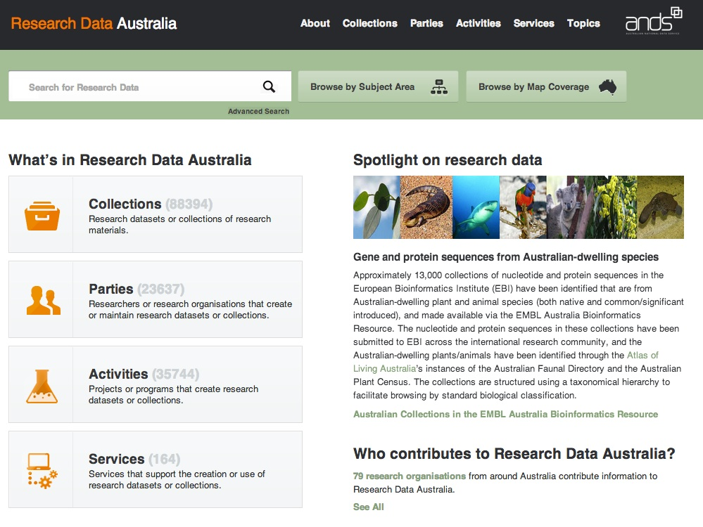
Federations of Data Repositories
ICSU-World Data System:
Prototype data portal.
Working group on how to enhance this metadata: in particular by linking to other sources of data and information.
Concept paper in preparation.
ANDS Research Data Australia
Now has nearly 90,000 collections!
Uses RIF-CS as interchange format.
Catalogue of data holdings in universities and data centres/labs.

Slide 24

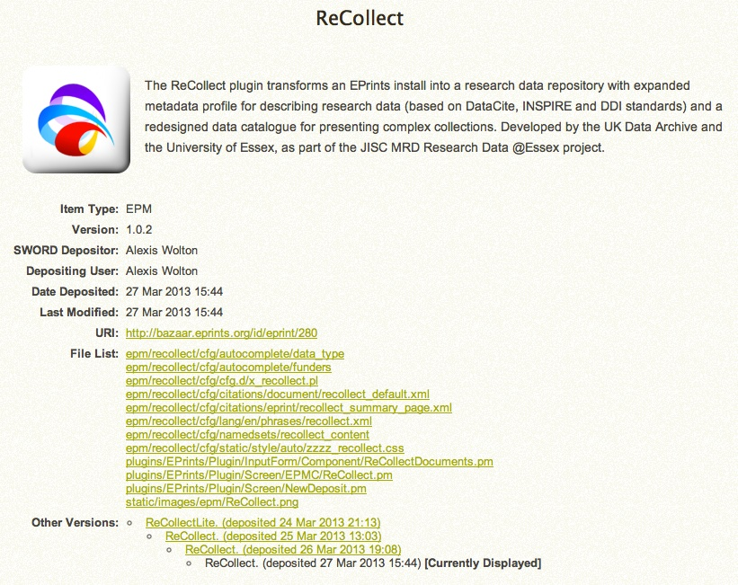
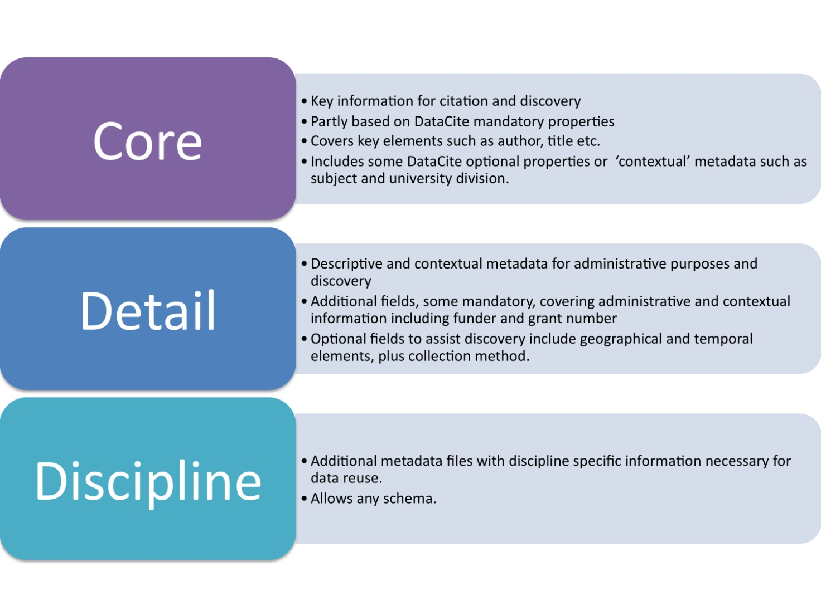
ReCollect App for Eprints Data Repositories
http://bazaar.eprints.org/280/
Metadata approach from Research Data @ Essex Project
Notes:
The ReCollect plugin expands an installation of Eprints into a research data repository with expanded metadata profile for describing research data. This metadata profile is based on DataCite, INSPIRE and DDI standards. It also provides a redesigned data catalogue for presenting complex collections.
It was developed by the UK Data Archive and the University of Essex, as part of the Jisc MRD project, ‘Research Data @ Essex’.

Slide 25
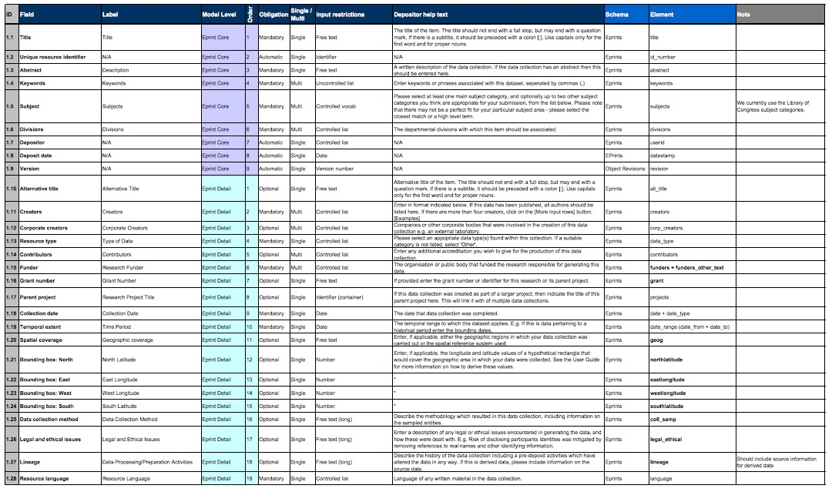
Metadata Schema for Institutional Data Repositories
http://www.data-archive.ac.uk/media/375386/rde_eprints_metadataprofile.pdf

Slide 26
Thank You!
Contact
Simon Hodson
Executive Director CODATA
www.codata.org/blog
Email: execdir@codata.org
Twitter: @simonhodson99
Tel (Office): +33 1 45 25 04 96 | Tel (Cell): +33 6 86 30 42 59
CODATA (ICSU Committee on Data for Science and Technology), 5 rue Auguste Vacquerie, 75016 Paris, FRANCE

