Slide 1
Virtual Research Environments (VRE) vs Research Infrastructures (RI) usage
Valerie BRASSE
IS4RI / euroCRIS

Slide 2
Agenda
VRE4EIC – The Vision
enhanced VRE for ENVRIplus
enhanced VRE for EPOS
Use-cases -> survey
Framapad: commenting on VRE vs RI

Slide 3
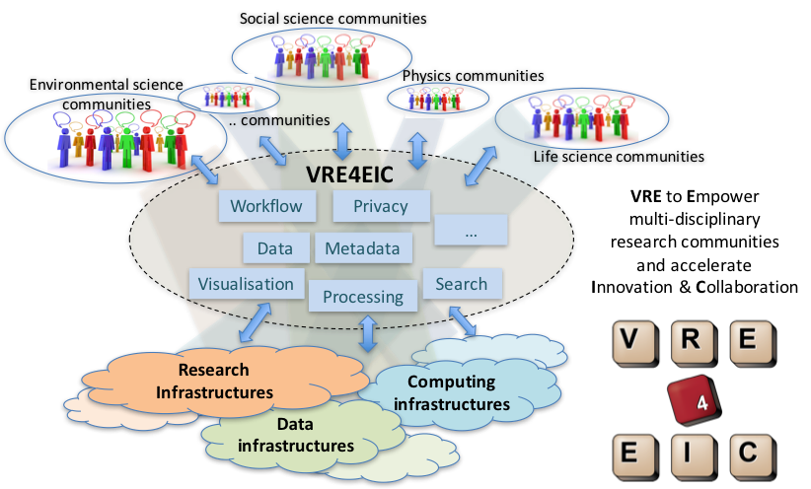
The Vision
A Reference Architecture,
a VRE prototype & Software
components for
enhanced Virtual
Research Environments
A Europe-wide interoperable Virtual Research Environment to Empower multidisciplinary research communities
and accelerate
Innovation and Collaboration
A solution for easier Collaboration within Research Communities
www.vre4eic.eu

Slide 4
ENVRI^{PLUS}
Slides from Zhiming Zhao
2015 - 2017, VRE4EIC project meetings
Zhiming Zhao
Informatics Institute

Slide 5























Research Infrastructures, I3, and ESFRIs in environmental Sciences
Common data services
Trans-
Disciplinary Access
Societal Economical impacts
Exploitation
Sensor technology innovation
Knowledge transfer
SIOS
Slide from Zhiming Zhao
Oct 2015, Rome meeting

Slide 6
Scientific problem
Slides from Zhiming Zhao
Nice 2017, Nice meeting
Research data/tool
Infrastructure/Services

Slide 7
Virtual research environments
Publication
Experiment plan
Scientific problem
Scientific problem
Scientific problem
Service/data/model discovery
Result analysis
execution
Execution plan
Data acquisition
Research infrastructures
Curation
Research data
Data usage
Research data/tool
Research data
Processing
Publication
E-Infrastructures
Infrastructure request
SLA negotiation
Failure recovery
Infrastructure/Services
Infrastructure/Services
Infrastructure/Services
Resource provisioning
Runtime monitoring
Job scheduling

Slide 8
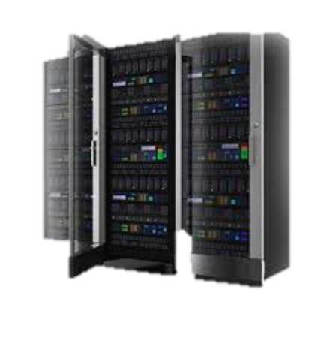

Research communities
Research communities
Research communities
Virtual Research Environment (VRE)
D4Science
….
VL-e
VRE4EIC
Research communities
Research Infrastructure (e-RI)
EPOS
ICOS
…
EMSO
Private infrastructures
Private infrastructures
Public clouds
E-Infrastructures
EGI
…
EUDAT
GEANT

Slide 9
HUC 001
Access eVRE
HUC 002
Annotate
HUC 003
Compare data
HUC 004
Create dataset
HUC 005
Create data from instr.
HUC 006
Manage data
HUC 007
Manage fund c
HUC 008
Manage inst.
HUC 009
Manage RI
HUC 010
Manage RProj
HUC 011
Process data
HUC 012
Publish dataset
HUC 013
Transform data
HUC 014
Manage person profile
HUC 015
Manage e-VRE services
HUC 016
Manage Users
HUC 017
Query data
HUC 018
Communicate
HUC 019
Get support
Virtual Research Environment (VRE)
SC_3: mosquito
Research Infrastructure (e-RI)
TC_2: Data subscription
IC_14: ontology based acquisition and NRT
IC_13: ICOS data processing
IC_1: data identification
TC_4: Sensor regis
TC_16: RM for marine RI
IC_3: data reprocessing
IC_8: cataloguing, curation, provenance
IC_11: semantic linking
Notes:
HUC001 Access services and data from eVRE
HUC002 Annotate data
HUC003 Compare datasets
HUC004 Create dataset
HUC005 Create dataset from instrument
HUC006 Manage data
HUC007 Manage funding calls
HUC008 Manage instrument
HUC009 Manage research infrastructure
HUC010 Manage research projects
HUC011 Process data
HUC012 Publish dataset
HUC013 Transform data
HUC014 Manage personal profile
HUC015 Manage services offered in eVRE
HUC016 Manage users
HUC017 Query data
HUC018 Communicate
HUC019 Get support

Slide 10
HUC 016
Manage Users
HUC 014
Manage person prof.
HUC 015
Manage e-VRE services
HUC 009
Manage RI
HUC 007
Manage fund c
HUC 010
Manage RProj
HUC 006
Manage data
HUC 004
Create dataset
HUC 002
Annotate
HUC 001
Access
HUC 017
Query data
HUC 011
Process data
HUC 018
Communicate
HUC 008
Manage inst.
HUC 005
Create data from instru
HUC 012
Publish data sets
HUC 013
Transform data
HUC 019
Get support
HUC 003
Compare data
Virtual Research Environment (VRE)
AAAI
System Manager
LD manager
Workflow manager
Metadata Manager
Inter-op Manager
SC_3: mosquito
Research Infrastructure (e-RI)
TC_4: Sensor regis
Processing
Optimization
Identification
Curation
Cataloguing
Semantic linking
Reference Model
Provenance
IC_14: ontology based acquisition and NRT
TC_16: RM for marine RI
IC_13: ICOS data processing
TC_2: Data subscription
IC_1: data identification
IC_11: semantic linking
IC_3: data reprocessing
IC_8: cataloguing, curation, provenance

Slide 11
Can ENVRI^{PLUS} E-RIs support VRE4EIC use cases?
Use cases in VRE4EIC | Relevant services in ENVRI RM | Services to be developed in ENVRIPLUS theme2 | How?
HUC9, 14 and 16 | Partially | Cataloguing | Data, sensors, not users
HUC7,10, and 15 | Not directly |  | Provided by VRE
HUC 4,5,6 and 8 | Acquisition | no direct services to be developed in ENVRI^{PLUS} theme2. Ris use their existing acquisition services. | Sensor catalogues
HUC 2 | Curation | Curation, Semantic linking | CERIF/OIL-E
HUC 1,12 and 17 | Publishing | Identification, curation, cataloguing | DOI, CERIF/CKAN
HUC 3,11 and 13 | Processing | Processing and optimization | D4Science, DRIP
HUC 18 and 19 | Data use | Community support (not as ICT service) | E-Infrastructure solutions
Notes:
HUC1,7,9, 10, 14 and 15: management of user, profile, funding, projects, services and Ris: cataloguing
HUC 4,5,6 and 8: acquisition in RM, but no direct services to be developed in ENVRI^{PLUS} theme2. Ris use their existing acquisition services.
HUC 2: curation, to be developed in ENVRI^{PLUS} theme2;
HUC 1,12 and 17: publish, (identification, cataloguing) to be developed in ENVRI^{PLUS} theme2
HUC 3,11 and 13: processing and optimization to be developed in ENVRI^{PLUS} theme2
HUC 18 and 19: user support, not as an ICT services.

Slide 12
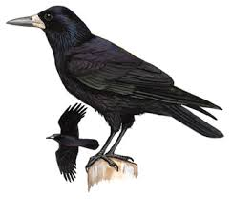
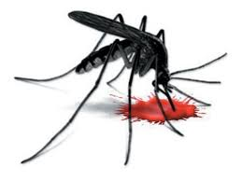


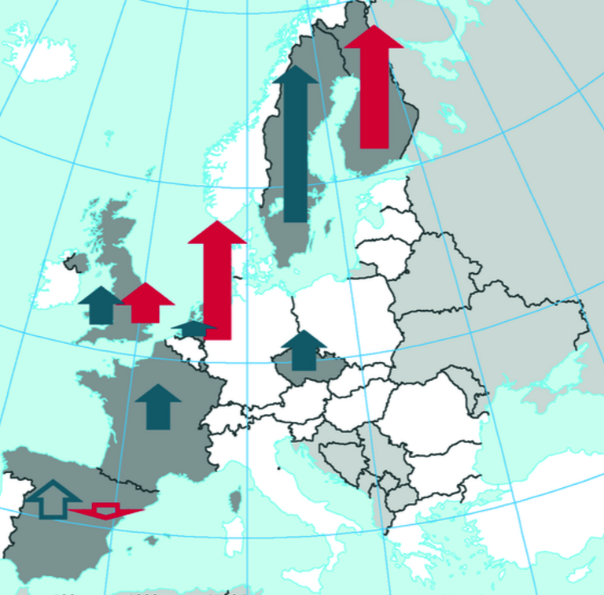


SC3: Mosquito and disease distribution
How do diseases emerge?
What are the trends?
Static correlation approach:
  Species distribution → pathogens distribution → disease emerge
Require information:
  Species/eco-system (different regions)
  Species distribution models
  Other information: weather models etc.
West Nile Fever, Chikungunya, Dengue, Usutu, Sindbis
BIOVEL: modeling platform

Slide 13
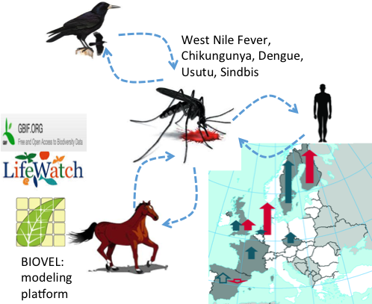



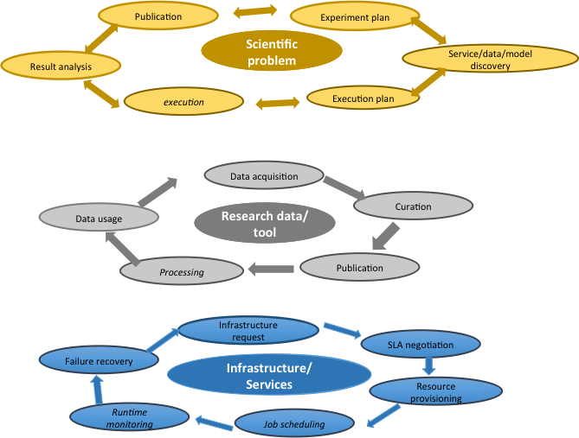
Scientist
E-VRE
e-RIs @ENVRIPLUS
E-I
User Mng, get access the system
HUC 16,
HUC 01
What metadata/ GUI/etc?
Create a Exp.
HUC 20
Describe steps
HUC 17
Let’s support first CERIF/CKAN based catalogues
Check the data/ components
Retrieve data (e.g., Lifewatch, )
Data content
Data/software availability / metadata visualization
Retrieve software (e.g., BIOVEL, )
Models
How? GUI?
HUC 20
Experiment workflow visualiz
Execute experiment

Slide 14
Mapping solid earth data and Research Infrastructures to CERIF:
EPOS approach
Slides taken from:
Martin Nayembil (BGS), Daniele Bailo (INGV), Damian Ulbricht (GFZ), Luca Trani (KNMI), Alessandro Spinuso (KNMI), Keith G. Jeffery (ERCIM)
13th International Conference on Current Research Information Systems, CRIS2016, 9-11 June, 2016 - Scotland

Slide 15
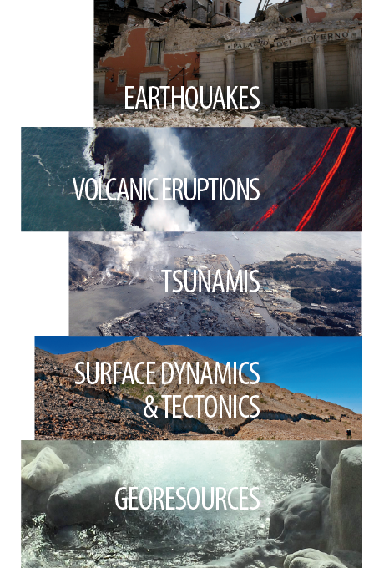
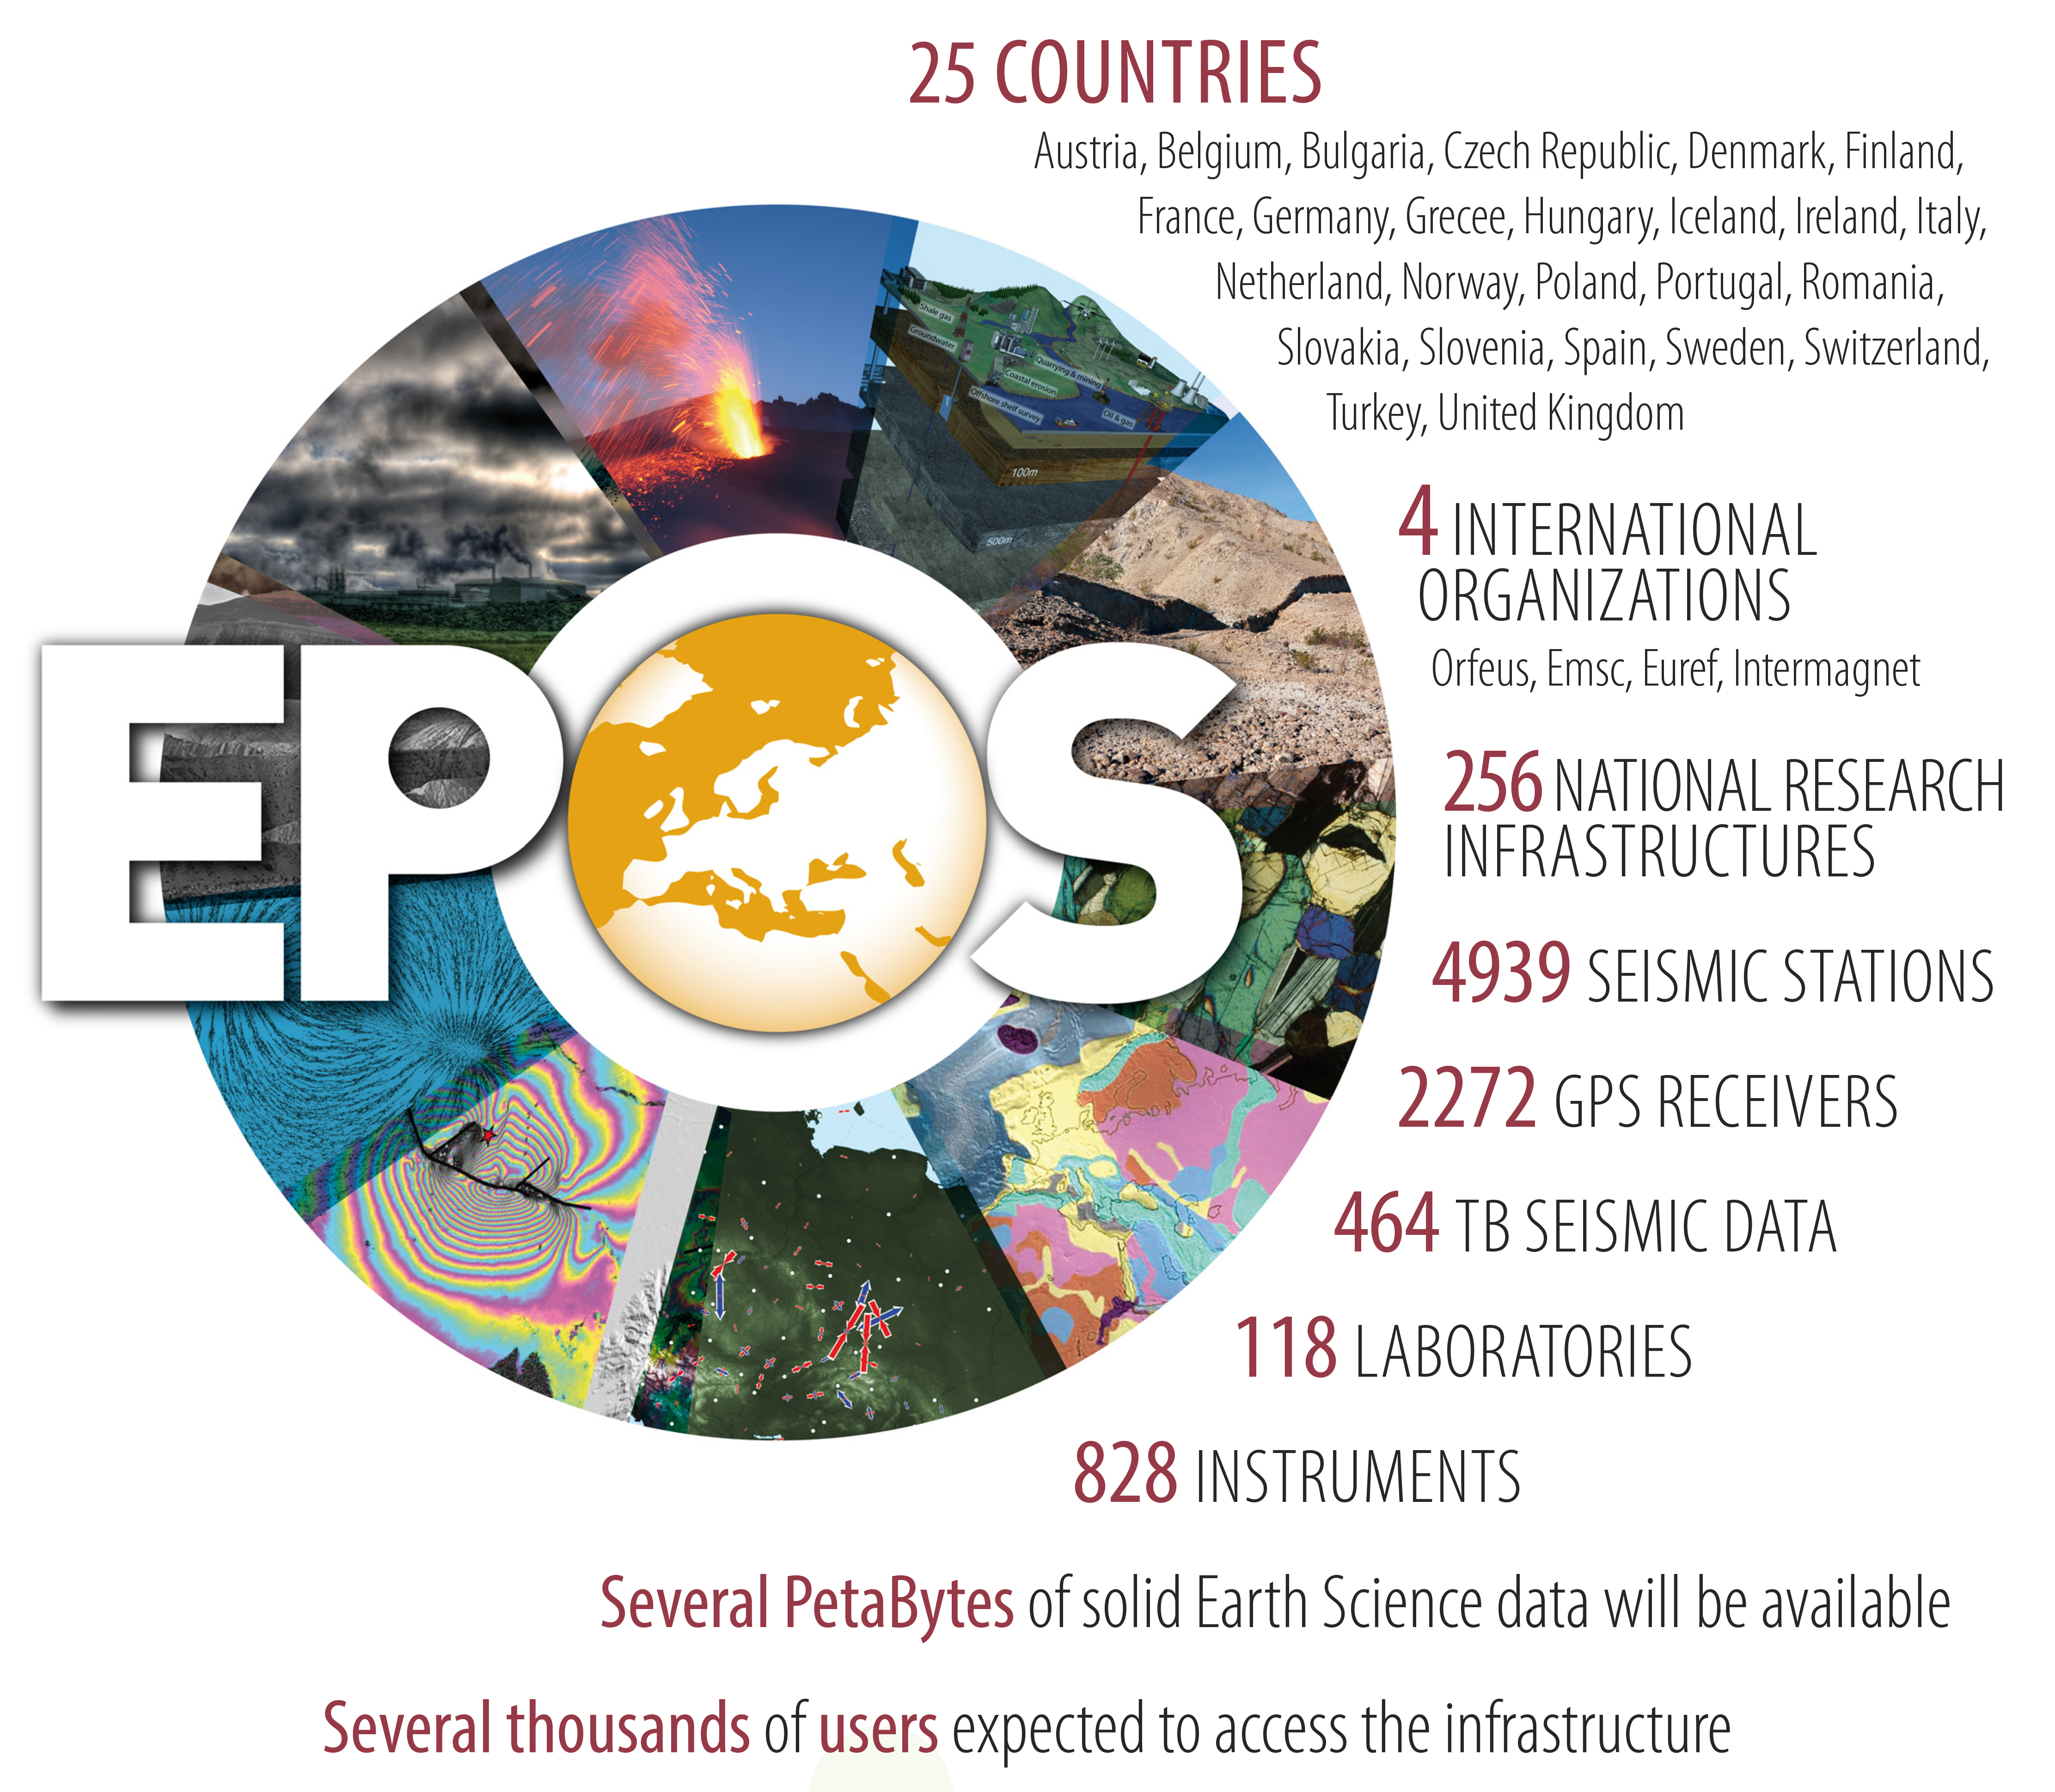
EPOS is a long-term plan
for the integration
of research infrastructures for
solid Earth Science in Europe

Slide 16
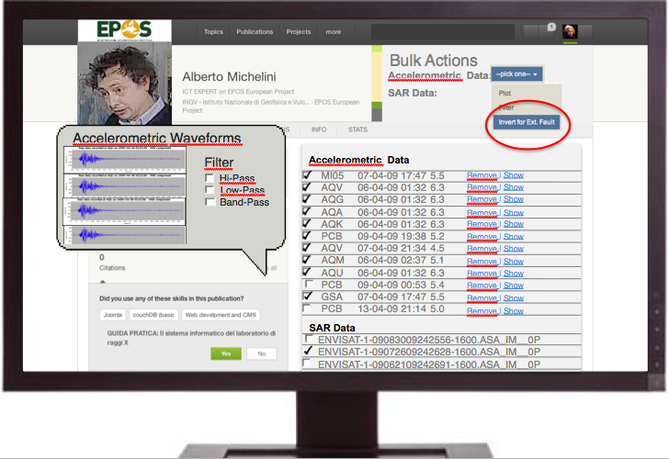
Scientist at work
Then… what can the scientist do?
  Integrate use of SAR, GPS, Accelerometric Data, etc.
  Use different codes and languages (python, fortran, any other…)
  Perform heavy processing online (use of HPC resources)
  Compare results (e.g. focal mechanism catalogues)
  Compare different data
  Save data in personal area
  …and more… (even download the data)

Slide 17
Metadata model
3-layers
Manage the complexity (see previous slide)
CERIF (formal syntax, declared semantics)
Functions
-Discovery, selection
-Impact assessment
-Manage interoperability
Issues (selection of)
heterogeneity
Many standards to be mapped from TCS
Ontologies
Complex work
Web portal, Spatio-Temporal Search
Discovery (DC) and (CKAN, eGMS)
Generate
Contextual (CERIF metadata model)
Point to
Detailed (community specific)
domain specific – data
(TCS or National RIs)
Notes:
Esempio carta identità

Slide 18
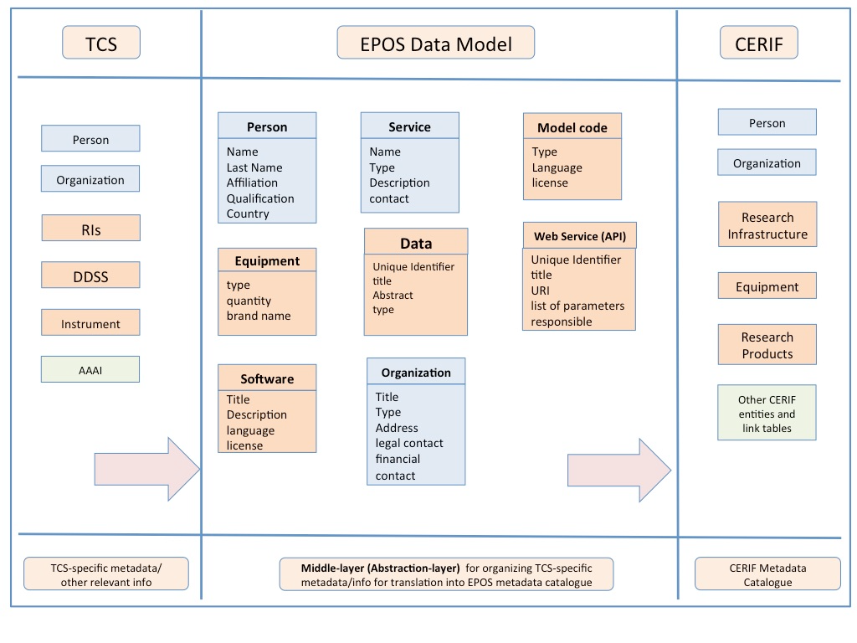
EPOS Metadata Baseline

Slide 19
Working on the Use-Cases: a survey and a collaborative pad

Slide 20
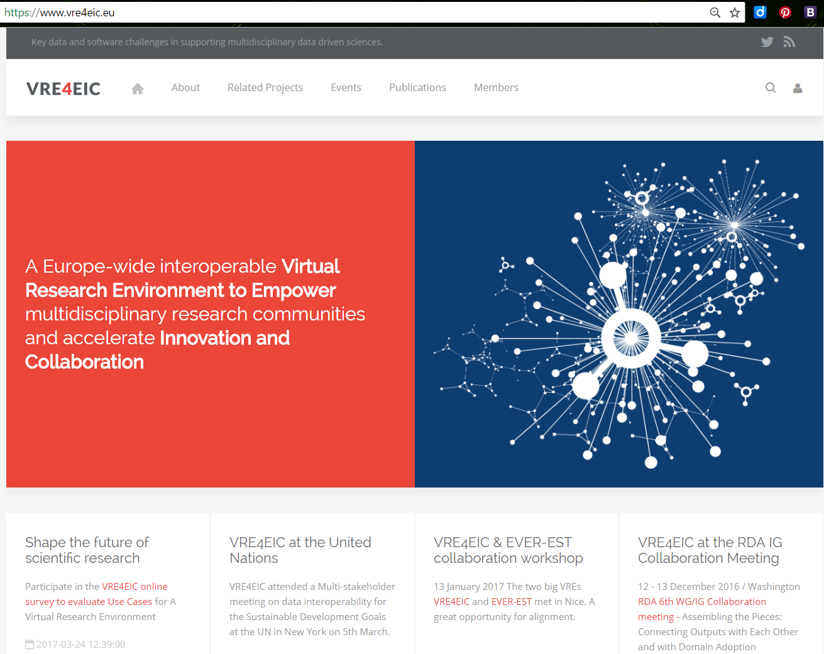

Slide 21
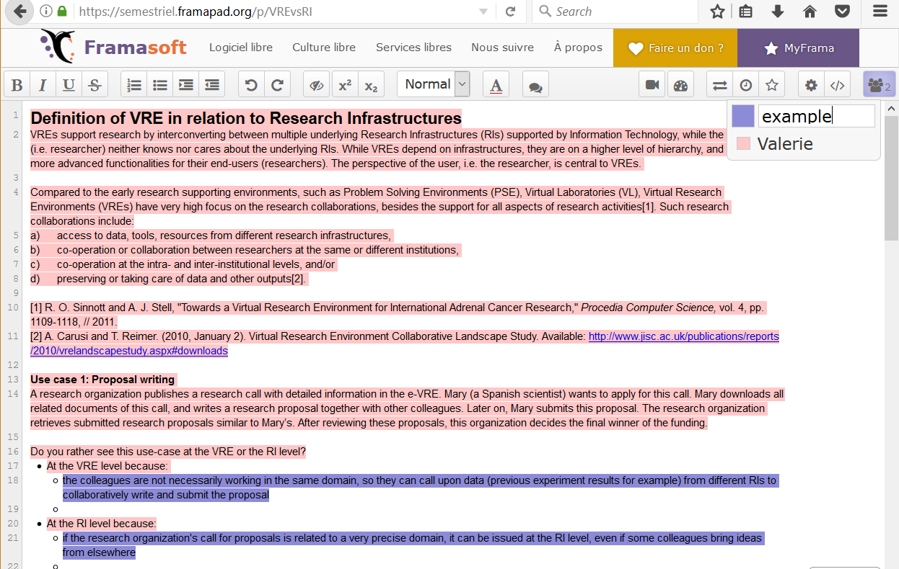
Notes:
https://semestriel.framapad.org/p/VREvsRI

Slide 22
Acknowledgment
The VRE4EIC project has received has received funding from the European Union’s Horizon 2020 research and innovation programme under grant agreement No 676247

