Slide 1

The Jisc Open Research hub
Hilda Muchando
euroCRIS Strategic Members Meeting, Nov 2019
By dirkcuys , CC BY-SA 2.0, https://flic.kr/p/jAZBNr/

Slide 2






About Jisc
Shared digital infrastructure and services
Sector wide deals
with IT vendors and commercial publishers
Expert and trusted practical support and assistance
Research and development
https://www.jisc.ac.uk/about/who-we-are-and-what-we-do

Slide 3

‘Directions for research data management’
Identified 5 key areas for action
  Policy development and implementation
  Skills and capabilities
  Infrastructure and interoperability
  Incentives for researchers and support stakeholders
  Business case and sustainability
… there is clear demand for national shared services ... the potential economies of scale that might result are attractive to the community
..There is also demand for a national approach to data preservation

Slide 4
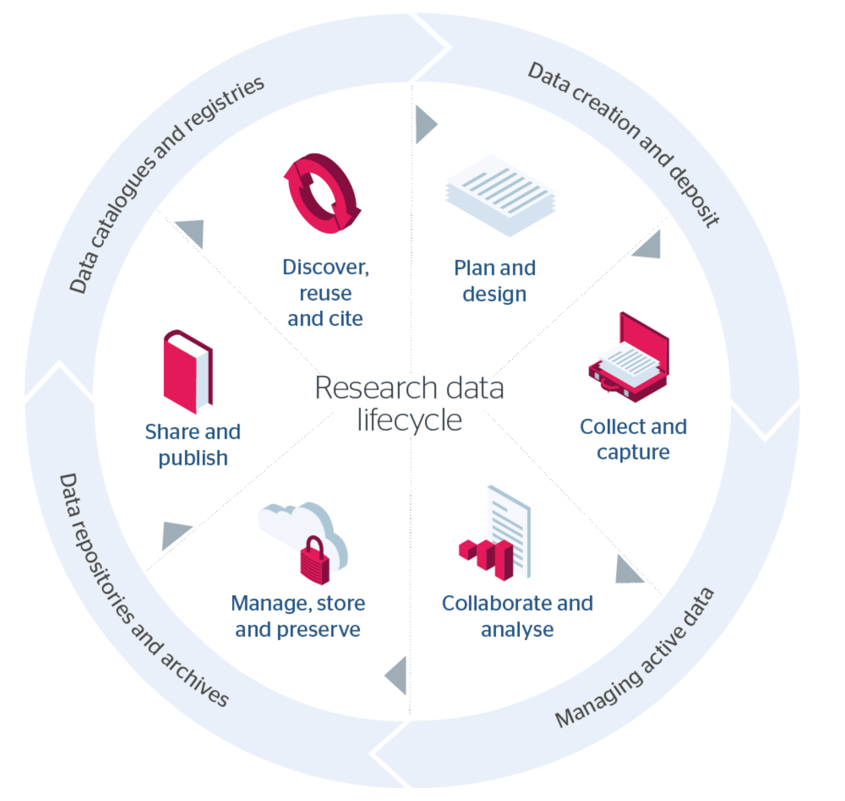
Research data lifecycle & Open research hub scope

Slide 5
A shared service
Reporting
Enhanced UX
Ease the digital preservation pain
Modular and inter-operable
Compliance
Multi-content
Cost effective
Community led
Input from >70 UK universities
A single solution to meet the requirements for universities to enable better management, sharing and preservation of research outputs
Repository
Preservation
Reporting

Slide 6

































Co-Design

Slide 7
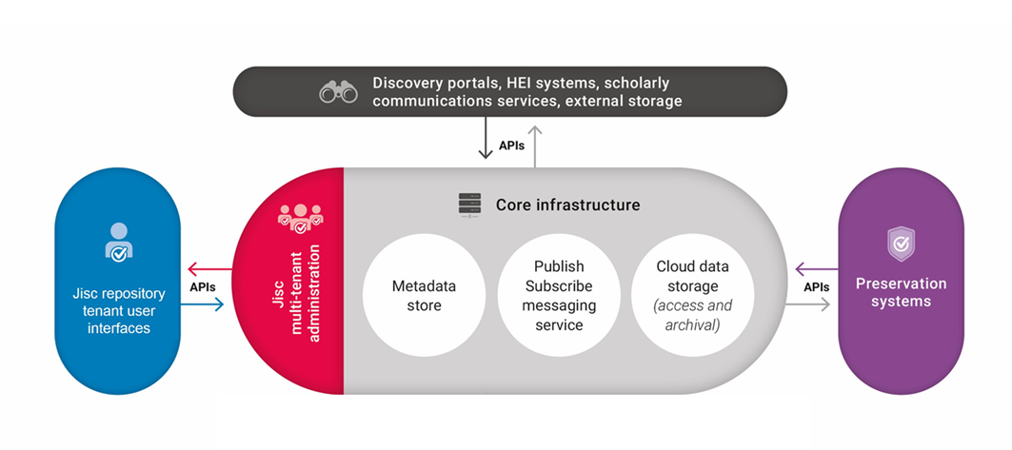
Jisc Open Research Hub

Slide 8
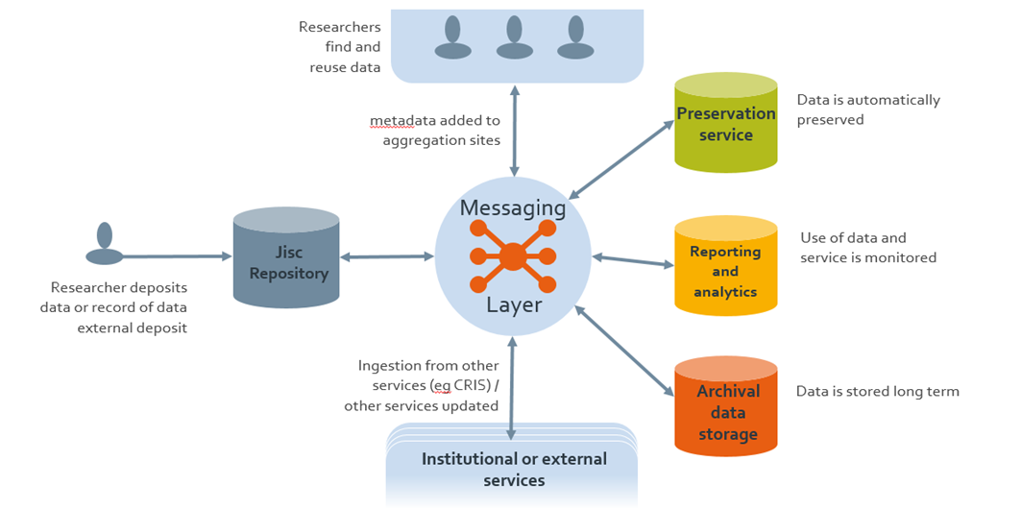
Service workflow

Slide 9
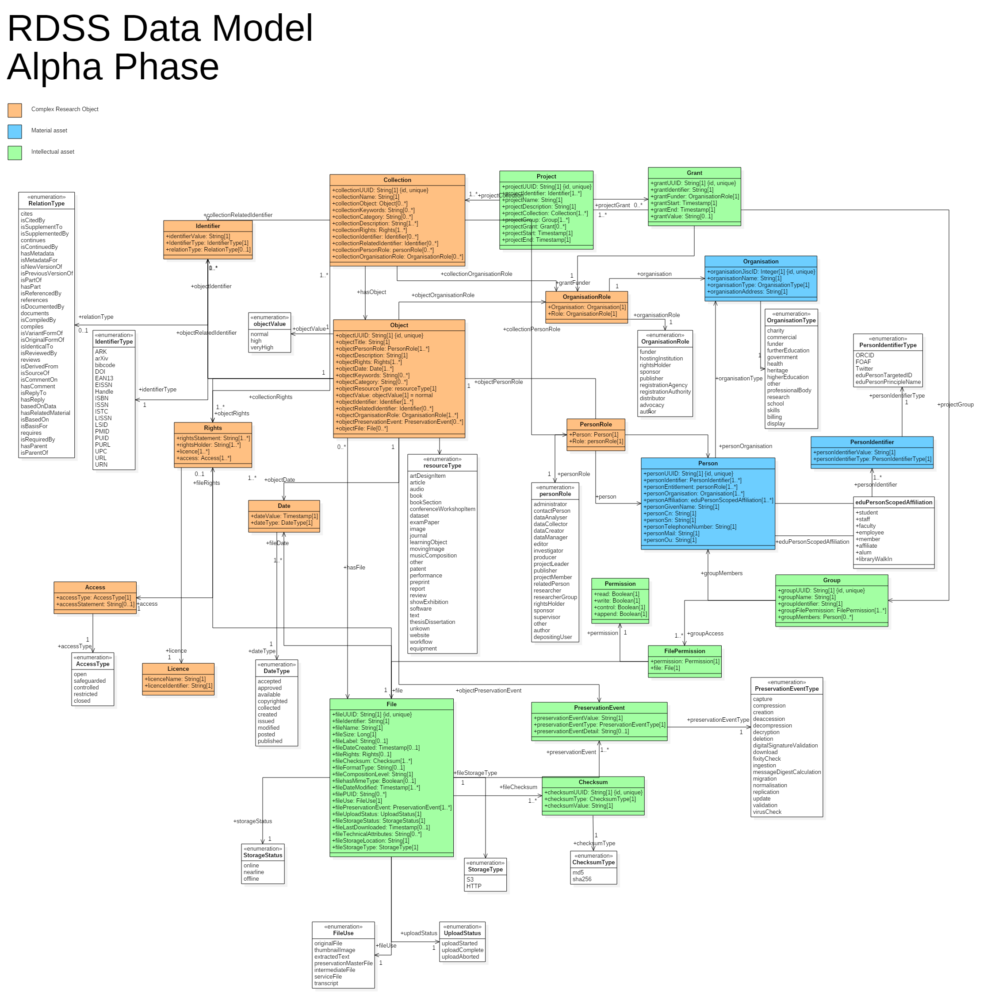
Open research hub Data Model
https://github.com/JiscRDSS/rdss-canonical-data-model

Slide 10


Demo: CRIS to Open research hub

Slide 11
Hilda Muchando
Hilda.Muchando@jisc.ac.uk
07552 346353
jisc.ac.uk

