Slide 1






Jordan PIŠČANC, University of Trieste
Information Services
Services for knowledge transfer
Andrea BOLLINI, CINECA
Head of Open Source and Open Standards Strategy
Regional Portal FVG: effective interoperability through DSpace-CRIS and open standards

Slide 2
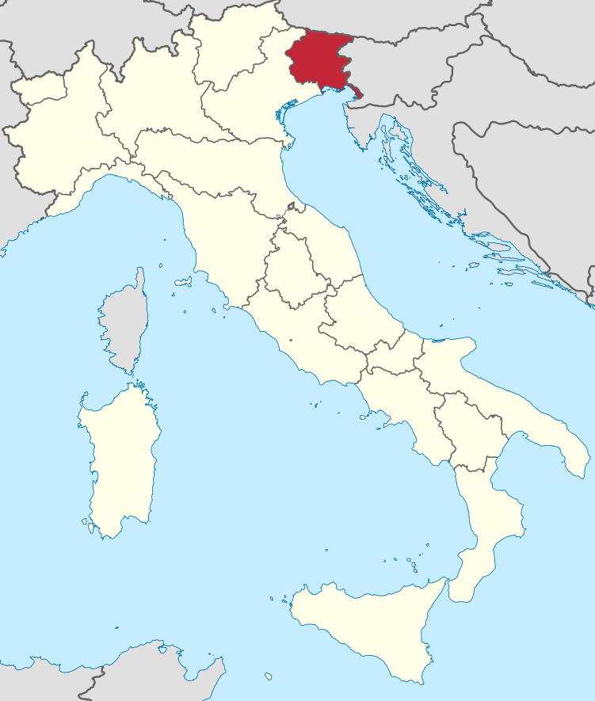

Friuli Venezia Giulia (FVG) Region

Slide 3




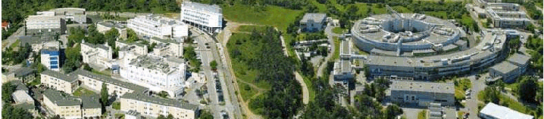


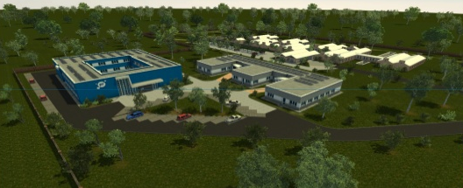






The FVG Research System
Public Research Institutions (MIUR) International Institutions Technology Parks
8 researchers / 1000 inhabitants 7500 researchers from all over the World

Slide 4

10 Departments
17.000 students
680 professors
1.800.000 monographs
15.000 e-journals

Slide 5
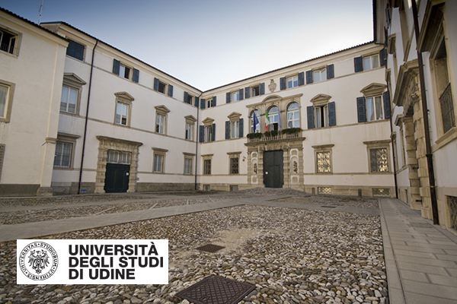
9 Departments
15.000 students
680 professors
850.000 monographs
54.500 ejournals

Slide 6
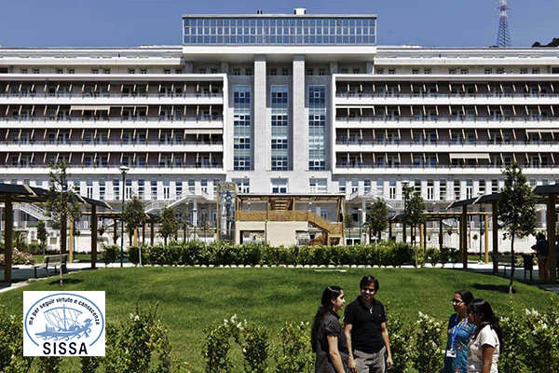
International School for Advanced Studies
3 Research Areas:
Physics, Neuroscience, Mathematics
130 post-docs
245 PhD students
67 professors
20,000 monographs
20,000 volumes of bound periodicals

Slide 7


OA and IR archives
10 year experience
2006 first version of DSpace 1.4 installed
  (2004 Messina declaration -> archive Doctoral Thesis)
2010 OAI-PMH harvesting from National Library for
2012 The National Bibliography Number Italia (NBN:IT)
2015 the 2nd place in the Italian national ranking
184th place in the international one.
TODAY
Over 10.000 items of
  Doctoral Thesis,
  EUT University Press publications
  Conferences

Slide 8

OA and IR archives
2005 first DSpace installation
  all PhD and magister theses digitized
  all scientific papers produced by SISSA authors archived
TODAY
Over 8.000 items (1981 -)
  magister theses
  master theses in HPC
  PhD theses
  Theses of the Master in Communication of Science
  papers

Slide 9

2014 UnityFVG project
Strategic cooperation in some common sectors:
  research output
  library services
  technological transfer
  integration of services for student

Slide 10

2015 adoption of IRIS archives
UniTS and UniUD starts
with CINECA IRIS (DSpace-CRIS) solution
100,000 research Items:
  scientific articles,
  chapters of books
  monographs
  conference proceedings

Slide 11
2015
Regional Research Portal
  unique point of access to Research Production
  dissemination of OA
  integration of «entities»:
    Publications
    Researchers
    Organisations
    Projects

Slide 12
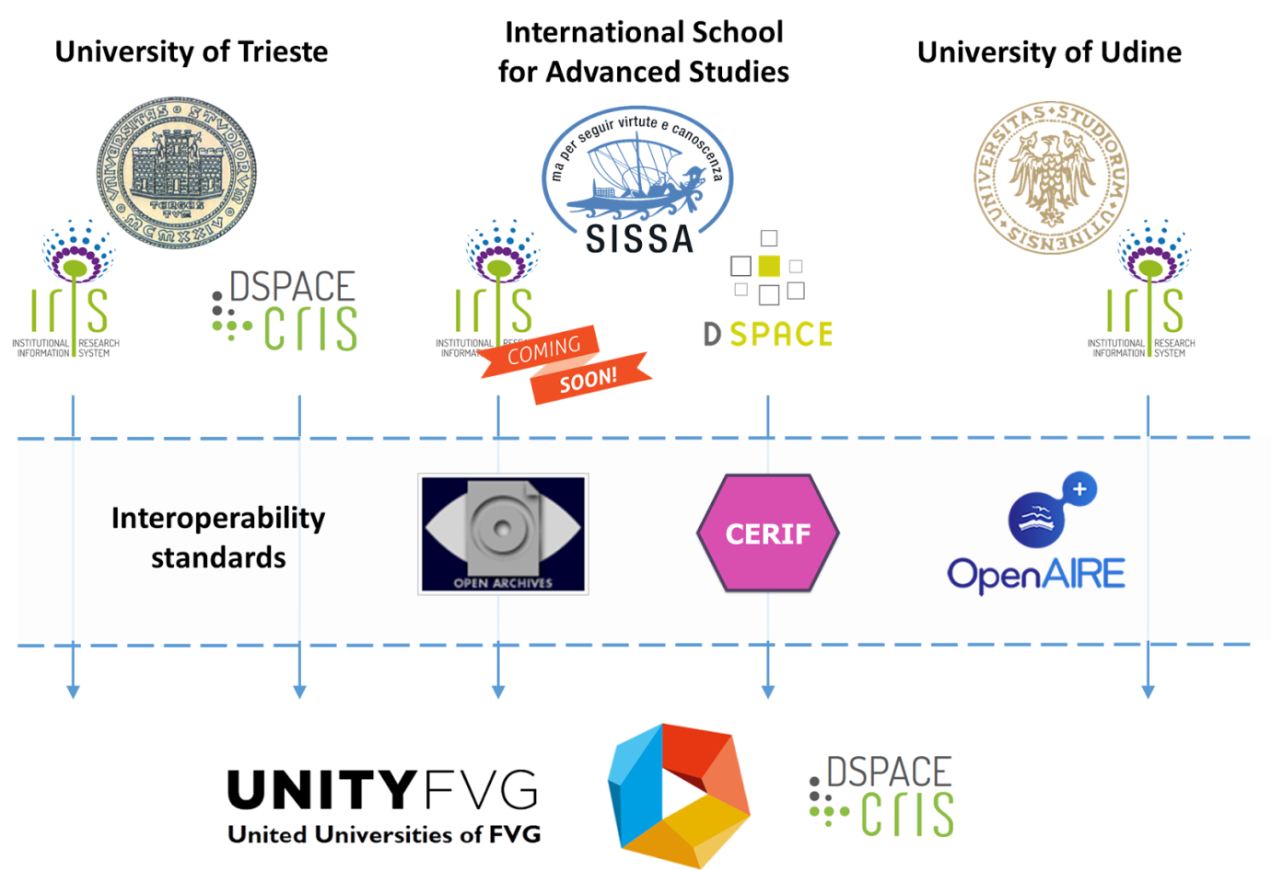

Slide 13
Why CERIF and the OpenAIRE guidelines?
Similarity of the landscape: mix of repositories and CRIS systems
  → New partners could be already compliant with the OpenAIRE profile
Define, agree and maintain a common exchange format is not trivial
  → The use of an international standard cancels conflicts and provides some components for free (Validator, Serialization and parser library, etc.)

Slide 14







XOAI-Indexer
CERIF
xml
CERIF-Tools (EKT)
DSpace-CRIS
Convert the database record in one or more SOLR Document (potential OAI record)
1
Apply rules to map the internal entity to a CERIF entity n:m
2
Build the CERIF XML using external configuration files
OAI-PMH Set
OpenAIRE_CRIS_Person, …
3

Slide 15
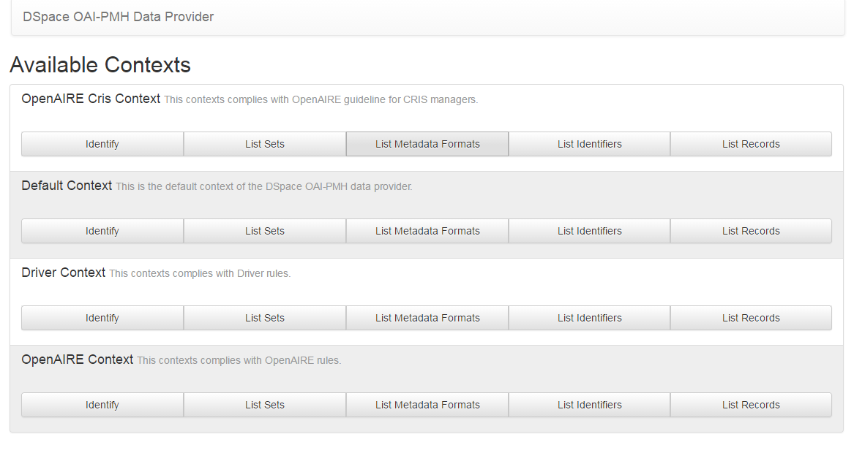
endpoint: /oai/openaire-cris
endpoint: /oai/openaire (Literature repository)

Slide 16
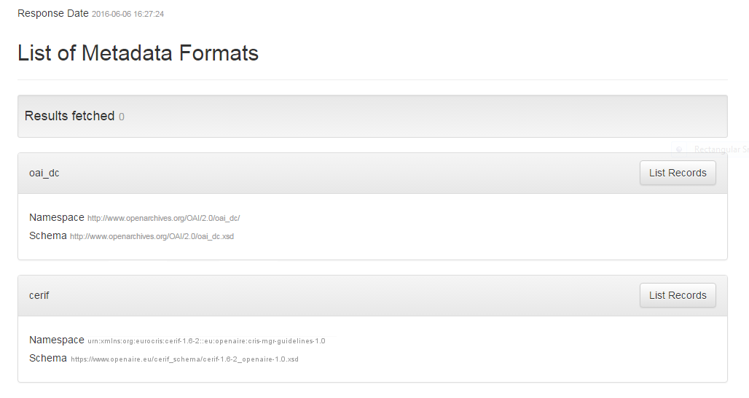
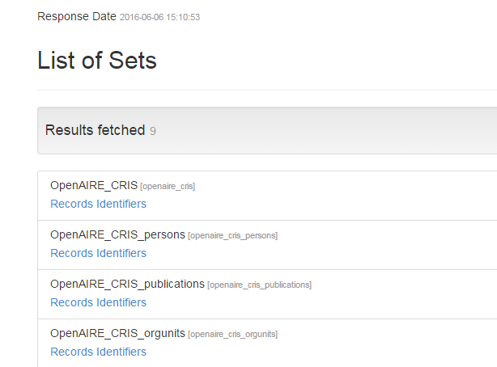

Slide 17
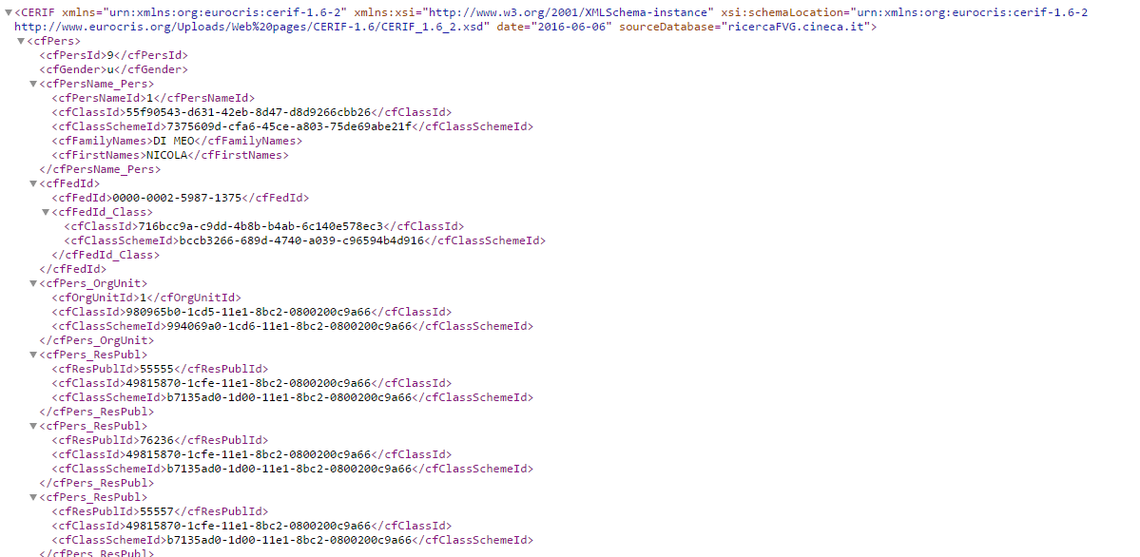
The name
ORCID
The affiliation
Many publications

Slide 18
Implementation status
Proof of concept up & running since the end of 2015; it shows a snapshot of data batch loaded in the system
Reviewing and improving the configurability of the mapping between the DSpace-CRIS data model and CERIF
Need to validate the implementation against the OpenAIRE validator
Harvester to be completed

Slide 19
Next steps
Focus on the overlapping content between systems providing automatic aggregation and enrichment of the information
Include the DSpace-CRIS Metrics data in the CERIF export
Improve the support of different CERIF profiles

Slide 20


Thanks for your attention
Jordan PIŠČANC
piscanc@units.it
@JordanPiscanc
Andrea BOLLINI
a.bollini@cineca.it
a.bollini

