Slide 1
National Open Access Scientific Articles Registration System (NOSARS)
Pouneh Mehrtash, MLIS.
Omid Fatemi, Ph.D.
Iranian Research Institute for Information Science and Technology
University of Tehran

Slide 2
Outline
Importance of the Management of Journal Articles
NOSARS concept
Similar National Repositories
Establishment of NOSARS
National Policy Making Body
Registration Process
Interoperability with national CRIS
Current Status

Slide 3
Review of CRIS2010 and CRIS2012
CRIS 2010:
  SEMAT, National Current Research Information System for Iran
CRIS 2012:
  CSTIS, Policy Making Body for National Research Information System in IRAN
CRIS 2014:
  NOSARS,
  The output of CSTIS for journal articles in operation with SEMAT

Slide 4
Why NOSARS?
The theme: Management, availability, quality and use of research information in the context of e-Science
Example of research outputs:
  books, book chapters, conference proceedings, dissertations and journal articles.
Peer review process for journal articles
Notes:
Collecting, Processing, Disseminating

Slide 5
Iran Scientific Articles
Notes:
In Islamic Republic of Iran, as Iran 1404, the Vision Document or 20-Year Document dictates the country will be the first in the region
This has resulted in a national research movement and hence, the number of scientific documents has been extremely rising in the recent years.
The number of scientific production has grown substantially in the recent years in Iran. At the end of 2009, the number of Iranian scientific papers was 17,000 out of 1,670,000 global scientific papers. In 2010, 1 percent of global scientific productions was from Iran, while this rate has been increased to 1.2% before the end of 2011. [ISC] Iranian scientists have recorded a total of 88,827 scientific papers during 1990 to 2010; while this record has been only 1387 papers during 1990-2000. [ISC]

Slide 6
NOSARS concept
We had SEMAT:
  Every research entity
  But – meta-data level
Full text is required
  Search, re-use, …
Repository of individual research object category (entity)
Open access
Registration mechanism
National Open Access Scientific Articles Registration System (NOSARS)

Slide 7
RIAN, Ireland
From 2007
Federated harvesting and discovery service
National portal with government funding
First 7 member institutes
Now 13 members
March 2014: 16333 journal articles
Link to full-text

Slide 8
NARCIS, Netherland
Central access to repositories of universities
9 universities:
  doctoral theses
890,054 PUBLICATIONS, 30,320 DATA SETS, 60,354 RESEARCH, 51,170 PEOPLE, 2,917 ORGANISATIONS
Link to full-text
Notes:
25 repositories

Slide 9
Comments
Meta-data
Link to full-texts
No full-text national repository
  Non-integrated search and indexing
Mostly on harvesting and data pulling mechanism
Distributed architecture
Covering publicly funded research

Slide 10
Design of NOSARS
CSTIS (“Commission of Science and Technology Information System”) role
Assigning of national individual full text repositories to Iranian institutes (institutional mapping)
Setting standards and requirements for NOSARS
Call for proposals
Defining selection criteria

Slide 11
Commission of Science and Technology Information System
From CRIS2012 slides
Only S&T Information
Information Policy Making
Developing Guidelines and standards
Establishing S&T Information Registry
Institutional Mapping:
  Determine the job description for subsidiaries, units, committees and work groups
Design

Slide 12
Research Information Documents
Assigning the registrar
Defining required meta-data
Defining required citation indices
Designing required security
Defining Access levels
Developing dissemination policies
Identifying:
  Theses and Dissertations, Journal articles, Conference papers, Research Projects (next)
Design

Slide 13
Journal Articles
Collecting and registration:
  Publisher as the copyright owner
  Submitting a (digital version of) accepted peer reviewed article to national registrar
Processing
  Indexing using controlled vocabulary and thesaurus
  Creating citation index.
  Providing citation analysis and related reports such as Impact Factor.

Slide 14
Journal Articles (2)
Dissemination:
  Presenting bibliographic information and abstract free of charge.
  Providing downloadable full text for members including:
    universities, research institute, and individuals
Design

Slide 15
Current Status
Institute in charge: Islamic World Science Citation center (ISC)
MSRT mandates all approved scientific journals publishers to deposit articles in NOSARS.
Launch: Aug. 31, 2009
http://www.isc.gov.ir
664121 Persian articles and 93008 English article
497 Persian and 8 English scientific journals.

Slide 16
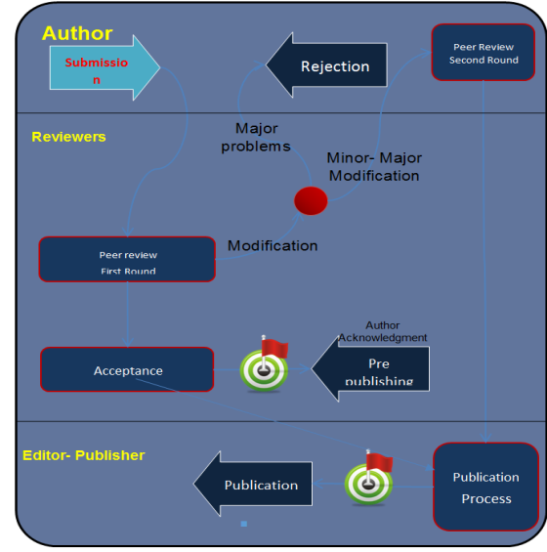
Registration System
The data is registered and managed during the work flow of every individual object.
The result:
  Completeness
  Validity
  Being current ad recent
  No extra effort

Slide 17
SEMAT and NOSARS
SEMAT (National CRIS)
Institute’s Library
Institute ‘s CRIS
Institutional Repository
Non – research system
National Repository of Dissertations
National Repository of Journal Articles (NOSARS)
National Repository of Patents

Slide 18
Message Hub
National CRIS - SEMAT
NOSARS
Message Hub
Message
Message
National Repository for Dissertations
Other systems: HR, EMS
Institutional CRIS, Journal Publishing System of Institute
National Repository for Patents
Message

Slide 19
Summary
Full texts of journal articles are important.
Registration mechanism works well.
Message hub for communicating among all systems.
Institutional mapping should be carefully done
NOSARS is alive now.

Slide 20
Thank you for your attention
Comments, Suggestions, Questions?
mehrtash@irandoc.ac.ir
omid@fatemi.net

