Slide 1


Conditor
Towards a national reference repository for French scientific production
Valérie Bonvallot (CNRS-Inist) – Thierry Dautcourt (Inria)
valerie.bonvallot@inist.fr thierry.dautcourt@inria.fr
- Paris
11 may 2015

Slide 2
Conditor: A national recommendation from the
Digital Scientific Library
Building a national reference repository
for French scientific production
based on common reference repositories
shared by universities and research organizations
A multi-partner project in the French higher education and research area : Ministry, public institutions with a scientific and technical vocation, Universities, Agencies, etc.

Slide 3



Conditor: aims and scope
  Building a bibliographic reference repository to:
  Share metadata describing French scientific production
  Pool inventories of scientific production
  Portal
  Archive
No browser interface for end users
No full text
  Current Research Information System
  Decision-making tool
No research management
No indicator production
  Conditor : a reference repository
  with quality data allowing interoperability

Slide 4
Conditor: position in the French STI landscape
Researchers, laboratory directors, research unit managers …
Common
reference repositories
« STI »
reference repositories
S
t
r R
u R
c
t.
CRIS
National
Repertory
of Research
Structures
(RNSR)
Local databases
Addresses, themes, authors, journals, congresses etc.
Archives
Hal
A
u
t R
h R
o
r
s
Conditor
Researchers, team leaders, information specialists
IdRef
Management
reference repositories
WoS
Scopus Pubmed etc.
International bibliographic databases
ORCID
ISNI
Structures, staff, NRA projects etc.
ISSN
Institutional identification databases
Management team

Slide 5
Conditor: experiment
  Experimental principles: pragmatism
  Working with multi-skill volunteers
  Using resources we already have
  Assessing difficulties, benefits and involvement
Experimental group:
representatives from 8 organizations and establishments
National Center for Scientific Research (CNRS)
National institute for agricultural research (Inra)
National institute dedicated to computational science (Inria)
French Research Institute for Development (IRD)
Bibliographic agency for higher education (Abes)
Bordeaux University
Paris Dauphine University
Ministry of Higher Education and Research

Slide 6
Conditor: constitution method of a corpus
Data from 9 databases for the 2011 publication year from
Open archives
Bibliometr.
database
Library
Catalogue
Bibliograph.
database
Mini CRIS
« Matching group »
Step 1
MetaData (MD)
Treatment and curation
Mapping
XML formatting
Normalisation / homogenisation
Identifiers
Document titles
Authors
Sources
Collations
Addresses
Document types
Step 2
Detection of duplicates
Several strict alignments of character strings
Reference repositories used
Step 3
Enrichment using reference repositories
Name entities, search in addresses
Incorporation of identifiers for
research structures and authors
IdRef
RNSR
Reference system of CNRS structures
« Enriched » Conditor corpus

Slide 7
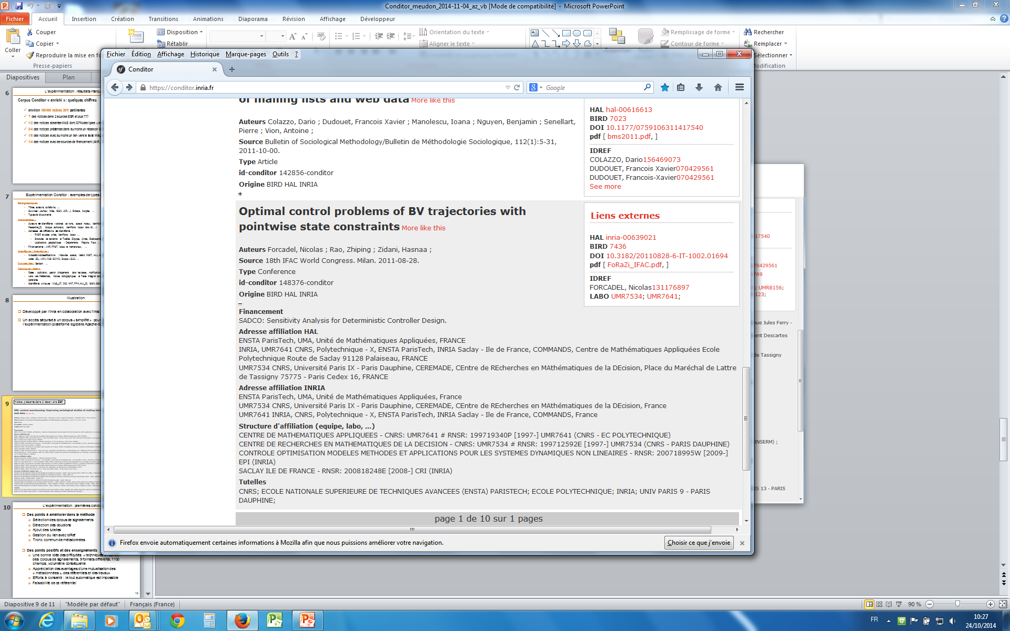
Record in 3 databases
BIRD HAL INRIA
  Curation and enrichment
  No funding in database 1
  No affiliation in database 1

Slide 8
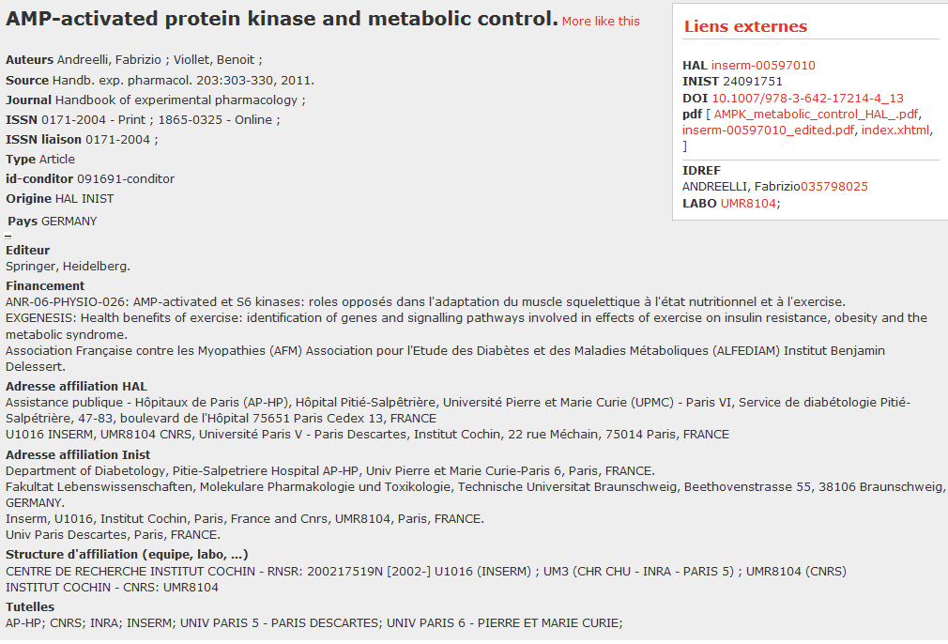
Record in 2 databases
HAL Inist
  No funding
  in database 2
  Curation and enrichment
  1 affiliation missing in database 1
  Record not
  in INRA database

Slide 9
Conditor: conclusions
Improving some aspects in the corpus building
  Detection of duplicates
  Data incorporation from national structures and authors systems
What we learn
  Conditor is « feasible »
  Fully-automated treatment isn’t sufficient
  A social structure is needed
Potential advantages
Sharing a common national warehouse of descriptive bibliographical records is essential to :
  Manage publications not found in databases used for evaluation
  Avoid several manual data entries
  Improve information systems interoperability
  Improve through use common reference data dictionaries repositories and persistent digital identifiers (national research structures, parent organizations, authors, journals, fundings, congresses, etc.)

Slide 10
What next?
Year N
Year N+1
Project launch
Design and development of functionalities in an iterative way and progressive implementation
Management functionalities
Retrieval
Modification
Deletion
Validation
Dissemination
Treatment functionalities
Duplicate identification
Enrichment through reference repositories
5 years corpus building
3 years corpus
5 years corpus corpus
Conditor service

Slide 11

Merci
мерси
Tänan
Mulţumesc
Obrigado/a
Danke
Dank je
Tak
Paldies
Köszönöm
Thanks
Gracias
Hhvala vam
Děkuji
Grazzi
Grazie
Efharisto
Dziękuję
Dakujem
Ačiū
Kiitos
http://marie-aux-usa.skyrock.com/2966393337-Des-questions-des-reponses.html
http://www.bibliothequescientifiquenumerique.fr/?Conditor,65

